Slide 1

Multi Camera Tracking Project
Spring 2025 – Biweekly progress, 17 April, 2025

Slide 2
Agenda
Objective
Recap , Progress Overview
Trace-1573 ReID Experiments
Various sampling strategies
Combination of Various proportions Market-1501 dataset
Ablation on ArcFace , Triplet Loss
Synthetic caption generation using LLaVA
Explored “LHM : Large Animatable Human Reconstruction Model for Single Image to 3D in Seconds”
Conclusion
Next steps

Slide 3
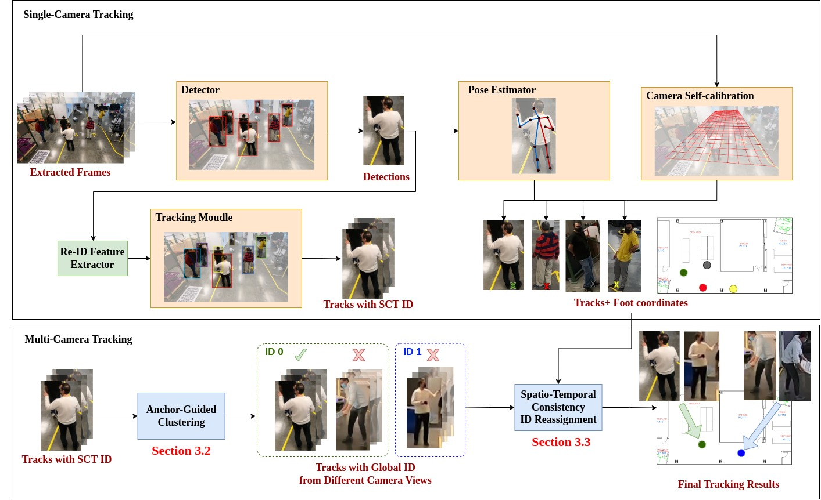
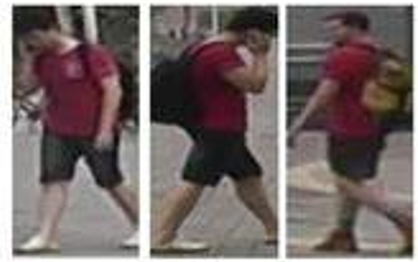
Objective
Develop a robust multi-camera tracking model with a focus on person re-identification (Re-ID).
Focus
Re-ID Module

Slide 4
Recap
Extensive data analysis on Trace-1573 multi camera dataset.
Trace-1573 ReID Dataset Curation.
Conducted initial experiments with CLIP-ReID and OSNET using Trace-1573.
Evaluated Trace-1573 dataset by scaling up the data with Market-1501
Random Identity sampling
Random dataset sampling (Equal proportions of datasets in a batch )
Ablation study on distance metric: Cosine vs Euclidean
While training in Triple hard mining loss
Used in computing distance matrix(Inference).

Slide 5
Trace-1573 ReId data set statistics
This dataset consists of 834 person identities.
All persons does not appear across all the cameras.
​​
Split | IDs | Images | Cameras
Train | 414 | 12720 | 45
Query | 420 | 4099 | 43
Gallery | 390 | 14976 | 43
Test set
Person 10 images in train and 15 in test (12 gallery , 3 query)
Notes:
594 previous IDS

Slide 6
ReID Evaluation metrics
mAP(Mean Average Precision )
Evaluates how well correct matches are ranked across the gallery
Considers all correct matches – not just the first match for a query
Top-1 Accuracy
Checks if the top-ranked match is the correct identity
Focuses on precision at the highest rank - just the first retrieved result.
​​
Notes:
594 previous IDS

Slide 7
Experimental Results
Method | Train data | Test data | MAP(%) | Top-1 Accuracy(%)
OSNeT | Market-1501 | Market-1501 | 78.3 | 93.8
CLIP-ReID | Market-1501 | Market-1501 | 89.8 (14.6 % ) | 95.3(1.6 % )
OSNET | Trace-1573 ReID | Trace-1573 ReID | 35.7 | 69.2
CLIP-ReID | Trace-1573 ReID | Trace-1573 ReID | 63.3 (77.3 % ) | 80.8 (16.7 % )
OSNET | Market-1501 | Trace-1573 ReID | 7.5 | 25.4
CLIP-ReID | Market-1501 | Trace-1573 ReID | 40.1 (434 % ) | 61.7(36.3 % )
Show Strong generalization
Results of CLIP-ReID , OSNET in same dataset setting(Top 4 rows ) and cross dataset(bottom 2 rows) setting evaluations using Market-1501 , Trace-1573 ReID datasets

Slide 8
ReID Triplet Loss : Cosine vs Euclidean distance
Training Objective : Triplet hard mining loss
During Inference , Euclidean distance is used to compute distance matrix.
Method | Metric | Train data | Test data | MAP(%) | Top-1 Accuracy(%)
CLIP-ReID | Euclidean | Market-1501 | Market-1501 | 89.8 | 95.3
CLIP-ReID | Cosine | Market-1501 | Market-1501 | 86.8 | 93.9
CLIP-ReID | Euclidean | Trace-1573 | Trace-1573 | 63.8 | 80.0
CLIP-ReID | Cosine | Trace-1573 | Trace-1573 | 57.9 | 77.2
Euclidean distance provides better clustering of person IDs compared to cosine distance.
Notes:
Euclidean distance forms clusters based on absolute positioning, making it more effective when featurerepresentations are well-distributed.
Cosine distance may place different identities closer together if they share similar directional features buthave different magnitudes, leading to less distinct clustering.

Slide 9
Experimental Results: Trace 1573 ReID Data
No of Samples per person ID per Camera | Method | MAP(%) | Top-1 Accuracy(%)
Train Set : 10 Gallery Set : 12 Query Set : 3 | OSNET | 34.2 | 68.4
 | CLIP-ReID | 63.3 | 80.8
Train Set : 30 Gallery Set : 12 Query Set : 3 | OSNET | 36.4 | 68.5
 | CLIP-ReID | 59.7 | 79.2
Train Set : 5 –min 50 max Gallery Set : 12 Query Set : 3 | OSNET | 36.1 | 67.2
 | CLIP-ReID | 56.5 | 77.2
Observation :
Traditional CNNs: Performance improves as training data increases.
Foundational models Perform well with few samples, but too much data may reduce to generalize.

Slide 10
Experimental Results : Varying Samples per person ID
No of Samples per person ID per Camera | Method | Train data | Test data | MAP(%) | Top-1 Accuracy(%)
Train Set : 10 Gallery Set : 12 Query Set : 3 | OSNET | Trace-1573 ReID | Trace-1573 ReID | 34.2 | 68.4
 | CLIP-ReID | Trace-1573 ReID | Trace-1573 ReID | 63.3 | 80.8
Train Set : 30 Gallery Set : 30 Query Set : 5 | OSNET | Trace-1573 ReID | Trace-1573 ReID | 41.2 | 80.3
 | CLIP-ReID | Trace-1573 ReID | Trace-1573 ReID | 62.5 | 83.0

Slide 11
Progress
ArcFace vs Triplet hard mining Loss.
Generate synthetic captions using LLaVA to enhance CLIP-ReID.
CLIP-SCGI Implementation
replace predefined learnable text tokens with LLaVA Captions.
Paper LHM: Large Animatable Human Reconstruction Model for Single Image to 3D in Seconds
Source : https://arxiv.org/abs/2503.10625

Slide 12
ReID evaluation : Cosine vs Euclidean similarity
In the experiments , models are trained on Euclidean distance
Method | Distance | Train data | Test data | MAP(%) | Top-1 Accuracy(%)
CLIP-ReID | Euclidean | Market-1501 | Market-1501 | 89.8 | 95.3
CLIP-ReID | Cosine | Market-1501 | Market-1501 | 89.8 | 95.2
Method | Distance | Train data | Test data | MAP(%) | Top-1 Accuracy(%)
CLIP-ReID | Euclidean | Trace-ReID | Trace-ReID | 63.3 | 80.8
CLIP-ReID | Cosine | Trace-ReID | Trace-ReID | 63.2 | 80.5
At inference , The features are normalized before computing the distance matrix so, both metrics attribute towards similar performance

Slide 13
Experimental Results: Trace 1573 ReID Data
No of Samples per person ID per Camera | Method | MAP(%) | Top-1 Accuracy(%)
Train Set : 10 Gallery Set : 12 Query Set : 3 | OSNET | 34.2 | 68.4
 | CLIP-ReID | 63.3 | 80.8
Train Set : 30 Gallery Set : 12 Query Set : 3 | OSNET | 41.2 | 80.3
 | CLIP-ReID | 59.7 | 79.2
Train Set minimum samples : 5 Maximum samples 50 | OSNET | 39.2 | 77
 | CLIP-ReID | 59.9 | 82.5

Slide 14
Experimental Results: Market+Trace 1573 ReID Data
Method | Sampling | Train set | Test set | MAP(%) | Top-1 Accuracy(%)
OSNET | Random Identity Sampling | Trace-1573 | Trace-1573 | 35.7 | 69.2
OSNET |  | Market-1501+ Trace-1573 | Trace-1573 | 36.5 | 67.6
CLIP-REID |  | Trace-1573 | Trace-1573 | 63.5 | 78.6
CLIP-REID |  | Market-1501+ Trace-1573 | Trace-1573 | 66 | 81.7
Method | Sampling | Train data | Test data | MAP(%) | Top-1 Accuracy(%)
OSNET | Random Dataset Sampling | Trace-1573 | Trace-1573 | 35.7 | 69.2
OSNET |  | Market-1501+ Trace-1573 | Trace-1573 | 33.5 | 65.4
CLIP-ReID |  | Trace-1573 | Trace-1573 | 63.5 | 78.6
CLIP-ReID |  | Market-1501+ Trace-1573 | Trace-1573 | 61.5 | 79.8

Slide 15
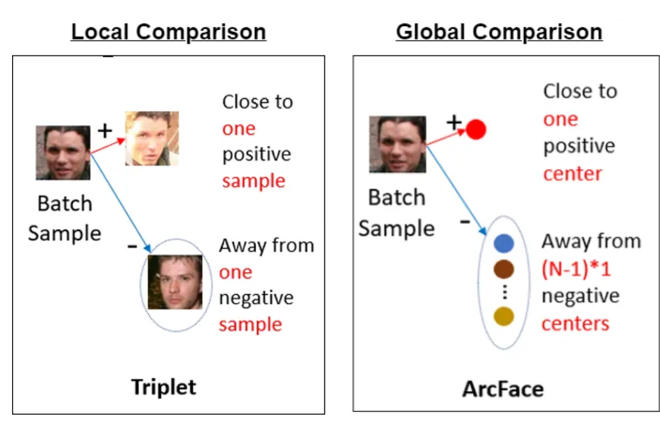
Arc Face vs Triplet Hard Mining Loss
Triplet Loss :
Optimizes the distance between positive and negative pairs .
Learns the embedding space
ArcFace Loss:
Classification-based loss that uses angular margin between class-centers
Works well in case of similar classes in training and testing.

Slide 16
Arc Face vs Triplet Hard Mining Loss
Experimental study on different loss functions with CLIP-ReID method.
Data | Loss Function | MAP(%) | Top-1 Accuracy(%)
Market-1501 | ArcFace | 86.1 | 94.4
 | Triplet | 89.8 | 95.3
Trace-1573 | ArcFace | 54.2 | 77.1
 | Triplet | 63.3 | 88.8
Data | ArcFace Margin M | MAP(%) | Top-1 Accuracy(%)
Trace -1573 | 15 | 56.1 | 77.7
 | 28.2 (default) | 54.2 | 77.1
 | 40 | 52.5 | 74.6
Triplet loss is better able to generalize across embedding space where as ArcFace is more sensitive to class imbalance and show poor generalization to unseen classes.

Slide 17
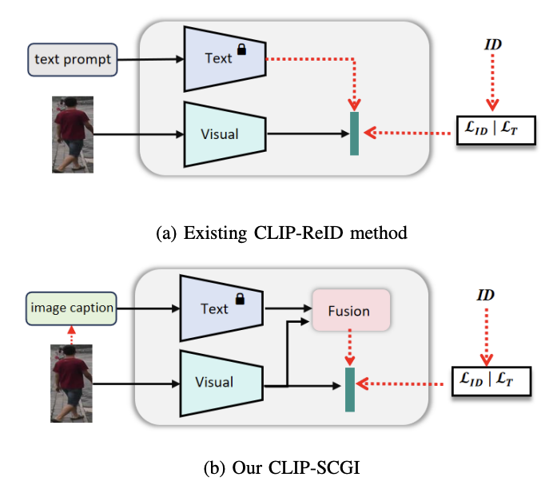
CLIP-ReID Vs CLIP-SCGI
Limitation: CLIP-ReID uses learnable prompt tokens .
Absence of concrete descriptions that capture key semantic attributes such as gender, clothing, and age. Solution :
Leverage existing image captioning models(LLaVA) to generate pseudo captions for describing person images.
CLIP-ReID
CLIP-SCGI
Notes:
One of recent CLIP based method (CLIP-SCGI) has shown using synthetic captions instead of static text to all the person ID.
CLIP-SCGI uses image captioner LLaVA (A large language vision model) to generate person specific captions.

Slide 18



Examples : Generated synthetic captions from LLaVA
Prompt : “Describe the most obvious one people using this template for no more than 45 words: A [age] [gender] is wearing [upper clothes]. [gender] is wearing [upper clothes] and [lower clothes]. The [gender] is wearing [shoes] and carrying a [others]. The [gender] has [hair length] [and whether wear glasses].”
A young woman is wearing a black shirt and shorts. She is carrying a backpack and has long blonde hair.
A man is wearing a black shirt and pants.
A woman is wearing a purple shirt and shorts. She is wearing a watch and carrying a purse. The woman has short hair and is wearing glasses.
Temperature : 0.2 ; No Top_p , Confidence scores :

Slide 19



Examples : Generated synthetic captions from LLaVA
A man is wearing camouflage shorts and a watch
A man is wearing a white shirt and khaki shorts. He is wearing a watch and carrying a cane. The man has short hair and is wearing glasses.
A young man is wearing a black shirt and shorts. He is carrying a backpack and has short hair.

Slide 20
CLIP-SCGI Implementation
All captions are synthetically generated using LLaVA.
No open-source code available.
Currently facing issues integrating captions into the CLIP-ReID pipeline.
Idea: Use captions as text prompts for matching image embeddings

Slide 21
LHM : Large Animatable Human Reconstruction Model for Single Image to 3D in Seconds
Lingteng Qiu* Xiaodong Gu* Peihao Li* Qi Zuo* Weichao Shen Junfei Zhang Kejie Qiu Weihao Yuan Guanying Chen† Zilong Dong † Liefeng Bo
Source : https://arxiv.org/abs/2503.10625

Slide 22
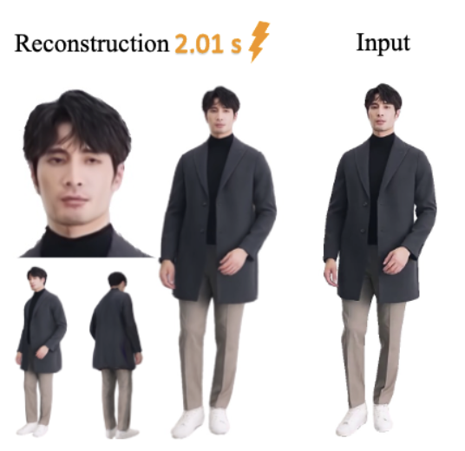
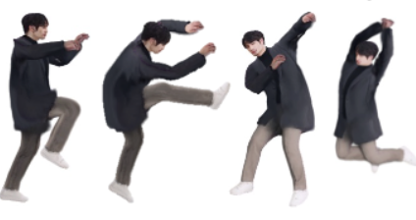
Introduction
What is LHM ?
LHM: An animatable 3D human reconstruction model from a single image.
LHM has shown impressive results on diverse real-world scenarios.
Why LHM ?
3D Representation for Viewpoint Invariance
Synthetic Data Generation for ReID
Face Identity Preservation
Detailed Appearance Modeling

Slide 23
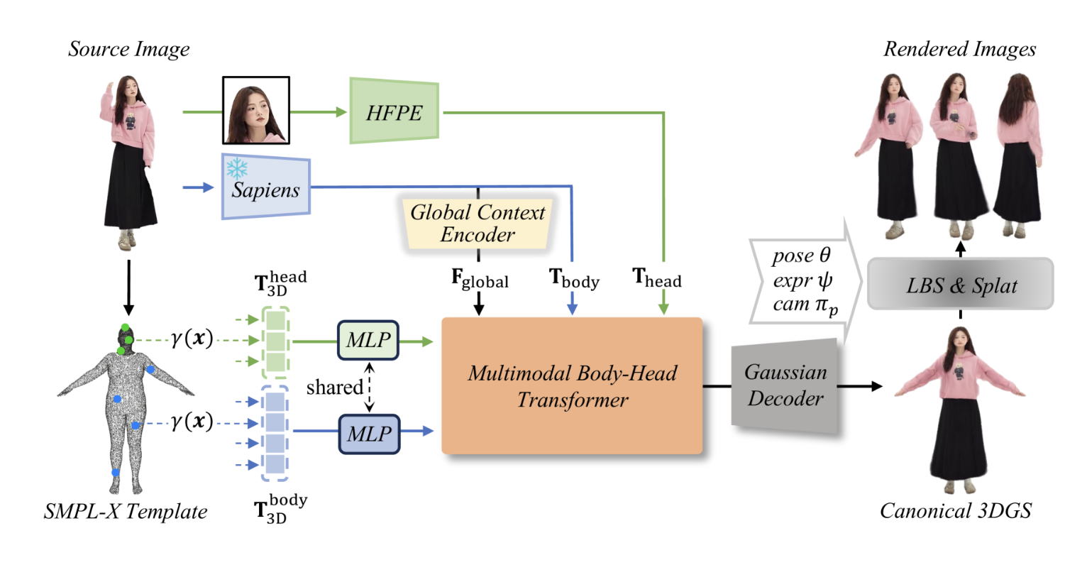
Method

Slide 24
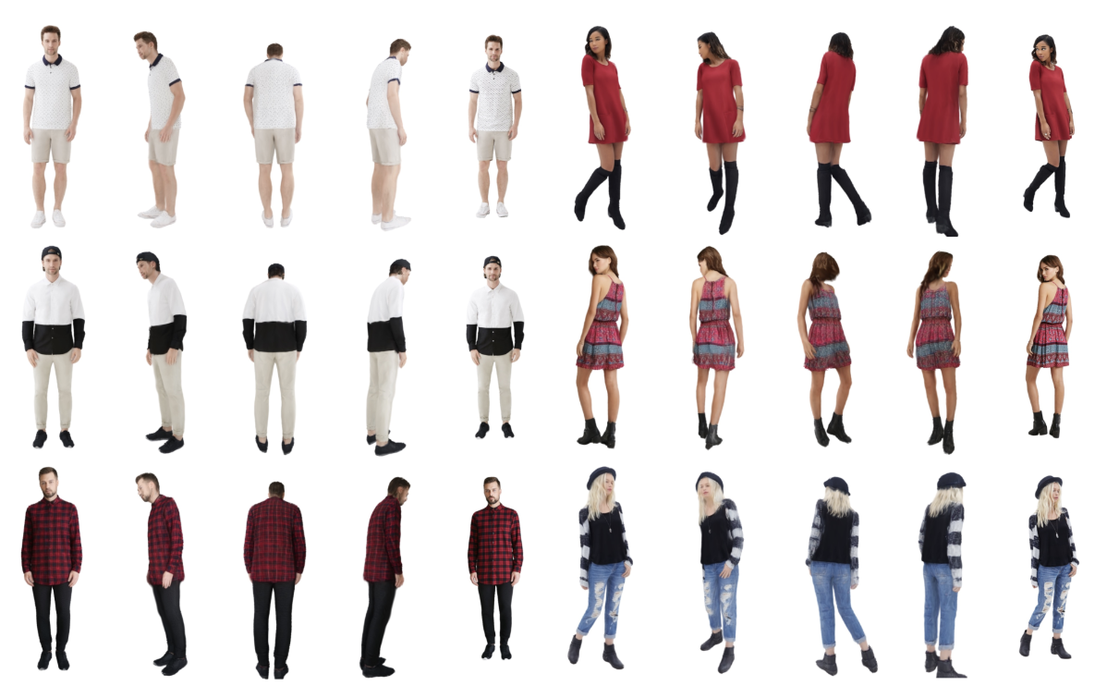
Qualitative Examples
Notes:
Examples of diverse human models generated by LHM, showcasing its ability to handle various clothing styles, poses, and body types.

Slide 25
Conclusion
Random Identity Sampling is better than Random Dataset Sampling
CLIP-ReID outperforms OSNET overall, but OSNET shows competitive performance when more training samples are available.
Triplet loss generalizes better than ArcFace on imbalanced or unseen classes, making it more effective for real-world ReID.
In occluded or overlapping scenarios, LLaVA may generate incorrect attribute details such as clothing, gender, or age.
LHM can be utilized to generate synthetic multi view data in case of missing and single view videos.
LHM offers a new path to build geometry-aware, pose-robust, and identity-preserving features for ReID systems.

Slide 26
Next steps
Implement CLIP-SCGI using existing synthetic generated captions in CLIP-ReID
Generate synthetic person images with varying view points using LHM

