Slide 1

Multi Camera Tracking Project
Spring 2025 – weekly progress, 10 April, 2025

Slide 2
Agenda
Objective
Recap , Progress Overview
Trace-1573 ReID Experiments
Various sampling strategies
Combination of Various proportions Market-1501 dataset
Ablation on ArcFace , Triplet Loss
Synthetic caption generation using LLaVA
Conclusion
Next steps

Slide 3
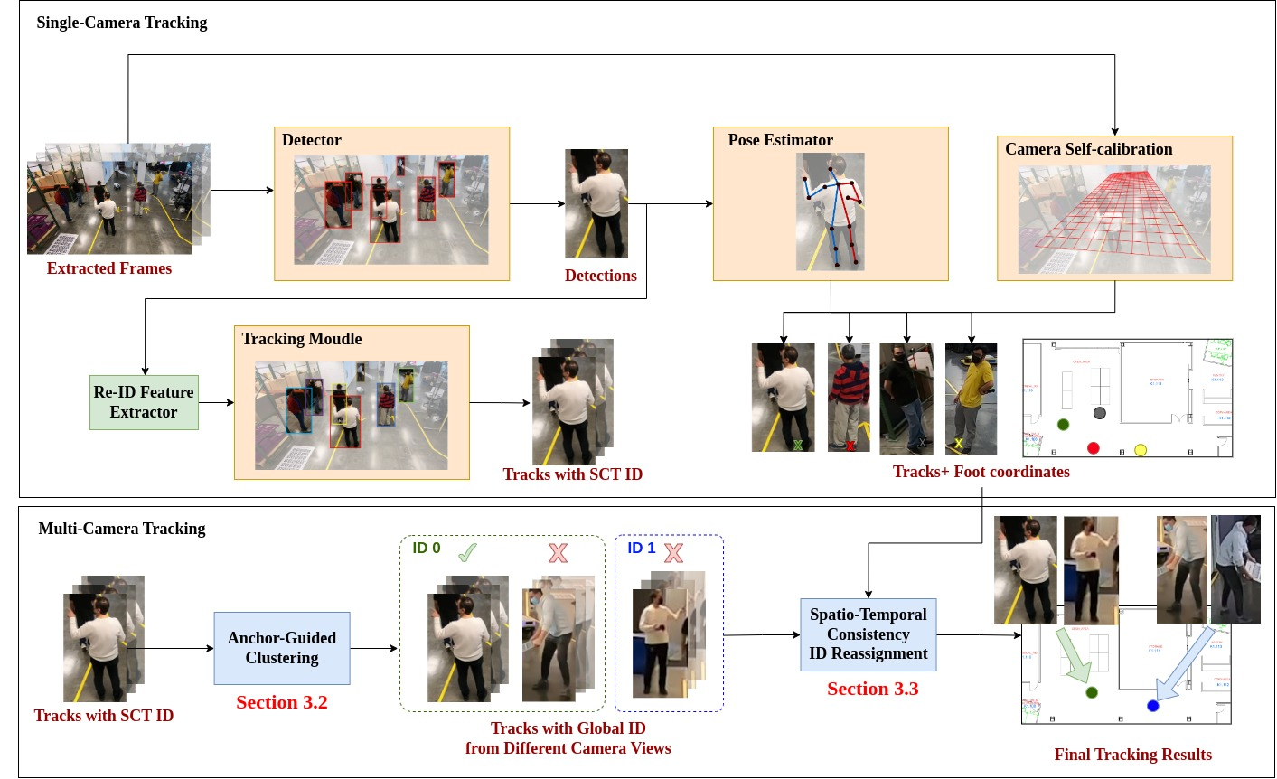
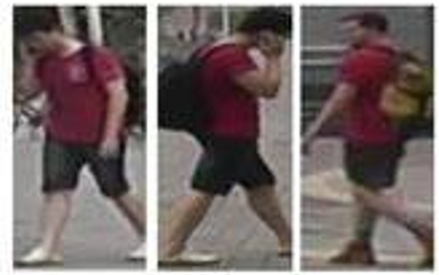
Objective
Develop a robust multi-camera tracking model with a focus on person re-identification (Re-ID).
Focus
Re-ID Module

Slide 4
Recap
Extensive data analysis on Trace-1573 multi camera dataset.
Trace-1573 ReID Dataset Curation.
Conducted initial experiments with CLIP-ReID and OSNET using Trace-1573.
Evaluated Trace-1573 dataset by scaling up the data with Market-1501
Random Identity sampling
Random dataset sampling (Equal proportions of datasets in a batch )
Ablation study on distance metric: Cosine vs Euclidean
While training in Triple hard mining loss
Used in computing distance matrix(Inference).

Slide 5
Trace-1573 ReId data set statistics
This dataset consists of 834 person identities.
All persons does not appear across all the cameras.
​​
Split | IDs | Images | Cameras
Train | 414 | 12720 | 45
Query | 420 | 4099 | 43
Gallery | 390 | 14976 | 43
Test set
Person 10 images in train and 15 in test (12 gallery , 3 query)
Notes:
594 previous IDS

Slide 6
ReID Evaluation metrics
mAP(Mean Average Precision )
Evaluates how well correct matches are ranked across the gallery
Considers all correct matches – not just the first match for a query
Top-1 Accuracy
Checks if the top-ranked match is the correct identity
Focuses on precision at the highest rank - just the first retrieved result.
​​
Notes:
594 previous IDS

Slide 7
Experimental Results
Method | Train data | Test data | MAP(%) | Top-1 Accuracy(%)
OSNeT | Market-1501 | Market-1501 | 78.3 | 93.8
CLIP-ReID | Market-1501 | Market-1501 | 89.8 (14.6 % ) | 95.3(1.6 % )
OSNET | Trace-1573 ReID | Trace-1573 ReID | 35.7 | 69.2
CLIP-ReID | Trace-1573 ReID | Trace-1573 ReID | 63.3 (77.3 % ) | 80.8 (16.7 % )
OSNET | Market-1501 | Trace-1573 ReID | 7.5 | 25.4
CLIP-ReID | Market-1501 | Trace-1573 ReID | 40.1 (434 % ) | 61.7(36.3 % )
Show Strong generalization
Results of CLIP-ReID , OSNET in same dataset setting(Top 4 rows ) and cross dataset(bottom 2 rows) setting evaluations using Market-1501 , Trace-1573 ReID datasets

Slide 8
ReID Triplet Loss : Cosine vs Euclidean distance
Training Objective : Triplet hard mining loss
During Inference , Euclidean distance is used to compute distance matrix.
Method | Metric | Train data | Test data | MAP(%) | Top-1 Accuracy(%)
CLIP-ReID | Euclidean | Market-1501 | Market-1501 | 89.8 | 95.3
CLIP-ReID | Cosine | Market-1501 | Market-1501 | 86.8 | 93.9
CLIP-ReID | Euclidean | Trace-1573 | Trace-1573 | 63.8 | 80.0
CLIP-ReID | Cosine | Trace-1573 | Trace-1573 | 57.9 | 77.2
Euclidean distance provides better clustering of person IDs compared to cosine distance.
Notes:
Euclidean distance forms clusters based on absolute positioning, making it more effective when featurerepresentations are well-distributed.
Cosine distance may place different identities closer together if they share similar directional features buthave different magnitudes, leading to less distinct clustering.

Slide 9
Experimental Results : Varying Samples per person ID
No of Samples per person ID per Camera | Method | Train data | Test data | MAP(%) | Top-1 Accuracy(%)
Train Set : 10 Gallery Set : 12 Query Set : 3 | OSNET | Trace-1573 ReID | Trace-1573 ReID | 34.2 | 68.4
 | CLIP-ReID | Trace-1573 ReID | Trace-1573 ReID | 63.3 | 80.8
Train Set : 30 Gallery Set : 30 Query Set : 5 | OSNET | Trace-1573 ReID | Trace-1573 ReID | 41.2 | 80.3
 | CLIP-ReID | Trace-1573 ReID | Trace-1573 ReID | 62.5 | 83.0
Observation :
In traditional CNN models, performance improves as the amount of data increases.
However, for foundational models like CLIP-ReID, only a few samples are sufficient for learning, but adding too many samples can reduce generalizability.

Slide 10
Progress
ArcFace vs Triplet hard mining Loss
Generate synthetic captions using LLaVA to enhance CLIP-ReID
ReID Experiments
Increase the lower bound of samples per person to provide model enough training samples.

Slide 11
ReID evaluation : Cosine vs Euclidean similarity
In the experiments , models are trained on Euclidean distance
Method | Distance | Train data | Test data | MAP(%) | Top-1 Accuracy(%)
CLIP-ReID | Euclidean | Market-1501 | Market-1501 | 89.8 | 95.3
CLIP-ReID | Cosine | Market-1501 | Market-1501 | 89.8 | 95.2
Method | Distance | Train data | Test data | MAP(%) | Top-1 Accuracy(%)
CLIP-ReID | Euclidean | Trace-ReID | Trace-ReID | 63.3 | 80.8
CLIP-ReID | Cosine | Trace-ReID | Trace-ReID | 63.2 | 80.5
At inference , The features are normalized before computing the distance matrix so, both metrics attribute towards similar performance

Slide 12
Experimental Results: Market+Trace 1573 ReID Data
Method | Sampling | Train set | Test set | MAP(%) | Top-1 Accuracy(%)
OSNET | Random Identity Sampling | Trace-1573 | Trace-1573 | 35.7 | 69.2
OSNET |  | Market-1501+ Trace-1573 | Trace-1573 | 36.9 | 68.2
CLIP-REID |  | Trace-1573 | Trace-1573 | 63.5 | 78.6
CLIP-REID |  | Market-1501+ Trace-1573 | Trace-1573 | 65.5 | 81.2
Method | Sampling | Train data | Test data | MAP(%) | Top-1 Accuracy(%)
OSNET | Random Dataset Sampling | Trace-1573 | Trace-1573 | 35.7 | 69.2
OSNET |  | Market-1501+ Trace-1573 | Trace-1573 | 52.7 | 79.1
CLIP-ReID |  | Trace-1573 | Trace-1573 | 63.5 | 78.6
CLIP-ReID |  | Market-1501+ Trace-1573 | Trace-1573 | R | R

Slide 13
Experimental Results: Trace 1573 ReID Data
No of Samples per person ID per Camera | Method | MAP(%) | Top-1 Accuracy(%)
Train Set : 10 Gallery Set : 12 Query Set : 3 | OSNET | 34.2 | 68.4
 | CLIP-ReID | 63.3 | 80.8
Train Set : 30 Gallery Set : 30 Query Set : 5 | OSNET | 41.2 | 80.3
 | CLIP-ReID | 62.5 | 83.0
Train Set minimum samples : 5 Maximum samples 50 | OSNET
 | CLIP-ReID

Slide 14
Arc Face vs Triplet Hard Mining Loss
Experimental study on different loss fuctions with CLIP-ReID method .
Data | Loss Function | MAP(%) | Top-1 Accuracy(%)
Market-1501 | ArcFace | 86.1 | 94.4
 | Triplet | 89.8 | 95.3
Trace-1573 | ArcFace | 54.2 | 77.1
 | Triplet | 63.3 | 88.8
Triplet loss is better able to generalize across embedding space where as ArcFace is more sensitive to class imbalance and show poor generalization to unseen classes.

Slide 15
Feature Visualization : ArcFace vs Triplet

Slide 16


Examples : Generated synthetic captions from LLaVA
A woman is wearing a purple shirt and shorts. She is wearing a watch and carrying a purse. The woman has short hair and is wearing glasses.
A young woman is wearing a black shirt and shorts. She is carrying a backpack and has long blonde hair.

Slide 17


Examples : Generated synthetic captions from LLaVA
A young man is wearing a black shirt and shorts. He is carrying a backpack and has short hair.
A man is wearing camouflage shorts and a watch

Slide 18
Conclusion

Slide 19
Next steps
Implement synthetic generated captions into CLIP-ReID
Explore latest ReID Foundational models
Synthetic Data Exploration
Rotational augmentations to existing single view camera to create multi-view data.(challenge with HMR 2.0)

