Slide 1
EMPLOYEE SALARY PREDICTION USING MACHINE LEARNING ALGORITHMS
CAPSTONE PROJECT
-----------------------------------------------------------------------------
Presented By:
Jagu Manish
Civil Engineering Department
IIT Bombay
lD: STU666004a8925781717568680
Email: manishjagu730@gmail.com
----------------------------------------------------------------------------------

Slide 2
OUTLINE
Problem Statement
System Development Approach
Algorithm & Deployment
Result
Conclusion
Future Scope

Slide 3
Problem Statement
Predicting employee salaries isn't straightforward — it depends on various factors like skills, experience, and job role.
Most available tools are either too complex or don’t offer a smooth user experience.
HR teams and analysts often struggle with model selection, data handling, and making accurate predictions.
There’s a clear need for a simple, intuitive application that brings everything together.
This project aims to solve that by building an all-in-one salary prediction tool using machine learning.

Slide 4
System Approach
System Requirements
  Platform: Windows/Linux/Mac (with Python installed)
  Python Version: 3.8 or higher
  RAM: Minimum 4 GB (8 GB recommended for smooth model training)
  Display: 1366x768 or higher for full UI visibility
Libraries Used
  GUI & Styling: tkinter, ttkbootstrap
  Data Handling: pandas, numpy
  Visualization: matplotlib
  Machine Learning: scikit-learn (for preprocessing, modeling, and evaluation)
  File I/O & Dialogs: tkinter.filedialog, tkinter.messagebox

Slide 5
Algorithm & Deployment
Overview
  The user can predict salaries using multiple machine learning algorithms at once and compare their accuracy.
  This helps in selecting the most suitable model for reliable predictions — all through a simple desktop interface.
Step-by-Step Procedure
  Dataset Loading
    User uploads a CSV file containing employee data via the GUI.
  Data Preprocessing
    Handles missing values (mean/mode), encodes categorical features, removes outliers (optional), and standardizes features.

Slide 6
  Target Selection
    User selects the target column (e.g., Salary) to predict from a dropdown menu.
  Model Selection & Training
    User selects one or more models like Linear Regression, KNN, or Neural Network.
    Models are trained using train_test_split and evaluated using cross-validation (cross_val_score).
  Accuracy Visualization
    Model accuracies are compared visually using a bar chart.
  Salary Prediction
    User inputs feature values; the app predicts salary using all trained models and displays results with accuracy.
  Export options
    User can export both processed data and prediction results as CSV files.

Slide 7
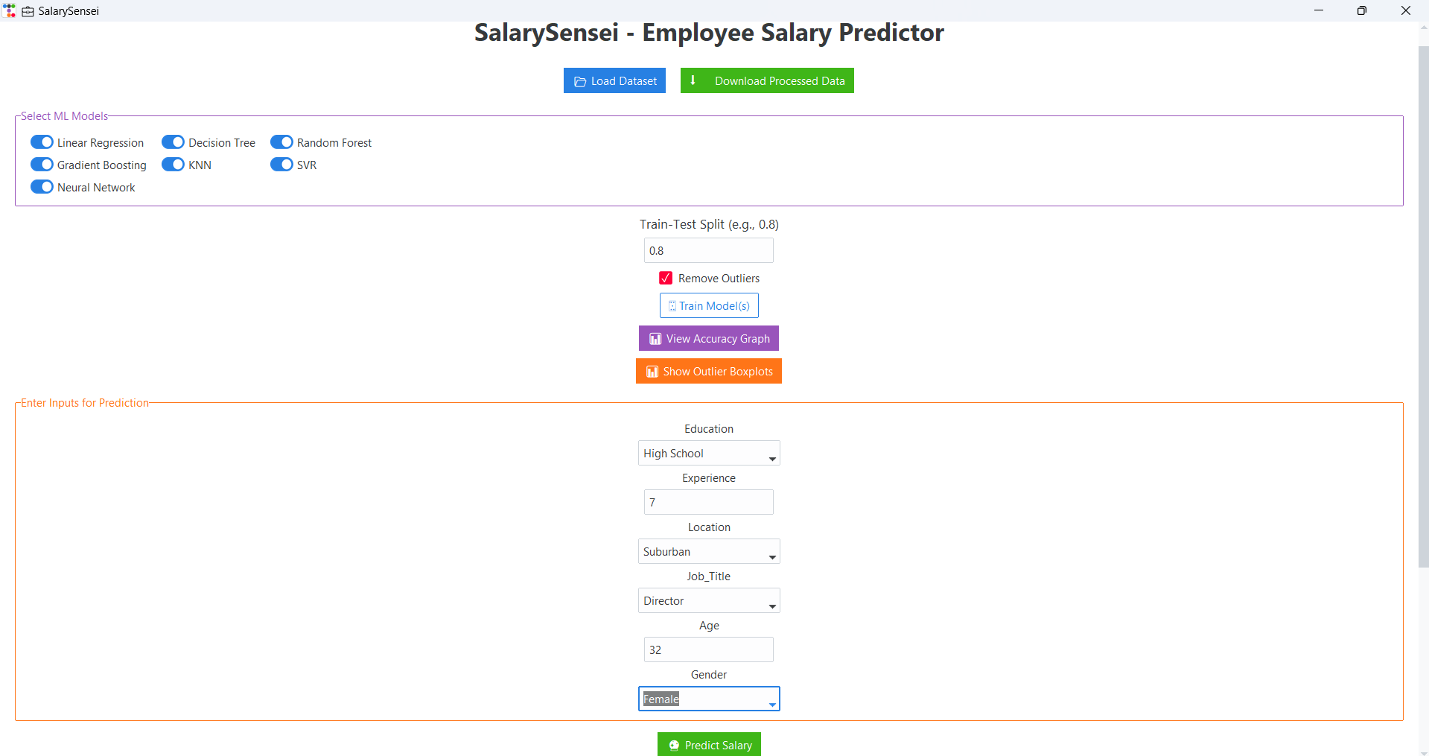
Result
Application’s UI:
Github:
https://github.com/ManishJaagu/SalarySensei_EmployeeSalaryPredictor_EdunetAIMLProject.git

Slide 8
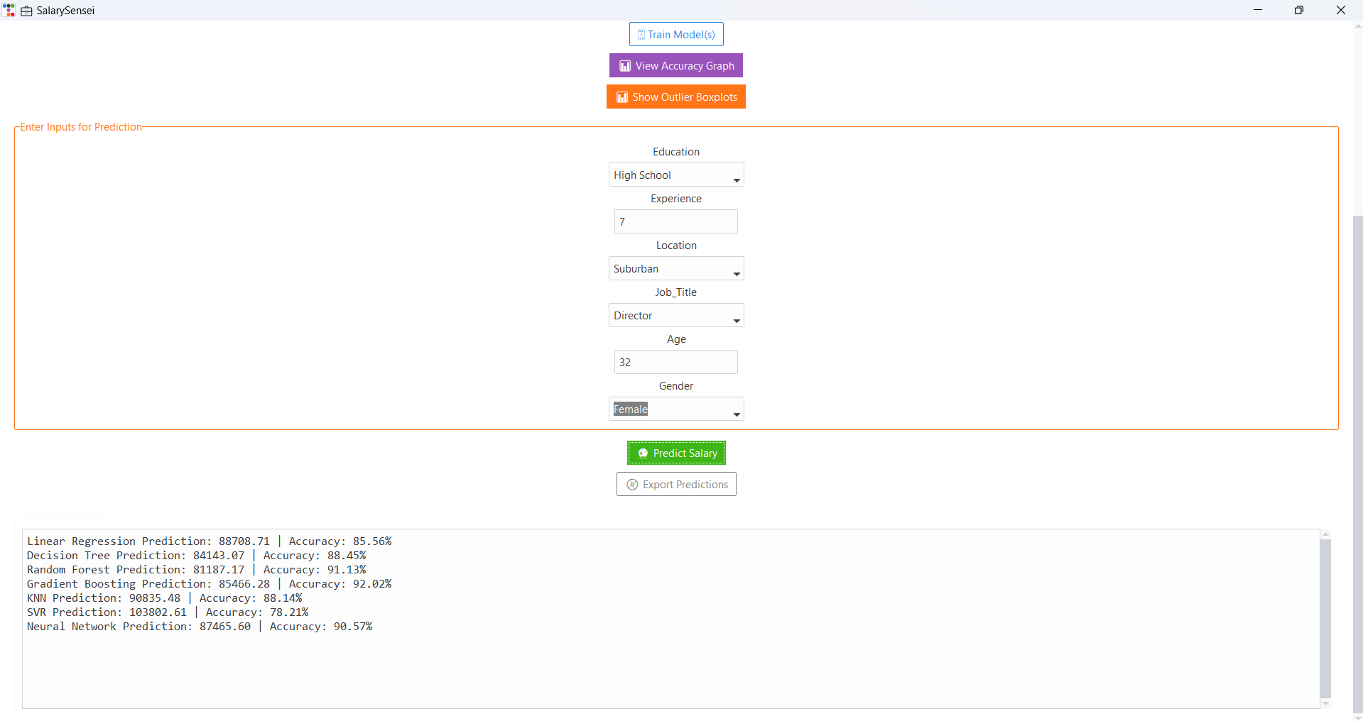

Slide 9
Conclusion
It was an educational and rewarding experience to create the Employee Salary Predictor. The project successfully combines machine learning processes with a quick, easy-to-use interface, thereby making salary prediction accessible to the masses, including those who do not have technical expertise.
It enables users to import their own data, train multiple ML models, and visually compare them, the app enables them to select which models are best for their own use case. Outlier removal, input customization, and exporting predictions add features that make it more than just a simple tech demo, but rather an actual functional tool.

Slide 10
Future scope
The Employee Salary Predictor has laid a strong foundation, but there’s plenty of room to grow. Here are a few ways it can be enhanced:
  More Model Options: Adding advanced algorithms like XGBoost or LightGBM can boost accuracy.
  Better Insights: Showing feature importance, detailed metrics (like RMSE, R²), and interactive charts would make results more meaningful.
  Smart Inputs: Auto-suggestions and real-time input validation could improve usability.
  Save & Reuse: Letting users save trained models and compare predictions across datasets would add great flexibility.
  Web Version: Bringing the app online using Flask or Django would make it accessible from anywhere.
  Real-World Data: Integrating salary trends from platforms like LinkedIn or Glassdoor could make predictions more realistic.
  With these upgrades, the app could evolve into a powerful tool for HR teams, job seekers, and analysts alike—offering not just predictions, but valuable guidance.

Slide 11
THANK YOU

