Slide 1


Docker
Containers Vs. Virtual Machines

Slide 2


Containers Vs. VMs?
What is a Virtual Machine?
In basic terms, a virtual machine (often referred to as a “VM” for short), is
an emulation of a specific computer system type. They operate based on the
architecture and functions of that real computer and its implementation
can involve specialized hardware, software or both.
When you think of a virtual machine, you probably think of VMWare, Citrix
and/or VirtualBox. Virtualization software allows you to set up one operating
system within another. Although they both share the same physical hardware,
the virtual machine is isolated from that hardware and has to communicate
with it through something called a Hypervisor.

Slide 3
Containers Vs. VMs?
What is a Container?
A container is exactly what you might expect it to be based on the general
definition of the word. It is an entirely isolated set of packages, libraries and/or
applications that are completely independent from its surroundings.
In the simplest example, you place your leftovers in a plastic container and then
set it on the table. Although the table lends the platform on which the
leftovers are resting upon, they are independent of the table itself. What you
do to one does not necessarily affect the other (although in certain instances it
can).

Slide 4
Containers Vs. VMs?
Why is the difference important?
As in most things in life, the importance is in perspective. From the perspective
of getting the most performance out of the hardware purchased, virtualization
was invented to allow us to share but segregate server instances from each other.
This way, we could protect one operating system from another without letting
spare CPU cycles, memory or disk space go to waste.
Now, virtualization is becoming more granular. We have virtual servers, but they
are based on emulating virtual hardware through a hypervisor. This means that
they are heavy in terms of system requirements. Containers however, use
shared operating systems and are more efficient in system resource
terms.

Slide 5
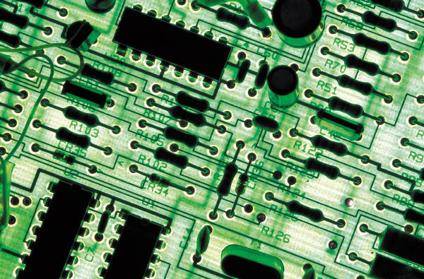

Containers Vs. VMs?
Summary:
Although the differences may seem subtle, as we continue our exploration of Docker, you will see the many difference in Virtual Machines vs. Containers as being extremely important. We continue to maximize what we get out of our systems by more and more granular management of our resources.

