Slide 1
EduLearn - Professional E-Learning Platform
AI-powered exams, insights, and personalized learning
Team: Manish Kumar, Akash Kumar, Manoj Kumar, Shiva Jadoun, Amit Saraswat, Somdatt Verma

Slide 2
Agenda
• Problem and Solution Overview
• Architecture and Tech Stack
• Features and User Benefits
• Live Screens and Demo Flow
• Team & Work Allocation
• Progress, KPIs, Roadmap
• Q&A

Slide 3
Problem Statement
• Traditional learning lacks personalization and deep analytics
• Hard to identify strengths/weaknesses for targeted improvement
• Admins require efficient management and oversight tools

Slide 4
Solution Overview
• Next.js platform with role-based auth and secure APIs
• Exam engine with reporting, charts, and ML analysis
• Modern, responsive UI for students and admins

Slide 5
Architecture Overview
• Next.js App Router for pages and APIs
• JWT-based authentication with middleware protection
• MongoDB-ready models and services (planned integration)

Slide 6
Tech Stack
• Next.js, React, TypeScript, Tailwind CSS, shadcn/ui
• Recharts for visualizations
• JWT auth, Node services, MongoDB (planned)

Slide 7
Authentication & RBAC
What it includes
How it helps users
• Signup/Login with form validation
• JWT issuance/verification
• Role-based route protection (Admin/Student)
• Secure middleware for API and pages
• Keeps accounts secure and scoped to the right role
• Smooth sign-in flow builds trust and speed
• Prevents unauthorized access and data leaks
• Auditable, maintainable security boundary

Slide 8
Exam Engine
What it includes
How it helps users
• Timed exams with progress tracking
• Question navigation and state restore
• Auto scoring hooks and persistence models
• Practice sections (Aptitude/DSA/CS/Reasoning)
• Realistic exam experience boosts readiness
• No loss on refresh or disconnect
• Fast feedback for learning loops
• Targeted practice by category

Slide 9
Reports & Analytics
What it includes
How it helps users
• Charts and breakdowns by category
• Attempt history and comparisons
• Strength/weakness highlights
• Export-ready summary view
• Visual feedback makes performance obvious
• Shows progress over time for motivation
• Helps plan next steps efficiently
• Easy to share with mentors/admins

Slide 10
Student Experience
What it includes
How it helps users
• Personalized dashboard and learning paths
• Responsive UI with accessible components
• Notifications and toasts for key actions
• Content library and practice modules
• Clear next actions reduce confusion
• Works great on mobile and desktop
• Keeps users informed without friction
• One place for study and practice

Slide 11
Admin Tools
What it includes
How it helps users
• CRUD for students, exams, questions
• Role management and settings
• Bulk operations and email triggers
• Dashboards for oversight
• Saves time managing large cohorts
• Reduces human error through workflows
• Automates communication at scale
• Quickly spots issues and trends

Slide 12
Email & Notifications
What it includes
How it helps users
• Registration and password reset emails
• Result and report notifications
• Provider-agnostic setup (SendGrid/Mailgun)
• Users stay updated on critical actions
• Encourages return and course completion
• Easy to switch providers when needed

Slide 13
ML Personalization (Planned)
What it includes
How it helps users
• Category-wise performance analytics
• Level classification (Beginner/Intermediate/Advanced)
• Personalized learning recommendations
• Adaptive learning path generation
• Improves outcomes with tailored insights
• Focuses effort where it matters most
• Provides clear guidance after every attempt
• Saves time by removing guesswork

Slide 14
Security & Authentication
• JWT issuance/verification and secure password hashing
• Role-Based Access Control (RBAC) on routes and APIs
• Centralized logging and security utilities

Slide 15
ML Analysis
• Category-wise performance and recommendations
• Strength/weakness detection and level classification
• Learning path suggestions based on results

Slide 16
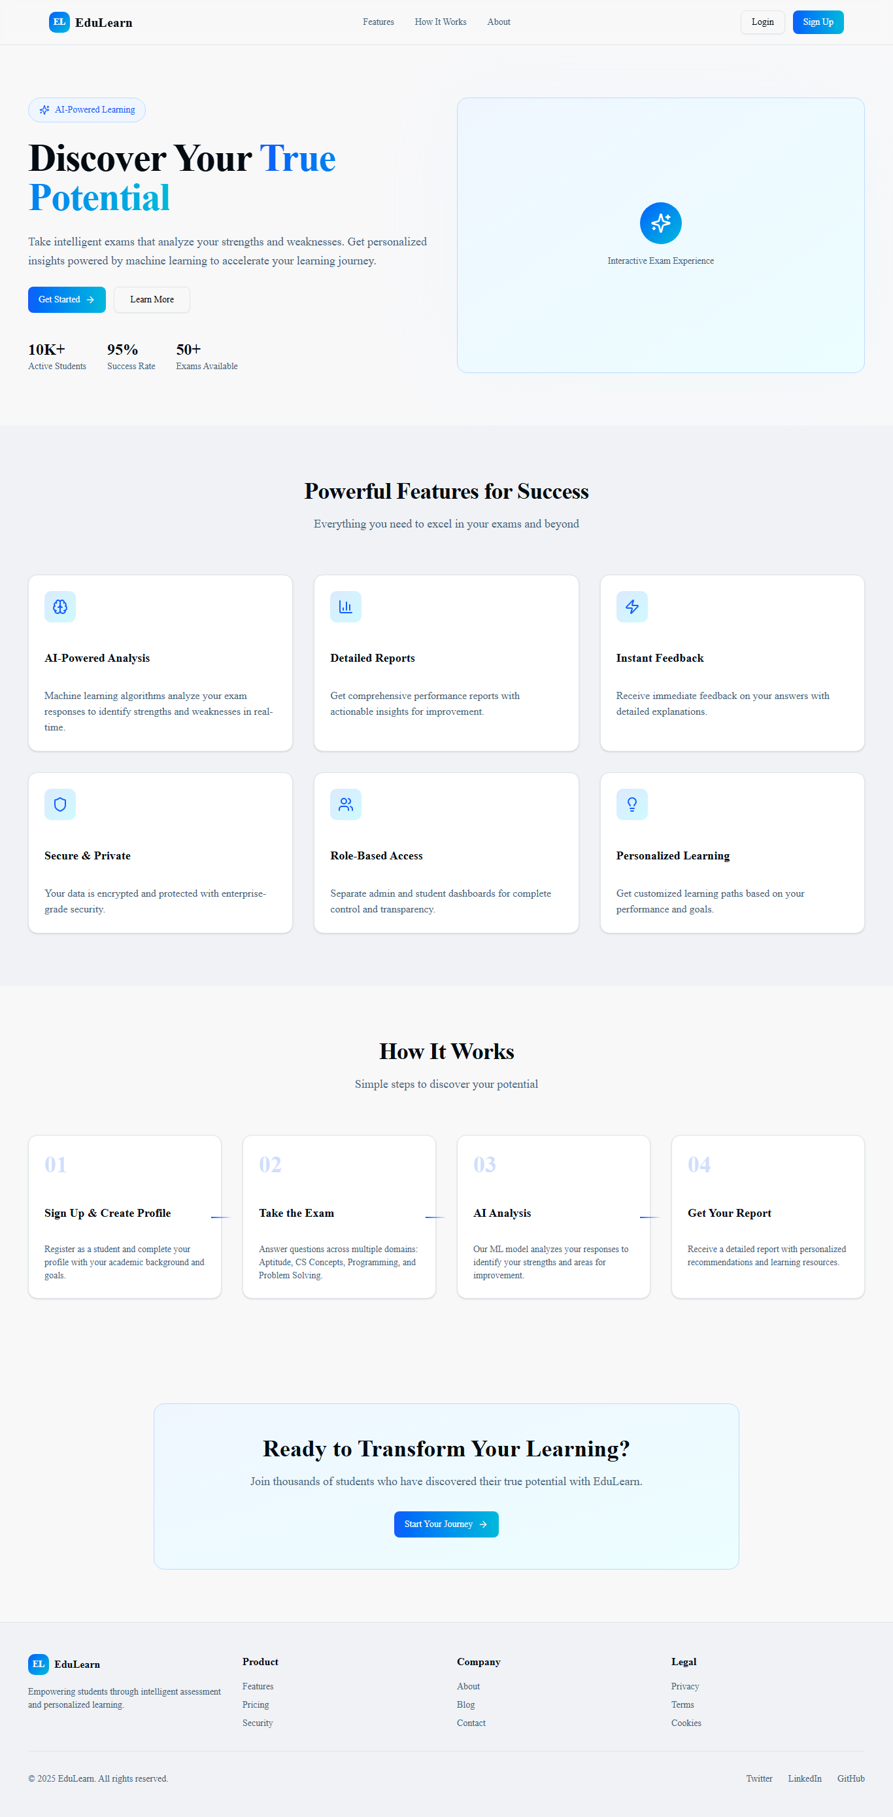
Landing Page

Slide 17
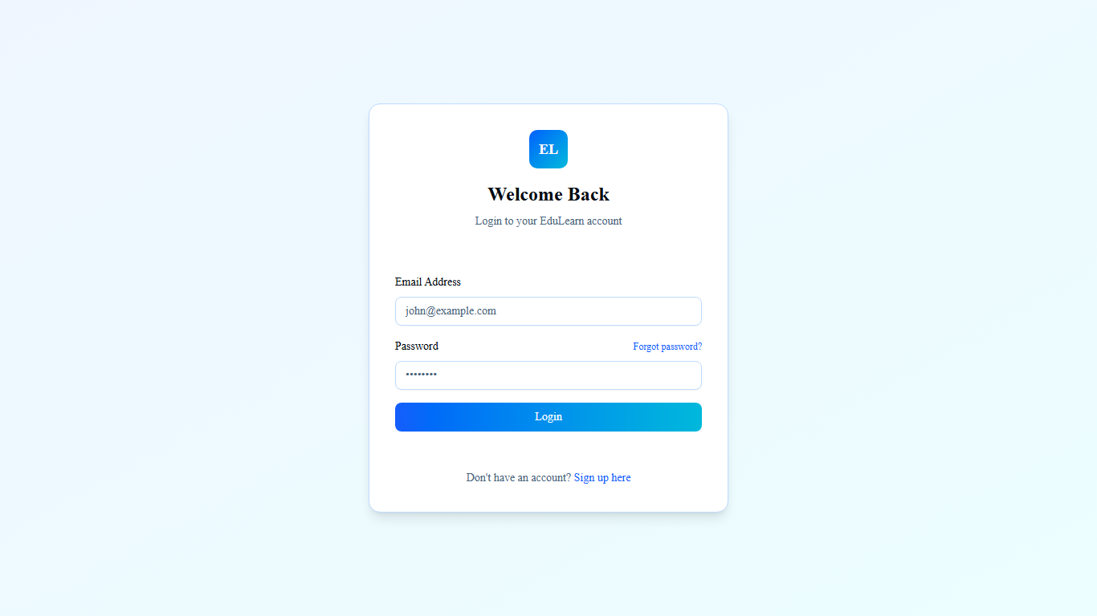
Auth - Login

Slide 18
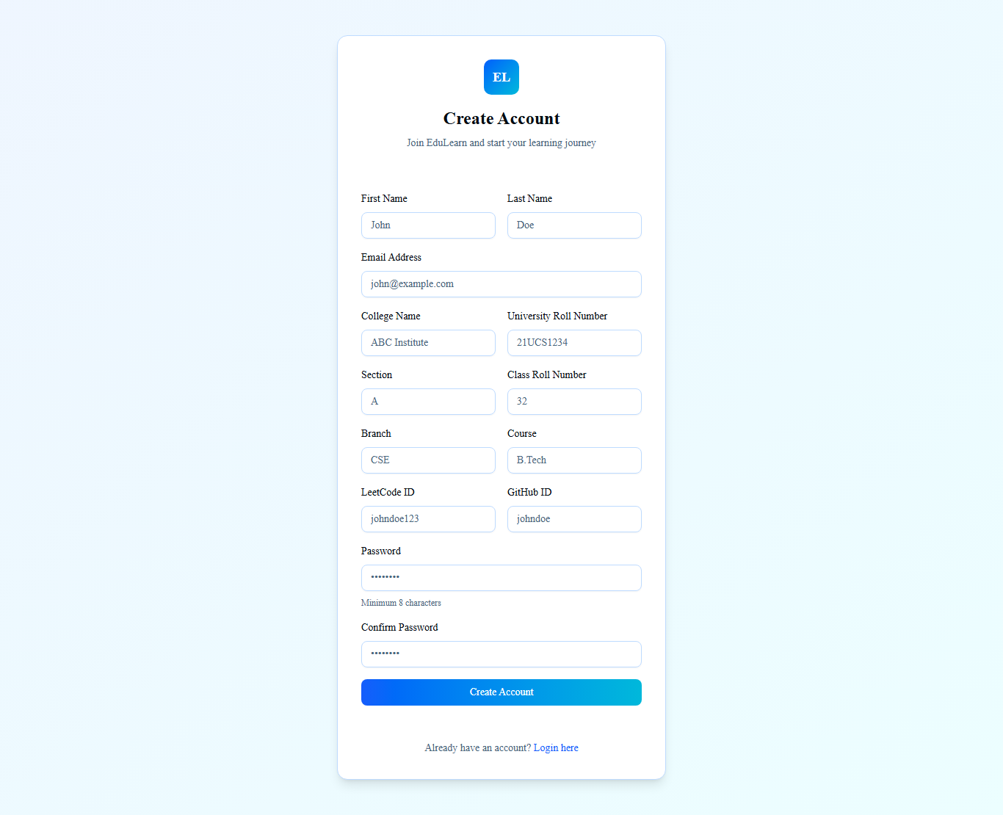
Auth - Signup

Slide 19
Student Dashboard

Slide 20
Student Exams

Slide 21
Reports & Charts

Slide 22
Admin Dashboard

Slide 23
Demo Flow
• 1) Landing → explore features
• 2) Auth → login/signup as role
• 3) Student Dashboard → review modules
• 4) Exams → attempt and submit
• 5) Reports → view insights
• 6) Admin → manage students/exams/questions

Slide 24
Team & Work Allocation
Name | Primary Modules | Responsibilities
Manish Kumar | Auth, RBAC, Security, Middleware | Auth flows, JWT, route protection, RBAC guards, security utils
Akash Kumar | Exam Engine, Reports, ML | Exam attempts, scoring, ML analysis, report visuals
Manoj Kumar | Admin CRUD, Email | Admin CRUD pages/APIs, email notifications
Shiva Jadoun | Student Dashboard & UX | Student flows, dashboard, responsive UX
Amit Saraswat | QA, CI, Docs, Seed | Test data, CI workflows, docs, .env.example
Somdatt Verma | UI Polish, A11y, Content | Responsive polish, accessibility, assets
Notes:
Each member presents their module responsibilities and contributions as per the table.

Slide 25
Manish Kumar — Auth & Security
• JWT issuance/verification
• RBAC policies and route guards
• Middleware protection
• Security utilities and logging
Notes:
Explain auth flow, token lifecycle, RBAC rules, and how middleware protects pages and APIs.

Slide 26
Akash Kumar — Exam Engine & Reports
• Exam attempt lifecycle and state restore
• Scoring hooks and models
• Charts and report generation
• ML integration plan
Notes:
Walk through attempt → submit → analyze; highlight data structures and report visuals.

Slide 27
Manoj Kumar — Admin & Email
• CRUD: students, exams, questions
• Admin dashboards and settings
• Email notifications (registration/results)
Notes:
Show admin flows and when emails are triggered for lifecycle events.

Slide 28
Shiva Jadoun — Student UX
• Dashboard and learning paths
• Responsive components and states
• Navigation & feedback (toasts/alerts)
Notes:
Emphasize ease of navigation and responsiveness across devices.

Slide 29
Amit Saraswat — QA & CI
• Seed/test data preparation
• Lint/build workflows on PRs
• Docs and .env.example maintenance
Notes:
Highlight reliability: automated checks, minimal tests, and documentation quality.

Slide 30
Somdatt Verma — UI Polish & A11y
• Responsive polish and theming
• Accessibility checks
• Content assets management
Notes:
Show before/after polish screens; mention a11y considerations.

Slide 31
Progress vs. Next Steps
Area | Status | Next Steps
Scaffolding & UI | Completed | Polish and tidy components
Landing & Auth UI | Completed | Finalize backend auth flow
Middleware & RBAC | In Progress | Refine role checks and tokens
Student Modules | In Progress | Wire to APIs and data models
Admin Dashboard | In Progress | Complete CRUD and validations
Reports & Charts | In Progress | Connect to ML and persistence
ML Integration | Pending | Implement data pipeline and outputs
Email Integration | Pending | Configure provider keys, test flows
Testing & CI | Pending | Add workflows, minimal tests, lint

Slide 32
KPIs & Success Metrics
Metric | Target | Why It Matters
Monthly Active Users | 500+ | Adoption and engagement
Exam Completion Rate | ≥ 75% | Stickiness and flow quality
Avg. Score Improvement | +10% | Learning impact
Report Views per User | ≥ 3 | Insight consumption
7-day Retention | ≥ 40% | Habit formation

Slide 33
Timeline
Phase | Scope | Window
Phase 1 | Auth, UI scaffolding, basic exams | Week 1–2
Phase 2 | Admin CRUD, student flows, reports UI | Week 3–4
Phase 3 | ML integration, email, polish & CI | Week 5–6

Slide 34
Risks & Mitigations
Risk | Impact | Mitigation
Data security | High | RBAC, validation, secure storage
Exam integrity | Medium | Timers, session checks, proctoring roadmap
Scale/performance | Medium | Caching, indexes, monitoring
Email delivery | Low | Provider retries, fallbacks
ML data quality | Medium | Validation & continuous evaluation

Slide 35
Testing & CI
• ESLint/type checks on PRs
• Build and smoke tests
• Planned e2e for key flows

Slide 36
Accessibility & Performance
• Keyboard navigation and ARIA labels
• Color contrast and focus states
• Lighthouse performance targets

Slide 37
Roadmap & Deployment
• Implement full auth backend and RBAC guards
• Complete Admin CRUD and Student data wiring
• Integrate ML analysis end-to-end
• Add CI, tests, and deployment (Vercel)
• Prepare demo walkthrough and documentation

Slide 38
Summary & Ask
• Delivering a secure, insightful e-learning experience
• Clear roadmap and measurable KPIs
• Feedback on ML scope and deployment plan appreciated

