Slide 1
EduLearn - Professional E-Learning Platform
AI-powered exams, insights, and personalized learning
Team: Manish Kumar, Akash Kumar, Manoj Kumar, Shiva Jadoun, Amit Saraswat, Somdatt Verma

Slide 2
Problem Statement
• Traditional learning lacks personalization and deep analytics
• Hard to identify strengths/weaknesses for targeted improvement
• Admins require efficient management and oversight tools

Slide 3
Solution Overview
• Next.js platform with role-based auth and secure APIs
• Exam engine with reporting, charts, and ML analysis
• Modern, responsive UI for students and admins

Slide 4
Architecture Overview
• Next.js App Router for pages and APIs
• JWT-based authentication with middleware protection
• MongoDB-ready models and services (planned integration)

Slide 5
Tech Stack
• Next.js, React, TypeScript, Tailwind CSS, shadcn/ui
• Recharts for visualizations
• JWT auth, Node services, MongoDB (planned)

Slide 6
Authentication & RBAC
What it includes
How it helps users
• Signup/Login with form validation
• JWT issuance/verification
• Role-based route protection (Admin/Student)
• Secure middleware for API and pages
• Keeps accounts secure and scoped to the right role
• Smooth sign-in flow builds trust and speed
• Prevents unauthorized access and data leaks
• Auditable, maintainable security boundary

Slide 7
Exam Engine
What it includes
How it helps users
• Timed exams with progress tracking
• Question navigation and state restore
• Auto scoring hooks and persistence models
• Practice sections (Aptitude/DSA/CS/Reasoning)
• Realistic exam experience boosts readiness
• No loss on refresh or disconnect
• Fast feedback for learning loops
• Targeted practice by category

Slide 8
Reports & Analytics
What it includes
How it helps users
• Charts and breakdowns by category
• Attempt history and comparisons
• Strength/weakness highlights
• Export-ready summary view
• Visual feedback makes performance obvious
• Shows progress over time for motivation
• Helps plan next steps efficiently
• Easy to share with mentors/admins

Slide 9
Student Experience
What it includes
How it helps users
• Personalized dashboard and learning paths
• Responsive UI with accessible components
• Notifications and toasts for key actions
• Content library and practice modules
• Clear next actions reduce confusion
• Works great on mobile and desktop
• Keeps users informed without friction
• One place for study and practice

Slide 10
Admin Tools
What it includes
How it helps users
• CRUD for students, exams, questions
• Role management and settings
• Bulk operations and email triggers
• Dashboards for oversight
• Saves time managing large cohorts
• Reduces human error through workflows
• Automates communication at scale
• Quickly spots issues and trends

Slide 11
Email & Notifications
What it includes
How it helps users
• Registration and password reset emails
• Result and report notifications
• Provider-agnostic setup (SendGrid/Mailgun)
• Users stay updated on critical actions
• Encourages return and course completion
• Easy to switch providers when needed

Slide 12
ML Personalization (Planned)
What it includes
How it helps users
• Category-wise performance analytics
• Level classification (Beginner/Intermediate/Advanced)
• Personalized learning recommendations
• Adaptive learning path generation
• Improves outcomes with tailored insights
• Focuses effort where it matters most
• Provides clear guidance after every attempt
• Saves time by removing guesswork

Slide 13
Security & Authentication
• JWT issuance/verification and secure password hashing
• Role-Based Access Control (RBAC) on routes and APIs
• Centralized logging and security utilities

Slide 14
ML Analysis
• Category-wise performance and recommendations
• Strength/weakness detection and level classification
• Learning path suggestions based on results

Slide 15
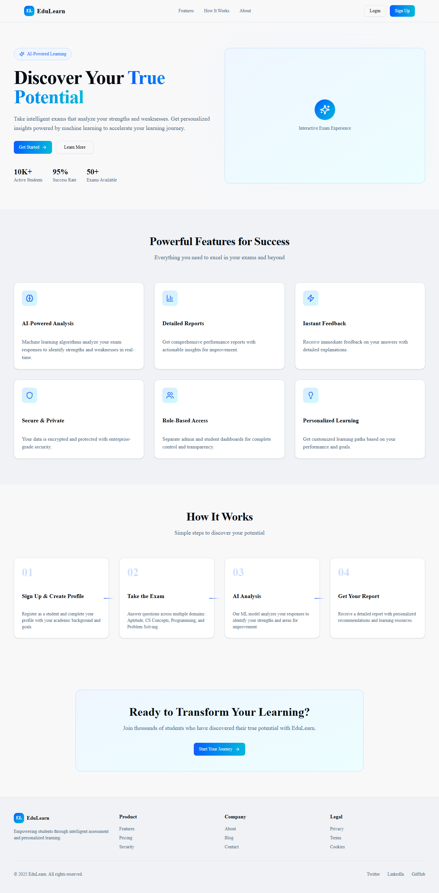
Landing Page

Slide 16
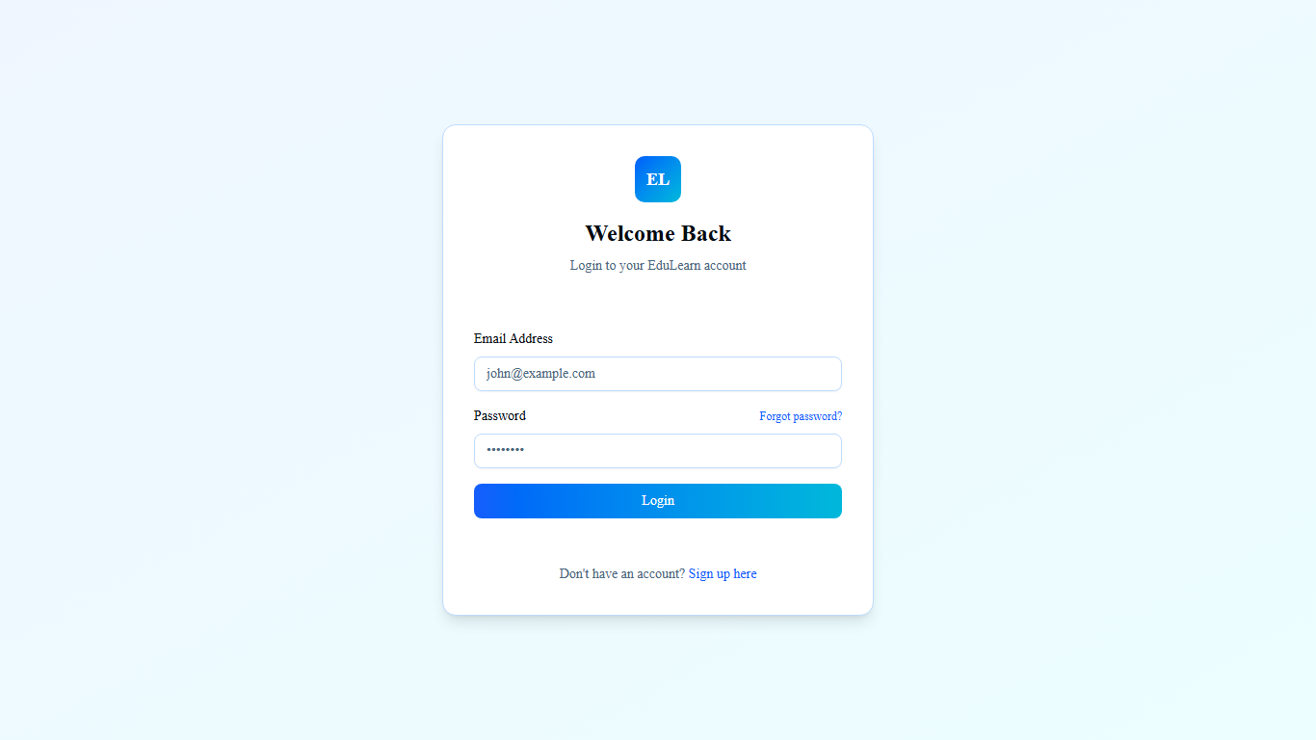
Auth - Login

Slide 17
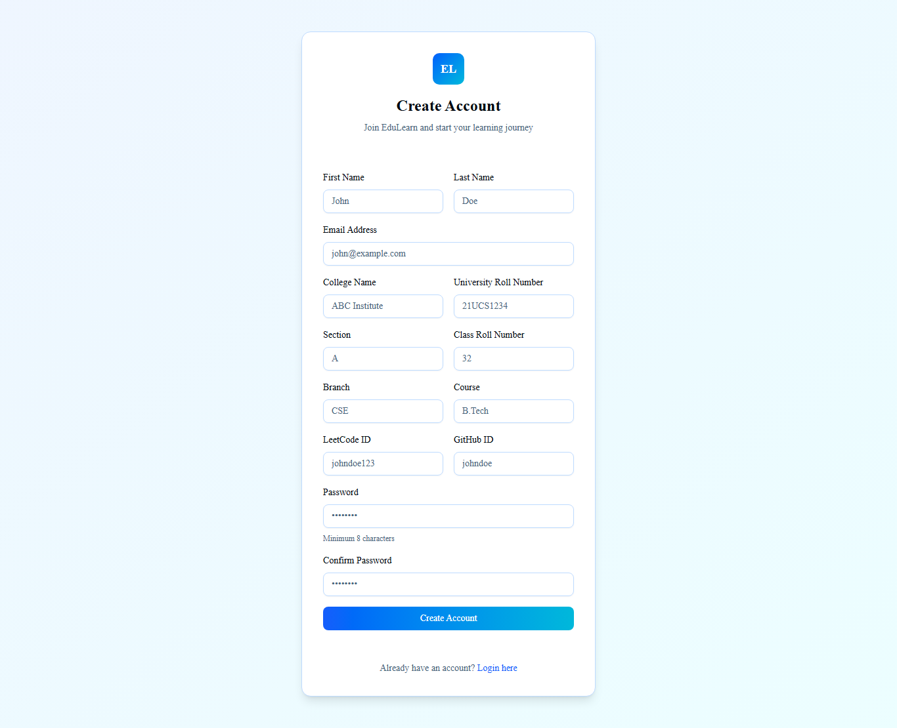
Auth - Signup

Slide 18
Student Dashboard

Slide 19
Student Exams

Slide 20
Reports & Charts

Slide 21
Admin Dashboard

Slide 22
Team & Work Allocation
Name | Primary Modules | Responsibilities
Manish Kumar | Auth, RBAC, Security, Middleware | Auth flows, JWT, route protection, RBAC guards, security utils
Akash Kumar | Exam Engine, Reports, ML | Exam attempts, scoring, ML analysis, report visuals
Manoj Kumar | Admin CRUD, Email | Admin CRUD pages/APIs, email notifications
Shiva Jadoun | Student Dashboard & UX | Student flows, dashboard, responsive UX
Amit Saraswat | QA, CI, Docs, Seed | Test data, CI workflows, docs, .env.example
Somdatt Verma | UI Polish, A11y, Content | Responsive polish, accessibility, assets

Slide 23
Progress vs. Next Steps
Area | Status | Next Steps
Scaffolding & UI | Completed | Polish and tidy components
Landing & Auth UI | Completed | Finalize backend auth flow
Middleware & RBAC | In Progress | Refine role checks and tokens
Student Modules | In Progress | Wire to APIs and data models
Admin Dashboard | In Progress | Complete CRUD and validations
Reports & Charts | In Progress | Connect to ML and persistence
ML Integration | Pending | Implement data pipeline and outputs
Email Integration | Pending | Configure provider keys, test flows
Testing & CI | Pending | Add workflows, minimal tests, lint

Slide 24
Roadmap & Deployment
• Implement full auth backend and RBAC guards
• Complete Admin CRUD and Student data wiring
• Integrate ML analysis end-to-end
• Add CI, tests, and deployment (Vercel)
• Prepare demo walkthrough and documentation

