Slide 1

Dr. D. Y. Patil Unitech Society's
Dr. D. Y. Patil Institute of Technology,
Sant Tukaram Nagar, Pimpri, Pune-411018, Maharashtra, India
Department of Computer Engineering 2022-2023
Project Domain
Deep Learning
GROUP MEMBERS:-
Manish Kumar
Chavhan Pravin
Prathamesh Singhare
Shurekha Suryawanshi
GUIDED BY:-
Prof. Chetana Shravage Ma’am

Slide 2
CONTENTS
Introduction
Abstract
Literature Survey
Problem Statement
Proposed Methodology
Software Requirements
Hardware Requirements
Challenges
Conclusion
Advantage
Reference

Slide 3
INTRODUCTION
Photos and videos are frequently used as evidence in police investigations to resolve legal cases since they are considered to be reliable sources.
Deepfake porn videos have already been used to blackmail female reporters and journalists.
Deepfake pornography is a phenomenon that exclusively targets and harms women.
Women's are not safe in india, the daily news of women molestation proves this right. Again in many cases women remain silent where they have been blackmailed, by fake photos as well that is why this project will help in securing every women's future.
However, sophisticated technology increases the development of fake videos and photos that have potentially made these pieces of evidence unreliable.
Fake videos and images created by deepfake techniques have been become a great public issue recently. So, predicting them becomes an important subject.
A prediction that can be accurate and relied on is the need for resolve all forensic cases. It gets us ready for all the worst possible scenarios and hence we focus on understanding deep learning algorithms, the necessity apparatus as well as theory required to do so.

Slide 4
ABSTRACT
According to reports, almost two billion pictures are uploaded every day on the internet.
This tremendous use of digital images has been followed by a rise of techniques to alter image contents, using editing software like Photoshop for instance.
Fake videos and images created by deepFake techniques have become a great public issue recently.
Nowadays several techniques for facial manipulation in videos have been successfully developed like FaceSwap, deepFake, etc. On one side, this technological advancement increase scope to new areas (e.g., movie making, visual effect, visual arts, etc.).
On the other side, contradicting, it also increases the ease in the generation of video forgeries by malicious users. Therefore by using deep learning techniques we can detect the video is fake or not.
In order to detect these malicious images, we are going to develop a system that can automatically detect and assess the integrity of digital visual media is therefore indispensable.

Slide 5
LITERATURE SURVEY
Sr No . | Title | Author | Model | Dataset | Analysis
1. | A universal forensic approach is proposed to detect multiple image manipulations using deep learning | Bayar et al. (2016) | CNN + RNN | Created own database of edited and unaltered images using 12 different camera models | The approach gives an accuracy of 99.10% in automatically detecting the multiple image manipulations
2. | A two-stream network is proposed for tampered face detection | Zhou et al. (2017 | CNN (face classification stream) + SVM (patch triplet stream) | GoogleNet dataset using steganalysis feature extraction technique for triplet stream | The proposed approach learns both hidden noise residual features and tampering artifacts

Slide 6
Sr No. | Title | Author | Model | Dataset | Analysis
3. | A method is proposed to detect AI-generated videos or images | Yang et al. (2019) | SVM using the difference between the estimated 3- D head poses as features | Fake video data (UADFV) fake image data (DARPAMedi for GAN image or video challenge) | SVM gives 0.89 AUC on UADFV and 0.843 AUC on DARPA corpora
4. | A method is proposed to expose fake face videos based on eye-blinking generated by NN | Li et al. (2018) | LRCN | Created own database eye blinking video | LRCN gives a 0.99 ROC curve

Slide 7
Sr no . | Title | Author | Model | Dataset | Analysis
5. | A novel capsule network with random noise is proposed to detect image and video forgeries | Nguyen et al. (2019) | CNN | Faceforensic, deepfake, REPLAY-ATTACK, computer generated images, and photographic images | faceforensic dataset with no compression, respectively. Also the model gives an accuracy of 97% for CGIs and PIs dataset and an HTER of 0% for REPLAY-ATTACK dataset

Slide 8
Sr.no | Title | Author | Model | Dataset | Analysis
6. | An automatic detection system is proposed for deepfake videos based on the temporal-aware pipeline | Guera et al. (2018) | CNN + RNN | Deepfake video collection from multiple video websites | A video is predicted as a subject to manipulation or not within 2 s of temporal frames
7. | A method is proposed to detect the difference between deep neural generated images and real scene images by analyzing the disparities in color components | Li et al. (2019) | LDA | CelebA, HQ-CelebA, and LFW datasets that contain various face images with different resolutions | Average accuracy achieved is >99%

Slide 9
Sr no . | Title | Author | Model | Dataset | Analysis
8. | A deep temporal-based CNN model is proposed to detect the deepfake video clip using temporal sequential frames | Proposed approach | CNN | Trained and generated own deepfake dataset of famous politicians | CNN model gives an accuracy of 98.21% on collected ground truth dataset

Slide 10
PROBLEM STATEMENT
To implement Fake Video Detection System that detect malicious video using deep learning algorithms and Tensor Flow .

Slide 11
PROPOSED METHODOLOGY

Slide 12
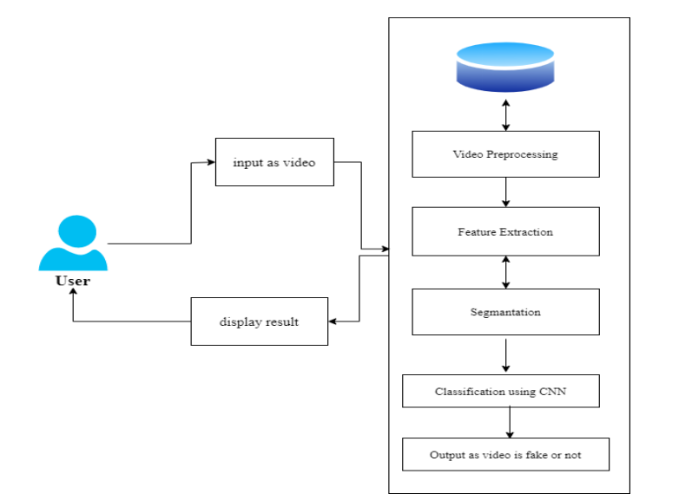
System Architecture

Slide 13
CNN
CNN is a type of deep learning model for processing data that has a grid pattern, such as images, which is inspired by the organization of animal visual cortex and designed to automatically and adaptively learn spatial hierarchies of features, from low- to high-level patterns.
CNN is a mathematical construct that is typically composed of three types of layers (or building blocks): convolution, pooling, and fully connected layers.

Slide 14

CNN LAYERS

Slide 15
CNN Architecture consists of THREE BLOCK LAYER
Convolution Layer is a fundamental component of the CNN architecture that performs feature extraction
Pooling Layer provides a typical downsampling operation which reduces the in-plane dimensionality.
3.Fully Connected Layer output feature maps of the final convolution or pooling layer is typically flattened

Slide 16
TECHNIQUES USED
In our project we are using technologies like CNN Models and TensorFlow library of deep learning .
CNN is used for image recognition CNN extract important features from the forged video frames.
TensorFlow allows for the recognition, localization, and detection of multiple objects within an image which provides us with a much better understanding of an image.
The deepfake video clips are predicted on the basis of temporal sequences and inconsistencies between the retrieved frames from the LSTM layer of the C-LSTM model

Slide 17
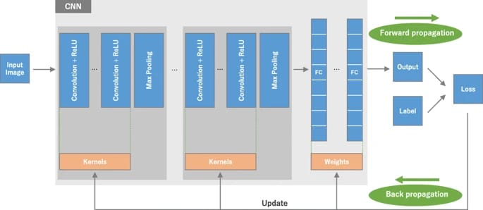

Slide 18
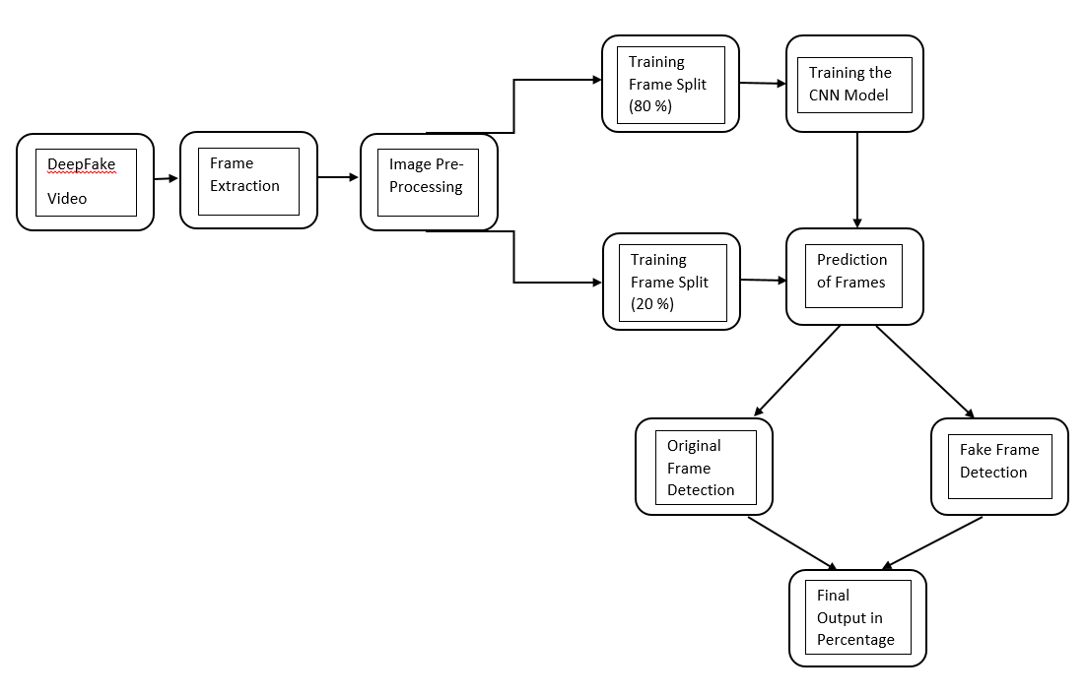
PROPOSED SYSTEM

Slide 19
PROPOSED OUTCOMES
The expected outcome from the system is to detect original and fake image frames on video as well as at the end to detect percentage i.e. how much percent video is real or fake.
Face swapping videos, swapping person identities in two videos, have attracted people's attention in recent years.
It is not unusual to find deepfake videos where the manipulation is only present in a small portion of the video (i.e. the target face only appears briefly on the video).

Slide 20
SOFTWARE REQUIREMENT
Operating System - Windows 7/8/10
Programming Language - Python
Software Version - Python3.7
CUDA cores: 3840
Graphic clock: 1404 MHz
Memory data rate: 11,410 MHz
Memory interface: 384-bit
Memory bandwidth: 547.68 GB∕s
Bus: PCI express × 16 Gen3
Dedicated video memory: 12,288 MB GDDR 5×5

Slide 21
Hardware Requirements
The Hardware Requirements are as follows: 1. Processor - Processor supporting streaming SIMD extensions instructions 2. Speed - 1.1GHz 3. RAM - 16GB 4. Graphics Card - OpenCL-compliant graphics card(NVIDIA) 5. Floppy Drive - 1.44MB 6. Generation - 7th or above

Slide 22
CHALLENGES
The goal of the challenge is to spur researchers around the world to build innovative new technologies that can help detect deepfakes and manipulated media. Challenge participants must submit their code into a black box environment for testing.

Slide 23
CONCLUSION
We provided a neural network-based method for determining if a video is a deep fake or a real thing, along with the model's level of confidence. The deep fakes produced by GANs with the aid of Autoencoders serve as an inspiration for the suggested strategy. Our approach uses ResNext CNN for frame-level detection and RNN and LSTM for video classification. Based on the factors stated in the study, the suggested method is capable of determining if a video is a deep fake or real. We think it will deliver real-time data with extremely high accuracy.

Slide 24
Advantages
Low Cost. Marketers can save money on video campaigns using deepfakes because in-person actors are unnecessary. Instead, they can purchase a license for an actor's identity, use previous digital recordings, insert the appropriate dialogue and create a new video.
he Deepfake videos affects life of popular personalities in our society. Politicians, actors or actress, other celebrities and notable personalities from corporate world. AI and machine learning based tools are used to generate such contents. But with the help of Deepfake detection services helps to identify such fake videos correctly.

Slide 25
REFERENCE
Tewari, A., Zollhoefer, M., Bernard, F., Garrido, P., Kim, H., Perez, P., and Theobalt, C. (2018).High-delity monocular face reconstruction based on an unsupervised model-based face autoencoder.IEEE Transactions on Pattern Analysis and Machine Intelligence.
DOI:10.1109/TPAMI.2018.2876842
Guo, Y., Jiao, L., Wang, S., Wang, S., and Liu, F. (2017). Fuzzy sparse autoencoder framework for single image per person face recognition. IEEE Transactions on Cybernetics, 48(8),2402-2415.
Liu, F., Jiao, L., and Tang, X. (2019). Task-oriented GAN for PolSAR image classication and clustering. IEEE transactions on Neural Networks and Learning Systems, 30(9),2707-2719.

Slide 26
Lyu, S. (2018, August 29). Detecting deepfake videos in the blink of an eye.Retrievedfrom http://theconversation.com/detecting-deepfake-videos-in-the-blink-of-an-eye-101072
Chesney, R., and Citron, D. (2019). Deepfakes and the new disinformation war: The coming ageof post-truth geopolitics. Foreign A airs, 98,147
Turek, M. (2019). Media Forensics (MediFor). Retrievedfrom https://www.darpa.mil/program/media-forensics

Slide 27
THANK YOU

