Slide 1

ASSIGNMENT GUIDELINES
Make the changes in the PPT as you solve the parts
This file contains the template for all the parts of the project.
Check the instructions added in the note section of every slide for clarity.
Don’t move around any image or text box
If you require more/lesser elements, be careful when you copy/delete the existing ones.

Slide 2
ASSIGNMENT
Name: Manish Shah.
Problem Statement
The sales pipeline conversion percentage at TechnoServe (a tech SaaS startup) has dropped from 35% at the end of last fiscal (FY 2017-18) to 25% at present.
Assignment Objective
Understand the problem, come up with a hypothesis for low conversions faced by TechnoServe, and analyse the dataset provided to arrive at possible solutions to increase it.
Notes:
Problem Statement

Slide 3
PART I : 1. Understanding the Problem
Sales Pipeline Conversion at a SaaS Startup
Who?
TechnoServe (A tech SAAS startup) has a problem of 10% loss in sales pipeline conversion rate
What?
Sales Pipeline conversion has dropped from 35% to 25%.
When?
Fiscal Year (2017 – 2018)
Where?
Among the clients in the industry basically from Delhi, Mumbai and Banglore
How?
The sales velocity ration is very low and proper attention is not given for marketing. The leads are generated but not converted to business. Which result in loss of 10%.

Slide 4
PART I : 2. Understanding the Problem
Sales Pipeline Conversion at a SaaS Startup
Situation
How many sales are handled by the company during the fiscal year?
What is the strength of the sales team?
Which marketing strategy mostly focused by the team?
How long it take to convert the lead into sales?
Does regular follow-up taken?
Which type of Co. size placed most orders?
Problem
Do you think that team is skilled enough to handle the sales?
Is there optimal distribution of different channels used for marketing among the team?
Does team have proper communication and understanding within and outside the co. and also among themselves?
Is there coordination among the marketing team and sales team as both are interdependent?
Implication
How does the problem impact company’s financial situation?
Does the problem impacts the market share of the company?
Is there revenue loss,? if so how will it impact your future goals?
Will it increase the number of unsatisfied clients?
Should it affect the sales of services you provided?
Should it required to discontinue any of the service provided by you?
Need-Payoff
How does excess revenue helps in financial planning (additional revenue)
Will it optimize the distribution of resources in the co. (lower cost)
Will it increase the efficiency of the employee?
Will it generate extra clients to the company?
Will it expand the business of the company in different territory?
Notes:
Provide at least three questions under each branch.

Slide 5
PART II : Formulating Hypotheses
Sales Pipeline Conversion at a SaaS Startup
Framework Used
SPIN framework is used
Reason for using the selected framework
Strongly used to success in Smaller as well as large scale enterprises also used more in calls that fails to convert the leads.
How you have used the framework here
Yes.
Notes:
All the frameworks that are used should be mentioned.
A suitable reason is a must to provide here

Slide 6
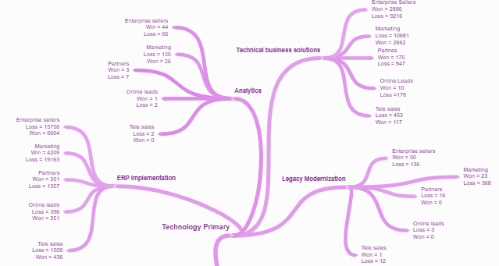
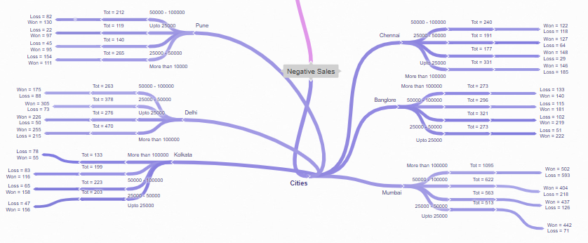
PART II : Formulating Hypotheses
Sales Pipeline Conversion at a SaaS Startup
Provide the structure of the framework here
(You can attach the screenshot or multiple screenshots depending on the clarity of the image)
Notes:
Use the “download as” feature of Coggle if you are using the tool.
Provide one image with complete tree along with separate elements where the text is readable.
Copy the slide if you require more space

Slide 7
PART II : Formulating Hypotheses
Sales Pipeline Conversion at a SaaS Startup
Branch 1
Branch one is showing Types of services
Branch 2
Branch two showing the name of cities
Notes:
Each branch must follow this naming pattern:
Problem – Branch 1 – Sub-branch 1 – Sub-branch 2 – …… – Hypotheses
There must be minimum 10 hypotheses in total and at least 1 in each branch.

Slide 8
PART II : Formulating Hypotheses
Sales Pipeline Conversion at a SaaS Startup
Branch 3
Name of Technical Services
Branch 4
Name of Cities
Notes:
Each branch must follow this naming pattern:
Problem – Branch 1 – Sub-branch 1 – Sub-branch 2 – …… – Hypotheses
There must be minimum 10 hypotheses in total and at least 1 in each branch.

Slide 9
PART II : Formulating Hypotheses
Sales Pipeline Conversion at a SaaS Startup
Branch 5
Showing the Service Product “Legacy Modernization”
Branch 6
Showing the Service product “Technical Business solution”
Notes:
Each branch must follow this naming pattern:
Problem – Branch 1 – Sub-branch 1 – Sub-branch 2 – …… – Hypotheses
There must be minimum 10 hypotheses in total and at least 1 in each branch.

Slide 10
PART II : Formulating Hypotheses
Sales Pipeline Conversion at a SaaS Startup
Branch 7
Showing service product “Analytics”
Branch 8
Showing service product “ERP Implementation”
Notes:
Each branch must follow this naming pattern:
Problem – Branch 1 – Sub-branch 1 – Sub-branch 2 – …… – Hypotheses
There must be minimum 10 hypotheses in total and at least 1 in each branch.

Slide 11
PART II : Formulating Hypotheses
Sales Pipeline Conversion at a SaaS Startup
Branch 9
Showing Location “Chennai” which is further splits into last year clients business which again splits into Total opportunity and after that it shows the opportunity won and loss
Branch 10
Showing Location “Bangalore” which is further splits into last year clients business which again splits into Total opportunity and after that it shows the opportunity won and loss
Notes:
Each branch must follow this naming pattern:
Problem – Branch 1 – Sub-branch 1 – Sub-branch 2 – …… – Hypotheses
There must be minimum 10 hypotheses in total and at least 1 in each branch.

Slide 12
PART II : Formulating Hypotheses
Sales Pipeline Conversion at a SaaS Startup
Branch 11
Showing Location “Mumbai” which is further splits into last year clients business which again splits into Total opportunity and after that it shows the opportunity won and loss
Branch 12
Showing Location “Pune” which is further splits into last year clients business which again splits into Total opportunity and after that it shows the opportunity won and loss

Slide 13
PART II : Formulating Hypotheses
Sales Pipeline Conversion at a SaaS Startup
Branch 13
Showing Location “Delhi” which is further splits into last year clients business which again splits into Total opportunity and after that it shows the opportunity won and loss
Branch 14
Showing Location “Kolkata” which is further splits into last year clients business which again splits into Total opportunity and after that it shows the opportunity won and loss

Slide 14
PART III A : Generating Insights
Sales Pipeline Conversion at a SaaS Startup
Variable
The different types of variable which I used is types of service provided, B2B Sales medium, city wise business distribution, last year business from clients, opportunity status(Win or Loss).
Insights if any
By using this variables I found that the more call we made to the customer the more chances are there of converting the leads to sales. The area which we basically focus on is “sales stage iteration” and “sales velocity” and that to with the “Marketing” branch, the frequent it is the more chances of converting the leads into cell. I also found out that we are getting more business from cities like “Pune” and “Mumbai” and “Delhi” which shows that there is less competition in that area as they are not IT hubs compare to “Bangalore” and “Chennai” where business is steep.
Pattern of Insight
The pattern which I found is that we should focus on large enterprises having clients revenue between more than 1M after that between 100K to 500K along with the employee base. In shorth the more the clients revenue and its employee size the more chances to convert the lead into productive sales.
Notes:
Analyse the variables in the dataset, find the insights and mention the pattern of insights in the data. Make more copies of this slide if needed.

Slide 15
PART III A : Generating Insights
Sales Pipeline Conversion at a SaaS Startup
Variable under consideration:
We should consider the variables such as opportunity status, opportunity sizing, clients revenue, employee size and B2B business solution
Notes:
For each variable that produced an interesting insight, explain you analysis bit here – the results you got from excel and the necessary visualisations. Note: it is compulsory for you to mention the results of the analysis on these variables - 'Technology Primary', 'B2B Sales Medium', 'Client Revenue Sizing', 'Opportunity Sizing' and 'Business from Client last year’.

Slide 16
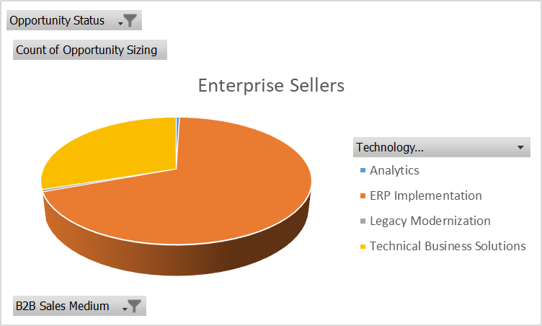
PART III A : Generating Insights
Sales Pipeline Conversion at a SaaS Startup
Variable under consideration:
By using the variable Business from clients last year I figure out that there is no business from the clients whose revenue is less and employee size is also low.
Notes:
For each variable that produced an interesting insight, explain you analysis bit here – the results you got from excel and the necessary visualisations. Note: it is compulsory for you to mention the results of the analysis on these variables - 'Technology Primary', 'B2B Sales Medium', 'Client Revenue Sizing', 'Opportunity Sizing' and 'Business from Client last year’.

Slide 17
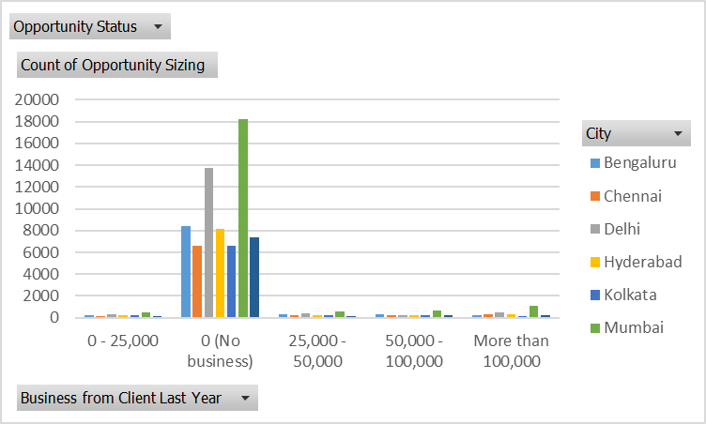
PART III A : Generating Insights
Sales Pipeline Conversion at a SaaS Startup
Variable under consideration:
Count of Business
Notes:
For each variable that produced an interesting insight, explain you analysis bit here – the results you got from excel and the necessary visualisations. Note: it is compulsory for you to mention the results of the analysis on these variables - 'Technology Primary', 'B2B Sales Medium', 'Client Revenue Sizing', 'Opportunity Sizing' and 'Business from Client last year’.

Slide 18
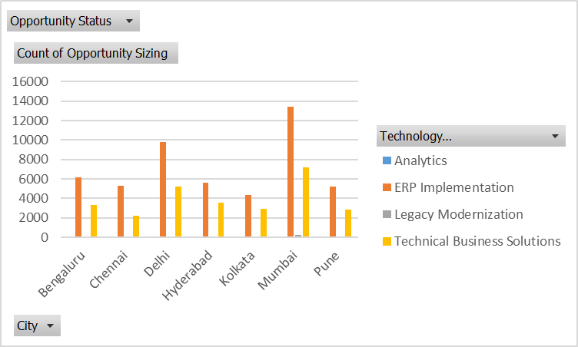
PART III A : Generating Insights
Sales Pipeline Conversion at a SaaS Startup
Variable under consideration:
City wise sales
Notes:
For each variable that produced an interesting insight, explain you analysis bit here – the results you got from excel and the necessary visualisations. Note: it is compulsory for you to mention the results of the analysis on these variables - 'Technology Primary', 'B2B Sales Medium', 'Client Revenue Sizing', 'Opportunity Sizing' and 'Business from Client last year’.

Slide 19
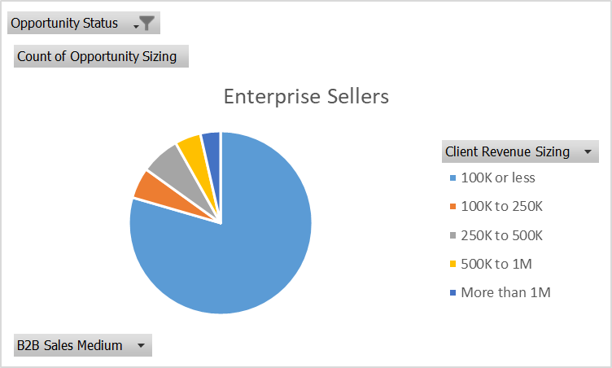
PART III A : Generating Insights
Sales Pipeline Conversion at a SaaS Startup
Variable under consideration:
Client Revenue Sizing
Notes:
For each variable that produced an interesting insight, explain you analysis bit here – the results you got from excel and the necessary visualisations. Note: it is compulsory for you to mention the results of the analysis on these variables - 'Technology Primary', 'B2B Sales Medium', 'Client Revenue Sizing', 'Opportunity Sizing' and 'Business from Client last year’. Make more copies of this slide if needed.

Slide 20
PART III A : Generating Insights
Sales Pipeline Conversion at a SaaS Startup
Recommendations
B2B Sales
Opportunity status
Corresponding Insights
B2B sales helps us to understand which channel is more productive in achieving our target and opportunity status shows us what should be done to won more clients.
Notes:
For each recommendation explain the insights that form the reasoning for giving that recommendation. Make more copies of this slide if necessary.

Slide 21
PART III B : Presenting Findings
Sales Pipeline Conversion at a SaaS Startup
Notes:
You are free to use the elements and boxes mentioned previously. Make sure you’re using the pyramid principle, data visualization, visual design principle and storyboarding concepts to design these slides.

Slide 22
PART III B : Presenting Findings
Sales Pipeline Conversion at a SaaS Startup
Notes:
You are free to use the elements and boxes mentioned previously. Make sure you’re using the pyramid principle, data visualization, visual design principle and storyboarding concepts to design these slides.

Slide 23
PART III B : Presenting Findings
Sales Pipeline Conversion at a SaaS Startup
Notes:
You are free to use the elements and boxes mentioned previously. Make sure you’re using the pyramid principle, data visualization, visual design principle and storyboarding concepts to design these slides.

