Slide 1
VOICE GPT
voice-based question-answering system using the OpenAI GPT-3

Slide 2
INTRODUCTION
The provided code is a simple voice assistant program that utilizes OpenAI's GPT-3 language model for generating responses based on user input. It uses the speech_recognition library to capture audio input, converts it to text using Google's speech recognition API, and then sends the text prompt to GPT-3 for generating a response.

Slide 3
The response is spoken out using the pyttsx3 text-to-speech engine. The program runs in a loop, continuously listening for the keyword "hello" to start the conversation and "stop" to end it. It provides a basic framework for building a voice-controlled assistant.

Slide 4
Code Explaination.
audiototext(): Transcribing audio to text using speech recognition
generate_response(): Generating responses using GPT-3
speak_text(): Converting text to speech using pyttsx3
main(): The main loop of the system

Slide 5
Code Explaination
This code implements a voice-based question-answering system using OpenAI's GPT-3 model. The program listens for the trigger word "hello" spoken by the user, records their question through a microphone, transcribes the audio to text, and sends the text prompt to the GPT-3 model for generating a response. The response is then converted into speech using the pyttsx3 library and played back to the user. The code utilizes the openai, pyttsx3, and speech_recognition libraries to interact with the OpenAI API and handle audio input/output. The system continuously loops, allowing the user to ask multiple questions. It provides a convenient interface for obtaining spoken answers to user queries.

Slide 6
How it is Useful in Real Life?
Hands-free operation: The voice assistant allows users to interact with the system without using their hands. This can be particularly helpful for individuals with mobility impairments or those who prefer a more convenient and intuitive way of interacting with technology.

Slide 7
Task Automation:
The voice assistant can be integrated with other systems or devices to perform tasks on behalf of the user. For example, it can control smart home devices, set reminders, schedule appointments, or make online reservations, simplifying daily routines and increasing efficiency.

Slide 8
Language practice:
The voice assistant can assist users in language learning by providing pronunciation feedback, answering language-related queries, or engaging in conversational practice. This can be especially beneficial for language learners who want to improve their speaking skills.

Slide 9
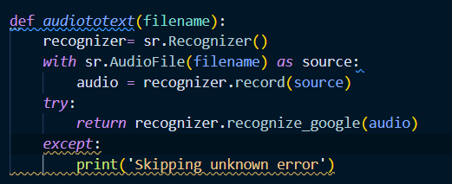
The audiototext function utilizes the SpeechRecognition library to convert audio from a file into text using Google's speech recognition service. If successful, it returns the recognized text; otherwise, it prints a message indicating an unknown error occurred.

Slide 10
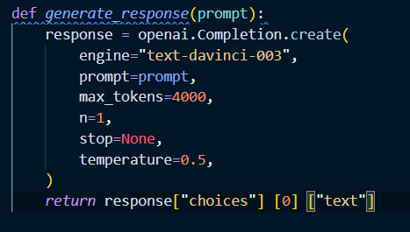
The generate_response function uses the OpenAI API to generate a response to a given prompt. It sends the prompt to the API and retrieves the generated text from the response. The function then returns the generated text for further use.

Slide 11

The speak_text function utilizes a text-to-speech engine to convert the provided text into speech and plays it back to the user.

Slide 12
The main function explains.
The main function runs in a loop, continuously waiting for the user to say "hello". It utilizes the speech_recognition library to capture audio input from the microphone. It recognizes the speech using Google's speech recognition service and checks if the recognized text is "hello". If so, it proceeds to record the user's question as audio, transcribe it to text, and generate a response using GPT-3. The response is then displayed and read out using text-to-speech. If any errors occur, they are printed out. The loop continues until the program is terminated.

Slide 13
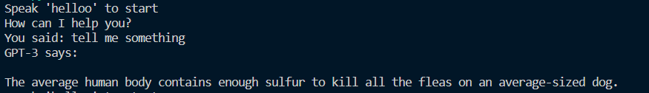
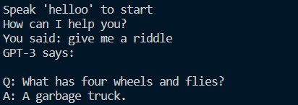
OutPuts:

Slide 14
Conclusion
In conclusion, the provided code sets up a voice-controlled assistant that utilizes OpenAI's GPT-3 model for generating responses. It listens for the keyword "hello" from the user, records their question as audio, transcribes it to text, generates a response using GPT-3, and reads the response using text-to-speech. The assistant continues running until the user says "stop". It demonstrates the integration of speech recognition, text generation, and text-to-speech technologies to create a voice-based conversational interface.

Slide 15
MANISH

