Slide 1
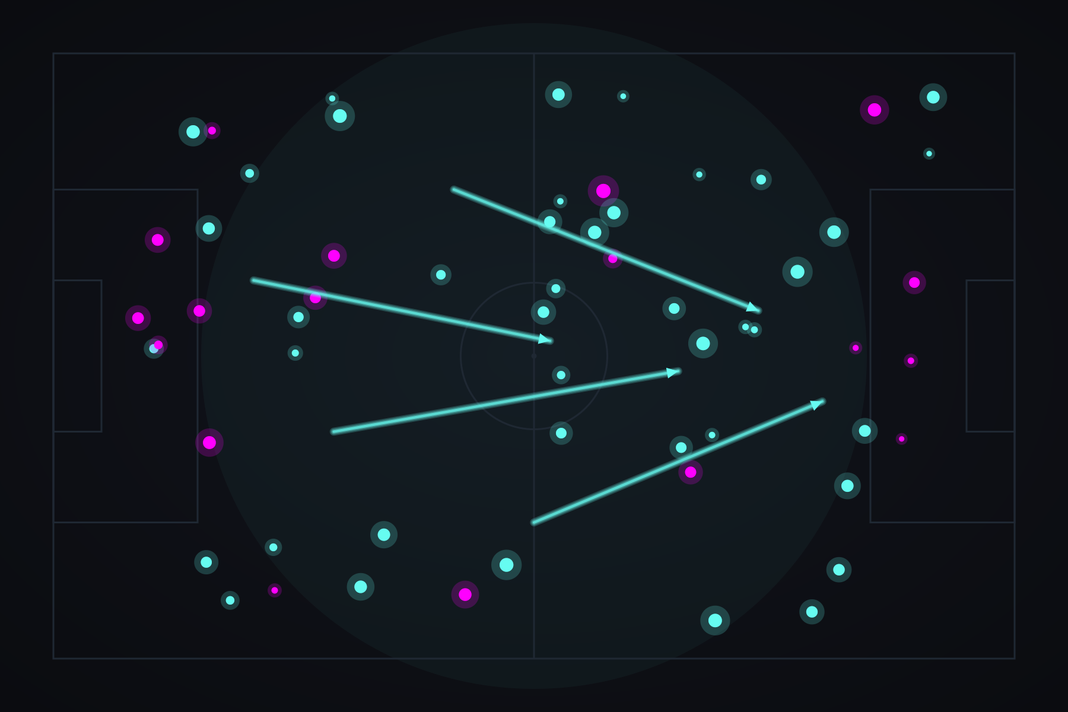
DATA VISUALIZATION · FINAL PROJECT 2026
THREAT, SPACE
& CONTROL
Spatial football analytics for UEFA Euro 2024 — built on StatsBomb open data, served through Streamlit, styled in neon.
PRESENTED BY
Shreyash Nadgouda
Manish Maudgalya
STATSBOMB · STREAMLIT · PYTHON 3.10

Slide 2



01 · MOTIVATION
Past counting. Toward space.
Football analytics has been stuck on counts.
DEPTH
Pass tallies, shot totals, possession percentages — these summarize a match without explaining it. They tell you what happened, never where it mattered or how dangerous it was.
Expected Threat (Markov chain) and Voronoi pitch control instead of pass counts.
This dashboard replaces those flat metrics with three spatial models that read the pitch the way a coach does: where threat lives, who controls space, and how the ball flows between players.
SPEED
Streamlit cache_data turns 3–4s loads into <100ms after first fetch.
AESTHETICS
Neon iterative-glow theme — every chart is recognisable at a glance.
THREAT · SPACE · CONTROL
02 / 08

Slide 3
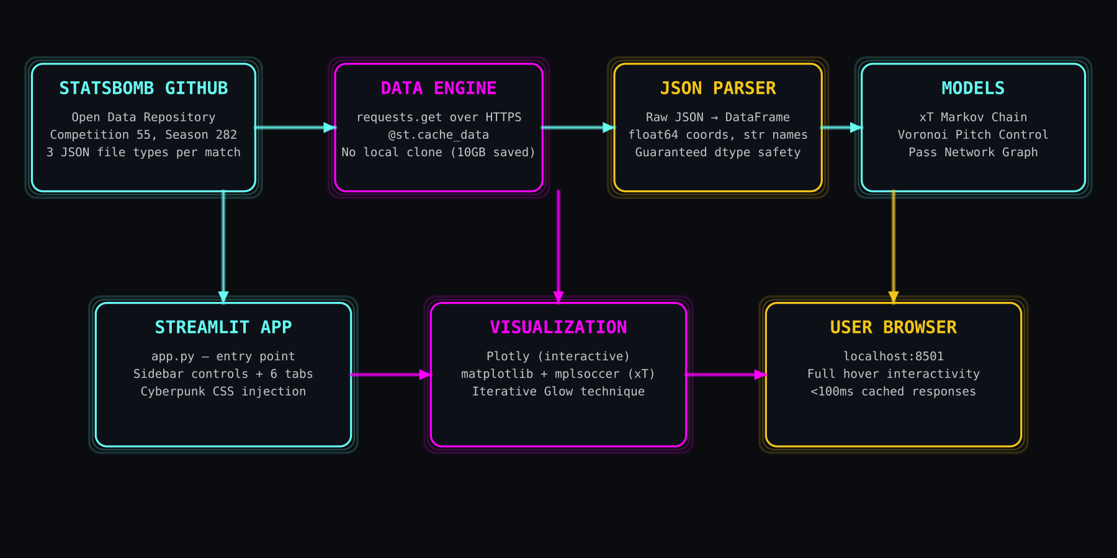
02 · DATA + ARCHITECTURE
From raw JSON on GitHub to a live dashboard.
51
180K+
120 × 80
3
Euro 2024 matches
Raw events parsed
Yards · pitch grid
JSON files / match
Every fetch is cached with @st.cache_data — the network call happens once per match per session, then everything is in-memory.
THREAT · SPACE · CONTROL
03 / 08

Slide 4
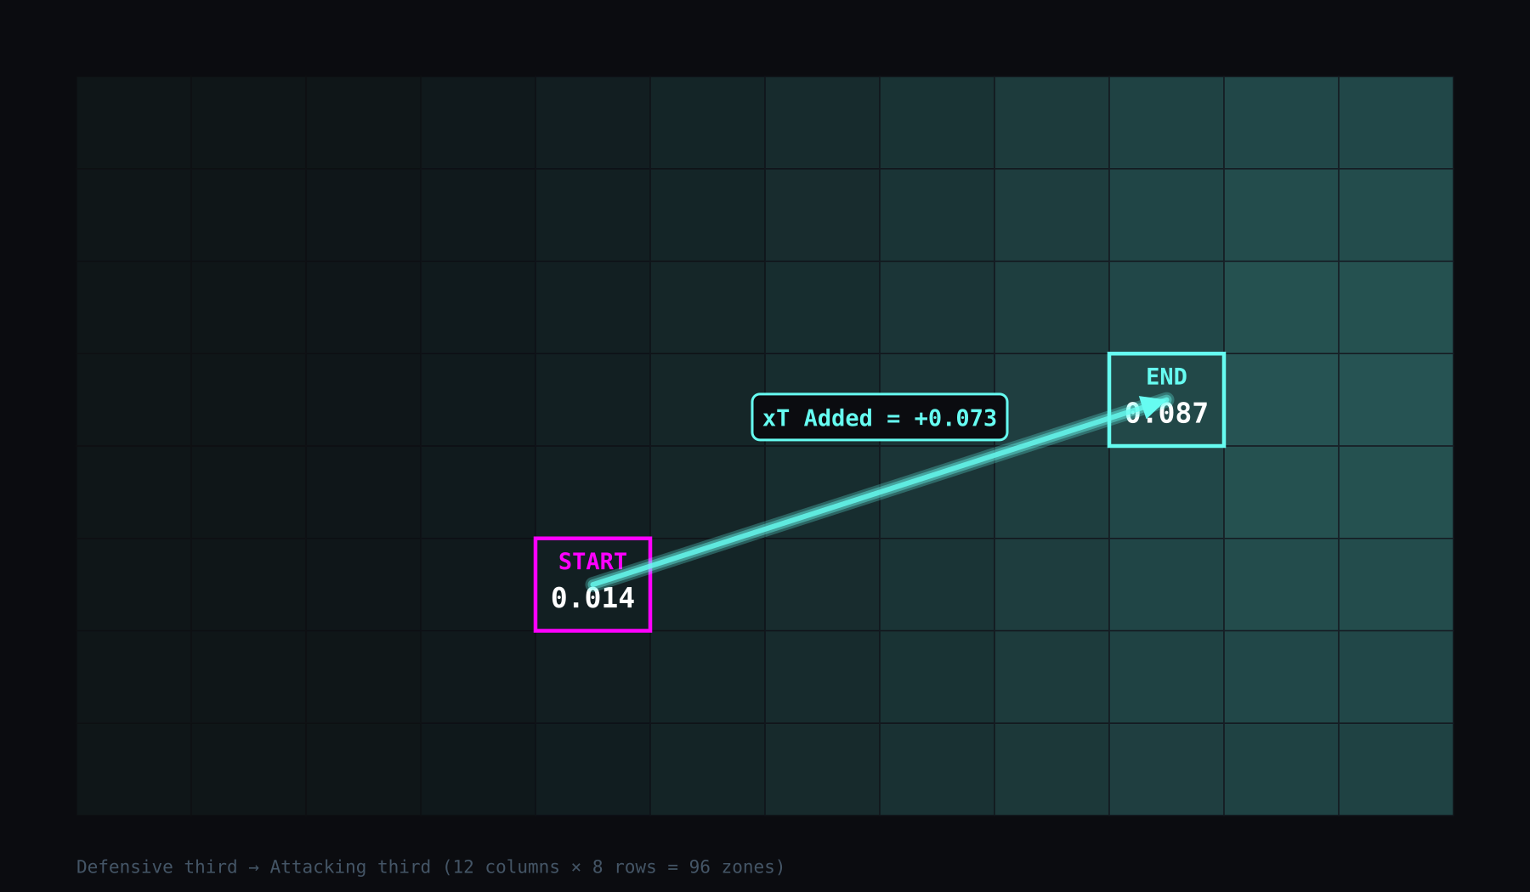
03 · THE MATH
Expected Threat — a Markov chain over the pitch.
BELLMAN EQUATION
xT(z) = P(shoot|z) · P(goal|shoot,z)
+ P(move|z) · Σ T(z→z') · xT(z')
Pitch divided into a 12 × 8 grid (96 zones).
Solved by value iteration — converges in 20–30 passes once max change < 1e-5.
Transition matrix flattened to (96 × 96) for a single matrix-vector multiply per iteration.
Per-action xT Added = xT(end) − xT(start). Positive = ball moved into more dangerous space.
P(shoot|z)
P(goal|shoot)
T(z → z')
Empirical shot rate per zone (Bayesian-smoothed).
Conversion rate, blended with a geometric prior.
Transition probabilities from passes & carries.
20–30 iterations · < 5 ms full solve / match
THREAT · SPACE · CONTROL
04 / 08

Slide 5
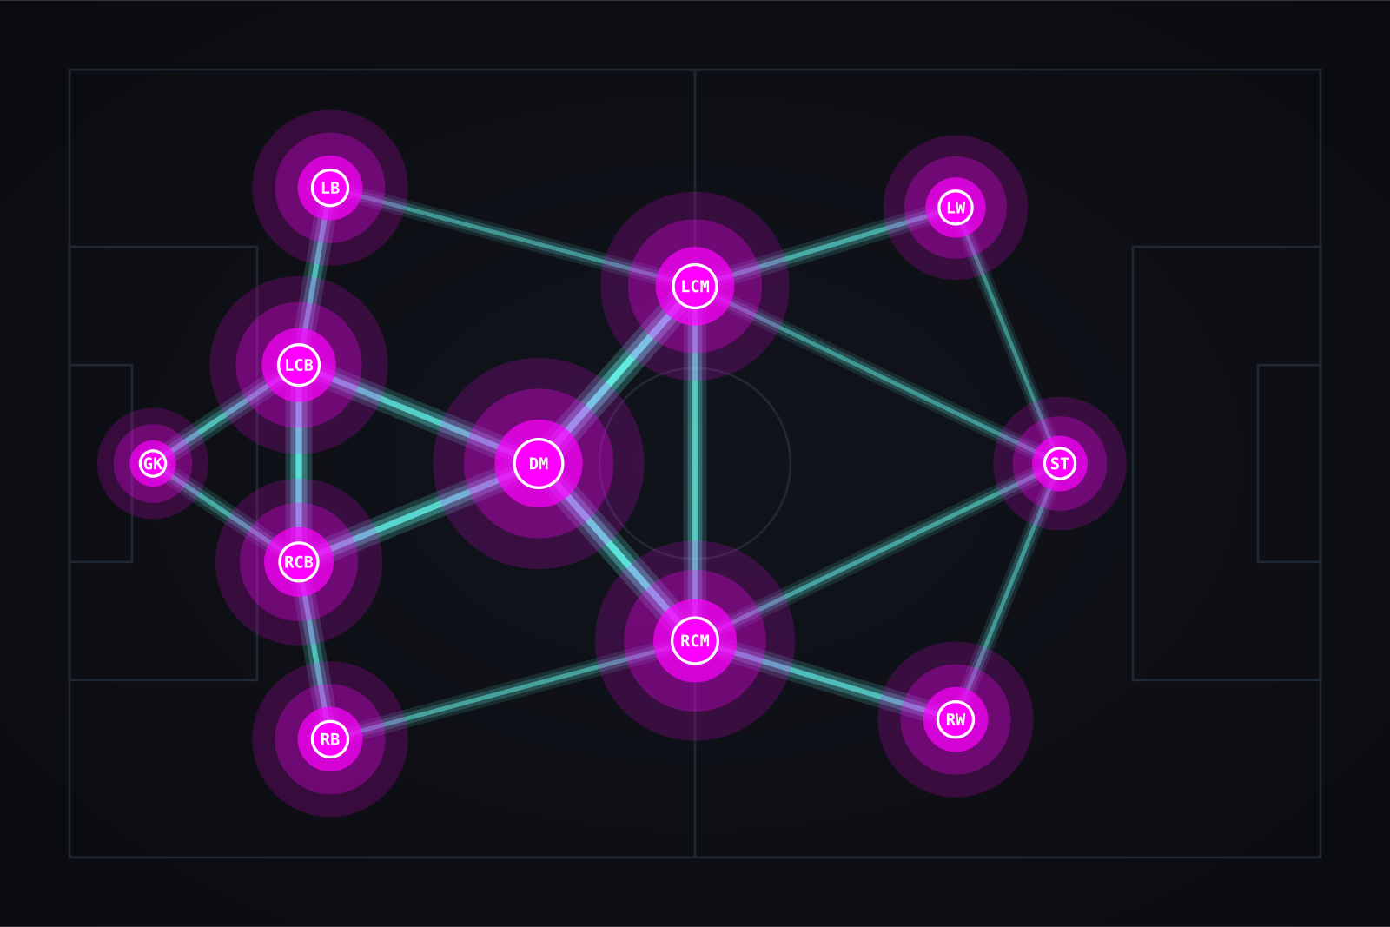



04 · GRAPH THEORY ON GRASS
Pass Network — who connects, where, and how often.
Nodes are players.
Position = mean (x, y) across every pass they made in the window — their tactical role this match, not a season average. Size scales with pass count.
Edges are connections.
Width and opacity both encode pass frequency between a pair. The thickest cyan lines are the team's primary circulation lanes.
Team Shape, side-by-side.
Tab 2 strips the edges and renders both teams' average positions on twin pitches — instant tactical comparison.
Fig. 1 · Pass network — node = mean position, size = pass volume, edge = pair frequency.
HOVER → Toni Kroos · 84 passes · top: Gündoğan (19)
THREAT · SPACE · CONTROL
05 / 08

Slide 6
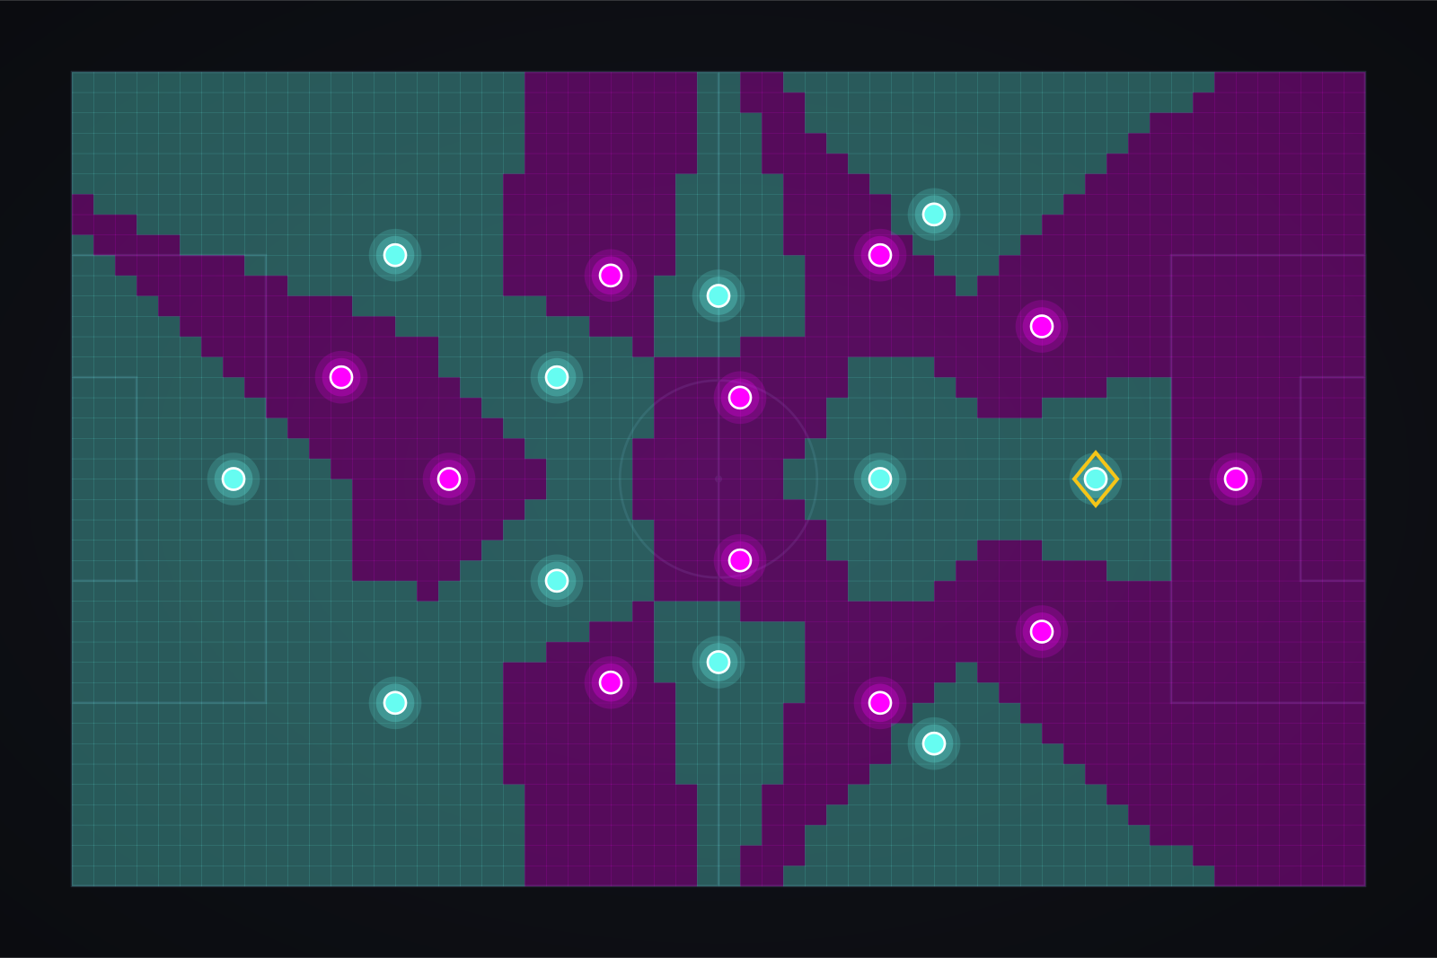
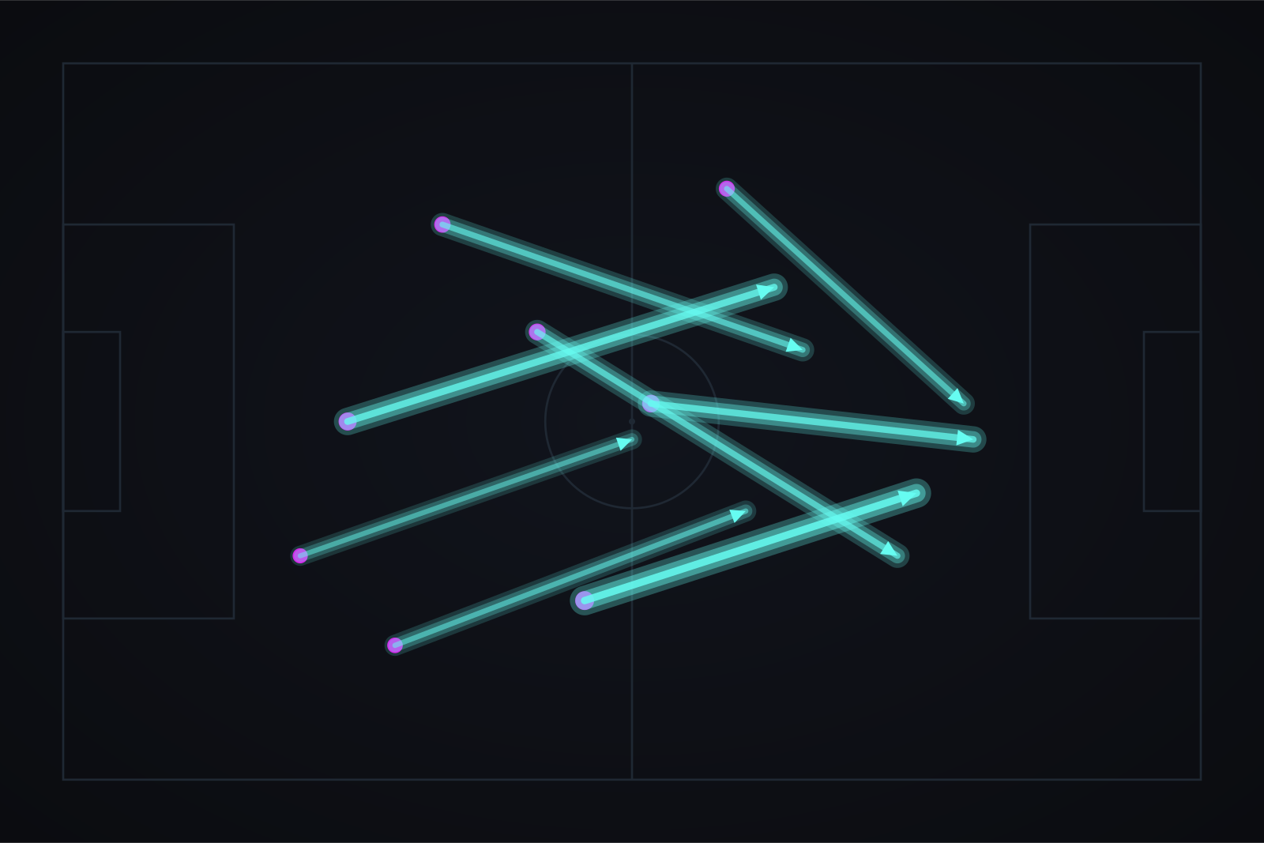
05 · SPATIAL CONTROL
Who owns the space — and who threatens it?
VORONOI PITCH CONTROL
THREAT-ADDED ARROWS (xT)
Every grid cell on a 240×160 raster is assigned to its nearest player at the freeze-frame instant. Cyan = attacking team's space, magenta = defending team's. The gold diamond marks the ball-holder.
Each arrow is a completed pass or carry, rendered with iterative glow. Brightness and width scale with xT Added — the move's contribution to scoring probability.
THREAT · SPACE · CONTROL
06 / 08

Slide 7





06 · THE DASHBOARD
Six tabs, one Cyberpunk language.
01
02
03
DESIGN SYSTEM
Cyberpunk · Neon · Dark
Pass Network
Team Shape
Pitch Control
Directed graph over pitch
Average positions, side-by-side
Voronoi from 360° freeze-frame
Pitch
Panel
04
05
06
Cyan
Expected Threat
Shot Map
Events Explorer
Magenta
12×8 heatmap + arrow map
xG bubbles, both teams
Filter raw events, plot + table
Gold
Text
ITERATIVE GLOW
THREAT · SPACE · CONTROL
07 / 08

Slide 8




FINAL STAGE
Moving on to the project demo now…
Cutting to the live Streamlit dashboard
https://github.com/ManishMaudgalya/DataVizProject.git
Shreyash Nadgouda · Manish Maudgalya
THREAT · SPACE · CONTROL
08 / 08

