Slide 1
Market Dynamics Analysis
A Study of S&P 500, VIX, and Inflation (2010–2023)
Final Project | Time Series Analysis | STAT-S 650

Slide 2
Data Description
The Data
•
S&P 500: Monthly Log Returns.
VIX Index: Monthly Level.
From Yahoo Finance
•
CPIAUCSL: Monthly change in consumer prices.
From FRED
•
168 Data Points Monthly from 2010 to 2023
•
Notes:
Tracked this data on a monthly basis spanning a 13-year period from January 2010 to December 2023, which gives us a robust sample size of 168 data points.
For our variables:
First, the S&P 500: We pulled this from Yahoo Finance and transformed it into monthly log returns so we could accurately model the percentage growth and market performance month-over-month.
Second, the VIX Index: This is also sourced from Yahoo Finance and serves as our primary proxy for market fear and expected volatility.
Finally, the CPI (Consumer Price Index): We sourced this directly from the FRED database. We calculated the monthly change in these consumer prices to represent our inflation rate shocks.

Slide 3
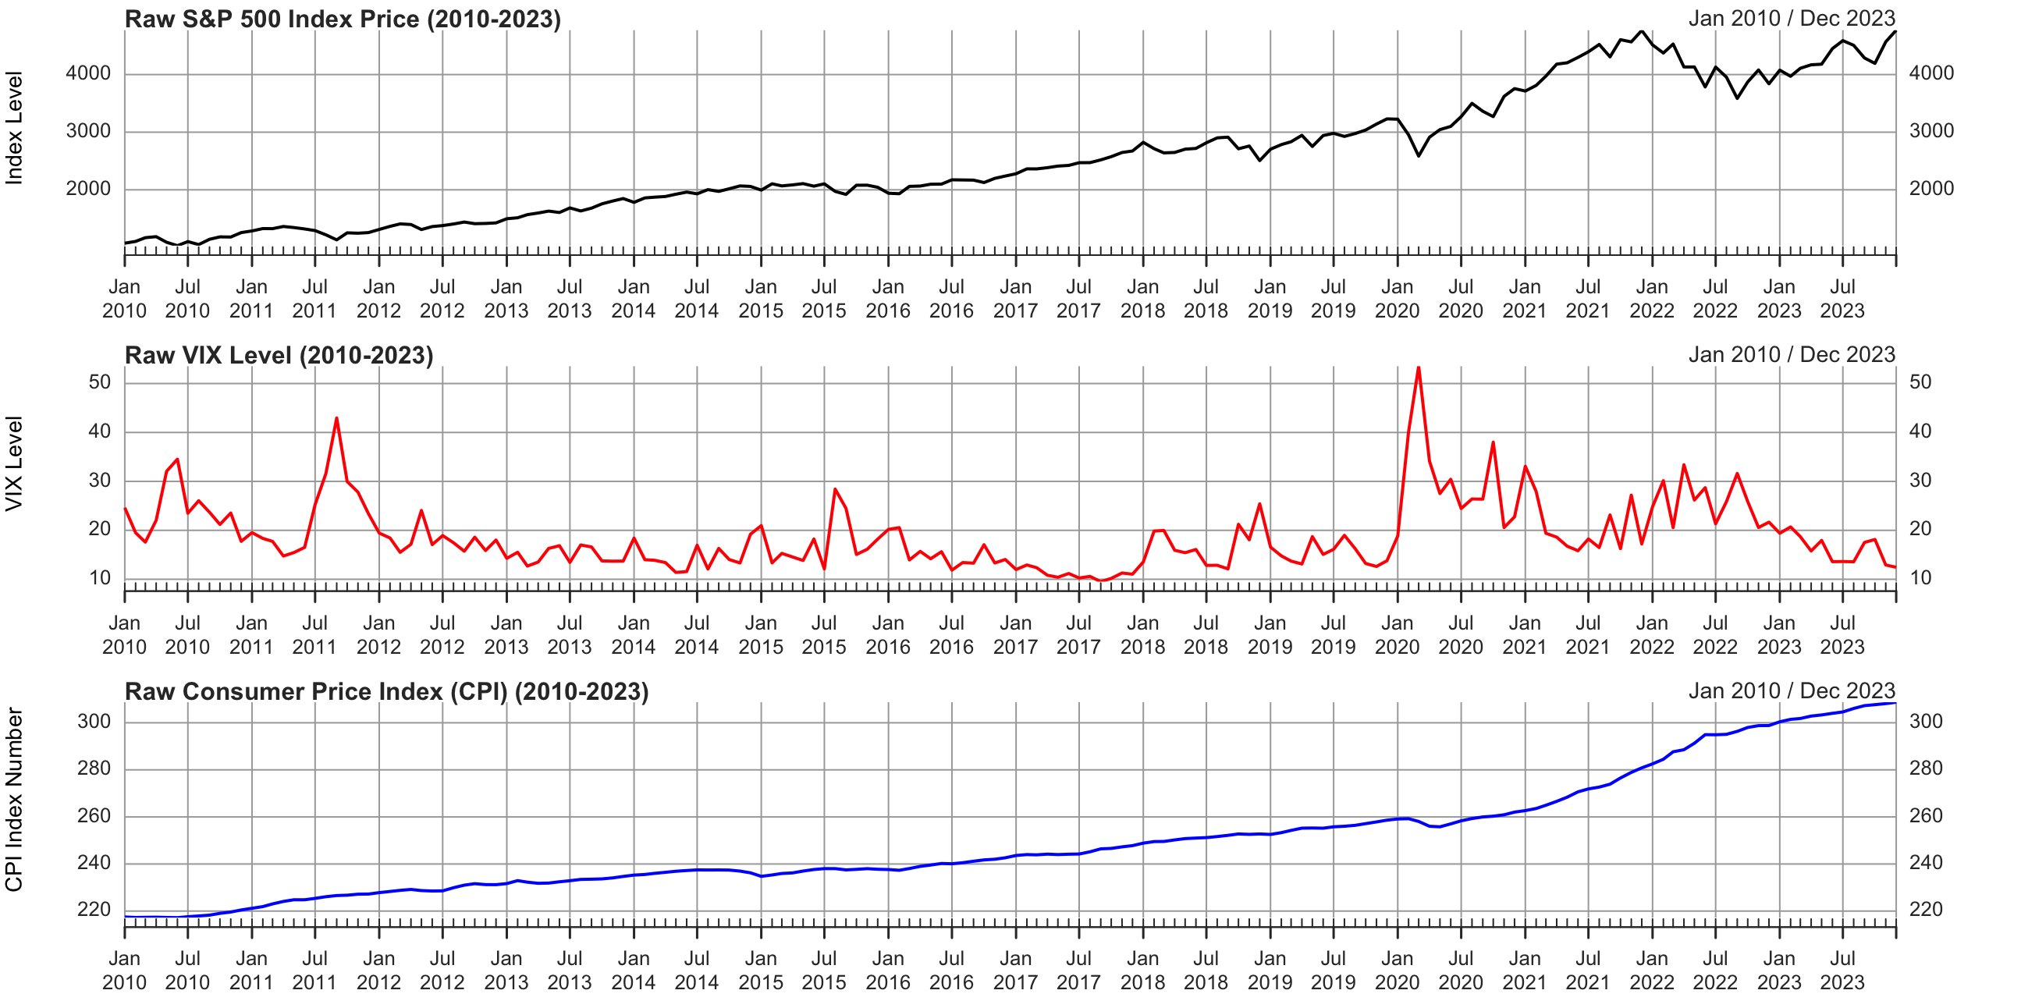
Raw Time Series Data (2010–2023)
Visualizing raw trends and major shocks over the 13-year period.
Notes:
S&P 500: You will see the classic stock market chart—a massive curve starting around 1,000 in 2010 and climbing near 4,700 by the end of 2023.
CPI: You will see a slow, steady upward slope that suddenly bends into a much steeper, aggressive climb starting around 2021 (the post-pandemic inflation surge).

Slide 4
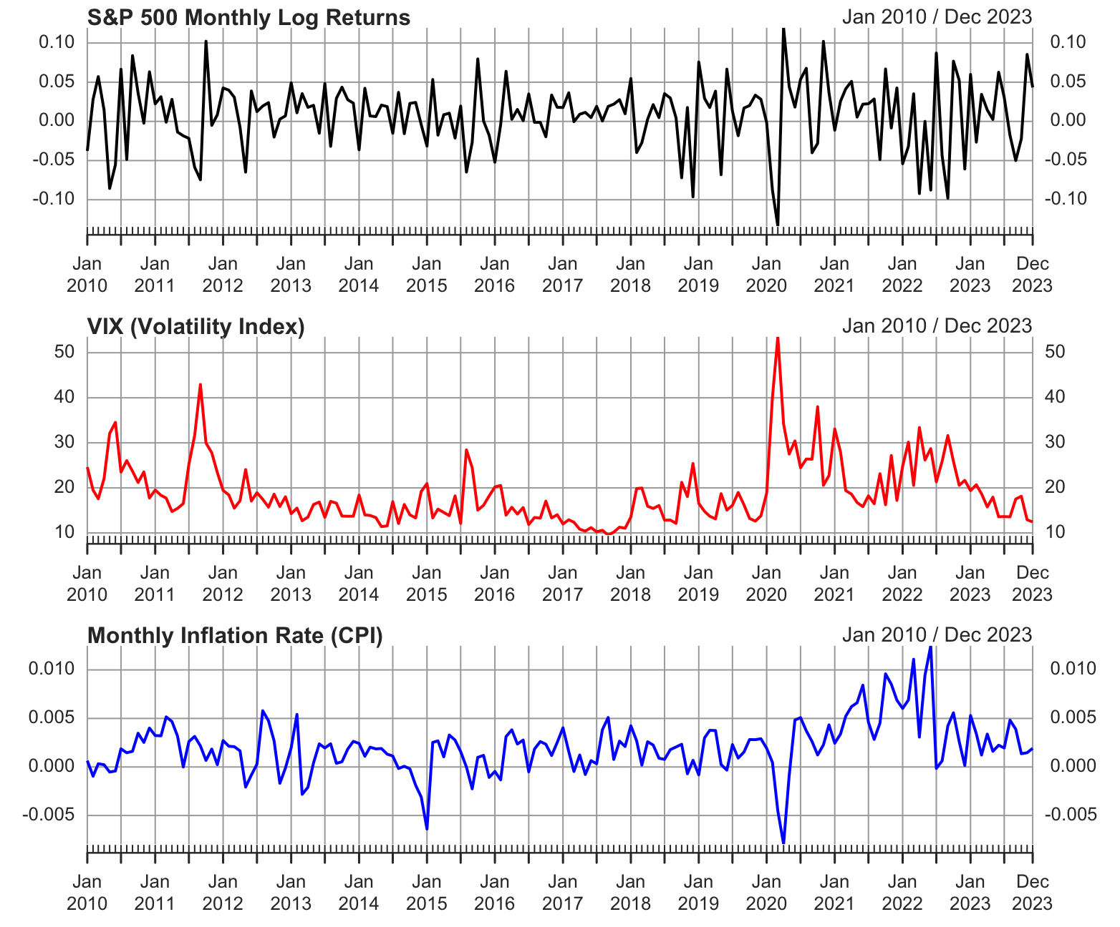
Visualizing log transformed data.
1. Time Series Data (2010–2023)
Notes:
Looking at the initial plots, major market drawdowns (like early 2020) line up perfectly with massive spikes in the VIX. Inflation shows a steadier, trend-following behavior.

Slide 5
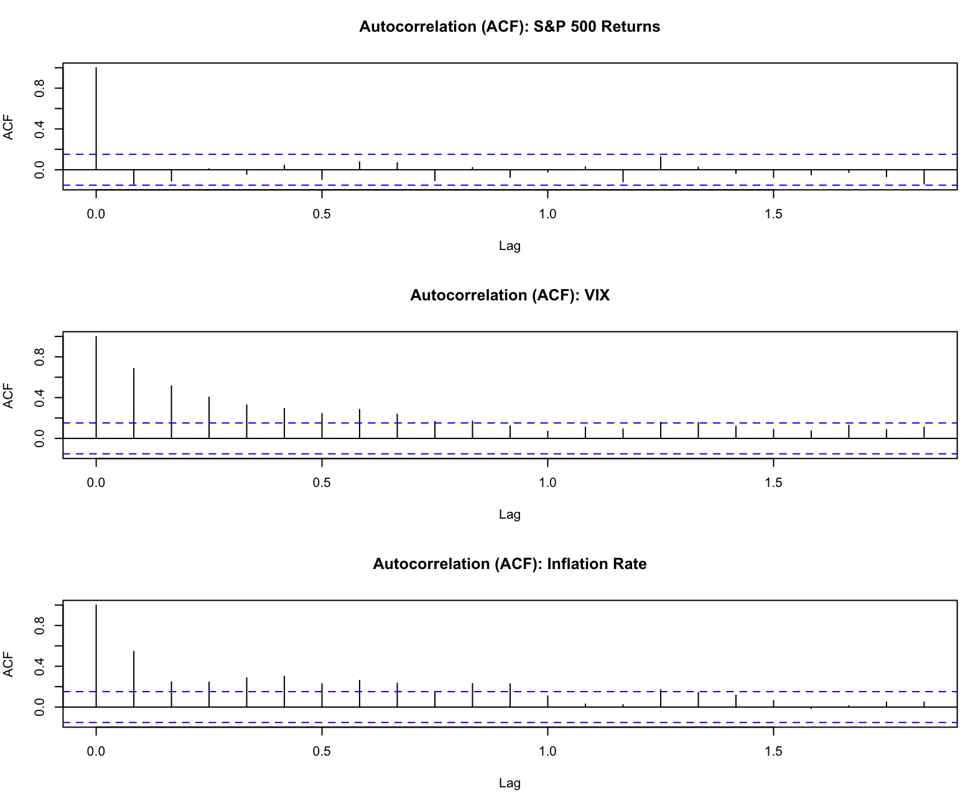
2. Autocorrelations (ACF)
Notes:
Autocorrelation (ACF): The S&P 500 returns look like white noise—past returns don't predict future returns. However, the VIX and Inflation have "memory." Their ACF bars trail off slowly, meaning high volatility today means high volatility tomorrow (volatility clustering).

Slide 6
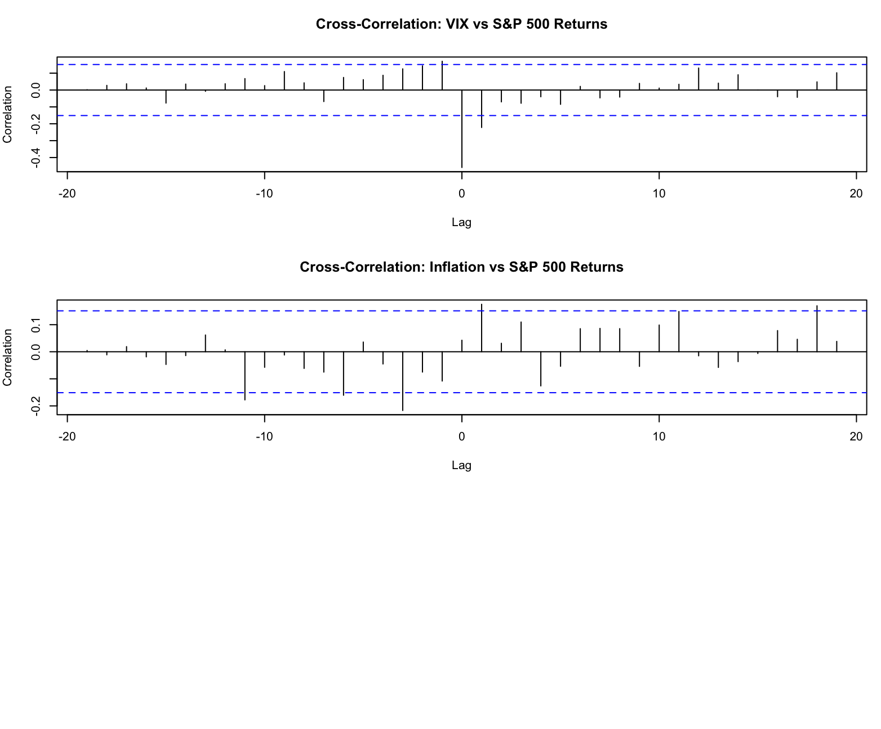
Look for the negative spike at Lag 0 between VIX and Market Returns.
3. Cross-Correlations (CCF)
Notes:
The most important takeaway here is the massive negative spike at "Lag 0" between the VIX and the S&P 500. This physically proves Hypothesis 1: high fear and market drops happen in the exact same month.

Slide 7
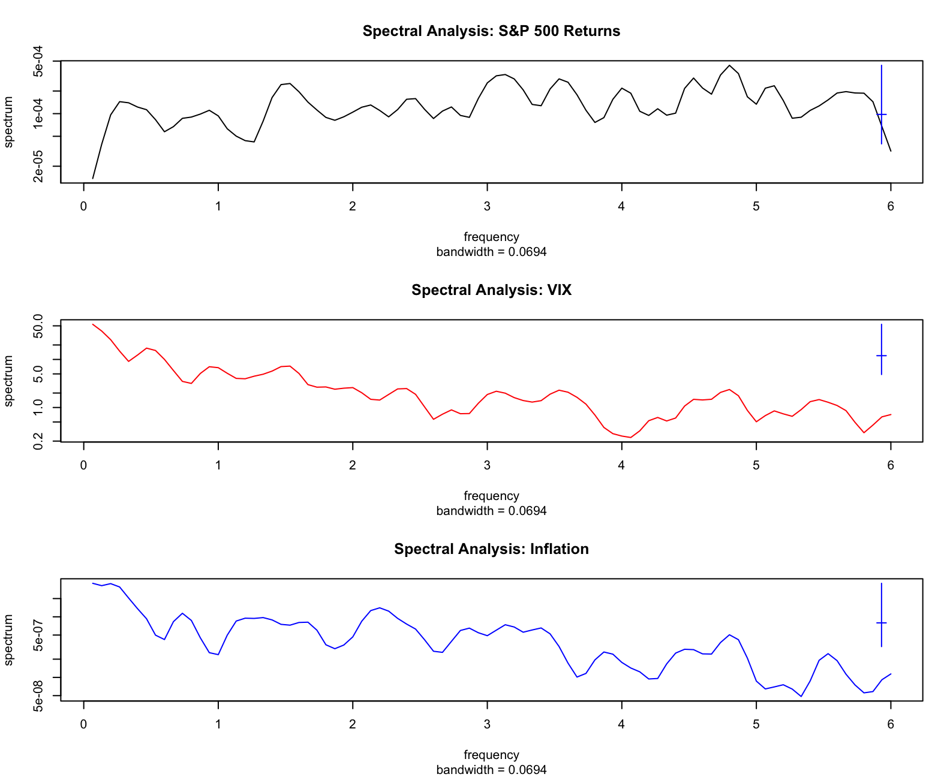
This shows the dominant cycles (frequencies) for each variable.
4. Spectral Analysis (Periodograms)
Notes:
The S&P 500 spectrum is relatively flat, confirming it behaves largely like unpredictable white noise.
The VIX and Inflation spectra show peaks at the lower frequencies (the left side of the chart). This indicates that these two variables are driven by longer-term, multi-month macro business cycles rather than fast, erratic daily noise.

Slide 8



Model Specifications
1. BASELINE ARIMA
2. CONTEMPORANEOUS SARIMAX
Univariate benchmark focusing strictly on the market's own history.
Best fit model capturing immediate market reactions to fear and inflation.
3. LAGGED SARIMAX
4. VECTOR AUTOREGRESSION (VAR)
Tests for lead-lag effects to see if inputs act as leading indicators.
Captures systemic feedback loops and shock ripples over time (p=4).
yt: S&P 500 Log Returns
Yt: Vector [SP500, VIX, INF]
β1,2: VIX & Inflation Coefficients
ε / E: Residual Error terms
ARMA: AR and MA components
t-1: One-month Lagged data
C: Constant Vector
AIC: Grading metric (Lower = Better)

Slide 9
Comparing different models to see what best explains the S&P 500.
5. Dynamic Model Comparison
Model Type | AIC | BIC
ARIMA (No Inputs) | -579.16 | -560.42
ARIMAX (Lagged Inputs) | -582.09 | -563.34
ARIMAX (Contemporaneous) | -622.66 | -594.54
The model using current-month VIX/Inflation (Contemporaneous) is the winner due to the lowest AIC/BIC scores.
2. CONTEMPORANEOUS SARIMAX
Best fit model capturing immediate market reactions to fear and inflation.
Notes:
The ARIMAX (Contemporaneous) model won decisively, scoring the lowest AIC (-622.66) and BIC (-594.54).
The Interpretation: This means that the stock market is best explained by what is happening right now with volatility and inflation, rather than what happened last month.

Slide 10
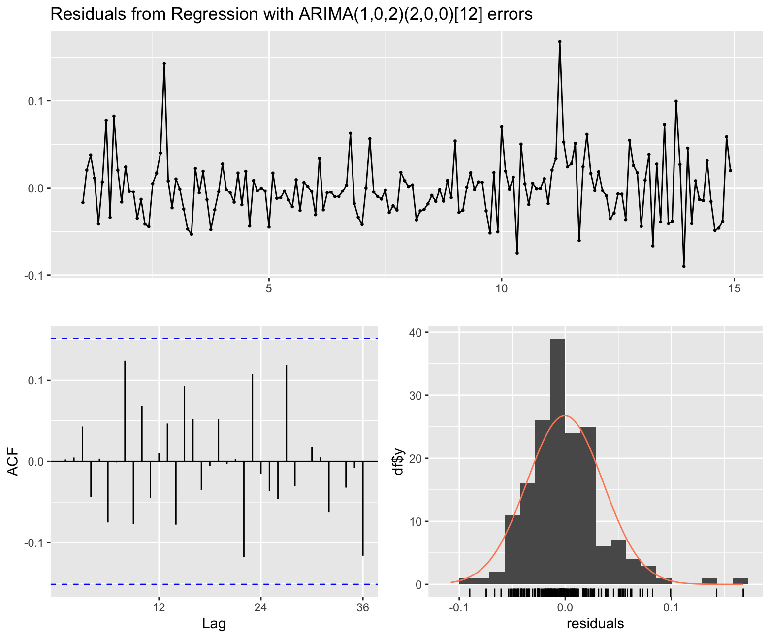
Ljung-Box p-value: 0.6489. Since p > 0.05, we conclude the residuals are White Noise and the model is valid.
6. Residual Checks (White Noise)
Notes:
Residual Diagnostics: To prove your winning model is mathematically valid, you ran a Ljung-Box test. It returned a p-value of 0.6489. Because this is well above 0.05, you can confidently tell your class: "The residuals are white noise. Our model successfully captured all the systematic patterns in the data.
The Ljung-Box Q-statistic tests for the joint significance of residual autocorrelations. With $Q^* = 16.125$ and $p = 0.6489$, we firmly fail to reject the null hypothesis of no serial correlation. This confirms the model is correctly specified and the error terms have been successfully reduced to strictly identically and independently distributed (i.i.d.) white noise.

Slide 11
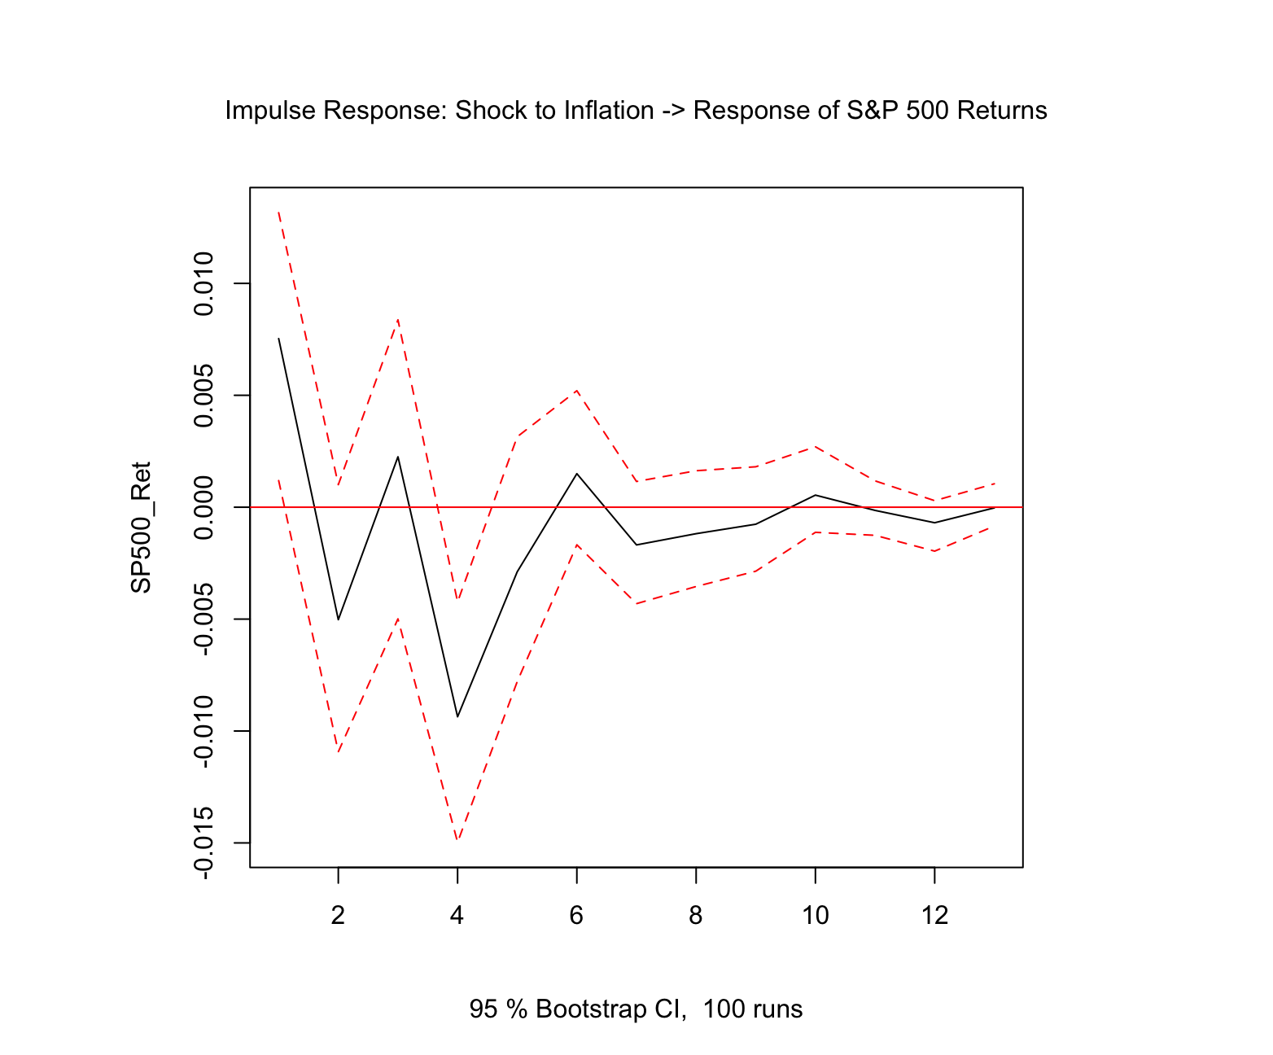
7. VAR Model: Inflation Shock on Market
Does a sudden jump in inflation significantly drop the market in the following months?
Notes:
The VAR model found a massive -0.8084 correlation between VIX and S&P 500 residuals, further cementing that fear and market returns move precisely opposite to each other.
Vector Autoregression (VAR): Rather than assuming a strict one-way causal relationship, we estimated a reduced-form VAR model with an optimal lag length of $p=4$ (selected via AIC). This captures the endogenous feedback loops between all three variables. The residual covariance matrix confirmed a massive negative correlation ($\rho = -0.8084$) between the structural innovations of VIX and the S&P 500.

Slide 12
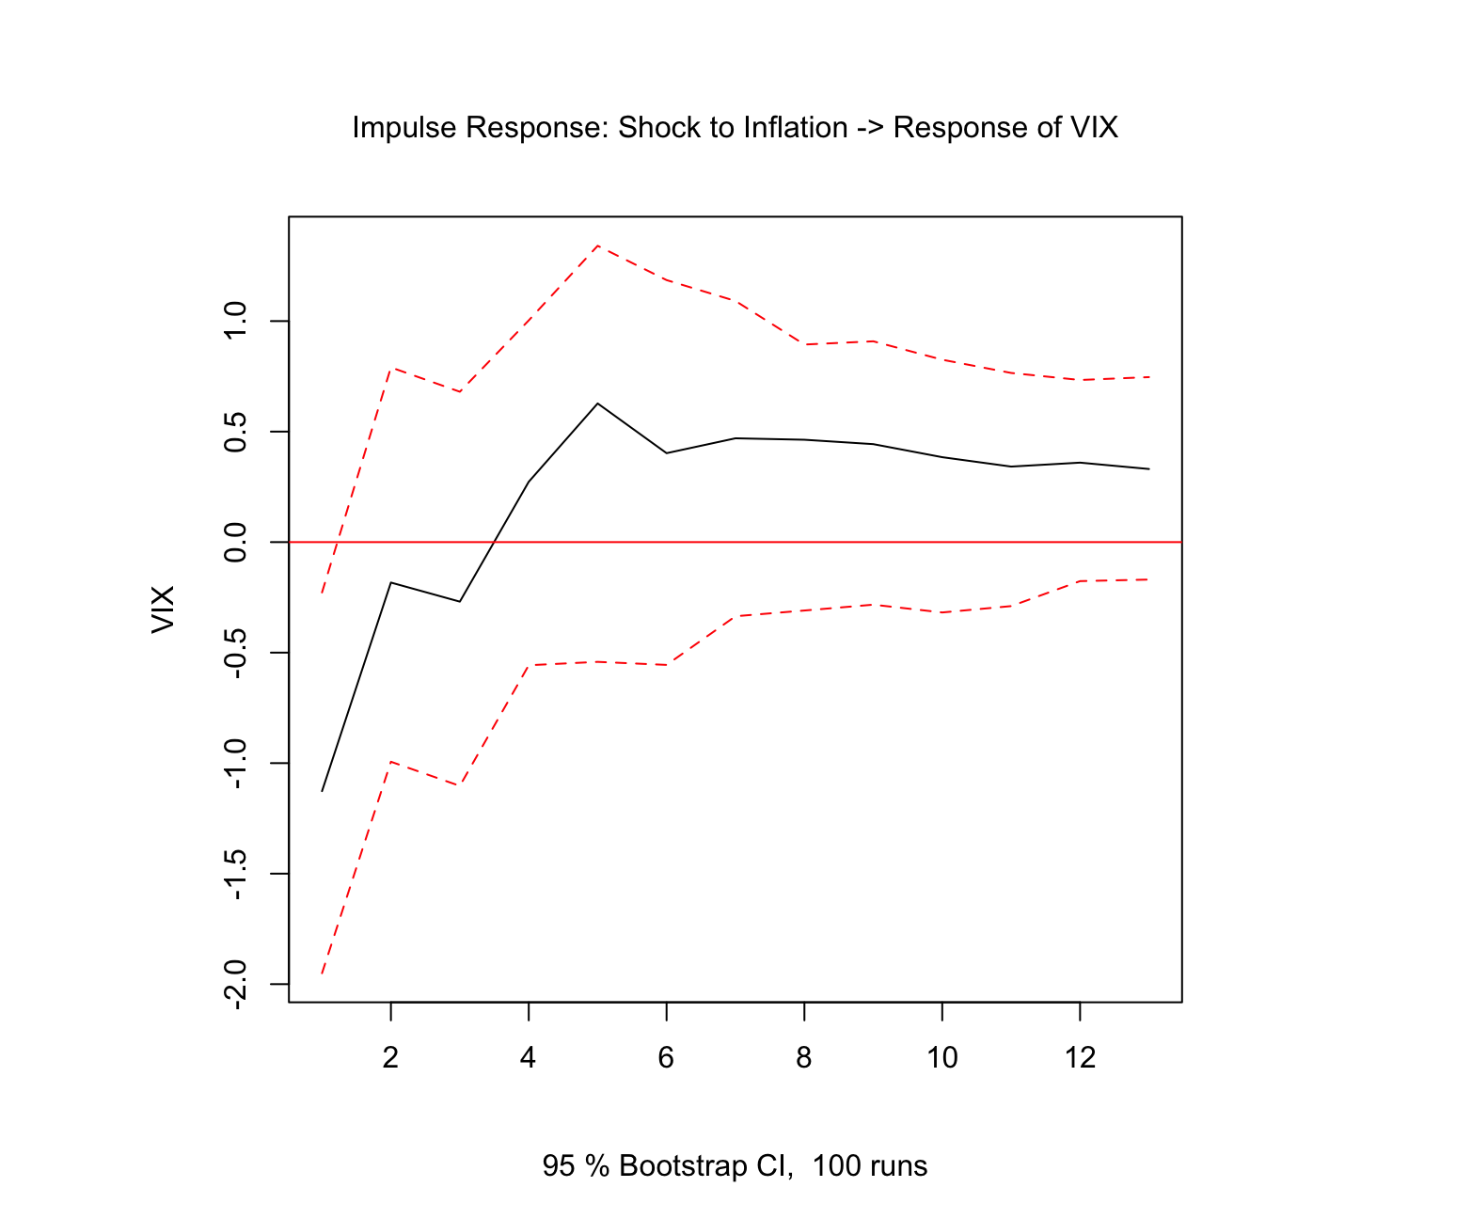
8. VAR Model: Inflation Shock on VIX
Does inflation uncertainty drive up market fear (VIX)?
Notes:
With these two graphs, we conclude that structural innovations to inflation do not induce statistically significant, persistent deviations from the steady state in either equity returns or implied volatility within this sample period. The shocks are purely transitory and absorbed without structural regime shifts.

Slide 13
Conclusions
Summary of Results
Hypothesis Testing
•
VIX dominance: Market returns are heavily tied to contemporaneous fear levels.
H1: Fear (VIX) and Market Returns move opposite and in unison.
•
Inflation: While significant in the long run, monthly CPI shocks have a smaller immediate impact than volatility.
H2: Inflation shocks show no statistically significant lasting impact in the VAR model.
Notes:
This analysis confirms that the VIX is a dominant, contemporaneous driver of S&P 500 returns—when fear spikes, the market immediately drops. However, while inflation is a crucial long-term macroeconomic indicator, our VAR and Impulse Response models show that sudden month-to-month shocks in inflation do not significantly dictate short-term market returns or volatility spikes.

Slide 14
Thank You
Questions?
Manish Suresh Maudgalya

