Slide 1

Exploratory Data Analysis on AMEO data for the year 2015

Slide 2
About me
My name is Manish Putnala, and I am currently pursuing the final year of B.Tech in Computer Science and Engineering.
I'm inclined towards learning Data Science for the following reasons:
1.The rapid growth and promising future of this domain.
2.Numerous career opportunities across the field.
3.I'm always curious to research and extract crucial insights, patterns, and relations from
data to find potential solutions to tackle real-world organizational requirements.
I am a student with no prior work experience seeking opportunities in the realm of Data Science.
My Linkedin: https://www.linkedin.com/in/manishputnala

Slide 3
About AMEO Data
For every engineer, AMEO dataset provides anonymised bio data information along with
their respective skill scores and employment outcome information. Specifically, the
following information is available for every engineer:
1. Scores on Aspiring Minds' AMCAT - a standardized test of job skills. The test includes
cognitive, domain and personality assessments.
2. Personal information like gender and date of birth.
3. Pre-university information like 10th and 12th grade marks, board of education and
12th grade graduation year.
4. University information like GPA, college major, college reputation proxy, graduation
year and college location.
5. The following employment outcome information is available for every engineer:
Job annual salary
Job title
Job location
Date of joining and leaving of job
Full report and Implementation :
https://drive.google.com/file/d/1w9FxTqvvG5iEk-Mujt3jV7ayvJDlir7v/view?usp=share_link

Slide 4
Objective
The main objective of the project is:
To understand the business requirements
To perform Exploratory Data Analysis
To find patterns and relations between variables
To extract the key findings and insights
To find the solutions for the business needs

Slide 5
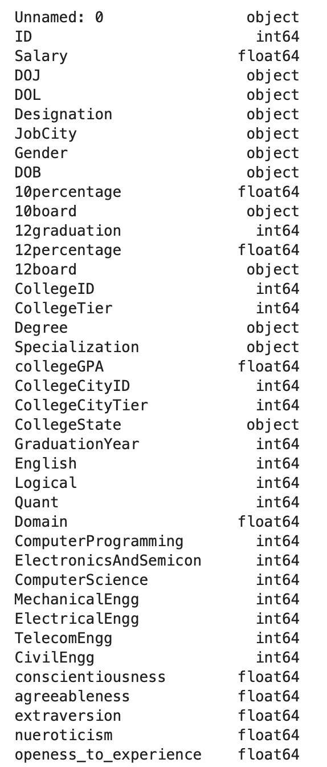
Summary of Data
The dataset contain 39 columns with Numerical and Categorical data types.
It has 3998 rows of data .
The dataset contains of engineering graduates.
It contains the attributes such as graduates Salary, Date of joining, Date of leaving, Personal information such as Date of birth, Gender.
It also contains data related to graduates academics such as 10th,12th and College academic performance, Graduation year and board.
Contains the geographical data such as Job City, College State.
It also contains standardized scored related to graduated Cognitive, Technical and Personality skills.

Slide 6
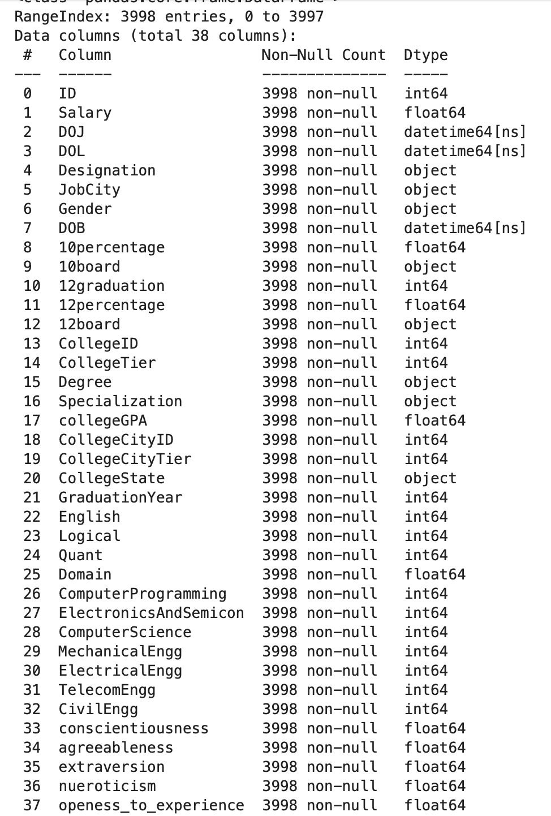
Data Cleaning and Transformation
The dataset contains no missing values.
Removed Unnamed column because it is not useful.
Filtered columns into Numerical and Categorical columns.
Changed datatype of Date columns from object type to datetime type.
Handled Invalid values and replaced them with valid ones

Slide 7
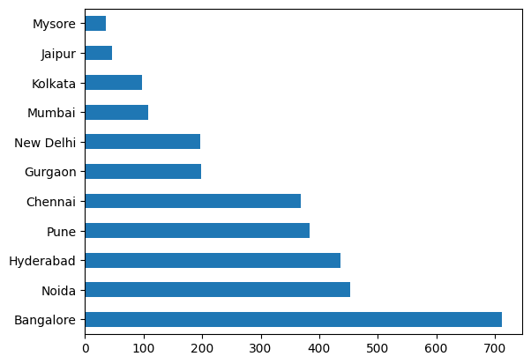
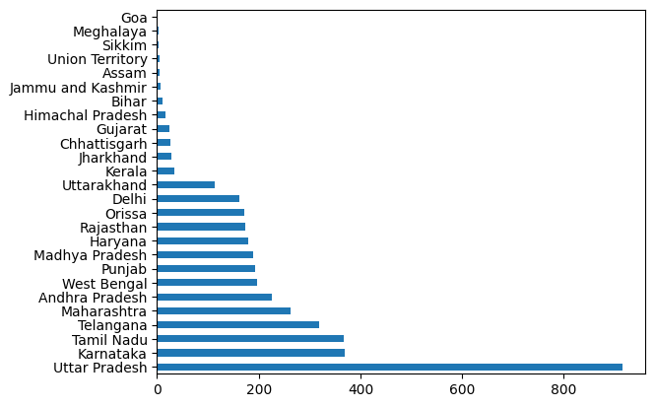
Univariate Analysis
Most of the graduates are working in cities like Bangalore, Noida, Hyderabad and Pune.
Most of the graduates pursued their graduation in Uttar Pradesh followed by Karnataka, Tamil Nadu, Telangana and Maharashtra.

Slide 8
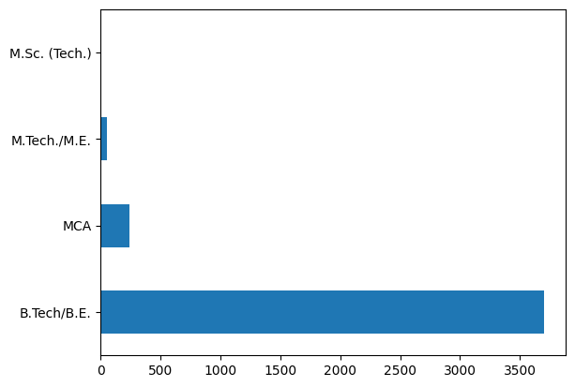
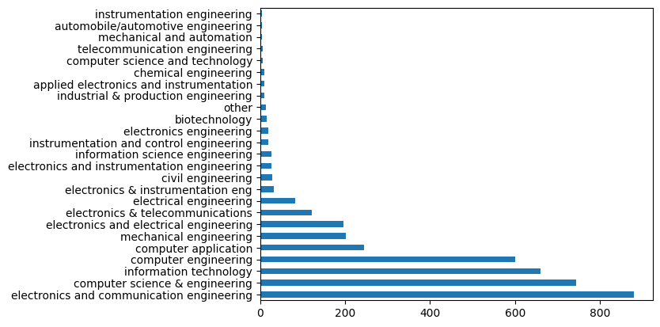
Univariate Analysis
Most of the graduates are working in cities like Bangalore, Noida, Hyderabad and Pune.
Most of the graduates pursued their graduation in Uttar Pradesh followed by Karnataka, Tamil Nadu, Telangana and Maharashtra.

Slide 9
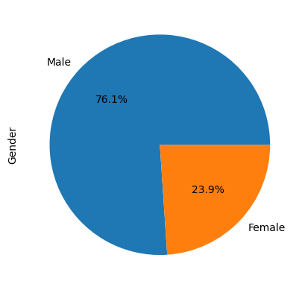
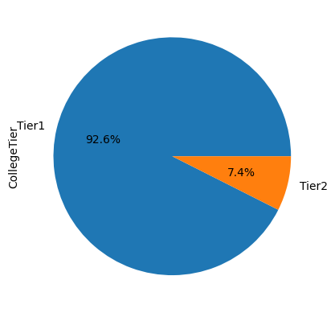
Univariate Analysis
76.1% of the graduates are men, The male to female ratio is approximately 3:1.
Most of the graduates belong to Tier 2 college there are only 7.4% of graduates who graduated from a Tier 1 College.

Slide 10
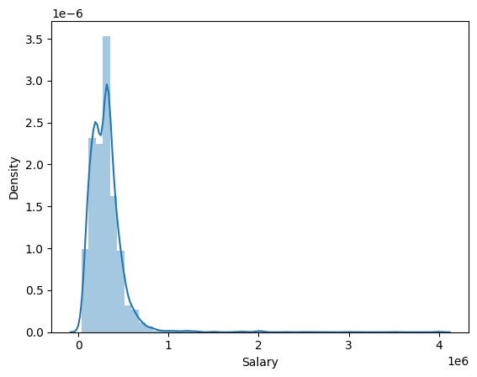
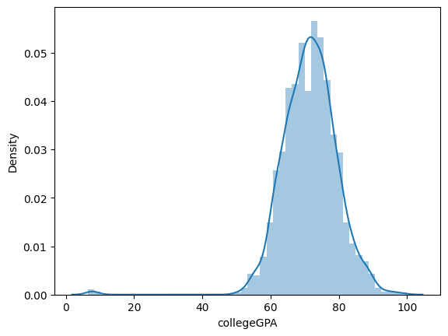
Univariate Analysis
The graphs display the distribution of Salary on left and Distribution of College GPA on Right
Most of the graduates earn approximately 2.5 lakhs - 3 lakhs
Most of the graduates have a College GPA between 6.0 - 8.0

Slide 11
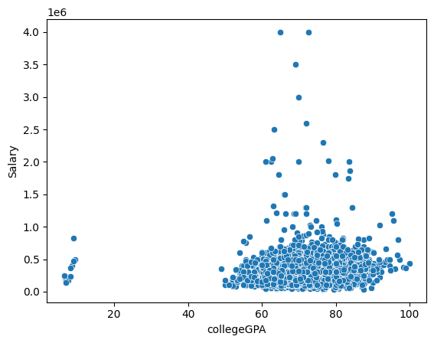
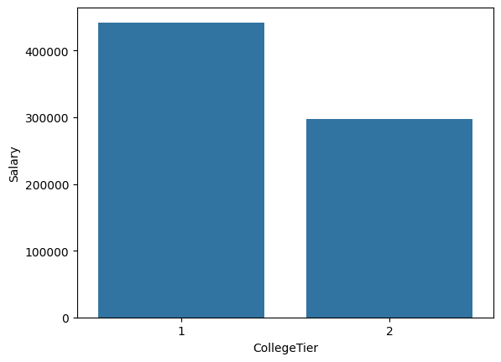
Bivariate Analysis
The graphs show the relationship between the Salary and College GPA on the left and Salary and College Tier.
The Salary and College GPA has a positive correlation as most of the graduates with higher College GPA secured higher salary package.
The graduates from Tier 1 colleges have higher salary packages than Tier 2 college graduates.

Slide 12
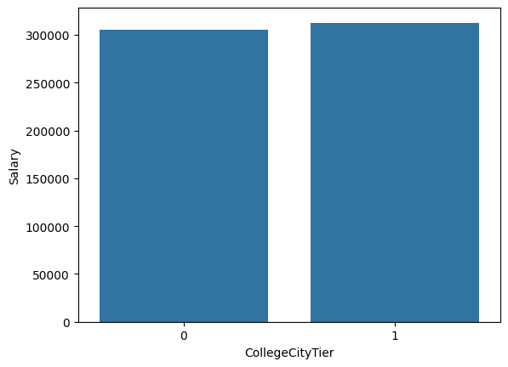
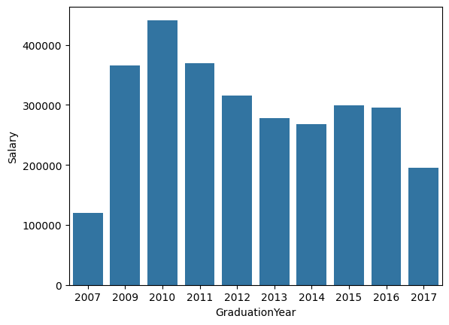
Bivariate Analysis
The graduates from colleges located in Tier 1 cities earn slightly more than graduates from colleges located in Tier 2 cities.
The graduates who graduated in the year 2010 have secured higher salary package compared to others.

Slide 13
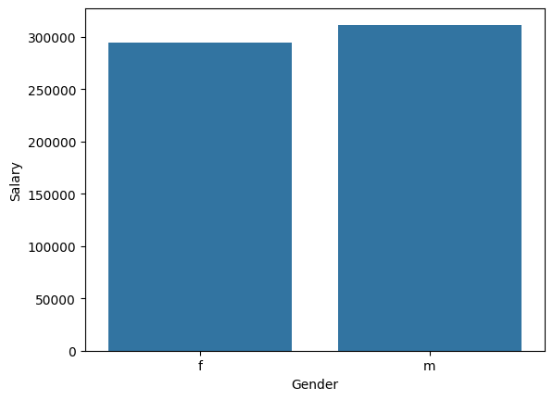
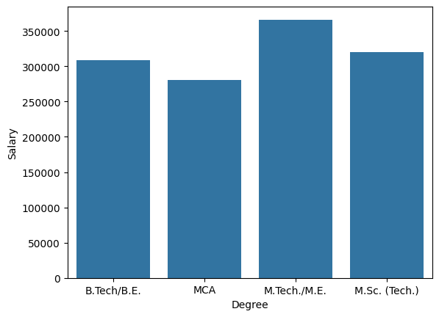
Bivariate Analysis
Males salary is slightly higher than the females.
M.Tech/M.E graduates earn higher salary compared to others.

Slide 14
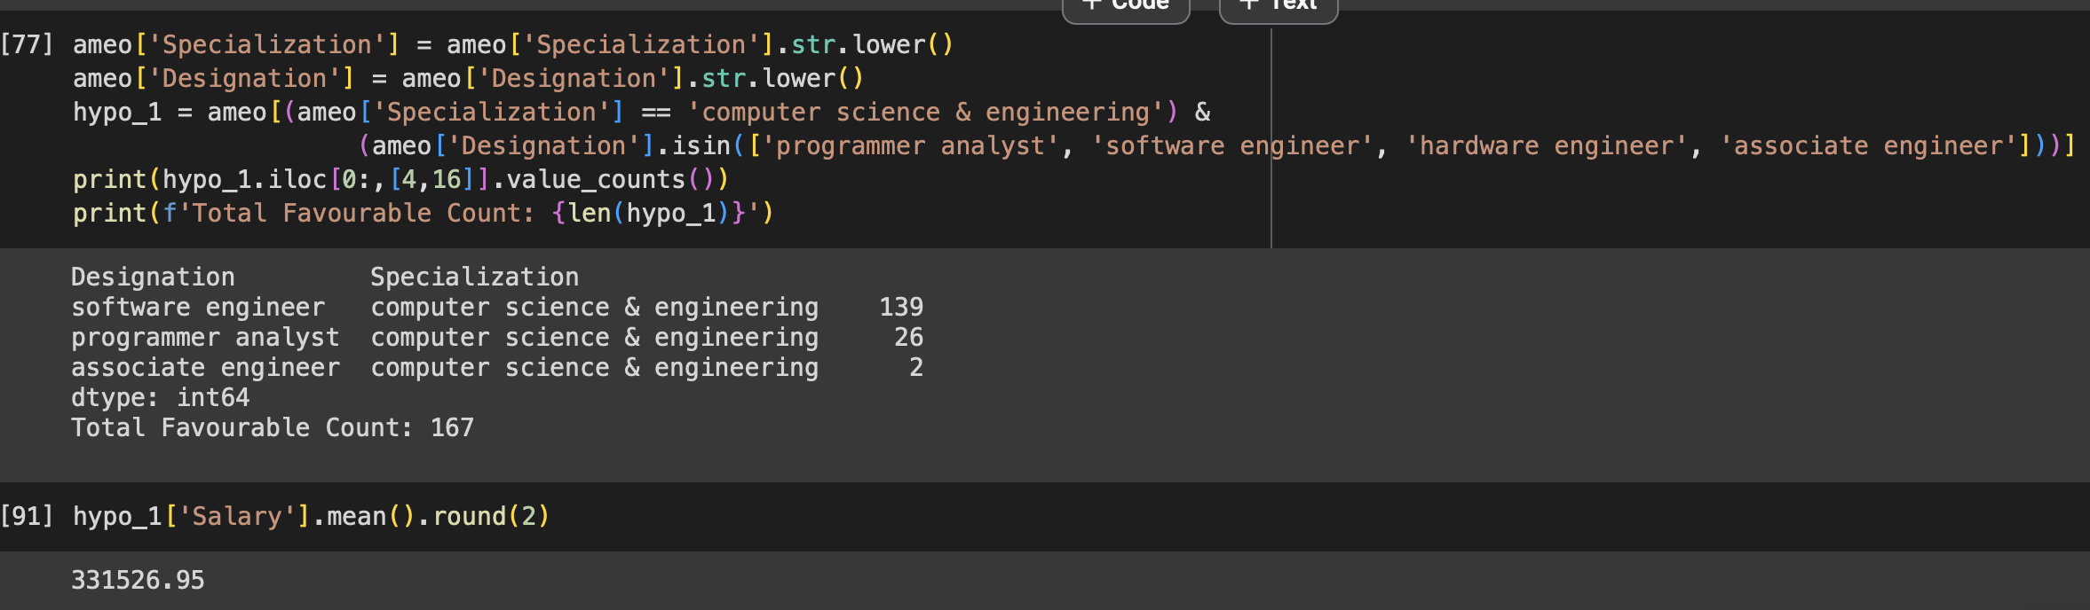
Research Question Analysis
Question -1 Times of India article dated Jan 18, 2019 states that “After doing your Computer Science Engineering if you take up jobs as a Programming Analyst, Software Engineer, Hardware Engineer and Associate Engineer you can earn up to 2.5-3 lakhs as a fresh graduate.” Test this claim with the data given to you.
The dataset only has 167 records that meet the criteria hence the data is inadequate to test the claim
However if we find the average of the available data it is approximately 331526.95
With respect to the outcome of the data we can say that a person with computer science engineering specialization can earn up more than 3 LPA if they take up jobs as Programming Analyst, Software Engineer, Hardware Engineer or as an Associate Engineer.

Slide 15
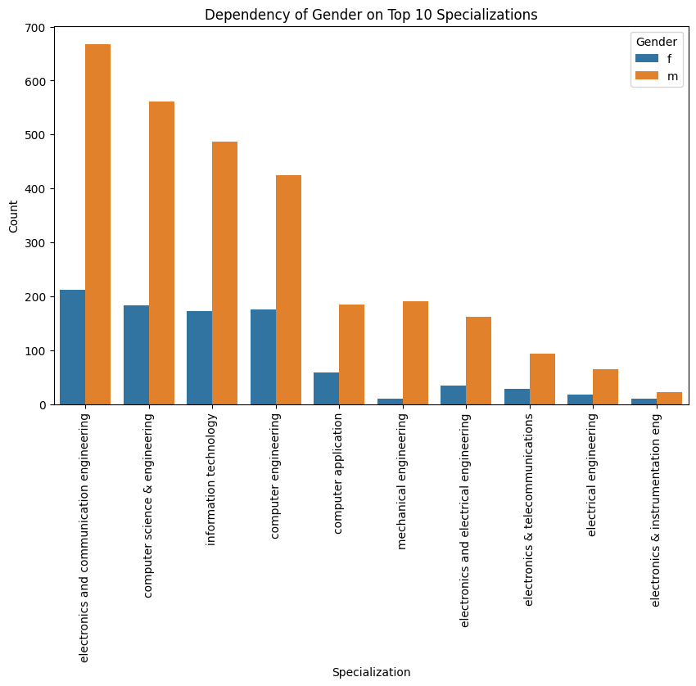
Question –2 Is there a relationship between gender and specialization? (i.e. Does the preference of Specialization depend on the Gender?
This count plot show us the relationship between genders and specialization.
By looking at the graph we can say that there is a relationship between gender and specialization.
The graph indicates that every specialization is male dominant.
The male to female ratio is significantly high in specializations such as Mechanical Engineering and Electronics and Electrical Engineering.
Most of the females prefer specializations such as Electronics and Communication Engineering, Computer Science Engineering and Information Technology.
From the available data we can conclude that there is a dependency between Gender and Specialization.

Slide 16
Conclusion
The dataset contains data of engineering graduates which was released by AMEO in the year 2015.
The dataset contains data of engineering graduates such as graduates personal, academic and professional information.
It also contains information related to their Technical, Cognitive and Personality skills.
Dataset has no missing values but few columns contain invalid values.
Around 76% of the data is of male graduates.
Average salary of these engineering graduates is approximately 3 lakhs per annum.
The Technical, Cognitive and Personality skills all are positively correlated with salary of the graduates.

Slide 17
Conclusion
Graduates from Tier 1 colleges and Tier 1 cities tend to earn more compared to those from Tier 2 colleges and Tier 2 cities.
Most of them work in cities like Bangalore, Noida, Hyderabad, Pune, and Chennai.
A majority of these graduates hail from states such as Uttar Pradesh, Karnataka, Tamil Nadu, Telangana, and Maharashtra.
The majority of graduates hold a B.Tech/B.E degree with specializations in branches such as Electronics and Communication Engineering, Computer Science Engineering, and Information Technology.
Graduates with good academic performance tend to have higher salaries compared to those who performed poorly during their academic years.
Graduates with an M.Tech/M.E degree earn the highest salaries, followed by those with an M.Sc and B.Tech/B.E degree.

Slide 18
Conclusion
The data is inadequate to test and answer the question, namely whether a graduate with a specialization in Computer Science Engineering, taking up a job as a Programmer Analyst, Software Engineer, Hardware Engineer, or Associate Engineer, can earn between 2.5 lakhs and 3 lakhs per annum.
However, with the limited data available, the average salary meeting the above criteria is approximately 3.3 lakhs per annum. So, if a Computer Science Engineering graduate takes up a job as a Programmer Analyst, Software Engineer, Hardware Engineer, or Associate Engineer, the expected salary range would be between 2.5 and 3 lakhs per annum.
Furthermore, the data suggests that Specialization and Gender are dependent on each other. Women predominantly consider specializations such as Electronics and Communication Engineering, Computer Science Engineering, and Information Technology, whereas men are diversely spread across different specializations according to the data.

Slide 19
Queries?

Slide 20
My Experience and Challenges Faced while performing EDA
Firstly I would like to thank Innomatics Research Labs for providing this opportunity and also Kanav Bansal Sir for his efforts to guide us throughout the internship program.
Kanav Sir's GitHub Repository resource has eliminated lot of stack overflow and ChatGPT searches which saved a lot of time and allowed me to learn each and every concept with precision while working on this project.
I found the project quite challenging as the dataset contained some invalid values as well as few columns were noisy, it was challenging to handle the noisy data.
Overall it was a challenging yet very useful project which allowed me to tackle challenging situations, explore and learn new concepts and allowed me to understand the workflow of a data scientist in depth.

Slide 21

THANK YOU

