Slide 1
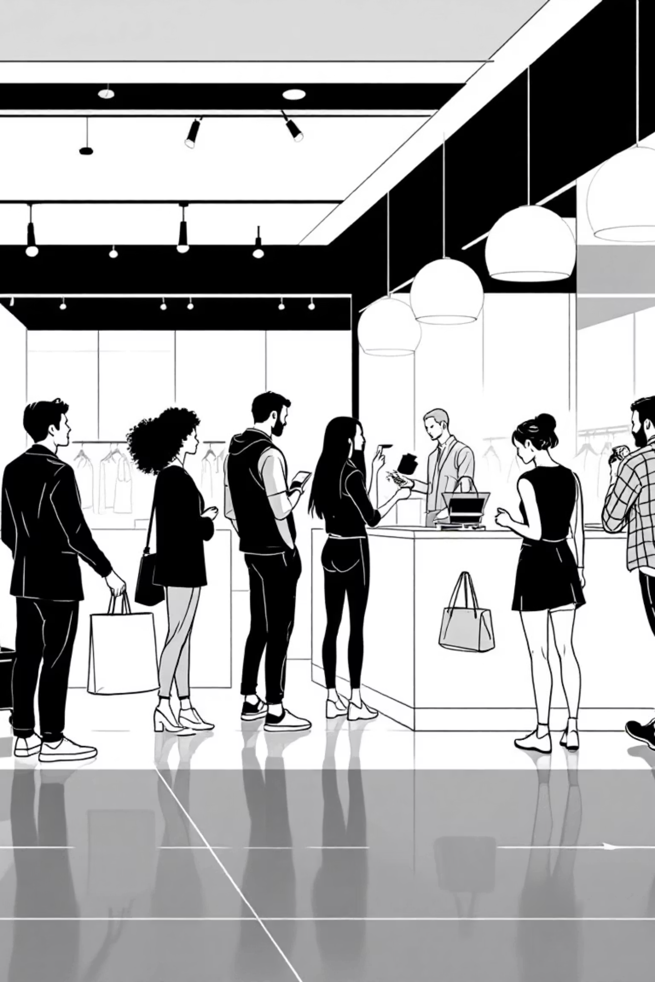
Customer Shopping Behavior Analysis
This project analyzes transactional data from 3,900 purchases to uncover insights into spending patterns, customer segments, product preferences, and subscription behavior. Our goal is to guide strategic business decisions.

Slide 2


Project Overview & Dataset Summary
Project Goal
Uncover insights from customer transactional data to inform strategic business decisions.
Dataset Size
3,900 rows, 18 columns, covering various product categories.
Key Features
Customer demographics, purchase details, and shopping behavior metrics.
Missing Data
37 values in the 'Review Rating' column were identified and handled.

Slide 3
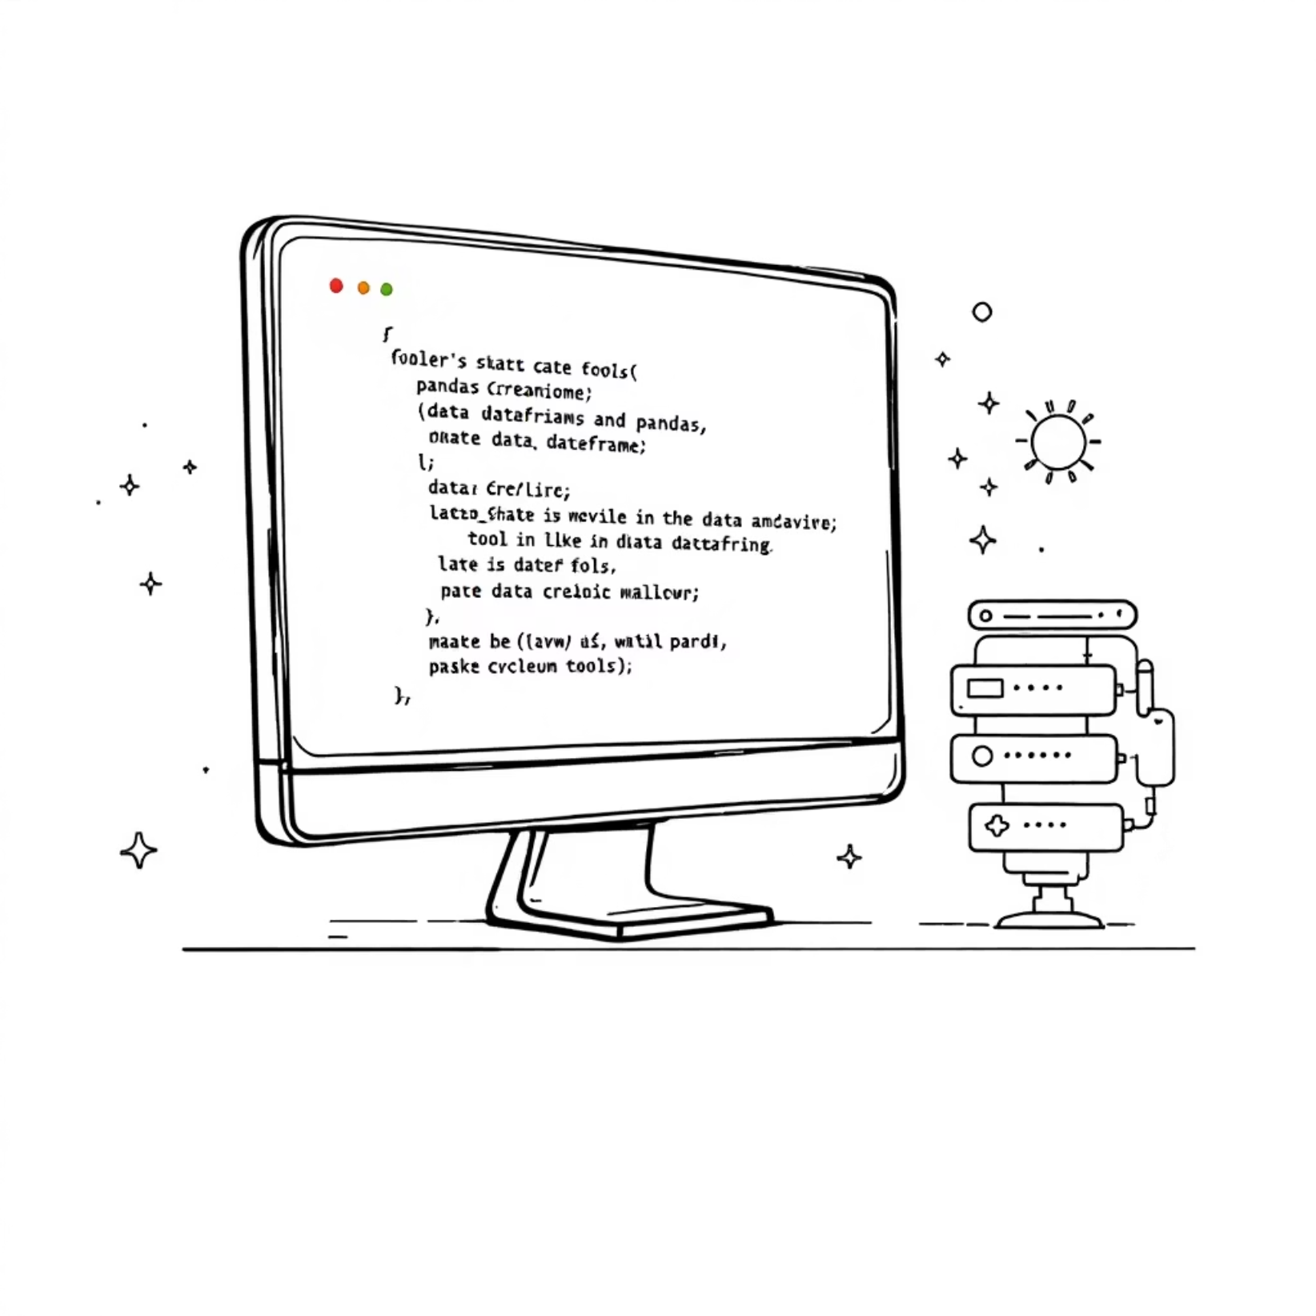
Exploratory Data Analysis with Python
Data Preparation & Cleaning
Data Loading: Imported dataset using pandas.
Initial Exploration: Checked structure and summary statistics.
Missing Data Handling: Imputed 'Review Rating' using median per category.
Column Standardization: Renamed columns to snake_case.
Feature Engineering: Created 'age_group' and 'purchase_frequency_days'.
Data Consistency: Dropped redundant 'promo_code_used' column.
Database Integration: Loaded cleaned data into PostgreSQL for SQL analysis.

Slide 4
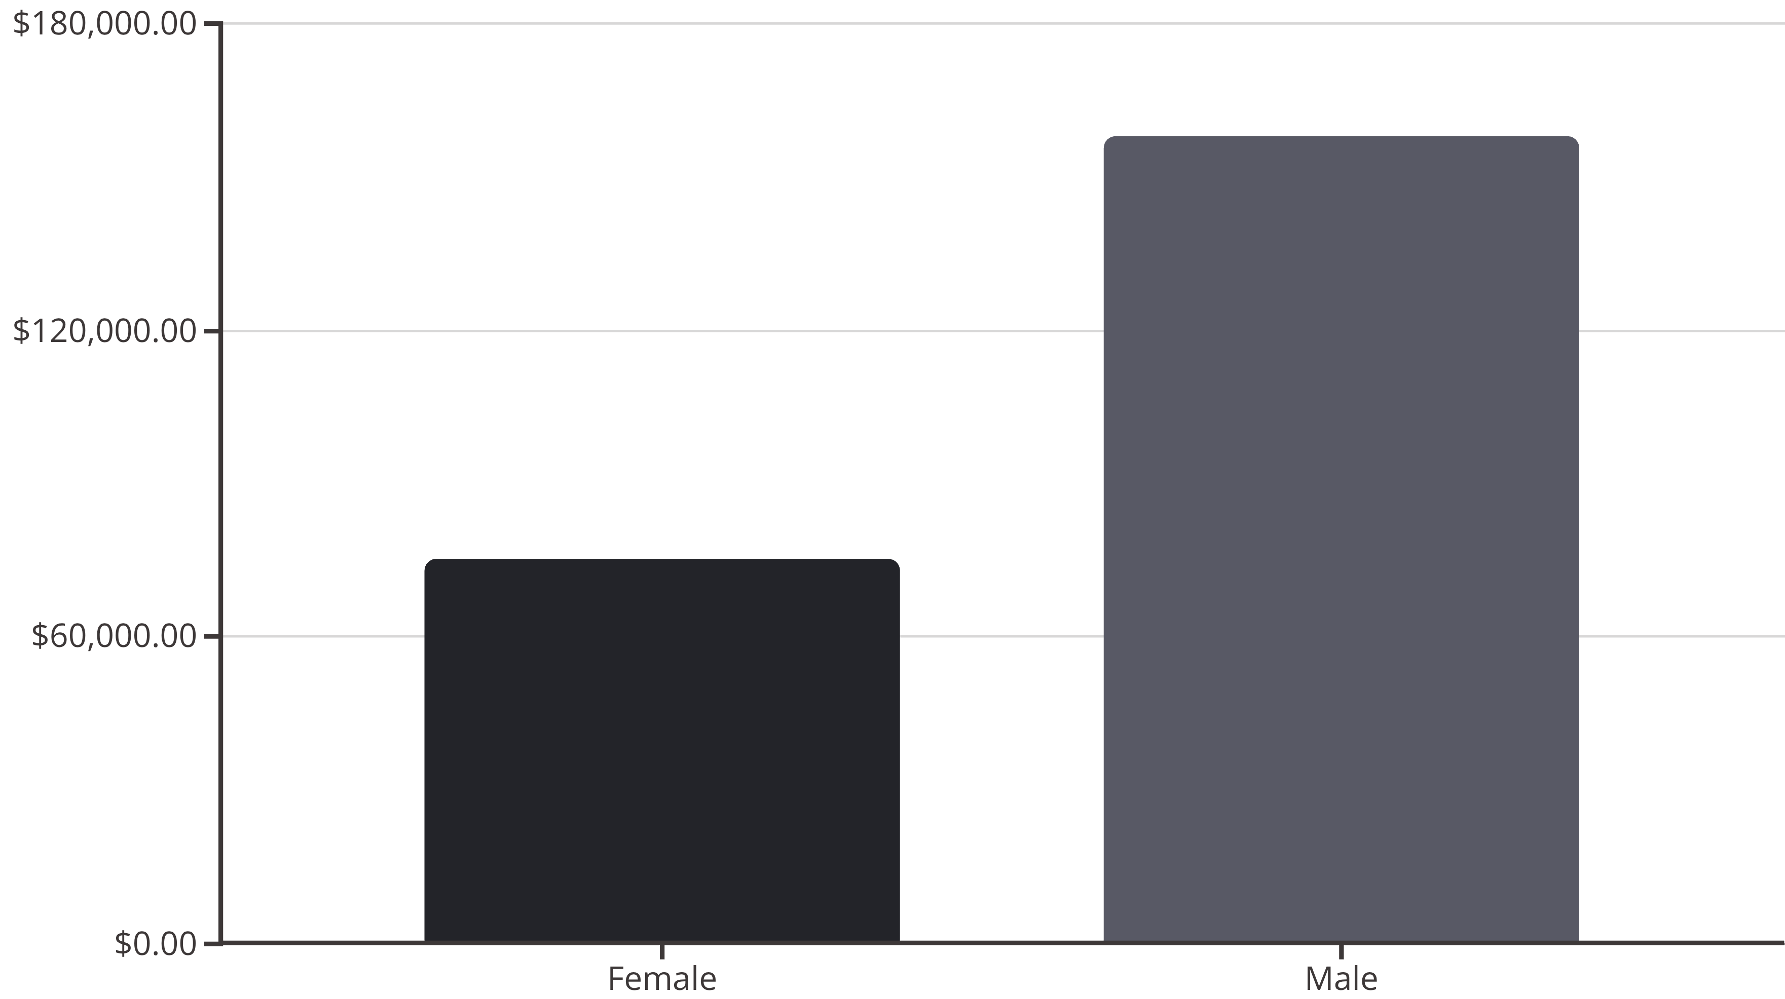
Revenue by Gender
Comparing total revenue generated by male versus female customers reveals a significant difference.

Slide 5

High-Spending Discount Users & Top Products
High-Spending Discount Users
Top 5 Products by Rating
839 customers used discounts but still spent above the average purchase amount, indicating effective discount strategies for higher value transactions.
Gloves
Avg Rating: 3.86
Sandals
Avg Rating: 3.84
Boots
Avg Rating: 3.82
Hat
Avg Rating: 3.80
Skirt
Avg Rating: 3.78

Slide 6




Shipping & Subscription Insights
Shipping Type Comparison
Subscribers vs. Non-Subscribers
Discount-Dependent Products
Express shipping users have a slightly higher average purchase amount ($60.48) compared to Standard shipping ($58.46).
Non-subscribers contribute more to total revenue ($170,436) than subscribers ($62,645), with similar average spend.
Hat, Sneakers, Coat, Sweater, and Pants show the highest percentage of discounted purchases, indicating price sensitivity.

Slide 7




Customer Segmentation
Customers are classified into three segments based on their purchase history.
Loyal
New
3,116 Customers
83 Customers
Returning
701 Customers

Slide 8
Top Products per Category
Identifying the most purchased items within each category helps optimize inventory and marketing efforts.
1
Accessories
Jewelry
171
1
Clothing
Blouse
171
1
Footwear
Sandals
160
1
Outerwear
Jacket
163
2
Accessories
Sunglasses
161
2
Clothing
Pants
171
2
Footwear
Shoes
150
2
Outerwear
Coat
161

Slide 9
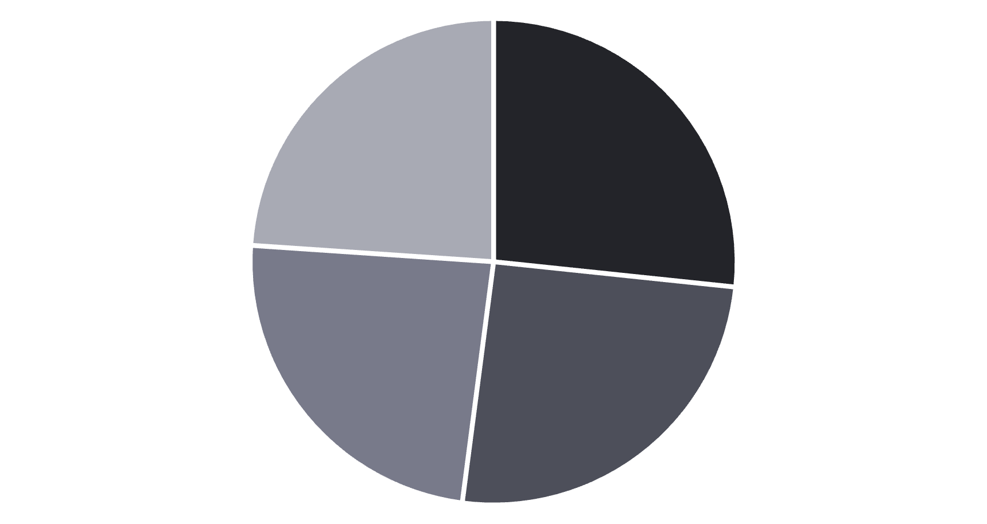
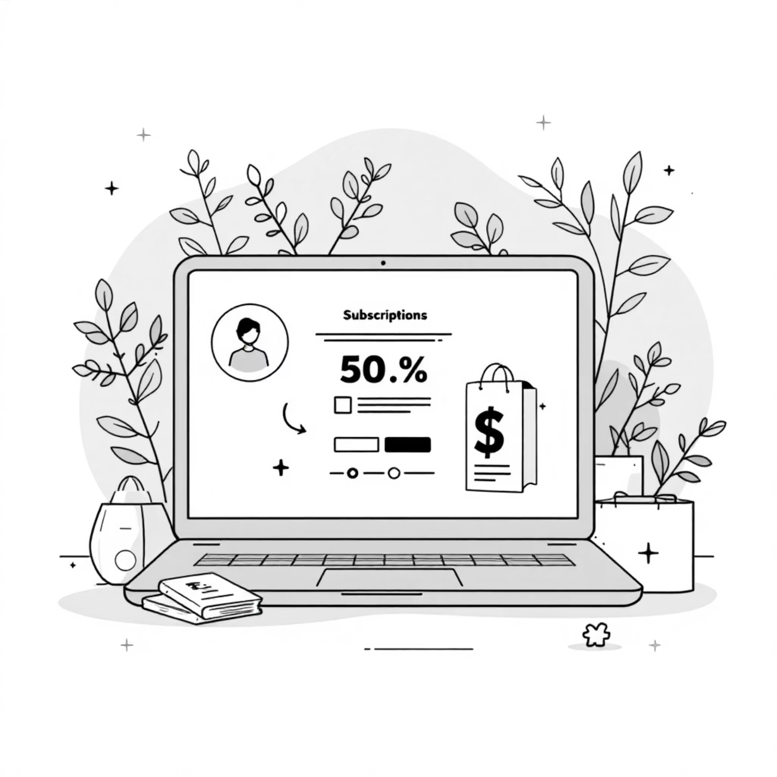
Repeat Buyers & Revenue by Age Group
Repeat Buyers & Subscriptions
Revenue by Age Group
Customers with more than 5 purchases are more likely to be non-subscribers (2,518) than subscribers (958). This suggests an opportunity to convert loyal non-subscribers.
Young Adult
Middle-aged
Adult
Senior

Slide 10


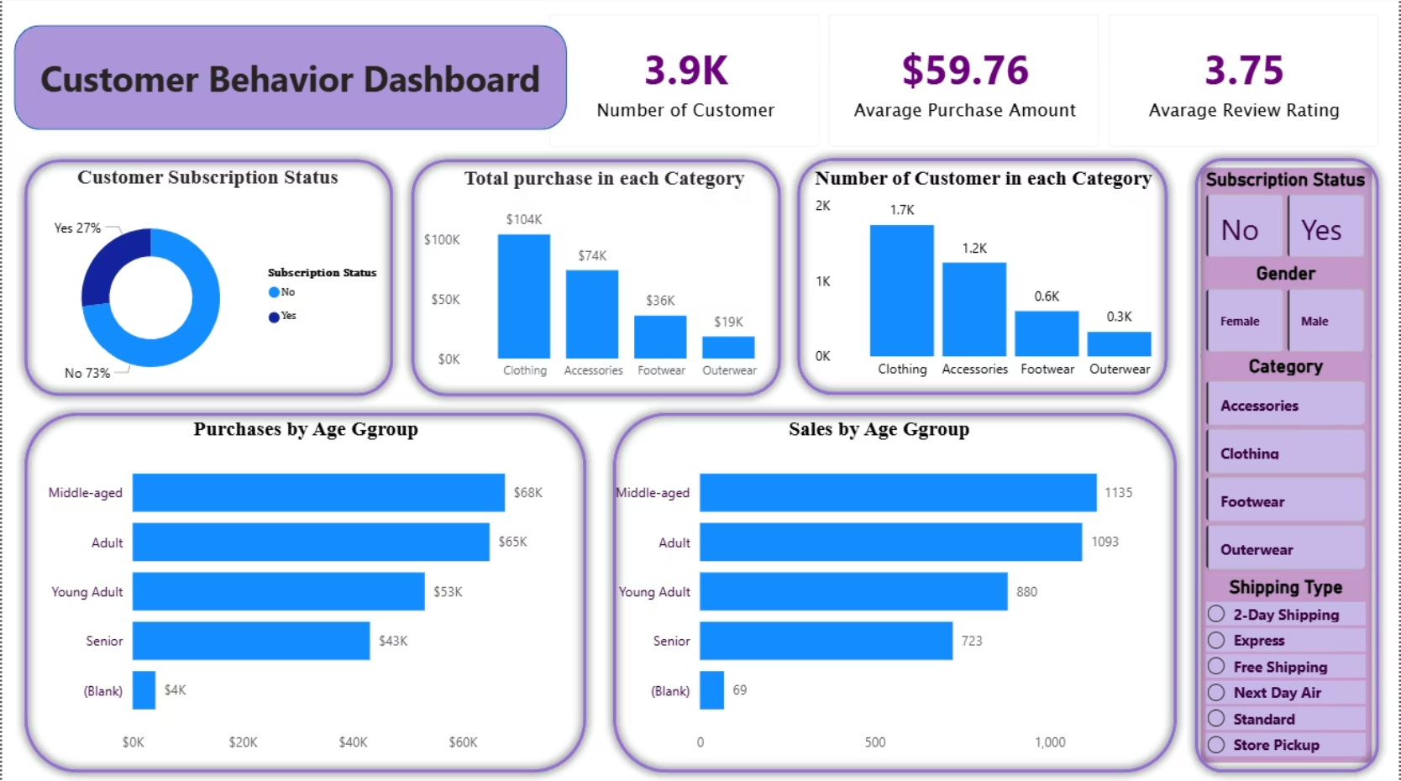



Business Recommendations
Boost Subscriptions
Promote exclusive benefits to increase subscriber base.
Customer Loyalty Programs
Reward repeat buyers to foster loyalty and move them into the "Loyal"
segment.
Review Discount Policy
Balance sales boosts with margin control for sustainable growth.
Product Positioning
Highlight top-rated and best-selling products in marketing campaigns.
Targeted Marketing
Focus efforts on high-revenue age groups and express-shipping
users for maximum impact.

