Slide 1

Conservation of Asiatic Lions
Team : Manish Narwal, Rahul Islam
Course : SYS 611 Final Project, Spring 2020
Advisor: Prof. Michael Geller

Slide 2
PROBLEM STATEMENT
Asiatic Lions are only found in India with many being extinct from other Asian countries.
With only 523 left they are classified as critically endangered animals.
All of them can be found only in Gir National Park in the state of Gujarat in India.
While many factors are responsible as threat to their survival, we will investigate using Stella Model how these animals can be protected from extinction.
The lions live in 545.2 Square miles area where there are some villagers as well.
We will also investigate using "What-if" analysis how the growing human population can affect the lion population.

Slide 3
APPROACH & METHODOLOGY
PHASE 1: Research about the factors affecting lion population and Relevant Data Collection and assumptions to be made.
PHASE 2: Prepare Stella Model 1 with factors affecting lion population
PHASE 3: Run the model by changing different parameters to observe how each factor affects the population of lions and determine which factors are responsible for rapid decline in lion population.
PHASE 4: Prepare Stella Model 2 showing the interference of humans in lion's habitat.
PHASE 5: Analysis of Output of Stella Model 2
PHASE 6: Conclusion and Recommendations

Slide 4
INPUT DATA
Lion Population (as of 2015) : Total 523, Male= 109, Female=201,Cubs= 213
Birth Rate : 0.82 , Death Rate : 0.097 (source in references)
Factors affecting Lion Population in the Gir National Park:
1) Accidents: Approx 25 lions die per year by falling into open wells and getting hit by train which passes through forest.
2) Human-Lion conflict:Around 20 incidents occur per year where Lions are killed by villagers for entering the village.
3) Disease: Canine distemper virus killed estimated 50 lions.
4) Fight for domination: Fights among the prides for territory domination kills around 23 lions per year.
5) Cubs Survival: Only 40% of the cubs survive as many are killed by pride fights

Slide 5
DATA PREPARATION AND CALCULATIONS
Factor: Accidents
(25/523)*100= 4.78%
So factor of 0.047 is taken
Factor: Human-Lion conflict
(20/523)*100= 3.82%
So factor of 0.038 is taken
Factor: Disease
(50/523)*100= Approx 10%
So factor of 0.1 is taken
Factor: Fight for Domination (only affects cubs and males in most cases)
(23/322)*100= 7.1%
So a factor of 0.071 is taken
Factor: Cubs Death Rate
Only 40% cubs survive
So factor of 0.6 is taken (Assumption: 50% of cubs are male and 50% are female)

Slide 6
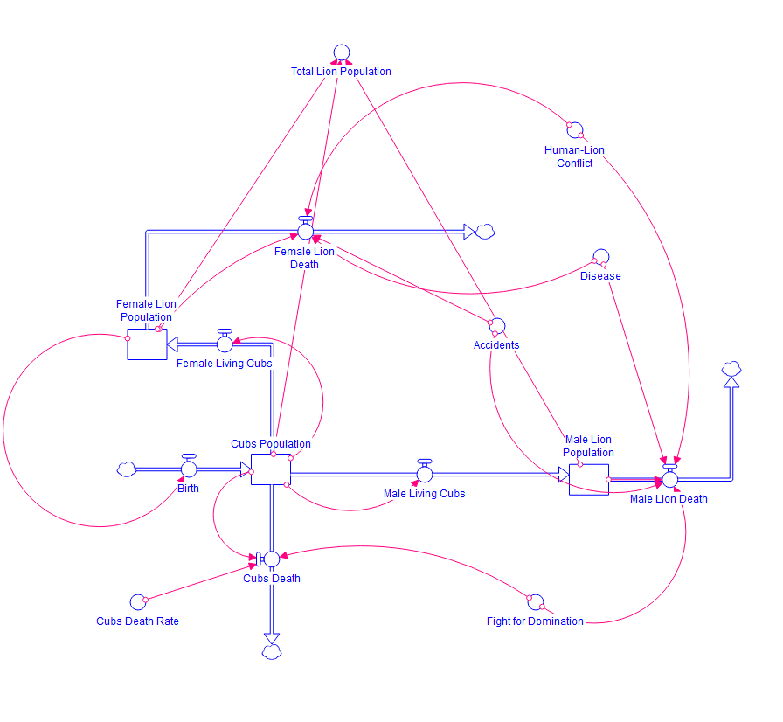
Stella Model 1

Slide 7
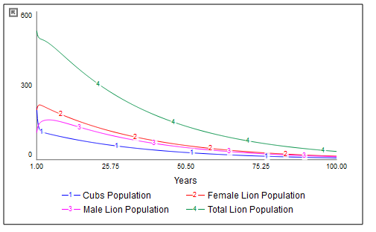
Output of the Model 1

Slide 8
Analysis of output of Model 1
According to the model the Asiatic lions will be near extinct in 75 years if the factors responsible for their death remain the same.
The low survival rate of the cubs is one of the factors besides human caused deaths.
For the next phase we will see which factors impact most on the lion population.
This can be accomplished by changing various parameter values and observing the change in the population.

Slide 9
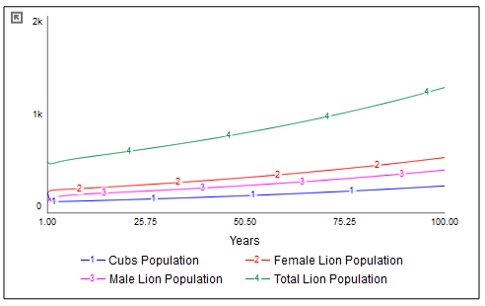

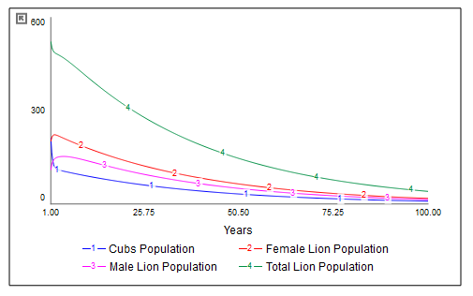
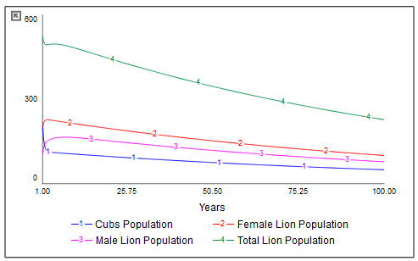
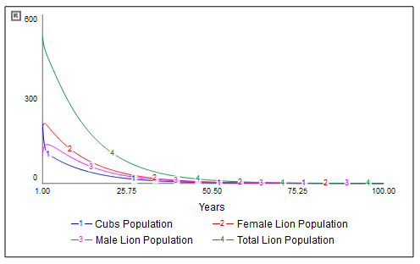
FACTOR: ACCIDENT
1) Accident=0.0
2) Accident=0.020
3) Accident=0.040
4) Accident=0.1

Slide 10
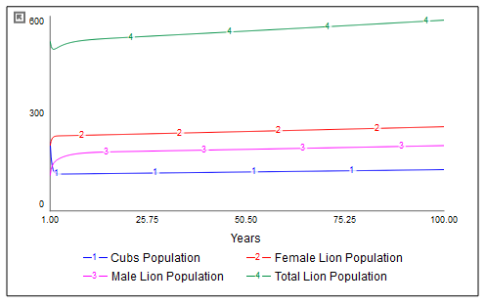
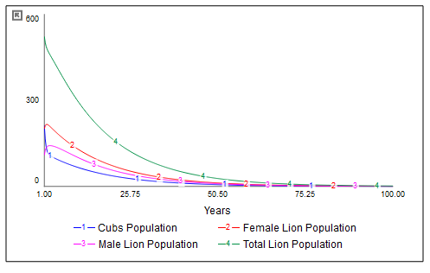
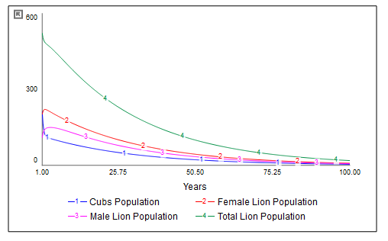
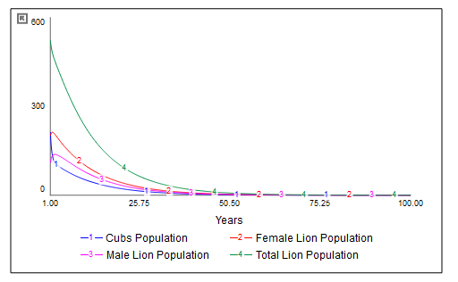
FACTOR: HUMAN-LION CONFLICT
1)Human-Lion conflict=0.0
2)Human-Lion conflict=0.040
3)Human-Lion conflict=0.070
4)Human-Lion conflict=0.1

Slide 11
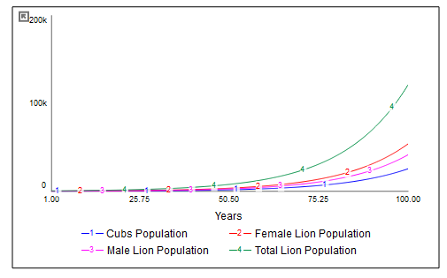
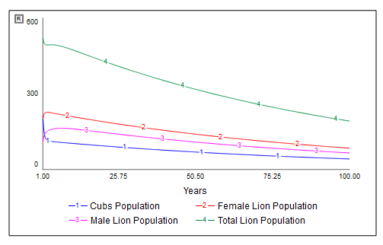
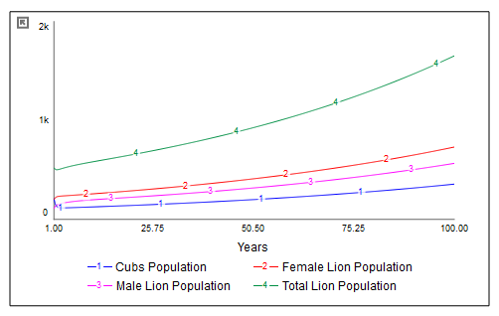
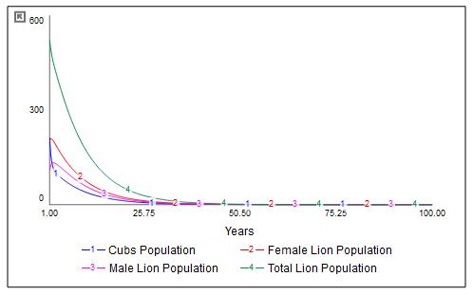
FACTOR: DISEASE
1) DISEASE = 0.0
2) DISEASE = 0.05
3)DISEASE= 0.075
4)DISEASE= 0.20

Slide 12
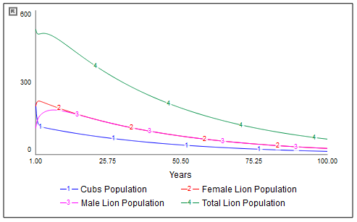
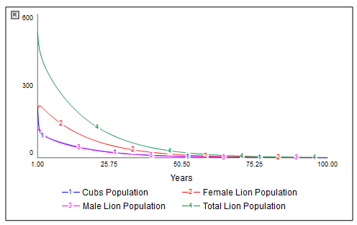
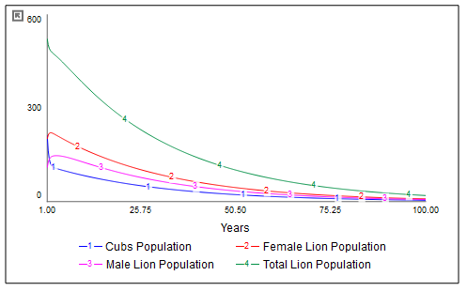
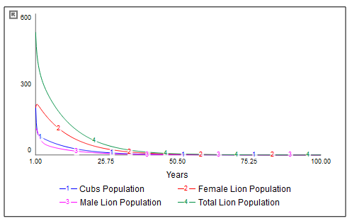
FACTOR: FIGHT FOR DOMINATION
1)Fight for domination = 0.0
2)Fight for domination = 0.1
3)Fight for domination= 0.3
4)Fight for domination= 0.6

Slide 13
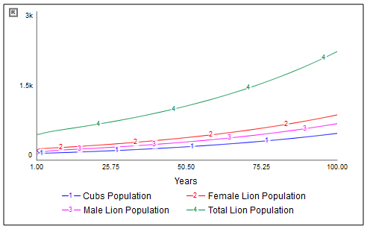
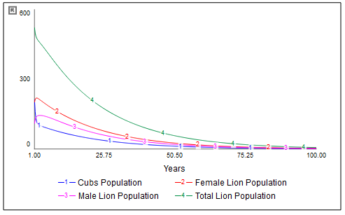
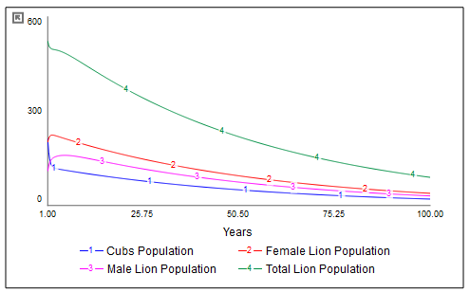
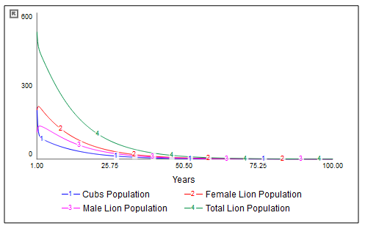
FACTOR: CUBS DEATH RATE
1) CDR = 0.3
2) CDR = 0.5
3) CDR = 0.7
4) CDR = 1

Slide 14
CONCLUSION FROM THE ANALYSIS SO FAR
When factors of accidents, human-lion conflict, disease and cub death rates are reduced then the population shows an exponential growth.
Reducing fight for domination still shows declining population and is understandable as the fights are taking amongst the pride of lions
Disease has the most impact on the lion population if the parameter is increased then it indicates that the entire population will be dead within 25 years.
Human based accidents are also the major factor after disease and that is why we are going to analyze even further why increase in human population will increase the cases of accidents and human-lion conflict and deforestation.
Cub death rate also needs to be reduced as it is the key to the survival of their species.

Slide 15
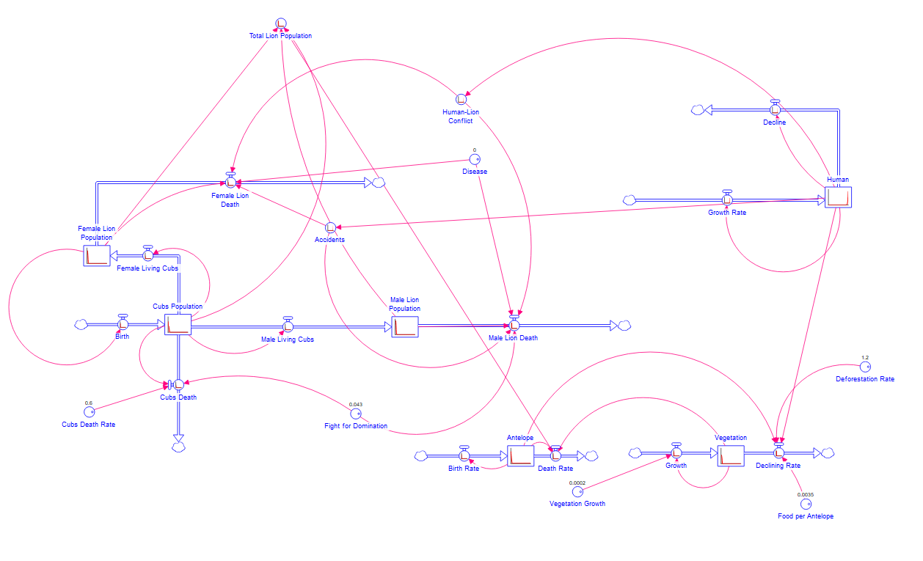
Ill-Effects of increasing human population in and around Gir National Park (Stella Model 2)

Slide 16
EXPLANATION of Stella Model 2
Major Initial values: Human= 200, Antelope=3200, Vegetation = 12000
Increase in human population will affect the accident and human-lion conflict factors as the cases will increase.
Lions feed on antelope (they can be spotted frequently in Gir National Park) and for both the forest cover is necessary for survival.
The forest cover is represented as "Vegetation" with assumed growth rate and decline depending on Deforestation Rate and Human Population.
The purpose of this model was to investigate how the lion population is affected by antelopes and humans.

Slide 17
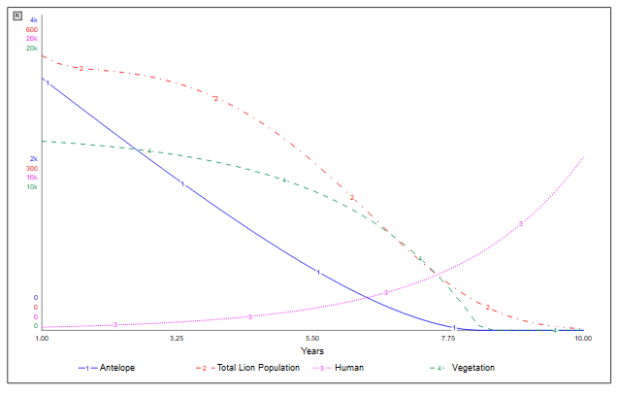
Stella Model 2 Output

Slide 18
EXPLANATION of Stella Model 2 Output
Increase in human population will require space for settlements and hence the vegetation or forest cover will be reduced.
Reducing vegetation will also result in decline of Antelope population.
Decline in antelope population will thus result in decline in population of lions.
The other factor which will also directly impact lion population is the increase in human population which will also increase the cases of accidents and human-lion conflict.
Hence, this proves that for better conservation of lions the human interference should be minimal or best if avoided.

Slide 19
CONSERVATION
We know until now that the factors accidents, disease and cub death rate had a huge impact on the lion population.
Thus reducing these rates significantly we can protect the Asiatic lions from extinction.
Also from Stella Model 2 the other factors which we can consider are necessary for conservation are less or no human interference in the Gir National Park ecosystem.
The park authorities should ensure that the lions are free from the deadly canine virus and should monitor cub health.
The Forecast graph of conservation is generated (next slide) and has the following changes in variables which indicates that conservation is implemented:
Cubs Death Rate = 0.3 (reduced by half from 0.6)
Disease = 0.09 (reduced by 0.01 as this can be sometimes out of control)
Accidents = 0.040 (reduced by 0.007 considering minimum human interference is achieved)

Slide 20
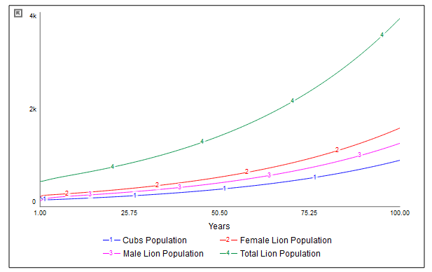
FORECAST of Lion Population if conservation is implemented

Slide 21
CONCLUSION AND RECOMMENDATION
Improving the death rates of cubs can have lot of impact on the total lion population. The following actions can be taken to improve the same
Separate inhabitant can be built inside the sanctuary to protect mothers and immature cubs from mature male lions. This will reduce cub's death from fight for domination
The Pride of Lions can be kept at different places in the park to avoid territorial clashes amongst different prides.
Disease tracking among the lions should be implemented to track and quarantine infected lions to stop further spread of disease among the other lions
From Model 2, we have also observed the dependence on antelopes as a major source of food for lions. Necessary steps should be taken to increase the population of antelopes. Further, new sources of food should be introduced to decrease the dependence on antelopes.

Slide 22
REFERENCES
[1] “Gir National Park.” Wikipedia, Wikimedia Foundation, 15 Apr. 2020, en.wikipedia.org/wiki/Gir_National_Park.
[2] “Asiatic Lion.” Wikipedia, Wikimedia Foundation, 3 May 2020, en.wikipedia.org/wiki/Asiatic_lion.
[3] Raghu, Sunil. “Fight for Territory Leads to Death of 11 Lions in Gir.” Deccan Herald, DH News Service, 21 Sept. 2018, www.deccanherald.com/national/fight-territory-leads-death-11-693862.html.
[4] SBS Australia. “The New Threat Faced by India's Asiatic Lions.” SBS Your Language, 10 Aug. 2018, www.sbs.com.au/language/english/the-new-threat-faced-by-india-s-asiatic-lions.
[5] Wang, Melissa. “Hawaiian Monk Seal Preservation Simulation.” SYS 611, Stevens Institute of Technology, 3 May 2012, sit.instructure.com/courses/37475/files/5478434?module_item_id=815745.
[6] Geller, Michael. “Deer-Lion-Food w Variable Kill Lion Rate New Food Eq.” Systems Modeling and Simulation, Stevens Institute of Technology, 2020, sit.instructure.com/courses/37475/files/5494771?module_item_id=816690.
[7] Banerjee, Kausik & Jhala, Yadvendradev. (2012). Demographic parameters of endangered Asiatic lions (Panthera leo persica) in Gir Forests, India. Journal of Mammalogy. 93. 1420 - 1430. 10.1644/11-MAMM-A-231.1.

