Slide 1
SECURE BANK
SECURE
NETWORK
BANK
Network Design & Security Project
Presented by: Manisha Chaudhari
Confidentiality • Integrity • Availability

Slide 2
Project Overview
A layered network design for a secure banking environment
01
Secure Banking Environment
02
Controlled Connectivity
03
Reliable Services
Design a secure and reliable network that protects customer data, transactions, servers, and internal systems.
Connect departments safely using segmentation, access control, and clearly defined traffic paths.
Support critical banking applications while maintaining availability and simplifying troubleshooting.
Core design principle
Defense in depth
Use multiple security layers—segmentation, ACLs, controlled server access, and monitoring—so one failure does not expose the entire network.
SECURE BANK NETWORK • Network Design & Security Project

Slide 3
Project Objectives
The security goals guiding the proposed design
01
Confidentiality
02
Integrity
Protect sensitive banking and customer information.
Prevent unauthorized changes to data and transactions.
03
Availability
04
Monitoring
Keep critical banking services accessible and reliable.
Detect suspicious activity and support quick response.
Security objective: allow business traffic while blocking unnecessary or unauthorized access.
SECURE BANK NETWORK • Network Design & Security Project
3

Slide 4
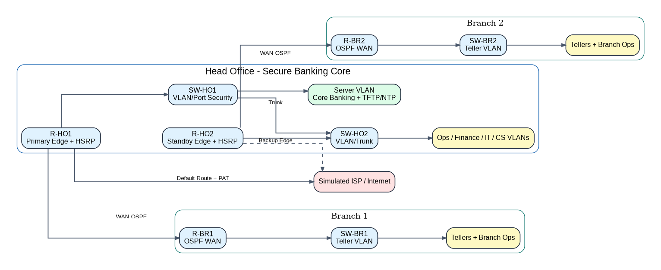
Reference architecture
Banking Network
4

Slide 5
Network Architecture
High-level traffic path from external connectivity to protected internal resources
Application / Web Servers
Internet / WAN
Edge Router + ACL
Core Network + VLANs
Database / Admin / Users
Router
Switches + VLANs
Servers
Connects different networks and applies controlled routing/ACL policies.
Separate departments into logical security zones.
Provide application services and store protected banking data.
SECURE BANK NETWORK • Network Design & Security Project

Slide 6
Main Network Devices
Key components and their role in the secure design
01
Router
02
Switches
Connects different networks and controls traffic between network segments.
Connect users and devices and provide VLAN-based segmentation.
03
Application / Web Servers
04
Database Server
Host banking applications and services that users are authorized to access.
Stores sensitive banking information and should be reachable only by authorized application/admin traffic.
SECURE BANK NETWORK • Network Design & Security Project

Slide 7
6
IP Addressing & VLAN Segmentation
VLAN 10 – Operations
VLAN 20 – Finance
VLAN 30 – Customer
VLAN 40 – IT Admin
Employee workstations & office devices
Finance systems & transaction devices
Customer service workstations
Network devices & admin access
VLAN 50 – Bank Server
VLAN 99 – Management
VLAN 110 – Branch 1
VLAN 120 – Branch 2
Core banking application & DB servers
Dedicated device management traffic
Remote branch office network
Remote branch office network
VLAN segmentation isolates departments from one another and reduces unnecessary broadcast traffic, so each business function operates on its own logical network even while sharing the same physical switching infrastructure.

Slide 8
Secure Traffic Flow
Only authorized traffic should move between security zones
User / Customer
ACL Check
Application Server
Database
Response
Request → policy check → application processing → protected data access → response
ACL
Segmentation
Monitoring
Allow only required source/destination traffic.
Keep users, servers, and admin access separated.
Review traffic and investigate unusual behavior.
SECURE BANK NETWORK • Network Design & Security Project

Slide 9
Routing & Redundancy
OSPF – Area 0
Gateway Redundancy – HSRP / FHRP
Head Office Router
Virtual Gateway IP
Branch 1 Router
Branch 2 Router
Router A – Active
Router B – Standby
Single OSPF Area 0 routes traffic between Head Office and both branches.
Each router advertises a unique Router ID used for neighbor identification.
Dynamic routing lets the network adapt automatically to link changes.
Router A and Router B share one virtual gateway IP address for end devices.
If the active router fails, the standby router takes over automatically.
The backup gateway keeps connectivity active with no manual reconfiguration.

Slide 10
HSRP Gateway Redundancy
High availability at the Head Office edge — users keep the same default gateway during router failure
HOW HSRP WORKS
VLAN 10 — EXAMPLE
R-HO1
R-HO2
R-HO1
192.168.10.2
Priority 110
ACTIVE
STANDBY
R-HO2
192.168.10.3
Standby
Virtual Gateway
192.168.10.1
Virtual GW
192.168.10.1
Users' default gateway
R-HO1 is preferred as the active gateway.
R-HO2 remains ready to take over.
Users point to one virtual gateway IP.
Failure test → R-HO1 fails → R-HO2 becomes Active
Failover happens automatically if the active router fails.

Slide 11
Default Route + PAT to the Simulated ISP
1
User VLANs
2
HSRP Gateway
3
R-HO1
4
PAT
5
ISP / Internet
10 / 20 / 30 / 40/110/120
Virtual GW
Active Edge
Private → Public
External Network
Return traffic follows the translated public session back through the ISP to the active edge, then to the originating user.
DEFAULT ROUTE
PAT
BUSINESS RESULT
R-HO1 forwards external traffic toward the simulated ISP.
Private IP addresses are translated for outbound Internet access.
Users reach external services while private IPs stay internal.

Slide 12
Network Security & Secure Management
1
SSH provides secure, encrypted remote management of network devices.
2
VLAN 99 is dedicated exclusively to management traffic, separated from user data.
3
Port security with sticky MAC addresses restricts switch ports to authorized devices.
4
Access-class restrictions limit which hosts can reach device management interfaces.
5
ACL-based traffic filtering enforces controlled communication between all VLANs.
Security Layers
VLAN
ACL
Port
SSH
NAT / PAT
Segmentation
Security

Slide 13
Security Controls
Practical controls that strengthen the proposed bank network
01
Access Control
02
Network Segmentation
03
Secure Server Access
Use ACLs and least-privilege rules to restrict unnecessary traffic.
Keep departments and sensitive resources in separate VLANs/zones.
Limit database access to approved application and administrator paths.
04
Monitoring & Logging
05
Backup & Recovery
06
Change Management
Monitor traffic, review logs, and investigate suspicious activity.
Maintain tested backups and recovery procedures for critical services.
Document configuration changes and verify them after implementation.
SECURE BANK NETWORK • Network Design & Security Project

Slide 14
Benefits of the Design
How the architecture supports banking operations
01
Data Protection
02
Reduced Exposure
Improved protection of customer and financial data.
Reduced impact of unauthorized access and network attacks.
03
Traffic Control
04
Scalability
Better control of internal and external traffic.
Architecture can grow with future banking services.
05
Troubleshooting
Centralized monitoring and documented segmentation make issues easier to isolate.
Business outcome: secure access without unnecessary complexity.
SECURE BANK NETWORK • Network Design & Security Project

Slide 15
Conclusion
A secure bank network requires layered security.
Segmentation and access control limit unnecessary exposure.
The proposed design balances security, reliability, and scalability.
CONFIDENTIALITY • INTEGRITY • AVAILABILITY
SECURE BANK NETWORK • Network Design & Security Project

Slide 16
THANK YOU
Secure Bank Network — Network Design & Security Project
SECURE BANK NETWORK • Network Design & Security Project

