Slide 1
Proxy-Mail
By:
(Team Name: Networ-KING)
Bala Sai Teja Gaddam
Teja Mosali
Manisha Kattukuri
Tejaswini Nalamotu

Slide 2
Project Goal
Determining whether the request is made from a mobile device or desktop device.
We are using proxy server and Java MailCilent along with browser fingerprinting to achieve the project goal.

Slide 3
System Design
LAN settings to proxy server
Requesting a web page
EmailProxy.java
Message box
Sending mail
MailJavaApp

Slide 4
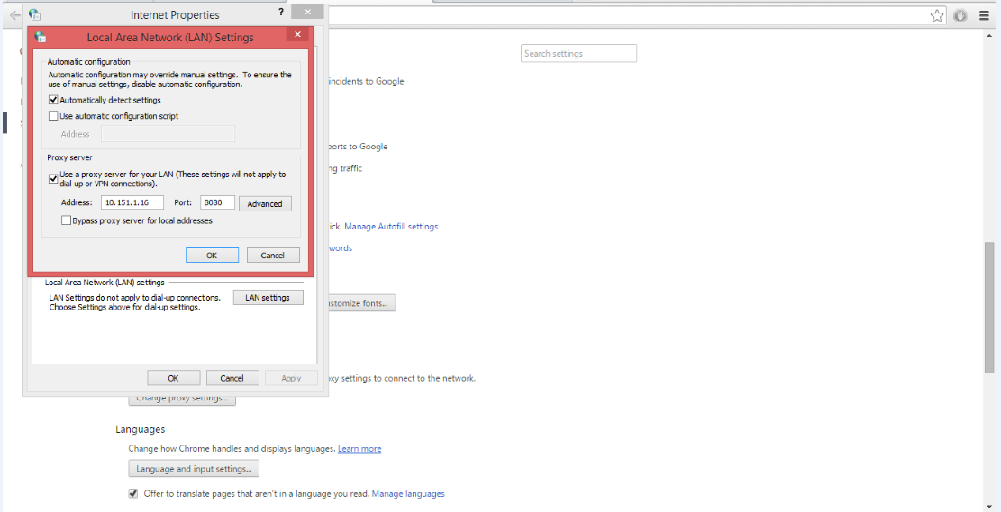
Changing Local Area Network settings to proxy

Slide 5
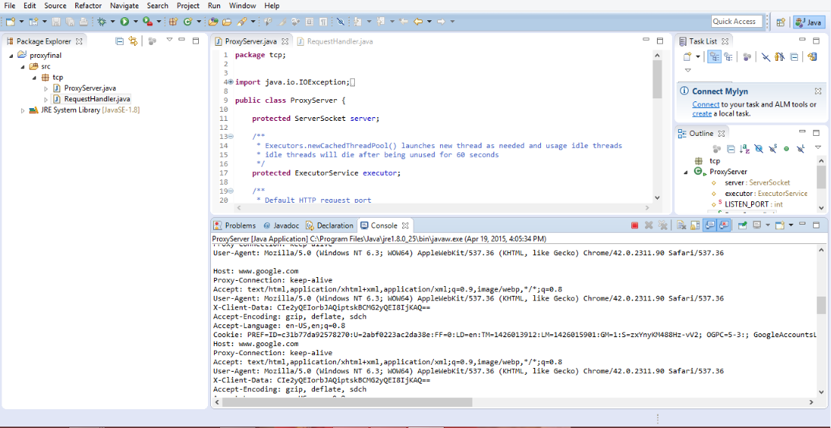
Creating proxy server using EmailProxy.java

Slide 6
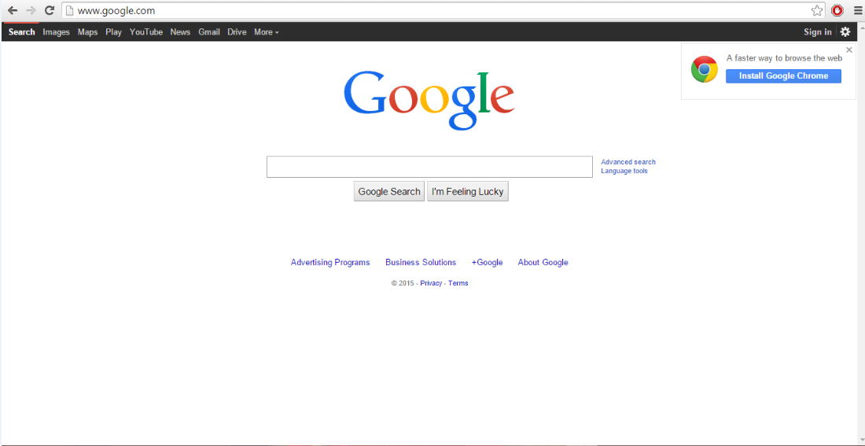
Requesting a Webpage or Website

Slide 7
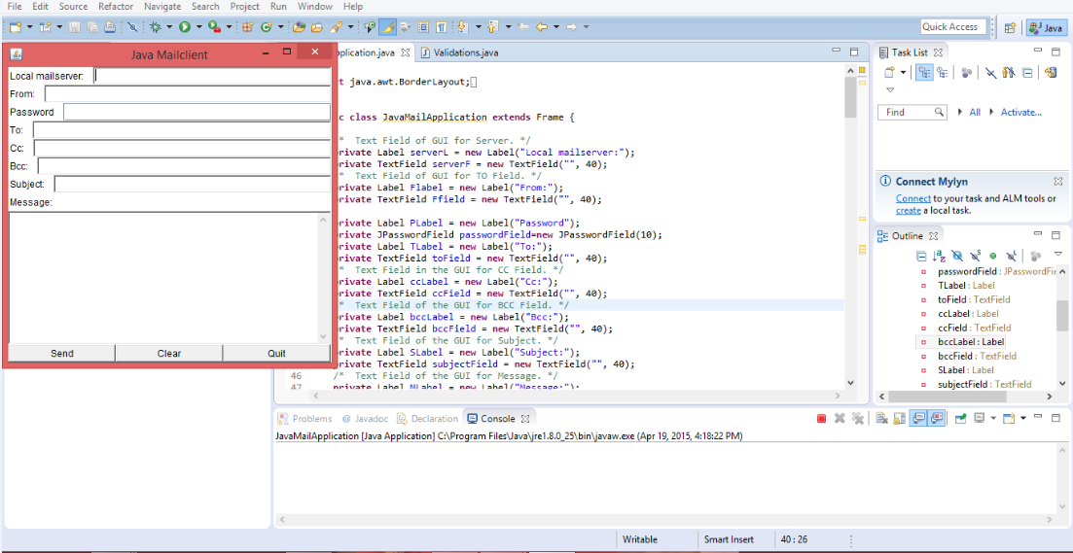
Creating MailJavaApp

Slide 8
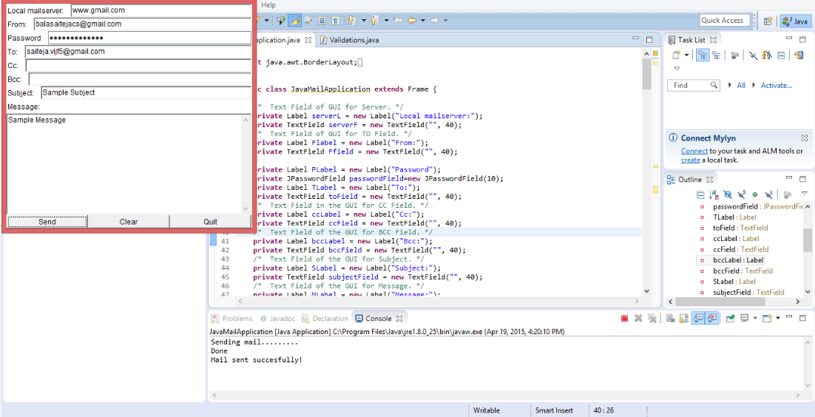
Cont..

Slide 9
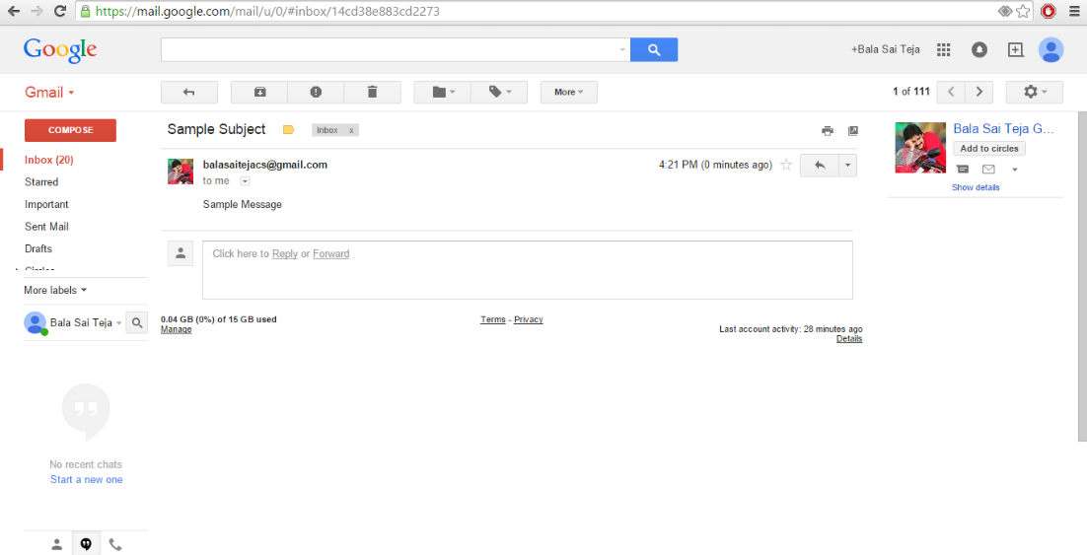
Sending mail

Slide 10
Conclusion
If the mail is opened using a mobile device, message will be displayed saying “It is opened on mobile device”.
If the mail is opened using a desktop device, message will be displayed saying “It is opened on desktop device”.

