Slide 1
Ambulance: Dijkstra’s Algorithm
Cameron Wheeless II
Jahnavi
Manisha

Slide 2

Application:
An ambulance needs to get from one place to another as quickly as possible in the time of an emergency. Generally, the shortest route will be the fastest route. This means that Dijkstra's algorithm would work great for a road network like that of which an ambulance would need.

Slide 3
Behind the Scenes
Back-End

Slide 4
File Reading
readBuildings():
Take in strings from a file and assign them to indexes to create a list of locations for the user to read.
readMatrix():
Take in a text file of numbers in the style of an NxN matrix where N is the number of buildings that have been assigned.
A value of 0 represents the lack of a connection to another vertex.
Any value greater than 0 represents a connection to another vertex.

Slide 5
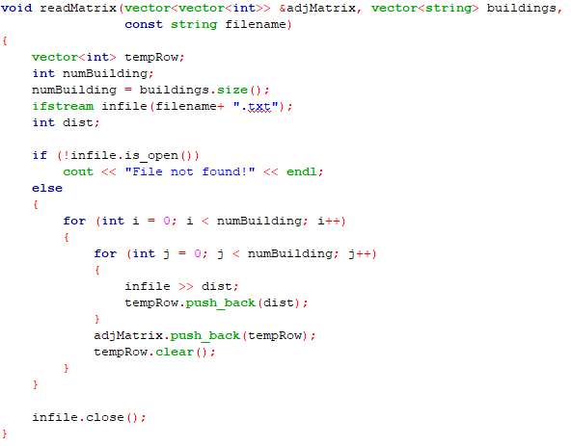
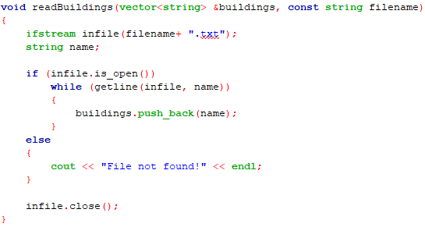

Slide 6
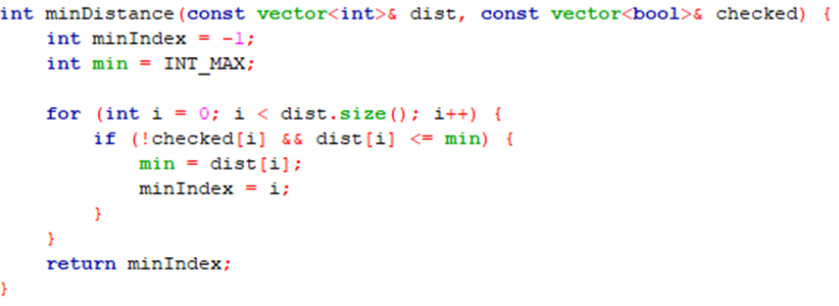
Dijkstra's Algorithm
Initializes the matrix and vectors to set the starting and ending indexes.
All distances are set to a constant large value except for the start index being set to 0.
The function iterates through the vertices setting their distance by using the minDistance() function.
minDistance():
Function made to find the vertex with the minimum distance and then assign its index to a value.
The function goes through and checks each path, updating the path if it finds a vertex with a connected value.
The final step is to output the shortest distance from the starting vertex (the hospital) to the ending vertex. It is shown by way of backtracking.

Slide 7
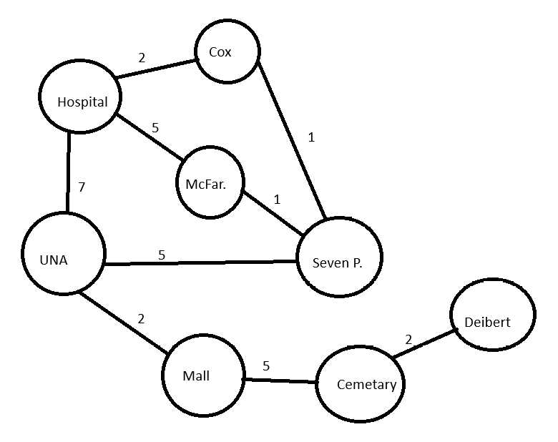
Fictional Recreation of Florence in Distances
For this instance, the distance in miles between locations has been remade inside of this graph.
The places listed are:
Hospital (North Alabama Medical Center) Cox Creek McFarland Park UNA Seven Points Florence Mall Florence Cemetery Deibert Park

Slide 8
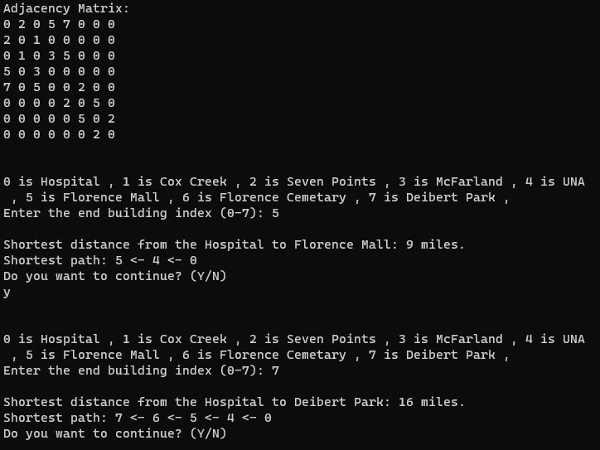
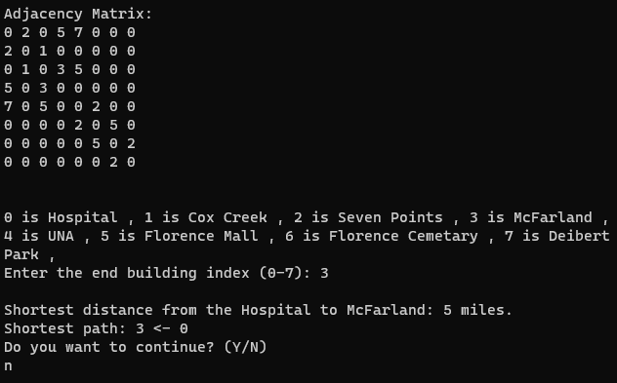
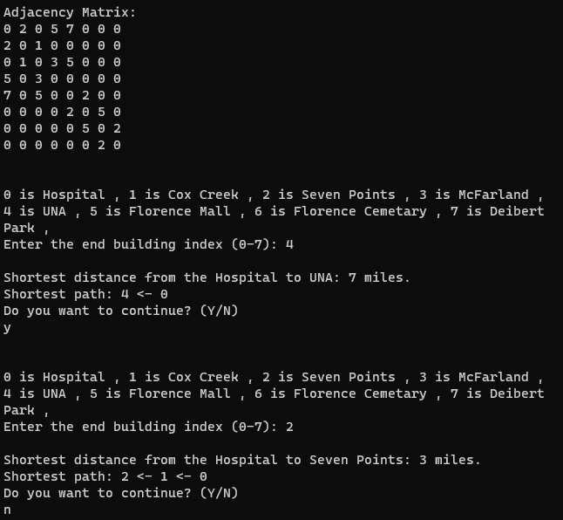
Test Case
Hospital to F.M. Hospital to D.P.
Hospital to McF.
Hospital to UNA
Hospital to 7P.

Slide 9




Thank you
Cameron Wheeless II
Jahnavi
Manisha

Slide 10



References
GeeksForGeeks
https://www.scaler.com/topics/data-structures/dijkstra-algorithm/
Professor Etheredge

