Slide 1

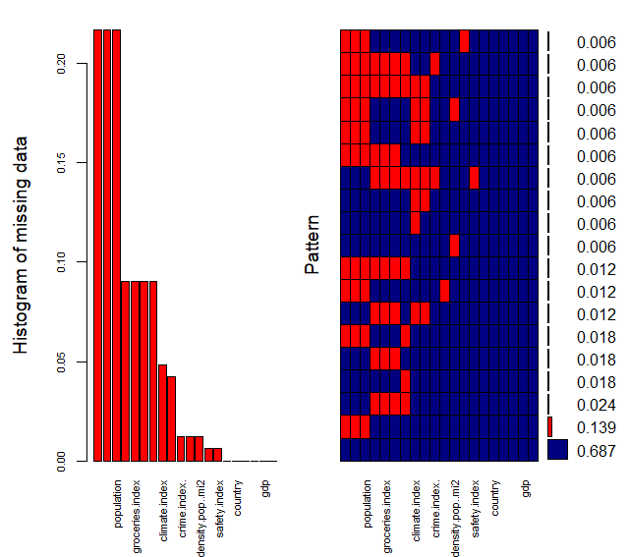
Imputing Missing values in the data
Checking the missing the values in the dataframe

Slide 2
Using K Means clustering to Impute the missing values
Library (Clustimpute)
ClustImpute( X, nr_cluster, nr_iter, c_steps,n_end , wf = default_wf)
X : Data frame with only numeric values or NAs
nr_cluster : Number of clusters
nr_iter : Iterations of procedure
c_steps : Number of clustering steps per iteration
Wf : Weight function. linear up to n end by default
n_end : Steps until convergence of weight function to 1
Default weight function. One minus the return value is multiplied with missing(=imputed) values. It starts with 1 and goes to 0 at n_end.

Slide 3
Algorithm of K Means Cluster Imputation
It replaces all NAs by random imputation, i.e., for each variable with missings, it draws from the marginal distribution of this variable not taking into account any correlations with other variables
Weights <1 are used to adjust the scale of an observation that was generated in step 1. The weights are calculated by a (linear) weight function that starts near zero and converges to 1 at n_end.
A k-means clustering is performed with a number of c_steps steps starting with a random initialization.
The values from step 2 are replaced by new draws conditionally on the assign cluster from step 3.
Steps 2-4 are repeated nr_iter times in total. The k-means clustering in step 3 uses the previous cluster centroids for initialization.
After the last draws a final k-means clustering is performed.
The intuition is that observation should be clustered with other observations mainly based on their observed values, while the resulting clusters provide donors for the missing value imputation, so that subsequently all variables can be used for the clustering.

Slide 4
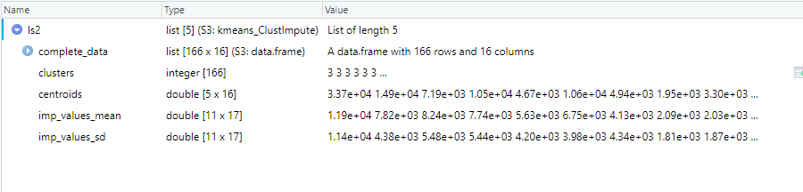
Results of the Imputation
Complete_data : Results consists of a dataframe with imputed values
Clusters : The cluster numbers to which each record belongs to.
Centroids : The centroids of each cluster
Imp Values Mean : The mean of imputed values after each iteration.
Imp Values sd : The mean of imputed values after each iteration.

Slide 5
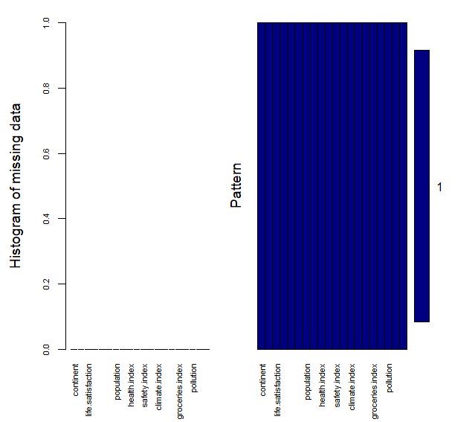
Checking for Missing values after imputation
No missing values
After looking at the results, I happen to see something about the clusters.
Plotting the clusters respective to each variable. (As we can’t plot the centroids as we have more than two dimensions – too many variables)

Slide 6
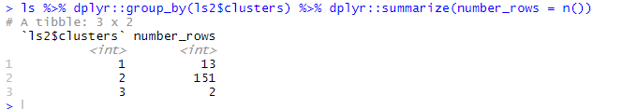
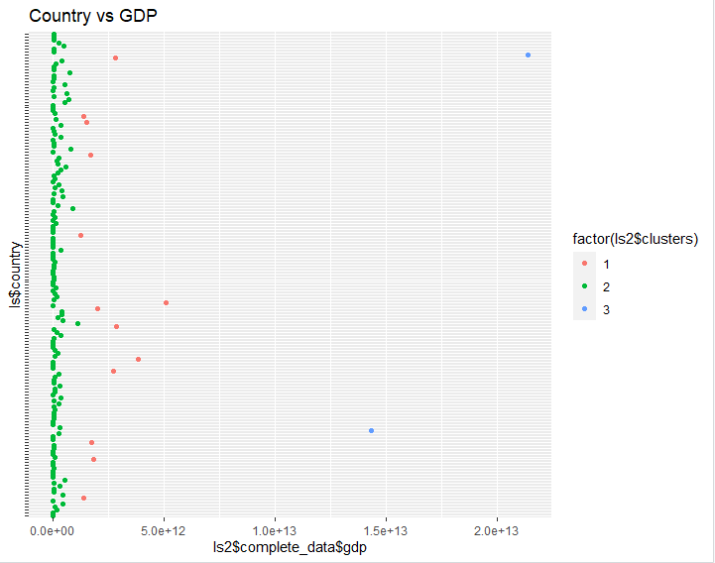
Number of records in each Cluster
Plot of country vs gdp with cluster indication.
As the GDP values are very high when compared to other variables, the clusters are clearly divided by GDP values.
We want the K means to consider all the variables and create clusters.
So, we scaled GDP to 1000’s and re run the imputation process on the modified data
Increasing the clusters also seems like a good idea as we don’t want most of the data in a single cluster.

Slide 7
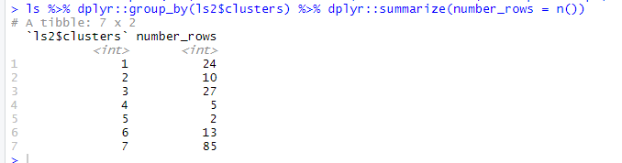
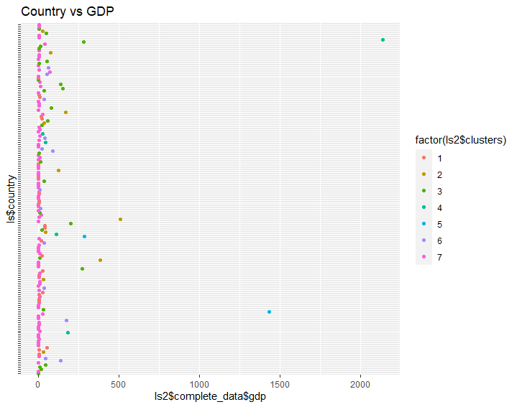
Number of records in each Cluster.
(7 Clusters)
Plot of country vs gdp with cluster indication.
Even after scaling there exists to be a cluster with only two records and the reason is GDP. But, we are able to divide the other two clusters better than last time.

