Slide 1
MRA MILESTONE - 1
Marketing & Retail Analytics
MANISHA PARAKANDLA

Slide 2
CONTENTS:
Agenda & Executive Summary of Data
Exploratory Analysis and Inferences
Customer Segmentation Using RFM Analysis
Inferences from RFM Analysis and identified segments

Slide 3
This project aims to find the underlying buying patterns of the customers of an automobile part manufacturer based on the past 3 years of the Company's transaction data and hence recommend customized marketing strategies for different segments of customers.
Problem Statement:
An automobile parts manufacturing company has collected data of transactions for 3 years. They do not have any in-house data science team, thus they have hired you as their consultant. Your job is to use your magical data science skills to provide them with suitable insights about their data and their customers.
Sales Dataset : Sales_Data.xlsx

Slide 4
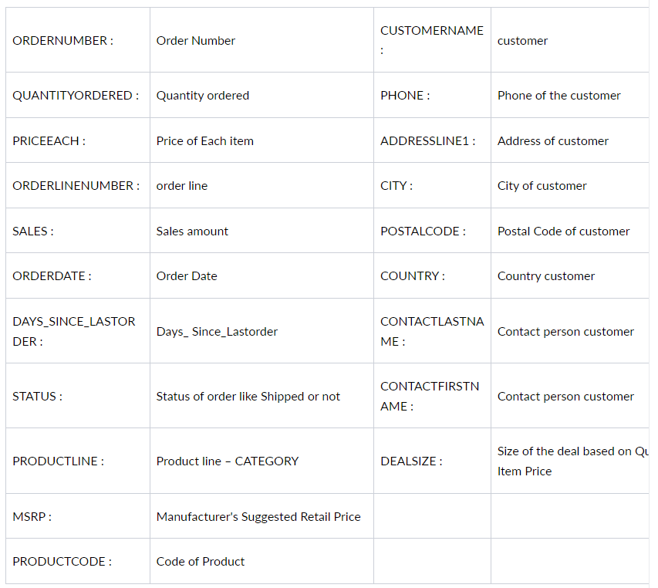
Data Dictionary

Slide 5
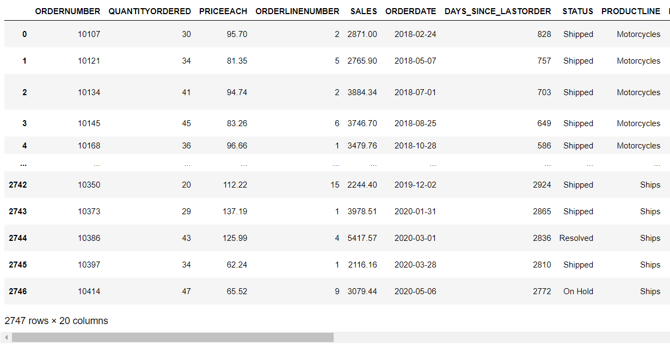
Exploratory Data analysis using python
Reading the dataset: The dataset is having 2747 rows and 20 columns

Slide 6
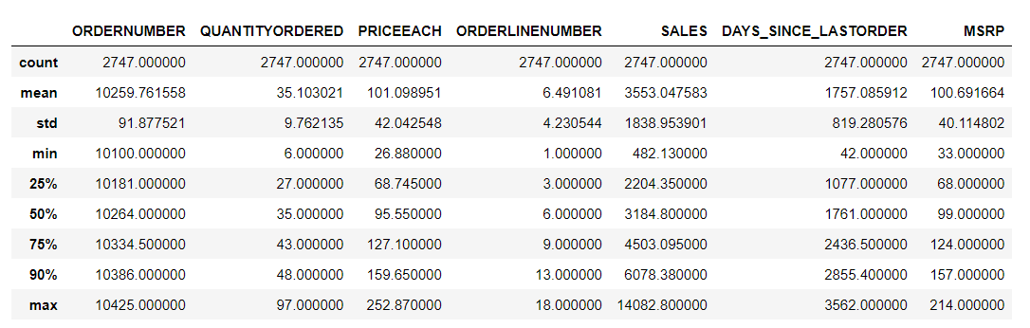
Description of the Data:
The data is measured using the central measures for all the categorical variables, which tells how the data is distributed, deviated or centrally aligned. The five number summary of the dataset is understood from the below table.

Slide 7
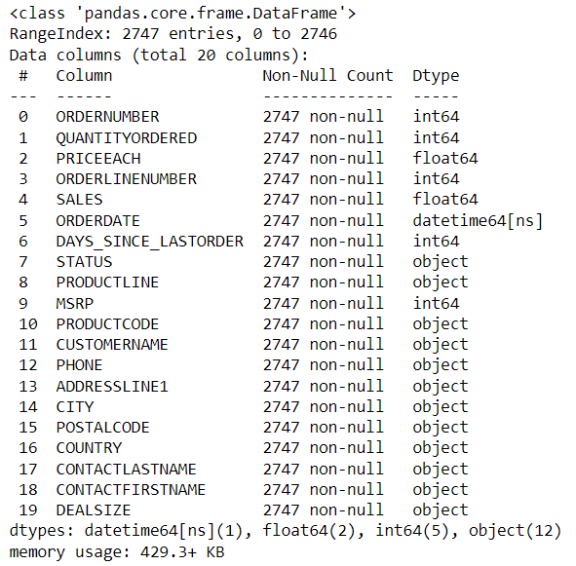
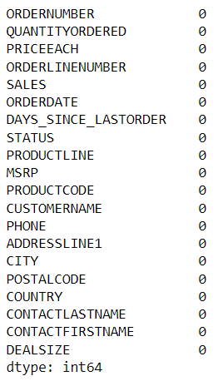
The dataset is having 20 variable columns
From the info function, we can see that most of the columns are of object datatype.
ORDERDATE is of datetime datatype.
SALES & PRICEEACH are of float datatype and the rest are integer datatype.
The dataset does not have any NULL / Missing values in the data.
The dataset does not have duplicate values present in the data.

Slide 8
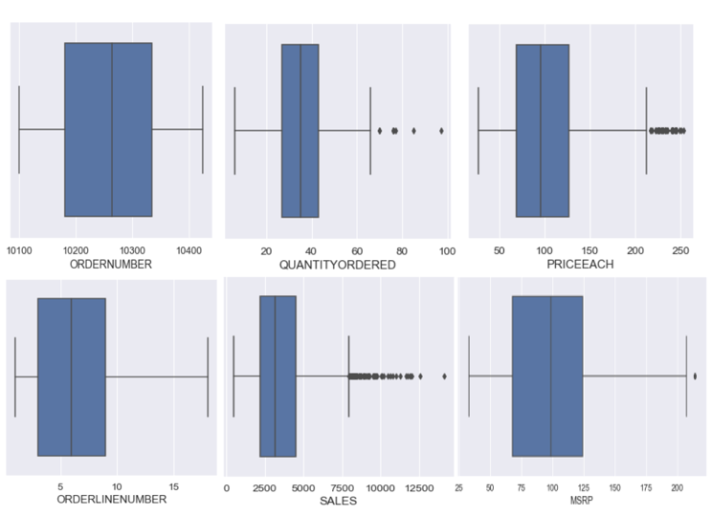
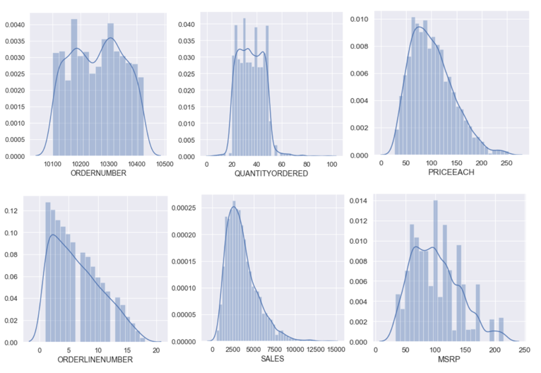
Boxplot for checking Outliers & Histogram for checking distribution
We can observe that, 4 features are having outliers. Sales variable is having more outliers.
Most of the data is Normally distributed.

Slide 9
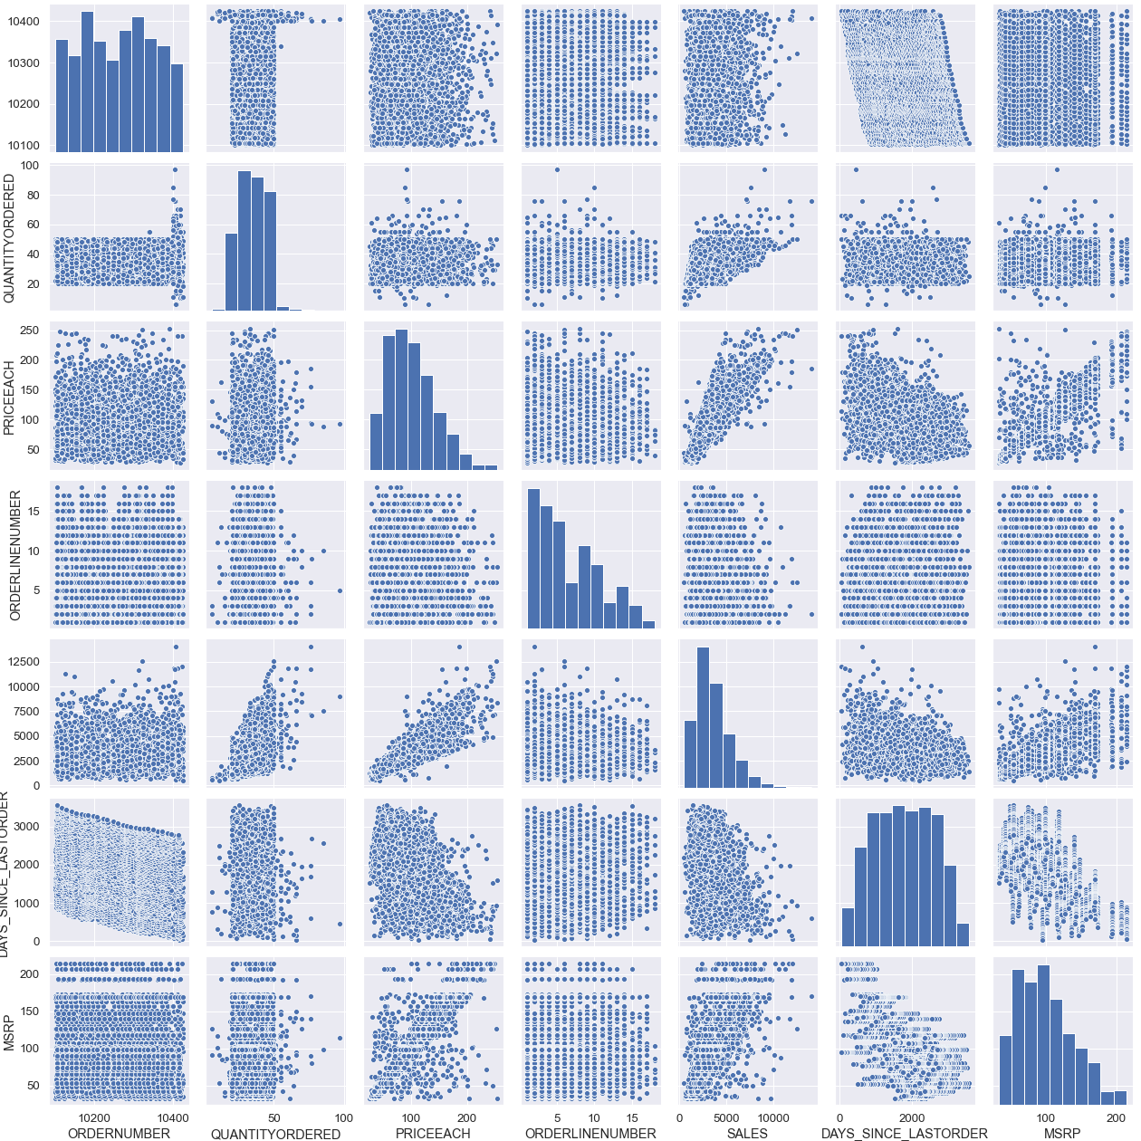
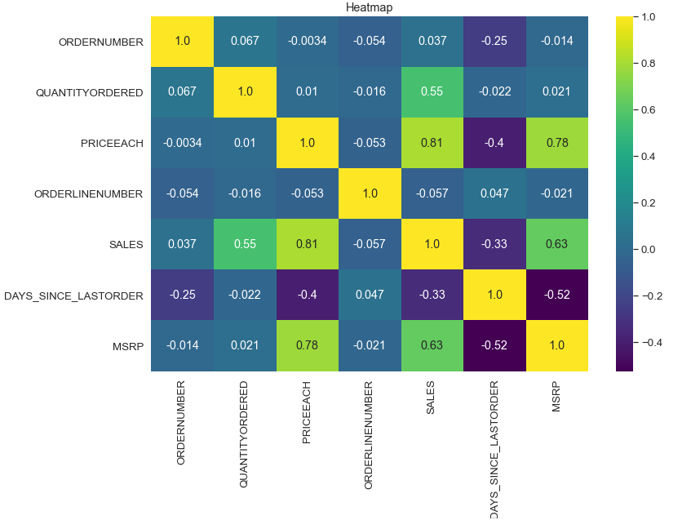
Pair plot & Heatmap
From multivariate analysis,
PRICEEACH is highly correlated with MSRP.
SALES is highly correlated to PRICEEACH

Slide 10
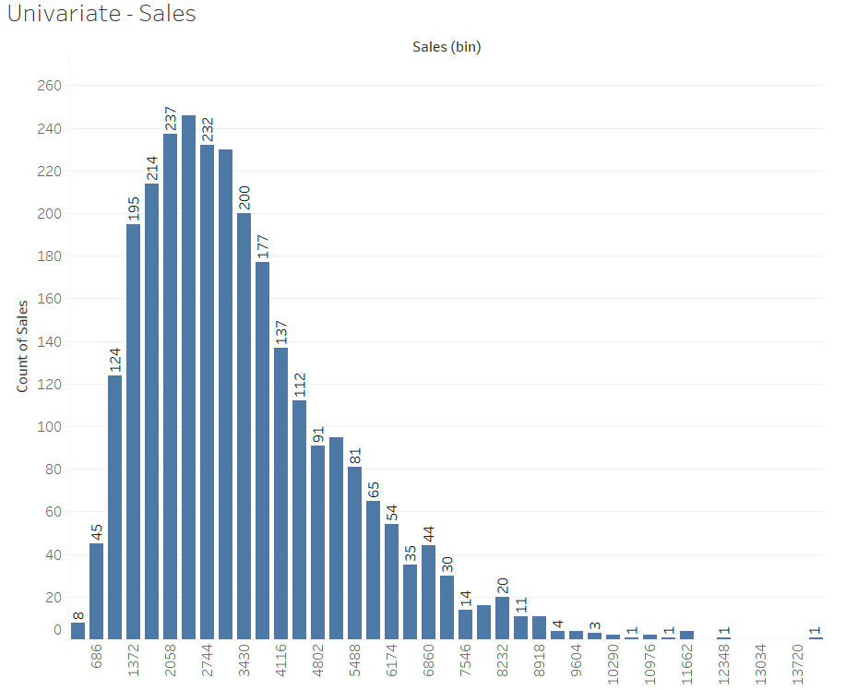

EXPLORATORY DATA ANALYSIS USING TABLEAU
EDA performed using tableau. TABLEAU public URL :
https://public.tableau.com/app/profile/manisha.parakandla/viz/MRA_MIlestone1_mp/RFMAnalysis
Univariate Analysis:
Both Sales and Monetary are right skewed.

Slide 11
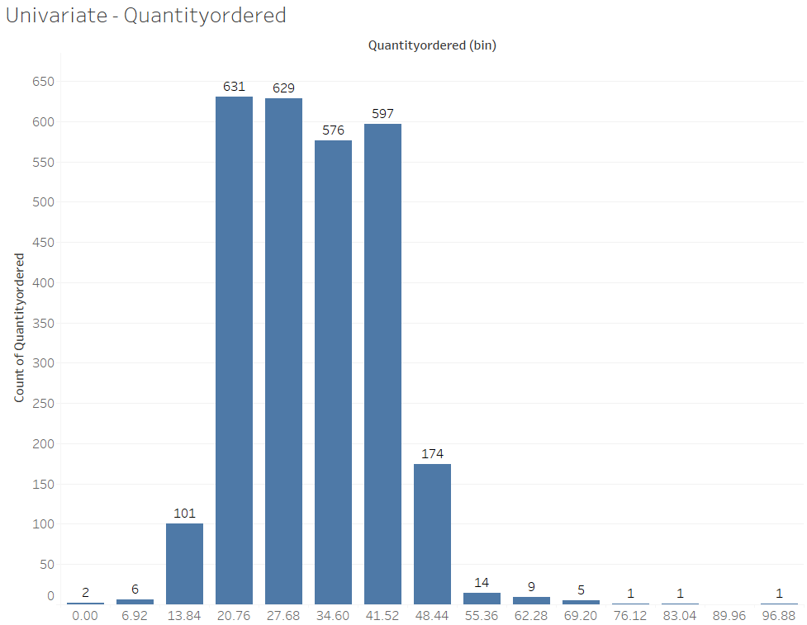
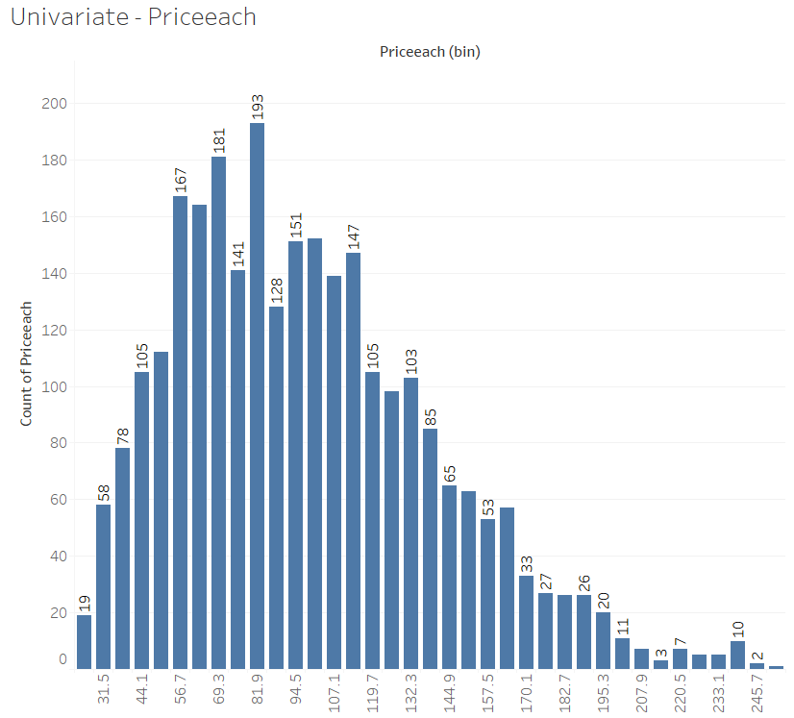
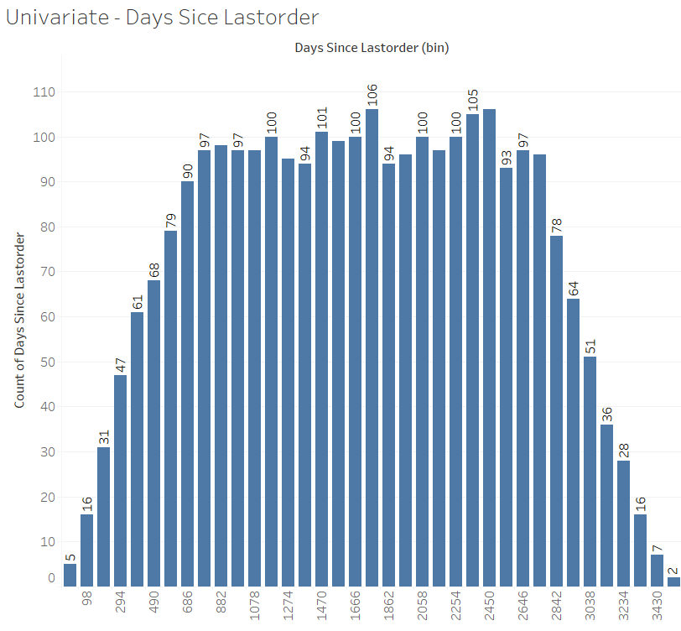
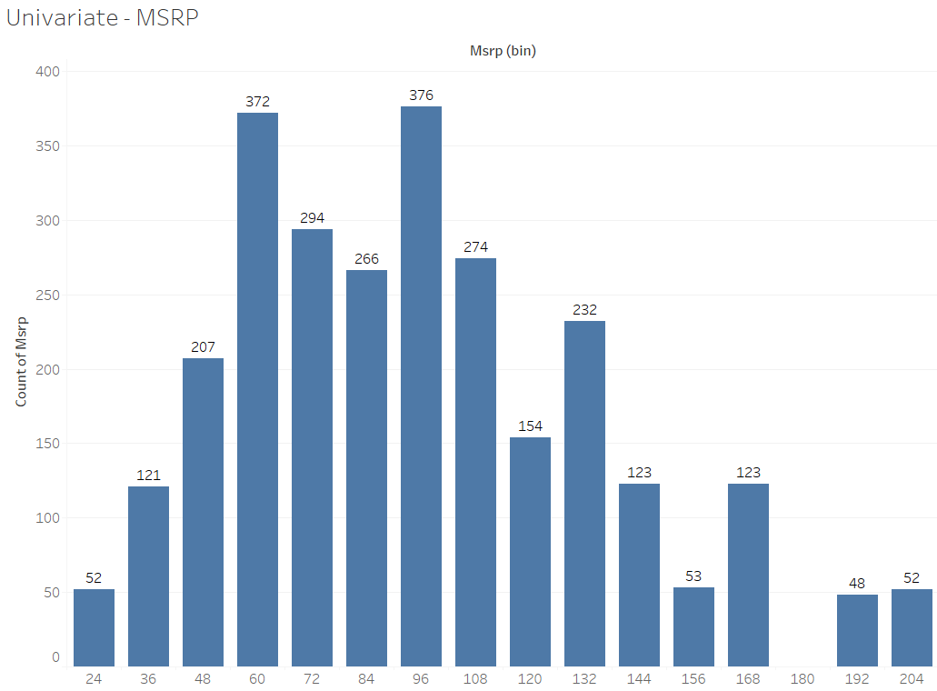
Lets check the Skewness of the other variables as well.

Slide 12
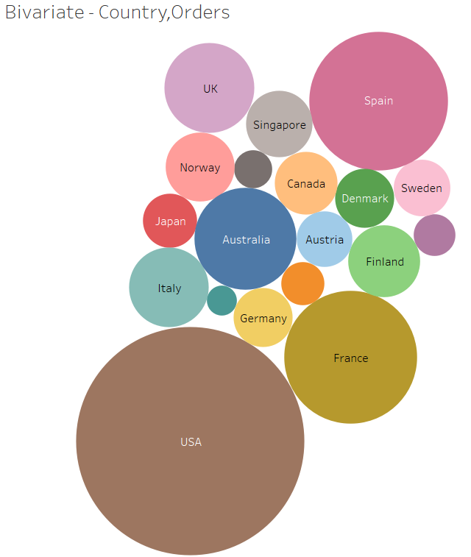
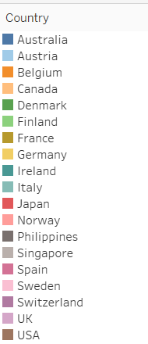
Bivariate Analysis:

Slide 13
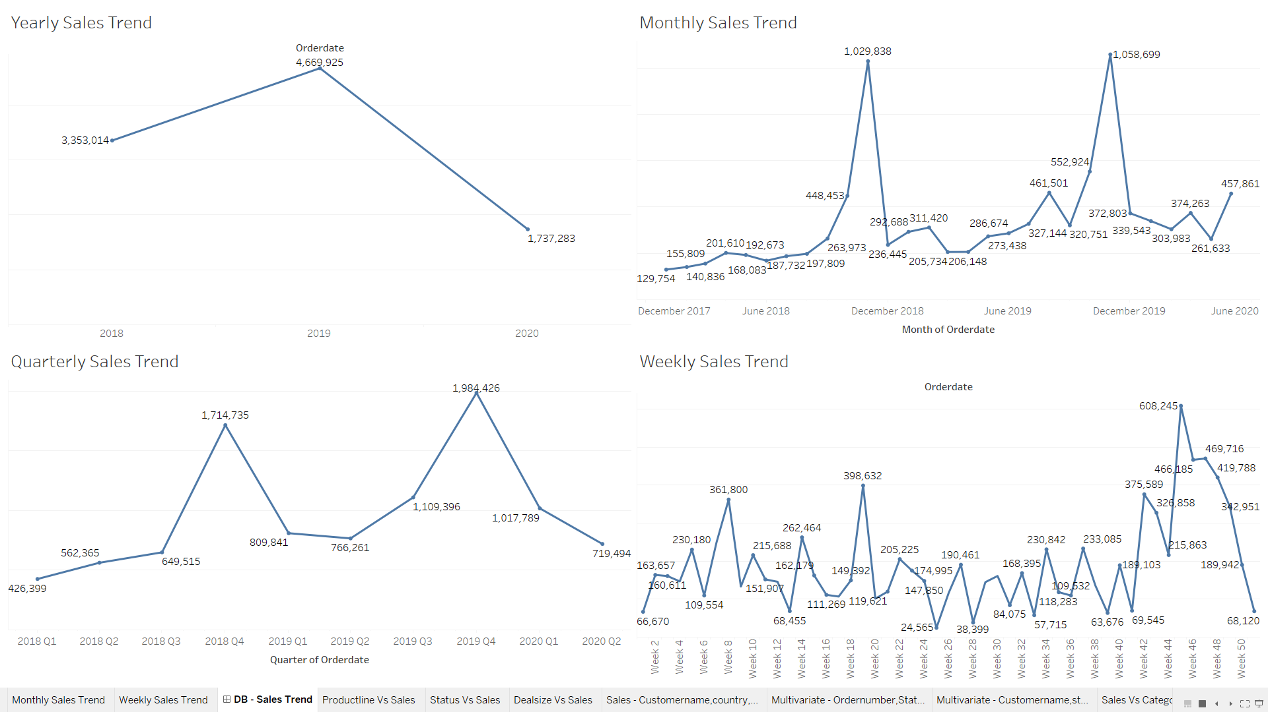
Sales Trends(Yearly, Quarterly, Monthly, Weekly)

Slide 14
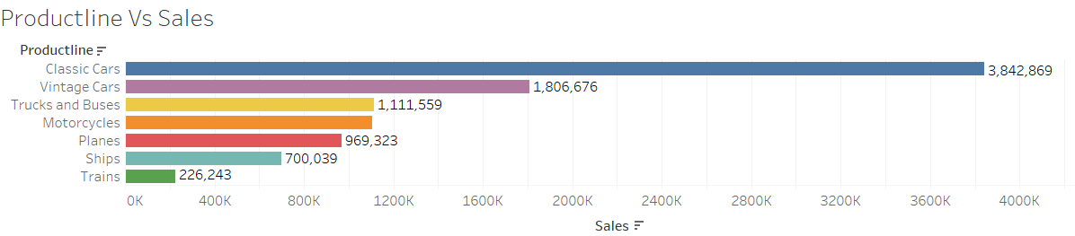
1. Sales in yearly trend is decreasing in 2020 from 2018. Whereas 2019 is having reportedly highest sales.
2. Quarterly & Monthly sales are having increasing trend and seasonality.
3. We can observe that Q4 is having the highest sales for the year 2018 and 2019 compared to the other quarters.
4. In 2020, Sales are highest in second quarter.
5. For the other quarters, sales are quite low and are on increasing and decreasing trend.
6. Weekly sales are having trend and seasonality in both increasing and decreasing fashion.
Sales Across different Categories of different features in the given data:
Classic Cars are having highest sales.
The flow of sales as per the Product line Classic Cars<Vintage Cars<Trucks and Buses<Motorcycles<Planes<Ships<Trains.

Slide 15
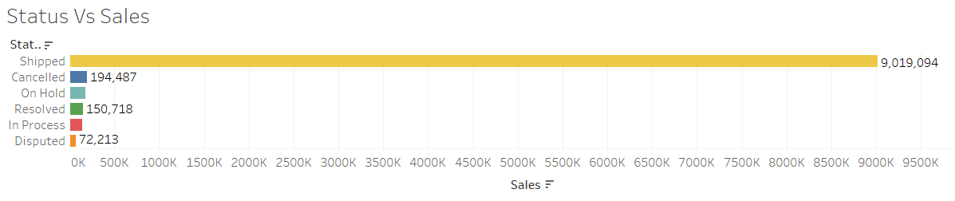
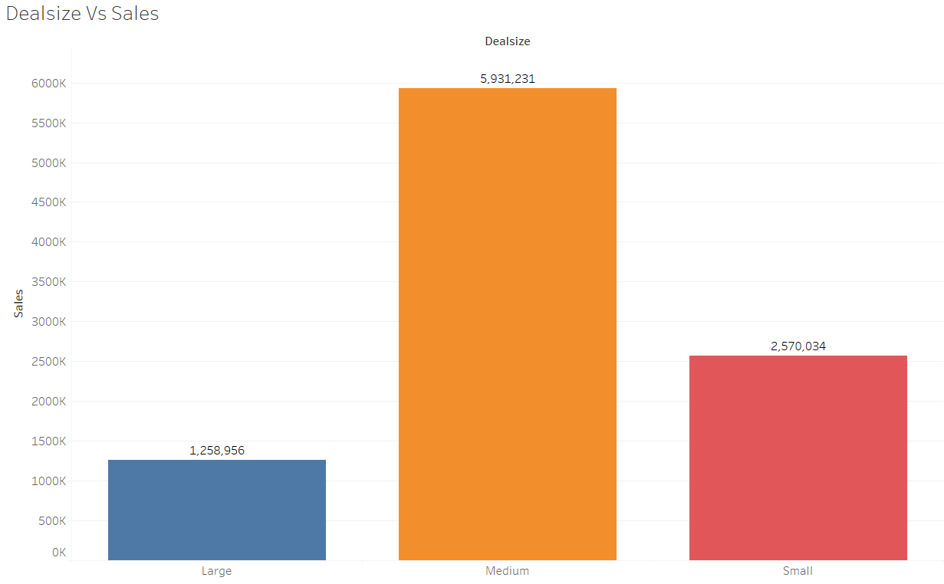
Status Vs Sales:
We can observe that most of the sales are of status shipped. Few orders have been cancelled and few are in progress. Most of the disputed orders are resolved and only few orders are yet to resolved.
The deal size medium are having the highest amount of sales.

Slide 16
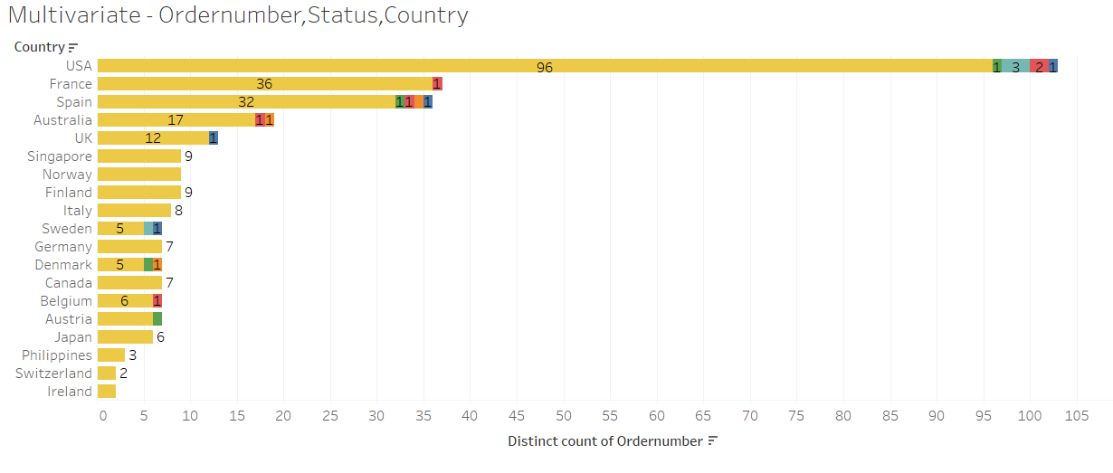
Multivariate Analysis:
USA is the country where highest number of orders placed
France is the second highest.
Spain is also having moderate amount of orders which are almost same to France.

Slide 17
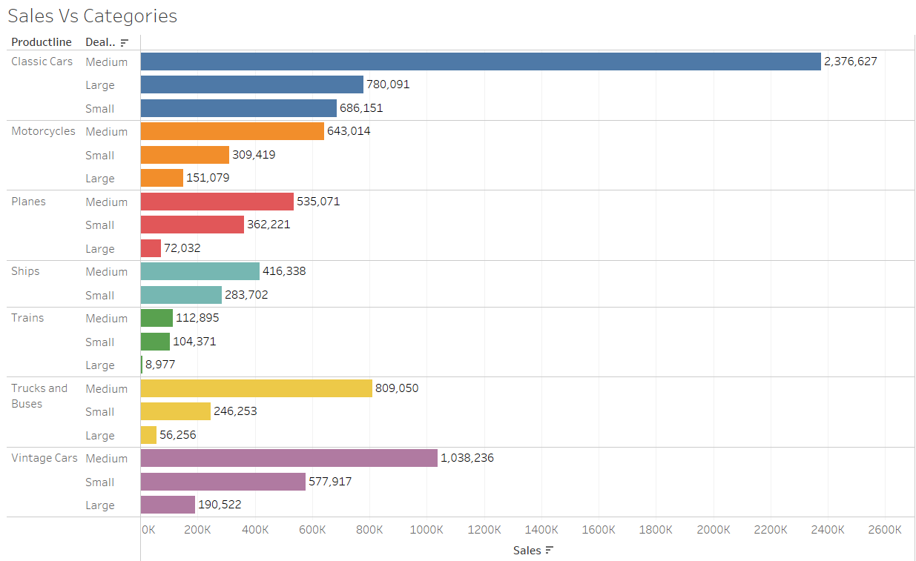
Status Vs Category & Sales:
Classic cars of Medium Deal Size are having the highest sales.

Slide 18
INFERENCE
→ The Medium deal size is almost stagnant over the three years and can be presumed further.
→ The sales of product line like Motorcycles, Ships and trains are in saturation stage and reportedly no scope of sales in them. However the trucks and buses, vintage cars still have scope for sales.
→The major chunk of sales are from 4 – 5 customers mainly. Hence the company is customer driven.
→Company has the most of orders which are disputed in classic cars category and Motorcycles category. Hence, the management should try to resolve these disputes so that sales are not impacted.
→we can observe that, from sales trend the sales are maximum during Q4. The company should concentrate more on balancing the sales in other quarters as well.
→The sales in some countries are very less compared to the USA, France & Spain. The company has to focus on improvement of sales in the countries having less sale.
→The Large size deals are lowest and almost stagnant. The company need to take the necessary actions to promote and attract the customers to buy more of large size deals.
→The company has to focus on cancelled orders to check the reason behind orders getting cancelled and has to work on it.
→The orders which are in Pending and dispute status should be resolved timely, so that this wont create any negative impact to the customers.
→ The Company can Improve and expand the sales by introducing exciting discounts, festive deals, and offer sales, No cost EMI, Low cost EMI which attracts the customers to buy the products.

Slide 19
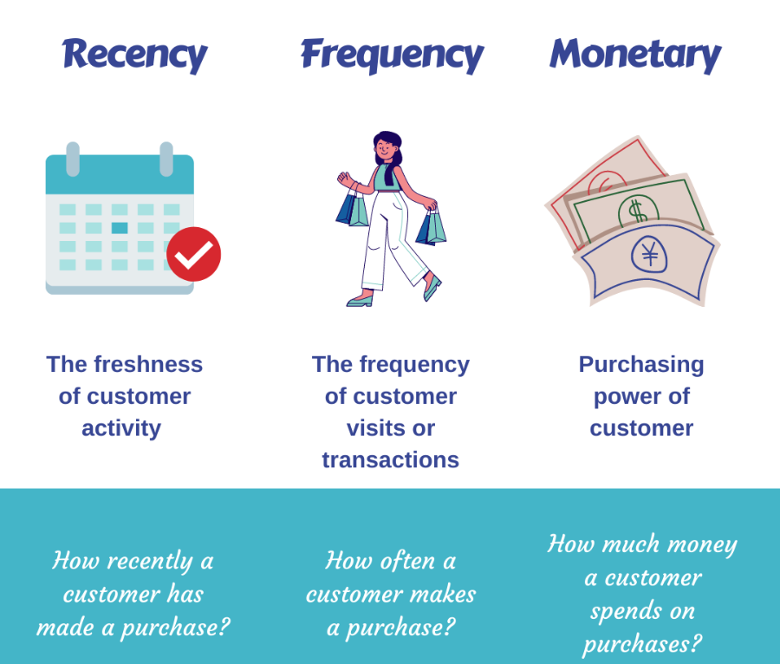
RFM Analysis:
RFM stands for Recency (“R”), Frequency (“F”), and Monetary value (“M”).
RFM represents a segmentation strategy that helps to analyze and split customers into segments based on three variables: Recency, Frequency, and Monetary Value. RFM model allows us to analyze historical transactional data and use this quantitative research to identify different types of customers and group them into segments based on their purchase history.
RFM Metrics:

Slide 20
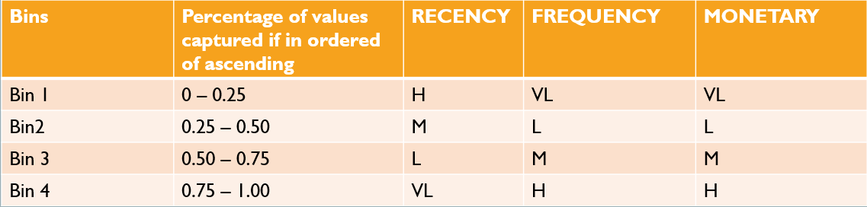
RECENCY: Recency is the most recent customer order which is calculated by taking the difference of MAX[ORDERDATE] & ORDERDATE.
Recency = MAX[ORDERDATE] – ORDERDATE (ORDERDATE – CURRENT DATE)
FREQUENCY: Frequency is how often orders are placed by the customers. We can get this by COUNT(ORDERNUMBER).
Frequency = COUNT(ORDERNUMBER).
MONETARY: Monetary is how much money customer spent on purchase.
Monetary = QUANTITYORDERED * PRICEEACH
I have taken 4 Bins, BIn1, Bin2, Bin3,Bin4. And the Segmentation values for recency, frequency and Monetary are given in below table.

Slide 21
I have performed RFM Analysis in Both Tableau & KNIME. In Tableau I have used all the columns and included all the countries in RFM Analysis.
For RFM Analysis in KNIME,
I have used customers from the country USA only. I have filtered the dataset for country USA.
The column Days Since Last order is removed using column filter.
Created Recency and Monetary metrics whereas the frequency can be obtained just by using COUNT[ORDERNUMBER] while grouping the data.
After that, configured the bins(Bin1,Bin2,Bin3,Bin4) for RFM segmentation.
Concatenated the Recency , Frequency and Monetary binned columns into one column for better understanding and sorted the data in ascending order.

Slide 22
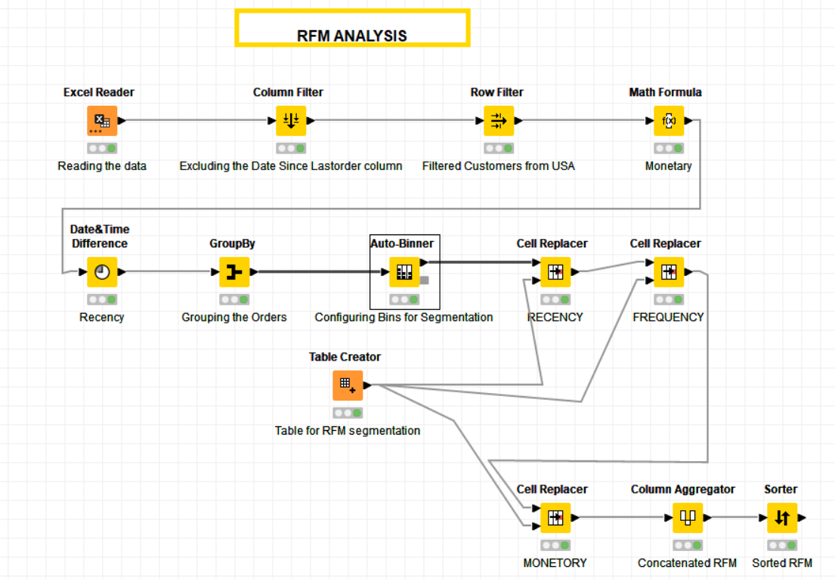
KNIME Workflow

Slide 23
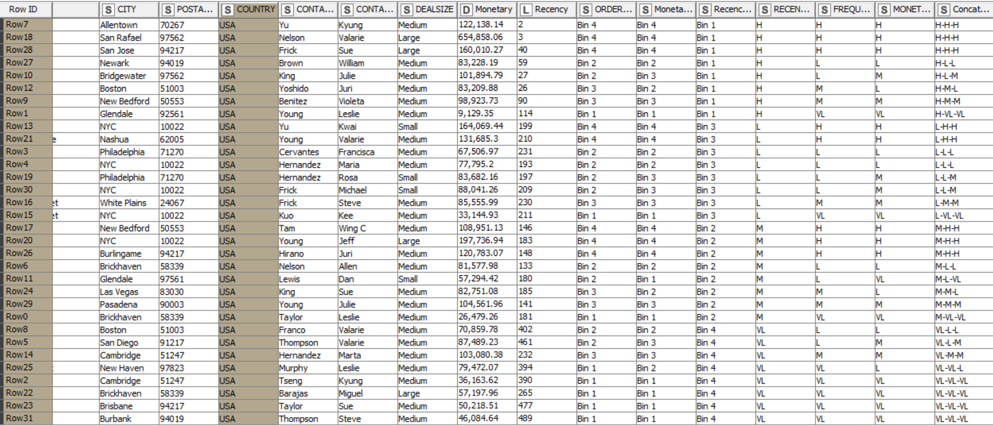
RFM Analysis Segmented

Slide 24
→ Best Customers are those who bought most recent, most often, and are high spenders. The best customers can become the early adopters for new products and they can help promote the brand.
→ Loyal Customers are the most recent customers with average frequency and those who spent a good amount.
→ New Customers are those customers who have a high overall RFM score but are not frequent shoppers. The company can start building relationships with these customers by providing onboarding support. They can also offer some special benefits for this kind of customers to increase their visits.
→ Customers who purchased often and spent big amounts, but haven’t purchased recently are At Risk customers.
→ Customers who used to visit and purchase quite often, but haven’t been visiting recently are the customers company cannot lose.
Inferences from RFM Analysis and identified segments
Best Customers:
Diecast Classics Inc.
Mini Gifts Distributors Ltd.
The Sharp Gifts Warehouse
Tekni Collectables Inc.
Gift Depot Inc.
Gifts4AllAges.com
FunGiftIdeas.com

Slide 25
Customers are on the verge of churning: Lost Customers:
Loyal Customers:
Mini Creations Ltd.
Muscle Machine Inc
Technics Stores Inc.
Collectables For Less Inc.
Gift Ideas Corp.
Super Scale Inc.
Cambridge Collectables Co.
Online Mini Collectables
Signal Collectibles Ltd.
West Coast Collectables Co.
Boards & Toys Co.
Land of Toys Inc.
Online Diecast Creations Co.
Classic Gift Ideas, Inc
Classic Legends Inc.
Motor Mint Distributors Inc.
Vitachrome Inc.
Mini Classics
Microscale Inc.
Mini Creations Ltd.
Muscle Machine Inc
Technics Stores Inc.

