Slide 1
MANISHA.V
Final Project
3/21/2024 Annual Review

Slide 2
FLOWER RECOGNITION USING CNN
3/21/2024 Annual Review

Slide 3


AGENDA
PROBLEM STATEMENT
PROJECT OVERVIEW
WHO ARE THE END USERS?
YOUR SOLUTION AND ITS VALUE PROPOSITION
THE WOW IN YOUR SOLUTIONS
MODELLING
RESULTS
3/21/2024 Annual Review

Slide 4

PROBLEM STATEMENT
Flower recognition plays a crucial role in various domains such as agriculture, environmental monitoring, and botany. With the advancement of computer vision techniques, automated flower recognition systems using Convolutional Neural Networks (CNNs) have gained significant attention. The problem statement revolves around developing an efficient and accurate flower recognition system using CNNs to classify images of flowers into predefined categories.
The objective of this project is to develop a robust flower recognition system using Convolutional Neural Networks (CNNs). With the proliferation of digital imagery, there's a growing need for automated systems capable of accurately identifying and classifying flower species from images. The primary aim is to address this need by leveraging deep learning techniques to build a CNN-based model capable of accurately recognizing and classifying various types of flowers.
3/21/2024 Annual Review

Slide 5

PROJECT OVERVIEW
The Flower Recognition Using Convolutional Neural Networks (CNN) project seeks to harness deep learning techniques to automate the identification and classification of diverse flower species from digital images. The project's primary objective is to develop a robust and accurate flower recognition system capable of categorizing flower images into predefined classes efficiently. This endeavor involves acquiring a comprehensive dataset comprising labeled images of various flower species, followed by preprocessing tasks such as resizing, standardizing, and augmenting the dataset to enhance its suitability for training. Through careful selection of an appropriate CNN architecture and rigorous training, the project aims to achieve high accuracy and generalization in recognizing different types of flowers. Model performance will be evaluated using standard metrics, with an emphasis on visualization techniques to gain insights into the model's behavior. Ultimately, the trained CNN model will be deployed into a practical application or system, enabling real-time flower recognition tasks across different platforms and devices. Through these efforts, the project aims to contribute to advancements in flower recognition technology with potential applications in agriculture, environmental monitoring, and botanical research.
3/21/2024 Annual Review

Slide 6

WHO ARE THE END USERS?
Botanists and Biologists: Researchers in botany and biology can utilize the flower recognition system to assist in species identification, biodiversity monitoring, and ecological studies. The automated classification provided by the CNN model can help expedite the process of cataloging and analyzing floral diversity in natural habitats.
Agriculture Industry: Farmers, agronomists, and horticulturists can benefit from the flower recognition system for crop management, pest control, and precision agriculture. By accurately identifying weeds and wildflowers in agricultural fields, farmers can implement targeted strategies for weed control and optimize crop yields.
Gardening and Landscaping Enthusiasts: Gardeners, landscape designers, and florists can leverage the flower recognition system for plant identification, garden planning, and landscape maintenance. Users can easily identify flowers in their gardens or landscapes, access information on optimal care practices, and explore new plant species for cultivation.
3/21/2024 Annual Review

Slide 7
4.Environmental Conservation Organizations: Conservationists and environmentalists can use the flower recognition system to monitor and protect endangered plant species, assess habitat health, and track changes in floral biodiversity over time. The system can aid in habitat restoration efforts and contribute to the conservation of rare and threatened plant species.
5.Educational Institutions: Teachers, students, and researchers in educational institutions can incorporate the flower recognition system into curriculum activities, research projects, and botanical studies. The system provides a valuable educational tool for teaching plant taxonomy, ecology, and biodiversity conservation concepts in classrooms and field-based learning environments.
6.Mobile Application Users: Developers can integrate the flower recognition system into mobile applications, allowing users to identify flowers on-the-go using their smartphones or tablets. Mobile apps featuring the flower recognition functionality can cater to a broad audience of nature enthusiasts, travelers, and outdoor enthusiasts seeking instant access to plant identification resources.

Slide 8

YOUR SOLUTION AND ITS VALUE PROPOSITION
Our solution for flower recognition utilizes state-of-the-art Convolutional Neural Networks (CNNs) to automate the process of identifying and classifying different species of flowers from digital images. Leveraging deep learning techniques, our system offers several key value propositions:
Accuracy and Precision: Our CNN-based flower recognition system achieves high levels of accuracy and precision in classifying diverse flower species. By leveraging the capability of CNNs to learn intricate patterns and features from images, our system can accurately differentiate between visually similar flower species, minimizing misclassifications and errors.
3/21/2024 Annual Review

Slide 9
3.Efficiency and Automation: Our solution streamlines the process of flower identification and classification, reducing the need for manual intervention and expertise. With automated recognition capabilities, users can quickly identify flowers in large datasets or real-time scenarios, saving time and effort compared to manual identification methods.
4.Scalability and Adaptability: Our CNN-based solution is scalable and adaptable to various environments and applications. Whether deployed in agricultural fields, botanical gardens, or mobile applications, our system can accommodate different datasets, environments, and user requirements, making it versatile and applicable across diverse use cases.
5.Accessibility and User-Friendliness: We prioritize accessibility and user-friendliness in our solution, ensuring that users with varying levels of technical expertise can easily interact with the system. Through intuitive interfaces, mobile applications, and web-based platforms, our solution makes flower recognition accessible to a broad audience of end users, including researchers, farmers, educators, and nature enthusiasts.

Slide 10

THE WOW IN YOUR SOLUTION
Instantaneous Recognition: The speed and efficiency of our CNN-based flower recognition system are truly impressive. Users can obtain instant results, even when processing large datasets or analyzing images in real-time. This instantaneous recognition capability revolutionizes workflows in fields such as agriculture, botany, and environmental monitoring, enabling faster decision-making and problem-solving.
User-Friendly Interface: Despite its advanced technology, our solution remains highly accessible and user-friendly. With intuitive interfaces, mobile applications, and web-based platforms, users can effortlessly interact with the system, regardless of their technical expertise. This user-centric design ensures that our solution can be seamlessly integrated into existing workflows and applications, maximizing its usability and impact.
3/21/2024 Annual Review
10

Slide 11
MODELLING
Modeling for flower recognition using Convolutional Neural Networks (CNNs) involves several key steps to design and train an effective deep learning model.
Data Preparation:
Acquire a labeled dataset containing images of different flower species.
Preprocess the dataset by resizing images to a uniform size, typically square dimensions (e.g., 224x224 pixels).
Split the dataset into training, validation, and testing sets (e.g., 70-15-15 split) to facilitate model training and evaluation.
Model Architecture Selection:
Choose a CNN architecture suitable for the flower recognition task. Common architectures include VGG, ResNet, Inception, or MobileNet.
Optionally, perform transfer learning by initializing the model with weights pretrained on large image datasets (e.g., ImageNet) to expedite training and improve performance.
3/21/2024 Annual Review
11

Slide 12
3.Model Construction:
Implement the selected CNN architecture using a deep learning framework such as TensorFlow or PyTorch.
Define the input layer to accept images of predefined dimensions and the output layer with softmax activation for multi-class classification.
Configure the model's layers, including convolutional, pooling, and fully connected layers, as per the chosen architecture.
4.Model Training:
Compile the model with an appropriate loss function (e.g., categorical cross-entropy) and optimizer (e.g., Adam or SGD).
Train the model on the training dataset using batch training, adjusting model parameters to minimize the loss function.
Monitor training progress by evaluating performance metrics (e.g., accuracy) on the validation set and adjusting hyperparameters as needed (e.g., learning rate, batch size).
5.Model Evaluation:
Evaluate the trained model's performance on the testing dataset to assess its generalization ability.

Slide 13
6.Fine-tuning and Optimization:
Fine-tune the model by adjusting hyperparameters and model architecture based on insights gained during evaluation.
Apply regularization techniques such as dropout or weight decay to prevent overfitting and improve generalization.
Explore techniques such as learning rate scheduling or gradient clipping to optimize model training and convergence.
7.Deployment:
Deploy the trained model into a production environment for inference, allowing users to perform real-time flower recognition tasks.
Integrate the model into an application or system, ensuring compatibility with various platforms and devices.
Monitor model performance in the deployed environment and iterate on improvements as necessary.

Slide 14
RESULTS
Input Image: The original picture of the flower that was provided as input to the CNN-based flower recognition system.
2.Predicted Flower Species: The output of the model, indicating the predicted flower species corresponding to the input image. For example, "Rose," "Sunflower," "Daisy," etc
3.Confidence Score: The probability or confidence score associated with the predicted flower species. It represents the model's confidence in its prediction and is usually presented as a percentage.
4.Visualization (Optional): Optionally, visualizations such as heatmaps or attention maps may be provided to highlight the regions of the input image that contributed the most to the model's prediction. This helps users understand which parts of the image influenced the classification decision.
3/21/2024 Annual Review
14

Slide 15
5.Qualitative Evaluation: A qualitative assessment of the accuracy and correctness of the model's predictions based on visual inspection of the input images and their corresponding classifications. Users may verify whether the predicted flower species aligns with their expectations and the characteristics of the input images.
6.Confidence Threshold (Optional): If applicable, a confidence threshold may be defined to filter out predictions with low confidence scores. Predictions with confidence scores below the threshold may be flagged as uncertain or inconclusive.
When conducting flower recognition using pictures and Convolutional Neural Networks (CNNs), the results typically include the classification of flower species in the input images. Here's how the results may look:

Slide 16
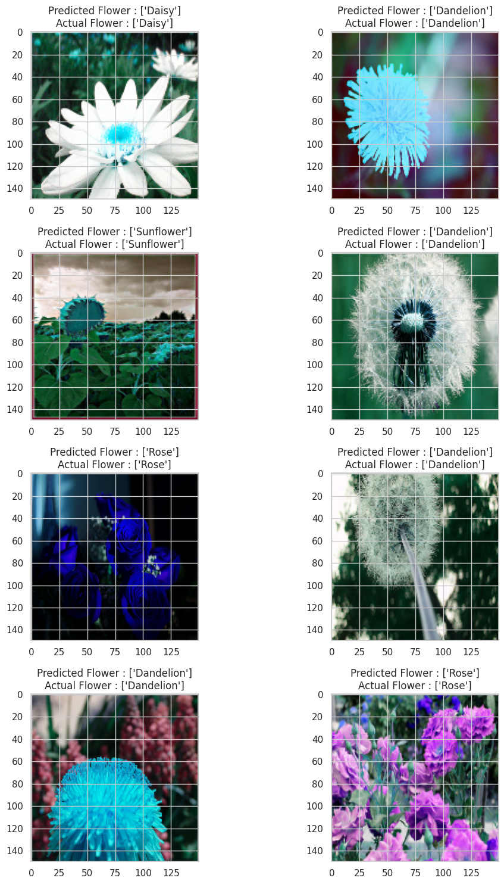
CORRECTLY CLASSIFIED FLOWER IMAGES

Slide 17
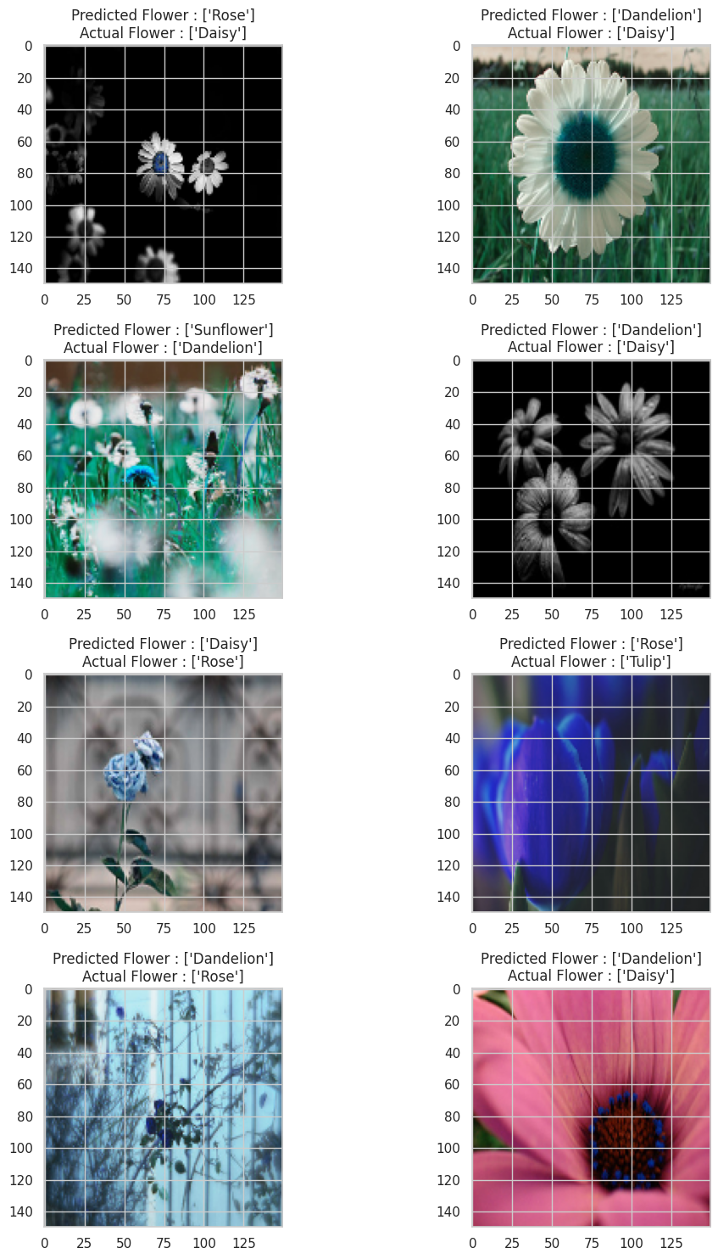
MISCLASSIFIED FLOWER IMAGES

