Slide 1
Principles of object – oriented programming
UNIT-1
Chapter-1

Slide 2
Outline
A look at Procedure Oriented Programming,
object Oriented Programming Paradigm,
Basic Concepts of OOP,
Benefits of OOP,
Object oriented languages,
Applications of OOP

Slide 3
A look at Procedure Oriented Programming
In POP the problem is viewed as the sequence of things to be done, such as:
reading, calculating and printing
Primary focus is on functions
Problem is decomposed into Tasks

Slide 4
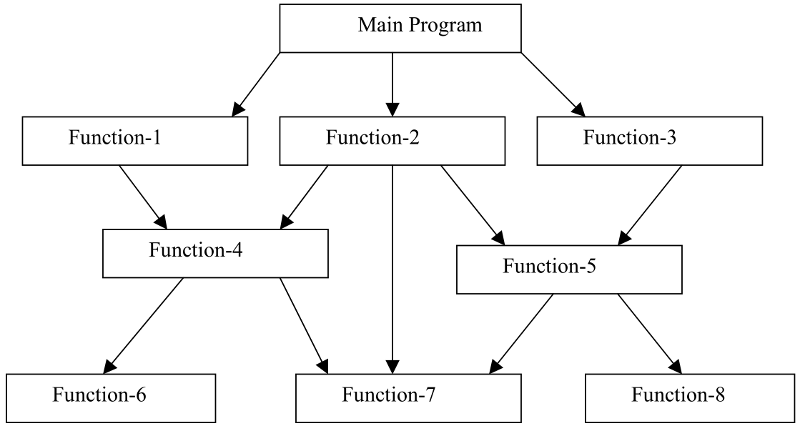
Typical structure of procedural oriented programs

Slide 5
A look at POP
In POP problem/task is represented by instructions/actions.
Instructions/actions are grouped into functions
Flow charts are used to organize these actions
Flow charts represent the flow of control from one action to another.
Little attention is given to data used by functions

Slide 6
A look at POP
In a multi-function program, important data items are placed as global
may be accessed by all the functions.
Each function may have its own local data
Global data is vulnerable to inadvertent change by a function
If data structure is revised, we need to revise all functions that access the data.
Also, procedural approach does not model real world problems very well
Emphasis is on action, not data

Slide 7
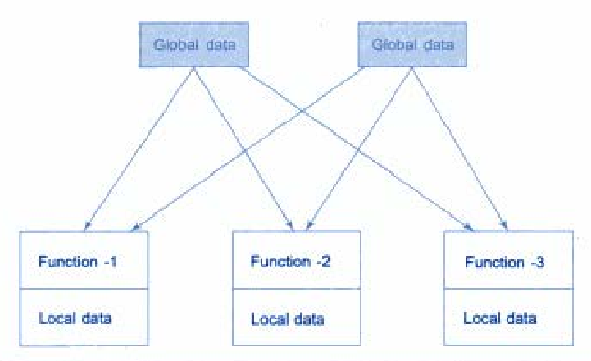
Relationship of data and functions in POP

Slide 8
Characteristics of POP
Emphasis is on doing things (algorithms).
Large programs are divided into smaller programs known as functions.
Most of the functions share global data.
Data move openly around the system from function to function.
Functions transform data from one form to another.
Employs top-down approach in program design.
divide the problem into tasks and then divide tasks into smaller sub-tasks and so on.

Slide 9
Object Oriented Paradigm
OOP treats data as a critical element in the program development.
Does not allow data to flow freely around the system.
Ties data more closely to the function that operate on it, and protects it from accidental modification from outside function.
Problem decomposed into a number of entities called objects and then builds data and function around these objects.

Slide 10
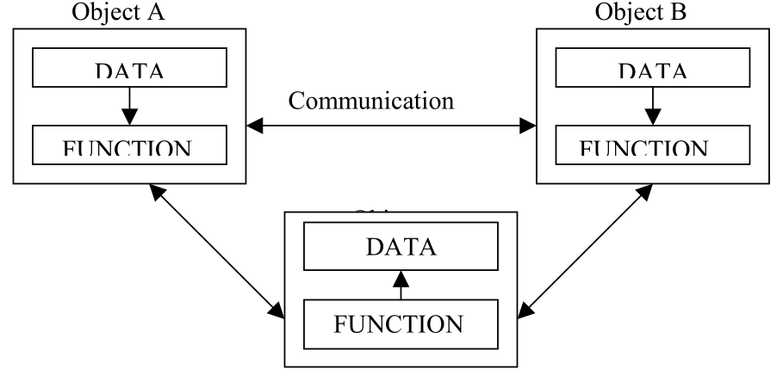
Organization of data and function in OOP
The data of an object can be accessed only by the function associated with that object.
However, function of one object can access the function of other objects

Slide 11
Program to find the square of number
C and C++ implementation

Slide 12
C program:
int x,y;
void sqr(void)
{
y= x*x ;
}
void get_data(void)
{
cout << "enter the value of x" << endl;
cin >>x;
}
void put_data()
{ cout << "square(x)=" <<y<< endl; }
int main()
{
get_data();
sqr();
put_data();
return 0;
}
C++ Program:
class SQUARE
{
int x,y;
public:
void get_data()
{ cout << "enter the value of x" << endl; cin>>x; }
void sqr(void)
{ y= x*x; }
void put_data()
{ cout << "square(x)=" <<y<< endl; }
};
int main()
{
SQUARE n1, n2;
n1.get_data();
n1.sqr();
n1.put_data();
n2.get_data(); n2.sqr(); n2.put_data();
return 0;
}

Slide 13
Features of OOP
Emphasis is on data rather than procedure.
Programs are divided into objects.
Data structures characterize the objects.
Functions that operate on the data of an object are tied together in the data structure.
Data is hidden and cannot be accessed by external function.
Objects may communicate with each other through function.
New data and functions can be easily added whenever necessary.
Follows bottom up approach in program design.
bottom level modules developed first

Slide 14
Definition of OOP
An approach that provides a way of modularizing programs by creating partitioned memory area for both data and functions that can be used as templates for creating copies of such modules on demand

Slide 15
Basic Concepts of OOP
Objects
Classes
Data abstraction and encapsulation
Inheritance
Polymorphism
Dynamic binding
Message passing

Slide 16
Objects
Objects are basic run time entities in OO system
An Object may represent a person, a place, a bank account, a table of data
May also represent user-defined data such as vectors, time, and lists.
Program objects match closely with the real-world objects.

Slide 17
Objects
During pgm execution objects interact by sending messages to one another
Customer object requesting for the bank balance with account object
For interaction an object need to know the type of message accepted, and the type of response returned
Code and data details are not needed
Object contains data, and code to manipulate data.

Slide 18
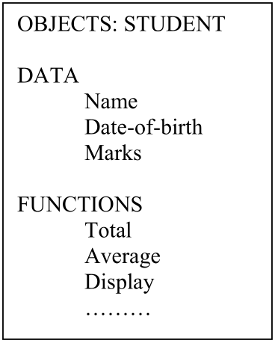
Representing an object

Slide 19
Classes
The entire set of data and code of an object can be made a user-defined data type using the class.
objects are variables of the type class
We can create any number of objects belonging to that class.
A class is thus a collection of objects of similar types
Eg. Mango, Apple and orange are members of class fruit

Slide 20
Data Abstraction and Encapsulation
wrapping up of data and function into a single unit (called class) is known as encapsulation
The data is not accessible to the outside world
only those functions which are wrapped in the class can access it
This feature is called data hiding or information hiding.
Functions provide the interface between the object’s data and the program.

Slide 21
Data Abstraction and Encapsulation
Abstraction refers to the act of representing essential features without including the background details or explanation.
A class is defined as a list of abstract attributes such as size, wait, and cost, and functions to operate on these attributes.
A class encapsulates all the essential properties of the object that are to be created.
attributes aka data members as they hold information
functions aka methods or member function

Slide 22
Inheritance
It is the process by which objects of one class acquire the properties of objects of another classes.
Supports hierarchical classification
Each derived class shares common characteristics with the class from which it is derived
Inheritance provides reusability (reuse a class)
add additional features to an existing class without modifying it

Slide 23
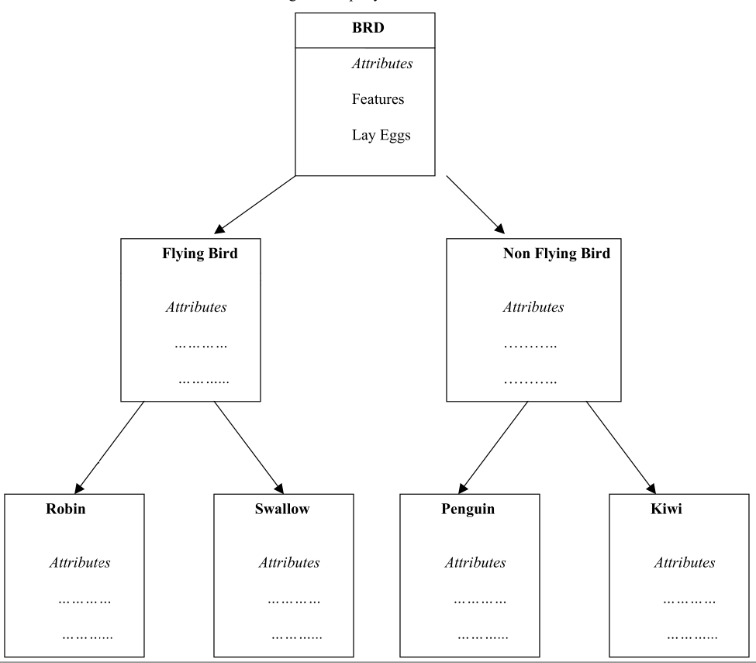
Inheritance - Example

Slide 24
Polymorphism - operator overloading
Polymorphism means the ability to take more than on form
Based on the type of data used, an operation may exhibit different behavior in different instances
Example: operation of addition.
For two numbers, the operation will generate a sum.
For two strings, the operation will produce a third string by concatenation.
Process of making an operator to exhibit different behaviors in different instances is known as operator overloading.

Slide 25
Polymorphism - function overloading
Using a single function name to perform different type of task is known as function overloading
A single function name can be used to handle different number and different types of argument.
Allows objects having different internal structures to share the same external interface

Slide 26
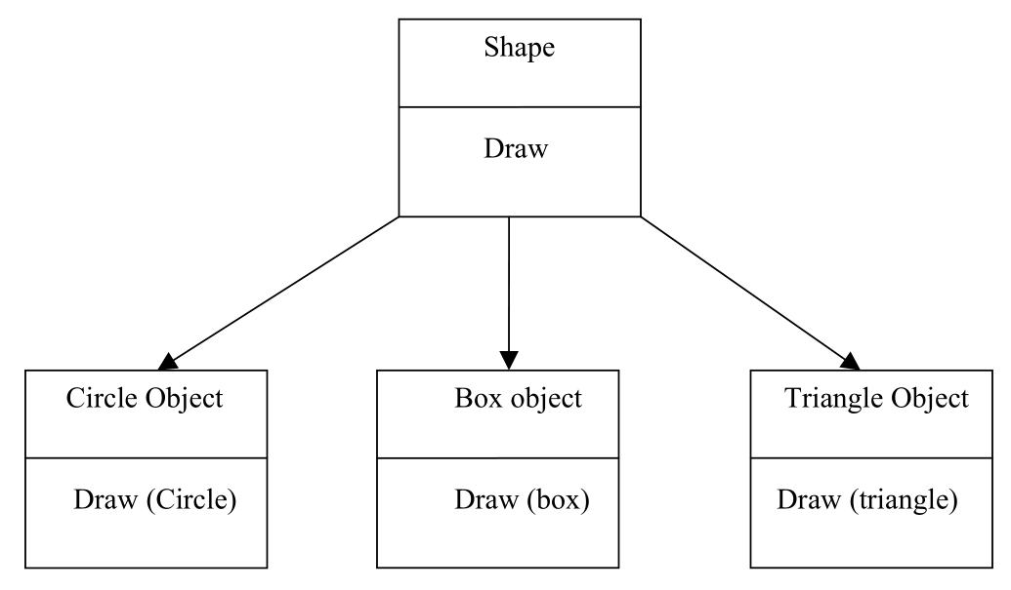
Function overloading -example

Slide 27
Dynamic Binding
Binding means linking of a procedure call to the code to be executed in response to the call.
Dynamic binding means that the code associated with a given procedure call is not known until the time of the call at run time
It is associated with polymorphism and inheritance.
Example- procedure “draw” in previous fig.
by inheritance, every object will have this procedure
but its algorithm is unique to each object
At run-time, the code matching the object under current reference will be called.

Slide 28
Message Passing
In OOP, set of objects communicate with each other
Objects communicate with one another by sending and receiving information
A message for an object is a request for execution of a procedure
Message invokes a function (procedure) in the receiving object

Slide 29
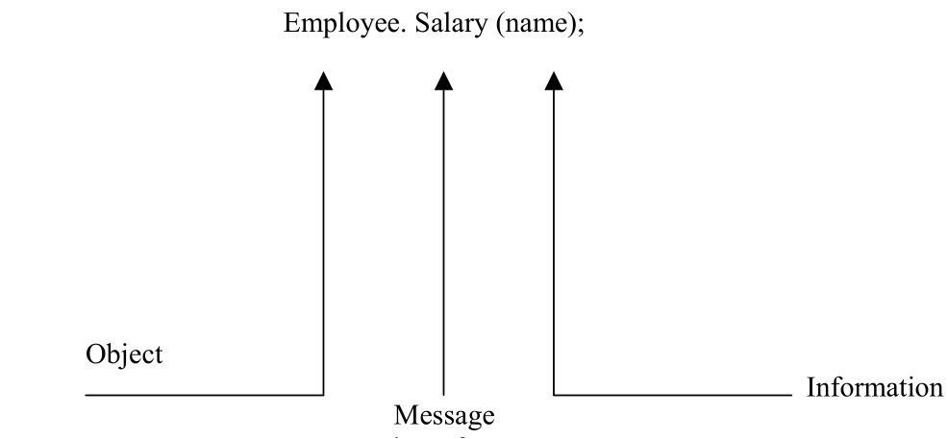
Message Passing
Message passing involves specifying the name of object, the name of the function
(message) and the information to be sent

Slide 30
Benefits of OOP
Through inheritance, we can eliminate redundant code and extend the use of existing Classes.
We can build programs from the standard working modules that communicate with one another, rather than having to start writing the code from scratch. This leads to saving of development time and higher productivity.
The principle of data hiding helps the programmer to build secure program that can not be invaded by code in other parts of a programs.
It is possible to have multiple instances of an object to co-exist without any interference.

Slide 31
Benefits of OOP
It is possible to map object in the problem domain to those in the program.
It is easy to partition the work in a project based on objects.
The data-centered design approach enables us to capture more details of a model in implementable form.
Object-oriented system can be easily upgraded from small to large system.
Message passing techniques for communication between objects makes to interface descriptions with external systems much simpler.
Software complexity can be easily managed.

Slide 32
Object Oriented Languages
Depending upon the features supported, the programs that support OOP concepts can be classified into the two categories:
Object-based programming languages
support programming with objects
do not support inheritance and dynamic binding
Example : Ada programming language
Object-oriented programming languages.
Object-based features + inheritance + dynamic binding
Example : C++, Java

Slide 33
Applications of OOP
Real-time system
Simulation and modeling
Object-oriented data bases
Hypertext, Hypermedia, and expertext
AI and expert systems
Neural networks and parallel programming
Decision support and office automation systems
CAM/CAD systems

