Slide 1
Beginning with C++ UNIT-1 Chapter-2

Slide 2
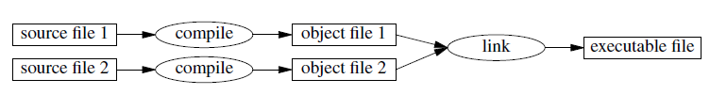
Beginning with C++
C++ is a compiled, object-oriented language
C was developed in the 1970’s by Dennis Ritchie of AT&T Bell Labs
C++ was developed in the early 1980’s by Bjarne Stroustrup of AT&T Bell Labs.
C++ is a superset of C

Slide 3
Application of C++
We can build special object-oriented libraries which can be used later by many programmers.
C++ maps the real-world problems, C part of C++ gives the language the ability to get closed to the machine-level details.
C++ programs are easily maintainable and expandable.
new feature can be easily added using the existing structure of an object.

Slide 4
Simple C++ Program
#include<iostream>
using namespace std;
int main()
{
cout<<” c++ is better than c \n”;
return 0;
}

Slide 5
Simple C++ Program
Like C, the C++ program is a collection of function.
The above example contain only one function main()
Program execution begins at main()

Slide 6
C++ comments
Comments are explanatory notes; they are ignored by the compiler.
There are two ways to include comments in a program:
single line comment.
// This is an example of
// C++ program to illustrate
// some of its features
multiline comment
/* This is an example of
C++ program to illustrate
some of its features
*/

Slide 7
Output operator
cout<<”C++ is better than C.”;
Above statement is an output statement
cout represents the standard output stream (represents the screen)
<< is called the insertion or put to operator.
cout is equivalent to printf()

Slide 8
C++ compiler directives
The #include directive tells the compiler to include some already existing C++ code in your program.
The included file is then linked with the program.
There are two forms of #include statements:
#include <iostream> //for pre-defined files #include "my_lib.h" //for user-defined files
Old versions of C++ use iostream.h
iostream should be included at the beginning of all programs that use input/output statements.

Slide 9
Example for pre-defined files
#include <cmath> //used for sqrt() function
#include <iomanip> //for output formatting utilities
#include <cstdlib> //for memory allocation etc
#include <cstring> //for string processing functions
#include <fstream> //for file input/output

Slide 10
Namespace
Namespace defines a scope for the identifiers that are used in a program
For using the identifier defined in the namespace scope we must include the following directive:
using namespace std;
std is the namespace where ANSI C++ standard class libraries are defined
Above directive brings all the identifiers defined in the std namespace to the current global scope

Slide 11
Ex. for different namespaces and scopes
.
#include <iostream>
using namespace std;
namespace first
{
int val = 500;
}
int val = 200;
int main()
{
int val = 100;
cout << "local val " << val<<'\n';
cout << "global val " << ::val<<'\n';
cout << "first-namespace val " <<first::val << '\n';
return 0;
}
Output:
local val 100
global val 200
first-namespace val 500

Slide 12
Return Type of main()
main() returns an integer value to the operating system.
Every main() should end with a return(0) statement
The default return type for all function in C++ is int
Even if int is explicitly not specified

Slide 13
Average of two numbers
#include<iostream.h> // include header file
using namespace std;
int main()
{
float number1, number2,sum, average;
cin >> number1; // Read Numbers
cin >> number2; // from keyboard
sum = number1 + number2;
average = sum/2;
cout << ”Sum = “ << sum << “\n”;
cout << “Average = “ << average << “\n”;
return 0;
} //end of example
The output would be:
Enter two numbers: 6.5 7.5
Sum = 14
Average = 7

Slide 14
Variables
float number1, number2,sum, average;
Input Operator
cin >> number1;
The operator >> is known as extraction or get from operator
cin is equivalent to scanf()

Slide 15
Cascading of I/O Operators
Cout << “Sum = “ << sum << “,”
<< “Average = “ << average << “\n”;
The output will be:
Sum = 14, average = 7
Cin >> number1 >> number2;

Slide 16
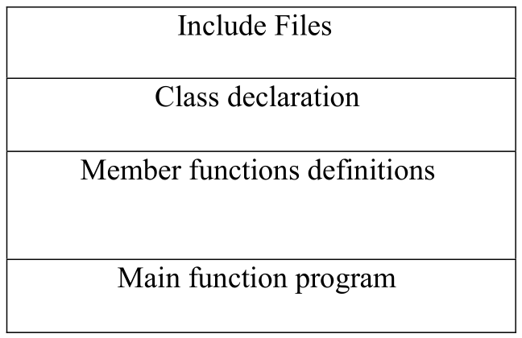
Structure of C++ Program

Slide 17
Structure of C++ Program
Program is normally organized into three separate files.
Class declarations are placed in a header file
definitions of member functions go into another file.
main program is placed in a third file
It should include the previous two files

Slide 18
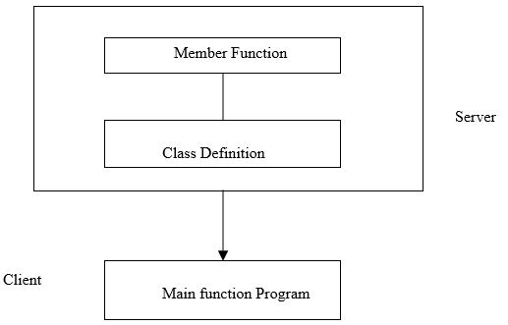
Structure of C++ Program
The class definition including the member functions constitute the server
Main program is known as client
server that provides services to the main program
The client uses the server through the public interface of the class.

Slide 19
Compile C++ Program
In Linux, use the “cc” (uppercase) command to compile the program.
CC example.C
The compiler produces the executable file a.out

Slide 20

TOKENS
○ The Smallest Units in a program are known as
tokens.
○ C++ has following tokens:
 Keywords
 Identifiers
 Constants
 Strings
 Operators

Slide 21
KEYWORDS
○ Keywords are reserved words in proramming .
○ Each keyword has fixed meaning and that can not
be changed by user.
○ For Ex:
int num1;
where int is keyword indicates num1 is of integer type.

Slide 22
asm
double
new
switch
auto
else
operator
template
break
enum
private
this
case
extern
protected
throw
catch
float
public
try
char
for
register
typedef
class
friend
return
union
const
goto
short
unsigned
continue
if
signed
virtual
default
inline
sizeof
void
delete
int
static
volatile
do
long
struct
while
bool
export
reinterpret_cast
typename
const_cast
false
static_cast
using
dynamic_cast
mutable
true
wchar_t
explicit
namespace
typeid

Slide 23
IDENTIFIERS AND CONSTANTS
○ Identifier is user defined names of variables,
functions,arrays, classes, etc.
○ They are the fundamental of any language.
○ Each language has its own rules for naming these
identifiers.These are as follows:
 Only alphabetic characters,digits and
underscores are permitted.
 The name can not start with digits.
 Uppercase and lowercase letters are distinct.
 A keyword cannot be used as a variable
name.

Slide 24
○ Constants refers to fixed values that do not change
during the execution of program.
○ They include integer,character,floating point
numbers and string

Slide 25
11/24/2016
C++ DATA TYPES
○ C++ data types divided mainly in three categories
as follows:
 Basic data types
 User defined data types
 Derived data types

Slide 26
BASIC
TYPES
BYTES
RANGE
DATA
char
1
-128 to 127
TYPES
unsigned char
1
0 to 255
signed char
1
-128 to 127
int
2
-32768 to 32767
unsigned int
2
0 to 65535
signed int
2
-32768 to 32767
short int
2
-32768 to 32767
unsigned short int
2
0 to 65535
signed short int
2
-32768 to 32767
long int
4
-2147483648 to 2147483647
signed long int
4
-2147483648 to 2147483647
unsigned long int
4
0 to 4294967295
float
8
3.4E-38 to 3.4E_38
double
10
1.7E-308 to 1.7E+308
long double
3.4E-4932 to 1.1E+4932

Slide 27
USER-DEFINED DATA TYPES
○ There are following user defined data types:

struct
union
enum
class




Slide 28
STUCT:
○ A structure is a collection of simple variables
○ The variable in a structure can be of different type
such as int,char,float,etc.
○ This is unlike the array which has all variables of
same data type
○ The data items in a structure is called the member
of structure.
○ Syntax:
struct structure_name
{
declaration of data member;
};
○ You can access data member of stucture by using
only structure variable with dot operator.

Slide 29
PROGRAMME OF STRUCTURE
#include<iostream>
using namespace std;
struct student{
int Roll_No;
char name[15];
int cPlus,maths,sql,dfs,total;
float per;
};
int main()
{
struct student s;
cout<<"Enter Roll No:";
cin>>s.Roll_No;
cout<<"Enter Name:";
cin>>s.name;
cout<<"Enter Marks For CPlus:";
cin>>s.cPlus;
cout<<"Enter Marks For Maths:";

Slide 30
PROGRAMME OF STRUCTURE
cin>>s.maths;
cout<<"Enter Marks For Sql :";
cin>>s.sql;
cout<<"Enter Marks For DFS:";
cin>>s.dfs;
s.total=s.cPlus+s.maths+s.sql+s.dfs;
s.per=s.total/4;
cout<<"Your Roll No is:"<<s.Roll_No<<"\n";
cout<<"Your Name is:"<<s.name<<"\n";
cout<<"Your Total is:"<<s.total<<"\n";
cout<<"Your Percentage is:"<<s.per<<"%"<<"\n";
return 0;
}

Slide 31
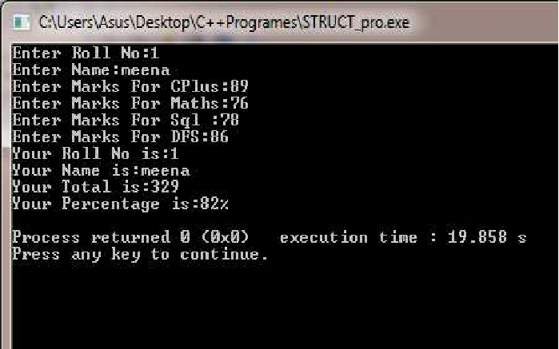

Slide 32
UNION
Structure and union both contain variables of different data types
The difference is :
The total memory required to store a structure variable is equal to the sum of size of all the members.
In union, the total memory space allocated is equal to the member with largest size

Slide 33
○ For example:
If a union contains variable like int, char,float then the memory
consumed will be equal to the size of float variable
because float is highest among all variable of data
type.
○ Syntax:
union union_name
{
//union declaration
data_type member1;
data_type member2;
…
};

Slide 34
○ Memory representation in union
union student {
int roll_no; //occupies 2 bytes
char grade ;
//occupies 1 bytes
} s1;
roll_no
Byte 0
Byte 1
grade

Slide 35
Difference between structure and union
To store the above union variable s1 we need 2 bytes
We can access only that variable whose value is recently stored.
If we use structure instead of union we need 3 bytes
We can access any member in any sequence.
s1.rollno = 20; s1.grade = ‘A’; printf("%d",s1.rollno);
If s1 is structure the above code prints 20
If s1 is union the above code prints erroneous output
Prints ‘A’

Slide 36
STRUCTURE
UNION
○
Define with ‘struct’ keyword.
○ Define with ’union’ keyword.
○
All member can be manipulated
simultaneosly.
○ Member can be manipulated
one at a time.
○
The size of object is equal to
the sum of individual size of the
member object.
○ The size of object is equal to
the size of largest member
object.
○
Members are allocated distinct
memory location.
○ All members are share common
memory space.

Slide 37
ENUM IN C++
○ An enumeration type is user defined type that enable
the user to define the range of values for the type.
○ Syntax:
enum [enum-type] { enum-list};
○ Name constants are used to represent the value of an
Enumeration. For example:
enum char{a,b,c};
○ The default value assigned to the enumeration canstant
Begins with zero. So in above example a=0,b=1 and so
on.

Slide 38
○ The user also can assign value to one or more
enumeration constant,and subsequent values that
are not assigned will be incremented.
For example :
enum char{a=3,b=7,c,d};
here, value of c is 8 and d is 9.

Slide 39
EXAMPLE-1:
int main()
{
enum letter{a,b,c,d};
letter val=c;
cout<<val<<" "<<d<<endl;
return 0;
}
Output:
2 3
EXAMPLE-2:
int main()
{
enum letter{a,b,c,d};
letter val=e;
cout<<val<<" "<<d<<endl;
return 0;
}
Compilation Error:
‘e’ was not declared
on this scope

Slide 40
Example 3:
#include<iostream>
using namespace std;
int main()
{
enum Fruits{apple,orange,guava,pinapple};
int i;
cout<<"Enter your choice:";
cin>>i;

Slide 41

switch(i)
{
case apple:
cout<<" first fruit is Apple.";
break;
case orange:
cout<<" second fruit is Orange.";
break;
case guava:
cout<<" third fruit is Guava.";
break;
case pinapple:
cout<<" fourth fruit is Pinapple.";
break;
}
return 0;
}

Slide 42

The previous code can also be written as follows:
switch(i)
{
case 0:
cout<<" first fruit is Apple.";
break;
case 1:
cout<<" second fruit is Orange.";
break;
case 2:
cout<<" third fruit is Guava.";
break;
case 3:
cout<<" fourth fruit is Pinapple.";
break;
}

Slide 43
What is the output of the following program?
int main()
{
enum color{red,orange,yellow,green,blue,violet};
color shirt, pants;
shirt=red;
pants=green;
cout<<shirt<<" "<<pants<<endl;
return 0;
}
Ans: 0 3

Slide 44
CLASS
○ The class type enables us to create sophisticated
use dfined type.
○ We provide data items for the class and the
operation that can be performed on the data.
○ Syntax:
class class_name{
data member variables;
data member mehods/functions;
};

Slide 45
CLASS PROGRAMME
#include<iostream>
using namespace std;
class piramid
{
int i,n,j;
public:
void getdata();
void buildpiramid();
};
void piramid::getdata()
{
cout<<"enter N:";
cin>>n;
}

Slide 46
void piramid::buildpiramid()
{
for(i=1;i<=n;i++)
{
for(j=1;j<=i;j++)
{
cout<<"*";
}
cout<<"\n";
}
}
int main()
{
piramid p;
p.getdata();
p.buildpiramid();
return 0;
}

Slide 47
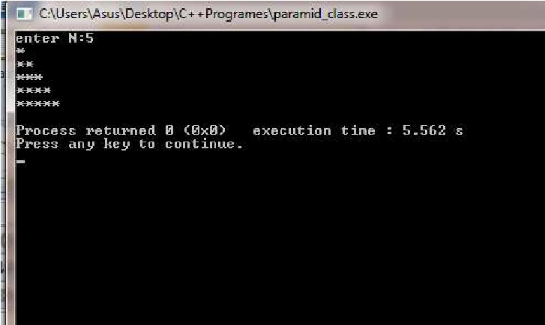

Slide 48
DERIVED DATA TYPE
○ The derived data type are:
 array
 function
 pointer

Slide 49
ARRAY
○ An array is a series of elements of the same data
type placed in contiguous memory location.
Like regular variable ,an array must be declared
before it is used.
○ Syntax:
data_type name[size];
○
Ex:
char name[10];
int student[10];

Slide 50
FUNCTION
○ A function is a group of statements that together
perform a task.
○ Every c++ program has at least one function that is
main() and programmer can define additional
function.
○ You must define function prototype before use
them.
○ A function prototype tells compiler the name of the
function ,return type, and parameters.

Slide 51
○ Syntax:
return_type function_name(parameter_list);
○ Ex:
int max(int n1,int n2);

Slide 52
FUNCTION PROGRAM
#include<iostream>
using namespace std;
int max(int n1,int n2); \\ function declaration
int main()
{
int n1;
int n2;
int a;
cout<<"Enter Number1: "<<"\n";
cin>>n1;
cout<<"Enter Number2: "<<"\n";
cin>>n2;
a=max(n1,n2); \\calling function
cout<<"max value is "<<a<<"\n";
return 0;
}

Slide 53
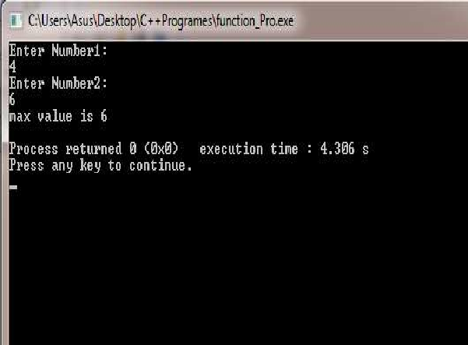
FUNCTION PROGRAM
int max(int n1,int n2)
{
int result;
if(n1>n2)
result=n1;
else
result=n2;
return result;
}

Slide 54
POINTER
Pointer is variable whose value is address
of another variable.
Syntax:
type *var_name;
Ex:
int *p;

Slide 55
○ There are few operation which will do frequently
with pointer is:
We define a pointer variable
Assign address of another variable to the pointer and
Finally access the value at the address available in the pointer variable.
.
○ Like,
I
int *p;
II.
int
var
=20;
p =&var;
III.
cout<<*p;

Slide 56

POINTER PROGRAM
#include<iostream>
using namespace std;
int main()
{
int var=34;
int *p;
p=&var;
cout<<"Value of variable var is "<<var<<"\n";
cout<<"Address stored in pointer p is "<<p<<"\n";
cout<<"Value of pointer p is "<<*p<<"\n";
return 0;
}

Slide 57
SYMBOLIC CONSTANT TYPE
○ Constant is an identifier with associated value
which can not be altered by the program during
execution.
○ You must initialize a constant when you craete
it,you can not assign new value later after constant
is initialized.
○ Symbolic constant is a constant that is
represented by name.

Defining constant with #define

Defining constant with const
Defining constant with enum


Slide 58
○ Ex:
#define pi 3.14
const max=10;
enum char{a,b,c};

Slide 59
TYPE COMPATIBILITY
○ The sizeof is a keyword but it is compile time
operator that determine the size, in byte, of a
variable or data type.
○ It can be used to get the size of classes, structure,
union and any other user defined data type.
○ Syntax:
sizeof(data_type)
○
Ex: float x;
sizeof(x) or sizeof(float)
○ sizeof operater will return integer value.

Slide 60
PROGRAM: USE OF SIZEOF OPERATOR
#include<iostream>
using namespace std;
Expression | Constant value
sizeof(int) | 4
sizeof(long) | 8
sizeof(float) | 4
sizeof(double) | 8
int main()
{
int a,x;
char b;
float c=10.02;
double d;
cout<<"size of a:"<<sizeof(a)*sizeof(x)<<"\n";
cout<<"size of b:"<<sizeof(b)<<"\n";
cout<<"size of c:"<<sizeof(10.02)<<"\n";
cout<<"size of d:"<<sizeof(d)<<"\n";
return 0;
}

Slide 61
VARABLE IN C++
○ Variable is a place to store information.
○ A variable is a location in your computer’s memory
in which you can store a value and from which you
can later retrive the value.
○ This is temporary storage,when you turn the
computer off these variable are lost.
○ Like c, in c++ all variable must be declare before
we used it.
○ The diiference is that in c, it requires to be defined
at the beginning of a scope,rather c++ allows the
declaration of variable anywhere in the scope.

Slide 62
○ This means that a variable can be declared right at
the place of its first use.
○ Declaration Of variable:
char name[12];
int a;
float num;
○ If you are going to declare more than one variable
having same data type, you can declare all of them
in single statement by separating their identifiers
with commas.
○ For ex:
int a,b,c;

Slide 63
○ You can assign value to the variable
when you declare them. It is called initialization.
○ Ex:
int a=0;
char name[]={‘h’,’e’,’l’,’l’,’o’};
char name[8]=‘computer’

Slide 64
❑ Dynamic initialization:
The additional feature of c++ is ,to initialize the
variable at run time. It is called dynamic initialization.
For example:
int c= a+b;
float avg=sum/n;

Slide 65
Reference variable:
A reference variable is an alias, that is, another name for an already existing variable.
Once a reference is initialized with a variable, either the variable name or the reference name may be used to refer to the variable.
C++ References vs Pointers:
You cannot have NULL references. You must always be able to assume that a reference is connected to a legitimate piece of storage.
Once a reference is initialized to an object, it cannot be changed to refer to another object. Pointers can be pointed to another object at any time.
A reference must be initialized when it is created. Pointers can be initialized at any time.

Slide 66
○ Syntax:
data_type& ref_name= var_name;
○ Ex:
int a;
int& i=a;
A reference variable must be initialized at the time of declaration

Slide 67
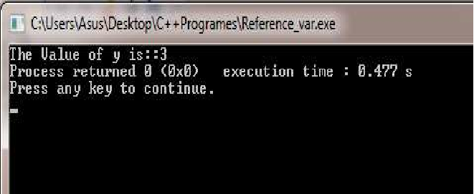
REFERENCE PROGRAM
#include<iostream>
using namespace std;
int main()
{
int x[5]={1,2,3,4,5};
int& y=x[2];
cout<< "The Value of y is::" << y;
return 0;
}

Slide 68
Passing arguments to function – call by reference
void f(int &x)
{
x=x + 10;
}
int main()
{ int m=10;
f(m);
cout<< "The Value of m is " << m;
}
Output: The Value of m is 20

Slide 69
OPERATORS IN C++
○ All the operator in c is available in c++,but some
additional operator that are not in c are:
<< Insertion operator
>> Extraction operator
Scope resolution operator
.* Pointer to member operator
delete memory release operator
::
endl
line feed operator
new memory allocation operator
setw
field width operator

Slide 70
SCOPE RESOLUTION OPERATOR(::)
○ Basically variable are two types ,local variable and
global variable.
○ The variable which are declared within a block or
function, that are used only inside a function is called
local variable.
○ The global variable are declared out side function
and used anywhere in the program.

Slide 71
A situation occurs when both global and local
variable names are same and we have to use global
variable inside a local block or function,
Then it is possible only by using Scope Resolution Operator,
it is used with global variable.
○ Syntax:
::variable_name;
○ A major application of the scope resolution
operator is in the classes to identify the class to
which a member function belongs.

Slide 72
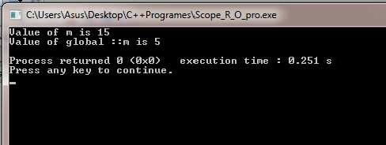
PROGRAME USING :: OPERATOR
#include<iostream>
using namespace std;
int m=5; //global declare
int main()
{
int m=15; //local to main
cout<<"Value of m is "<<m<<"\n";
cout<<"Value of global ::m is "<<::m<<"\n";
return 0;
}

Slide 73
MEMBER DEREFERENCING OPERATOR
○ The member dereferencing operators are used in
class, a class contain various type of data and
function as member.
○ A c++ also permit us to access the class member
through pointer, so required a pointer to member
operator which are,
class
.* to access a member using object name or
pointer to that member.
▪
::*
to declare a
pointer to a
member
▪
pointer to the
object and a pointer to that member.
▪
-
>* to
access a
member using a

Slide 74
MEMORY MANAGEMENT OPERATORS
○ C++ uses two unary operators new and delete, that
perform the task of allocating and freeing the memory in
better and easy way.
○ A new operator can create an object of any type and allocate
memory for the object
○ Syntax:
pointer_variable= new data_type;
○ Ex:
int *p=new int;
○
A delete operator deallocates memory.
○ Syntax:
delete pointer_variable;
○ Ex:
delete p;

Slide 75
○ You can also create space for any data type
including user-defined data type like array, structure, classes ,etc.
○ Syntax :
pointer_variable=new data_type[size];
○ Ex: create an array pointed to by p
int *p=new int[100];
p[0] refers to first element , p[1] refers to second element
○ Delete array.
○ Syntax:
delete [] pointer_variable;
○ Ex: Delete the array pointed to by p
delete []p;

Slide 76
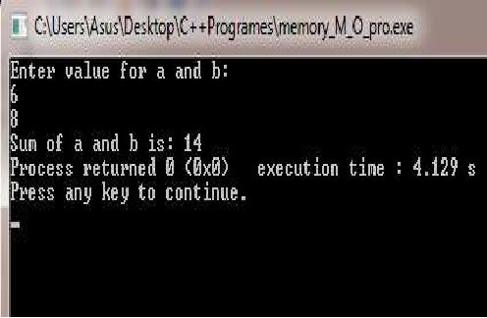
PROGRAM USING NEW AND DELETE OPERATOR
#include<iostream>
using namespace std;
int main()
{
int *a=new int;
int *b =new int;
int *sum= new int;
cout<<"Enter value for a and b:"<<"\n";
cin>>*a>>*b;
*sum=*a+*b;
cout<<"Sum of a and b is: "<<*sum;
delete a;
delete b;
Delete sum;
return 0;
}

Slide 77
MANIPULATORS
○ C++ provides the operator called manipulator for
formatting the output or manipulate the data in the
way programmers wants to display it.
○ Most commonly used manipulators are:
▪
endl
▪
setw
()
○ endl manipulator same as the new line(“\n”)
character and used to move to the next line.
○ setw() is used to provide the field width for the
value and display them right-justified.

Slide 78
○ Like,
int x=22;
cout<<setw(5)<<x;
2
2
○ The <iomanip> header file provide rich set of
manipulators.

Slide 79
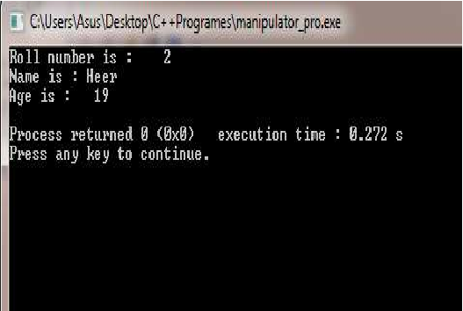
MANIPULATOR PROGRAM
#include<iostream>
#include<iomanip>
using namespace std;
int main()
{
int roll_no=2;
char name[]="Heer";
int age=19;
cout<<"Roll number is :"<<setw(5)<<roll_no<<endl;
cout<<"Name is :"<<setw(5)<<name<<endl;
cout<<"Age is :"<<setw(4)<<age<<endl;
}

Slide 80
TYPE CASTING
○ While evaluating an expression if both operands for
an operator are not of same data type, then using
implicit conversion rule of c++ convert smaller type
to wider type.
○ For example, if two operands are respectively int
and float type, then int is converted into a float and
then operation is performed.
○ Many times implicit conversion cause the problem
and we do not get proper result.

Slide 81
○ For that, like c, c++ also uses explicit type casting
with the type cast operator in two different style as
follow:
○ Syntax:
(type_name) expression; //c notation
type_name (expression) //c++ notation;
○ Ex:
average=(float) sum/n; //c notation;
average=float(sum)/n; //c++ notation;

Slide 82
What is the o/p
int main()
{
char symbol[3] = {'a', 'b', 'c’};
for (int index=0;index<3;index++)
cout<< int(symbol[index])<<"\n";
return 0;
}
ANS:
97
98
99

Slide 83
End of chapter-2

