Slide 1
Working with Files
UNIT V
Chapter 10

Slide 2

Introduction
• Many real-life problems handle large volumes of
data.
• The data is stored in the devices using the concept of
files.
• A file is a collection of related data stored in a
particular area on the disk.
• Programs are designed to perform read and write
operations on these files.

Slide 3
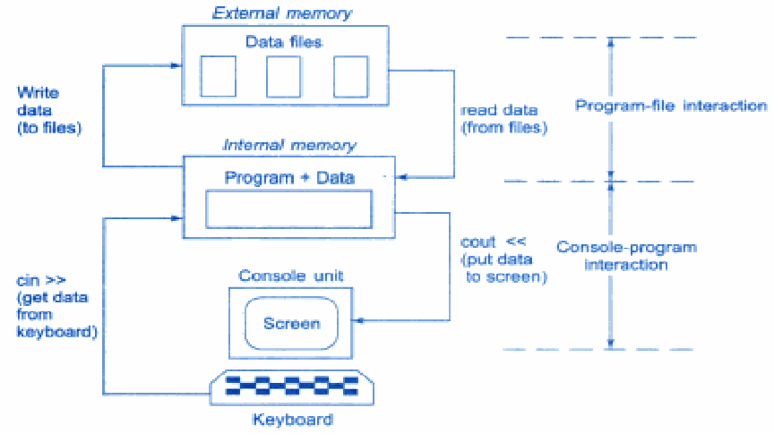
Console-Program-File interaction

Slide 4
Program File Communication
• In C++ file streams are used as an interface
between the program and the files.
• The stream that supplies data to the program is
known as input stream and the one that receives
data from the program is known as output stream.
• Input stream => reads data
• Output stream => writes data

Slide 5
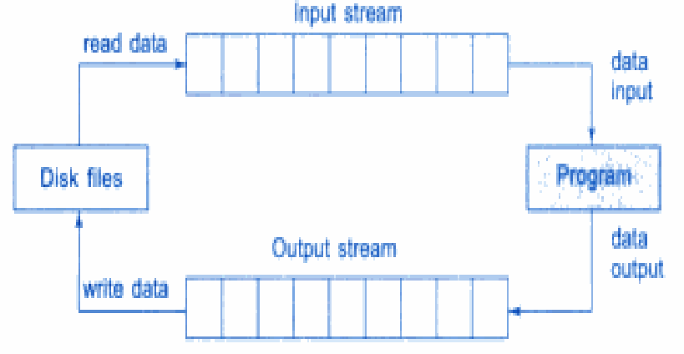
File input and Output Streams

Slide 6







Classes for File Stream Operations
ios
iostream
file
istream
streambuf
ostream
iostream
ifstream
fstream
ofstream
filebuf
fstream
file
fstream base

Slide 7
File stream classes
filebuf | Its purpose is to set the file buffers to read and write. Contains Openprot constant used in the open() of file stream classes.Also contain close() and open() as members.
fstreambase | Provides operations common to file streams.Serves as a base for fstream,ifstream and ofstream class.Contains open() and close() functions.
ifstream | Provides input operations. Contains open() with default input mode.Inherits the functions get(),getline(),read(),seekg(),tellg() functions from istream.
ofstream | Provides output operations.Contains open() with default output mode.Inherits put(),seekp(),tellp() and write() functions from ostream.
fstream | Provides support for simultaneous input and output operations.Contains open with default input mode.Inherits all the functions from istream and ostream classes through iostream.

Slide 8
Opening and Closing a File
• To open a file, a file stream is created and then it
is linked to the filename.
• A file can be opened in two ways:
▫ Using the constructor function of the class.
▫ Using the member function open() of the class.
• A file is closed by using the function close().
• eg:
outfile.close();

Slide 9
Opening File using Constructor
• Filename is used to initialize the file stream object.
• Create a file stream object using appropriate class.
▫ ofstream class is used to create output stream.
▫ ifstream class is used to create input stream.
• Initialize the file object with the desired filename.
• Eg:
ofstream outfile (“results”);
//output only
ifstream infile (“data”);
// input only

Slide 10
ofstream outfile (“results”);
Creates outfile as an object of ofstream class that manages the output stream
This statement opens the file results and attaches it to the output stream outfile
ifstream infile (“data”);
Creates infile as an object of ifstream class that manages the input stream
This statement opens the file data and attaches it to the input stream infile

Slide 11
A program may contain statements like :
outfile << “TOTAL”;
outfile << sum;
infile >> number;
infile >> string;

Slide 12
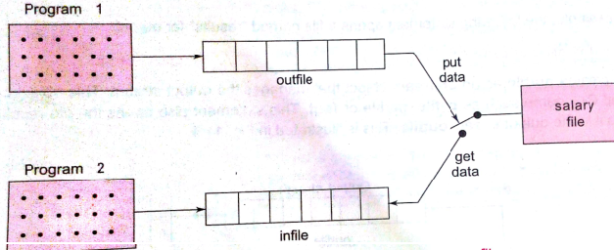
We can use the same file for reading and writing data as follows:
Program1
…………………..
……………….
ofstream outfile (“salary”); //creates outfile and connects salary to it
………………
…………………..
Program 2
………………
……………
ifstream infile (“salary”); //creates infile and connects salary to it
………………..
………………….

Slide 13
The connection with a file is closed automatically when the stream object expires i.e when a program terminates.
In the above statement ,when the program 1 is terminated, the salary file is disconnected from the outfile stream.
Instread of two programs, a single program can be used to do both reading and writing operations on a file as follows:
…………….
…………….
outfile.close(); //disconnect salary from outfile and connect to infile
ifstream infile (“salary”);
………….
……………
infile.close();

Slide 14
Opening File using Constructor
Program to use a single file for writing and reading the data
#include<iostream.h>
#include<fstream.h>
int main()
{
ofstream
cout<<“Enter item name:”;
char name[30];
cin >> name;
outf(“Item”);
outf<<name;
cout<<“Enter item cost:”;
float cost;
cin >> cost;
outf << cost;
outf.close(); //Disconnect the ITEM file from outf

Slide 15
Opening File using Constructor
ifstream inf(“Item”); //Connect the ITEM file from inf
inf >> name;
inf >> cost;
cout << “Item name :” << name;
cout << “Item cost :” << cost ;
inf.close();
return 0;
}
Output:
Enter item name: CD-ROM
Enter item cost: 250
Item name: CD-ROM
Item cost: 250

Slide 16
Note that:
When a file is opened for writing only, a new file is created if there is no file of that name.
If a file by that name exists already , then its contents are deleted.

Slide 17
Opening Files Using open()
• The
function
open()
can
be
used
to
open
multiple files that use the same stream object.
• Syntax:
file-stream-class
stream-object;
stream-object.open(“filename”);
• A stream object can be connected to only one file
at a time.

Slide 18
Opening Files Using open()- Working with multiple files
#include<iostream.h>
#include<fstream.h>
int main()
{
ofstream fout; //create output stream
fout.open(“country”); //connect country to it
fout<<“United state of America”;
fout<<“United Kingdom”;
fout.close(); //disconnect country
fout.open(“capital”); //connect capital
fout<<“Washington”;
fout<<“London”;
fout.close(); //Disconnect capital

Slide 19
Opening Files Using open()- Working with multiple files
const int N=80;
char line[N];
ifstream fin; //create input stream
fin.open(“country”); //connect country
cout<<“Contents of country file” ;
while(fin) //check end of file
{
fin.getline(line, N);
cout<<line;
}
fin.close(); //disconnect country

Slide 20
Opening Files Using open()- Working with multiple files
fin.open(“Capital”); //connect capital
cout<<“Contents of capital file”;
while(fin) //check eof
{
fin.getline(line, N);
cout<<line;
}
fin.close(); //Disconnect capital
return 0;
}

Slide 21
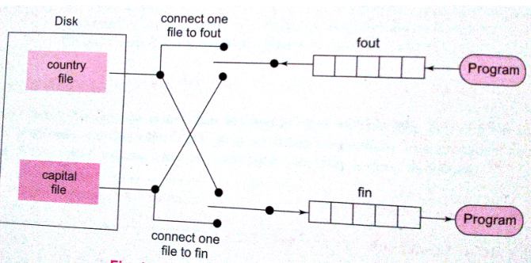
A stream can be connected to only one file at a time.
Hence first file is closed before opening second one.

Slide 22
Detecting End-of File
• Detection of the end-of-file condition is necessary
for preventing any further attempt to read data from
the file. Following statement is used for the same:
while(fin)
The fstream object returns zero if any error occurs in the file operation or if the EOF is encountered

Slide 23
• Another approach to detect EOF is as follows:
if(fin1.eof() != 0 ) { exit(1); }
• The eof() is a member function of ios class returns a
non zero value if the end-of-file condition is encountered
and zero otherwise

Slide 24
Opening two files simultaneously
• When two or more files are used simultaneously
ie: when we want to merge two files into a single
file.
• In
such
case we create
two
separate
input
streams for handling the two input files and one
output stream for handling the output file.

Slide 25
Open & read from two files simultaneously
#include<iostream.h>
#include<fstream.h>
#include<stdlib.h>
int main()
{
const int size = 80;
char line[size];
ifstream fin1, fin2;
fin1.open(“country”);
fin2.open(“capital”);

Slide 26
Open & read from two files simultaneously
for(int i = 1; i <= 10; i++ )
{
if ( fin1.eof() ! = 0)
{
cout << “\n Exit from country \n ” ;
exit(1);
}
fin1.getline(line,size);
cout << “Capital of “ << line;

Slide 27
Open & read from two files simultaneously
if ( fin2.eof() ! = 0 )
{
cout << “ \n Exit from capital \n“ ;
exit(1);
}
fin2.getline(line, size);
cout << line << “\n”;
}
//end of for loop
return 0;
}

Slide 28
Error Handling During File Operations
• Following conditions may arise while dealing with
files:
▫ A file which we are attempting to open for reading does
not exists.
▫ The file name used for a new file may already exists.
▫ We may attempt an invalid operation such as reading
past the end-of-file.
▫ There may not be any space in the disk for storing more
data.
▫ We may use invalid file name.
▫ We may attempt to perform an operation when the file is
not opened for that purpose.

Slide 29
Error Handling During File Operations
• The ios class supports several member functions that can
be used to read the status recorded in a file stream.
Function
Return value and meaning
eof( )
Returns true (non zero value) if end-of-file is encountered
while reading otherwise returns false (zero).
fail( )
Returns true when an input or output operation has failed.
bad ( )
Returns true if an invalid operation is attempted or any
unrecoverable error has occurred. However, if it is false, it
may be possible to recover from any other error reported, and
continue operation.
good ( )
Returns true if no error has occurred. When it returns false,
no further operations can be carried out.

Slide 30
Error Handling During File Operations
......
......
ifstream infile;
infile.open(“ABC”);
while ( !infile.fail( ))
{
......... ( process the file )
.........
}
if (infile.eof( ) )
{
.........
(terminate program normally)
}
else
if(infile.bad ( ))
{
.......... (report fatal error )
}
else
{
infile.clear ( ); // clear error state
.........
}
..........
..........

Slide 31
Thank You

