Slide 1
Big picture of JVM, jre, jdk JVM Architecture
Sabareesh S U
Kumar Aman
Manisha Dangi
Samarth Anand

Slide 2
Big picture of jdk, jre and jvm

Slide 3
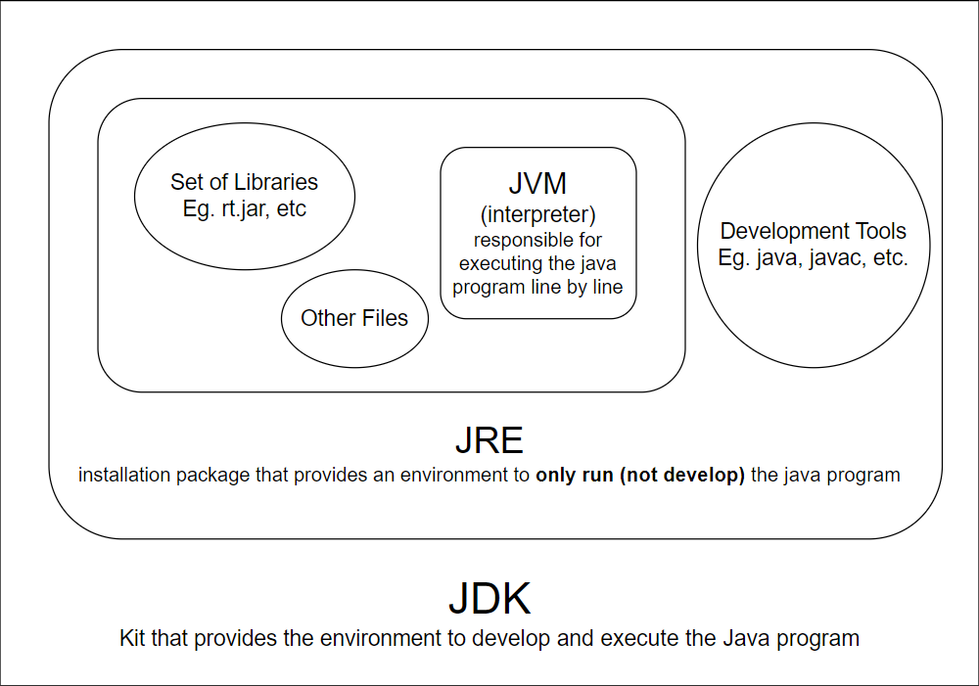

Slide 4
JDK (JAVA DEVELOPMENT KIT)
JDK (Java Development Kit) is a Kit that provides the environment to develop and execute(run) the Java program. JDK is a kit(or package) that includes two things
Development Tools
an interpreter/loader (Java),
a compiler (javac),
an archiver (jar),
a documentation generator (Javadoc), etc.
JRE (to execute your java program).

Slide 5
JRE (JAVA Runtime Environment)
JRE is an installation package that provides an environment to only run(not develop) the java program onto your machine. JRE is only used by those who only want to run Java programs that are end-users of your system.
The Java Runtime Environment provides the minimum requirements for executing a Java application; it consists of the Java Virtual Machine (JVM), core classes, and supporting files.

Slide 6
JVM (JAVA Virtual Machine)
JVM(Java Virtual Machine) acts as a run-time engine to run Java applications. JVM is the one that calls the main method present in a java code.
JVM becomes an instance of JRE at the runtime of a Java program. It is widely known as a runtime interpreter. JVM largely helps in the abstraction of inner implementation which makes use of libraries for their programs from JDK.
It is mainly responsible for three activities.
Loading
Linking
Initialization

Slide 7
IMPORTANT components of jdk
 | Components | Use
Basic tools | javac | Source code to bytecode
 | java | Loads java apps
 | javap | Class file disassembler
 | javadoc | Documentation generator
 | jar | Java archiver
 | appletviewer | Debugging applets
 | xjc | Accepts XML schema and generates Java classes
 | apt | Annotation processing tool
 | jdb | Debugger
Java Troubleshooting, Profiling, Monitoring and Management Tools | jmc | Mission control
 | JConsole | Console management
 | Components | Use
Java Deployment Tools | pack200 | JAR compression tool
 | javafxpackager | Package and sign JavaFX applications
 | idlj | IDL-to-java compiler
Security tools | keytool | Keystore manipulation tool
Monitoring tool | jStat | JVM statistics monitor
 | jShell | to test out the functioning of individual statements of your JAVA code
Troubleshooting tool | jStack | Java stack traces
 | jPackage | Generate self-contained application bundles
 | jarsigner | Jar signing and verification

Slide 8
JDK 17 features
Nice Developer | Specific Developer | Keeping up with Apple | Cleaning Up
Pattern matching for switch | Restore Always-Strict Floating-Point Semantics | New macOS Rendering pipelines | Deprecate the Applet API for Removal
Sealed classes | Enhanced pseudo-Random Number Generators | macOS/AArch64 Port | Removal RMI Activation
 | Strongly Encapsulated JDK Internals |  | Removal Experimental AOT and JIT Compiler
 | Foreign Functions & memory API(Incubator) |  | Deprecate the Security manager for Removal
 | Vector API
 | Context-Specific Deserialization Filters

Slide 9

JVM Architecture

Slide 10
What is JVM ?
JVM is an abstract machine.
It provides runtime environment in which java bytecode can be executed.
A specification where working of Java Virtual Machine is specified. Its implementation has been provided by Oracle.
An implementation Its implementation is known as JRE (Java Runtime Environment).
Runtime Instance Whenever you write java command on the command prompt to run the java class, an instance of JVM is created.

Slide 11
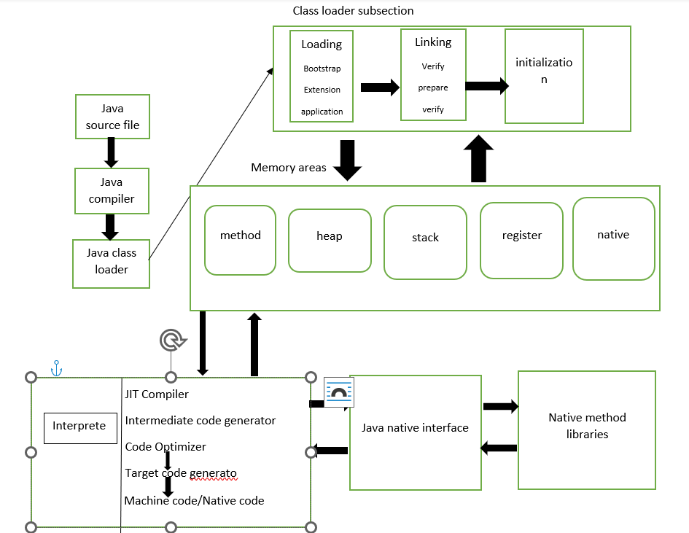
JVM Architecture diagram

Slide 12
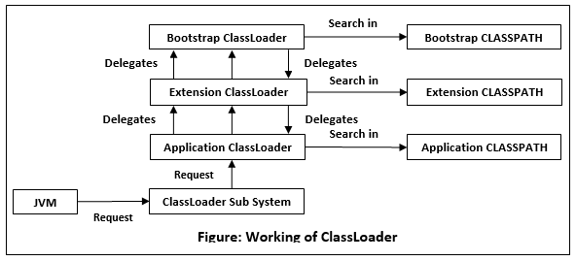

Slide 13
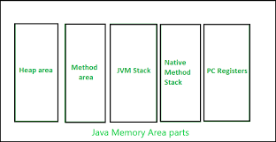
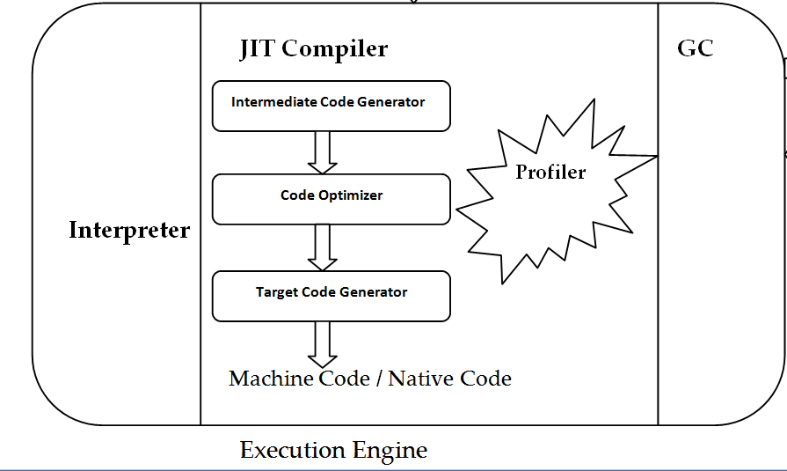

Slide 14

GET THE FUTURE YOU WANT
capgemini.com

Slide 15
About Capgemini
Capgemini is a global leader in partnering with companies to transform and manage their business by harnessing the power of technology. The Group is guided everyday by its purpose of unleashing human energy through technology for an inclusive and sustainable future. It is a responsible and diverse organization of over 360,000 team members more than 50 countries. With its strong 55-year heritage and deep industry expertise, Capgemini is trusted by its clients to address the entire breadth of their business needs, from strategy and design to operations, fueled by the fast evolving and innovative world of cloud, data, AI, connectivity, software, digital engineering and platforms. The Group reported in 2022 global revenues of €22 billion.
Get The Future You Want | www.capgemini.com

