Slide 1
Google Cloud-Career Readliness
Subject Code: 21AL59F
Submitted By: Manish A R
USN:4VV22IS403
Dept of ISE

Slide 2


Essential Google Cloud Infrastructure: Core Services
Unlock the full potential of your digital solutions with Google Cloud Platform (GCP), a cutting-edge suite of cloud computing services designed to revolutionize the way organizations build, deploy, and scale.

Slide 3
Google Cloud Platform (GCP) Overview
Compute Services
Storage and Databases
Networking and Security
GCP provides powerful computing resources, including virtual machines, containerized applications, and serverless functions, enabling businesses to run their workloads efficiently.
Robust storage options, from object storage to managed databases, ensure data is securely stored and easily accessible.
Comprehensive networking and security services safeguard applications and data, while providing seamless connectivity across hybrid and multi-cloud environments.

Slide 4

Compute Services: Virtual Machines, Containers, and Serverless
Virtual Machines
1
Fully configurable and scalable virtual machines to run your custom applications and workloads.
2
Containers
Containerized applications that are portable, scalable, and easy to manage with Google Kubernetes Engine (GKE).
Serverless
3
Event-driven, scalable, and highly available serverless functions with Google Cloud Functions, eliminating the need for infrastructure management.

Slide 5
Storage and Database Services
Object Storage
Managed Databases
Data Warehousing
Reliable and highly scalable object storage with Google Cloud Storage, suitable for a wide range of data types and use cases.
Fully managed database services, such as Cloud SQL and Cloud Datastore, that simplify database management and operations.
Enterprise-grade data warehousing with BigQuery, enabling fast and scalable analysis of large datasets.

Slide 6




Resource Management
GCP's resource management capabilities allow you to effectively organize, manage, and monitor your cloud resources. From hierarchical resource organization using the Resource Manager, to cost control and optimization through Billing, to security and compliance through Access Control, GCP empowers you to maintain a well-governed and efficient cloud infrastructure.
Resource Manager
Organize and manage your cloud resources in a hierarchical structure.
Billing
Monitor and optimize your cloud costs, ensuring efficiency and cost control.
Access Control
Secure your cloud resources with fine-grained access control and identity management.

Slide 7



Resource Monitoring
GCP's robust monitoring capabilities provide visibility and insights into the health and performance of your cloud resources. From real-time monitoring and logging to advanced analytics and alerting, Monitoring empowers you to proactively identify issues, optimize resource utilization, and ensure the reliability and availability of your applications and services running on Google Cloud.
Dashboards
Alerting
Analytics
Gain a comprehensive view of your cloud infrastructure and application performance.
Set up custom alerts to proactively detect and address issues in your environment.
Leverage advanced analytics and reporting to optimize your cloud resource utilization.

Slide 8
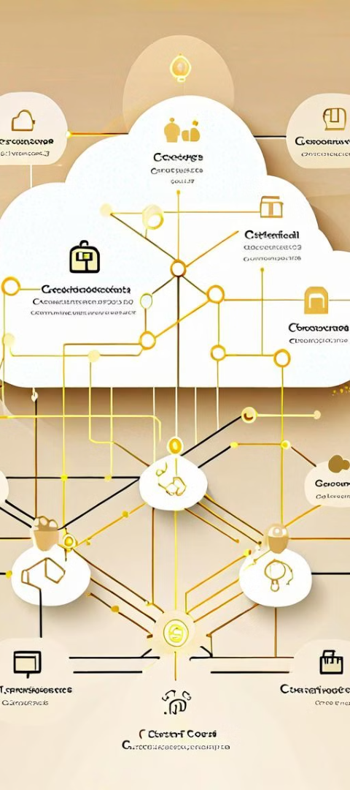



Networking and Security Services
Virtual Private Cloud
Fully customizable virtual networks to isolate and secure your cloud resources.
Cloud Identity and Access Management
Centralized user and permission management for fine-grained access control.
Cloud Security Command Center
Comprehensive security monitoring and threat detection across your GCP environment.

Slide 9
BENEFITS
We learnt so many new things, in terms of definition and programs about the cloud computing.
Learn and build skills for the future on Google Cloud at no cost
Cost savings.
Faster time to market Scalability and flexibility.
Advanced security.

Slide 10
Conclusion and Key Takeaways
1
Comprehensive Cloud Capabilities
2
Scalability and Flexibility
GCP's scalable and flexible infrastructure allows organizations to adapt and grow their cloud solutions.
GCP offers a diverse range of cloud services to address the evolving needs of modern businesses.
3
Seamless Integration
4
Trusted Security and Reliability
The seamless integration of GCP's services enables efficient and streamlined cloud deployments.
GCP's robust security measures and high availability ensure the protection and reliability of your data and applications.

Slide 11
Thank You

