Slide 1
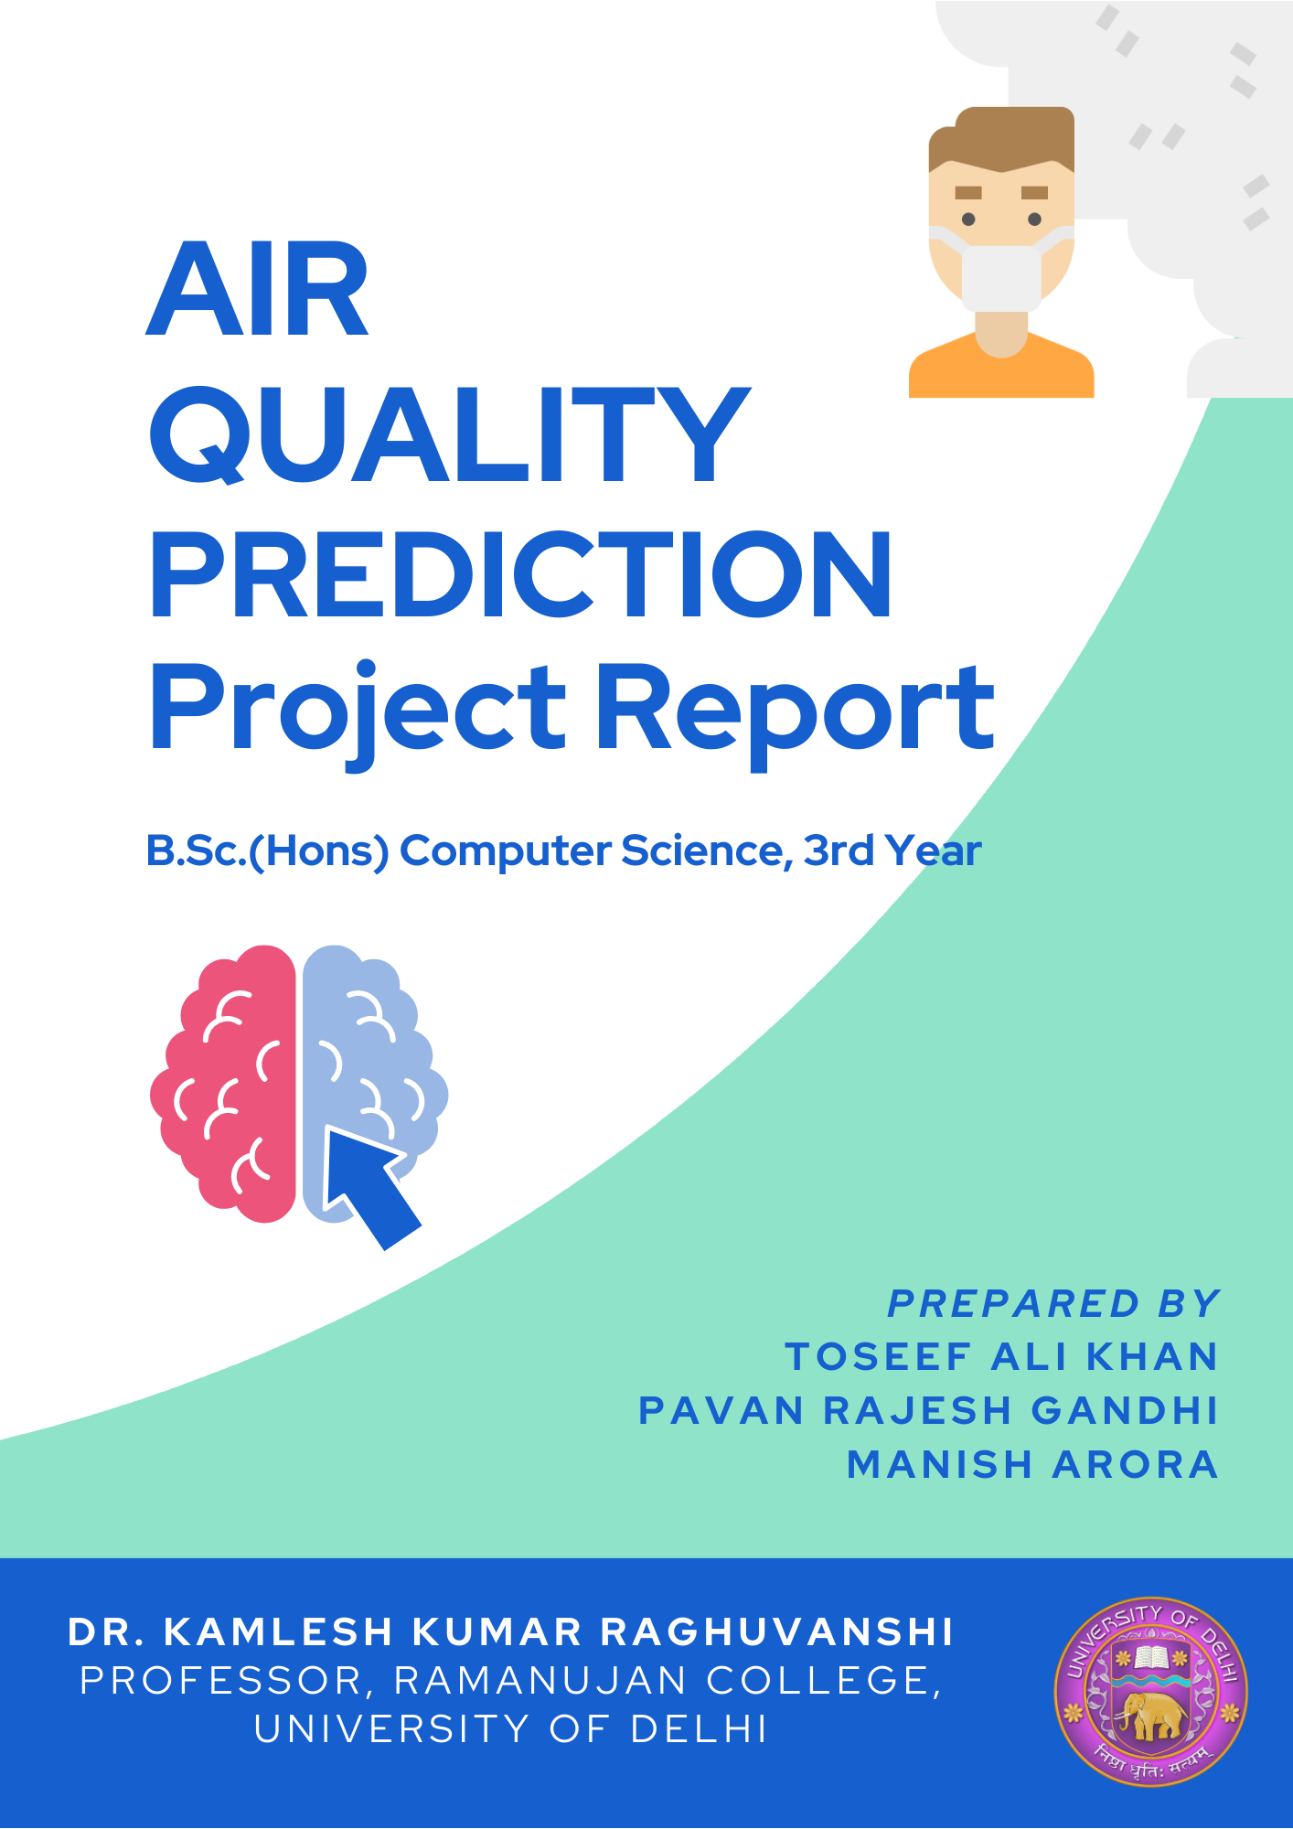

Slide 2
ACKNOWLEDGMENT
We would like to express our special thanks of gratitude to our teacher Dr. KAMLESH KUMAR RAGHUVANSHI for his able guidance and support.
His constructive advice and constant motivation have been responsible for the successful completion of this project.

Slide 3
CERTIFICATE
This is to certify that the project report entitled “AIR QUALITY PREDICTION” is the work carried out by Toseef Ali Khan(1436), Pavan Rajesh Gandhi(1423), Manish Arora(1417), students of B.Sc.(Hons) Computer Science, VI semester, Ramanujan College, University of Delhi under the supervision of Dr. KAMLESH KUMAR RAGHUVANSHI for the subject Project Work.
Dr. KAMLESH KUMAR RAGHUVANSHI, Professor,
Ramanujan College, DU

Slide 4
INDEX
ACKNOWLEDGEMENT
CERTIFICATE
1. PROJECT PROFILE …...............................................................................................5
2. INTRODUCTION TO THE PROBLEM………………….……................................6
3. IMPACTS OF AIR POLLUTION ……………………..............................................7
4. PREDICTING AIR POLLUTION (BENEFITS).....................................................8-9
4.1 ROADMAP........................................................................................................9
5. SOFTWARE SPECIFICATION (TECHSTACK)......................................................10
6. SYSTEM FLOWCHART ………………………………………………………….11
7. GANTT CHART…………………………………………………………………....12
8. GETTING THE DATA...…………………………………………….……………..13
9. SCRAPING DATA..…………………………………………..…………..………..14
10. DATA DICTIONARY (DATASET DESCRIPTION)………...……….....……….15
11. DATA CLEANING……………………………………………………………16-20
12. DATA ANALYSIS (EXPLORING TRENDS)..................................................21-25
13. APPLYING ALGORITHMS & ERROR ANALYSIS…………………..……26-28
14. POST IMPLEMENTATION REVIEW………………………………………..29-30
15. FUTURE ENHANCEMENTS……………………………………………………31
16. BIBLIOGRAPHY………………………………………...………………………32

Slide 5
1. Project Profile
Project Definition | Air Quality Prediction System
Objective | The air we breathe is full of tiny particles of chemicals, soil, smoke, dust or allergens, also known as particulate matter, or PM. High PM poses a high risk to human health.So we decided to create a model for New Delhi which can be used to predict its AQI. This is will be an end-to-end project, i.e. from getting data to data wrangling to feature extraction to model creation and then finally developing a Flask WebApp.
Front-end | HTML5, CSS3, Javascript, Bootstrap 4
Back-end | Python, Flask, Pandas, Matplotlib, Seaborn
Tools | Google Colab, Jupyter Notebook, Git, Github
Submitted To | Dr. Kamlesh Kumar Raghuvanshi
Submitted By | Toseef Ali Khan - 1436 Pavan Rajesh Gandhi - 1423 Manish Arora -1417

Slide 6
2. Introduction to the Problem & Measuring
Although mostly invisible to the naked eye, the air we breathe is full of tiny particles of; chemicals, soil, smoke, dust or allergens, in the form of liquids, gases, or solids. When we burn fossil fuels for energy use and production. The release of gases and chemicals are created air pollution, posing a risk to human health and the planet as a whole. These minuscule airborne hazards are referred to as Particulate Matter, or PM.

Slide 7
3. Impacts of Air Pollution
Depending on how healthy you are in general, PM2.5 will have different long and short term negative health effects. When exposed to levels of PM2.5 between to moderate - hazardous range, one may experience the following effects:
shortness of breath
eye, nose and throat irritation
excessive coughing and wheezing
diminished lung function and lung disease
diminished heart function, sometimes resulting in heart attack
asthma attacks
death
PM2.5 also damages the environment by increasing acidity in the soil and water bodies. Which in turn affects their ability to produce food and support life.

Slide 8
4. Predicting Air Pollution ( benefits )
Air pollution forecasting is a worthwhile investment on multiple levels - individual, community, national and global. Accurate forecasting helps people plan ahead, decreasing the effects on health and the costs associated.
If people are aware of variations in the quality of the air they breathe, the effect of pollutants on health as well as concentrations likely to cause adverse effects and actions to curtail pollution. Furthermore, there is a greater likelihood of motivating changes in both individual behaviour and public policy, as people want air quality information.
Such awareness has the potential to create a cleaner environment and a healthier population. Governments also make use of early forecasting to establish procedures to reduce the severity of local pollution levels.

Slide 9
4.1 Road Map
Get the data
Daily Air quality data for all months (on day to day basis) for the past 10 years.
Get PM2.5 values too.
Research about the key factors for determining the PM2.5 Values.
Accordingly remove the unwanted features from the dataset.
Data Cleaning / Wrangling
Exploratory Data Analysis.
Trend in PM2.5 levels.
Season's impact on air quality.
Applying different algorithms.
Error Analysis.
Use the best algorithm for pkl model.
Make a flask webApp.

Slide 10
5. Software Specification ( Techstack )
Front-end
HTML5, CSS3, Javascript, Bootstrap 4
Back-end
Python, Flask, Pandas, Matplotlib, Seaborn
Additional libraries used:-
Flask==1.1.1
gunicorn==19.9.0
itsdangerous==1.1.0
Jinja2==2.10.1
MarkupSafe==1.1.1
Werkzeug==0.15.5
numpy>=1.9.2
scipy>=0.15.1
scikit-learn>=0.18
matplotlib>=1.4.3
pandas>=0.19

Slide 11
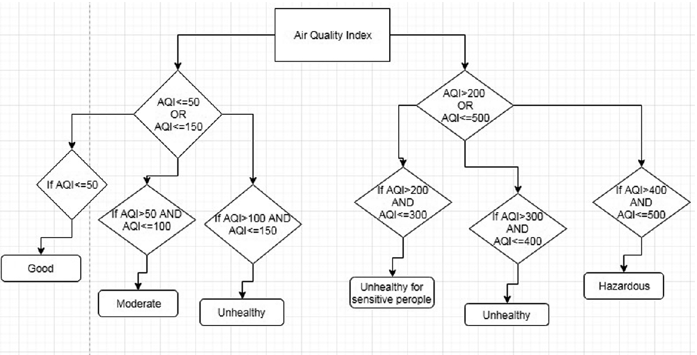
6. System flowchart

Slide 12
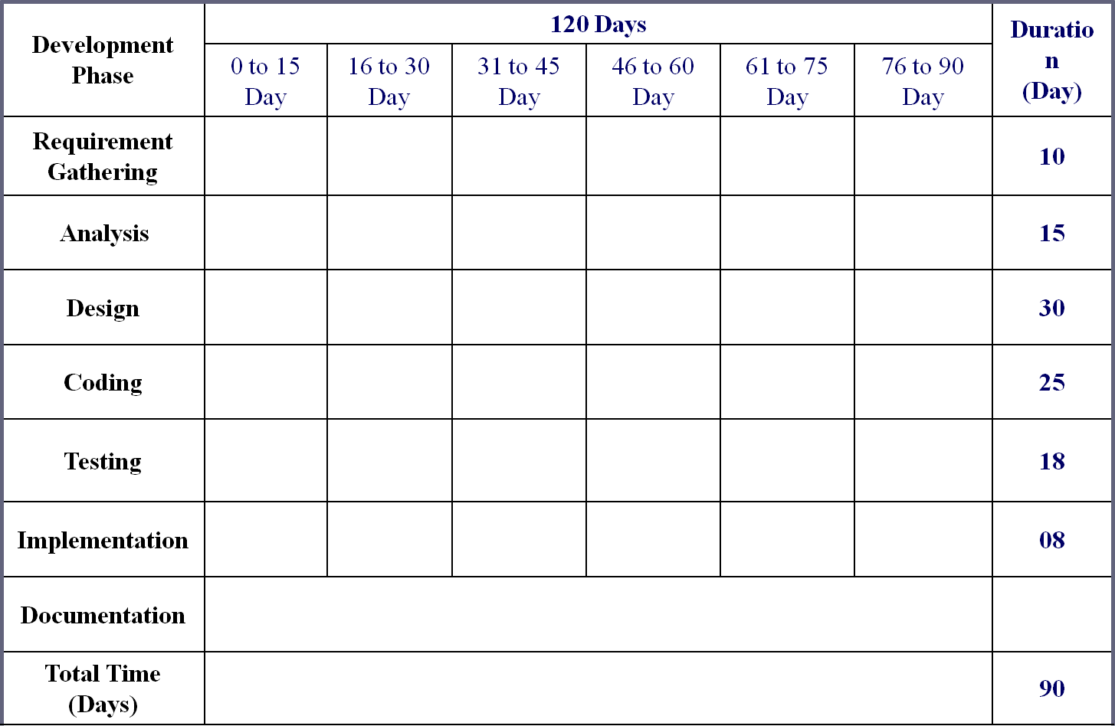
7. Timeline Chart (GANTT)

Slide 13
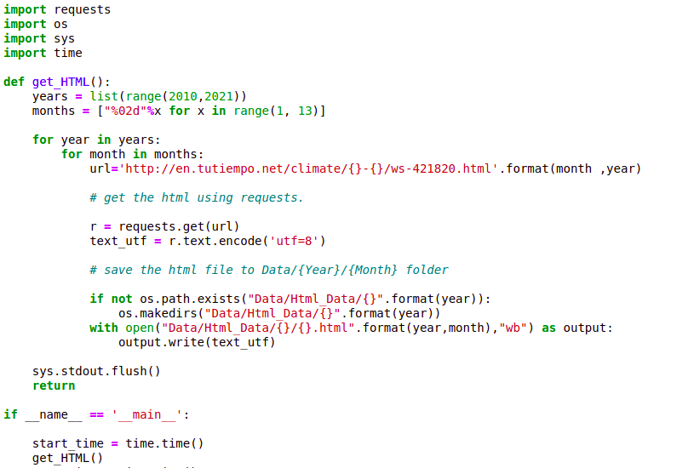
8. GETTING THE DATA
We used Web scraping to acquire the data:-
Gathered weather data from the website: http://en.tutiempo.net/climate/
using the following code:-

Slide 14
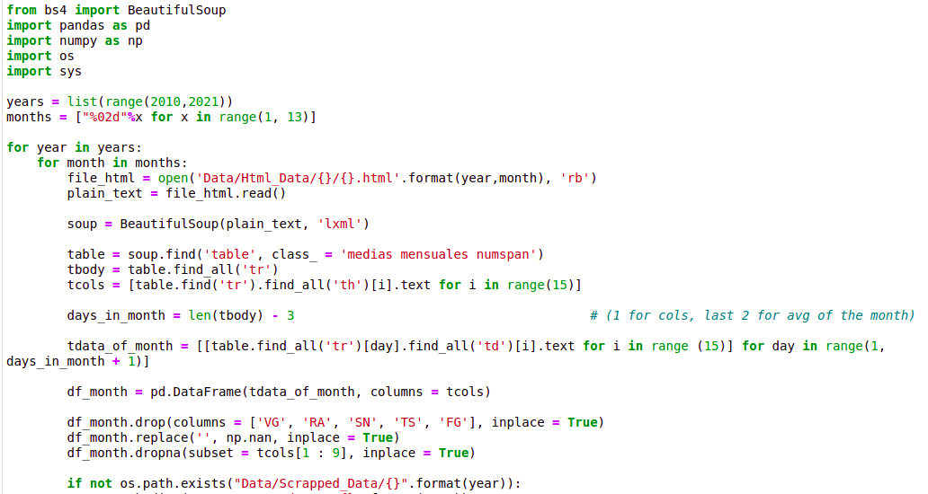
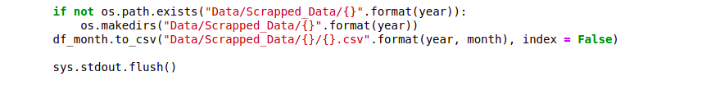
9. SCRAPING THE DATA
Scraped the data in different folders, year wise and month wise.
Gathered PM 2.5 data from the website:
https://aqicn.org/data-platform/register/
Merged the two datasets into one Data.csv file

Slide 15
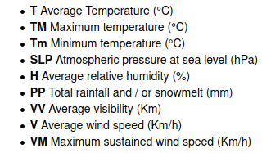
10. DATA DICTIONARY
The following naming convention has been used in the data set:-

Slide 16
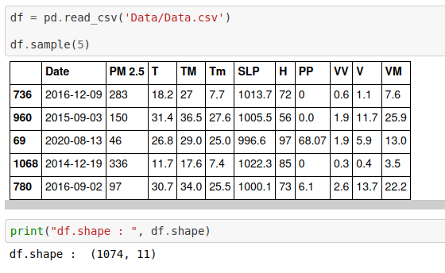
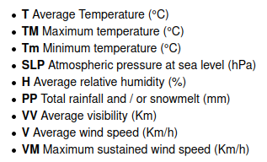
11. DATA CLEANING
11.1 Reading the Dataset
11.2 Dataset Fields

Slide 17
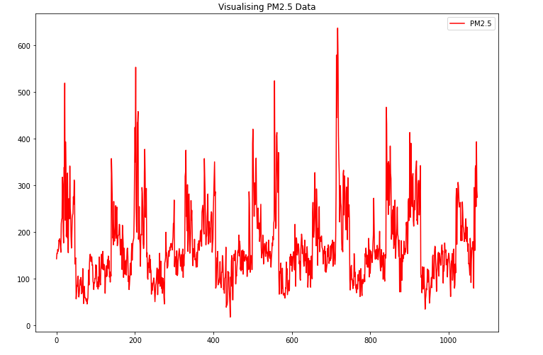
11.3 Visualizing the Dataset

Slide 18
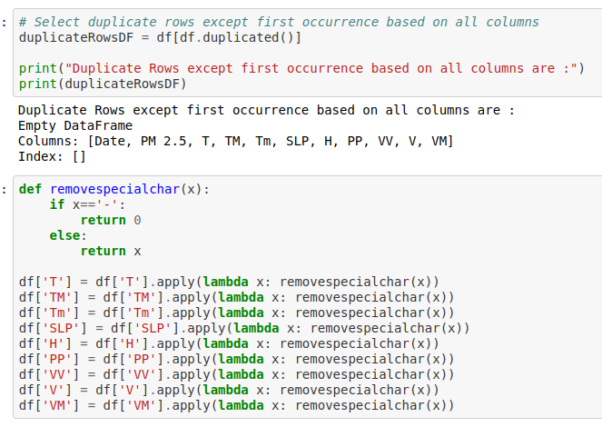
11.4 Removing Duplicates and Special Characters

Slide 19
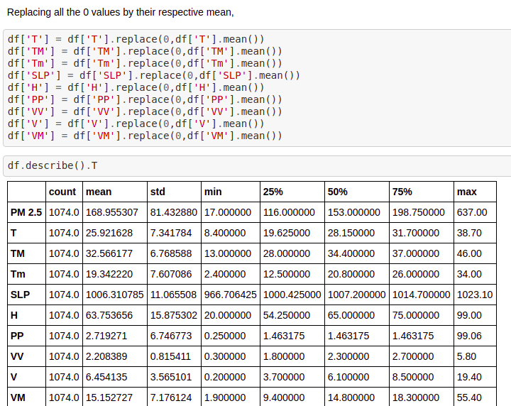
11.5 Replacing 0 values with mean values

Slide 20
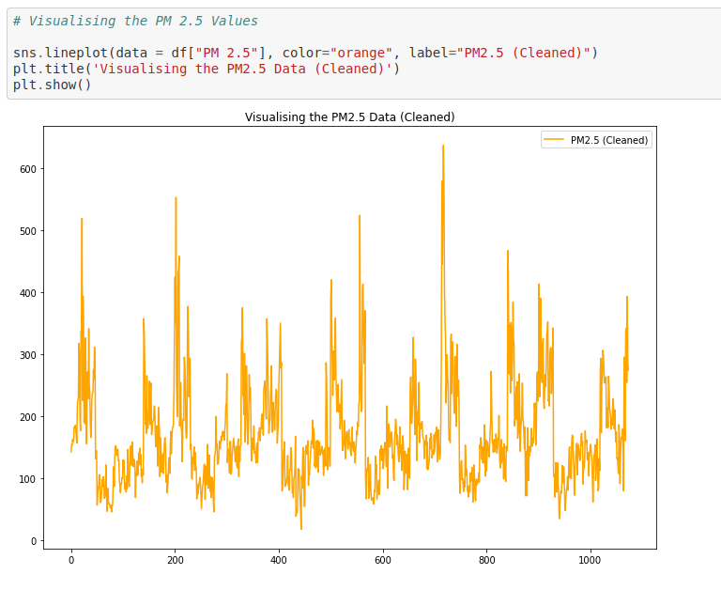
11.6 Visualizing the Dataset (Cleaned)

Slide 21
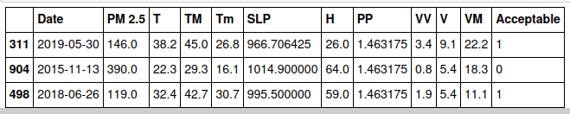
12. DATA ANALYSIS (EXPLORING TRENDS)
Exploratory Data Analysis (EDA)
Fine particulate matter (PM2.5) is an air pollutant that is a concern for people's health when levels in air are high. PM2.5 are tiny particles in the air that reduce visibility and cause the air to appear hazy when levels are elevated.
Outdoor PM2.5 levels are most likely to be elevated on days with little or no wind or air mixing.
Creating a new binary feature Acceptable, its value will be 1 if the PM 2.5 lvl is acceptable and 0 if not.

Slide 22
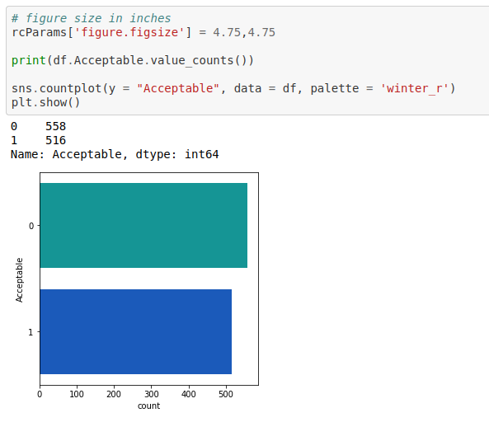
Acceptable Data

Slide 23
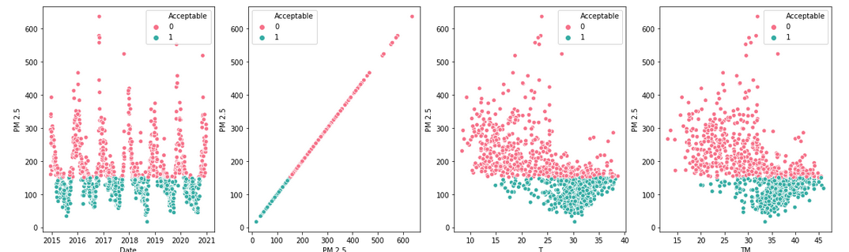
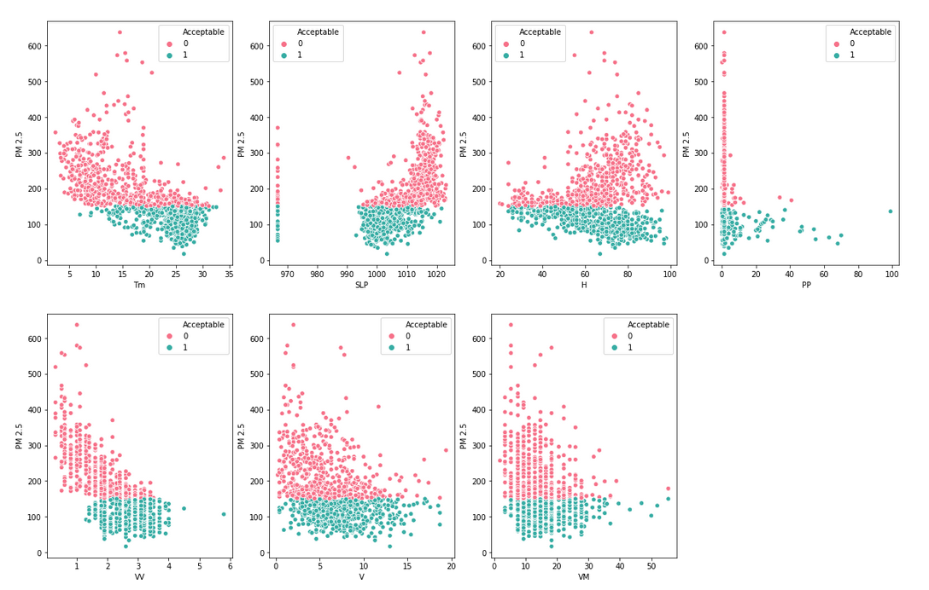
Plot to see the relation between different climatic features and Acceptable PM2.5 levels

Slide 24
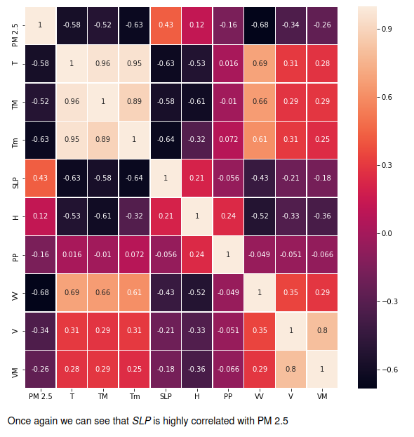
Heat Map of the Analyzed Data
Once again we can see that SLP is highly correlated with PM 2.5

Slide 25
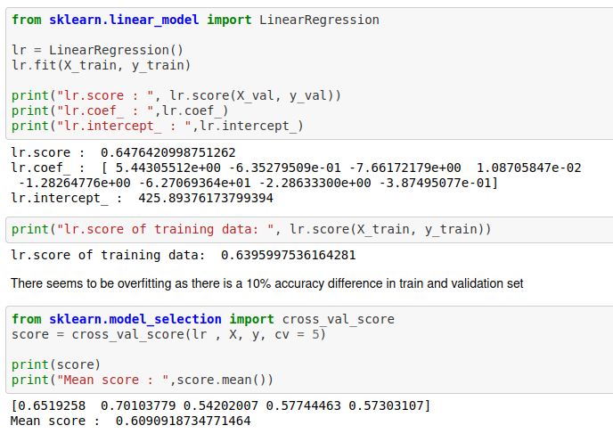
13. APPLYING ALGORITHMS & ERROR ANALYSIS
Preparing Data for Model Preparation and Applying Machine Learning Algos :
We will be applying various Regression algos and then later deploy using the best model.
Linear Regression
Lasso Regression
Decision Forest Regression
Linear Regression

Slide 26
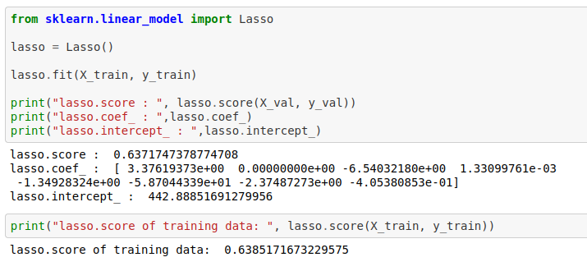
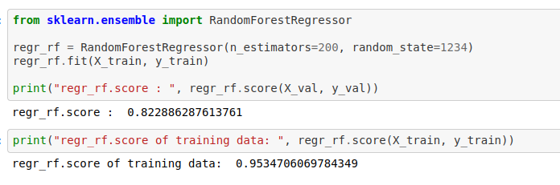
Lasso Regression
Decision Forest Regression

Slide 27
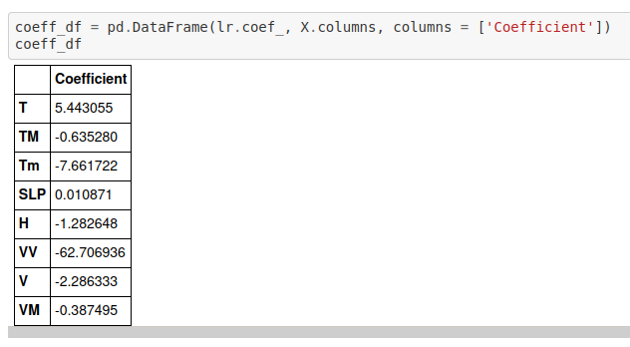
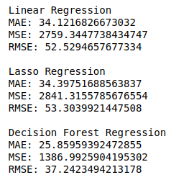
Model Evaluation

Slide 28
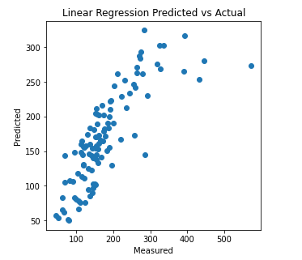
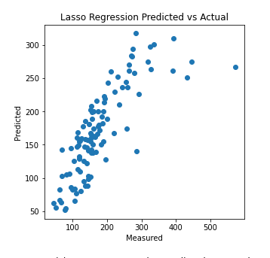
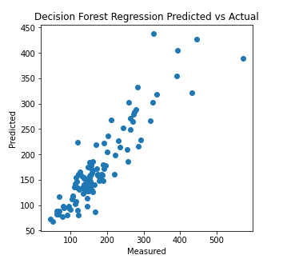
Scatter Maps for Model Evaluation

Slide 29
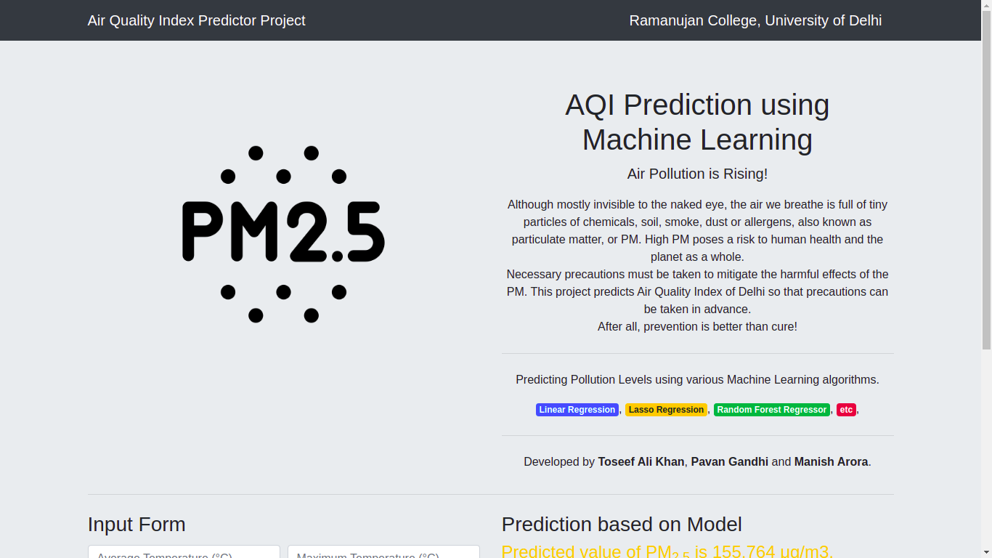
14. POST IMPLEMENTATION REVIEW
After the system implemented and conversion is completed, a review of system is usually conducted by users and analyst this is called post implementation review.
The most fundamental concern post implementation review is determining the system has met its objective, that is analyst want to know if the performance level of the system has improved and if the system is producing the result intended.

Slide 30
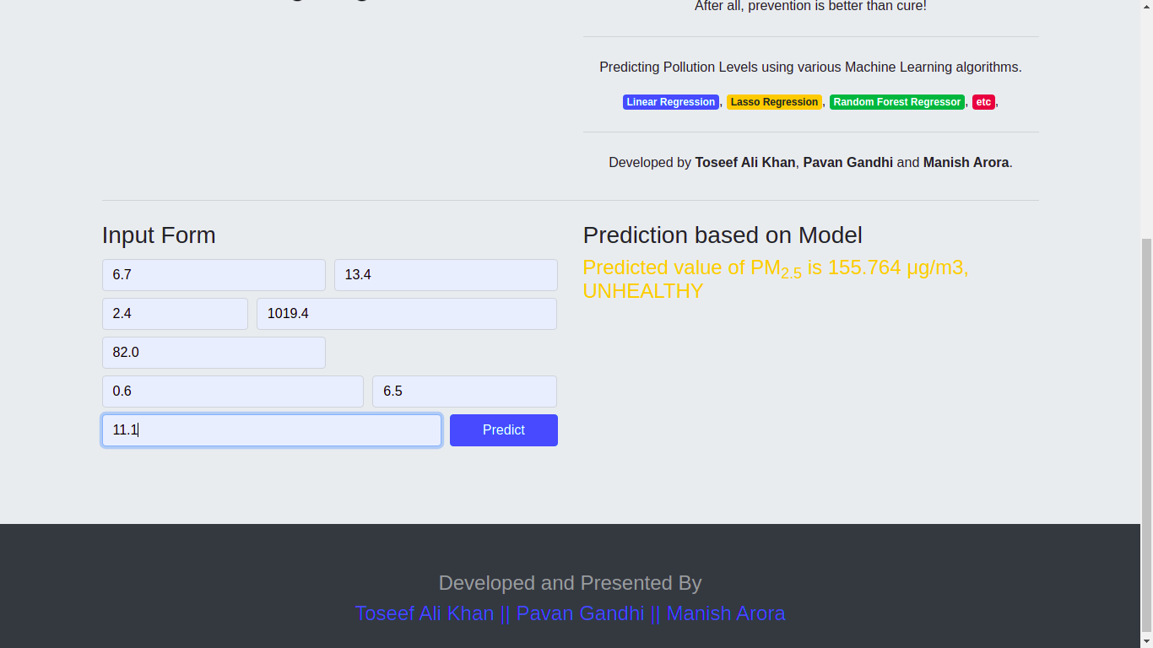
By using current system, all the requirements of all users are fulfilled.

Slide 31
15. FUTURE ENHANCEMENT
In future we will be trying other ML algorithms and models to improve the efficiency of the system.
We will include more functionality as per user requirement.
Not a single website is ever consider as complete forever firstly because there is always something new requirement also are growing day by day.
We want to improved our ml models, as it is the main thing to give better results to all the users.

Slide 32
16. BIBLIOGRAPHY
DATASET :-
https://en.tutiempo.net/climate/ws-421810.html
WEBSITES :-
https://machinelearningmastery.com/linear-regression-for-machine-learning/
https://pandas.pydata.org/
https://cambridgemask.com/blogs/news/6-things-you-need-to-know-about-pm2-5
https://aqicn.org/data-platform/register/

