Slide 1

INTRODUCTION
Presentedby : -
Manish Rajak
Aman Patel Mohamed Athif

Slide 2
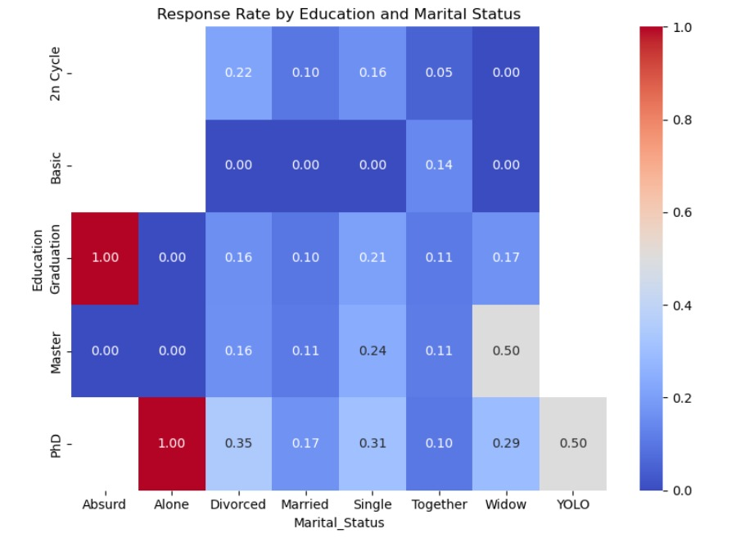
Key Insights:-
1. Response rate is highest among customers who are Graduates and Divorced.
2. Lowest response is seen in Basic education and Married group.
3. Overall, customers with higher education levels (Graduation or Master) respond better to campaigns.

Slide 3
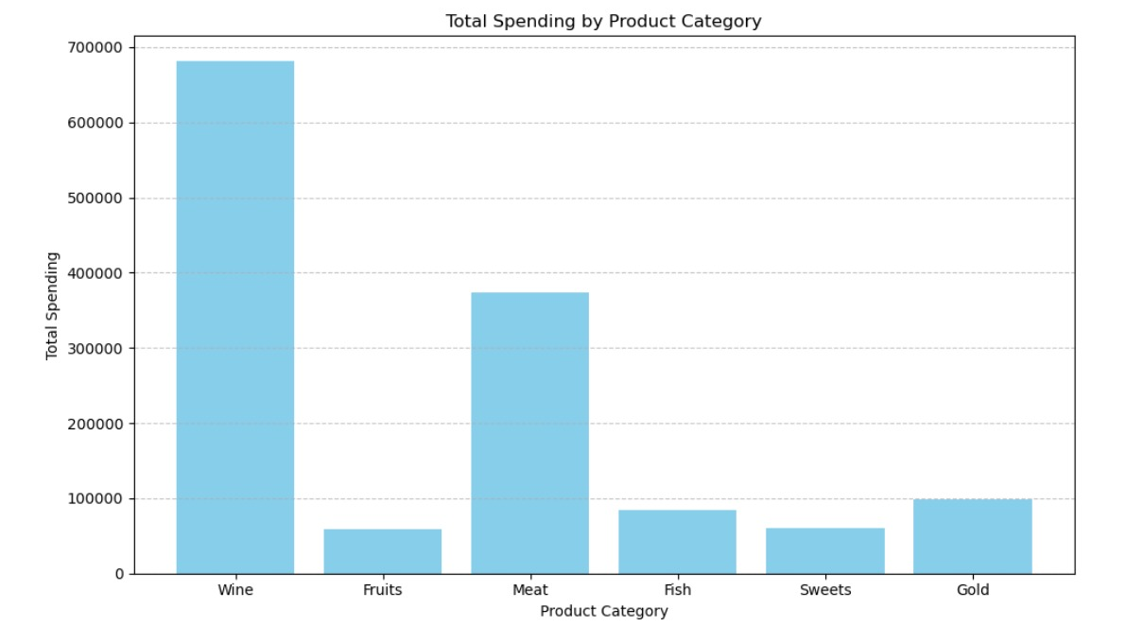
Key Insights:-
1. Customers spend the most on Wine, followed by Meat products.
2. Gold and Fruits have the lowest total spending.
3. This shows customers prefer luxury consumables (like Wine and Meat) over other categories.

Slide 4
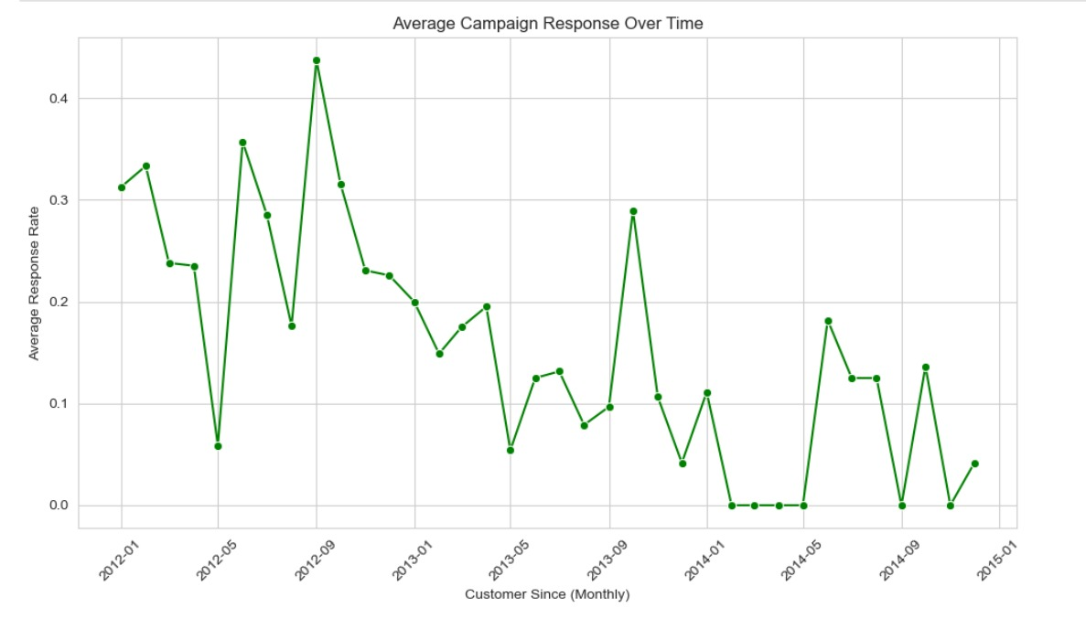
Key Insights:-
1. The average response rate stays mostly low and steady across all months.
2. There is no strong upward trend, which means campaigns may not be improving in effectiveness.
3. For Suggestion: Try new campaign strategies or better targeting to boost responses.

Slide 5
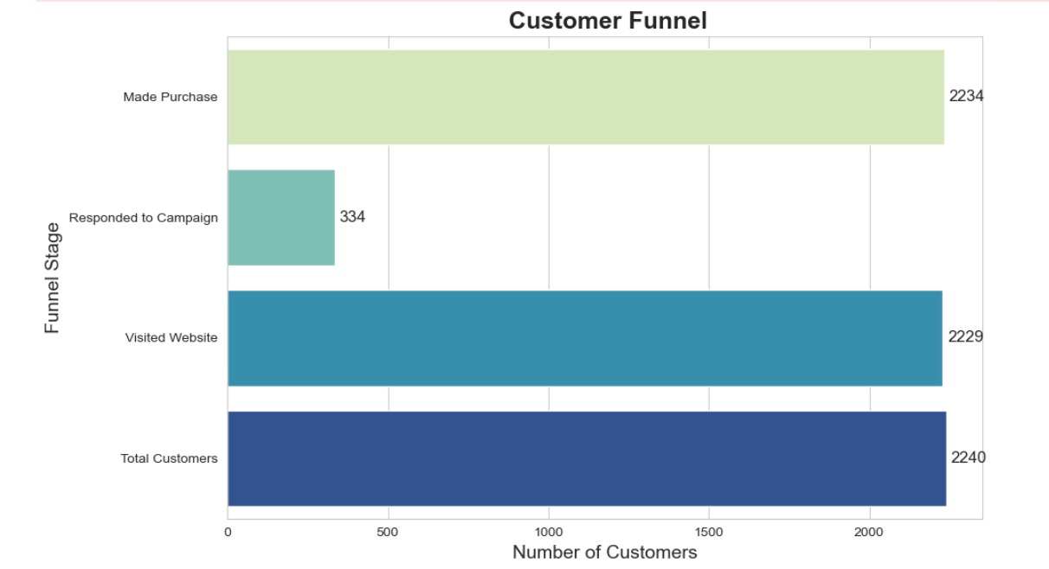
Key Insights:-
1. While there are many total customers, only a smaller group visits the website.
2. Even fewer respond to campaigns, and only a small fraction actually make a purchase.
3. This means most customers drop off before buying so, try to improve website experience, campaign targeting, and follow-ups to reduce drop-off.

Slide 6
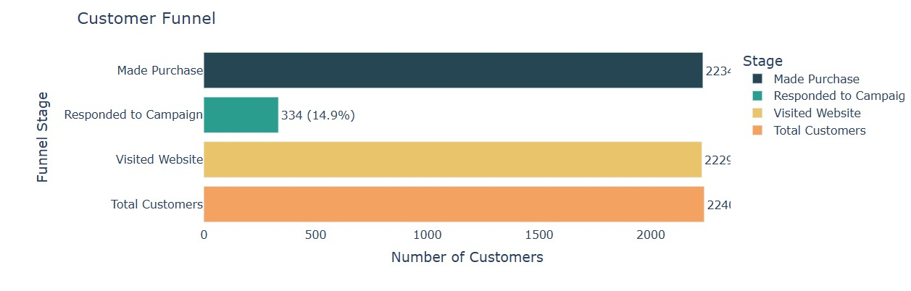
Key Insights:-
1. Out of all customers, only ~43% visit the website.
2. Just 15% respond to campaigns, and around 12% actually make a purchase.
3. This shows a big drop between each step, especially after visiting the website.
4. To increase sales, improve your campaign targeting and guide website visitors better toward making a purchase.

Slide 7
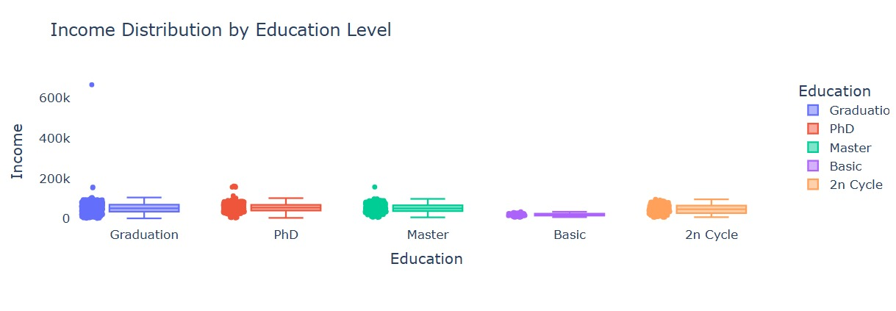
Key Insights:-
1. Customers with PhD and Master’s degrees generally have higher incomes.
2. Basic and 2n Cycle education groups have the lowest income ranges.
3. There's a wide variation (outliers) in income, especially in higher education groups.
4. Targeting highly educated customers may be better for premium products or campaigns.

Slide 8
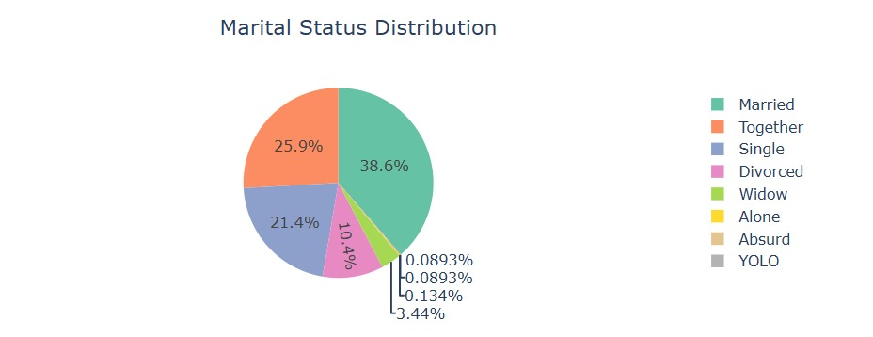
Key Insights:-
1. Most customers are Married and Together – these two groups make up the majority.
2. Single and Divorced customers are also present in decent numbers.
3. Very few customers are Widowed or in Other categories.
4. This helps in designing targeted campaigns based on relationship status.

Slide 9
Thank You

