Slide 1







Superstore Sales Analysis
Presented by:
Moumita Majumder Mohamed Athif Manish Rajak

Slide 2


Introduction:
In today’s competitive retail landscape, understanding sales performance is crucial for making informed business decisions. This project presents an in-depth analysis of Superstore sales data using data science techniques. By exploring key metrics such as sales, profit, and customer behavior across different regions, categories, and segments, we aim to uncover hidden patterns and actionable insights.
The analysis is performed using Python and data visualization tools to transform raw data into meaningful business intelligence. This presentation highlights the most impactful trends that influence profit and performance in the Superstore's operations.

Slide 3
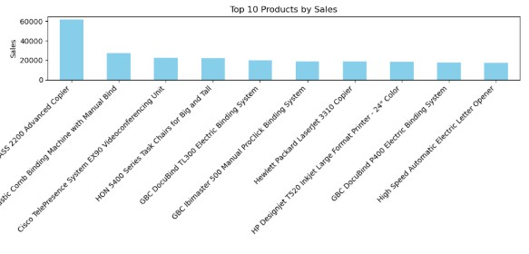


Key Insight:
Canon imageCLASS 2200 leads with sales over
₹61,000.
Most top-selling products are office electronics and binders.
High-value tech items contribute significantly to total revenue.
1.Bar Chart – Top Products by Sales

Slide 4
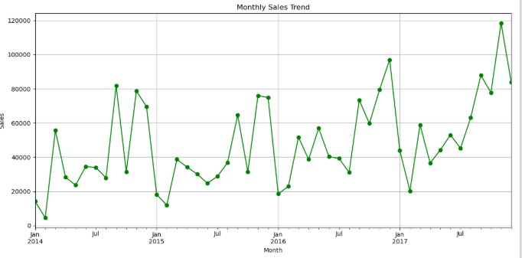


Key Insight:
Sales show a clear upward trend toward the end of each year (Q4 spike).
Seasonal peaks often occur in November and December, likely due to holiday shopping.
Some months, like January and February, may reflect lower sales activity, showing seasonality.
2.Line Chart – Monthly Sales Trend

Slide 5

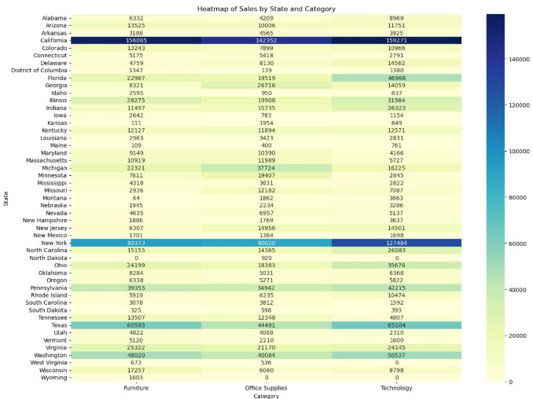


Key Insight:
California typically dominates sales across all categories, especially Technology.
New York and Texas often follow, showing strong performance in Office Supplies.
Some states like Wyoming or Montana may show low or negligible sales, indicating less market penetration.
3.Heatmap – Sales Distribution by State and Category

Slide 6

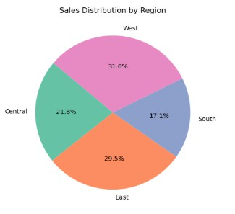
Key Insight:
The West region usually contributes the highest share of total sales.
East and Central regions follow with moderate sales contributions.
The South often lags in sales, indicating potential for market growth.
4.Sales Distribution by Region (Pie Chart)

Slide 7

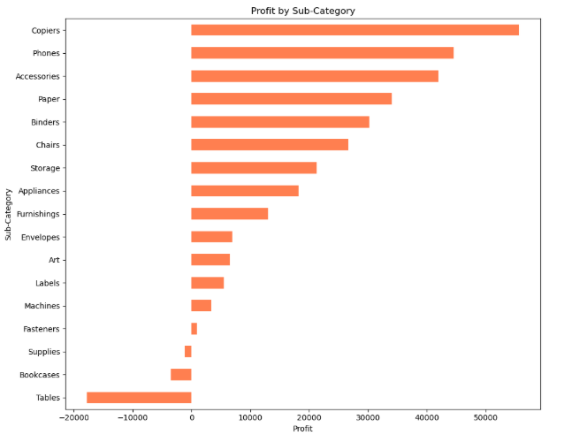
Key Insight:
Copiers and Phones generate the highest profits among all sub-categories.
Tables consistently show negative profit, indicating losses despite sales.
Binders and Supplies also perform poorly in terms of profitability.
5.Sub-Category Profitability (Horizontal Bar Chart)

Slide 8
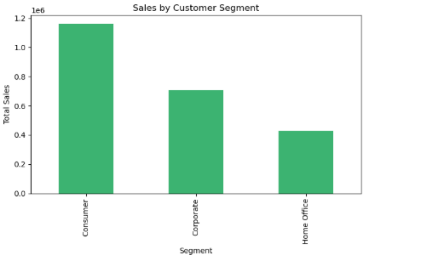

Key Insight:
The Consumer segment generates the highest sales volume.
Corporate customers contribute moderately to overall sales.
The Home Office segment lags behind, suggesting untapped potential.
6.Sales by Customer Segment (Bar Chart)

Slide 9

Conclusion
In conclusion, the Superstore sales analysis uncovered valuable insights into the company’s performance across regions, categories, and customer segments. The data shows that technology and office equipment are the most profitable product lines, while categories like tables and binders often incur losses. Sales are highest in the West region and among Consumer customers, indicating strong market presence in those areas. Conversely, the South region and Home Office segment show lower sales, suggesting opportunities for growth. Overall, this analysis highlights the importance of leveraging data to guide strategic decisions in marketing, inventory, and regional expansion.

Slide 10


Thank You For Attention

