Slide 1
Project Phase 2: Build
Smart Study Planner & Quiz Generator
Code Implementation, Screenshots & System Workflow
Project Structure
Code Walkthrough
Application Screens
GitHub Repository
Name: Manish Kumar Mayank
USN: 1OX22AI025
Email: manishkmaiml2026@gmail.com
Internship Domain: Web Development with Gen-AI
Internship Company: FUTUREACAD Pvt. Ltd.

Slide 2
01 Project Structure & File Organization
Complete file structure with frontend, backend, and configuration files
Backend (Spring Boot)
Frontend (React)
backend/
src/main/java/com/studyplanner/
controllers/
- AuthController.java
- QuizController.java
- ScheduleController.java
models/
- AuthProvider.java
- Quiz.java
- QuizScore.java
- Schedule.java
- User.java
repositories/
- QuizRepository.java
- QuizScoreRepository.java
- ScheduleRepository.java
- UserRepository.java
security/
- CustomUserDetailsService.java
- JwtRequestFilter.java
- JwtUtil.java
- OAuth2LoginSuccessHandler.java
- SecurityConfig.java
services/
- GeminiService.java
- BackendApplication.java
frontend/public/src/
api/
- axiosInstance.js
components/
- Navigation.jsx
pages/
- AuthPage.css
- AuthPage.jsx
- Dashboard.css
- Dashboard.jsx
- LandingPage.css
- LandingPage.jsx
- Leaderboard.css
- Leaderboard.jsx
- QuizGenerator.css
- QuizGenerator.jsx
- SchedulePlanner.css
- SchedulePlanner.jsx
- App.css
- App.jsx
- index.css
- main.jsx
- index.html
- package-lock.json
- package.json
- README.md
- vite.config.js

Slide 3
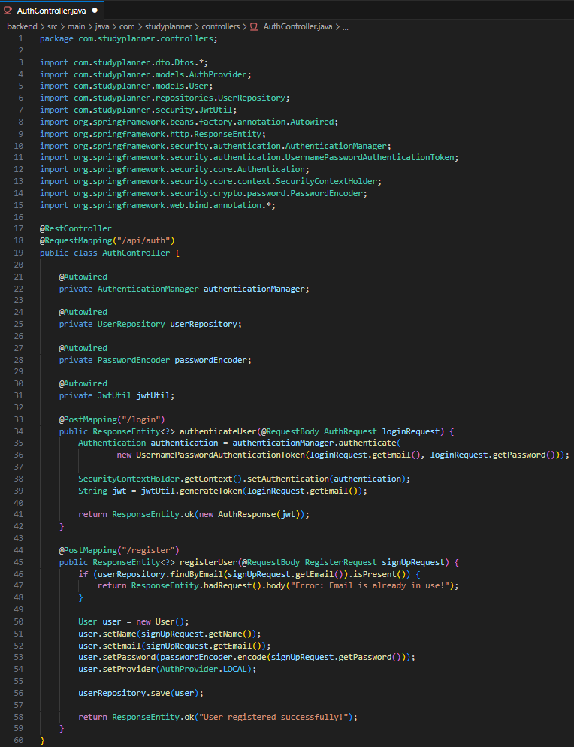
02 Backend Code — Authentication Flow
Authentication
Workflow
1. User Registration • Email/password validation • Password hashing (BCrypt) • User entity saved to MySQL 2. Google OAuth Flow • Redirect to Google • Exchange code for token • Create user profile 3. JWT Session • Generate token • Validate on API calls

Slide 4
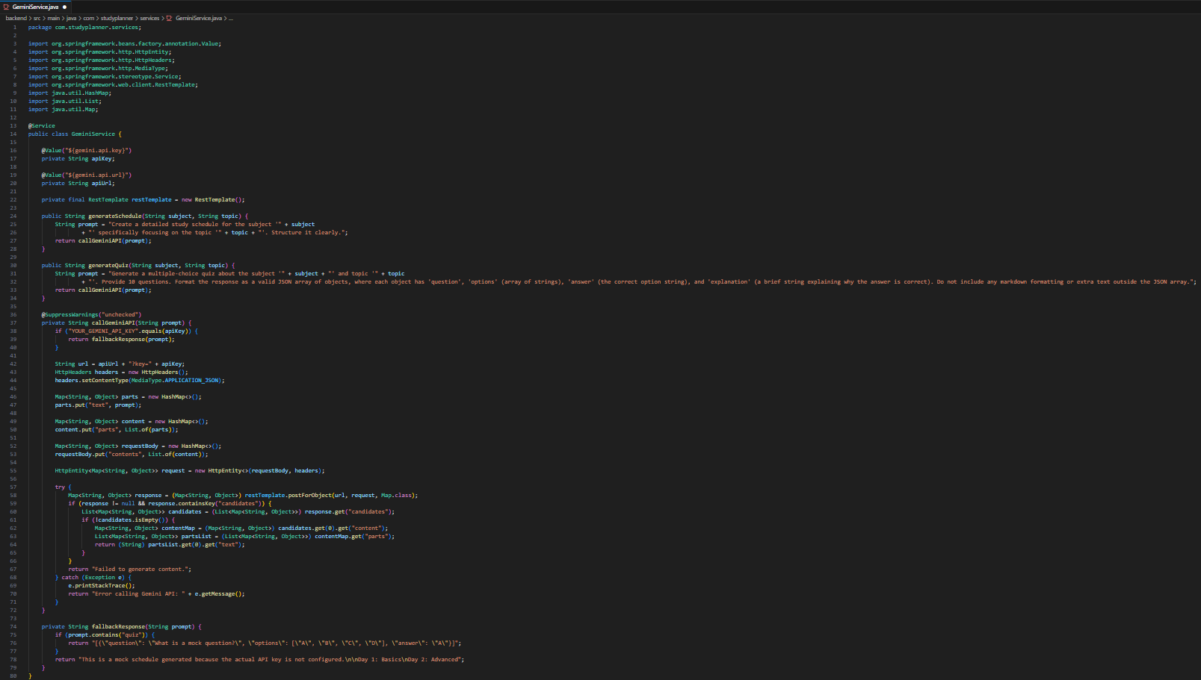
03 Backend Code - Gemini API
Integration
AI Generation
Workflow
Schedule Generation: 1. Receive subject+topic 2. Construct prompt 3. POST to Gemini API 4. Parse JSON response 5. Save to database Quiz Generation: 1. Request MCQs 2. Validate format 3. Save quiz entity 4. Return questions

Slide 5
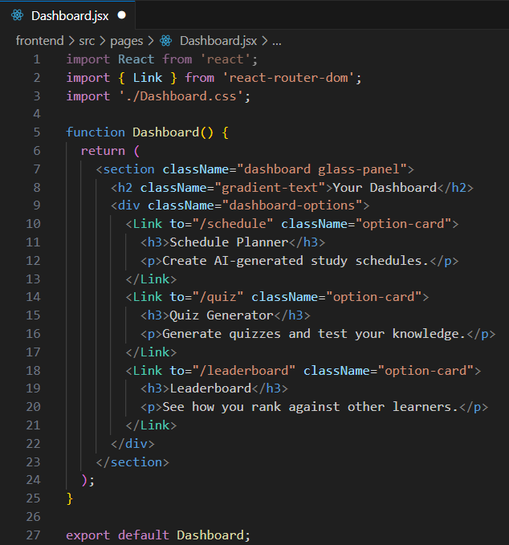
04 Frontend Code — Dashboard
Component
Component
Structure
State Management: • useState for session • useEffect for auth Navigation: • Card 1: Schedule Gen • Card 2: Quiz Gen • Routing to modules Services: • authService.js • scheduleService.js • quizService.js

Slide 6
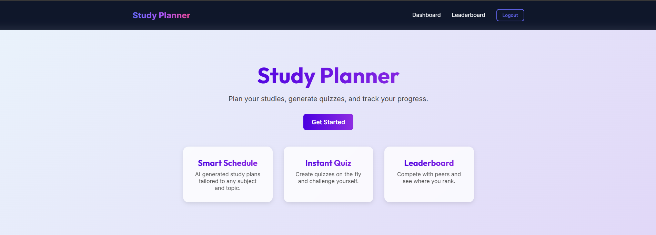
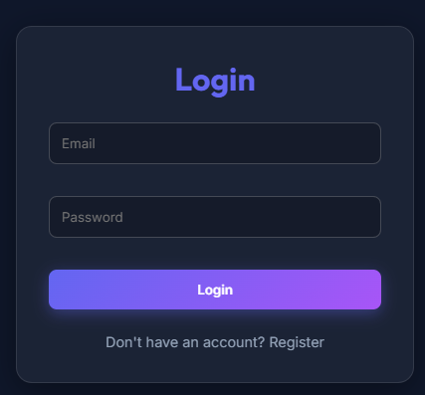
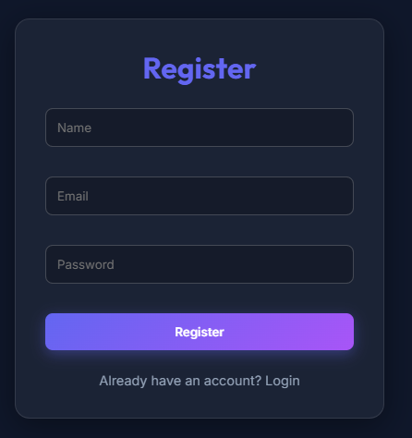
05 Application Screenshots —
Landing & Auth
Landing Page
Login Page
Registration Page

Slide 7
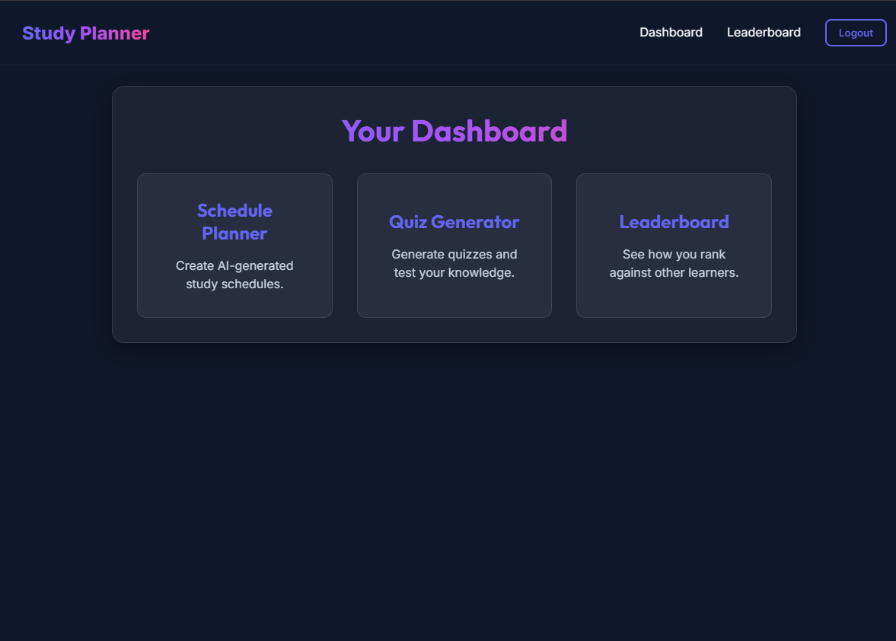
06 Application Screenshots —
User Dashboard

Slide 8
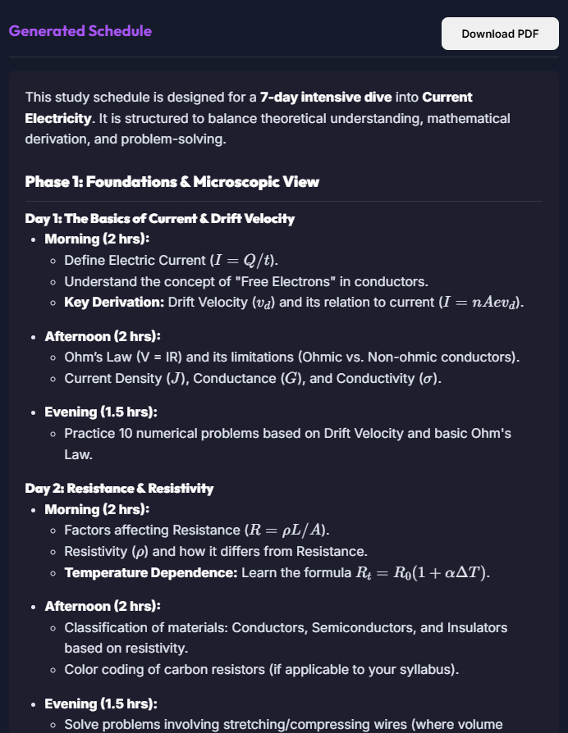
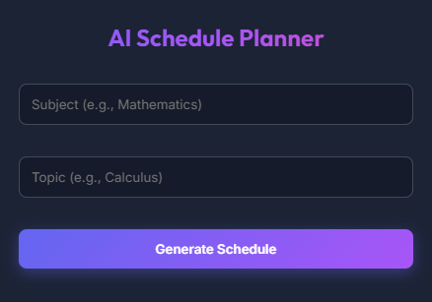
07 Application Screenshots —
Schedule Generator
Input Form
Generated Output

Slide 9
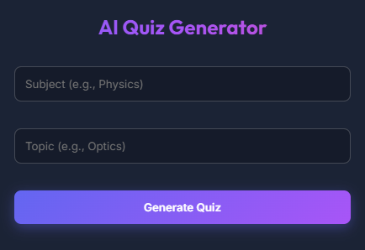
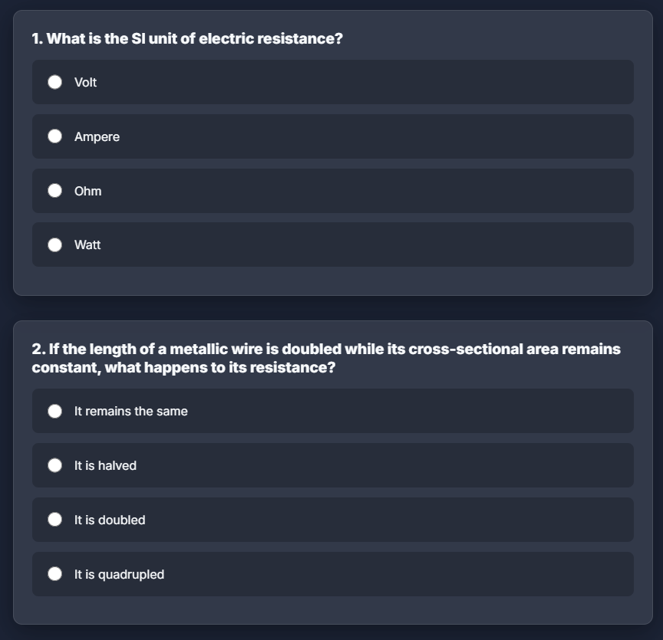
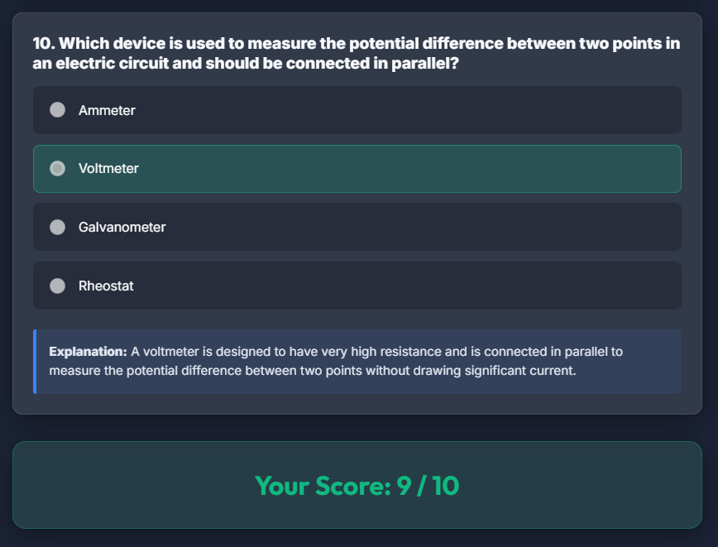
08 Application Screenshots —
Quiz Generator
Quiz Setup
Active Quiz View

Slide 10
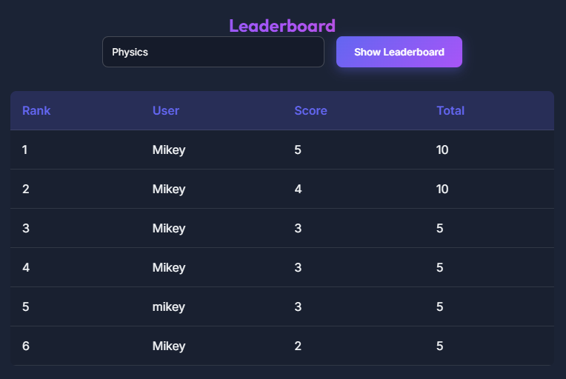
09 Application Screenshots —
Leaderboard

Slide 11
10 Database Schema (MySQL)
User
Quiz
Schedule
id (PK) email password_hash oauth_provider oauth_id created_at
id (PK) user_id (FK) subject topic score attempted_at
id (PK) user_id (FK) subject topic schedule_json generated_at
Relationships:
• User → Quiz: One-to-Many • User → Schedule: One-to-Many • Quiz scores aggregated for leaderboard

Slide 12
11 GitHub Repository &
Source Code
[ INSERT YOUR GITHUB REPOSITORY URL HERE ]
Complete frontend and backend code
Database schema & scripts
Setup instructions

Slide 13
Implementation Complete.
The Smart Study Planner is fully functional with AI-powered scheduling, dynamic quiz generation, and competitive leaderboards.
Code Reviewed
Screens Captured
Database Structured
Deployed & Tested

