Slide 1


SMART INDIA HACKATHON 2025
TITLE PAGE
Problem Statement ID- 25102
Problem Statement Title- AI-Based Drop-Out Prediction and Counselling System
Theme- Smart Automation
PS Category- Software
Team ID-
Team Name (Registered on portal)-

Slide 2
IDEA TITLE
Proposed Solution
AI system for predicting student dropouts. Personalized counseling & preventive measures. ML-based insights & real-time dashboard. Alerts for at-risk students.
Detailed explanation of the proposed solution
Early identification of dropout-prone students. Timely counseling & support. Data-driven, unbiased decisions. Reduced manual monitoring
How it addresses the problem
Prediction + actionable counseling combined. Personalized AI-driven guidance. Considers academic & psychological factors. Scalable across institutions.
Innovation and uniqueness of the solution

Slide 3
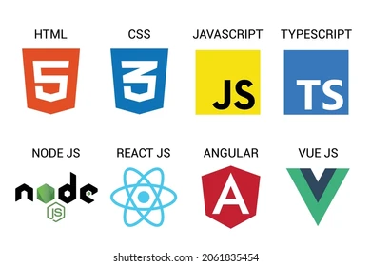
















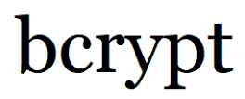


TECHNICAL APPROACH
Technologies
Architectural Flow
Client/Server Side
Data Analysis & Machine Learning
Attendance, test scores, fees, academic records
1
2
3
4
5
6
7
Collect Data:
Preprocess Data:
Clean missing values, normalize, handle categories
Feature Engineering:
Extract indicators (attendance %, avg. score, attempts)
Encryption and security
PDF conversion of data
Model Development:
Train & validate model
Database
Predict Risk:
Low / Medium / High
Dashboard Alerts:
Show results, early warnings
Counselling & Support:
Advice, mentor follow-up, academic help

Slide 4
FEASIBILITY AND VIABILITY
Analysis of the feasibility of the idea
The idea is highly feasible due to:
Built using free, open-source tools (MySQL, Flask, Pandas, Chart.js).
Modular design allows easy upgrades and scalability.
Rule-based dropout detection provides quick and reliable results..
Works effectively even with small datasets (simple CSV to database integration).
Can be hosted locally, eliminating extra costs.
Potential challenges and risks
Ensuring data security (student personal info is sensitive). Managing large-scale datasets across multiple institutions. Ensuring user adoption (teachers may resist new tools). Maintaining accuracy & reducing false alarms.
Strategies for overcoming these challenges
Use encryption & authentication for secure access. Optimize backend (FastAPI/Node.js) for scalability. Design intuitive & user-friendly UI for teachers & parents. Iterative testing with sample student data before deployment.

Slide 5
IMPACT AND BENEFITS
Potential impact on the target audience
Benefits of the solution
Enables early identification of students at risk of dropping out.
Reduces manual workload for mentors and administrators.
Promotes data-driven decisions, minimizing personal bias.
Can be applied across schools, colleges, and universities.
Enables personalized student counseling.
Improves student retention and academic performance.
Increases transparency and accountability in the system.
Supports institutions in achieving their educational goals.
Provides real-time alerts to parents and mentors.

Slide 6
RESEARCH AND REFERENCES
https://unesdoc.unesco.org
https://www.nature.com/articles/s41598-025-93918-1
https://pmc.ncbi.nlm.nih.gov/articles/PMC7334184
https://datascience.codata.org/articles/10.5334/dsj-2019-014
https://www.mdpi.com/2414-4088/9/1/3

