Slide 1


Road Crash Data Analysis & Visualization (South Australia, 2019–2023)
Course Code: INT217 Lovely Professional University
by Manish Kumar Singh

Slide 2

Introduction
Project Purpose
Importance
Analyze road crashes to improve safety and awareness.
Crash data helps identify risks and supports prevention.
Why Excel?
User-friendly tool with powerful data analysis capabilities.

Slide 3
Project Objectives
1. Identify crash trends over recent years
2. Analyze the trend of road accidents over time
3. Assess impact of impaired driving on crash severity
4. Analyze severity levels across regions
5. Evaluate traffic control measures' effectiveness

Slide 4
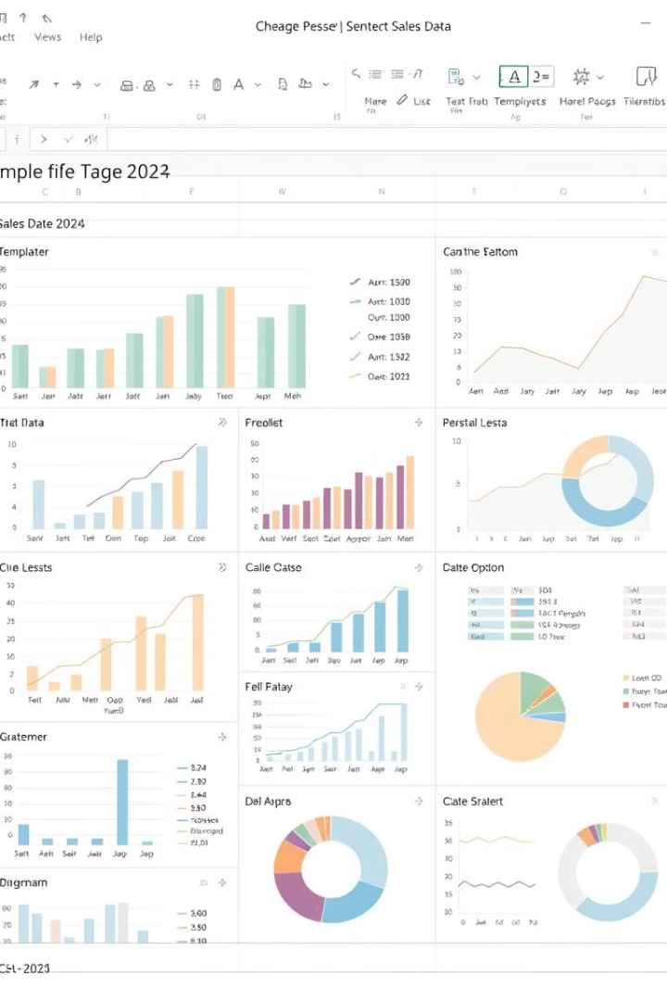
Tools & Methods Used
Pivot Tables & Slicers
Charts & Visualization
Filter Using Slicer
Efficient grouping and filtering of crash data
Visual tools to highlight trends and comparisons
Slicers for interactive filtering (by year, suburb, DUI, etc.)

Slide 5
Objective 1 – High-Risk Stats
Area / Suburbs / Postcodes
Pivot Tables grouped data by suburb to calculate Total Casualities.
Top Stats Area displayed in a bar chart for easy interpretation.
Identifies hotspots for targeted safety interventions.

Slide 6
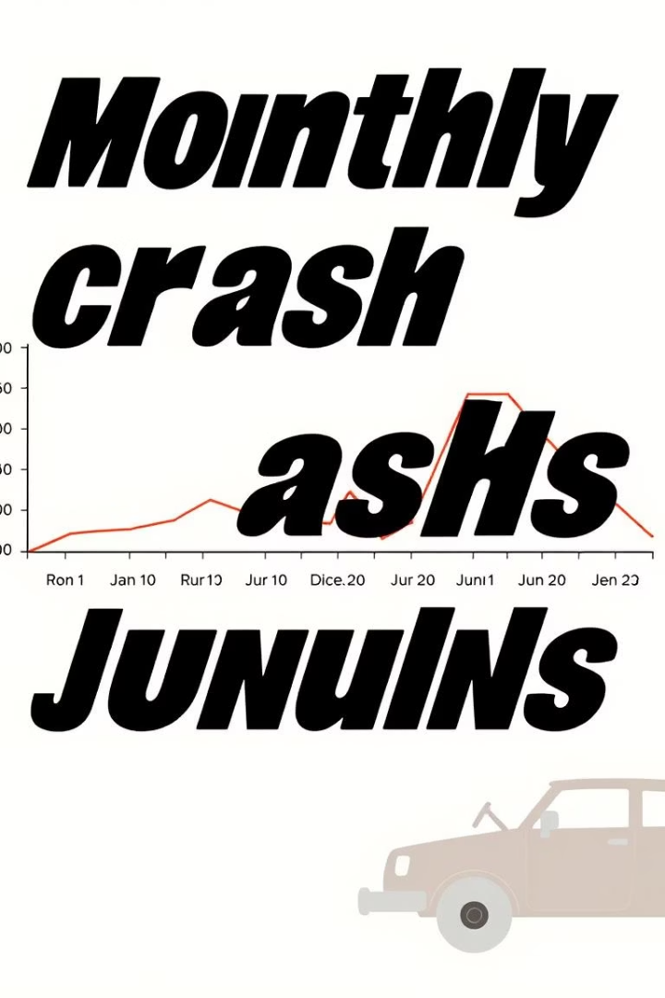
Objective 2 – Crash Trends Over Time
Date Extraction
Used year/month fields from crash data for time analysis.
Trend Insights
Spikes observed in between April to May every year, indicating seasonal effects.

Slide 7
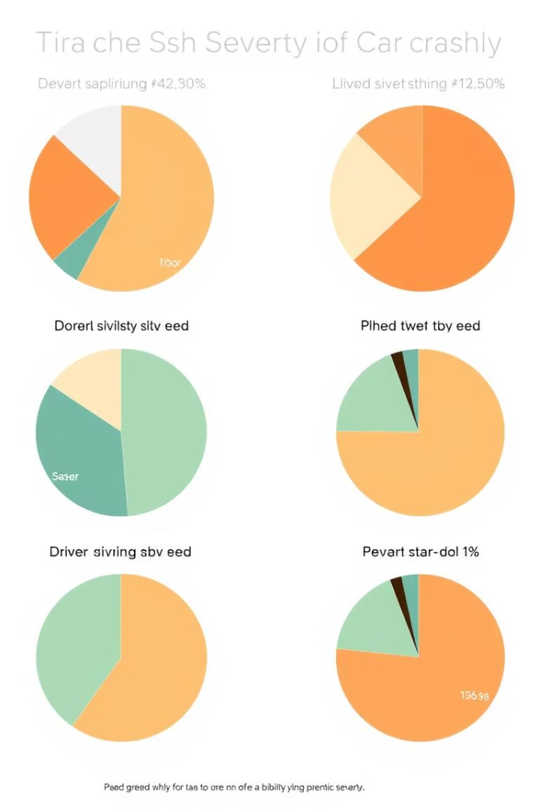


Objective 3 – Impaired Driving Impact
Data Combination
Combined DUI and drug data for unified analysis.
Severity Comparison
Charts reveal higher severity in impaired driving crashes.

Slide 8
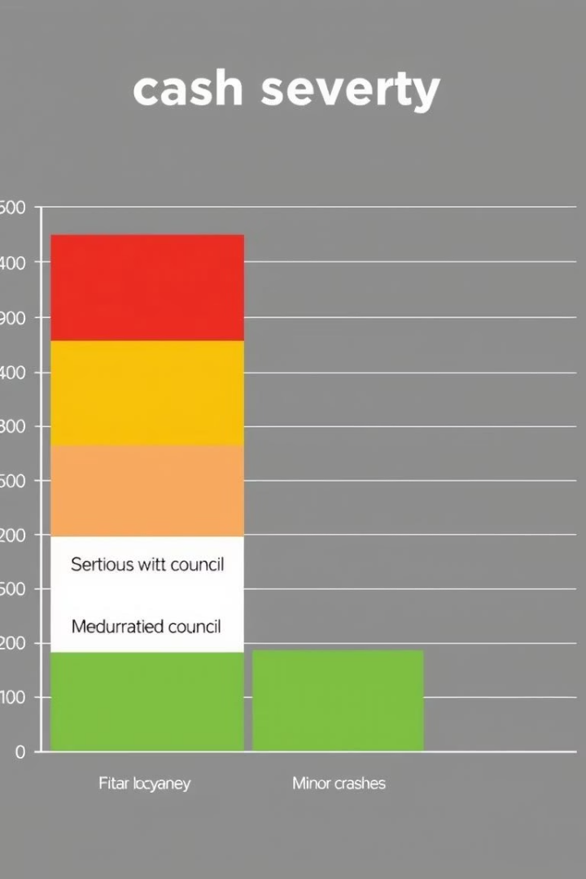
Objective 4 – Regional Severity Analysis
Grouped crashes by Local Government Area (LGA) to identify severity variations.
Stacked bars illustrate distribution of severity levels per region.

Slide 9
Objective 5
Analyzed impact of traffic control types on crash severity.
Dashboard uses slicers for interactive data exploration.
“No Control” zones linked to more severe outcomes.
Pivot summaries provide quick insights.

Slide 10
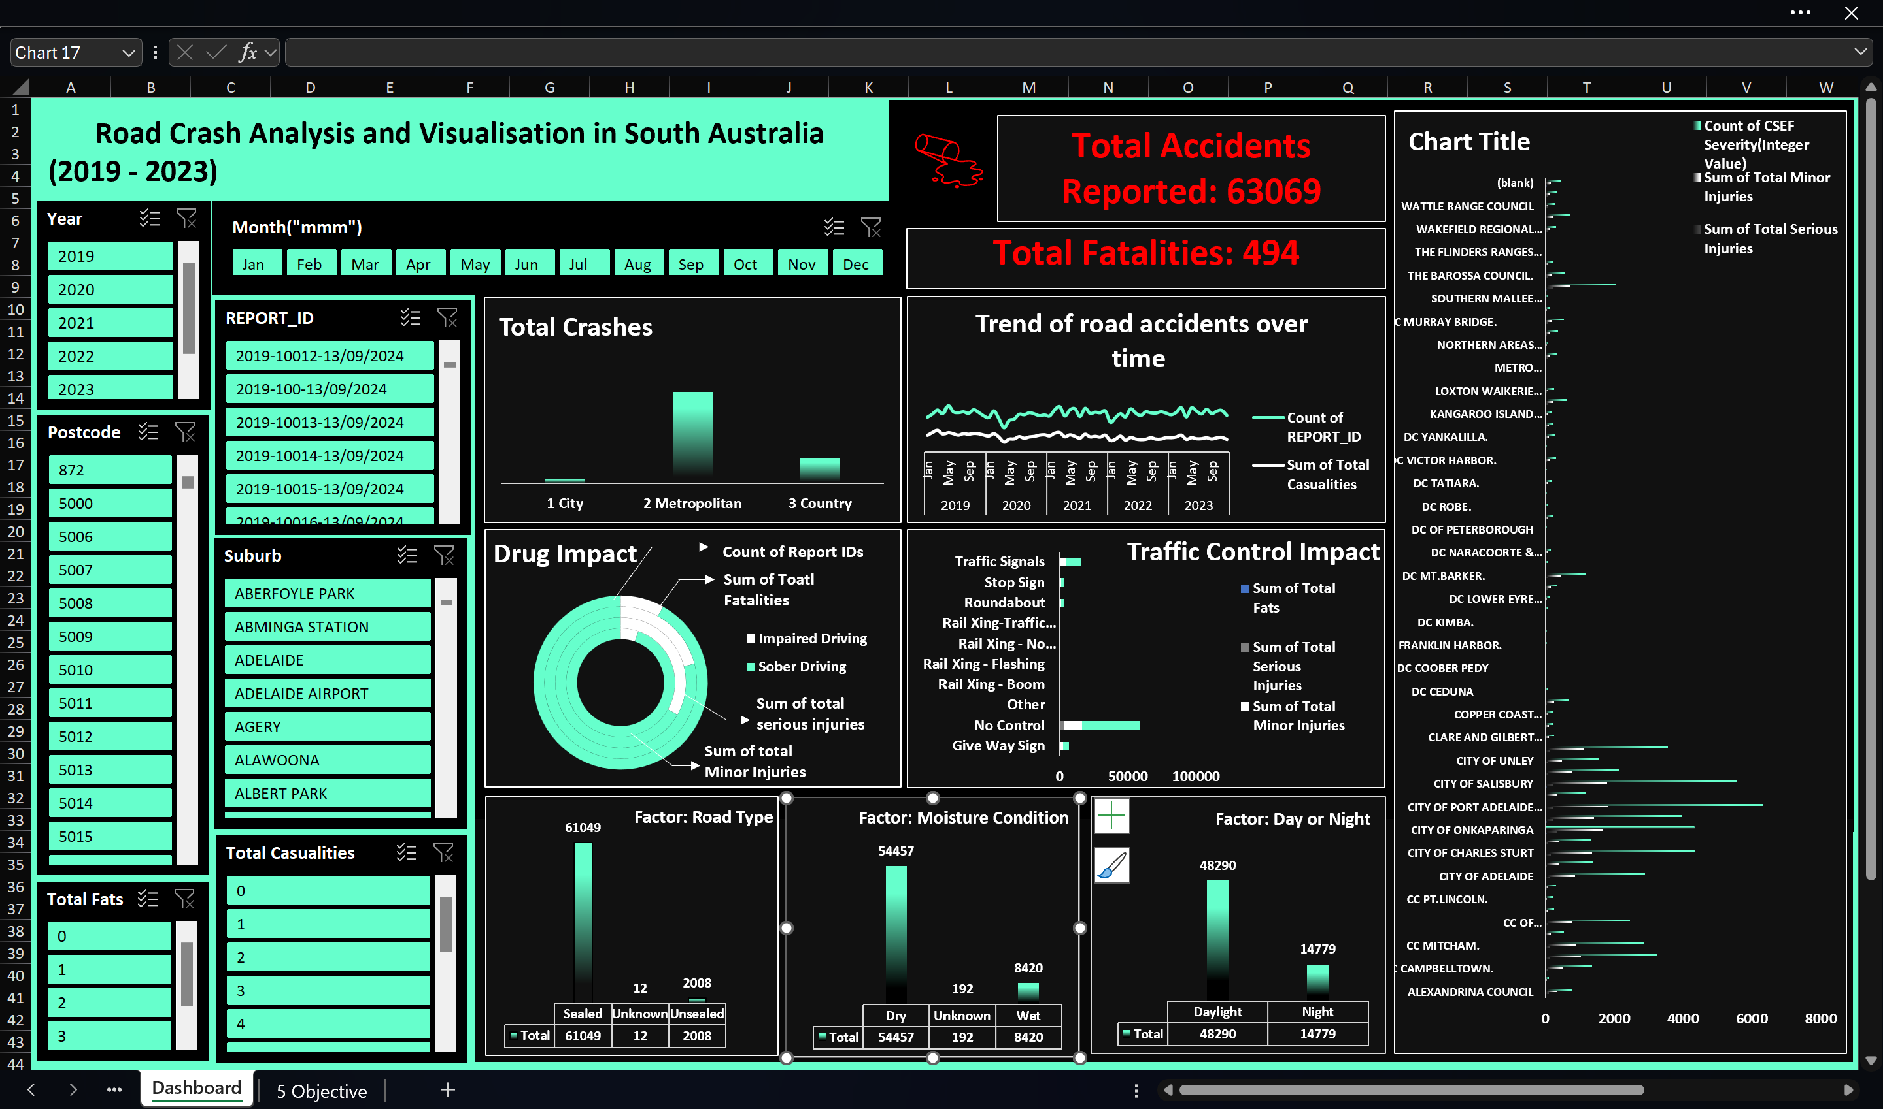
Dashboard Overview

Slide 11
Go to Linkedin Post
Go to Excel Dashboard
Go to Report of Project

Slide 12
Thank You
Grateful for your guidance Mam — Excel finally makes sense thanks to you.

