Slide 1
Capstone Project
Stock Market Portfolio Optimization
Presented by: Manish Malik
Batch: PGA-43

Slide 2

Objective
Analyzing Historical Data: Stock market portfolio optimization involves analyzing price trends, calculating expected returns and volatilities.
Correlation between Stocks: Determining the correlation between different stocks to achieve diversification.
Generating report: We can construct an efficient portfolio that represent the optimal trade-off between risk and return.

Slide 3


DATASET
This Dataset contains the recent 365 days of stock market data of the ['RELIANCE.NS', 'TCS.NS', 'INFY.NS', 'HDFCBANK.NS’]
This data is dynamic and has been downloaded by using the API of yahoo finance.

Slide 4

Data Pre-Processing
Data has been preprocessed using the melt and the pivot function to convert the data into a long form and then to get the desired columns.
Date has been formatted into the Date format.

Slide 5
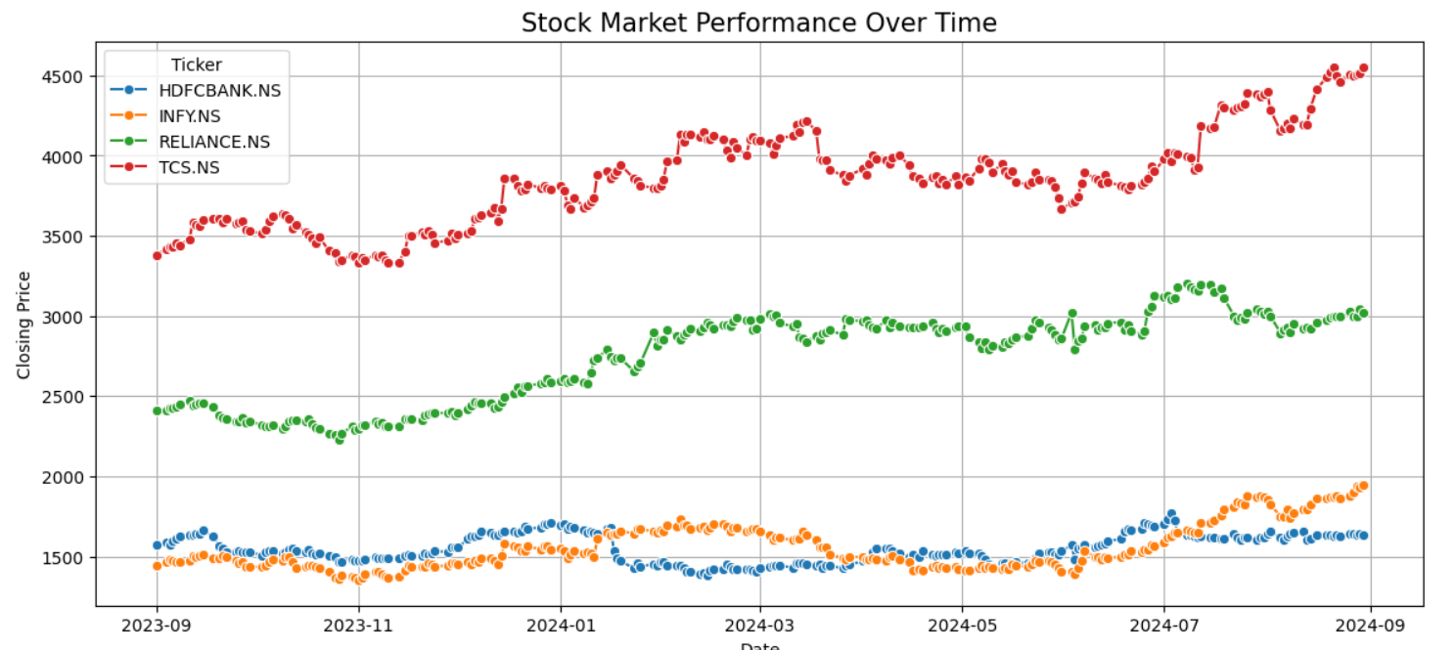
Exploratory Data Analysis
This graph displays the adjusted close prices of four stocks over time. It shows:
TCS has the highest adjusted closed prices, followed by Reliance.
Infosys and HDFCBANK exhibit more stability with relatively lower price fluctuations.

Slide 6
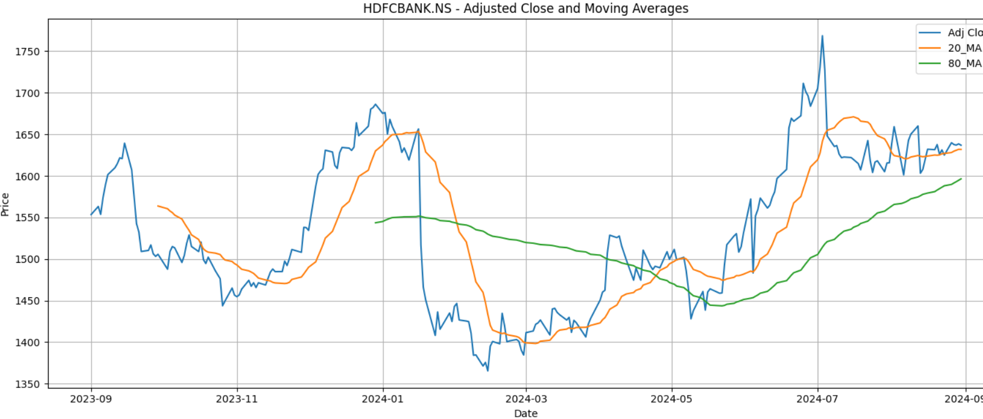
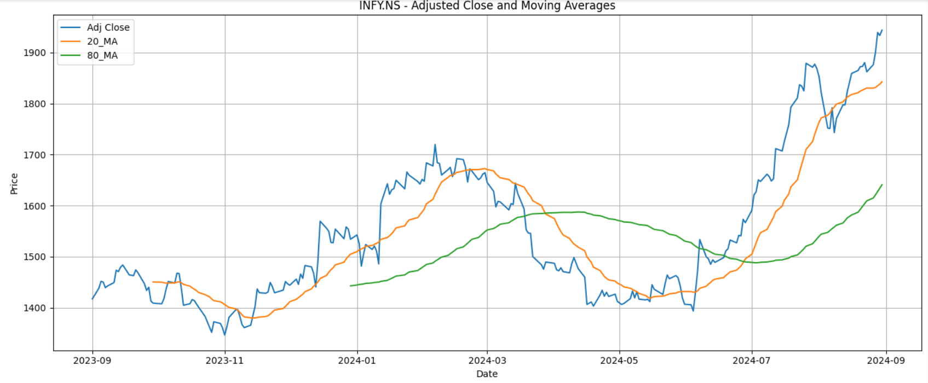
We calculated the 20Days and 80 days moving average of all the above stocks to analyze an overall trend in the fluctuation of the prices.
What we analyzed is:
For HDFCBANK and INFY, the prices initially decline but later show signs of recovery, as indicated by the moving averages.
RELIANCE and TCS display a more consistent upward trend in their adjusted close prices.

Slide 7
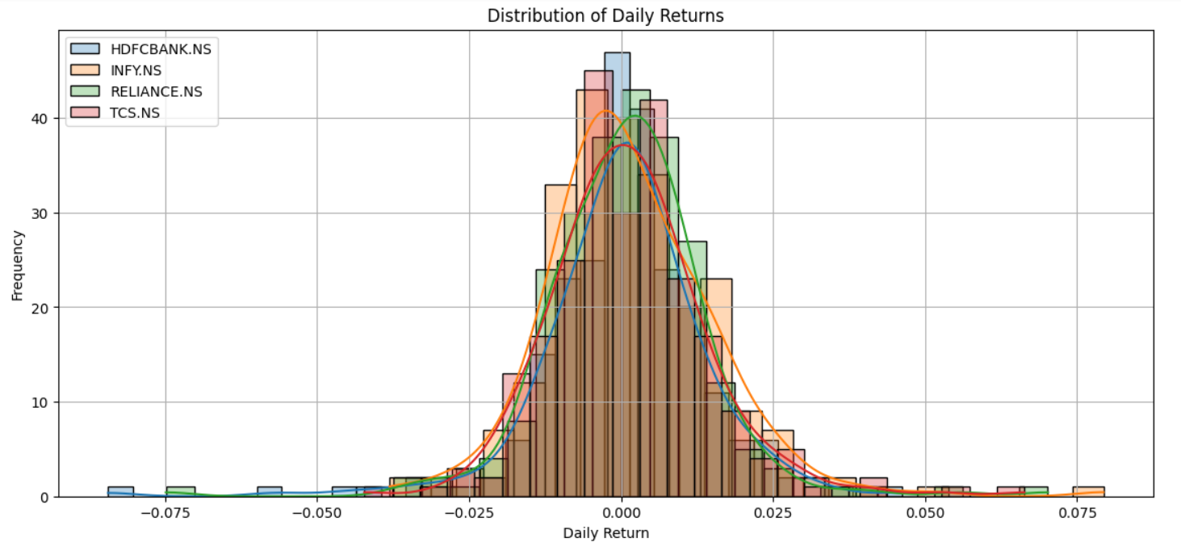
This is a distribution of daily returns of these stocks.
This Distribution is approximately normal, centered around zero, which indicates that most daily returns are close to the average return. However, there are tails on both sides, which reflect occasional significant gains or losses. TCS has the least volatility compared to other stocks above analyzed.

Slide 8
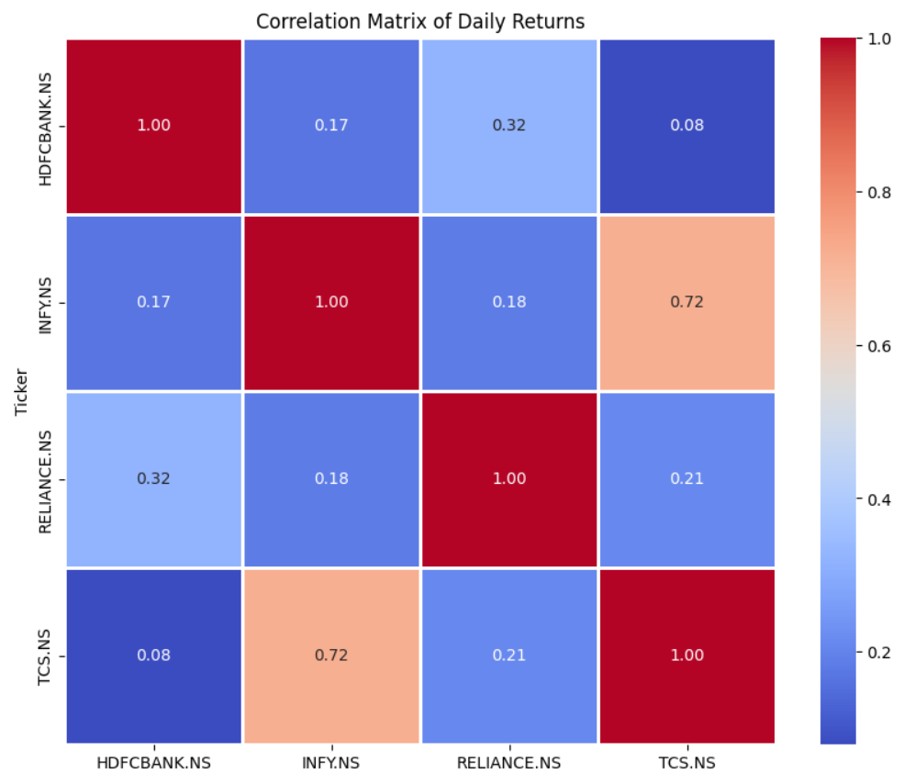
INFY and TCS have high positive correlation which indicates that they tend to move in the same direction.
While other stocks have a lower correlation with each other. Combining stocks with lower correlations can reduce overall portfolio risks.

Slide 9
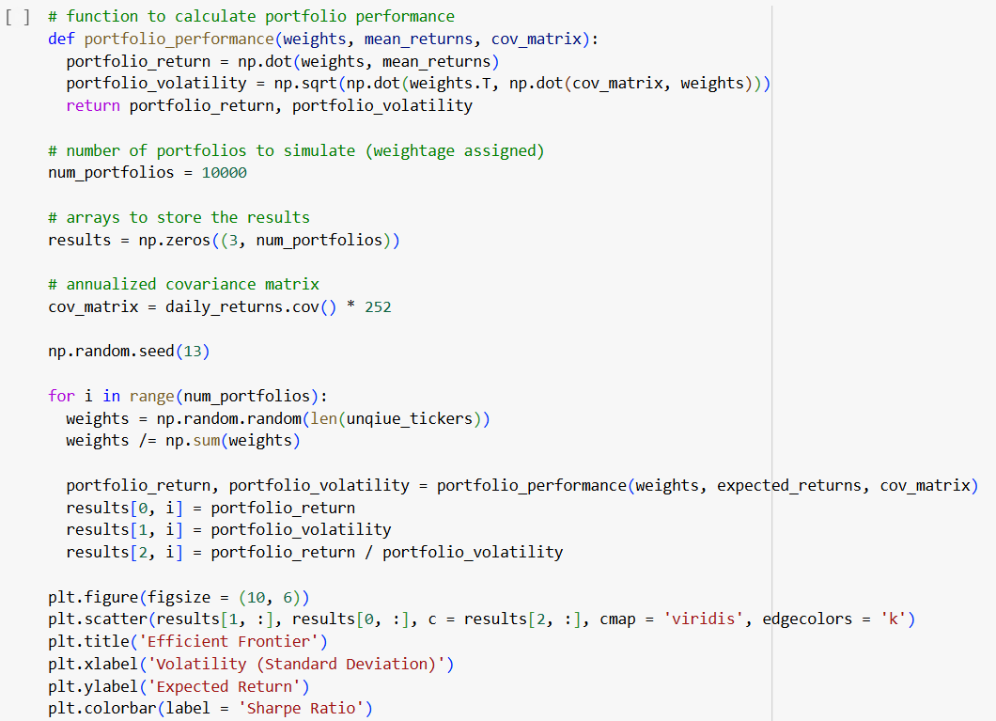

Slide 10
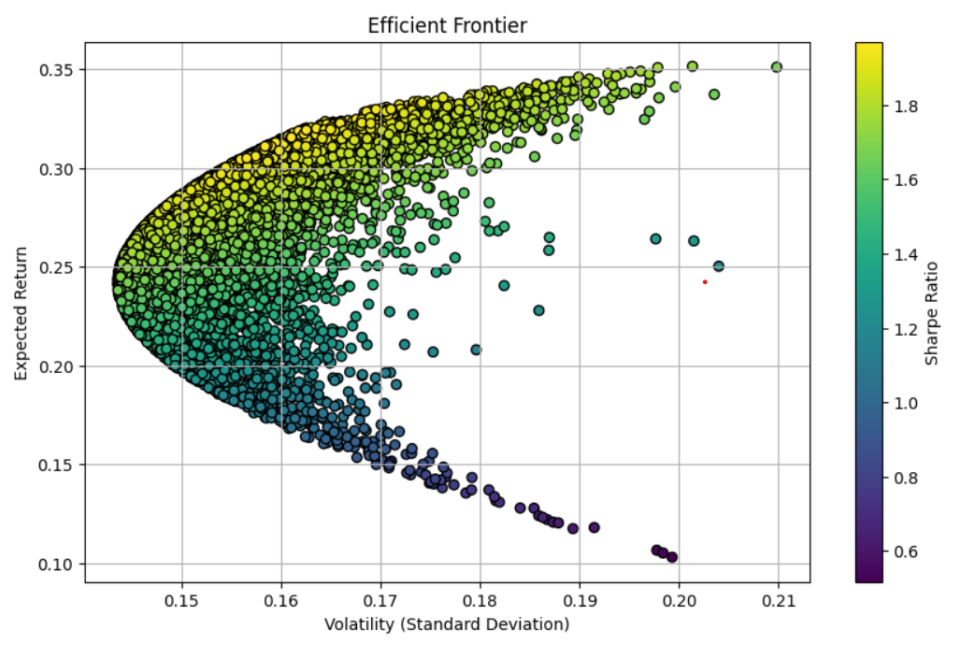
Each dot represents a portfolio, with the colour indicating the sharpe ratio. Portfolio on the leftmost side represent the optimal portfolio according to the Modern Portfolio Theory.

Slide 11
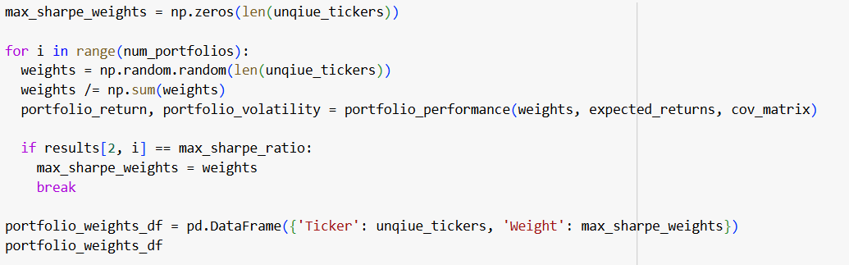
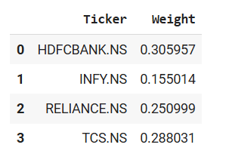
We will be extracting the values for the max sharpe ratio and index using the above code. Which will give us the optimal portfolio with the best return and lesser risk.
Our optimal portfolio looks like:

Slide 12
The output shows a diversified portfolio with the following allocations:
HDFCBANK.NS(30.5%)
INFY.NS(15.5%)
RELIANCE.NS(25.1%)
TCS.NS(28.9%)
THANK YOU!

