Slide 1

Group - Digressors
IAS Hackathon
Complete Explanation on this link:
https://www.youtube.com/watch?v=Pl7aWUykvvE&t=325s

Slide 2
STORY- LINE
STEPS WE TOOK TO SOLVE THE PROBLEM
1) PROJECT GOALS
Goals of UNICEF
Choosing Under-5 Mortality as core principle
Defining goals and finding insights
4) MACHINE LEARNING
Preparing data and feature selection
XGBoost, Random Forest and Logistic Regression
Feature Importance and Partial Dependency
2) REASONS FOR MORTALITY
Factor selection for Under-5 Mortality
Proposing hypothesis for causality
Granger Test to check Causality
Trend Analysis and Correlation
5) CATEGORY TRANSITION
High Mortality cause in Africa
Medium to Low
High to Medium
High to Low
3) MORTALITY DISTRIBUTION
Worldwide Distribution
K-Means clustering
Statistics for clusters
6) INSIGHTS & RECOMMENDATIONS
Insights to UNICEF
Examples with specific Countries
Uniqueness of Analysis
6

Slide 3
ANALYSIS GOAL :
To Find Factors Causing Under 5 Mortality, Trend Analsyis
and Recommendations For Reducing Under-5
Mortality Rate at Country level

Slide 4
REASONS
According to UNICEF:
69 Million children under age 5 will die between 2016 and 2030.
The poorest children are 1.9 times as likely to die before age 5 compared to the riches
At current trends, 9 out of 10 of the world’s children living in extreme poverty will live in sub-Saharan Africa in 2030.
An estimated 5.3 million children under age five died in 2018–roughly half of those deaths occurred in sub-Saharan Africa.
3 in 4 children aged 2 to 4 worldwide experience violent discipline by their caregivers on a regular basis.
Question : What are the causes of Under-5 Mortality?

Slide 5
Under 5 Mortality Rate for the World
Causality Factors
Hypothesis:
Under 5 Mortality caused by:
Exclusive Breastfeeding (Breastfeeding)
Children Sleeping under ITN’s (ITN)
Violent Discipline by parents (Punishment)
Having Children Books (Books)
Irresponsible Supervision (Left_alone)
Postnatal Care of Newborns (Postnatal)
Youth Literacy 15-24 years (Literacy)
Granger Causality Test (Confidence Interval : 90%, P-Value = 0.1) :
Insights : Breastfeeding, Left_alone, Books cause under 5 Mortality, after 1 year
Insights : Breastfeeding, Punishment, Books, Left_alone, Literacy cause under 5 Mortality, after 2 years
Question : What are the correlations for considered factors?
6

Slide 6
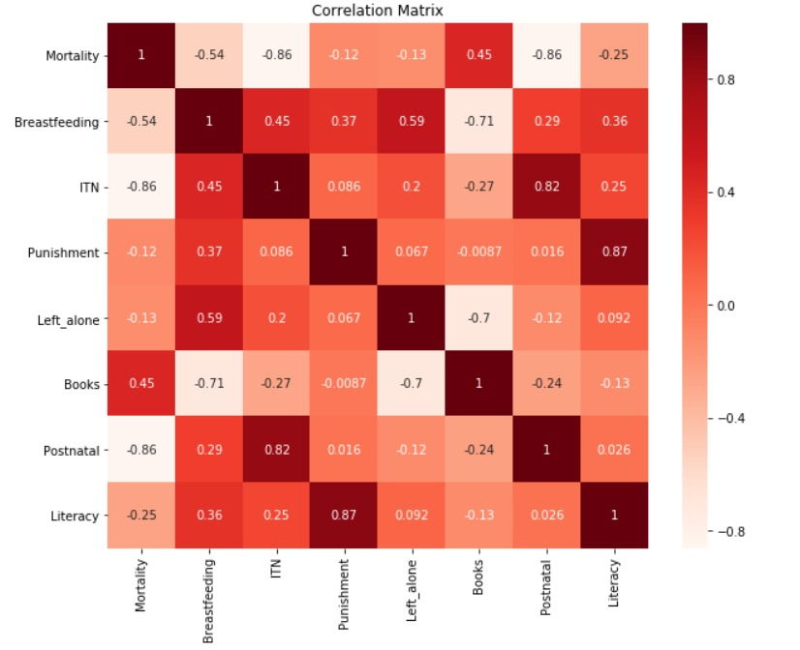
Under 5 Mortality Rate for the World
Correlation factors
Insights : Postnatal is negatively correlated to Under_5 Mortality but doesn’t cause it.
Insights : Left Alone, Books, Punishment are not correlated to Under_5 Mortality but cause it.
Insights ::Breastfeeding is negatively correlated to Under-5 Mortality and causes it.
Question : What are the trends for correlated factors POSTNATAL and BREASTFEEDING ?
6

Slide 7
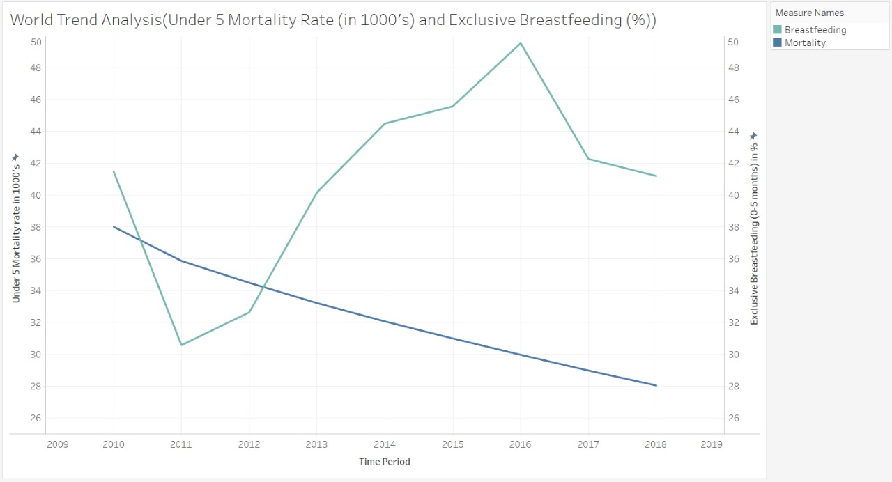
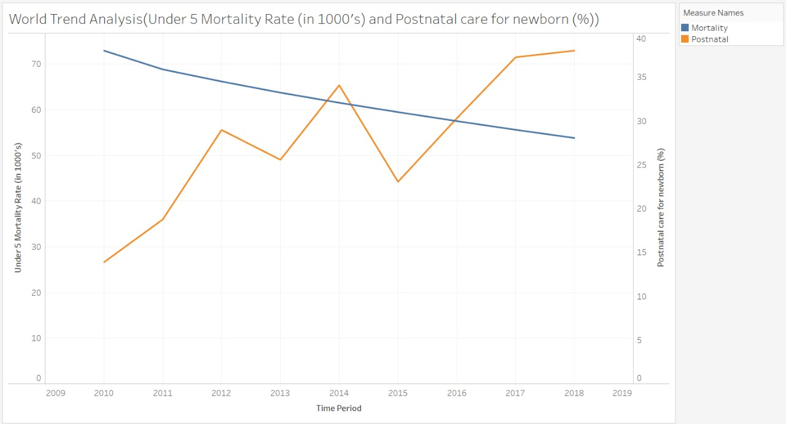
WORLD TREND ANALYSIS
Trend Analysis : Under 5 Mortality Rate (in 1000's) and Exclusive Breastfeeding (%)
Trend Analysis : Under 5 Mortality Rate (in 1000's) and Postnatal care for newborn (%)
Recommendations : Exclusive Breastfeeding for newborns (0-5 months) severely impacts under-5 mortality, so UNICEF should educate pregnant and new mothers about benefits of breastfeeding
Insights: As posited, from timeline graph we see increase in postnatal care, decreases under 5 mortality from 2011 - 2018
Question : How is Under 5 Mortality distributed World-wide?
*Data Source: UNICEF Website

Slide 8
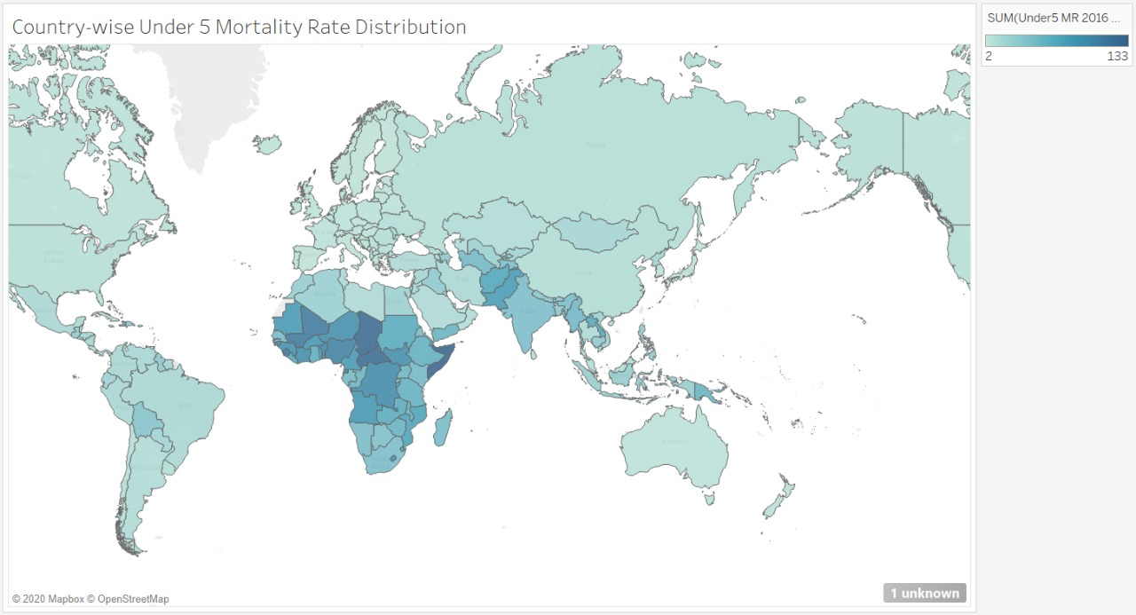
MORTALITY RATE DISTRIBUTION
Insights : We see that the African Continent and SAARC Nations have high under 5 mortality compared to other countries
Question: What causes high mortality in the African continent?

Slide 9
What causes high mortality in the African continent?
Granger Causality Test (Confidence Interval : 90%, P-Value = 0.1):
Insights : Major factor affecting under-5 Mortality in African continent is use of Insecticide treated net for household and indoor residual spraying compared to other regions, after 1 year.
Insights : ITN still cause under-5 mortality, including factors such as Breastfeeding, Books,
Youth literacy compared to other regions, after 2 years.
Insights : ITN is negatively correlated to Under-5 Mortality for African countries
Recommendations : A distinct cause for Under-5 mortality are the use of IRS and ITN, so UNICEF should take measures to improve the accessibility and educate people about the advantages of Insecticide treated net and indoor residual spraying
Question: How are the countries categorized based on Under-5 Mortality?

Slide 10
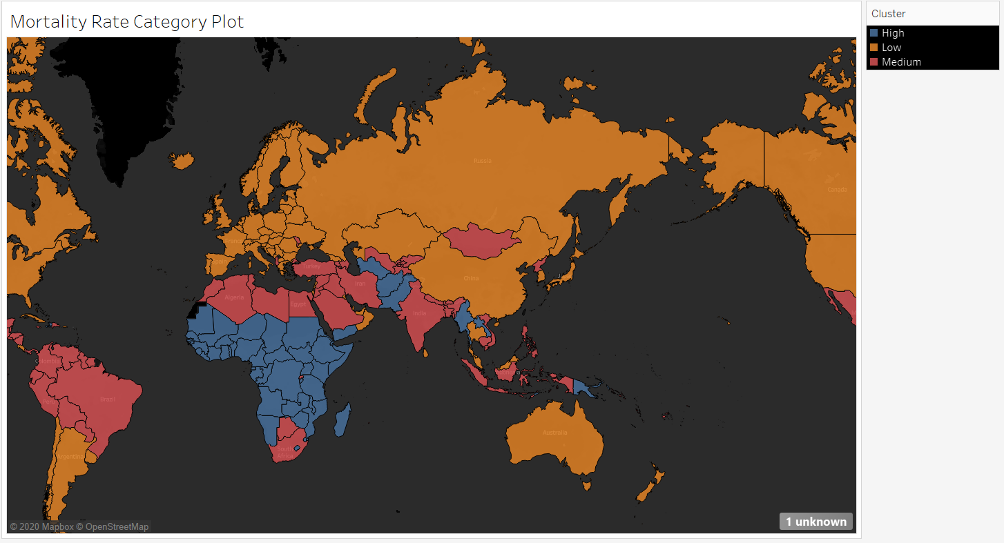
How are the countries categorized based on Under-5 Mortality?
K-Means Clustering :
Question : What factors influence the categories for Under-5 Mortality?

Slide 11
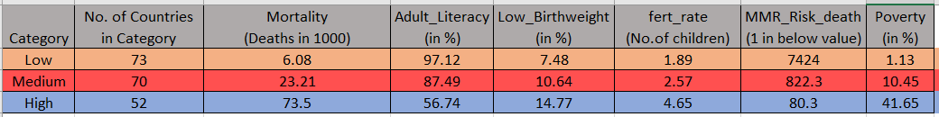

Country’s Transit into next better category
Insights across Categories :
1
As Adult literacy increases, Mortality decreases
1 in 7424 mothers die after birth in Low category, whereas 1 in 80 for High category
5
2
Low Birthweight follows same pattern as Literacy
As Below poverty Line increases, Mortality increases
4
3
High category has almost 3 more children than Low
Question : How can a Country transit into next better category?

Slide 12
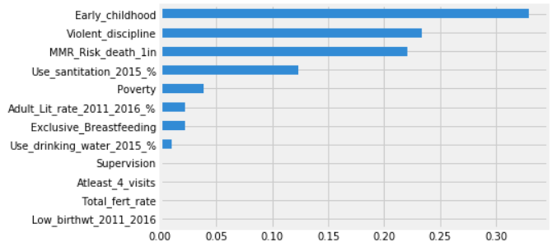
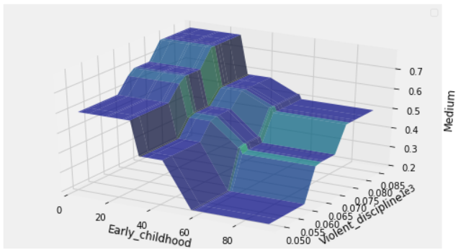
Country’s Transit into next better category
Medium to Low category
Feature Importance plot
Partial Dependency plot
Insights : Early childhood, Violent discipline and MMR Risk death are top 3 major factors influencing a Country’s transition from Medium to Low Category of Under-5 Mortality
Insights : If Early childhood is greater than 60%, which indicates greater involvement of parents, and violent discipline less than 65%, which says child growing in safe environment, the probability of falling into Low category becomes 0.8, i.e., (1-0.2) as seen from partial dependency plot
Example: Recommendation for India’s Journey into Low Category

Slide 13
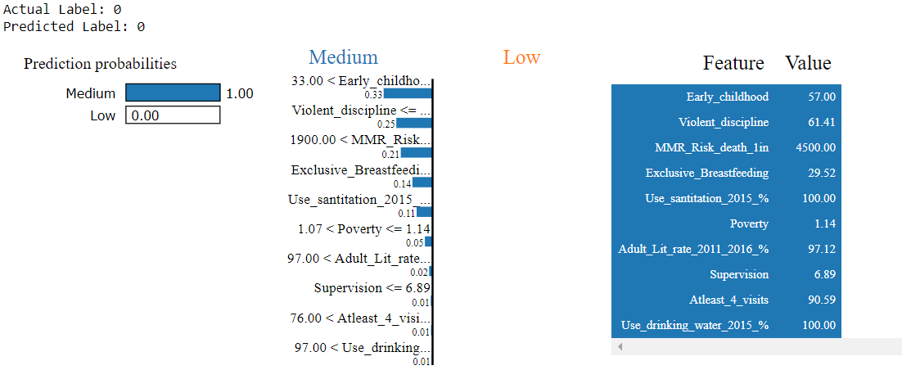
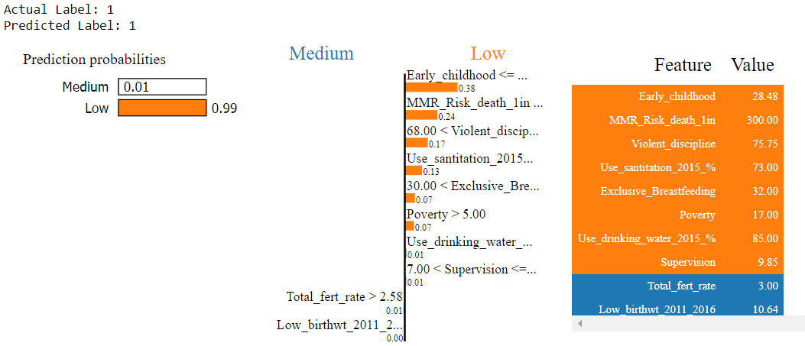
What Should India do to transit into Low category? (Recommendations)
Recommendations : 5% increase in the Early childhood of India would account India’s transition into Low category.
Recommendations : Approx. 8% decrease in violent discipline practiced would make the case for India’s transition.
1
Recommendations : Reducing the Supervision, which means leaving children alone with individuals under 10 years, to 6.89% from the present 9.85%, would help reducing the Mortality.
Question : How can a Country transit into next better category?

Slide 14
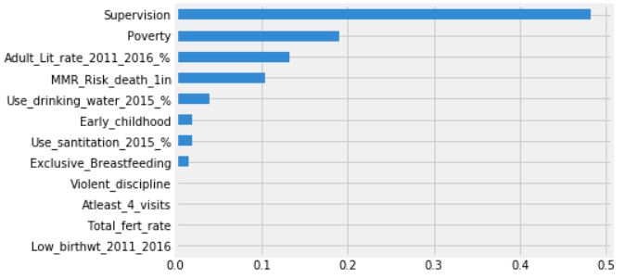
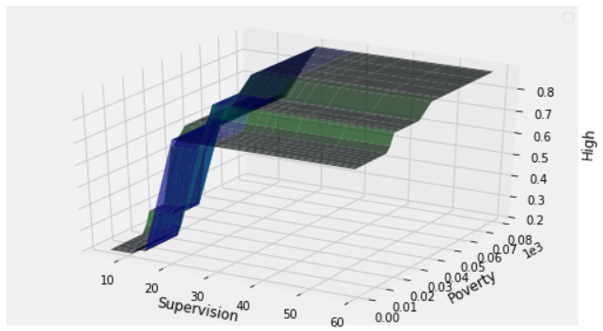
Country’s Transit into next better category
High to Medium category
Feature Importance plot
Partial Dependency plot
Insights : Supervision, Poverty and Adult Literacy Rate are top 3 major factors influencing a Country’s transition from High to Medium Category of Under-5 Mortality
Insights : If Supervision by individuals under 10 years is less than 10%, which indicates greater responsibility by parents, and poverty is less than 30%, which says child growing in an economically reliable environment, the probability of falling into Medium category becomes 0.8, i.e., (1-0.2)
Example: Recommendation for Nigeria’s Journey into Medium Category

Slide 15
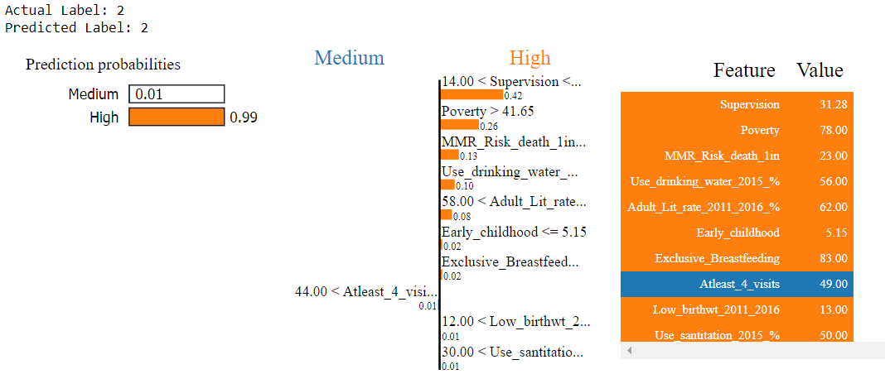
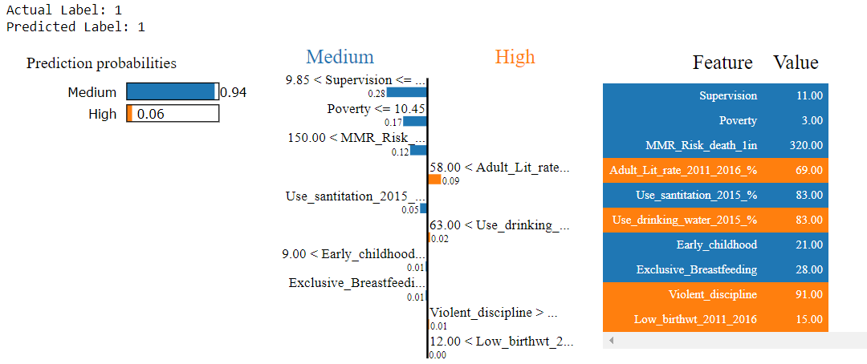
What Should Nigeria do to transit into Medium category? (Recommendations)
Recommendations: Rise of literacy rate by 7%, by ensuring more access to education will help transition into Medium category.
Recommendations: If Low Birth is reduced to 12% from 15% will make a case for Nigeria into Medium Category.
Recommendations : Reducing the Maternal deaths from 1 in 22 to 1 in 150, by ensuring safer delivery practices will help Nigeria migrate into the Medium Category. This can also be ensured by carrying out delivery in the presence of skilled practitioners.
Question : How can a Country transit into next better category?

Slide 16
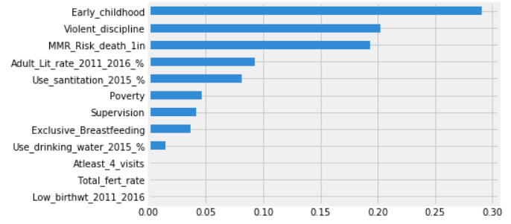
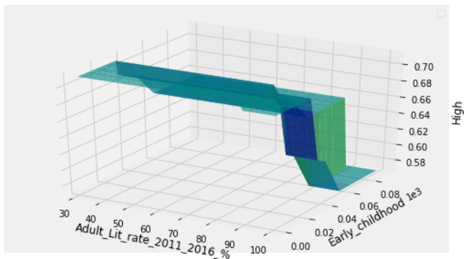
Country’s Transit into next better category
High to Low category
Feature Importance plot
Partial Dependency plot
Insights : Early Childhood, Violent Discipline and MMR are top 3 major factors influencing a Country’s transition from High to Low Category of Under-5 Mortality
Insights : If Adult Literacy rate is greater than 90%, which indicates better accessibility of education, and Early childhood involvement is more than 60%, which says parents are better involved with children in their well-being and growth, the probability of falling into Low category becomes 0.42, i.e., (1-0.58)
Example: Recommendation for Ghana’s Journey into Low Category

Slide 17
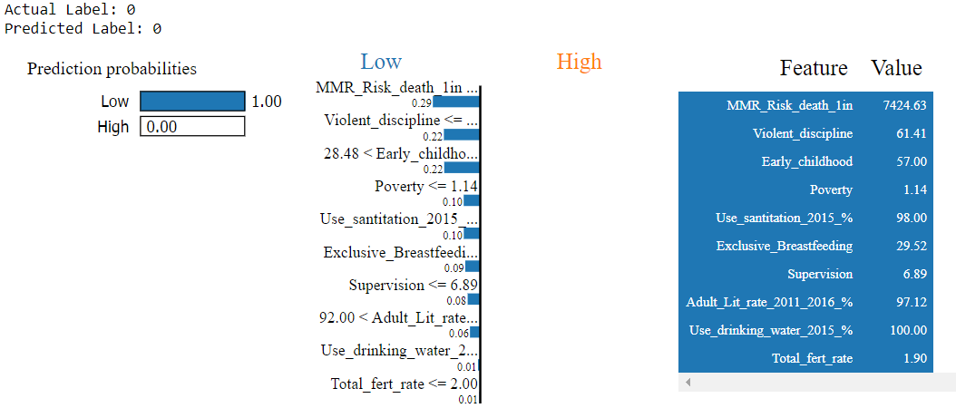
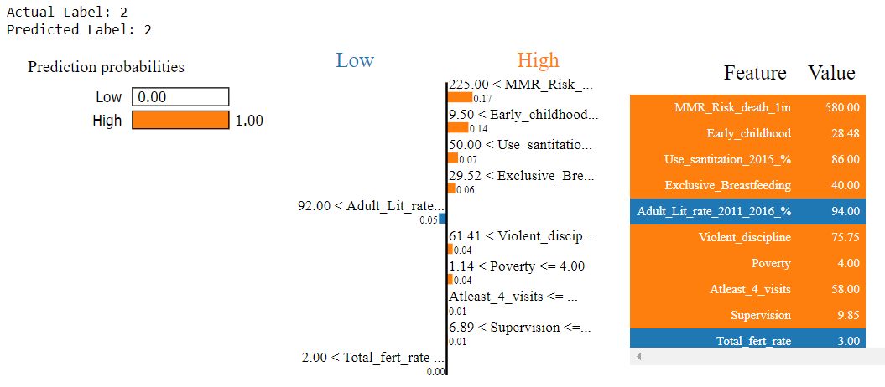
What Should Ghana do to transit into Low category? (Recommendations)
Recommendations: Early childhood involvement is extremely low and needs to improve by assuring better maternity/paternity leaves.
Recommendations: If the fertility rate of Ghana can be brought down to 2, by ensuring better birth control, it can help in its journey to a Low Category.
Recommendations: Violent Discipline for Ghana is 94%, one of the highest and needs drastic decrease to up to 61%. This needs to propagate by better awareness drives and ensuring that parents know the long-term psychological effects violent discipline leaves in children.
Question : How we carry out our analysis?

Slide 18
CHALLENGES & CONCLUSIONS
FOUND MAJOR REASON (ITN) OF HIGH MORTALITY IN AFRICAN COUNTRIES
01
USE OF ADVANCED ML & TIME SERIES TECHNIQUES FOR DEEPER ANALYSIS
05 02
GRANGER TEST FOR
FINDING CAUSAL FACTORS & EFFECTS
ANALYSIS & RECOMMENDATIONS AT COUNTRY & CATEGORY LEVEL
04
03
UNICEF WEBSITE AS
DATA SOURCES
FOR TREND ANALYSIS
18

Slide 19
THANK YOU
GROUP-DIGRESSORS

