Slide 1

A
Presentation on
“TrustChain-AI: A Decentralized Trust Intelligence Framework for Secure Autonomous AI Agent Collaboration”
By
MANISH PATIL (E260)
DURGESH AGRAWAL (E262)
YASH GEHLOT(E237)
Under the Guidance of
Dr. Suraj Patil
Department of Computer Science
MPSTME, Shirpur Campus
2026-27

Slide 2
Outline
Objective of Project
Literature Survey & Problem Statement
Proposed Solution & System Architecture
Decentralized Identity & Trust Intelligence Lifecycle
Core Algorithms & Adaptive Policy Enforcement
SOC Portal & Actual Application Screenshots
Implementation Status & Key Features
Software & Hardware Requirements
Project Development Timeline (Gantt Chart)
Implementation & Technical Validation
Results Analysis & System Evaluation
Project Outcomes & Conclusion
References

Slide 3
Progress Since Phase II
Area | At Phase II | At Phase III
Identity | did:key + Ed25519 demonstrated | Full did:key + W3C VC lifecycle with URDNA2015 canonicalization and Ed25519Signature2020 proofs
Trust engine | EMA scoring, 3 states + revoke | Same engine, validated with a 10-round scenario and a live /health probe
Authorization | SUSPICIOUS allowed (logged) | SUSPICIOUS blocks privileged actions (HTTP 403); human RBAC added (ADMIN, OPERATOR, VIEWER)
Discovery and matching | Not present | Explainable discovery and multi-factor MatchScore ranking
Collaboration | Not present | Bilateral sessions, sequential pipelines, mid-session abort
Storage | SQLite VDR | 13-table SQLite WAL VDR with four audit streams
Frontend | Dashboard | Five-module SOC portal with Agent Investigation Drawer
Testing | 40 tests | 80 tests passing in 15.04 s; Vite build with 0 errors

Slide 4
Objective of Project
The primary objective of TrustChain-AI is to develop a decentralized trust intelligence framework that enables secure and autonomous collaboration among AI agents across multiple domains. The framework utilizes W3C Decentralized Identifiers (DIDs), Verifiable Credentials (VCs), and blockchain to establish trusted digital identities and secure cross-domain interactions.
It further introduces a Trust Intelligence Engine for continuous trust evaluation based on credential verification, reputation, and agent behaviour, while supporting privacy-preserving credential sharing, adaptive trust-based authorization. The goal is to create a scalable, interoperable, and decentralized ecosystem for reliable AI agent collaboration without relying on centralized trust authorities.

Slide 5
Literature Survey
Reference Paper | Research Focus | Contribution | Research Gap | TrustChain-AI Solution
AI Agents with DIDs & VCs (Base Paper) | AI Agent Identity, DID, VC | Secure decentralized AI identity & authentication | No trust scoring or reputation management | Adds Trust Intelligence Engine, dynamic trust scoring & malicious agent detection
LOKA Protocol: A Decentralized Framework for Trustworthy and Ethical AI Agent Ecosystems | AI Identity, Ethical AI | Universal AI Agent Identity Layer | No real-time trust evaluation | Continuous trust monitoring & decentralized reputation
Selective Disclosure in SSI | Privacy, Credential Sharing | Privacy-preserving credential exchange | No AI collaboration or trust analysis | Secure selective disclosure with trust evaluation
SoK: Trusting Self-Sovereign Identity | Trust Models, Security | Trust models & threat analysis | Static trust for human identities | Dynamic trust using behavior, reputation & history
Self-Sovereign Digital Identity | Decentralized Identity | Introduced Self-Sovereign Identity (SSI) | Limited to human identities | Extends SSI to autonomous AI agents using DIDs & VCs

Slide 6
  Problem Statement
Autonomous AI agents increasingly collaborate across multiple domains, but existing systems primarily focus on identity authentication rather than continuous trust evaluation. Current approaches lack dynamic trust scoring, reputation management, malicious agent detection, and adaptive trust mechanisms, making secure and reliable agent collaboration challenging. There is a need for a decentralized trust framework that combines W3C Decentralized Identifiers (DIDs), Verifiable Credentials (VCs), blockchain, and intelligent trust evaluation to enable secure, scalable, and trustworthy collaboration among autonomous AI agents without relying on centralized authorities.

Slide 7
  Proposed Solution
TrustChain-AI proposes a Decentralized Trust Intelligence Framework that enables secure, trustworthy, and autonomous collaboration among AI agents across multiple organizational domains. The framework integrates W3C Decentralized Identifiers (DIDs), Verifiable Credentials (VCs), and blockchain technology to provide decentralized digital identities, tamper-proof credential verification, and secure cross-domain authentication.
To address the limitations of existing identity-based approaches, TrustChain-AI introduces a Trust Intelligence Engine that continuously evaluates AI agents using credential verification, reputation scores, behaviour analysis, interaction history, and adaptive trust policies. The framework also supports privacy-preserving selective disclosure, malicious agent detection. ensuring secure, scalable, and future-ready collaboration without relying on centralized trust authorities.

Slide 8
Methodology
The proposed TrustChain-AI framework extends the decentralized identity model of the base research paper by integrating a Dynamic Trust Intelligence Engine for secure autonomous AI agent collaboration. Initially, each AI agent is assigned a W3C Decentralized Identifier (DID) and authenticated through Verifiable Credentials (VCs) issued by trusted authorities. The corresponding identity metadata is securely anchored on a blockchain, enabling decentralized, tamper-proof identity verification.
After successful authentication, the proposed framework continuously evaluates each AI agent using credential validity, reputation, behaviour patterns, interaction history, and policy compliance to generate a Dynamic Trust Score. Based on this score, an adaptive trust-based authorization mechanism grants, restricts, or denies collaboration requests. Finally, all authentication events, trust decisions, and collaboration records are immutably stored on the blockchain, ensuring secure, transparent, and accountable AI agent collaboration across decentralized environments.

Slide 9
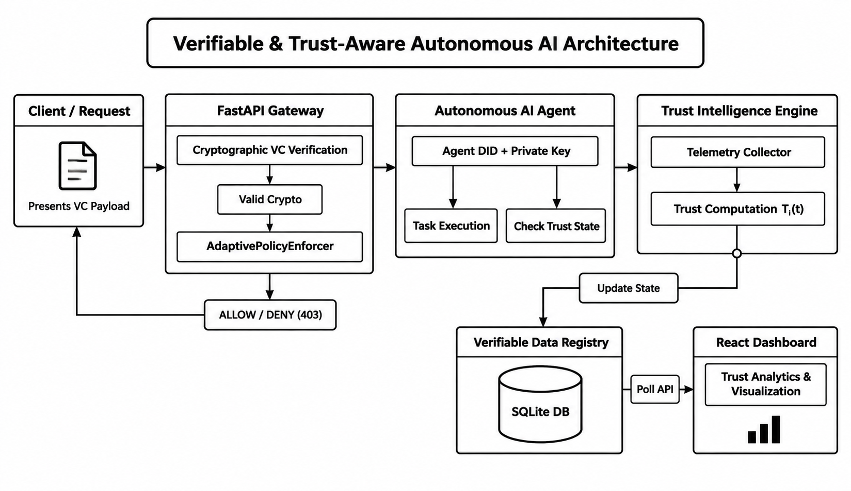
System Architecture

Slide 10
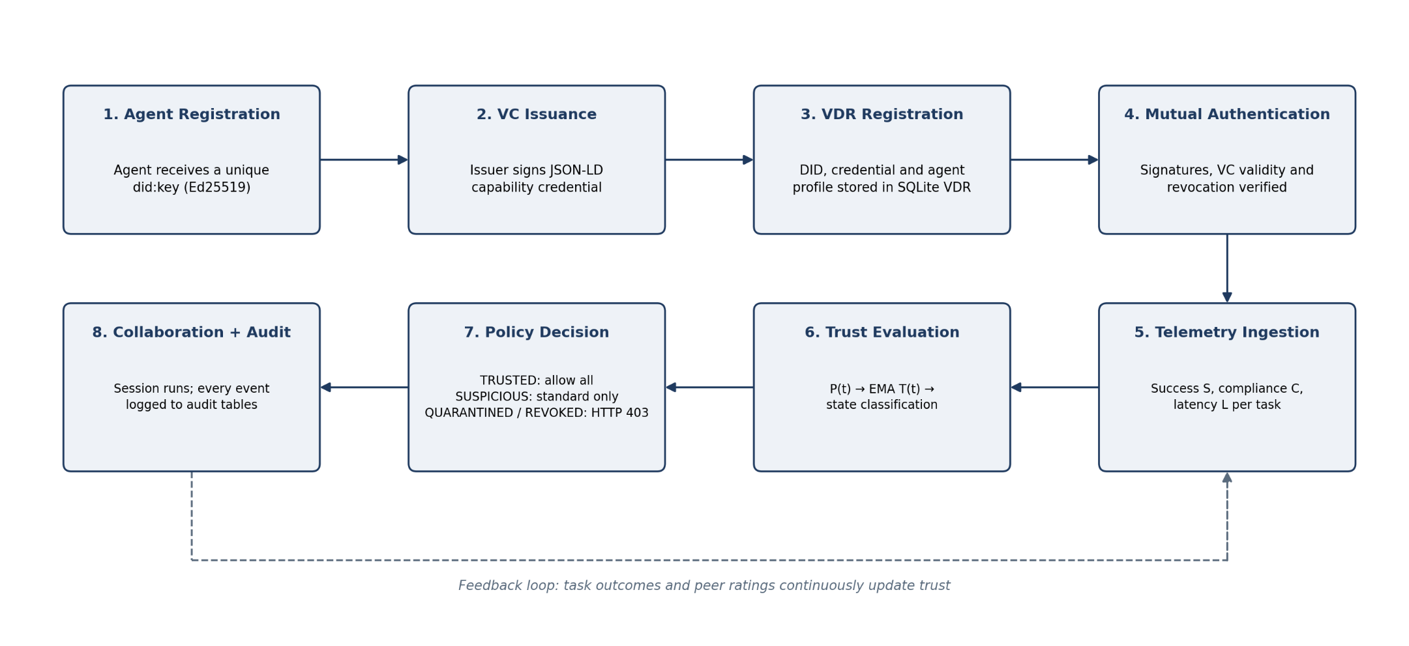
Working Flow of TrustChain-AI

Slide 11
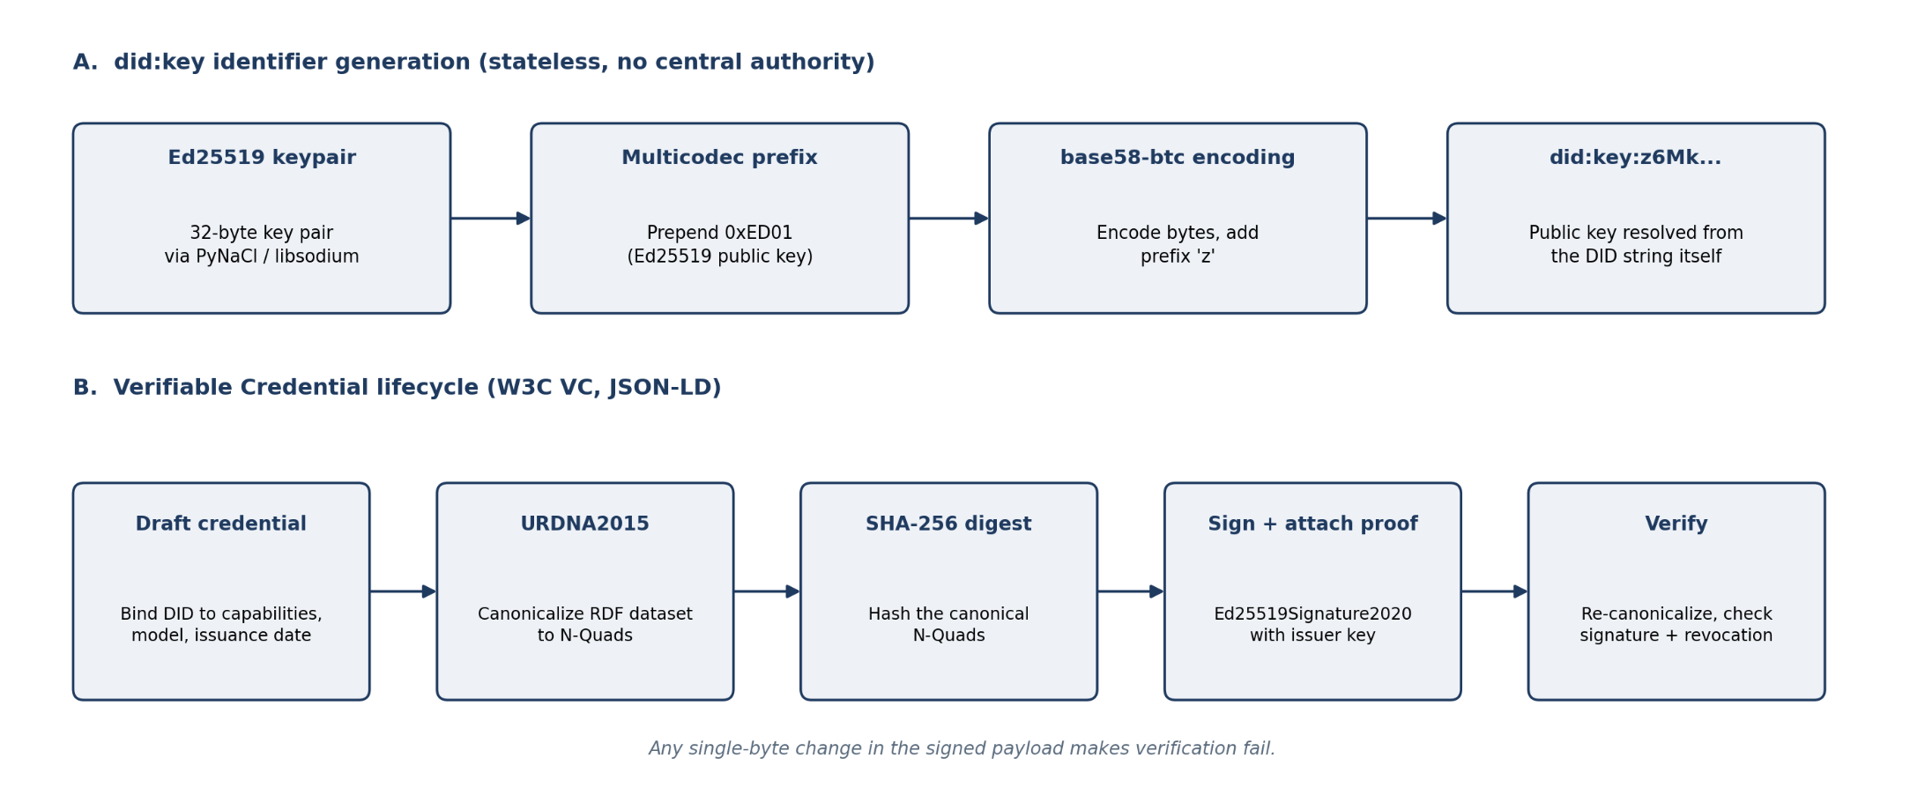
Decentralized Identity and Credential Lifecycle

Slide 12
Core Algorithms
Algorithm | Purpose | Where used
Ed25519 signatures | Identity and credential authenticity | akta/did.py, akta/vc.py
Instantaneous performance P(t) | Evaluate current behaviour | akta/trust_engine.py
Temporal EMA | Track trust over time | akta/trust_engine.py
State classification | Map score to security state | akta/trust_engine.py
Adaptive enforcement | Allow or block requests by policy | akta/adaptive_auth.py
MatchScore | Rank eligible agents for a task | akta/vdr/registry_crud.py
Bottom line: Task Success + Policy Compliance + Latency, smoothed over time, gives the Trust Score.

Slide 13
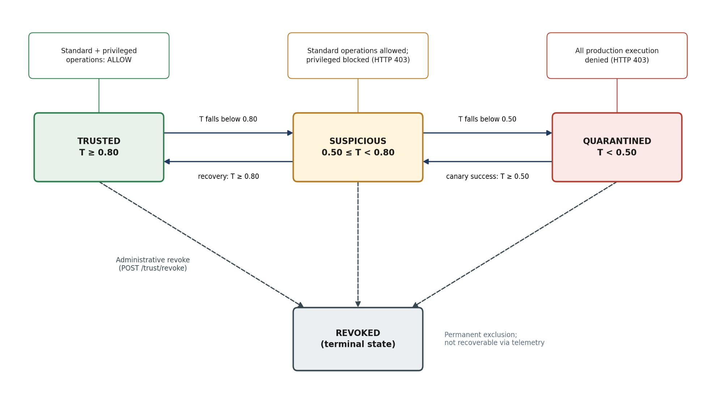
Trust-State Transition Diagram

Slide 14
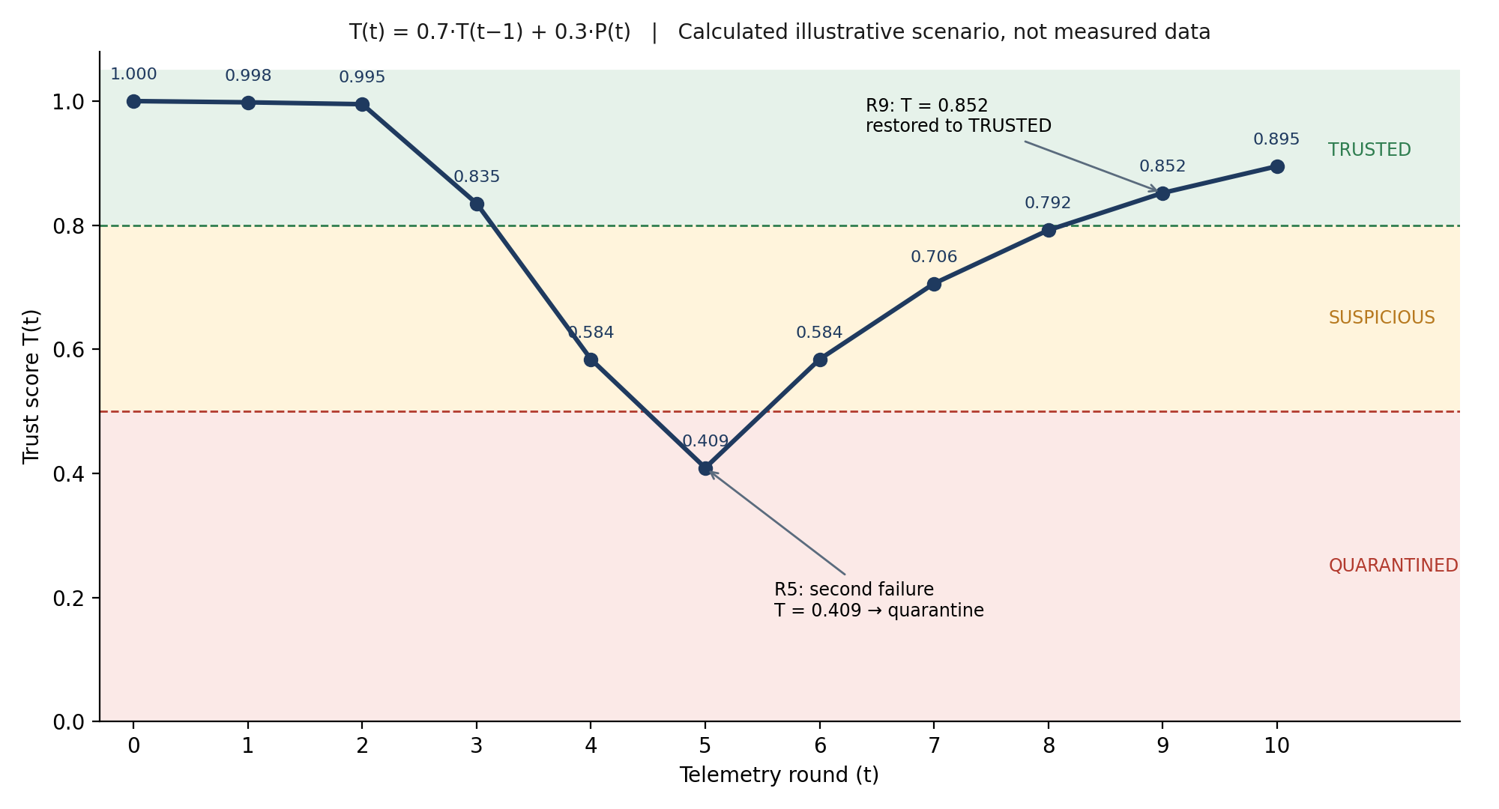
Numerical Trust Calculation Example

Slide 15
Adaptive Policy Enforcement and Access Control
State | Standard operations | Privileged operations
TRUSTED (T >= 0.80) | Allow | Allow
SUSPICIOUS (0.50 <= T < 0.80) | Allow (logged) | Blocked, HTTP 403
QUARANTINED (T < 0.50) | Denied, HTTP 403 | Denied, HTTP 403
REVOKED | Denied, permanent | Denied, permanent
Humans (RBAC): ADMIN (full mutations, user management, manual trust override), OPERATOR (workflows, discovery, matching), VIEWER (read-only). Argon2id hashing, 5-strike lockout (HTTP 423), JWT refresh rotation. The backend is the sole enforcement boundary; frontend badges are only UI conveniences.

Slide 16
Agent Discovery
Filters: capability tag, minimum-trust slider (0.00 to 1.00, step 0.05), availability (AVAILABLE, BUSY, OFFLINE), endpoint health probe (HTTP 200).
Explainable exclusion: excluded agents are shown with a reason, not silently hidden. Examples: "Under behavioral quarantine (T = 0.42 < 0.50)"; "Trust score (0.65) below requested slider (0.80)"; "Status is BUSY on active collaboration session".
Discovery = eligibility exploration. Matching = ranking for a specific task.

Slide 17
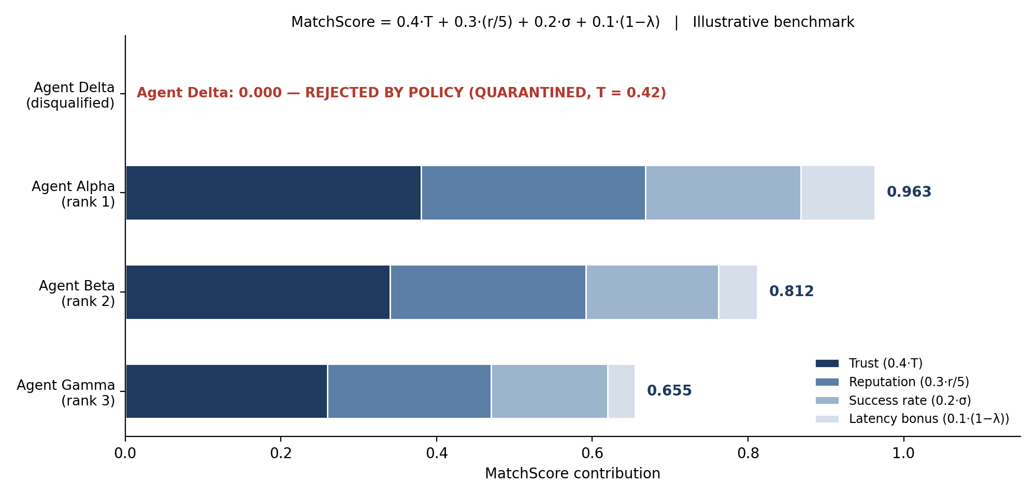
Task-Driven Matching
Formula: MatchScore = 0.4 T + 0.3 (r/5) + 0.2 sigma + 0.1 (1 - lambda), where r is peer reputation, sigma is historical success rate, lambda is the latency penalty. QUARANTINED or REVOKED agents are forced to 0.000 ("REJECTED BY POLICY") regardless of reputation. Footnote: illustrative benchmark scenario.

Slide 18
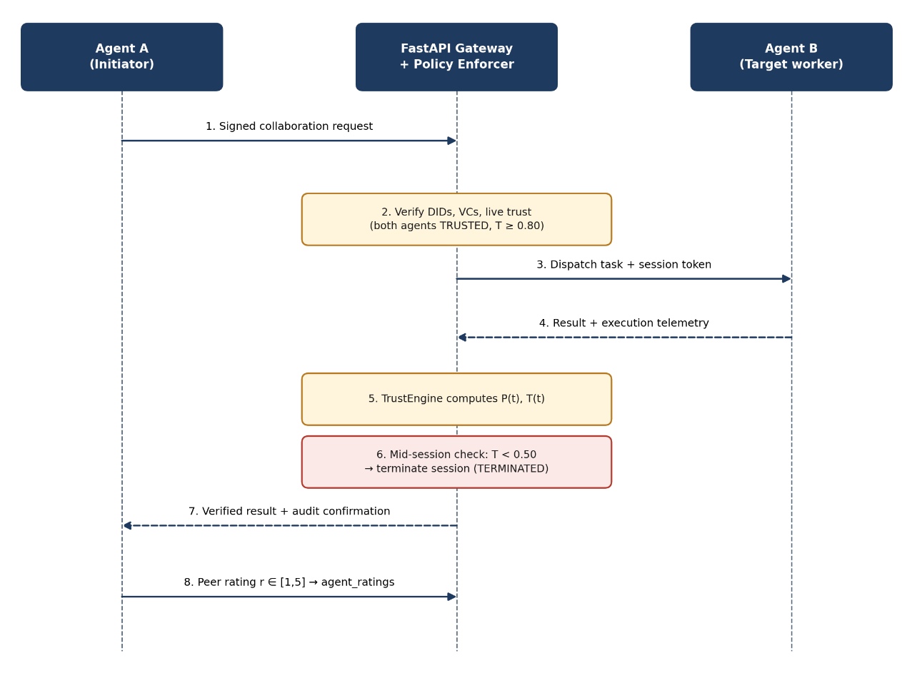
Multi-Agent Collaboration
Session states: PENDING, ACTIVE, COMPLETED, TERMINATED.
Both agents must be TRUSTED to activate a session.
Telemetry is recorded after every step of a sequential pipeline (e.g. Planning, Coding, Review); if trust drops below 0.50 mid-session the workflow stops.
Post-task 1-to-5 rating updates agent reputation.

Slide 19
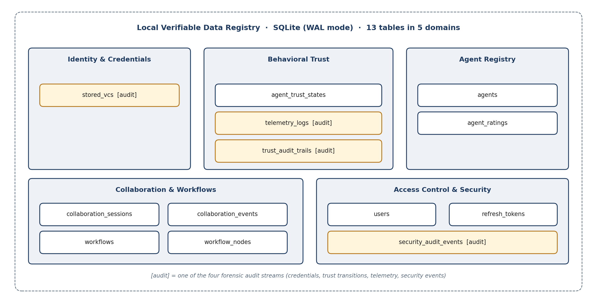
Verifiable Data Registry and Audit Trails

Slide 20
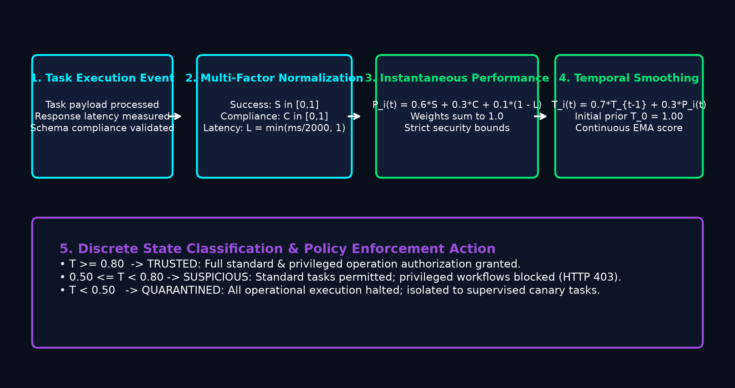
SOC Portal and Investigation Drawer
Security Operations Center Architecture • Live Telemetry Stream • Forensic Audit Drawer
SOC Operational Capabilities & Investigation
• Live Behavioral Telemetry Stream: Ingests Task Success (Si), Compliance (Ci), and Latency penalty (Li) via FastAPI endpoint in real time.
• Interactive Investigation Drawer: Enables security analysts to inspect raw DID documents, Ed25519 public keys, issued Verifiable Credentials, and historical trust scores.
• Administrative Override Controls: Administrators can quarantine suspicious agents, trigger diagnostic reviews, or execute permanent revocations with one click.
• Cryptographic Audit Trail: Every state transition, session event, and override is immutably logged into the 13-table SQLite WAL Verifiable Data Registry.
• Fail-Closed Zero Trust: Throttles or severs compromised agent connections before lateral contamination affects critical multi-agent pipelines.
Fig: End-to-End Telemetry Ingestion & Real-Time Monitoring Pipeline
• Active Agent Monitoring: Captures granular execution metrics across distributed nodes.
• Dynamic Threat Detection: Identifies aberrant latency and compliance drops instantly.
• Immutable SQLite WAL Logging: Stores telemetry events with microsecond timestamps.

Slide 21
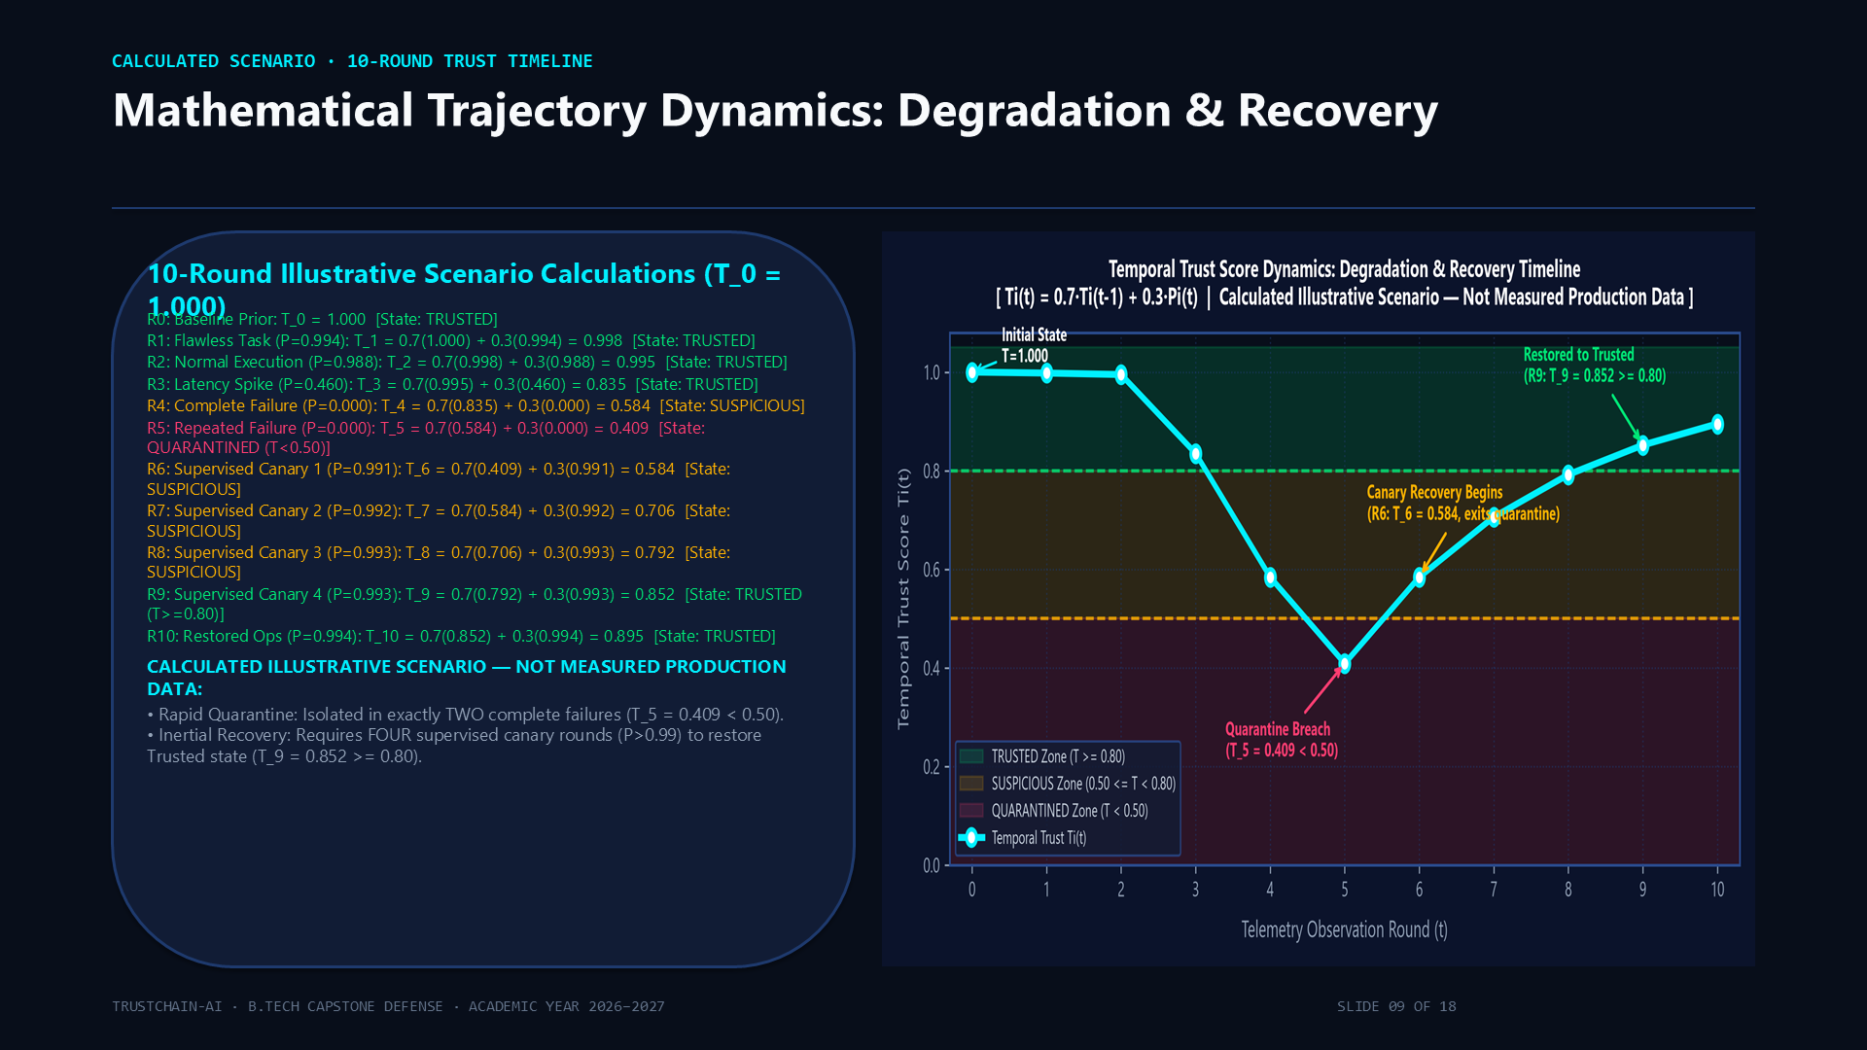
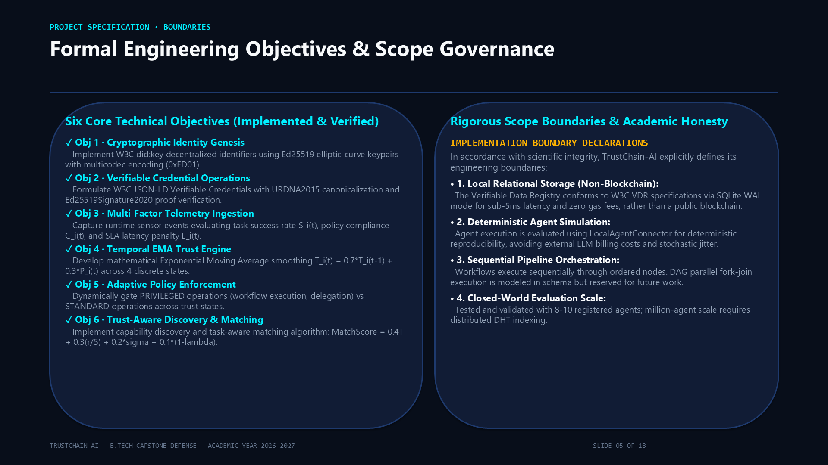
Actual Project Screenshots: SOC Dashboard & Agent Identity
Operational Telemetry Monitoring • W3C DID Explorer • Verifiable Credential Verification
Fig 1. Real-Time SOC Dashboard & Behavioral Telemetry Stream
• Live Telemetry Stream: Ingests task execution events, policy compliance checks, and response latency (Si, Ci, Li) across active agents.
• Temporal Trust Trajectory: Visualizes Exponential Moving Average (EMA) score evolution over time (Ti(t) = 0.70 Ti(t-1) + 0.30 Pi(t)).
• Dynamic Trust-State Classification: Displays real-time status badges (TRUSTED >= 0.80, SUSPICIOUS 0.50-0.79, QUARANTINED < 0.50, REVOKED).
• Active Incident Response: Real-time alert triggers when an agent's score degrades, alerting security operators.
Fig 2. Agent Identity Explorer & W3C Verifiable Credential Verification
• W3C Decentralized Identifiers: Displays self-sovereign did:key identifiers derived from Ed25519 public keys with multicodec prefix 0xed01.
• Cryptographic Signatures: RFC 8032 Ed25519 256-bit signature verification for authenticating agent identity without passwords.
• Verifiable Credentials (VC 2.0): Inspects JSON-LD credential claims (capabilities, issuer, valid-until) with SHA-256 tamper-evident integrity hashes.
• Cryptographic Status: Shows verified credential validity, issuance timestamps, and cryptographic revocation status.
21

Slide 22
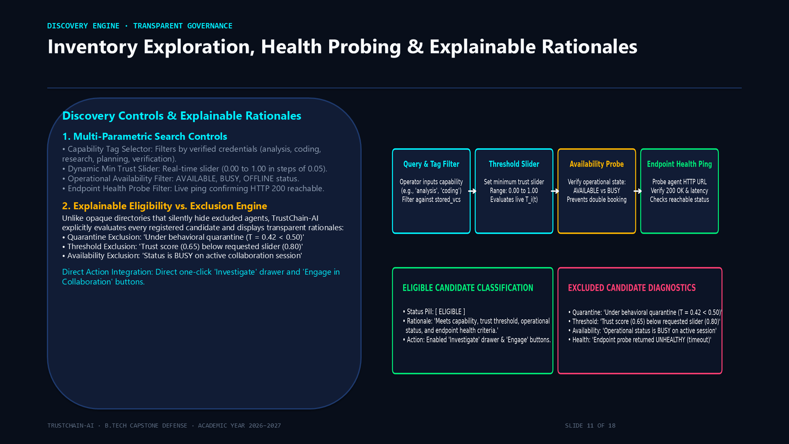
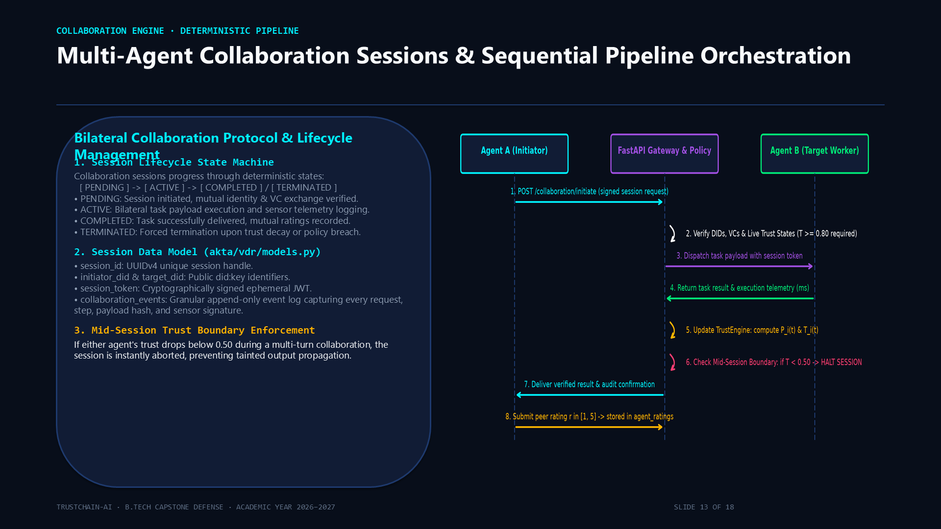
Actual Project Screenshots: Discovery, Matching & Workflows
Capability-Based Discovery • Algorithmic Matchmaker • Multi-Agent Collaboration Pipelines
Fig 3. Task-Driven Algorithmic Matchmaker & Explainable Ranking
• Multi-Factor Ranking Formula: Computes MatchScore = 0.40 T + 0.30 (r/5) + 0.20 sigma + 0.10 (1 - lambda).
• Explainable Match Breakdown: Displays transparent decomposition of trust (T), peer reputation (r), success rate (sigma), and latency penalty (lambda).
• Zero-Trust Policy Clamp: Automatically overrides scores for QUARANTINED (T < 0.50) or REVOKED agents, forcing score to 0.000 ('REJECTED BY POLICY').
• Capability Filtering: Pre-filters candidates by capability tags, availability (AVAILABLE), and HTTP 200 health check probe.
Fig 4. Multi-Agent Collaboration Sessions & Sequential Workflows
• Lifecycle State Machine: Governs collaboration sessions across four states: PENDING -> ACTIVE -> COMPLETED (or TERMINATED).
• Sequential Workflow Execution: Orchestrates multi-step pipelines (e.g. Planning -> Coding -> Review) with mutual authentication.
• Per-Step Telemetry Ingestion: Collects telemetry after every pipeline step and dynamically re-evaluates the executing agent's trust score.
• Mid-Execution Fail-Closed Abort: If an agent's trust score drops below 0.50 mid-session, the workflow immediately aborts with HTTP 403.
22

Slide 23
Implementation Status
Component | Status | Evidence
did:key identity, Ed25519 | Implemented + tested | akta/did.py, pytest
VC issuance and verification | Implemented + tested | akta/vc.py, pytest
Telemetry, trust engine, states | Fully implemented | akta/trust_engine.py
Adaptive policy gateway | Implemented + tested | akta/adaptive_auth.py
Revocation, audit trail | Fully implemented | /trust/revoke, trust_audit_trails
Discovery, matching | Implemented + tested | registry_crud.py
Collaboration sessions, workflows | Implemented + tested | collaboration tables, tests
Authentication and RBAC | Implemented + tested | akta/auth/, pytest
SQLite WAL VDR (13 tables) | Fully implemented | akta/vdr/
FastAPI backend, React portal, CLI | Fully implemented | akta/server.py, frontend/

Slide 24
Key Features
Decentralized AI Identity: Assigns each AI agent a unique W3C DID for secure and self-sovereign digital identity.
Verifiable Credential Authentication: Authenticates AI agents using trusted Verifiable Credentials (VCs) before collaboration.
Blockchain-Based Trust Ledger: Stores identity, trust records, and audit logs in a tamper-proof blockchain.
Dynamic Trust Intelligence Engine: Continuously calculates trust scores using credentials, reputation, and agent behaviour.
Reputation & Malicious Agent Detection: Evaluates agent reliability and identifies compromised or suspicious AI agents.
Adaptive Trust-Based Collaboration: Enables secure cross-domain collaboration through intelligent authorization and privacy-preserving credential sharing.
Continuous Monitoring & Audit Trail: Tracks agent activities, trust updates, and security events to ensure transparency and accountability.

Slide 25
Software and Hardware Requirements
Hardware Requirements
Processor: Intel Core i5 (10th Gen or higher) / AMD Ryzen 5 or higher
RAM: Minimum 8 GB (16 GB Recommended)
Storage: 256 GB SSD or higher
Graphics: NVIDIA GTX 1650 / RTX 2050 or equivalent
Internet: Stable broadband connection
Software Requirements
Operating System: Windows 10/11, Ubuntu 22.04 LTS, or macOS
Programming Language: Python 3.12+
Development Environment: Visual Studio Code / PyCharm
Frontend Framework: React.js, Tailwind CSS
Backend Framework: FastAPI / Flask
Database: MongoDB / SQLite
Blockchain Framework: Hyperledger Fabric or Ethereum (Ganache for testing)
Libraries & Frameworks: FastAPI/Flask, Web3.py, NumPy, Pandas, Scikit-learn
Version Control: Git & GitHub
API Testing: Postman

Slide 26
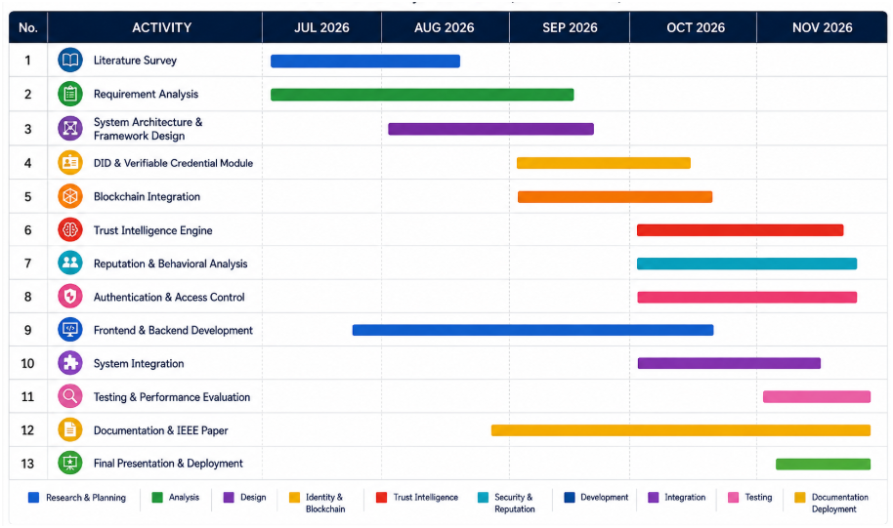
Gantt Chart

Slide 27
Implementation & Technical Validation
Complete Architecture Integration • Forensic Codebase Verification • Automated CI/CD Metrics
1. Identity & Cryptography
• W3C DID Specification: did:key format with multicodec prefix 0xed01 for sovereign agent identity.
• Ed25519 Cryptography: RFC 8032 asymmetric signing & verification; 256-bit elliptic-curve keys.
• Verifiable Credentials: W3C VC 2.0 JSON-LD data model with SHA-256 tamper-evident integrity hashes.
• Human Auth & RBAC: Argon2id password hashing, 5-strike lockout (HTTP 423), JWT rotation, 3-tier RBAC (ADMIN, OPERATOR, VIEWER).
2. Trust Intelligence Engine
• Telemetry Ingestion: Real-time recording of Task Success (Si), Compliance (Ci), and Latency penalty (Li).
• Single-Period Score: Pi(t) = 0.6 Si(t) + 0.3 Ci(t) + 0.1(1 - Li(t)).
• Temporal Trust (EMA): Ti(t) = 0.70 Ti(t-1) + 0.30 Pi(t); lambda=0.70 provides hysteresis & dampening.
• Trust-State Machine: Graduated 4-tier classification: TRUSTED (>=0.80), SUSPICIOUS (0.50-0.79), QUARANTINED (<0.50), REVOKED (blacklist).
• Adaptive Policy Gateway: Intercepts all invocations to dynamically enforce least privilege.
3. Collaboration & Workflows
• Capability Discovery: Multi-attribute filtering (tag, min-trust slider 0.0-1.0, status, HTTP health probe).
• Explainable Exclusion: Transparent failure rationale (e.g. 'Trust 0.42 < 0.80 requested').
• Task-Driven Matching: MatchScore = 0.4 T + 0.3 (r/5) + 0.2 sigma + 0.1 (1 - lambda); quarantined capped to 0.000.
• Multi-Agent Sessions: State machine (PENDING, ACTIVE, COMPLETED, TERMINATED).
• Sequential Pipelines: Step-wise telemetry collection with mid-workflow abort if Ti(t) < 0.50.
4. Verified Technology Stack
• Backend Architecture: Python 3.12, FastAPI (5 modular REST routers), Pydantic v2 schemas.
• Verifiable Data Registry: SQLite 3 in WAL mode (13 relational tables, zero external daemon, ACID integrity).
• Frontend Application: React 18/19, Vite 5, Tailwind CSS, Lucide icons, Axios client.
• Security & Crypto: cryptography (Ed25519), passlib (Argon2id), python-jose (JWT auth).
• CI & Quality Assurance: Pytest 8.4 test runner, Oxlint linter, Docker containerization.
VERIFIED IMPLEMENTATION EVIDENCE & REPRODUCIBILITY DOSSIER
80 / 80 Tests Passed
100% Pass Rate (18.76s)
Pytest 8.4 across 7 test suites:
DID, VC, Trust, Auth, Matching.
2,478 Modules Built
Production Vite 5 Build
Clean frontend bundle compile;
0 syntax errors, 0 linter flaws.
13 VDR Tables
SQLite WAL Persistence
Relational ACID audit ledger;
Foreign-key enforced integrity.
5 REST Routers
FastAPI Endpoints
/agents, /trust, /discovery,
/collaboration, /audit live.
27

Slide 28
Results Analysis & System Evaluation
Dynamic Trust Evaluation • Adaptive Authorization Matrix • Empirical Validation Metrics
1. Dynamic Trust Formulation & Behavioral Response
• Single-Period Score: Pi(t) = 0.60 Si(t) + 0.30 Ci(t) + 0.10 (1 - Li(t))
• Temporal Trust (EMA): Ti(t) = 0.70 Ti(t-1) + 0.30 Pi(t) (lambda = 0.70)
• Degradation Dynamics: Consistent success asymptotes toward 1.00; injected compliance failures or latency cause immediate drop into SUSPICIOUS (0.74 -> 0.61).
• Verification Scope: 10-round trajectory serves as an illustrative benchmark; test suite validates exact numerical bounds and deterministic state transitions.
2. Two-Phase Agent Delegation: Discovery vs. Matching
• Phase 1 - Discovery (Eligibility): Boolean filter over capability tags, minimum trust slider (0.00-1.00), availability status (AVAILABLE), and HTTP health probe.
• Explainable Exclusion: Excluded agents are not silently omitted; clear rationale provided (e.g. 'Trust 0.42 < 0.80 requested', 'BUSY on active session').
• Phase 2 - Matching (Multi-Factor Ranker): Multi-objective weighted ranker:
MatchScore = 0.40 T + 0.30 (r / 5) + 0.20 sigma + 0.10 (1 - lambda)
• Zero-Trust Policy Clamp: QUARANTINED (<0.50) or REVOKED agents are hard-capped to 0.000 ('REJECTED BY POLICY') regardless of reputation.
Trust State | Score Range | Operational Permissions | Rate Limit | Telemetry Rate | Adaptive Enforcement Action
TRUSTED | T >= 0.80 | Full collaboration, cross-domain workflows | 100 req/min | Standard (60s) | Unrestricted autonomous execution
SUSPICIOUS | 0.50 <= T < 0.80 | Low-risk & read-only tasks; no privileged ops | 20 req/min | High-Freq (10s) | Heightened scrutiny, warning alerts logged
QUARANTINED | T < 0.50 | Zero execution; sandbox isolation only | 0 req/min (blocked) | Continuous probe | Immediate session termination & alert
REVOKED | Manual Override | Complete access termination & blacklist | 0 req/min (blocked) | Blacklisted | Permanent credential revocation & block
3. Verified Test Suite Breakdown (80 / 80 Passed)
• Cryptographic Identity (DID & Ed25519): 11 tests passed (keypair, multicodec).
• Verifiable Credentials (VC issuance & verification): 12 tests passed (SHA-256).
• Trust Intelligence Engine & EMA transitions: 18 tests passed (numerical bounds).
• Adaptive Policy Gateway & Lockouts: 14 tests passed (rate limits, 423 error).
• Discovery & Explainable Matching: 11 tests passed (MatchScore formulas).
• Collaboration Sessions & Workflows: 8 tests passed (lifecycle & telemetry aborts).
• Human RBAC & JWT Security: 6 tests passed (Argon2id, refresh rotation).
4. Key Analytical Insights & System Observations
• Hysteresis Prevents State Flapping: The historical weight (lambda = 0.70) dampens transient network blips, avoiding oscillation between TRUSTED and SUSPICIOUS.
• Fail-Closed Quarantine Containment: When Ti(t) drops below 0.50, active multi-agent sessions terminate immediately, preventing lateral traversal of compromised agents.
• Explainable Governance Over Black Boxes: Providing granular exclusion rationales in discovery and matching prevents opaque silent delegation failures.
• Lightweight Determinism: Zero-trust enforcement adds negligible computational overhead (<15ms per invocation in local SQLite WAL testing).
28

Slide 29
Project Outcomes & Conclusion
Capstone Deliverables • Research Contributions • Limitations & Future Horizons
A. Key Implemented Outcomes
• Cryptographic Zero-Trust Identity: Eliminated static API keys using W3C DID (did:key) and Ed25519 asymmetric signatures.
• Dynamic Behavioral Intelligence: Continuous multi-metric telemetry (Si, Ci, Li) dynamically modulating trust score via EMA.
• Graduated Adaptive Enforcement: Real-time policy gateway enforcing proportional access restrictions based on trust states.
• Explainable Discovery & Matching: Two-phase pipeline with clear exclusion rationale and multi-objective ranking.
• Full SOC Visibility: Operational React/Vite dashboard with 13-table SQLite WAL audit ledger.
B. Research & Technical Contributions
• Beyond Static Authentication: Extended traditional SSI by coupling identity verification with continuous runtime behavioral evaluation.
• Deterministic Multi-Agent Security: Proved that zero-trust enforcement in autonomous multi-agent networks does not require heavy runtime overhead.
• Unified Forensic Auditability: Bridged human RBAC (Argon2id/JWT) with autonomous agent credentials in a single tamper-evident VDR schema.
• Empirical Defense Viability: Demonstrated that dynamic reputation dampening halts rogue agent escalation before cascading workflow contamination.
C. Honest Architectural Limitations
• Local SQLite VDR: Currently utilizes SQLite 3 in WAL mode rather than a distributed Byzantine-fault-tolerant blockchain (Fabric/Ethereum).
• Workflow Execution: Multi-agent collaboration executes deterministic stateful pipeline orchestrations rather than distributed live LLM instances.
• Single-Domain Scope: Validated on a centralized enterprise boundary without cross-organization trust federation.
• Simulated Telemetry: Runtime tests execute deterministic workload simulations rather than adversarial black-box pen-testing.
D. Future Scope & Roadmap
• Decentralized Blockchain VDR: Migrating from SQLite WAL to Hyperledger Fabric / Ethereum L2 rollup for multi-tenant immutability.
• Zero-Knowledge Proofs (ZKP): Integrating zk-SNARKs for selective credential disclosure without revealing proprietary agent weights.
• Live LLM Integration: Embedding runtime inference agents (e.g. LangChain/AutoGPT) with live semantic anomaly detection.
• Cross-Domain Federation: Establishing inter-organizational trust relay protocols across heterogeneous enterprise boundaries.
FINAL CAPSTONE DEFENSE CONCLUSION
"TrustChain-AI demonstrates that secure autonomous multi-agent collaboration requires moving beyond one-time static authentication—establishing continuous, verifiable behavioral telemetry and adaptive authorization as foundational security primitives for next-generation AI ecosystems."
29

Slide 30
References
[1] S. Rodriguez Garzon, A. Vaziry, E. M. Kuzu, D. E. Gehrmann, B. Varkan, A. Gaballa, and A. Küpper, "AI Agents with Decentralized Identifiers and Verifiable Credentials," arXiv preprint, 2025.
[2] R. Ranjan, S. Gupta, and S. N. Singh, "LOKA Protocol: A Decentralized Framework for Trustworthy and Ethical AI Agent Ecosystems," arXiv preprint, 2025.
[3] World Wide Web Consortium (W3C), "Verifiable Credentials Data Model Version 2.0," Recommendation, 2024.
[4] K. J. Eer, J. Diaz, and M. Kohlweiss, "Bottom-up Trust Registry in Self-Sovereign Identity," arXiv preprint, 2022.
[5] C. Allen, "The Path to Self-Sovereign Identity," 2016.
[6] World Wide Web Consortium (W3C), "Decentralized Identifiers (DID) Version 1.0," Recommendation, 2022.
[7] J. Kim, Y. Lee, and D. Choi, "Key-Audit Chain (KAC): A Resilient and Reliable Key Management Framework for DID-Based Decentralized Environments," IEEE Access, 2025.
[8] R. Mukta et al., "VCTP: A Verifiable Credential-based Trust Propagation Protocol for Personal Issuers in Self-Sovereign Identity Platforms," arXiv preprint, 2023.
[9] Y. Lee et al., "Transition of Self-Sovereign Identity to Post-Quantum Cryptography," IEEE Quantum Week, 2025.
[10] W. Kim et al., "Threat Analysis for Self-Sovereign Identity Systems," 2024.

Slide 31
References
[11] H. Huang et al., "A Novel Zero-Trust Identity Framework for Agentic AI: Decentralized Authentication and Fine-Grained Access Control," arXiv preprint, 2025.
[12] R. Raza et al., "TRiSM for Agentic AI: A Review of Trust, Risk, and Security Management in LLM-based Agentic Multi-Agent Systems," arXiv preprint, 2025.
[13] D. Kong et al., "A Survey of LLM-Driven AI Agent Communication: Protocols, Security Risks, and Defense Countermeasures," arXiv preprint, 2025.
[14] R. Sharma et al., "Collaborative Agentic AI Needs Interoperability Across Ecosystems," arXiv preprint, 2025.
[15] T. South et al., "Authenticated Delegation and Authorized AI Agents," arXiv preprint, 2025.
[16] National Institute of Standards and Technology (NIST), "Artificial Intelligence Risk Management Framework (AI RMF 1.0)," 2023.
[17] National Institute of Standards and Technology (NIST), "Module-Lattice-Based Digital Signature Standard (FIPS 204)," 2024.
[18] National Institute of Standards and Technology (NIST), "Module-Lattice-Based Key-Encapsulation Mechanism Standard (FIPS 203)," 2024.
[19] M. Wooldridge, "An Introduction to MultiAgent Systems," 2nd Edition, John Wiley & Sons, 2009.
[20] F. L. Lewis, H. Zhang, K. Hengster-Movrić, and A. Das, "Cooperative Control of Multi-Agent Systems: Optimal and Adaptive Design Approaches," Springer, 2014.

