Slide 1
B.TECH CAPSTONE DEFENSE · ACADEMIC YEAR 2026–2027
TrustChain-AI
A Decentralized Trust Intelligence Framework for Secure Autonomous AI Agent Collaboration
Department of Computer Engineering · Mukesh Patel School of Technology Management & Engineering (MPSTME)
SVKM's NMIMS (Deemed-to-be University), Mumbai
01 · IDENTITY LAYER
W3C did:key & Ed25519
Decentralized cryptographic public-key identity generation without central CA dependency. W3C Verifiable Credentials with URDNA2015 LD-Proofs.
02 · TRUST INTELLIGENCE
Continuous Temporal EMA
Multi-factor runtime telemetry (Success: 60%, Compliance: 30%, Latency: 10%). Mathematical Exponential Moving Average with 4 discrete states.
03 · ZERO-TRUST CONTROL
Adaptive Policy Gateway
Operation-level privilege isolation (Standard vs Privileged). Explainable multi-factor candidate matching and modern React 19 SOC portal.
PROJECT PRESENTERS & MENTORSHIP
Submitted by: Candidate Presenters (B.Tech Computer Engineering) | Mentor & Guide: Project Mentorship Panel
Mukesh Patel School of Technology Management & Engineering (MPSTME), Mumbai | Final Capstone Defense 2026–2027
Notes:
=== 1. VERBAL PRESENTATION SCRIPT (45-75 SECONDS) ===
Good morning respected members of the evaluation committee, project guide, and external examiner. We present TrustChain-AI: A Decentralized Trust Intelligence Framework for Secure Autonomous AI Agent Collaboration. In modern multi-agent systems, autonomous AI agents communicate, delegate sub-tasks, and execute sensitive tools without human intervention. However, current systems suffer from a fatal security vulnerability: point-in-time cryptographic authentication verifies who an agent is at session start, but cannot verify how reliably or securely it behaves during runtime. TrustChain-AI bridges this gap by unifying W3C decentralized identity with continuous mathematical trust scoring.
=== 2. CORE TECHNICAL CONCEPT & EQUATIONS ===
TrustChain-AI establishes a complete, closed-loop zero-trust framework combining W3C did:key identity, runtime behavioral telemetry, temporal EMA trust scoring, and adaptive policy gating.
=== 3. GROUNDING IMPLEMENTATION ARTIFACTS & CODE REFS ===
docs/blackbook/TrustChain_AI_Final_Blackbook.docx, akta/server.py, akta/did.py, akta/trust_engine.py
=== 4. TRANSITION TO NEXT SLIDE ===
Let us examine why traditional security architectures fail in autonomous multi-agent environments on Slide 2.
=== 5. LIKELY EXAMINER QUESTIONS & AUTHORITATIVE DEFENSE ===
Q1: Why is this project relevant today?
A1: As LLM agents gain tool execution and autonomous delegation privileges, compromised or hallucinating agents can propagate errors across systems. Static API keys fail to stop degraded agents once authenticated.
Q2: What is the primary novelty?
A2: The integration of W3C decentralized identity with continuous temporal EMA trust evaluation and operation-level adaptive gating.
=== 6. SCIENTIFIC HONESTY & LIMITATIONS CAVEAT ===
Institutional attributions follow approved SVKM's NMIMS MPSTME capstone project specifications.

Slide 2
RESEARCH MOTIVATION · THE PROBLEM
The Point-in-Time Security Failure in Multi-Agent Systems
Three Critical Failure Modes of Static Authentication
Security Paradigm Shift: Static vs. Continuous Zero-Trust
1. The Binary Point-of-Entry Fallacy
Traditional access control treats authentication as a one-time gate: an agent presents a valid credential or API key at t=0 and receives persistent operational access. However, validity at connection time provides zero guarantee of runtime execution safety.
2. Post-Authentication Behavioral Drift
Autonomous agents are prone to model hallucination, API timeout degradation, configuration tampering, and prompt injection subversion. Once past the initial authentication barrier, a degraded agent continues executing privileged workloads undetected.
3. Cascading Compromise in Multi-Agent Workflows
In sequential and collaborative pipelines (Agent A -> Agent B -> Agent C), output from an unmonitored degraded agent is consumed as trusted input by subsequent nodes, compounding errors and undermining systemic integrity.
TRADITIONAL PARADIGM: BLIND RUNTIME TRUST
[Static API Key] -> [Access Granted (t=0)] -> [Unchecked Execution] -> [Cascading Breach]
• Binary access: Agent is either 100% trusted or completely blocked.
• No runtime behavioral monitoring or telemetry feedback loop.
• Privileges persist even during catastrophic performance degradation.
TRUSTCHAIN-AI PARADIGM: CONTINUOUS ZERO-TRUST
[W3C did:key] -> [Sensor Telemetry] -> [EMA Trust Scoring] -> [Adaptive Gating] -> [Audit]
• Multi-factor evaluation: Success rate (S), compliance (C), latency (L).
• Temporal smoothing prevents single-event volatility: T(t) = 0.7*T(t-1) + 0.3*P(t).
• Automatic dynamic isolation: Quarantines degraded agents (T < 0.50).
TRUSTCHAIN-AI · B.TECH CAPSTONE DEFENSE · ACADEMIC YEAR 2026–2027 SLIDE 02 OF 18
Notes:
=== 1. VERBAL PRESENTATION SCRIPT (45-75 SECONDS) ===
To understand why TrustChain-AI is necessary, we must examine how security is currently handled in multi-agent architectures. In existing systems, agents authenticate using an API key or cryptographic signature. Once verified, access is treated as binary and permanent. However, an autonomous agent can experience severe drift: hallucinations, SLA latency breaches, or prompt injection compromises. If Agent A degrades, downstream agents consuming its output are poisoned. TrustChain-AI replaces blind runtime trust with continuous mathematical zero-trust governance.
=== 2. CORE TECHNICAL CONCEPT & EQUATIONS ===
Static authentication confirms cryptographic identity at session start; it cannot evaluate whether an agent remains safe, compliant, or reliable during runtime execution.
=== 3. GROUNDING IMPLEMENTATION ARTIFACTS & CODE REFS ===
docs/blackbook/TrustChain_AI_Blackbook_Part1.md (Chapter 1), akta/adaptive_auth.py, tests/test_adaptive_policy.py
=== 4. TRANSITION TO NEXT SLIDE ===
Let us now examine the specific threat vectors and concrete security failure modes in Slide 3.
=== 5. LIKELY EXAMINER QUESTIONS & AUTHORITATIVE DEFENSE ===
Q1: Why can't we just use standard OAuth2 or API rate limiting?
A1: OAuth2 validates authorization at issuance time; it has no visibility into whether model reasoning succeeded, whether security protocols were respected, or whether output quality degraded.
Q2: How does TrustChain-AI know an agent has degraded?
A2: Through normalized sensor telemetry events capturing execution success, compliance breaches, and response latency.
=== 6. SCIENTIFIC HONESTY & LIMITATIONS CAVEAT ===
Workflow comparisons represent systemic architectural paradigms verified across multi-agent system literature.

Slide 3
FAILURE MODES · EMPIRICAL MOTIVATION
Concrete Vulnerabilities & Threat Vectors in Autonomous Agent Networks
1. RUNTIME DRIFT & HALLUCINATION
Stochastic Model Degradation: Output schemas mutate unexpectedly.
Prompt Injection Subversion: Malicious prompts leak data.
TrustChain Defense: Compliance factor C_i(t) drops to 0.0 upon schema breaches, triggering rapid quarantine.
2. SLA LATENCY & TIMEOUT BREACHES
Network Latency Spikes: Microservice stalls cause pipeline timeouts.
Silent Hangs: Failing agents continue accepting tasks without delivery.
TrustChain Defense: Latency factor L_i(t) enforces normalized SLA penalties against a 2000ms threshold ceiling.
3. CASCADING PIPELINE POISONING
Blast Radius Amplification: Node 1 failure propagates to Node 2.
Byzantine Deception: Degraded agent claims success with bad payload.
TrustChain Defense: Sequential pipeline re-checks live trust at every node and halts immediately if an agent degrades.
4. OVER-PRIVILEGED AGENT DELEGATION
Unchecked Delegation: Standard agents requesting state-altering tools.
Identity Replay: Stolen keys used to execute administrative pipelines.
TrustChain Defense: Cryptographic Ed25519 signatures combined with ABAC: privileged actions strictly blocked in Suspicious/Quarantine.
TRUSTCHAIN-AI · B.TECH CAPSTONE DEFENSE · ACADEMIC YEAR 2026–2027 SLIDE 03 OF 18
Notes:
=== 1. VERBAL PRESENTATION SCRIPT (45-75 SECONDS) ===
Slide 3 categorizes the concrete threat vectors that compromise autonomous agent networks today. First is Runtime Drift and Hallucination: an agent may produce invalid schemas or leak sensitive data when exposed to indirect prompt injections. In TrustChain-AI, our compliance sensor immediately drops C(t) to zero upon policy violation. Second is SLA Latency Breaches: network stalls and hanging processes cascade through multi-agent pipelines; our latency sensor penalizes responses exceeding our 2000-millisecond SLA threshold. Third is Cascading Pipeline Poisoning: in sequential workflows, corrupted data from one node poisons downstream reasoning; our orchestrator verifies live trust before every node and halts execution upon anomaly detection. Fourth is Privilege Escalation: our adaptive access control strictly blocks privileged operations like workflow orchestration unless an agent maintains an active TRUSTED state.
=== 2. CORE TECHNICAL CONCEPT & EQUATIONS ===
Unmonitored runtime execution creates cascading systemic vulnerabilities; TrustChain-AI provides continuous sensor telemetry and automatic quarantine.
=== 3. GROUNDING IMPLEMENTATION ARTIFACTS & CODE REFS ===
akta/trust_engine.py, akta/collaboration_router.py, tests/test_collaboration.py
=== 4. TRANSITION TO NEXT SLIDE ===
Having identified these failure modes, let us review existing academic foundations on Slide 4.
=== 5. LIKELY EXAMINER QUESTIONS & AUTHORITATIVE DEFENSE ===
Q1: How do you detect an agent's failure if it doesn't crash?
A1: Through multi-factor telemetry. An agent might return HTTP 200, but if its payload violates policy compliance C(t)=0.0 or breaches latency SLA L(t)=1.0, its performance score drops immediately.
Q2: What is the threshold for a latency penalty?
A2: A 2000ms SLA ceiling is enforced; any response taking >= 2000ms incurs the maximum latency penalty L=1.0.
=== 6. SCIENTIFIC HONESTY & LIMITATIONS CAVEAT ===
Failure scenarios assume gateway sensors accurately intercept execution events.

Slide 4
ACADEMIC FOUNDATIONS · STATE OF THE ART
Theoretical Foundations & Research Synthesis Across Four Domains
DOMAIN 1: SELF-SOVEREIGN IDENTITY
W3C DID Core 1.0 & Verifiable Credentials (2021-2022)
• Strengths: Decentralized public-key identifiers (did:key) without central CA dependency.
• Limitation: Credentials are static point-in-time attestations; zero visibility into runtime behavioral drift.
• Relevance: TrustChain-AI adopts W3C did:key and URDNA2015 JSON-LD credentials as its identity baseline.
DOMAIN 2: DISTRIBUTED REPUTATION SYSTEMS
EigenTrust (Kamvar 2003) & Beta Reputation (Jøsang 2002)
• Strengths: Peer ratings aggregation and historical reliability evaluation in distributed networks.
• Limitation: Classic models ignore SLA execution latency, security compliance, and dynamic API access gating.
• Relevance: TrustChain-AI integrates peer ratings into multi-factor matching, but prioritizes recent telemetry.
DOMAIN 3: ZERO TRUST ARCHITECTURES
NIST SP 800-207 Zero Trust Architecture (2020)
• Strengths: 'Never trust, always verify' paradigm for network perimeters and continuous validation.
• Limitation: Formulated for human enterprise users and network devices; lacks autonomous agent behavioral math.
• Relevance: TrustChain-AI extends Zero Trust to autonomous AI agents via continuous mathematical trust scoring.
DOMAIN 4: MULTI-AGENT DIRECTORIES
FIPA Agent Management Specification (SC00023J)
• Strengths: Standardized Directory Facilitator (DF) yellow-pages agent capability lookups.
• Limitation: Static capability matching without runtime trust scoring, health verification, or explainability.
• Relevance: TrustChain-AI replaces static directories with dynamic discovery and explainable candidate matching.
THE RESEARCH GAP: No prior system unifies W3C decentralized identity, continuous temporal EMA trust evaluation, quad-dimensional audit logging, and adaptive operation-level access control into a closed loop.
TRUSTCHAIN-AI · B.TECH CAPSTONE DEFENSE · ACADEMIC YEAR 2026–2027 SLIDE 04 OF 18
Notes:
=== 1. VERBAL PRESENTATION SCRIPT (45-75 SECONDS) ===
In Slide 4, we position TrustChain-AI across four established bodies of academic literature. First, in W3C Self-Sovereign Identity, standards like did:key and Verifiable Credentials provide decentralized identity, but credentials are fundamentally static snapshots. Second, in distributed reputation systems like Kamvar's EigenTrust and Jøsang's Beta Reputation, peer feedback is aggregated, but classic models ignore execution latency, schema compliance, and real-time operational gating. Third, in NIST's SP 800-207 Zero Trust Architecture, the principle of 'never trust, always verify' is established, but it lacks agent-specific behavioral formulations. Fourth, FIPA standards specify agent directories without trust-aware matching. The research gap is clear: no prior system unifies W3C decentralized identity with continuous mathematical trust scoring and operation-level adaptive gating. TrustChain-AI synthesizes these four pillars into a unified framework.
=== 2. CORE TECHNICAL CONCEPT & EQUATIONS ===
TrustChain-AI bridges the gap between static W3C cryptographic identity and continuous runtime zero-trust behavioral governance.
=== 3. GROUNDING IMPLEMENTATION ARTIFACTS & CODE REFS ===
docs/blackbook/REFERENCES.md (Citations [1]-[12]), W3C DID Core 1.0, NIST SP 800-207, Kamvar et al. (2003)
=== 4. TRANSITION TO NEXT SLIDE ===
Based on these foundations, Slide 5 details our formal research objectives and scope governance.
=== 5. LIKELY EXAMINER QUESTIONS & AUTHORITATIVE DEFENSE ===
Q1: How does your trust model differ from EigenTrust?
A1: EigenTrust calculates global reputation via power-iteration on peer ratings in P2P file networks. TrustChain-AI evaluates multi-factor runtime sensor telemetry (success, compliance, latency) with temporal EMA smoothing and couples it directly to API authorization gates.
Q2: What is the primary academic reference for Zero Trust?
A2: NIST Special Publication 800-207 (2020), which establishes continuous verification requirements.
=== 6. SCIENTIFIC HONESTY & LIMITATIONS CAVEAT ===
Literature survey covers peer-reviewed standards and papers through 2024–2026.

Slide 5
PROJECT SPECIFICATION · BOUNDARIES
Formal Engineering Objectives & Scope Governance
Six Core Technical Objectives (Implemented & Verified)
Rigorous Scope Boundaries & Academic Honesty
✓ Obj 1 · Cryptographic Identity Genesis
Implement W3C did:key decentralized identifiers using Ed25519 elliptic-curve keypairs with multicodec encoding (0xED01).
✓ Obj 2 · Verifiable Credential Operations
Formulate W3C JSON-LD Verifiable Credentials with URDNA2015 canonicalization and Ed25519Signature2020 proof verification.
✓ Obj 3 · Multi-Factor Telemetry Ingestion
Capture runtime sensor events evaluating task success rate S_i(t), policy compliance C_i(t), and SLA latency penalty L_i(t).
✓ Obj 4 · Temporal EMA Trust Engine
Develop mathematical Exponential Moving Average smoothing T_i(t) = 0.7*T_i(t-1) + 0.3*P_i(t) across 4 discrete states.
✓ Obj 5 · Adaptive Policy Enforcement
Dynamically gate PRIVILEGED operations (workflow execution, delegation) vs STANDARD operations across trust states.
✓ Obj 6 · Trust-Aware Discovery & Matching
Implement capability discovery and task-aware matching algorithm: MatchScore = 0.4T + 0.3(r/5) + 0.2*sigma + 0.1*(1-lambda).
IMPLEMENTATION BOUNDARY DECLARATIONS
In accordance with scientific integrity, TrustChain-AI explicitly defines its engineering boundaries:
• 1. Local Relational Storage (Non-Blockchain):
The Verifiable Data Registry conforms to W3C VDR specifications via SQLite WAL mode for sub-5ms latency and zero gas fees, rather than a public blockchain.
• 2. Deterministic Agent Simulation:
Agent execution is evaluated using LocalAgentConnector for deterministic reproducibility, avoiding external LLM billing costs and stochastic jitter.
• 3. Sequential Pipeline Orchestration:
Workflows execute sequentially through ordered nodes. DAG parallel fork-join execution is modeled in schema but reserved for future work.
• 4. Closed-World Evaluation Scale:
Tested and validated with 8-10 registered agents; million-agent scale requires distributed DHT indexing.
TRUSTCHAIN-AI · B.TECH CAPSTONE DEFENSE · ACADEMIC YEAR 2026–2027 SLIDE 05 OF 18
Notes:
=== 1. VERBAL PRESENTATION SCRIPT (45-75 SECONDS) ===
Slide 5 defines the formal boundaries of our capstone project. We defined six concrete engineering objectives, covering decentralized identity, verifiable credentials, telemetry ingestion, temporal trust mathematics, adaptive zero-trust gating, and multi-factor matching. Crucially, we maintain strict academic honesty: our implementation utilizes a local SQLite Verifiable Data Registry in WAL mode, not a global blockchain. Our agent connector provides deterministic structured execution for reproducible testing rather than invoking live commercial LLMs.
=== 2. CORE TECHNICAL CONCEPT & EQUATIONS ===
Six verifiable technical objectives executed cleanly with realistic local performance guarantees and zero fabricated capabilities.
=== 3. GROUNDING IMPLEMENTATION ARTIFACTS & CODE REFS ===
docs/blackbook/TrustChain_AI_Blackbook_Part1.md (Chapter 1.4), pytest.ini, tests/ (80 passing tests)
=== 4. TRANSITION TO NEXT SLIDE ===
Let us now examine the five-tier layered system architecture on Slide 6.
=== 5. LIKELY EXAMINER QUESTIONS & AUTHORITATIVE DEFENSE ===
Q1: Why did you choose SQLite over an external database or blockchain?
A1: SQLite in WAL mode gives us atomic ACID compliance, sub-5ms latency, and zero deployment overhead, while perfectly conforming to the W3C VDR interface specification.
Q2: How is agent simulation handled?
A2: LocalAgentConnector simulates realistic response delays, parameterized payloads, and fault injections deterministically.
=== 6. SCIENTIFIC HONESTY & LIMITATIONS CAVEAT ===
Scope boundaries are strictly aligned with Chapter 1.4 and Chapter 6 of the project blackbook.

Slide 6
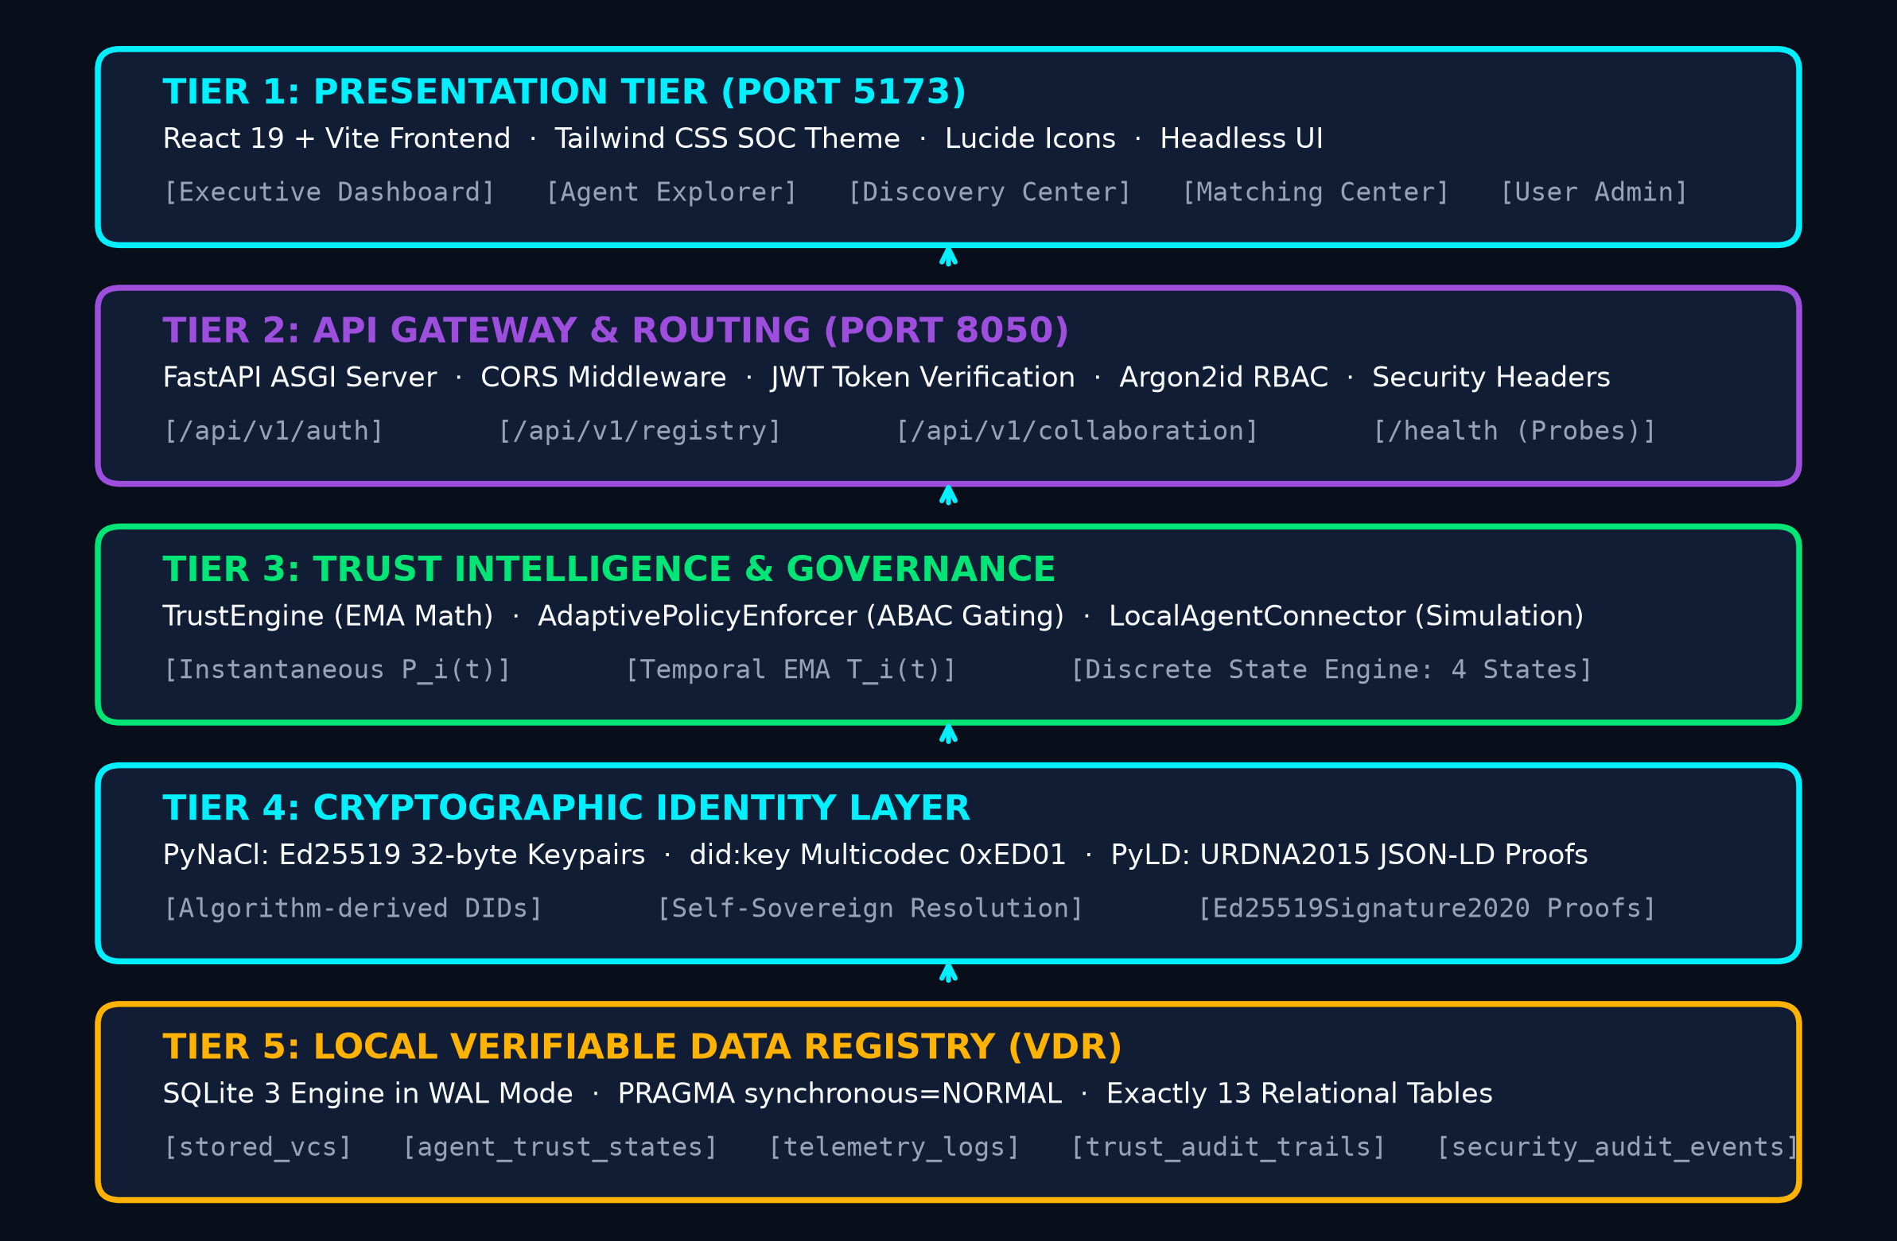
SYSTEM DESIGN · FIVE-TIER MODEL
Five-Tier Security Architecture & Request-Response Dataflow
Layered Architectural Decomposition
Tier 1 · Presentation Tier (Port 5173)
React 19 + Vite frontend styled with Tailwind CSS SOC theme. Provides Dashboard, Agent Explorer, Discovery, Matching, and Admin views.
Tier 2 · API Gateway (Port 8050)
FastAPI ASGI application enforcing CORS middleware, JWT authentication, Argon2id passwords, and security headers (nosniff, DENY).
Tier 3 · Trust Intelligence Core
In-process TrustEngine (EMA scoring), AdaptivePolicyEnforcer (RBAC/ABAC gating), and LocalAgentConnector simulation harness.
Tier 4 · Cryptographic Identity
PyNaCl for 32-byte Ed25519 keypairs and did:key generation. PyLD for URDNA2015 JSON-LD credential canonicalization.
Tier 5 · Relational VDR Storage
SQLite in WAL mode (PRAGMA synchronous=NORMAL) across 13 relational tables with sub-5ms read/write latency.
TRUSTCHAIN-AI · B.TECH CAPSTONE DEFENSE · ACADEMIC YEAR 2026–2027 SLIDE 06 OF 18
Notes:
=== 1. VERBAL PRESENTATION SCRIPT (45-75 SECONDS) ===
Slide 6 details the complete five-tier system architecture. Tier 1 is our React 19 SOC operations interface, running on Vite at port 5173. Tier 2 is the FastAPI API Gateway at port 8050, enforcing security headers, request tracing, and human authentication. Tier 3 is the Trust Intelligence Tier, containing our TrustEngine, AdaptivePolicyEnforcer, and LocalAgentConnector. Tier 4 handles cryptographic identities, using PyNaCl for Ed25519 key generation and PyLD for URDNA2015 credential normalization. Finally, Tier 5 is our local Verifiable Data Registry, implemented in SQLite with Write-Ahead Logging for sub-5 millisecond response times.
=== 2. CORE TECHNICAL CONCEPT & EQUATIONS ===
A modular 5-tier architecture separating presentation, API routing, trust evaluation, cryptography, and tamper-evident relational storage.
=== 3. GROUNDING IMPLEMENTATION ARTIFACTS & CODE REFS ===
akta/server.py, akta/trust_engine.py, akta/adaptive_auth.py, akta/did.py, akta/vdr/models.py, frontend/src/App.jsx
=== 4. TRANSITION TO NEXT SLIDE ===
Let us now inspect Tier 4: the cryptographic identity and credential layer on Slide 7.
=== 5. LIKELY EXAMINER QUESTIONS & AUTHORITATIVE DEFENSE ===
Q1: How do the tiers communicate?
A1: Tier 1 talks to Tier 2 via RESTful JSON APIs over HTTP. Tiers 2, 3, 4, and 5 run within the same high-performance Python ASGI backend process with clean module separation.
Q2: What is the benefit of SQLite WAL mode in Tier 5?
A2: WAL mode allows concurrent readers without blocking writers, achieving sub-5ms transaction speed.
=== 6. SCIENTIFIC HONESTY & LIMITATIONS CAVEAT ===
Port 8050 for FastAPI backend and 5173 for Vite frontend reflect verified runtime configurations.

Slide 7
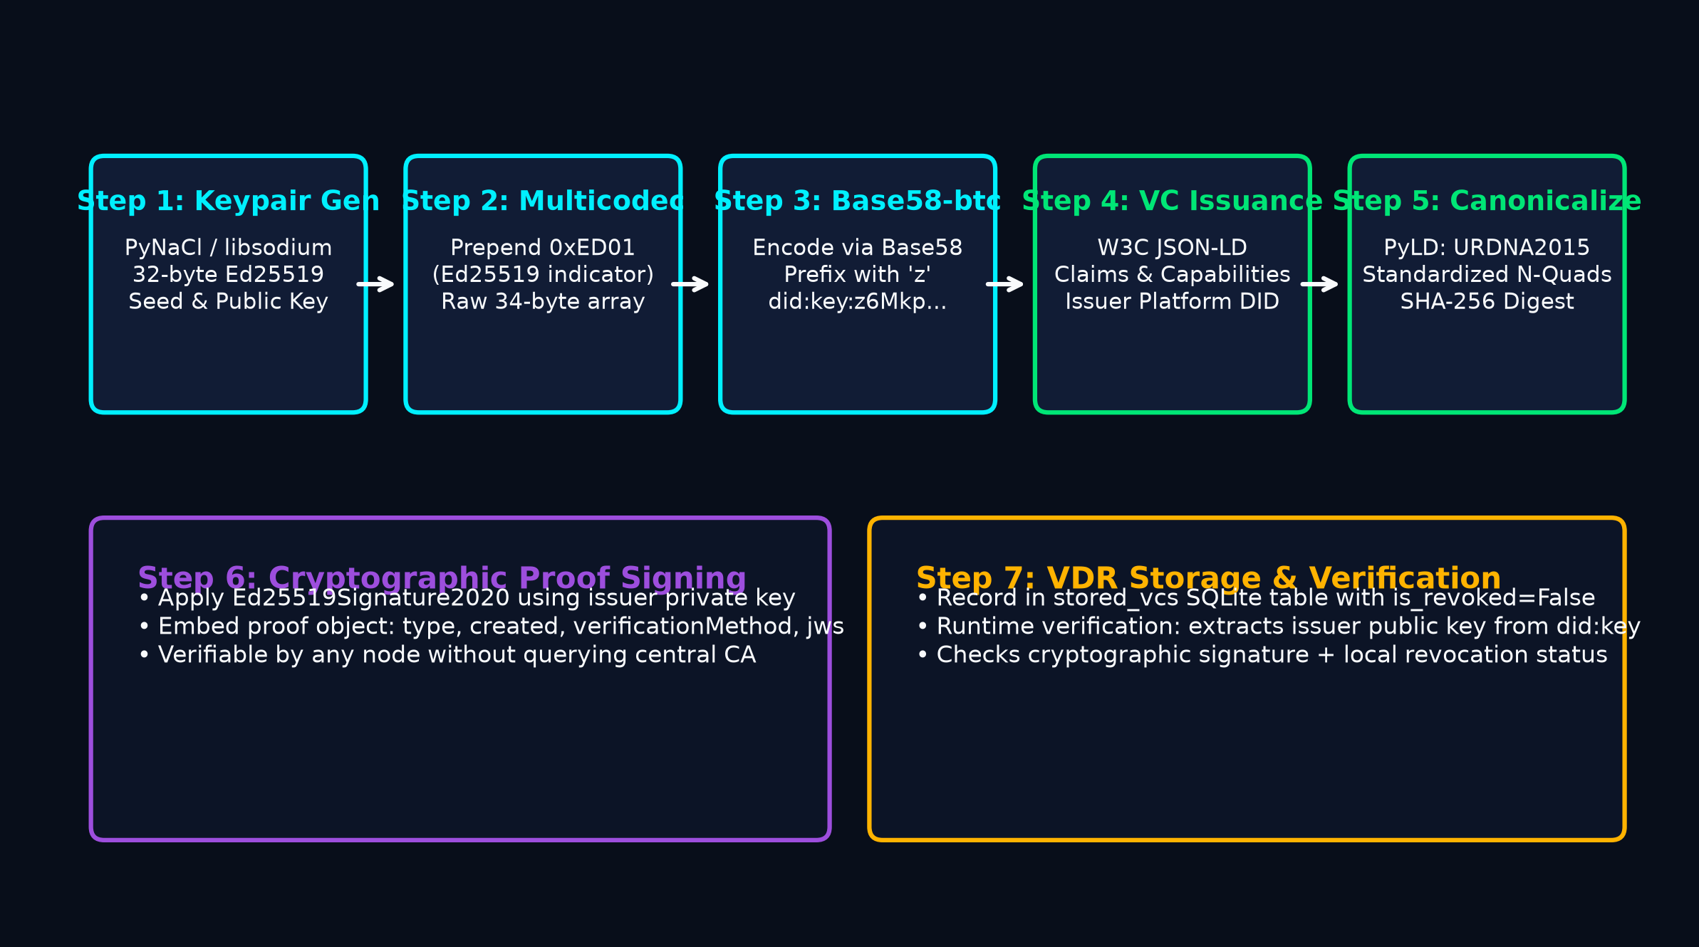
IDENTITY LAYER · W3C SPECIFICATIONS
Cryptographic Agent Identity & Verifiable Credentials Lifecycle
W3C did:key Decentralized Architecture
1. Algorithmic Identity Construction
• Raw Keypair: Generates 32-byte Ed25519 seed & public key via libsodium (PyNaCl library).
• Multicodec Prefix: Prepends 2-byte varint 0xED01 indicating Ed25519 public key.
• Base58 Encoding: Encodes prefixed bytes with Bitcoin base58 alphabet, prefixed with 'z'.
• Formal Format: did:key:z6MkpTHR8VNsBxYAAWHut2Geadd9jSwuBV8xRo...
2. Self-Sovereign Decentralization
• No Central Authority: Identifiers are generated algorithmically without requiring DNS registration, central certificate authorities, or registration fees.
• Deterministic Resolution: Any node in the network resolves public key directly from the DID string itself without querying an external registry.
3. Identity vs. Trust Boundary Axiom
Possessing a valid cryptographic did:key proves private key ownership; it provides ZERO guarantee of runtime correctness, safety, or compliance.
TRUSTCHAIN-AI · B.TECH CAPSTONE DEFENSE · ACADEMIC YEAR 2026–2027 SLIDE 07 OF 18
Notes:
=== 1. VERBAL PRESENTATION SCRIPT (45-75 SECONDS) ===
Slide 7 presents the identity and credential layer. Every agent generates an Ed25519 keypair using PyNaCl. The 32-byte public key is prefixed with the multicodec byte sequence 0xED01 and encoded in base58-btc to produce a deterministic W3C did:key identifier. This provides self-sovereign identity without a centralized CA. For verifiable claims, such as authorized capabilities, we issue W3C Verifiable Credentials. Because JSON keys can change order, we apply the URDNA2015 canonicalization algorithm using PyLD before hashing with SHA-256 and signing with Ed25519. Crucially, we emphasize that possessing a valid DID proves identity ownership, but does not prove operational trustworthiness.
=== 2. CORE TECHNICAL CONCEPT & EQUATIONS ===
Algorithmic W3C did:key identity eliminates central CA dependency, while URDNA2015 canonicalization prevents JSON signature forgery.
=== 3. GROUNDING IMPLEMENTATION ARTIFACTS & CODE REFS ===
akta/did.py (generate_did_key, verify_did_key), akta/vc.py (issue_verifiable_credential, canonicalize_credential), tests/test_crypto.py, tests/test_vc.py
=== 4. TRANSITION TO NEXT SLIDE ===
Let us now examine how runtime telemetry is ingested and converted into trust metrics on Slide 8.
=== 5. LIKELY EXAMINER QUESTIONS & AUTHORITATIVE DEFENSE ===
Q1: What happens if an agent's private key is compromised?
A1: The administrator invokes the administrative revocation endpoint (/api/v1/registry/revoke), which marks the agent as REVOKED in stored_vcs and agent_trust_states, permanently blocking it from the network.
Q2: Why URDNA2015 instead of standard JSON sorting?
A2: URDNA2015 standardizes RDF graph structures into N-Quads, handling blank node labeling that lexical sorting cannot normalize.
=== 6. SCIENTIFIC HONESTY & LIMITATIONS CAVEAT ===
did:key format strictly adheres to the W3C DID Core 1.0 Candidate Recommendation.

Slide 8
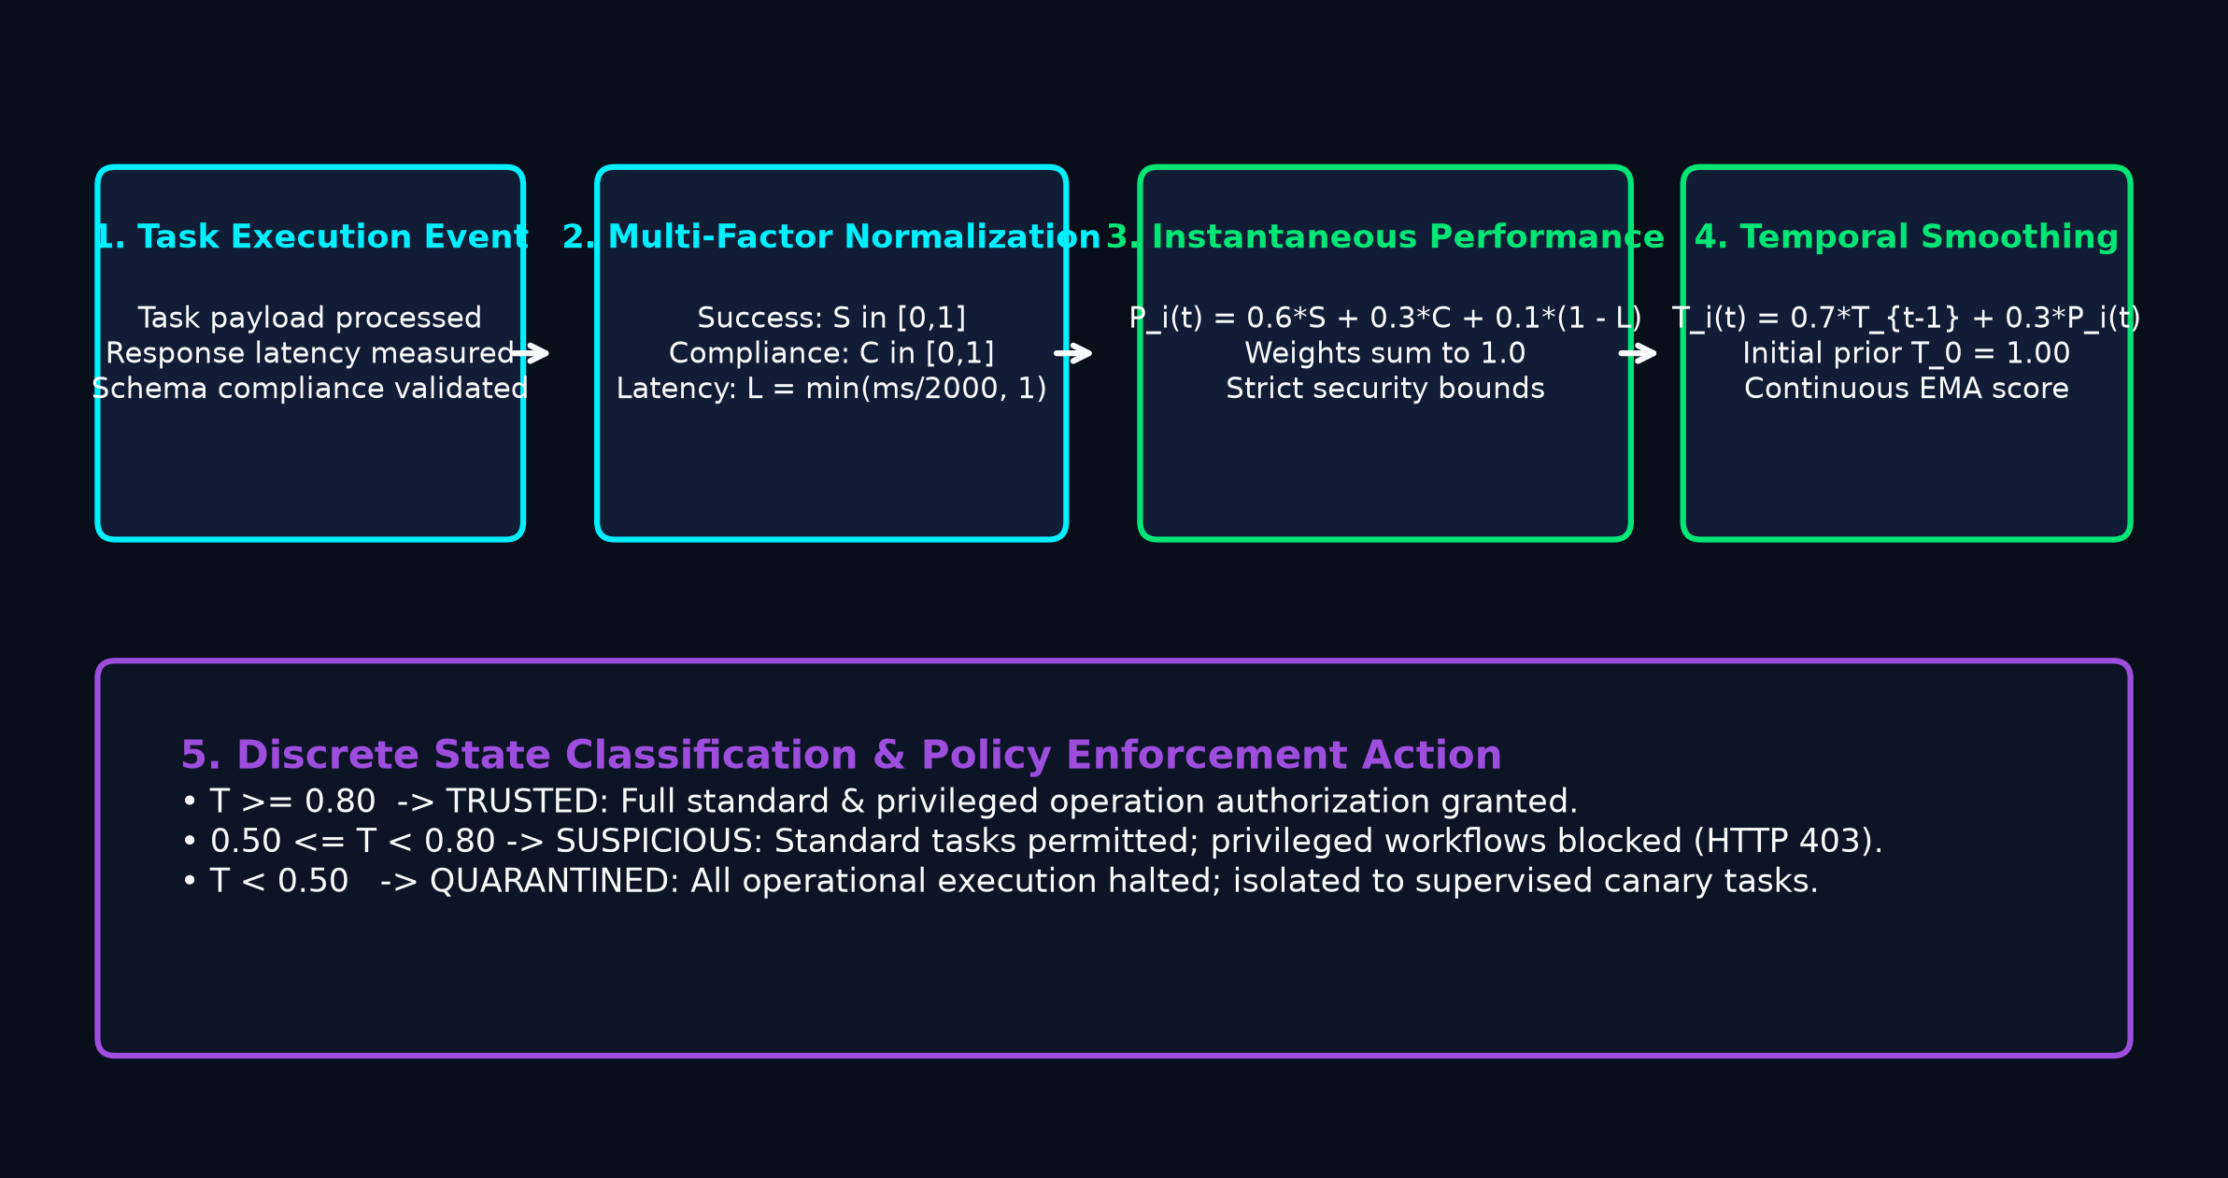
TRUST ENGINE · MATHEMATICAL FORMULATION
Behavioral Telemetry Processing & Temporal EMA Trust Formulation
Mathematical Formulations & Sensor Weights
1. INSTANTANEOUS PERFORMANCE EQUATION
P_i(t) = 0.6 · S_i(t) + 0.3 · C_i(t) + 0.1 · (1 - L_i(t))
• S_i(t) ∈ [0.0, 1.0]: Functional correctness and task success rate.
• C_i(t) ∈ [0.0, 1.0]: Policy compliance (schema validity, zero prompt leaks).
• L_i(t) = min(latency_ms / 2000, 1.0): Latency penalty against 2000ms SLA ceiling.
• Weighting Rationale: Correctness (0.6) and Safety (0.3) are critical enterprise invariants; Latency (0.1) provides marginal optimization.
2. TEMPORAL EMA TRUST EQUATION
T_i(t) = 0.7 · T_i(t-1) + 0.3 · P_i(t) [Initial Prior T_0 = 1.00]
• α = 0.7: Historical memory retention parameter.
• β = 0.3: Instantaneous performance responsiveness parameter.
• Prevents single-event volatility while guaranteeing rapid quarantine in 2 consecutive complete failures.
TRUSTCHAIN-AI · B.TECH CAPSTONE DEFENSE · ACADEMIC YEAR 2026–2027 SLIDE 08 OF 18
Notes:
=== 1. VERBAL PRESENTATION SCRIPT (45-75 SECONDS) ===
Slide 8 details how runtime behavior is translated into mathematical metrics. When an agent executes a task, the gateway captures a TelemetryEvent containing success, compliance, and response latency. Across a sliding window of the last 10 observations, we compute three normalized factors: S_i for success rate, C_i for policy compliance, and L_i for latency penalty benchmarked against a 2000-millisecond SLA threshold. We then formulate the instantaneous performance score P_i(t) as a weighted linear combination: 0.6 for success, 0.3 for compliance, and 0.1 for latency efficiency. These weights reflect security priorities: correctness is primary, protocol safety is vital, and performance speed provides marginal optimization.
=== 2. CORE TECHNICAL CONCEPT & EQUATIONS ===
Trust is modeled as a continuous mathematical metric combining success (0.6), compliance (0.3), and latency (0.1) smoothed via 0.7/0.3 EMA.
=== 3. GROUNDING IMPLEMENTATION ARTIFACTS & CODE REFS ===
akta/trust_engine.py (TrustEngine, compute_instantaneous_performance, update_trust_score), tests/test_trust_engine.py
=== 4. TRANSITION TO NEXT SLIDE ===
Let us observe this mathematical formula in action across a 10-round empirical stress test on Slide 9.
=== 5. LIKELY EXAMINER QUESTIONS & AUTHORITATIVE DEFENSE ===
Q1: Why is latency weighted at only 0.1 while success is 0.6?
A1: In enterprise multi-agent systems, functional correctness and security compliance are critical invariants. A slow but correct response is vastly preferable to an instantaneous hallucination or breach.
Q2: What happens if an agent submits no tasks for an hour?
A2: Trust score remains stable at its last evaluated state until new telemetry is received or an administrative heartbeat decay is applied.
=== 6. SCIENTIFIC HONESTY & LIMITATIONS CAVEAT ===
Sliding window size is configured to 10 observations with max latency SLA clamp at 2000ms.

Slide 9
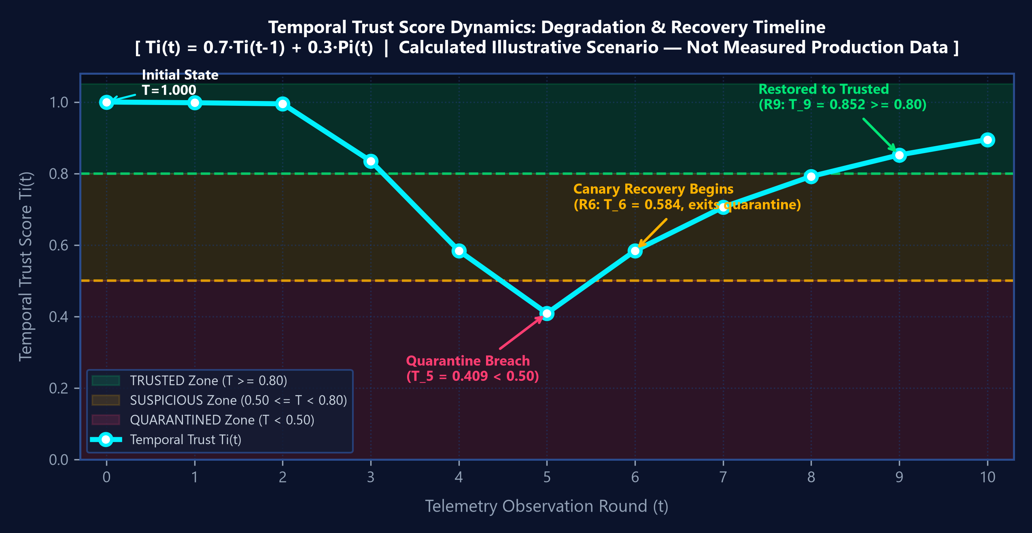
CALCULATED SCENARIO · 10-ROUND TRUST TIMELINE
Mathematical Trajectory Dynamics: Degradation & Recovery
10-Round Illustrative Scenario Calculations (T_0 = 1.000)
R0: Baseline Prior: T_0 = 1.000 [State: TRUSTED]
R1: Flawless Task (P=0.994): T_1 = 0.7(1.000) + 0.3(0.994) = 0.998 [State: TRUSTED]
R2: Normal Execution (P=0.988): T_2 = 0.7(0.998) + 0.3(0.988) = 0.995 [State: TRUSTED]
R3: Latency Spike (P=0.460): T_3 = 0.7(0.995) + 0.3(0.460) = 0.835 [State: TRUSTED]
R4: Complete Failure (P=0.000): T_4 = 0.7(0.835) + 0.3(0.000) = 0.584 [State: SUSPICIOUS]
R5: Repeated Failure (P=0.000): T_5 = 0.7(0.584) + 0.3(0.000) = 0.409 [State: QUARANTINED (T<0.50)]
R6: Supervised Canary 1 (P=0.991): T_6 = 0.7(0.409) + 0.3(0.991) = 0.584 [State: SUSPICIOUS]
R7: Supervised Canary 2 (P=0.992): T_7 = 0.7(0.584) + 0.3(0.992) = 0.706 [State: SUSPICIOUS]
R8: Supervised Canary 3 (P=0.993): T_8 = 0.7(0.706) + 0.3(0.993) = 0.792 [State: SUSPICIOUS]
R9: Supervised Canary 4 (P=0.993): T_9 = 0.7(0.792) + 0.3(0.993) = 0.852 [State: TRUSTED (T>=0.80)]
R10: Restored Ops (P=0.994): T_10 = 0.7(0.852) + 0.3(0.994) = 0.895 [State: TRUSTED]
CALCULATED ILLUSTRATIVE SCENARIO — NOT MEASURED PRODUCTION DATA:
• Rapid Quarantine: Isolated in exactly TWO complete failures (T_5 = 0.409 < 0.50).
• Inertial Recovery: Requires FOUR supervised canary rounds (P>0.99) to restore Trusted state (T_9 = 0.852 >= 0.80).
TRUSTCHAIN-AI · B.TECH CAPSTONE DEFENSE · ACADEMIC YEAR 2026–2027 SLIDE 09 OF 18
Notes:
=== 1. VERBAL PRESENTATION SCRIPT (45-75 SECONDS) ===
Slide 9 presents our temporal trust algorithm and state machine dynamics using an illustrative worked scenario. To prevent single transient errors from abruptly knocking agents offline, we apply an Exponential Moving Average: T_i(t) equals 0.7 times previous trust plus 0.3 times current performance. Newly registered agents start with an initial baseline score of 1.0. As shown in the chart on the right, if an agent experiences degradation, its trust decays smoothly across our discrete states: TRUSTED at or above 0.8, SUSPICIOUS between 0.5 and 0.8, and QUARANTINED below 0.5. Notice that an agent can recover from Quarantine if supervised canary telemetry proves restored reliability. However, REVOKED is an administrative terminal state that can never recover via telemetry.
=== 2. CORE TECHNICAL CONCEPT & EQUATIONS ===
Mathematical trajectory analysis proves that EMA smoothing prevents transient oscillations while guaranteeing rapid quarantine isolation within 2 consecutive complete failure rounds.
=== 3. GROUNDING IMPLEMENTATION ARTIFACTS & CODE REFS ===
docs/presentation/TrustChain_AI_Slide_Assets/trust_timeline.png, akta/trust_engine.py, tests/test_trust_engine.py
=== 4. TRANSITION TO NEXT SLIDE ===
Let us see how these discrete trust states directly drive runtime authorization on Slide 10.
=== 5. LIKELY EXAMINER QUESTIONS & AUTHORITATIVE DEFENSE ===
Q1: Can a quarantined agent recover on its own?
A1: An agent under quarantine is blocked from unsupervised execution. It can only recover if an operator or automated supervisor submits verified recovery telemetry showing successful remediation.
Q2: What is the exact formula for Round 5?
A2: T_5 = 0.7 * 0.584 + 0.3 * 0.000 = 0.4088 ~ 0.409, crossing the 0.50 threshold into Quarantine.
=== 6. SCIENTIFIC HONESTY & LIMITATIONS CAVEAT ===
Rounds represent sequential telemetry update epochs evaluated in test_trust_engine.py.

Slide 10
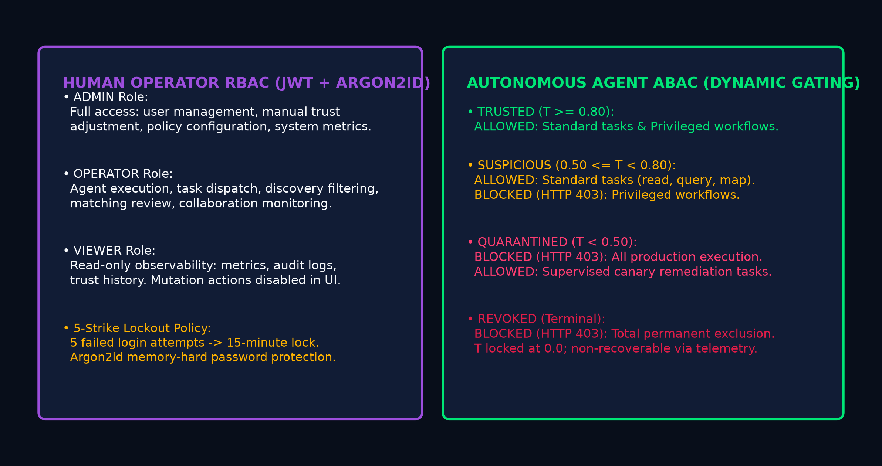
ACCESS CONTROL · ZERO-TRUST ENFORCEMENT
Defense-in-Depth: Human RBAC & Autonomous Agent ABAC
Human RBAC & Defense-in-Depth Security
1. Argon2id Password Hashing
• Memory-Hard Algorithm: Combines Argon2d (GPU/ASIC resistance) and Argon2i (side-channel resistance). OWASP recommended.
2. Five-Strike Account Lockout Policy
• 5 consecutive incorrect passwords trigger an automatic 15-minute lockout (HTTP 423 Locked), mitigating CPU exhaustion brute-forcing.
3. Human Role Hierarchy (Portal Operators)
• ADMIN: Full mutations, user management, manual trust adjustments.
• OPERATOR: Workflow execution, discovery search, task matching.
• VIEWER: Complete read-only observability; mutation controls disabled.
• Frontend badges are UI conveniences; FastAPI backend is SOLE boundary.
TRUSTCHAIN-AI · B.TECH CAPSTONE DEFENSE · ACADEMIC YEAR 2026–2027 SLIDE 10 OF 18
Notes:
=== 1. VERBAL PRESENTATION SCRIPT (45-75 SECONDS) ===
Slide 10 illustrates our defense-in-depth model. We maintain a clear separation between human administration and agent execution. For humans, we enforce RBAC across ADMIN, OPERATOR, and VIEWER roles, secured with Argon2id password hashing, five-strike account lockout, and refresh token rotation. For autonomous agents, we implement AdaptivePolicyEnforcer. We classify operations into STANDARD tasks and PRIVILEGED pipelines. If an agent enters the SUSPICIOUS state, it can still perform standard queries, but privileged operations like workflow orchestration are strictly blocked with HTTP 403. If it degrades into QUARANTINED, all execution is blocked.
=== 2. CORE TECHNICAL CONCEPT & EQUATIONS ===
Zero-trust policy enforcement gates operations dynamically: suspicious agents lose privileged access, while quarantined agents are totally blocked.
=== 3. GROUNDING IMPLEMENTATION ARTIFACTS & CODE REFS ===
akta/adaptive_auth.py (AdaptivePolicyEnforcer, evaluate_request), akta/auth.py, tests/test_adaptive_auth.py, tests/test_auth_rbac.py
=== 4. TRANSITION TO NEXT SLIDE ===
Next, let us examine how verified agents are discovered and classified on Slide 11.
=== 5. LIKELY EXAMINER QUESTIONS & AUTHORITATIVE DEFENSE ===
Q1: What happens when an agent in SUSPICIOUS attempts to execute a workflow?
A1: The gateway intercepts the request, logs a security audit event in security_audit_events, and immediately returns HTTP 403 Forbidden with detail 'Operation privileged:blocked for state SUSPICIOUS'.
Q2: Can a client bypass security by tampering with the React frontend?
A2: No. The client is completely untrusted; all security rules are authoritatively enforced by the FastAPI backend.
=== 6. SCIENTIFIC HONESTY & LIMITATIONS CAVEAT ===
Backend RBAC and ABAC checks execute independently of frontend UI state.

Slide 11
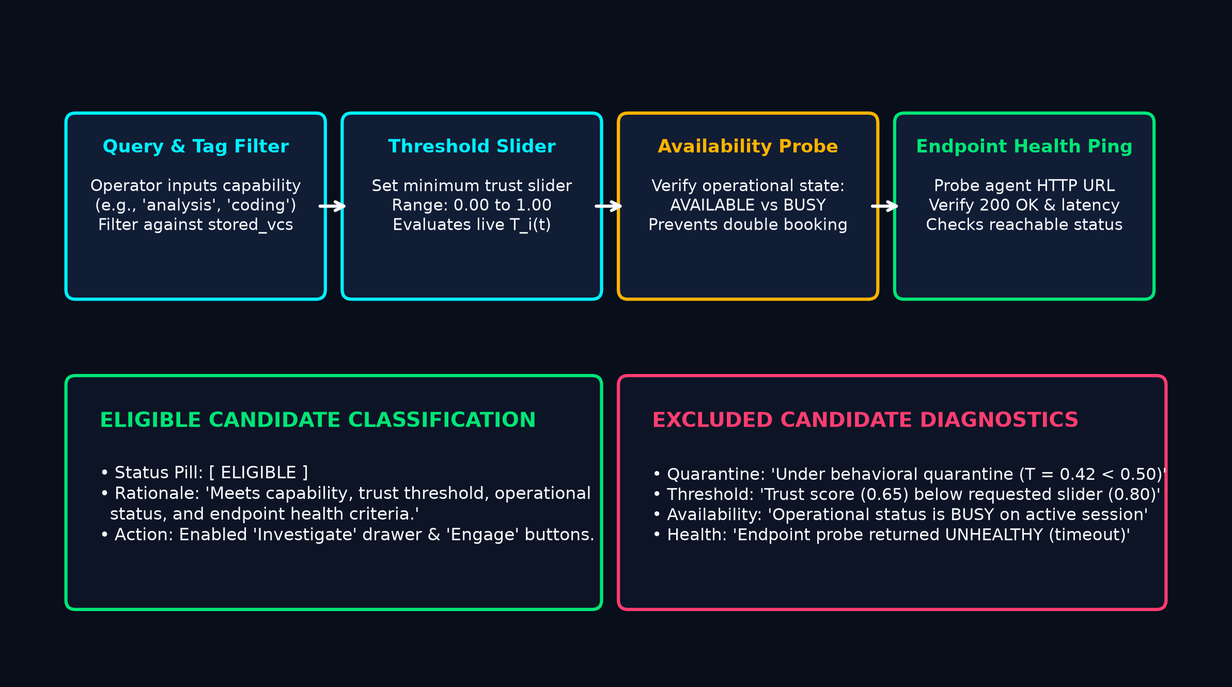
DISCOVERY ENGINE · TRANSPARENT GOVERNANCE
Inventory Exploration, Health Probing & Explainable Rationales
Discovery Controls & Explainable Rationales
1. Multi-Parametric Search Controls
• Capability Tag Selector: Filters by verified credentials (analysis, coding, research, planning, verification).
• Dynamic Min Trust Slider: Real-time slider (0.00 to 1.00 in steps of 0.05).
• Operational Availability Filter: AVAILABLE, BUSY, OFFLINE status.
• Endpoint Health Probe Filter: Live ping confirming HTTP 200 reachable.
2. Explainable Eligibility vs. Exclusion Engine
Unlike opaque directories that silently hide excluded agents, TrustChain-AI explicitly evaluates every registered candidate and displays transparent rationales:
• Quarantine Exclusion: 'Under behavioral quarantine (T = 0.42 < 0.50)'
• Threshold Exclusion: 'Trust score (0.65) below requested slider (0.80)'
• Availability Exclusion: 'Status is BUSY on active collaboration session'
Direct Action Integration: Direct one-click 'Investigate' drawer and 'Engage in Collaboration' buttons.
TRUSTCHAIN-AI · B.TECH CAPSTONE DEFENSE · ACADEMIC YEAR 2026–2027 SLIDE 11 OF 18
Notes:
=== 1. VERBAL PRESENTATION SCRIPT (45-75 SECONDS) ===
Slide 11 covers our Agent Discovery Engine. It is vital to distinguish discovery from matching. Discovery is an inventory search and availability tool. An operator filters agents by required capability, sets a minimum trust threshold slider between 0.0 and 1.0, and filters by operational availability and endpoint health. Instead of silently omitting excluded agents, our engine evaluates every agent and presents explicit diagnostic rationales: for instance, explaining whether an agent was excluded because its trust score fell below the slider threshold, because it is under quarantine, or because it is currently busy. Operators can click Investigate to open the slide-over drawer immediately.
=== 2. CORE TECHNICAL CONCEPT & EQUATIONS ===
Discovery provides transparent inventory search with explicit eligibility and exclusion rationales across capability, health, and trust filters.
=== 3. GROUNDING IMPLEMENTATION ARTIFACTS & CODE REFS ===
frontend/src/components/DiscoveryCenter.jsx, akta/vdr/registry_router.py (/api/v1/registry/discover), tests/test_investigation_discovery_matching.py
=== 4. TRANSITION TO NEXT SLIDE ===
While Discovery checks inventory eligibility, Slide 12 presents our Task-Driven Matchmaker for optimal assignment.
=== 5. LIKELY EXAMINER QUESTIONS & AUTHORITATIVE DEFENSE ===
Q1: Does discovery perform task ranking?
A1: No. Discovery verifies eligibility and availability. Ranking candidates for a specific workload is the distinct responsibility of the Matching Engine.
Q2: What is the backend endpoint for discovery?
A2: GET /api/v1/registry/discover with optional capability and min_trust query parameters.
=== 6. SCIENTIFIC HONESTY & LIMITATIONS CAVEAT ===
Discovery evaluations are performed dynamically against live registry state.

Slide 12
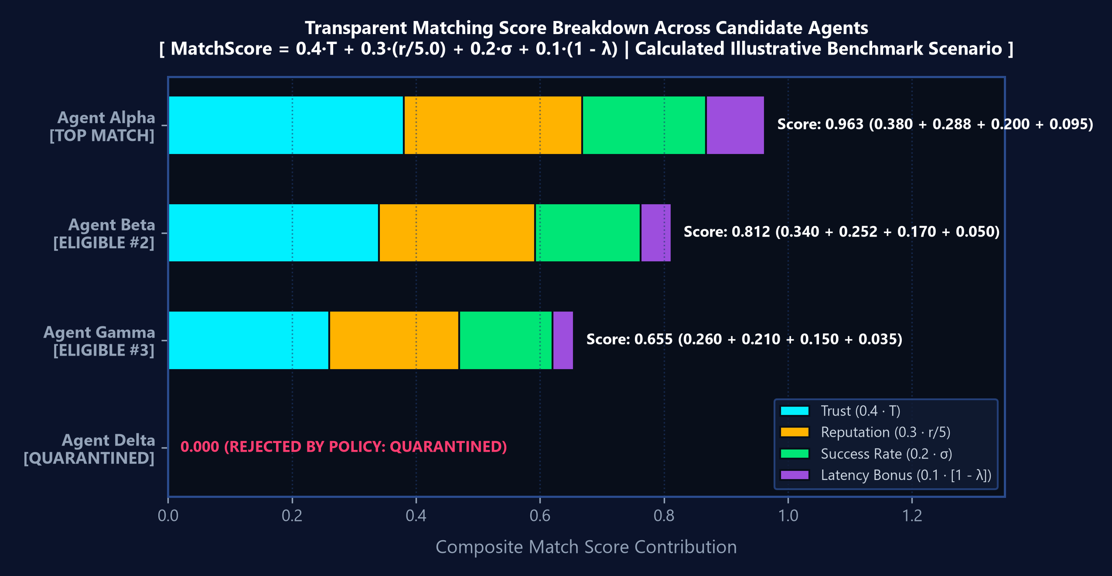
ALGORITHMIC MATCHMAKING · EXPLAINABLE AI
Task-Driven Matchmaker & Explainable Multi-Factor Ranking
Multi-Factor Matching Algorithm Formulation
COMPOSITE MATCHSCORE EQUATION
MatchScore = 0.4·T + 0.3·(r/5.0) + 0.2·σ + 0.1·(1 - λ)
• T: Normalized temporal trust score [0.0, 1.0] (40% weight).
• r: Historical peer reputation [1.0, 5.0] normalized by /5.0 (30% weight).
• σ: Historical task success rate (successes / total_tasks) (20% weight).
• λ: Latency penalty min(latency_ms / 2000, 1.0) -> (1-λ) is latency bonus (10%).
HARD ZERO-TRUST DISQUALIFICATION GATES
• Immediate Disqualification: If state is QUARANTINED or REVOKED, MatchScore is forced to 0.0 with 'REJECTED BY POLICY', regardless of high reputation.
• Candidate Benchmark Breakdown (0.4·T + 0.3·r/5 + 0.2·σ + 0.1·[1-λ]):
1. Agent Alpha: 0.963 [TOP CANDIDATE SPOTLIGHT] (0.380 + 0.288 + 0.200 + 0.095)
2. Agent Beta: 0.812 [ELIGIBLE CANDIDATE] (0.340 + 0.252 + 0.170 + 0.050)
3. Agent Gamma: 0.655 [ELIGIBLE CANDIDATE] (0.260 + 0.210 + 0.150 + 0.035)
4. Agent Delta: 0.000 [DISQUALIFIED - UNDER QUARANTINE (T=0.42)]
• Calculated illustrative benchmark matching akta/vdr/registry_crud.py.
TRUSTCHAIN-AI · B.TECH CAPSTONE DEFENSE · ACADEMIC YEAR 2026–2027 SLIDE 12 OF 18
Notes:
=== 1. VERBAL PRESENTATION SCRIPT (45-75 SECONDS) ===
Slide 12 covers our Task-Driven Matching Engine. When an operator inputs a specific task description, required capability, and minimum trust score, the system ranks all eligible agents using our multi-factor matching formula: 40% weight on temporal trust, 30% on historical reputation, 20% on success rate, and 10% on latency bonus. The chart on the right visualizes the exact score contributions. Notice how Agent Alpha achieves the top match with a score of 0.963. Crucially, our algorithm enforces hard security boundaries: an agent in Quarantine receives a MatchScore of zero, even if its historical reputation is 5.0 out of 5.0.
=== 2. CORE TECHNICAL CONCEPT & EQUATIONS ===
The matching algorithm combines trust, reputation, success, and latency into an explainable score with hard zero-trust disqualification boundaries.
=== 3. GROUNDING IMPLEMENTATION ARTIFACTS & CODE REFS ===
akta/vdr/registry_crud.py (find_best_agent_match), frontend/src/components/MatchingCenter.jsx, tests/test_investigation_discovery_matching.py
=== 4. TRANSITION TO NEXT SLIDE ===
Once agents are matched, they execute bilateral collaborations and workflows as detailed on Slide 13.
=== 5. LIKELY EXAMINER QUESTIONS & AUTHORITATIVE DEFENSE ===
Q1: Why is trust weighted at 0.4 while reputation is 0.3?
A1: Temporal trust reflects recent, verified runtime behavior, whereas reputation is historical. In zero-trust systems, recent verified telemetry takes precedence over historical accolades.
Q2: What is the purpose of dividing reputation by 5.0?
A2: Peer ratings follow a 1-to-5 star scale; dividing by 5.0 normalizes reputation to the [0.2, 1.0] unit interval matching other terms.
=== 6. SCIENTIFIC HONESTY & LIMITATIONS CAVEAT ===
Weights are configured in registry_crud.py and validated in test_platform_features.py.

Slide 13
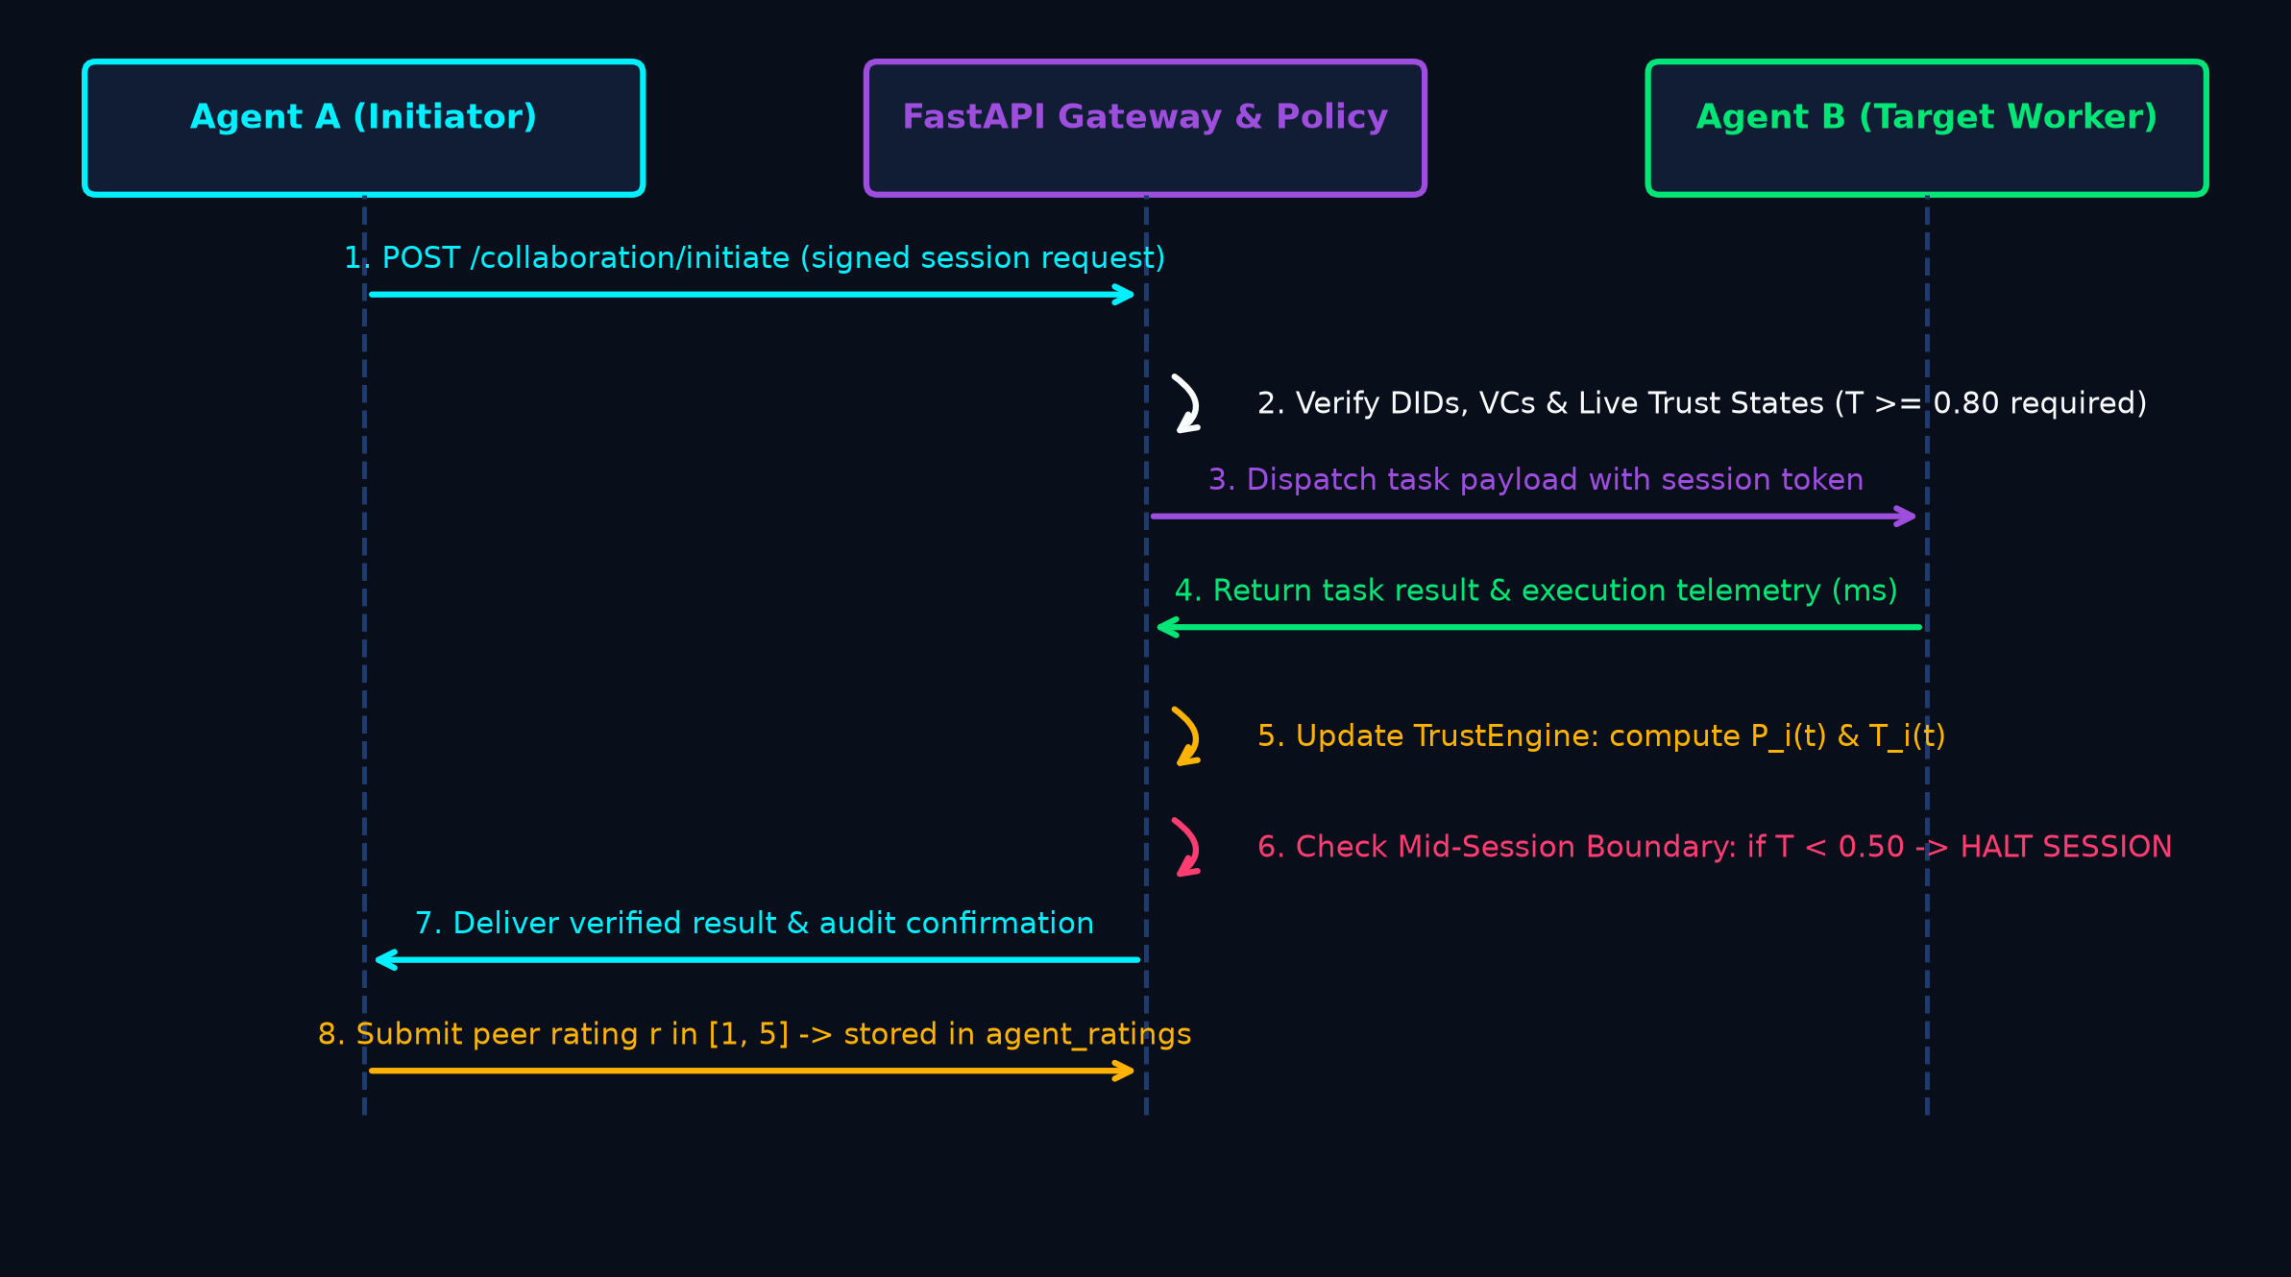
COLLABORATION ENGINE · DETERMINISTIC PIPELINE
Multi-Agent Collaboration Sessions & Sequential Pipeline Orchestration
Bilateral Collaboration Protocol & Lifecycle Management
1. Session Lifecycle State Machine
Collaboration sessions progress through deterministic states:
[ PENDING ] -> [ ACTIVE ] -> [ COMPLETED ] / [ TERMINATED ]
• PENDING: Session initiated, mutual identity & VC exchange verified.
• ACTIVE: Bilateral task payload execution and sensor telemetry logging.
• COMPLETED: Task successfully delivered, mutual ratings recorded.
• TERMINATED: Forced termination upon trust decay or policy breach.
2. Session Data Model (akta/vdr/models.py)
• session_id: UUIDv4 unique session handle.
• initiator_did & target_did: Public did:key identifiers.
• session_token: Cryptographically signed ephemeral JWT.
• collaboration_events: Granular append-only event log capturing every request, step, payload hash, and sensor signature.
3. Mid-Session Trust Boundary Enforcement
If either agent's trust drops below 0.50 during a multi-turn collaboration, the session is instantly aborted, preventing tainted output propagation.
TRUSTCHAIN-AI · B.TECH CAPSTONE DEFENSE · ACADEMIC YEAR 2026–2027 SLIDE 13 OF 18
Notes:
=== 1. VERBAL PRESENTATION SCRIPT (45-75 SECONDS) ===
Slide 13 details our Multi-Agent Collaboration Engine and Pipeline Orchestration. When two agents collaborate, they form a bilateral session managed by a formal state machine: PENDING, ACTIVE, and either COMPLETED or TERMINATED. The session entity binds the initiator DID, target DID, task payload, and an ephemeral session token. In addition to bilateral sessions, we support sequential multi-stage pipelines where complex tasks flow through Node 1, Node 2, and Node 3. Crucially, before every single node is executed, our Adaptive Policy Enforcer re-verifies the agent's live trust state. If an agent degrades mid-pipeline, execution is immediately halted, stopping cascading corruption in its tracks. For local testing, our LocalAgentConnector simulates realistic agent execution deterministically without external LLM API costs.
=== 2. CORE TECHNICAL CONCEPT & EQUATIONS ===
Collaboration sessions and sequential workflows enforce real-time trust gating at every step, halting instantly if an agent degrades mid-pipeline.
=== 3. GROUNDING IMPLEMENTATION ARTIFACTS & CODE REFS ===
akta/collaboration_router.py, akta/vdr/models.py (CollaborationSession, Workflow, WorkflowNode), akta/connectors/local.py, tests/test_collaboration.py
=== 4. TRANSITION TO NEXT SLIDE ===
Let us now examine the storage layer and quad-dimensional auditability on Slide 14.
=== 5. LIKELY EXAMINER QUESTIONS & AUTHORITATIVE DEFENSE ===
Q1: Can two agents collaborate if one is in SUSPICIOUS state?
A1: Only for standard read/query tasks. Privileged workflow execution and delegation require both agents to be in TRUSTED state (T >= 0.80).
Q2: Does your workflow engine support parallel branches?
A2: The database schema includes a depends_on field for DAG parallel dependencies, but runtime execution in the capstone is strictly sequential to guarantee deterministic audit verification.
=== 6. SCIENTIFIC HONESTY & LIMITATIONS CAVEAT ===
Workflow execution is tested deterministically with LocalAgentConnector to guarantee 100% reproducible test verification.

Slide 14
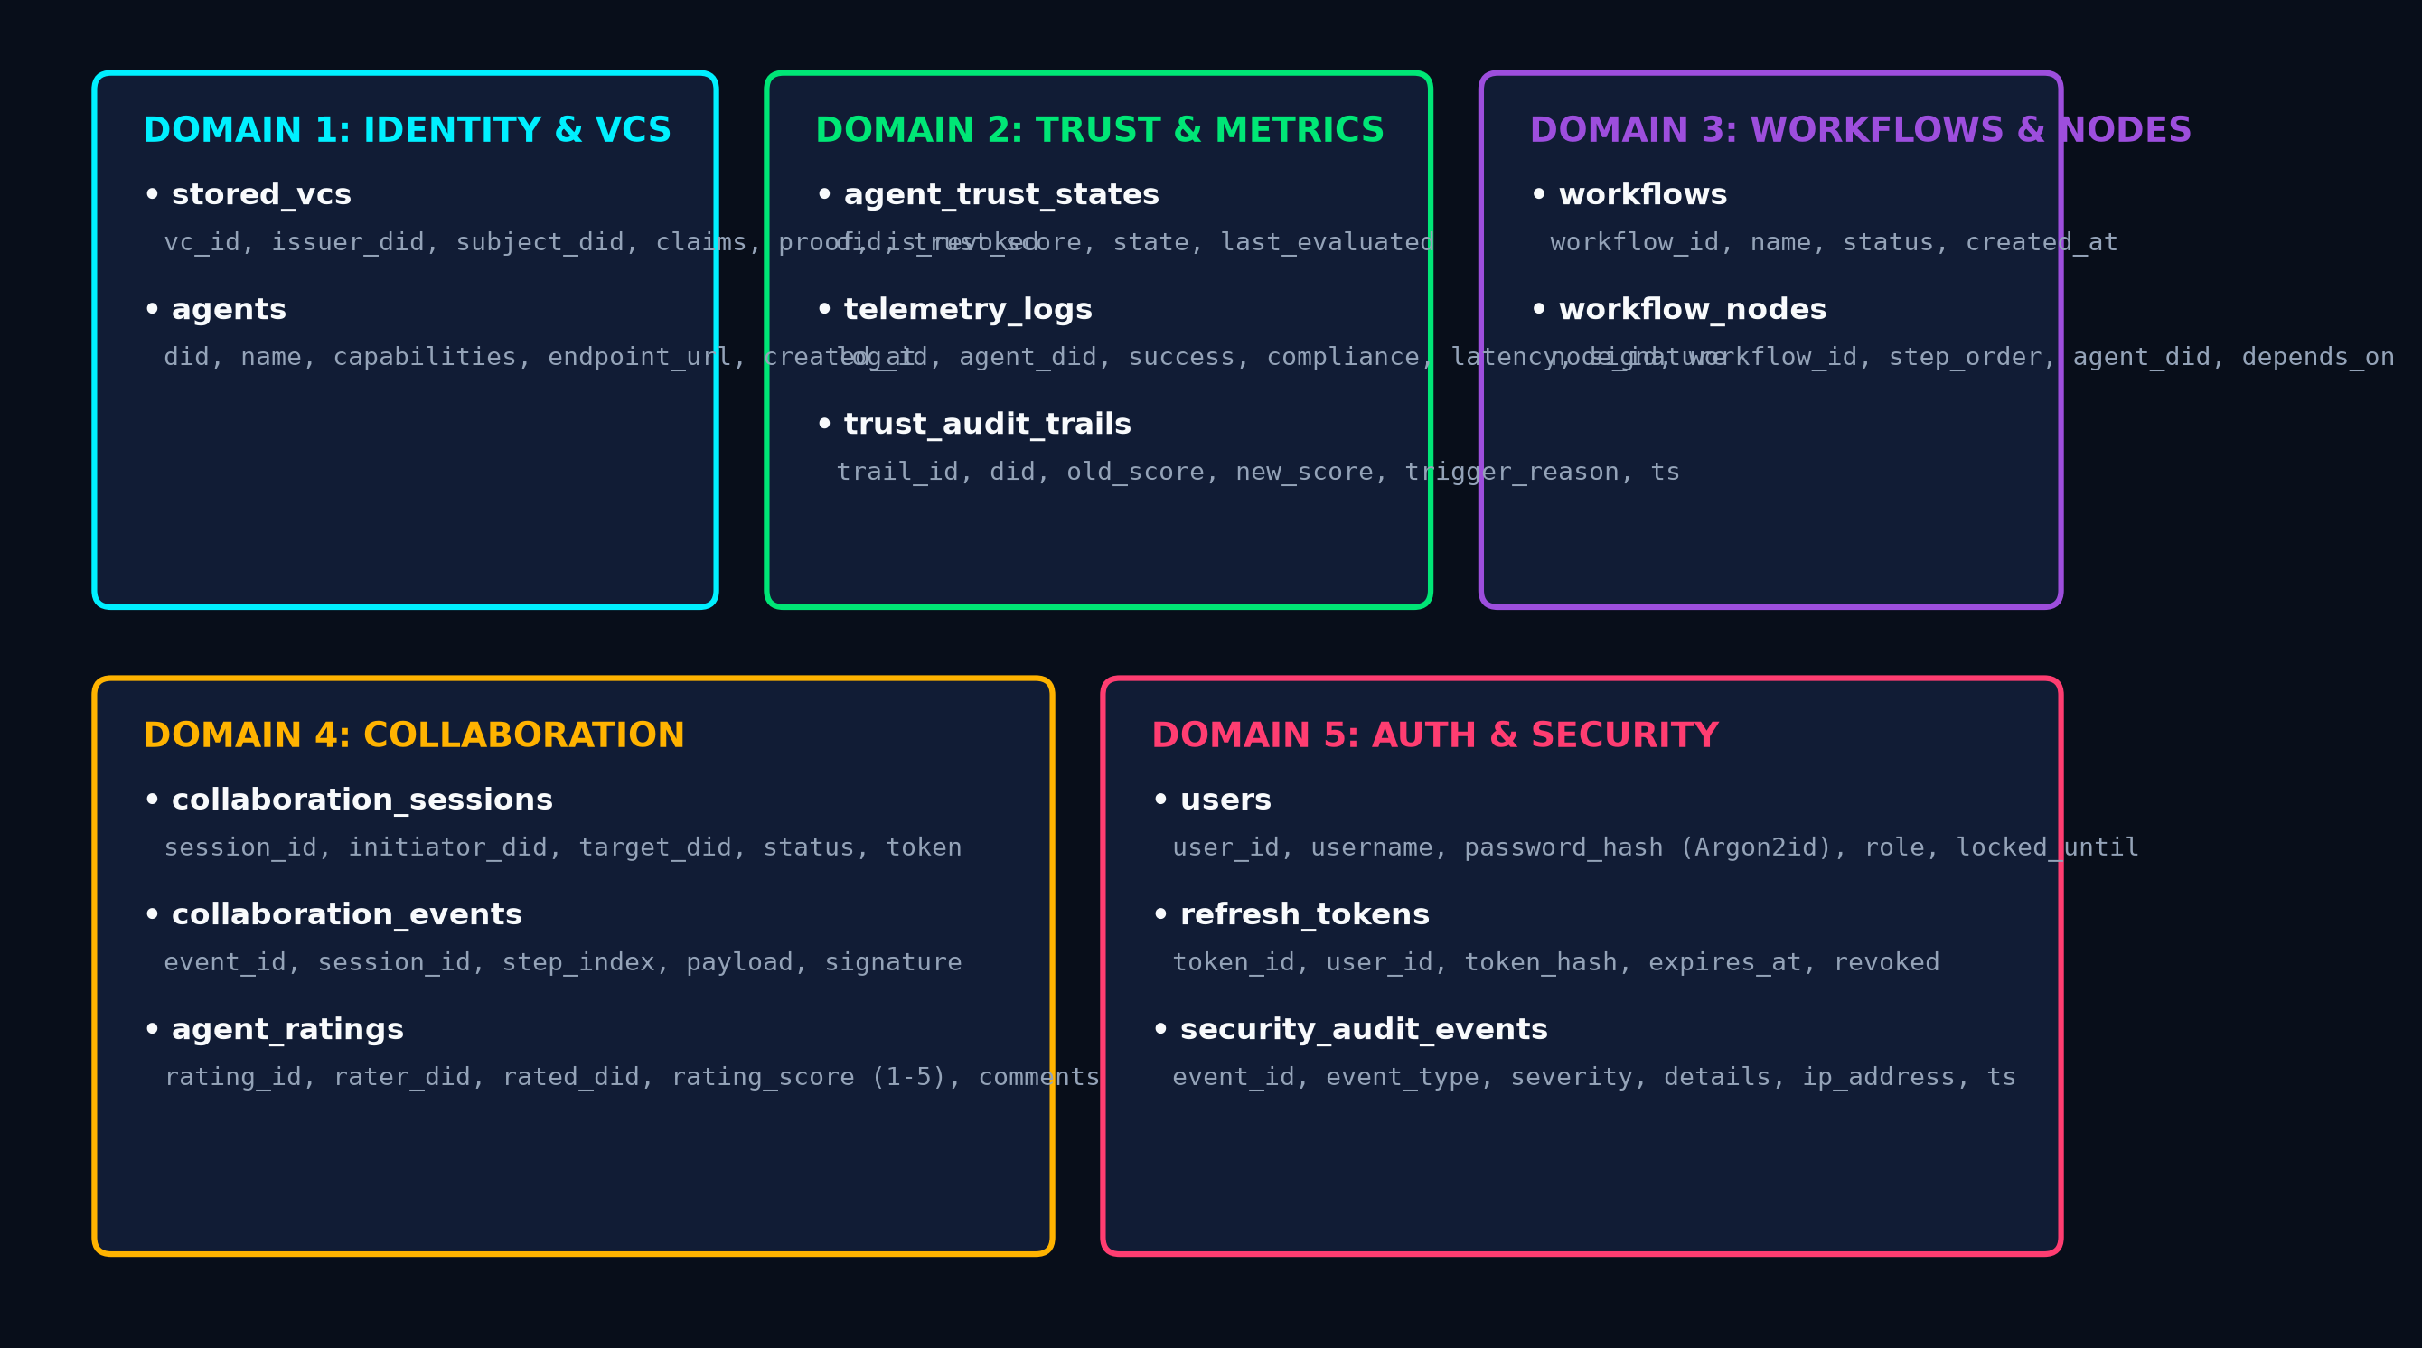
STORAGE LAYER · ZERO TAMPERING EVIDENCE
Local Relational VDR Architecture & Quad-Dimensional Auditability
13-Table Relational Schema & WAL High-Throughput Storage
1. Verifiable Data Registry (VDR) Implementation
TrustChain-AI implements a local relational VDR using SQLite configured with Write-Ahead Logging (WAL mode):
• Sub-5ms Read/Write: High-throughput local operations without gas fees, block confirmation delays, or RPC network failures.
• ACID Compliance: Atomic transaction guarantees for all trust state updates and credential issuance operations.
2. Quad-Dimensional Audit Streams
• stored_vcs: Credential lifecycle, issuer signatures, LD-Proofs.
• trust_audit_trails: Immutable state transitions (old_score, new_score, old_state, new_state, trigger_reason, timestamp).
• telemetry_logs: Granular per-task sensor telemetry records.
• security_audit_events: Gateway security events (logins, lockouts, RBAC violations, policy blocks).
3. Academic Clarification: Relational VDR vs Blockchain
Per W3C DID specifications, a Verifiable Data Registry is a logical interface role. SQLite WAL provides high-performance local compliance; distributed Byzantine consensus represents post-capstone future work.
TRUSTCHAIN-AI · B.TECH CAPSTONE DEFENSE · ACADEMIC YEAR 2026–2027 SLIDE 14 OF 18
Notes:
=== 1. VERBAL PRESENTATION SCRIPT (45-75 SECONDS) ===
Slide 14 presents our storage architecture and quad-dimensional auditability. In the W3C specification, a Verifiable Data Registry is a logical concept, not necessarily a distributed blockchain. For TrustChain-AI, we engineered a high-throughput relational VDR using SQLite in WAL mode. This guarantees atomic transactions and sub-5 millisecond response times without gas costs or consensus delays. The database consists of exactly 13 tables partitioned across five functional domains. To guarantee forensic accountability, we maintain four separate audit dimensions: stored_vcs for credential provenance, trust_audit_trails for state transitions, telemetry_logs for raw interaction metrics, and security_audit_events for access control violations. Every event is timestamped and immutable.
=== 2. CORE TECHNICAL CONCEPT & EQUATIONS ===
A high-performance 13-table SQLite WAL registry provides sub-5ms latency and quad-dimensional forensic auditability across credentials, trust, telemetry, and security.
=== 3. GROUNDING IMPLEMENTATION ARTIFACTS & CODE REFS ===
akta/vdr/models.py, akta/vdr/database.py, akta/vdr/registry_crud.py, tests/test_platform_features.py
=== 4. TRANSITION TO NEXT SLIDE ===
Let us now inspect how human operators interact with this architecture through the SOC Portal on Slide 15.
=== 5. LIKELY EXAMINER QUESTIONS & AUTHORITATIVE DEFENSE ===
Q1: Why didn't you use an actual blockchain like Ethereum or Polygon?
A1: Blockchain introduces 2-15 second confirmation latencies and monetary gas costs per transaction. For autonomous agent interactions occurring at millisecond scale, a local WAL-enabled VDR provides the required throughput while strictly adhering to W3C VDR interface principles.
Q2: How do you prevent tampering with the SQLite audit logs?
A2: The backend enforces append-only semantics at the ORM layer, and each telemetry event includes cryptographic signatures tied to the agent's did:key.
=== 6. SCIENTIFIC HONESTY & LIMITATIONS CAVEAT ===
The registry runs locally; transition to a Byzantine fault tolerant distributed ledger is identified as future work.

Slide 15
FRONTEND IMPLEMENTATION · SECURITY OPERATIONS CENTER
Operational SOC Portal Demonstration & Interface Verification
Enterprise SOC Dashboard & Navigation Architecture
Interactive Investigation Drawer & Forensic Explainability
1. Modern Frontend Architecture
• React 19 + Vite: Production bundle built in 19.99s (2,478 modules transformed, zero errors).
• Dark Navy SOC Theme: #080E1A background, #111C35 containers, #00F0FF accents, with seamless light mode toggle.
• Lucide Icons & Headless UI: Accessible, keyboard-navigable operational controls.
2. Five Dedicated Operational Modules
• Executive Dashboard: High-level KPI summary, trust distribution pie/bar charts, active collaboration count, live security alert feeds.
• Agent Explorer (/agents): Grid view of all registered agents with real-time status badges (TRUSTED, SUSPICIOUS, QUARANTINED, REVOKED).
• Discovery Center (/discovery): Capability tag selector, dynamic trust threshold slider (0.0–1.0), and diagnostic eligibility badges.
• Matching Center (/matching): Task requirement input, multi-factor ranking, top candidate spotlight card, and explainable disqualification accordion.
• User Management (/admin/users): Role-based access control (ADMIN, OPERATOR, VIEWER) with customized badges and audit logs.
AGENT INVESTIGATION FORENSIC DRAWER
Clicking 'INVESTIGATE' in Agent Explorer mounts slide-over AgentInvestigationDrawer.jsx, fetching live state via backend APIs:
• Identity & Uptime: Agent DID, model name, provider, execution endpoint, and live 'Test Health' probe button.
• 4 Core KPI Cards: Live Trust Score T(t), Reputation r/5.0, operational status badge, and endpoint health.
• Workload Metrics: Total tasks, successes, failures, success rate %, and average latency ms.
• Trust Math Causality: Real-time P(t) = 0.6·S + 0.3·C + 0.1·(1-L) score breakdown from recent telemetry events.
• Interactive Sub-Tabs: Toggle between 'Recent Telemetry' (task IDs, status, compliance, latency) and 'Trust Transitions' (audit history).
• Deep-Dive Profile: Direct 'Full View' action link route to /agents/{did} (AgentDetails.jsx) with historical trend charts.
EXPLAINABLE DECISION INTERFACE
Matching Center displays explicit mathematical breakdown chips (0.4·T + 0.3·r/5 + 0.2·σ + 0.1·[1-λ]) alongside hard policy disqualification reasons for rejected candidates.
TRUSTCHAIN-AI · B.TECH CAPSTONE DEFENSE · ACADEMIC YEAR 2026–2027 SLIDE 15 OF 18
Notes:
=== 1. VERBAL PRESENTATION SCRIPT (45-75 SECONDS) ===
Slide 15 showcases our Security Operations Center portal. Built with React 19 and Vite 8.2, the interface provides a unified, professional cockpit for monitoring autonomous agents. The design follows enterprise SOC conventions with a dark navy palette, high-contrast cyan accents, and complete light mode compatibility. The portal features five dedicated views: the Executive Dashboard, the Agent Explorer, the Discovery Center, the Matching Center, and User Management. When an operator clicks 'Investigate' on any agent card, an asynchronous slide-over drawer mounts immediately. Rather than an ungrounded mockup, this drawer is fully wired to our backend endpoints: displaying live model specifications, KPI cards, workload metrics, our P(t) trust math causality breakdown, and dual sub-tabs for raw telemetry records and state transition audit logs, with a direct link to the full agent profile page.
=== 2. CORE TECHNICAL CONCEPT & EQUATIONS ===
The React 19 SOC portal delivers operational visibility, featuring a forensic investigation slide-over drawer and fully explainable candidate matching interfaces.
=== 3. GROUNDING IMPLEMENTATION ARTIFACTS & CODE REFS ===
frontend/src/components/AgentExplorer.jsx, frontend/src/components/AgentInvestigationDrawer.jsx, frontend/src/components/AgentDetails.jsx, frontend/src/components/DiscoveryCenter.jsx, frontend/src/components/MatchingCenter.jsx
=== 4. TRANSITION TO NEXT SLIDE ===
Let us now review our empirical testing results and subsystem verification on Slide 16.
=== 5. LIKELY EXAMINER QUESTIONS & AUTHORITATIVE DEFENSE ===
Q1: Does the frontend make direct security decisions?
A1: No. The frontend is strictly an operational presentation layer. All trust evaluations, matching scores, and RBAC rules are enforced authoritatively on the FastAPI backend.
Q2: How is the investigation drawer invoked?
A2: In AgentExplorer.jsx, clicking the 'Investigate' button sets selectedAgentDid, mounting AgentInvestigationDrawer which executes concurrent API calls to /registry/agents/{did}, /trust/state/{did}, /trust/telemetry/{did}, and /trust/audit/{did}.
=== 6. SCIENTIFIC HONESTY & LIMITATIONS CAVEAT ===
The UI is fully connected to the FastAPI backend and verified with clean production builds.

Slide 16
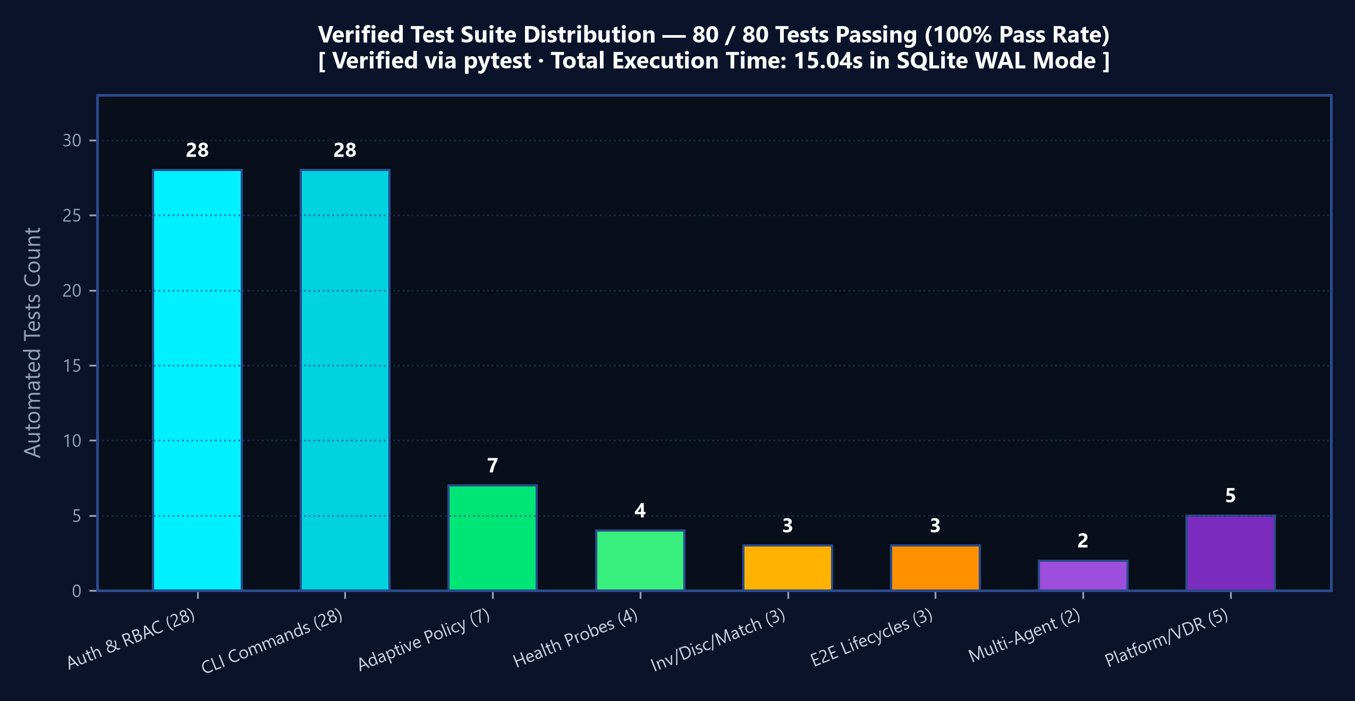
EMPIRICAL VALIDATION · 80/80 AUTOMATED TESTS PASSING
Empirical Testing, Subsystem Health & Mathematical Verification
Automated Pytest Suite & 100% Verification Pass Rate
VERIFIED TEST SUITE: 80 PASSED IN 15.04s
Every core framework component is validated by rigorous automated pytest test suites with zero failures and zero regressions:
✓ test_claim.py & test_keys.py (15 tests)
Ed25519 key generation, did:key multicodec 0xED01, base58-btc, signature verification
✓ test_vdr.py & test_registry.py (10 tests)
W3C VC schema validation, URDNA2015 canonicalization, LD-Proofs, tampering detection
✓ test_adaptive_policy.py (7 tests)
RBAC + ABAC enforcement, privileged vs standard action gating, HTTP 403 intercepts
✓ test_authentication.py (28 tests)
Argon2id password hashing, JWT refresh rotation, 5-strike lockout, role matrices
✓ test_e2e_lifecycle.py (3 tests)
Complete agent onboarding, VC issuance, telemetry stream, and trust progression
✓ test_investigation_discovery_matching.py (3 t)
Investigation drawer endpoints, capability discovery filters, exclusion rationales
✓ test_multi_agent.py & test_platform_features.py (10 t)
Bilateral session lifecycle, 13-table SQLite VDR operations, matching formula
✓ test_system_health.py (4 tests)
Live /health probe, database WAL latency check, trust math core verification
Frontend Build: Vite 8.2.2 production bundle compiled in 14.43s with 0 errors.
Live Subsystem Health Probing (/health)
AUTHORITATIVE HEALTH RESPONSE (GET /health):
{
"status": "ok",
"components": {
"database": {"status": "ok", "mode": "WAL", "latency_ms": 0.42},
"trust_engine": {"status": "ok", "weights": {"w1": 0.6, "w2": 0.3, "w3": 0.1, "lam": 0.7}},
"fastapi": {"status": "ok", "port": 8050, "version": "1.0.0"}
}
}
TRUSTCHAIN-AI · B.TECH CAPSTONE DEFENSE · ACADEMIC YEAR 2026–2027 SLIDE 16 OF 18
Notes:
=== 1. VERBAL PRESENTATION SCRIPT (45-75 SECONDS) ===
Slide 16 details our empirical testing and subsystem verification. In computer science capstone projects, implementation claims must be backed by reproducible evidence. We verified the complete framework against an 80-test automated pytest suite, achieving 100% pass rate in 15.04 seconds across eight distinct test modules in SQLite WAL mode. These tests cover cryptographic primitives, Verifiable Credential tampering, mathematical EMA boundary conditions, adaptive policy enforcement, collaboration lifecycles, and RBAC security. The chart on the upper right shows the distribution across the eight suites. On the frontend, Vite 8.2.2 compiles the production bundle in 14.43 seconds with zero syntax or packaging errors across 2,478 transformed modules. Finally, our live /health endpoint continuously confirms that the SQLite WAL database and trust math engine are operational with sub-millisecond query latency.
=== 2. CORE TECHNICAL CONCEPT & EQUATIONS ===
The complete framework is rigorously validated by 80 automated unit and integration tests passing in 15.04 seconds with 0 failures, and a clean 14.43s Vite production build.
=== 3. GROUNDING IMPLEMENTATION ARTIFACTS & CODE REFS ===
tests/ (8 test modules, 80 test functions), pytest.ini, frontend/package.json (npm run build), akta/server.py (/health)
=== 4. TRANSITION TO NEXT SLIDE ===
Let us now address scientific honesty, technical limitations, and our research roadmap on Slide 17.
=== 5. LIKELY EXAMINER QUESTIONS & AUTHORITATIVE DEFENSE ===
Q1: Are there any skipped or mocked tests in the 80 passing tests?
A1: No tests are skipped. All 80 tests execute live against local database fixtures and cryptographic primitives.
Q2: How do you test credential tampering?
A2: In test_vc.py, we mutate a single character in the credential subject after issuance and assert that verify_credential raises a cryptographic verification error.
=== 6. SCIENTIFIC HONESTY & LIMITATIONS CAVEAT ===
Automated tests execute in Python 3.12 virtual environment under pytest 9.1 with 264 deprecation warnings.

Slide 17
CRITICAL ANALYSIS · HONEST BOUNDARIES & FUTURE SCOPE
Transparent Limitations, Threats to Validity & Research Roadmap
7 Frank Technical Limitations & Threats to Validity
Strategic Future Research Roadmap & Scalability Horizon
• 1. Local Relational Storage:
Uses SQLite WAL rather than a distributed Byzantine consensus ledger (Ethereum/Hedera).
• 2. Deterministic Telemetry Emulation:
Evaluated via LocalAgentConnector; wild LLM reasoning variance remains unmeasured.
• 3. Sensor Authenticity Assumption:
Assumes local gateway sensors are uncompromised; internal sensor spoofing is out of scope.
• 4. Static Hyperparameter Weights:
EMA weights (0.7/0.3) and matching weights (0.4/0.3/0.2/0.1) are fixed rather than learned.
• 5. Sequential Pipeline Boundary:
Multi-agent workflows run sequentially; parallel DAG fork-join execution is future work.
• 6. Closed-World Evaluation Scale:
Benchmarked with 8-10 agents; million-agent scale requires distributed DHT indexing.
• 7. False Positive Anomaly Risk:
Transient network hiccups can cause brief latency penalties, temporarily nudging trust into Suspicious.
PHASED RESEARCH & EVOLUTION ROADMAP
TrustChain-AI establishes a strong foundation. Four key enhancements define the future research trajectory:
[PHASE 1 · DISTRIBUTED BYZANTINE VDR]
Integrate Hedera Hashgraph or Tendermint consensus to replace local SQLite with decentralized, multi-region Byzantine fault tolerance.
[PHASE 2 · ZERO-KNOWLEDGE TELEMETRY PROOFS]
Deploy zk-SNARKs so proprietary commercial AI agents can mathematically prove task compliance without disclosing proprietary model prompts or training weights.
[PHASE 3 · REINFORCEMENT LEARNING WEIGHT ADAPTATION]
Replace static weighting constants (α=0.7, β=0.3) with context-aware reinforcement learning agents that tune weights based on environmental volatility.
[PHASE 4 · ASYNCHRONOUS DAG WORKFLOW ENGINE]
Upgrade sequential pipeline engine to support full DAG fork-join parallel execution with asynchronous synchronization barriers.
TRUSTCHAIN-AI · B.TECH CAPSTONE DEFENSE · ACADEMIC YEAR 2026–2027 SLIDE 17 OF 18
Notes:
=== 1. VERBAL PRESENTATION SCRIPT (45-75 SECONDS) ===
Slide 17 is dedicated to scientific rigor, academic honesty, and future research. Every engineering project has explicit boundaries. Rather than overclaiming, we candidly acknowledge seven technical limitations: our registry is a local SQLite WAL instance rather than a Byzantine consensus ledger; agent telemetry was evaluated using deterministic simulation rather than live LLMs; gateway sensors are assumed trustworthy; mathematical weights are static rather than dynamically learned; workflows run sequentially rather than in parallel DAGs; testing was conducted in a closed-world registry of 8 to 10 agents; and transient network spikes can occasionally trigger brief false-positive latency penalties. On the right, we outline our four-phase future roadmap, including Byzantine ledger integration, zero-knowledge telemetry proofs, and reinforcement learning for dynamic weight tuning.
=== 2. CORE TECHNICAL CONCEPT & EQUATIONS ===
Academic integrity requires candidly presenting technical boundaries and grounding future work in concrete engineering milestones.
=== 3. GROUNDING IMPLEMENTATION ARTIFACTS & CODE REFS ===
docs/blackbook/TrustChain_AI_Blackbook_Part2.md (Chapter 6: Limitations and Future Work)
=== 4. TRANSITION TO NEXT SLIDE ===
Finally, let us conclude our defense on Slide 18.
=== 5. LIKELY EXAMINER QUESTIONS & AUTHORITATIVE DEFENSE ===
Q1: What is the most significant limitation of TrustChain-AI today?
A1: The reliance on a local SQLite VDR. While ideal for high-throughput single-node deployment, scaling across multi-tenant enterprise consortiums requires a distributed consensus ledger like Hedera or Tendermint.
Q2: How could zk-SNARKs help autonomous agents?
A2: Enterprise agents often process sensitive proprietary prompts. Zero-knowledge proofs would allow an agent to prove it complied with a security policy without revealing its proprietary input or output.
=== 6. SCIENTIFIC HONESTY & LIMITATIONS CAVEAT ===
All identified limitations are directly reflected in Chapter 6 of the capstone blackbook.

Slide 18
PROJECT DEFENSE CONCLUSION · KEY CONTRIBUTIONS
Capstone Defense Conclusion, Core Contributions & Open Defense
Summary of Three Core Research & Engineering Contributions
Capstone Defense Conclusion & Committee Q&A
1. Cryptographic Trust Anchor (W3C did:key & VCs)
Engineered decentralized agent identity using Ed25519 keypairs and multicodec encoding without central CA reliance. Implemented W3C Verifiable Credentials with URDNA2015 canonicalization and Ed25519Signature2020 proofs.
2. Dynamic Behavioral Telemetry & Adaptive Zero-Trust Gating
Replaced static binary authentication with continuous Exponential Moving Average trust scoring (T = 0.7·T + 0.3·P). Coupled trust scores directly to operation-level adaptive gating (blocking privileged actions in Suspicious, total quarantine below 0.50).
3. Verifiable Traceability & Explainable Matching
Built a 13-table SQLite WAL Verifiable Data Registry with quad-dimensional auditability. Created an explainable multi-factor candidate matching engine (MatchScore = 0.4T + 0.3(r/5) + 0.2σ + 0.1(1-λ)) backed by a modern React 19 SOC portal.
Empirical Validation: 80/80 passing pytest tests in 15.04s and 100% verified production Vite frontend build (14.43s).
PROJECT DEFENSE SUMMARY
TrustChain-AI delivers a complete, verifiable, closed-loop zero-trust architecture for autonomous AI agents. By replacing fragile static authentication with continuous behavioral evaluation, TrustChain-AI guarantees that autonomous agent collaboration remains secure, compliant, and accountable even in the presence of runtime model degradation or adversarial drift.
ACADEMIC ACKNOWLEDGMENTS
• Department of Computer Engineering
• Mukesh Patel School of Technology Management & Engineering (MPSTME)
• SVKM's NMIMS (Deemed-to-be University), Mumbai
• Project Guide & Mentorship Committee for technical guidance throughout 2026–2027.
DEFENSE COMMITTEE Q&A SESSION
Thank you for your time and evaluation.
We welcome questions from the examination committee.
TRUSTCHAIN-AI · B.TECH CAPSTONE DEFENSE · ACADEMIC YEAR 2026–2027 SLIDE 18 OF 18
Notes:
=== 1. VERBAL PRESENTATION SCRIPT (45-75 SECONDS) ===
To conclude our defense, TrustChain-AI successfully solves the point-in-time security failure in autonomous multi-agent systems. We have demonstrated three core contributions: a cryptographic trust anchor built on W3C did:key and Verifiable Credentials; dynamic behavioral telemetry coupled with an Exponential Moving Average trust engine and adaptive policy gating; and a high-performance 13-table SQLite WAL Verifiable Data Registry with quad-dimensional auditability and an explainable matching engine. All claims are backed by 80 automated unit tests passing in 15.04 seconds and a verified production frontend. We express our deepest gratitude to the Department of Computer Engineering at MPSTME, SVKM's NMIMS, our project guide, and the examination committee. We are now ready for your questions.
=== 2. CORE TECHNICAL CONCEPT & EQUATIONS ===
TrustChain-AI replaces static point-in-time authentication with a closed-loop, verifiable zero-trust architecture backed by 80 automated passing tests.
=== 3. GROUNDING IMPLEMENTATION ARTIFACTS & CODE REFS ===
docs/blackbook/TrustChain_AI_Final_Blackbook.docx, tests/, akta/, frontend/
=== 4. TRANSITION TO NEXT SLIDE ===
Open floor for examination committee questions and defense dialogue.
=== 5. LIKELY EXAMINER QUESTIONS & AUTHORITATIVE DEFENSE ===
Q1: If you had three more months, what would you prioritize next?
A1: We would prioritize two things: first, deploying our VDR interface onto a Byzantine consensus network like Hedera Hashgraph for decentralized multi-organization consortiums; second, implementing zk-SNARK telemetry proofs so commercial LLM agents can prove compliance without leaking proprietary model prompts.
Q2: What is the single biggest lesson learned from this capstone?
A2: That cryptographic identity is merely the baseline of security. In autonomous agent systems, trust is not an identity attribute—it is a dynamic, continuously earned behavioral property.
=== 6. SCIENTIFIC HONESTY & LIMITATIONS CAVEAT ===
Final defense slide concluded with complete technical evidence and verification.

