Slide 1


Overview of Linux NSS, Network Device Driver
IMAGINE IT. DONE.

Slide 2
Contents
Linux Kernel Network Stack Architecture
  Kernel Network Layers
  Data Structure
    Network Device
    Socket Buffer
  Network Intermodule Communication
    Socket Initialization
    Inet Initialization
    Socket Creation
Network SubSystem
Network Drivers

Slide 3
Kernel Network Layers
Application
User Space Application
Presentation
Session
Kernel
L4 (TCP/UDP,..)
Transport
Kernel
Network
Stack
L3 (IPv4, IPv6)
Network
L2
Data Link
Physical
Hardware
Physical
OSI 7 Layer Model
Linux

Slide 4
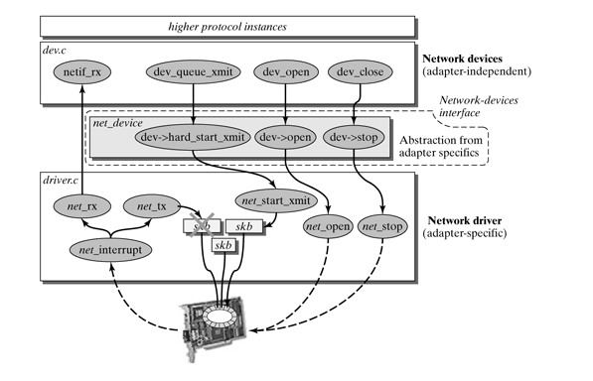
Structure of a network device interface

Slide 6
Network Device Drivers
Manages interaction between NIC and software
NIC performs DMA of network packets into kernel memory
NIC raises interrupts to indicate packet rx

Slide 7
Interrupt Handling
How are interrupts handled ?
  CPU is running process P and interrupt arrives
  CPU saves context of P, runs OS code to handle interrupt in kernel mode
  Restore context of P, resume in user mode
Interrupt handling code is part of OS device drivers
Network device drivers handle interrupts from NICs

Slide 8
Network Interrupt Handling
Interrupt handling from NIC has lot of work
  Pkt processing, IP routing, TCP reliability and ..
To avoid excess disruption, interrupt handling split up in two parts
  Top half interrupt, acknowledges interrupts and does minimal processing
  Bottom half interrupt, scheduled by top half for full interrupt handling

Slide 9
Device Driver rings
NIC and kernel exchange information about pkts via TX/RX rings
Ring : Contains pointers to rx packets
NIC does DMA, updates pointers in ring, interrupts
Top half does minimal processing, schedules bottom half

Slide 10
Bottom half interrupt handler
It runs when CPU is free
Process all pkts collected in the ring
Allocates skb structure for each pkt
Skb contains pkt header etc.

Slide 11
Packet copy to socket
Packet headers are used to map pkt to socket
On read from application, pkt gets copied from kernel to user memory

Slide 12
Overheads in the linux network stack
Interrupt handling, transition across user and kernel mode
Context switching from application to kernel process
Packet copy from kernel space to user space

Slide 13
Alternatives
Fast I/O techniques
  In-Kernel Program offload
  Kernel bypassing
  Hardware Offload

Slide 14
Network Device
net_device – Defines an instance of network interface
Tracks the information of all network interfaces
Large structure, consisting device params like
  MAC
  MTU
  Driver callback operations
  Name of the device
  Flags of the device
  IRQ number

Slide 15
Register/Unregister callbacks
Src code : include/linux/netdevice.h
Allocate net_device
Register net_device
Unregister net_device
Free net_device
Network device operations → struct net_device_ops (netdevice.h)

Slide 16
Network Device Operations
Operation | Description
Ndo_open() | Called when n/w IF is up
Ndo_close() | Called when n/w IF is down
Ndo_start_xmit() | Start pkt tx
Ndo_get_stats() | Get statistics
Ndo_do_ioctl() | Implement device specific operations
Ndo_set_rx_mode() | Select promiscuous, multicast etc
Ndo_set_mac_address() | Set mac address

Slide 17
Socket Buffer
sk_buff – Represents an incoming or outgoing packet
  Supports encapsulation/decapsulation through protocol layers
It is the core data structure of Linux Network Stack
Src code -> include/linux/sk_buff.h
Sk_buff maintains
  Head
  Tail
  Data
  End
  Len
These fields are manipulated when packet passes through the protocol layers

Slide 18
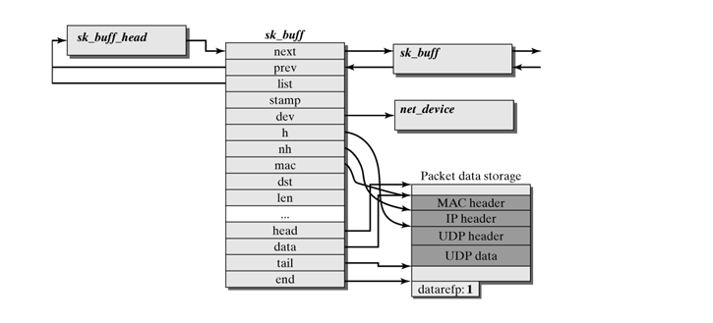
Socket Buffer Structure

Slide 19
Socket Initialization
socket
sock_init
inet_init
sock_register
inet
inet6
Registers lower layer protocols like UDP
Registers with socket sub module

Slide 20
SKB Operations
Allocation
  By dev_alloc_skb() function
  Can be done in ISR
Reservation
  By skb_reserve() function
Data copying
  From DMA buffer to SKB during reception
  SKB to DMA buffer during reception

Slide 21
Flow control functions
Operation | Description
Netif_start_queue() | Tells the kernel that driver is ready to send the pkts
Netif_stop_queue() | Tells the kernel to stop sending the pkts
Netif_queue_stopped() | Tells whether queue is stopped or not
Netif_wake_queue() | Wakes up queue after netif_stop_queue
Netif_rx() | Gives skb to kernel

Slide 22
Transmission
Kernel calls ndo_start_xmit() with SKB as an arg
Ndo_start_xmit():
  Sets up DMA buffers and other HW mechanisms
  Starts Tx
  Can stop queueing if no free DMA buffers available
  Returns NETDEV_TX_OK or NETDEV_TX_BUSY
When N pkts are sent, an interrupt is raised and the driver should:
  Acknowledging interrupt
  Freeing used up DMA buffers
  Freeing SKB
  If the queue was stopped, start it again

Slide 23
Reception
Interrupt vs Polled mode
Copy pkt from DMA buffers to SKB
Update SKB pointers
Give SKB to kernel by netif_rx()

Slide 24
Reference links
https://blogchiasekienthuc.wordpress.com/2016/06/23/path-of-a-packet-in-linux-kernel-stack-part-1/
https://www.youtube.com/watch?v=aq0TLYXGQCA
https://flylib.com/books/en/3.475.1/

Slide 25
Thank You

