Slide 1


Linux Driver Fundamentals
IMAGINE IT. DONE.

Slide 2
Linux Kernel : Contents
Linux Kernel
Linux Kernel Sub-components
Linux Library Files and Directory structure
Device driver classification and fundamentals

Slide 3
Linux : Kernel
The Kernel provides a platform for programs and various services to run on top of it.
It acts as a bridge between software applications and the underlying hardware of a computer system.
It is responsible for managing system resources, handling hardware communication and ensuring smooth execution of processes.
The Linux kernel follows a monolithic architecture, meaning that it runs as a single large process in a privileged mode.
Supports loadable kernel modules (LKMs), allowing dynamic addition or removal of features.

Slide 4
Linux: Kernel
The kernel virtualizes the computer’s common hardware resources to provide each process with its own virtual resources.

Slide 5
Kernel
Process 1
Process 2
Process 3
Process/Programs cannot directly interact with H/W
Hardware Resources

Slide 6
Linux: Kernel
Kernel
Process 1
Process 2
Process 3
Kernel
Hardware Resources

Slide 7
Linux Kernel Sub-Components
Process Scheduler
Memory Management Unit
Virtual File System
Network Sub-System
Inter Process Communication Unit

Slide 8
Linux Kernel Sub-Components

Slide 9
Linux: Kernel
Process Scheduler
It is responsible for managing how processes are allocated to the CPU
Primary goal is to maximize CPU utilization and ensure smooth multitasking.
Key Elements :
  Scheduling Policy
  Process States
  Pre-emptive vs Non-Preemptive scheduling
  Context Switching
  Load Balancing

Slide 10
Linux: Kernel
Virtual File System (VFS)
  Abstraction layer that allows the linux kernel to interface with different file systems in same manner.

Slide 11
Linux: Kernel
Network Sub System
It manages communication between devices over a network
It is responsible for processing, routing and managing all network packets as they pass through the system
Key Elements:
  Socket API : Interface between the user space application and kernel
  Protocol : Link layer (Ethernet, Wi-Fi), Network Layer (IP, IPv6), Transport Layer (TCP, UDP), Application Layer (HTTP, FTP)
  Network Stack, Network Devices
  Packet Processing, Routing, Traffic Control .

Slide 12
Linux: Kernel
Inter Process Communication
It allows processes to communicate and synchronize their actions
Essential in multi processes or shared access to system resource is needed
Key Elements :
  Message Queues – Allows processes to exchange messages
  Shared memory – Allows multiple processes to access the same memory region
  Semaphores (Synchronization primitives), Signals (Asynchronization Notifications) etc..

Slide 13
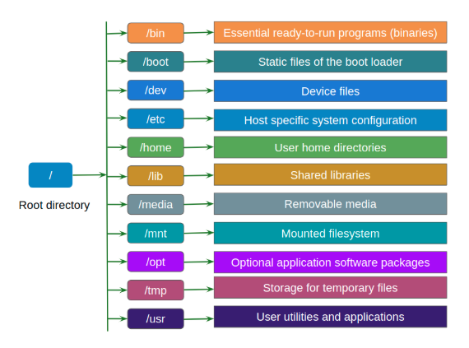
Linux Library files & Directory Structure

Slide 14
Linux: Library Files
“In the Linux, Mostly Everything is a File”
In Linux, most system resources and devices are represented as files
This abstraction simplifies interaction with various components of the system
System libraries are essential components that provide commonly used functions and services to programs
System libraries are shared by multiple applications, making them highly efficient in terms of memory usage and execution speed

Slide 15
Linux: Types of Files
Regular Files : e.g. – text files, binary files, scripts
Directory : Treated as files which contains information about other files
Devices : Devices such as hard drives, keyboards and printers are represented as files in /dev directory
Symbolic links : A file that points to another file or directory
Network Interfaces : such as eth0, wlan0 are treated as files in Linux
Exception – File concept doesn’t strictly apply to processes, threads or memory directly

Slide 16
What is Linux Driver?
Linux Driver Ecosystem
Linux Kernel Source Organization
Linux Kernel Module
Writing a Linux Driver

Slide 17
What is Driver ?
Piece of software which drives, operates, monitors, controls
  Another piece of software
  Device
Need for the driver
  Abstraction

Slide 18
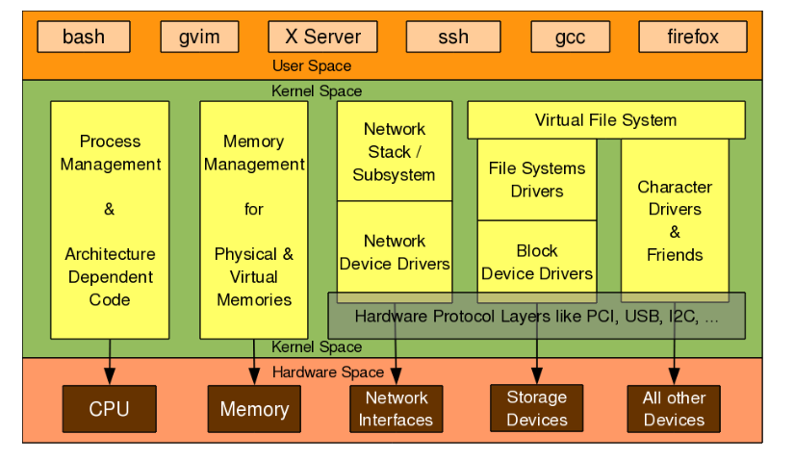
Linux Driver Ecosystem

Slide 19
Device Driver - Categories
Network Device Drivers – packets oriented
Block Device Drivers – storage oriented
Character Drivers – bytes oriented
Process and memory units are core functionalities of kernel and not considered as drivers

Slide 20
Linux Kernel Module
Hot plug and play driver
Can be loaded & unloaded dynamically
Need for LKM
  Expedites the development cycle
  Provides modularity
Standard module path
  Lib/modules/$(kernel-version)

Slide 21
Module related commands
Located under /sbin and requires root privilege
Lsmod – listing the modules
Insmod – loading the module
Rmmod – unloading the module
modprobe

Slide 22
Writing a Driver
Prerequisites
  Kernel’s C
  C without standard user space libs & headers
Kernel Source code
  For headers & libs
  Libraries for commonly used functions at lib path

Slide 23
Module Initialization
static int __init driver_init (void)
  {
  …
  return 0;
  }
  module_init(driver_init);

Slide 24
Module Deinitialization
static void __exit driver_exit (void)
  {
  …
  return 0;
  }
  module_exit (driver_exit);

Slide 25
Character Drivers
What is a character driver ?
Major & Minor Numbers
Registering the char drivers

Slide 26
Character Driver
The driver which allows the byte-oriented transaction
Character device special files
  ls –l /dev/* | grep ^c
  Two attributes for a file – Name & Number
  Kernel deals with 32-bit number – Major (MSB-12bit)& Minor (LSB-20bit)
  Name – useful for application
  Numbers – Used by kernel
  E.g.: ttyS0 – Name, 4,64 – Major (category) & Minor (functionality)
  Size will be 0, just a placeholder and not for storing data

Slide 27
Device File Number
Represented by type dev_t, split into 2 parts
  MSB 12 bits, to represent the category
  LSB 20 bits, to represent the functionality
  MACROS
    MAJOR (dev)
    MINOR (dev)
    MKDEV (major, minor)

Slide 28
Character Driver Flow

Slide 29
Application Open
User Space
/dev/abc
Virtual File System
Kernel Space
Driver
Hardware Space
HW

Slide 30
Registering/Deregistering the driver
Registration
  Static registration
    register_char_dev (dev_t dev, char *name, *fops)
      register_chrdev(222,"new_device",&my_fops)
      Disadvantage with hardcoding is – not portable
  Dynamic registration
    alloc_char_dev_region(dev_t *dev, unsigned int first, unsigned int count, char *name)
      alloc_char_dev_region (&dev, 0, 3, “abc”);

Slide 31
Registering/Deregistering the driver
Deregistration
  unregister_chrdev
    dev_t first → beginning of device number range to be freed
    Returns void
    Usually invoked in module’s cleanup

Slide 32
mknod
Creates block or char special device files
mknod [OPTIONS] NAME TYPE [MAJOR] [MINOR]
NAME → special device file name
TYPE → c, b, p
MAJOR → major number of device file
MINOR → minor number of device file

Slide 33
File Operations
Callback handlers to be invoked by VFS
struct file_operations
  struct module owner
  int (*open) (struct inode *, struct file *)
  int (*release) (struct inode , struct file *)
  read
  write
  poll
  ioctl
  mmap
  llseek
  readdir
  flush
  fsync

Slide 34
File Ops – Example
struct file_operations demo_fops = {
.owner = THIS_MODULE,
.llseek = hello_llseek,
.read = hello_read,
.write = hello_write,
.ioctl = hello_ioctl,
.release = hello_release,
};

Slide 35
Char Dev Reg Flow
struct cdev
Allocating dynamically
  cdev_alloc
cdev_init
  cdev => cdev structure pointer
  fops => file operations structure pointer
cdev_add
  cdev => cdev structure pointer
  dev_t num => first device number
  count => number of devices associated

Slide 36
Char device removal
cdev_del
  cdev => cdev structure pointer
cdev structure pointer shouldn’t be accessed after using cdev_del

Slide 37
copy_to_user
to => user pointer where data to be copied
from => kernel pointer is data source
count => number of bytes to be copied
Used during driver read operations

Slide 38
Copy_from_user
to => kernel pointer where data to be copied
from => user pointer is data source
count => number of bytes to be copied
Used during driver write operation

Slide 39
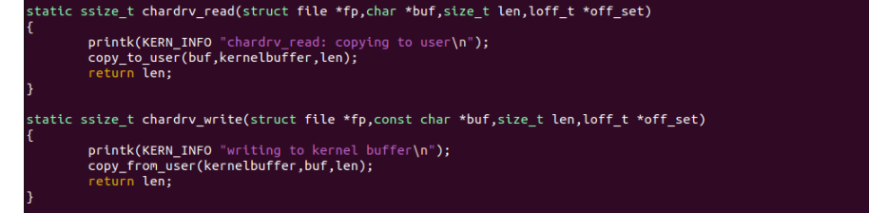

Slide 40
Reference links
https://sysprog21.github.io/lkmpg/
https://www.apriorit.com/dev-blog/195-simple-driver-for-linux-os
https://embetronicx.com/tutorials/linux/device-drivers/linux-device-driver-part-1-introduction/

Slide 41
Thank You

