Slide 1
Recap of Day 4
_______ tag has to be used in any JSP, and it acts as a container tag for all remaining UI tags.
In order to display drop down list, __________ tag and ___________are used as nested sub tags in
__________ or ___________ family of tags.
Beans could be created, initialized and managed in different scopes using _______________________.
_____________ types of UI Components fire Action Events, where as components for input which are editable, fire __________ event.
<f:view>
<f:selectItem>
<f:selectItems>
<h:selectOne>
<h:selectMany>
Managed Bean Facility
UICommand
ValueChange

Slide 2
Session Plan – Day5
Converters
Validators
Data Table
Internationalization and Localization
JSF Request Processing Lifecycle

Slide 3
Data Conversion
In a web application, you accept data from user in html form elements such as inputText
When you send it to the server, what is its data type?
String
Consider, user form contains fields for name, age, salary and dateOfBirth
Managed bean for this form will have, String, int, double and Date data types to store this data respectively
Normally, programmer has to convert the query parameters before setting up the data in Model / Managed Bean
This is repetitive task, and JSF provides a mechanism to convert these String values to appropriate types in the managed bean

Slide 4
Introduction to Conversion Model
JSF has conversion model, which performs the job of converting the user input
For primitive data types, JSF implementation performs implicit conversion
For non-primitive data types, we need to convert the data types explicitly, either by using standard converters or by creating our own converters (custom converter)
Notes:
A bounded component’s data has two views in JSF application:
Model view: Data type representation of data (such as int, char, java.util.Date etc)
Presentation view: Type of data accepted using UIComponent which is read or modified by the user (i.e. java.lang.String)

Slide 5
Standard Converters
Standard Converters are located in javax.faces.convert package
DoubleConverter
FloatConverter
IntegerConverter
LongConverter
NumberConverter
ShortConverter
BigDecimalConverter
BigIntegerConverter
BooleanConverter
ByteConverter
CharacterConverter
DateTimeConverter
Notes:
BigDecimalConverter – Used to convert the user input string values into values of type java.math.BigDecimal
BigIntegerConverter – Used to convert the user input string values into values of type java.math.BigInteger
BooleanConverter – Used to convert the user input string values into values of type java.lang.Boolean
ByteConverter – Used to convert the user input string values into values of type java.lang.Byte
CharacterConverter – Used to convert the user input string values into values of type java.lang.Character
DateTimeConverter – Used to convert the user input string values into values of type java.util.Date with a default format.
DoubleConverter – Used to convert the user input string values into values of type java.lang.Double
EnumConverter – Used to convert the user input string values into values of type java.lang.Enum
FloatConverter – Used to convert the user input string values into values of type java.lang.Float
IntegerConverter – Used to convert the user input string values into values of type java.lang.Integer
LongConverter – Used to convert the user input string values into values of type java.lang.Long
NumberConverter – Used to convert the user input string values into values of type java.lang.Number
ShortConverter – Used to convert the user input string values into values of type java.lang.Short
Notes:
Both DateTimeConverter and NumberConverter have their own Tags.
Each of these converters has a standard error message associated with them

Slide 6
Registering Standard Converters
There are 4 ways to register standard converters:
Using converter attribute in Input Tags
Using a nested sub-tag, <f:converter> with converterId attribute (nested within UIComponent tag)
Using a nested sub-tag, <f:converter> with binding attribute (nested within UIComponent tag)
Using standard converter tags (nested within UIComponent tag)
<f: convertDateTime>
<f:convertNumber>
Notes:
Using a nested sub-tag, <f:converter> with binding attribute (nested within UIComponent tag) [For Your Reference, and further interest]

Slide 7

1. Setting converter Attribute in Input Tags
Declarative way of specifying converter type
Tags that support this attribute –
inputText, inputSecret, inputHidden, outputText
Example: Let us consider we want user to enter a date in the text field
User may enter date in any format. But, we want user to enter data in mmm dd, yyyy (Example: Jul 24, 2009)
Notes:
Notes:
Here user should enter account creation date in the format mmm dd, yyyy
DateTime converter converts component’s data into a java.util.Date

Slide 8
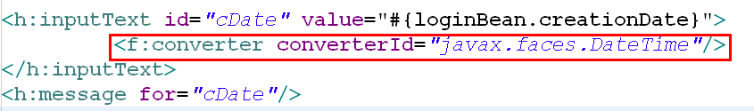
2. Using <f:converter> with converterId attribute
Nest a converter tag inside component tag and use the converter tag’s converterId attribute to refer to the converter

Slide 9
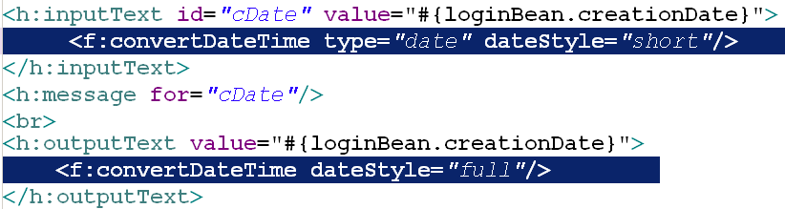
4. Using Standard Converter Tags
Nest one of the standard converter tags inside the component’s tag. For e.g. using convertDateTime and convertNumber tag
Using convertDateTime
Example: While displaying the account creation date, we want to show in the following format: “weekday, MMM dd, yyyy”
Notes:
Notes:
You can convert a component’s data to a java.util.Date by nesting the convertDateTime tag inside the component tag
The convertDateTime tag has several attributes that allow you to specify the format and type of the data

Slide 10
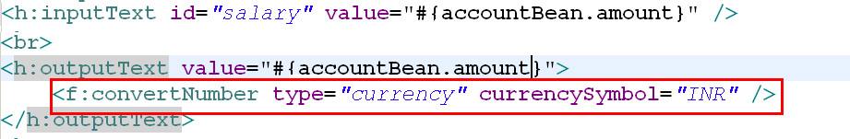
4. Using Standard Converter Tag
Using convertNumber
Example: While displaying amount, “INR” should be prefixed
Notes:
Notes:
You can convert a component’s data to a java.lang.Number by nesting the convertNumber tag inside the component tag
The convertNumber tag has several attributes that allow you to specify the format and type of the data

Slide 11
Custom Convertors : Introduction
Problem Definition:
In a Banking Transaction, user has to supply account Number. User may enter this account number as a combination of digits and spaces, like 123 456 789 , 1 2 3 4 5 6 7 8 9, etc.. But in backing bean this account number is of type String, which can contain digits without spaces .
In this case, what is the role of a converter?
Can we use a standard converter to perform this conversion?
11
Notes:
Notes:
In this case role of a converter is to remove the white space in user input to convert it into AccountNumber type.
Can we use any standard converter to implement account number conversion?
Ans: we can’t implement this conversion using standard converters.

Slide 12
Custom Convertors
When application demands conversion, which is not supported by standard converters, like in the previous banking transaction application, we will have to create Custom Converters
We can implement any application specific data conversion
Then what is the solution for this Problem?
Notes:
They perform application specific data conversions
User can implement any conversion using Custom converters

Slide 13
Steps for Creating/Using Custom Converter
Step1: Implement the Converter interface
Each custom converter class must implement the javax.faces.convert.Converter interface
Each custom converter class must implement following two methods of Converter interface
getAsObject(FacesContext, UIComponent, String) : Object
getAsString(FacesContext, UIComponent, Object) : String
getAsString(..)
Model View
Presentation View
getAsObject(..)
Notes:
Note:
Both getAsObject(….) and getAsString(….) methods throw ConverterException

Slide 14
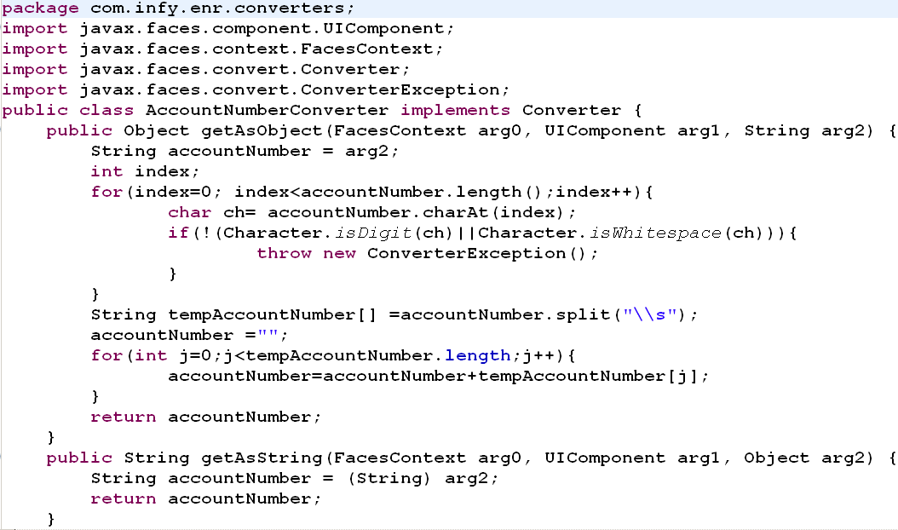
Step 1: Create a Custom Converter Class

Slide 15
Step 2: Register the Custom Converter Class
<converter>
<description>
</description>
<converter-id>
</converter-id>
<converter-class>
</converter-class>
</converter>
faces-config.xml
This element identifies description for custom converter
Converts data between String and AccountNumber
trimConverter
This element identifies an ID that is used by the converter attribute of a UI component tag to apply the converter to the component’s data.
This element identifies the Converter implementation class
com.infy.enr.converters.AccountNumberConverter

Slide 16
Step 3: Use it!
Using converter attribute of the component tag
Using converter tag nested inside the component tag
<h:inputText id="payeeAccountNumber"
value="#{account.accountNumber}"
converter =“trimConverter”/>
OR
<h:inputText id="payeeAccountNumber"
value="#{account.accountNumber}">
<f:converter converterId=“trimConverter"/>
</h:inputText>
Notes:
The converterId attribute must reference the converter’s ID. This Id must match the ID as defined in the faces-config.xml
The converter attribute can reference to the fully-qualified class name of the converter. It can also take the ID of the converter as defined in the faces-config.xml file.

Slide 17
Can You Answer It?
The converter attribute can reference either ____________________________________or ______________
__________________and ___________________ are two standard converters which are having their own tags. These tags are____________________ and____________________ respectively
____________________________ interface should implemented by each custom converter
_________________ and _________________ are two important methods of javax.faces.convert.Converter interface which throw _______________________
converter’s fully-qualified class name
converter’s ID
DateTimeConverter
NumberConverter
<f:convertDateTime>
<f:convertNumber>
javax.faces.convert.Converter
getAsObject
getAsString
ConverterException

Slide 18
Can You Answer It?
Presentation
Converters convert data from _______________ view to___________ view and vice versa
Arrange the following steps in correct order
The converterId attribute must reference the _____________
Model
Using Custom Converter in the view
Implementing Converter Interface
Registering the Custom Converter
converter’s ID

Slide 19

JSF Validation Model
Education and Research
We enable you to leverage knowledge anytime, anywhere!
ER/CORP/CRS/ED113/003
Ver. No.: 1.0
Confidential
Copyright © 2008, Infosys Technologies Ltd.
Notes:
As a JSP Author, you have access to certain objects, which are available for use in JSP without being declared first.
These objects are parsed by JSP engine and inserted into the generated servlets as if you have defined hem yourself.
But in reality, JSP engine recognizes these implicit object names and knows that they will be declared by, or passed into , the generated servlet.

Slide 20
Validating data in JSF
JSF supports the validation of editable UIComponents
Validation occurs before updating the model data with the corresponding local values
The model defines a set of standard classes for performing common data validations
The JSF core tag library defines a set of standard tags corresponding to the standard validators
Notes:
There are two types of validators:
1)Standard Validators – provided by the Framework
2) Custom Validators – Written by the programmer
Custom validators and the corresponding tags are created to perform custom validations

Slide 21
1. Standard Validators
Tag | Validator Class | Function
validateDoubleRange | DoubleRangeValidator | Checks whether the local value of a component is within a certain range. The value must be floating-point or convertible to floating-point.
validateLength | LengthValidator | Checks whether the length of a component’s local value is within a certain range. The value must be java.lang.String.
validateLongRange | LongRangeValidator | Checks whether the local value of a component is within a certain range. The value must be any numeric type or String that can be converted to a long.
Notes:
JSF provides a set of standard classes and associated tags to validate component’s data
All the standard validators implement Validator interface, which has following method:
public void validate(FacesContext context, UIComponent component, Object value) throws ValidationException;

Slide 22
Example: Standard Validator
<h:inputText value="#{loginBean.name}">
<f:validateLength minimum="4" maximum="8"/>
</h:inputText>
<h:inputText value="#{employeeBean.salary}">
<f:validateDoubleRange minimum=“10000.00" maximum=“200000.00"/>
</h:inputText>
<h:inputText value="#{customerBean.zipcode}">
<f:validateLongRange minimum=“123456" maximum=“999999"/>
</h:inputText>
Notes:
Validation of length of the element can be carried out using <f:validateLength/>

Slide 23
2. Custom Validation
Applications have many kinds of validations, which may not be provided as standard validator
Hence, we need to create custom validators
Custom validation can be implemented in two ways:
Writing a class that implements the Validator interface
Writing a backing bean method that performs validation

Slide 24
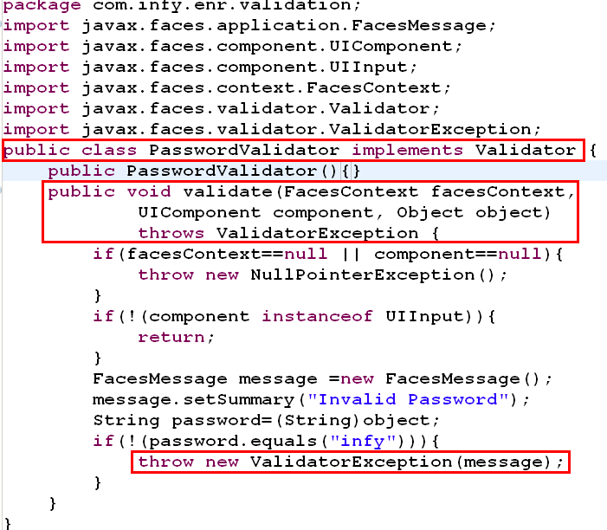
Custom validation :implementing Validator interface
Notes:
A class implementing the validator interface must implement a single method:
validate(FacesContext context, UIComponent component, Object object)
The validate method takes FacesContext instance, the component whose data needs to be validated and the value that needs to be validated as parameters
The component should be an editable component such as a text field i.e. the component should have implemented EditableValueHolder
The validator must have a default constructor

Slide 25
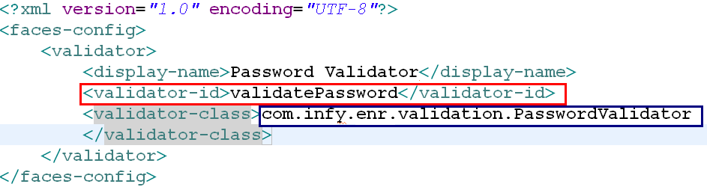
Registering a custom validator
The following tags has to be added in the
faces-config.xml to register the custom validator
Use it in the JSP as,
<h:inputSecret id=“pass” value="#{loginBean.password}">
<f:validator validatorId="validatePassword"/>
</h:inputSecret>
<h:message for=“pass” />
Notes:
To perform custom validation by implementing Validator interface:
Create the Validator class
Register it with application configuration file, faces-congif.xml
<validator></validator> tag serves this purpose
Two sub-tags within <validator></validator> tags, <validator-id> and <validator-class> register the Validator class
The validator-id element represents the identifier under which the Validator class should be registered. This ID is used by the tag class corresponding to the custom validator tag.
The validator-class element represents the fully qualified class name of the Validator class.
Use it in the JSP

Slide 26
3. Custom validation: backing bean method
public void validatePassword(FacesContext context,
UIComponent toValidate, Object value) {
String message= "";
String password = (String) value;
if (!(password.equals("infy"))) {
((UIInput)toValidate).setValid(false);
message="Invalid password“; context.addMessage(
toValidate.getClientId(context),
new FacesMessage(message));
}
}
Notes:
Instead of writing an implementer of validator, a method of the backing bean can be asked to perform validation
The method performing validation must accept FacesContext instance, the component whose data must be validated and the data to be validated as parameters
Only UIInput or the components that extend UIInput can be validated

Slide 27
Using the bean method to perform validation
<h:inputSecret id="msg1" value="#{loginBean.password}"
validator="#{loginBean.validatePassword}">
</h:inputSecret>
Notes:
The method can be referenced from the element which needs to be validated using the attribute validator.

Slide 28
Displaying error messages with the <h:message> and <h:messages> tags
The <h:message> and <h:messages> tags are used to display error messages when conversion or validation fails
The <h:message> tag displays error message related to a specific input component
The <h:messages> tag displays the error messages for the entire page

Slide 29


Example:
<h:inputText id=“custName” value="#{loginBean.name}">
<f:validateLength minimum="4" maximum="8"/>
</h:inputText>
<h:message for=“custName”/>

Slide 30
Data Table
Education and Research
We enable you to leverage knowledge anytime, anywhere!
ER/CORP/CRS/ED113/003
Ver. No.: 1.0
Confidential
Copyright © 2008, Infosys Technologies Ltd.
Notes:
As a JSP Author, you have access to certain objects, which are available for use in JSP without being declared first.
These objects are parsed by JSP engine and inserted into the generated servlets as if you have defined hem yourself.
But in reality, JSP engine recognizes these implicit object names and knows that they will be declared by, or passed into , the generated servlet.

Slide 31
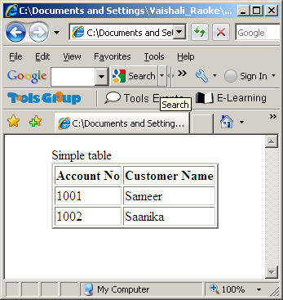
How do we display report on HTML page?
<html>
<body>
<table border="2" align="center">
<thead>Simple table</thead>
<tr>
<td><B>Account No</B></td><td><B>Customer Name</B></td>
</tr>
<tr>
<td>1001</td><td>Sameer</td>
</tr>
<tr>
<td>1002</td><td>Saanika</td>
</tr>
</table>
</body>
</html>
Notes:
The above report is a static table

Slide 32
How do we display dynamic data report on HTML page?
If we want to populate dynamic data, then what are the steps programmer has to take?
Create a JSP page, add scriptlet
The scriptlet will have Java code to iterate over a collection of items to populate the <td> and <tr> tags of the table
But is it a good practice to hardcode Java codes in JSP?
JSF provides a way to create dynamic data report using <h:dataTable>
NO!
Notes:
In JSF-enabled web application, in order to use the UIComponent, which tag has to be used?

Slide 33
Data Table
This tag renders html table which can be associated with a backing bean to obtain its data and this helps in event handling
We can use <f:facet> to render the header and footer
Table body is rendered as per the values of attributes of the h:dataTable, such as : value and var
Ex: <h:dataTable id=“itemTable” value= “#{shoppingCartBean.items}” var=“item”>
Notes:
JSF supplies 2 different component hierarchies for managing tables.
1) UIData and its subclasses are designed to work with a list of repeating elements.
2) UIPanel and its subclasses, manage the heterogeneous items, the kind of table that is most often used
h:dataTable is used to represent UIData. It will have one or more f:facet, h:column nested tags.
h:panelGrid is used to represent UIPanel. f:facet and h:panelGroup tags are used with it.

Slide 34
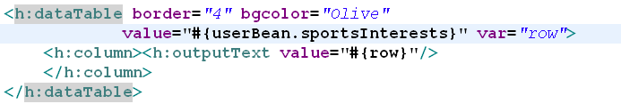
Data Table contd..
value attribute binds a data source to dataTable, which typically is a collection
var attribute defines request-scoped variable that will contain the current item from the collection, when the collection is iterated through
column tag defines single column for the table
outputText tag is used to render the value of that column

Slide 35
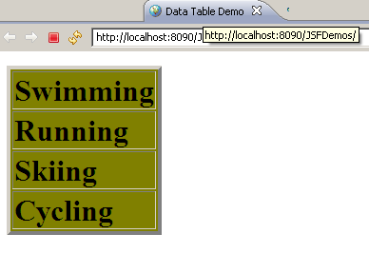
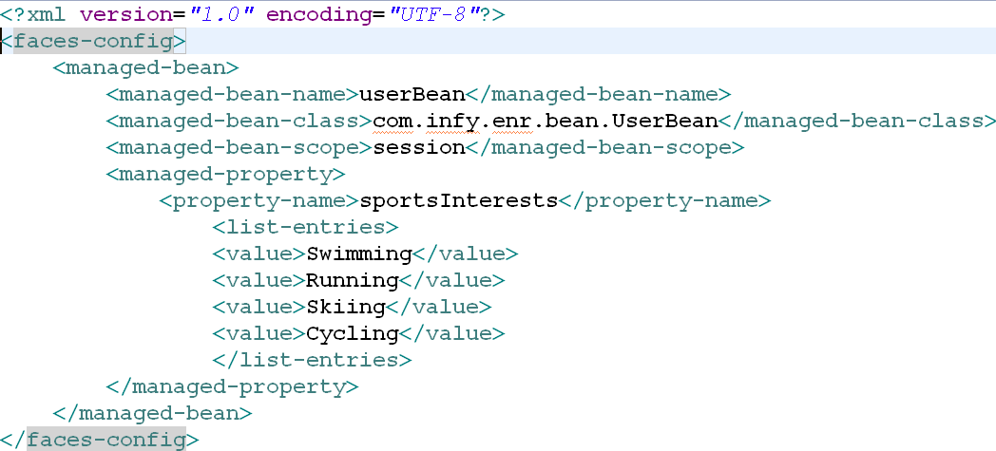
Output
Data Table demo

Slide 36
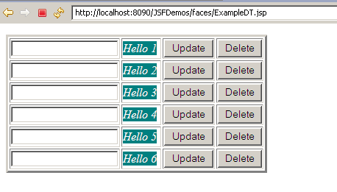
Example
Notes:
Code is provided with Lab guide

Slide 37
Internationalization and Localization
Education and Research
We enable you to leverage knowledge anytime, anywhere!
ER/CORP/CRS/ED113/003
Ver. No.: 1.0
Confidential
Copyright © 2008, Infosys Technologies Ltd.

Slide 38
Internationalization and Localization
Internationalization(i18n): The process of preparing an application to support more than one language and to represent data in different formats.
Localization(L10N): The process of adapting an internationalized application to support a specific region or locale
Locale: Represents a language and country combination, <language code>_<country code> for e.g. en_US and en_UK
Notes:
Why to internationalize an application?
In current global scenario a website/application should service requests from multiple countries. Even when the languages are same cultural differences exist. So, we cannot use a common language and format to cater all these varied requests. This requires internationalizing the application.
What to internationalize in an application?
Usually internationalization will be done for label text for UI components, messages and other static strings displayed on the page. The format of display of date, currency etc can be internationalized to suit a particular locale.

Slide 39
Steps to Internationalize
Create Resource Bundle.
Load the Resource bundle. Two ways
Using faces-config.xml
Using <f:loadBundle>
Replace the text to be internationalized on the jsp page with value expressions using Unified EL
Let us internationalize the Login application to support English(US) and French(FR) locales
Notes:
Resource Bundle: Each entry of the resource bundle is a key-value pair, where the keys uniquely identify a locale-specific object in the bundle. Keys and values are separated with a colon(:) JSF implementation will read this properties file and make it available to application automatically.
Steps for internationalization
Create Resource Bundle: Externalize the text to be internationalized into a property file. We can have multiple property files to support multiple languages(locales) e.g. ApplicationResource_en.properties and ApplicationResource_fr.properties for english and french locales respectively.
Loading the resource Bundle:
Using <f:loadBundle> core tag in each view stores the resource bundle as a request scoped attribute which is exposed by the var attribute to the view. var and basename attributes are mandatory. <f:loadBundle var=“msg” basename=“ApplicationResource” />
Using faces-config.xml makes the resource bundle available to the entire application. The resource bundle should be configured in the faces-config.xml in <application> element as shown below.
<application>
<resource-bundle>
<base-name>ApplicationResource</base-name>
<var>msg</var>
</resource-bundle>
<locale-config>
<default-locale>en</default-locale>
<supported-locale>fr</supported-locale>
</locale-config>
</application>
In the above configuration <base-name> element is the resource bundle name which can be referenced in the views by using the parameter in <var> element. <locale-config> element configures all locales supported by the application. <default-locale> will be used for all client requests for locales other than the one’s supported by the application.

Slide 40
Step 1/3: Create resource bundle
LoginId: Login Id:
Password: Password:
Login: Login
Reset: Reset
ApplicationResource.properties
LoginId: Identification d'ouverture :
Password: Mot de passe :
Login: Ouverture
Reset: Remettre à l'état initial
ApplicationResource_fr.properties
Notes:
The resource bundle should be placed into the source directory of the web application. The resource bundle should be saved with .properties extension only. If it is kept inside a package then the package name is to be prefixed when referring to the resource bundle like referring to a class in a package
Here, two resource bundles (ApplicationResource.properties, ApplicationResource_fr.properties) are created for English and French locales. First resource bundle is used as the default locale(explained in next slide). Resource bundles for all other supported locales should append the language code and/or country code to the default resource bundle name e.g. ApplicationResource_fr.properties has “_fr” appended to the default bundle’s name.

Slide 41
Step 2/3: Load the resource bundle
Using <f:loadBundle> in each view
Using faces-config.xml for entire application
<f:loadBundle var="msg" basename="ApplicationResource"/>
<application>
<resource-bundle>
<base-name>ApplicationResource</base-name>
<var>msg</var>
</resource-bundle>
<locale-config>
<default-locale>en_US</default-locale>
<supported-locale>fr_FR</supported-locale>
</locale-config>
</application>
Notes:
<f:loadBundle>: used to load resource bundle.
Syntax:
<f:loadBundle basename="LocalizationResources" var="bundle"/> both basename and var are mandatory attributes
The basename attribute specifies the name of the resource bundle (should include the fully qualified bundle name if the bundle is placed inside any package, like com.infy.enr.msg when msg.properties is placed inside com.infy.enr package)
var attribute specifies the request scoped variable name used to refer the bundle. This variable will be used to get the values from the resource bundle.

Slide 42
Step 3/3: Use EL in JSP page
<f:view>
<h:form id="loginform">
<h:outputText value="#{msg.LoginId}" id=“login" />
<h:inputText id="username" value="#{loginBean.loginId}" required="true" maxlength="4" />
<h:message for="username" />
<br/>
<h:outputText value="#{msg.Password}" id=“pwd”/>
<h:inputSecret id="password" value="#{loginBean.password}" required="true" />
<h:message for="password" />
<br/>
<h:commandButton id="login" value="#{msg.Login}" action="#{loginBean.authenticate}" />
<h:commandButton id="reset" type="reset" value="#{msg.Reset}" />
<br/>
<h:outputText value="#{loginBean.loginId}" />
<h:outputText value="#{loginBean.message}" />
</h:form>
</f:view>
login.jsp

Slide 43
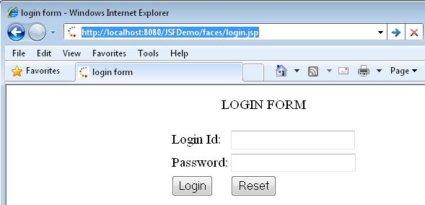
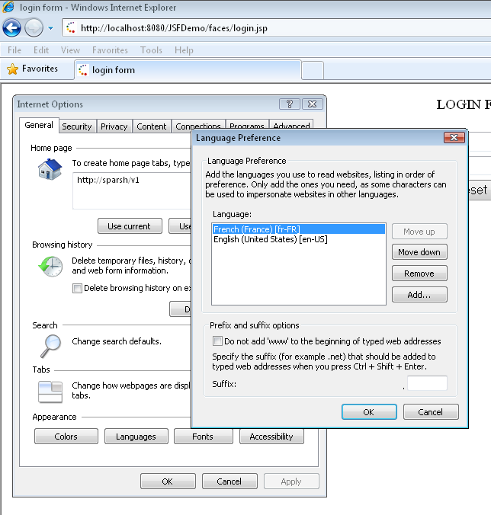
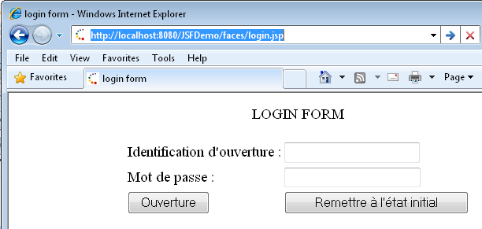
there is no change in the url. We have just changed the language of the browser and getting output in different locale
Let us see the output

Slide 44
Do you know??
Internationalization Vs Localization
Internationalization allows the application to be adapted to any language and cultural convention. Localization is the process of adapting a program for use in a specific locale
How is internationalization implemented?
Using value-binding expression to refer to messages written in properties file for displaying labels, messages etc
How is localization implemented?
By adding multiple properties file specific to different locale and adding them in supported-locale list within <locale-config> tag in faces-config.xml

Slide 45
JSF Request Processing Lifecycle
Education and Research
We enable you to leverage knowledge anytime, anywhere!
ER/CORP/CRS/ED113/003
Ver. No.: 1.0
Confidential
Copyright © 2008, Infosys Technologies Ltd.
Notes:
As a JSP Author, you have access to certain objects, which are available for use in JSP without being declared first.
These objects are parsed by JSP engine and inserted into the generated servlets as if you have defined hem yourself.
But in reality, JSP engine recognizes these implicit object names and knows that they will be declared by, or passed into , the generated servlet.

Slide 46
JSF Request-Processing Lifecycle
Steps each JSF application is required to go through when accepting a request and then generating appropriate response, and rendering it back to the client
Element which plays important role in lifecycle is FacesContext
FacesContext holds all contextual information required for processing a request and generating a response
Notes:
One needs to understand various scenarios and accordingly the lifecycle phases are executed.
Scenario 1) Faces Request generate Faces Response (will be covered in this course)
Scenario 2) Non-Faces Request generate Faces Response (FYR)*
Scenario 3) Faces Request generate non-Faces Response (FYR)*
Scenario 4) Non-Faces Request generate non-Faces Response (nothing to do with JSF application)
*FYR: For your reference

Slide 47
What FacesContext contains / manages?
Current component tree: reference to tree of all UI components of the current request
It also provides a standard way to access the external context in which the JSF application is running (i.e. web container environment)
Life-cycle flow control methods – to alter the sequential execution of life-cycle phases
Event queue, Message queue
In nutshell, FacesContext stores information about the request, it is processing

Slide 48
JSF Life-cycle phases
FacesServlet
Request
Restore View
Apply Request Values
Process Validations
Update Model Values
Invoke Application
Each of these phases may optionally skip to rendering the response
Response
Render Response

Slide 49
Restore View
Each component tree has unique identifier
In this phase, after receiving client request, the JSF implementation, tries to restore the component tree
If it does not find the identifier, it constructs a new component tree and sets in the FacesContext
If request does not contain any query parameters or POST data, then at the end of this phase, FacesContext.renderResponse() method is called, which forces all other life-cycle phases to skip and component tree is rendered
Notes:
You want to access the component tree, invoke, getViewRoot() on FacesContext at any point in the lifecycle.

Slide 50
Apply request values
Purpose of this phase it to allow each UIComponent in the component tree to update itself with new information from the request
If any Converter is associated with UIComponent, it will be invoked in this phase
At the end of this phase, all UI components will be updated with any new value from the request and with all conversions (if any)
If any conversion results in error, message will be queued in Message Queue and ultimately results in skipping all the other phases and going directly to rendering response phase
Notes:
At the end of this phase, all UI components will be updated with new values from the request. It is also possible that events which are queued and some(or all) have been processed. At this point, the lifecycle may :
proceed to Process Validation phase or
Skip to the Render Response phase or
Terminate all together

Slide 51
Process Validations
The purpose of this phase is to give each UI Component opportunity to validate its state
At the end of this phase, all UI components will be validated against any registered validators
If validation of one more UI Components fails, messages will be queued in Message Queue… this ultimately results in skipping all the other phases and going directly to rendering response phase
Notes:
At the end of this phase, all UI components will be validated. It is also possible that events which are queued and some(or all) have been processed. At this point, the lifecycle may :
proceed to Update Model Values phase or
Skip to the Render Response phase or
Terminate all together

Slide 52
Update Model values
Till this point in life cycle, the component tree has been restored, updated with new data from request, and successfully converted and validated
The purpose of this phase is to update each UI component’s data model i.e. managed bean values
In case this updating fails for one more components, messages may be queued in FacesContext
At the end of this phase, all components’ model values will be properly updated
Notes:
At the end of this phase, all components’ models will be properly updated. It is also possible that events which are queued and some(or all) have been processed. At this point, the lifecycle may :
proceed to Invoke Application phase or
Skip to the Render Response phase or
Terminate all together

Slide 53
Invoke Application
The purpose of this phase is, to process any ActionEvents that have been previously queued

Slide 54
Render Response
The purpose of this phase is, to render the current state of the component tree and prepare a response to the current request
All queued messages, if any, will be rendered in this phase

Slide 55
Session Tracking in JSF (Self Study)
Session tracking is one of the important feature of any Enterprise Application
For more details, Refer to Assignment-7 in the lab guide and the integrated assignment
Notes:
Please refer to Day-5 lab guide for learning session tracking using JSF.

Slide 56
Reference Material
For more information about the topics covered today, refer the supplementary material given in the following link:
http://myshec123505d/EBook

Slide 57
Summary
<h:dataTable > tag for formatting tables, while iterating the data
Iterates over the data, which is collection or array of values
Typically this data is coming from a managed bean
Main attributes:
value: Binding to the data happens through this
var: implicitly declared variable to iterate over the data
To represent column, use <h:column> tag
To display the header and footer, use <f:facet> tag
Any JSF UI Component can be placed in table cell
Notes:
Further reference : http://java.sun.com/javaee/javaserverfaces/1.2/docs/tlddocs/h/dataTable.html

Slide 58
Summary continued…
Conversion model provides conversion between data types with no or minimal code using standard converters
Multi-lingual support is possible using i18n and adding resource properties files to the web application
JSF Request-Processing Lifecycle phases which any JSF request has to go through

Slide 59
Thank You
“The contents of this document are proprietary and confidential to Infosys Technologies Ltd. and may not be disclosed in whole or in part at any time, to any third party without the prior written consent of Infosys Technologies Ltd.”
“© 2008 Infosys Technologies Ltd. All rights reserved. Copyright in the whole and any part of this document belongs to Infosys Technologies Ltd. This work may not be used, sold, transferred, adapted, abridged, copied or reproduced in whole or in part, in any manner or form, or in any media, without the prior written consent of Infosys Technologies Ltd.”

Slide 60
asf

Slide 61
asf

Slide 62
asf

