Slide 1
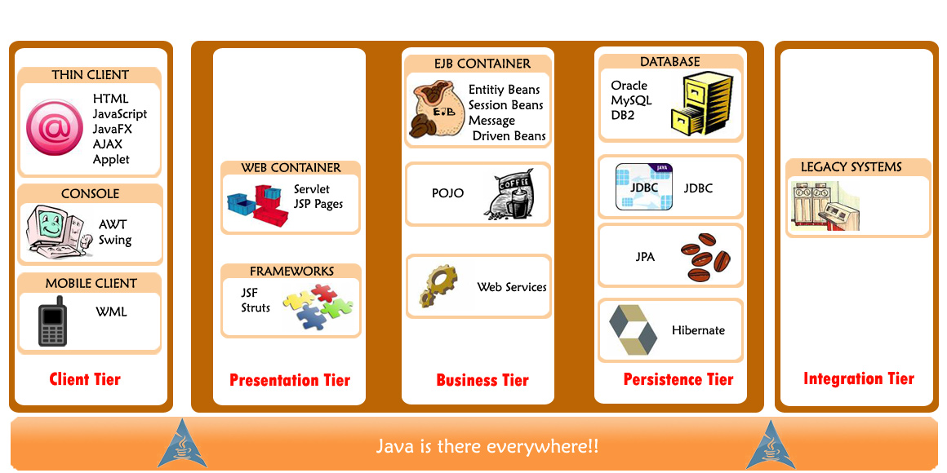
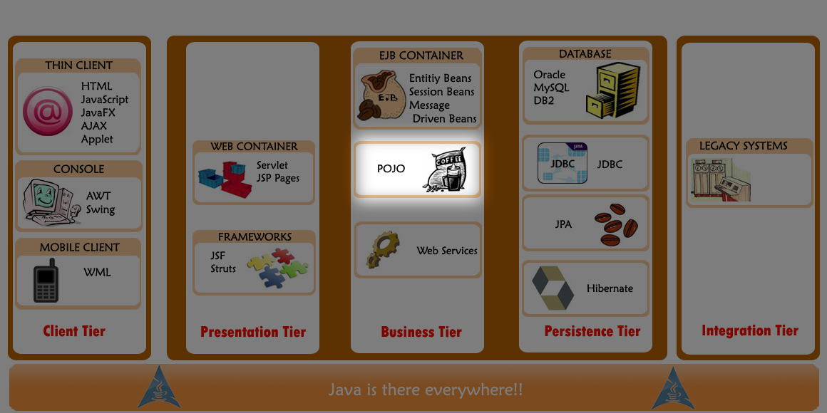
Business Tier in the Big Picture

Slide 2
Business Tier - Design Decisions
Presentation Tier
How to present Information?
Deals with Business Components
Business Tier
How to encapsulate the business logic?
How to organize the business logic?
Persistence Tier
How to handle concurrency in short and long-running transactions?
How to access the database?
Notes:
A typical Web-based Enterprise Application is built on Client-Server architecture.
The Server side consists of tiers namely Presentation Tier, Business Tier and Persistence Tier
Presentation Tier is for Presentation of the information requested by the client
Business Tier is for Business rules implementation to achieve the business goals
Persistence Tier is for Business Data Storage

Slide 3
Business Tier uses Frameworks
Business Components are independent business functionalities built to work together to achieve an intended goal
Example:
Effort of developing business components can be reduced using Frameworks
Frameworks offer Application programming Interfaces (APIs), which the business components can use
Notes:
Frameworks are basic conceptual structures for solving and addressing complex issues in software development.
In the Business Tier the issues could be like delegation of control, logging etc
Frameworks are extensively used for Architecture, Design, Coding and Testing to reduce on effort investment and simplify the task.
A software framework is a re-usable software providing libraries and other support software to help develop and combine the different components of a software project.
Java frameworks are evolving constantly. The use of a framework for an application should be decided based on pros and cons of the framework.
Design decisions in the business tier (given below) can be influenced by POJOs(discussed next) because POJO based business logic can be tested outside of the application server and without a database.
‘How to organize the business logic?’ - Can be achieved using extensibility, reusability features of Object-Oriented design
‘How to encapsulate the business logic?’ - Can be achieved using encapsulation feature of Object-Oriented design
Other important issues like security, logging, transaction management, persistence also need to be taken care of in the Business Tier

Slide 4
POJO (Plain Old Java Object)
Among the business components, those Java objects that do not implement any special interfaces or invoke any framework APIs are called POJOs
POJOs
simplify development
offer improved portability
offer decoupling
provide better separation of design concerns
are non-invasive
make testing easier
Notes:
The name POJO was coined by Martin Fowler, Rebecca Parsons and Josh MacKenzie in September 2000.
Coined to give regular Java objects a new nomenclature and there by attract developers community to use them.
The benefits of using POJOs make it to be the choice of designers and developers. They are
They simplify development
Because they support thinking about business logic first and then, persistence, transaction etc in a step by step manner, focusing one thing at a time. One can design and implement the business logic and then deal with persistence and transactions. This will lead to faster and error-free development
They offer improved portability
Infrastructure frameworks used for applications development are volatile and constantly evolving. Use of POJOs decouples the business logic from these infrastructure frameworks and there by makes the application's business logic future proof i.e version upgrade or switch to a different framework will become easier and lowers the risk
They offer decoupling
POJOs decouple the application code from the infrastructure frameworks and decoupling allows to construct an application from loosely coupled components
They provide better separation of design concerns like flow control, behavior etc
They are non-invasive in nature i.e They do not impose unnecessary constraints on the code
Examples of non-invasive frameworks - Spring, Hibernate etc.
These non-invasive frameworks offer transaction management, security and persistence services for POJOs; but mere POJOs cannot
They make testing easier, which simplifies and accelerates development
Other advantage is with regard to deployment
Deploying a POJO application can be done using a simpler, web container-only application server and in some cases cheaper server as well.
This is a derived advantage of improved portability
[Deployment becomes specific to the application only in the cases where the application needs sophisticated services like security management and services which the web-container alone cannot provide or needs a particular application server for deployment.]

