Slide 1
Spring Overview
Spring is an open source layered Java/J2EE application framework
Created by Rod Johnson
Based on book “Expert one-on-one J2EE Design and Development” (October, 2002)
Current version of Spring is 3.0.x
The Spring Framework is licensed under the terms of the Apache License, Version 2.0 and can be downloaded at:
http://www.springframework.org/download
Philosophy: J2EE should be easier to use, “Lightweight Container” concept
A software framework is a re-usable design for a software system.
Notes:
Spring provides elegant integration points with standard and defacto-standard interfaces: Hibernate, JDO, TopLink, EJB, RMI, JNDI, JMS, Web Services, Struts etc

Slide 2
Characteristics of Spring
Lightweight
Dependency Injection
Aspect – Oriented
Container
Framework

Slide 3
What are Lightweight Frameworks?
Non-intrusive
No container requirements
Simplify application development
Remove re-occurring pattern code
Productivity friendly
Unit test friendly
Very pluggable
Usually open source
Examples:
Spring, Pico, Hivemind
Hibernate, IBatis, Castor
WebWork
Quartz
Sitemesh

Slide 4
Why Spring Framework?
All frameworks integrate well with Spring.
Spring offers an open yet structured framework, using dependency-injection, a type of inversion-of-control to integrate different technologies together.
Consistent Configuration, open plug-in architecture
Integrates well with different O/R Mapping frameworks like Hibernate
Easier to test applications with.
Less complicated then other frameworks.
Active user community.
Notes:
Want to integrate your existing web-app with a Spring middle tier?
Struts, Web Work, Tapestry
If working with .NET then can use spring framework .NET
Spring enables developers to develop enterprise-class applications using POJOs. The benefit of using only POJOs is that you do not need an EJB container product such as an application server but you have the option of using only a robust servlet container such as Tomcat or some commercial product.
Checked exceptions are overused in Java. A framework shouldn't force you to catch exceptions you're unlikely to be able to recover from.
It's best to program to interfaces, rather than classes. Spring reduces the complexity cost of using interfaces to zero.

Slide 5
Modules of the Spring Framework
The Spring Framework can be considered as a collection of frameworks-in-the-framework:
Core - Inversion of Control (IoC) and Dependency Injection
AOP - Aspect-oriented programming
DAO - Data Access Object support, transaction management, JDBC-abstraction
ORM - Object Relational Mapping data access, integration layers for JPA, JDO, Hibernate, and iBatis
MVC - Model-View-Controller implementation for web-applications
Remote Access, Authentication and Authorization, Remote Management, Messaging Framework, Web Services, Email, Testing, …

Slide 6
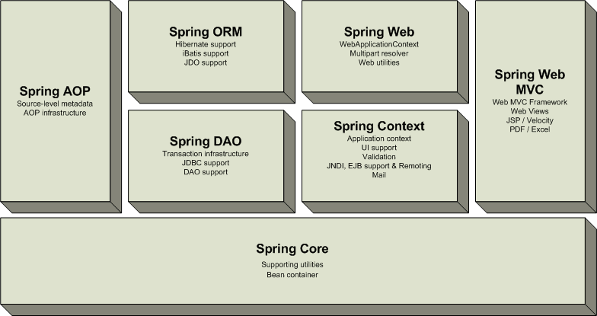
Overview of the Spring Framework
Very loosely coupled, components widely reusable and separately packaged.

Slide 7
SPring
Spring Framework Runtime
Data Access/Integration
Web
(MVC / Remoting)
JDBC
ORM
Web
Servlet
OXM
JMS
Portlet
Struts
Transactions
Aspects
Instrumentation
AOP
Core Container
Expression Language
Beans
Core
Context
Test

Slide 8
Core Container
The Core Container consists of the Core, Beans, Context, and Expression Language modules whose detail is as follows:
The Core module provides the fundamental parts of the framework, including the IoC and Dependency Injection features.
The Bean module provides BeanFactory which is a sophisticated implementation of the factory pattern.
The Context module builds on the solid base provided by the Core and Beans modules and it is a medium to access any objects defined and configured. The ApplicationContext interface is the focal point of the Context module.
The Expression Language module provides a powerful expression language for querying and manipulating an object graph at runtime.

Slide 9
Data Access/Integration
The Data Access/Integration layer consists of the JDBC, ORM, OXM, JMS and Transaction modules whose detail is as follows:
The JDBC module provides a JDBC-abstraction layer that removes the need to do tedious JDBC related coding.
The ORM module provides integration layers for popular object-relational mapping APIs, including JPA, JDO, Hibernate, and iBatis.
The OXM module provides an abstraction layer that supports Object/XML mapping implementations for JAXB, Castor, XMLBeans, JiBX and XStream.
The Java Messaging Service JMS module contains features for producing and consuming messages.
The Transaction module supports programmatic and declarative transaction management for classes that implement special interfaces and for all your POJOs.

Slide 10
Web
The Web layer consists of the Web, Web-Servlet, Web-Struts, and Web-Portlet modules whose detail is as follows:
The Web module provides basic web-oriented integration features such as multipart file-upload functionality and the initialization of the IoC container using servlet listeners and a web-oriented application context.
The Web-Servlet module contains Spring's model-view-controller (MVC) implementation for web applications.
The Web-Struts module contains the support classes for integrating a classic Struts web tier within a Spring application.
The Web-Portlet module provides the MVC implementation to be used in a portlet environment and mirrors the functionality of Web-Servlet module.

Slide 11
Miscellaneous
There are few other important modules like AOP, Aspects, Instrumentation, Web and Test modules whose detail is as follows:
The AOP module provides aspect-oriented programming implementation allowing you to define method-interceptors and pointcuts to cleanly decouple code that implements functionality that should be separated.
The Aspects module provides integration with AspectJ which is again a powerful and mature aspect oriented programming (AOP) framework.
The Instrumentation module provides class instrumentation support and class loader implementations to be used in certain application servers.
The Test module supports the testing of Spring components with JUnit or TestNG frameworks.

Slide 12
Spring IoC Containers
Spring container is at the core of the Spring Framework. The container will create the objects, wire them together, configure them, and manage their complete lifecycle from creation till destruction. The Spring container uses dependency injection (DI) to manage the components that make up an application. These objects are called Spring Beans
The container gets its instructions on what objects to instantiate, configure, and assemble by reading configuration metadata provided. The configuration metadata can be represented either by XML, Java annotations, or Java code.
Java POJO classes
The Spring Container
Metadata
Final Result
Ready to use application

Slide 13
asf

Slide 14
Spring Details
Spring allows to decouple software layers by injecting a component’s dependencies at runtime rather than having them declared at compile time via importing and instantiating classes.
Spring provides integration for J2EE services such as EJB, JDBC, JNDI, JMS, JTA. It also integrates several popular ORM toolkits such as Hibernate and JDO and assorted other services as well.
One of the highly touted features is declarative transactions, which allows the developer to write transaction-unaware code and configure transactions in Spring config files.
Spring is built on the principle of unchecked exception handling. This also reduces code dependencies between layers. Spring provides a granular exception hierarchy for data access operations and maps JDBC, EJB, and ORM exceptions to Spring exceptions so that applications can get better information about the error condition.
With highly decoupled software layers and programming to interfaces, each layer is easier to test. Mock objects is a testing pattern that is very useful in this regard.

Slide 15
Advantages of Spring Architecture
Enable you to write powerful, scalable applications using POJOs
Lifecycle – responsible for managing all your application components, particularly those in the middle tier container sees components through well-defined lifecycle: init(), destroy()
Dependencies - Spring handles injecting dependent components without a component knowing where they came from (IoC)
Configuration information - Spring provides one consistent way of configuring everything, separate configuration from application logic, varying configuration
In J2EE (e.g. EJB) it is easy to become dependent on container and deployment environment, proliferation of pointless classes (locators/delegates); Spring eliminates them
Cross-cutting behavior (resource management is cross-cutting concern, easy to copy-and-paste everywhere)
Portable (can use server-side in web/ejb app, client-side in swing app, business logic is completely portable)

Slide 16
Spring Solutions
Solutions address major J2EE problem areas:
Web application development (MVC)
Enterprise Java Beans (EJB, JNDI)
Database access (JDBC, iBatis, ORM)
Transaction management (JTA, Hibernate, JDBC)
Remote access (Web Services, RMI)
Each solution builds on the core architecture
Solutions foster integration, they do not re-invent the wheel

Slide 17
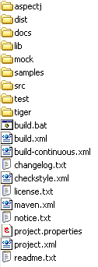
How to Start Using Spring
Download Spring from www.springframework.org, e.g.
spring-framework-2.0.6-with-dependencies.zip
Unzip to some location, e.g.
C:\tools\spring-framework-2.0.6
Folder C:\tools\spring-framework-2.0.6\dist
contains Spring distribution jar files
Add libraries to your application classpath
and start programming with Spring

Slide 18
Inversion of Control (IoC)
Method to create needed dependencies or look them up somehow without doing it in the dependent code
Often called Inversion of Control (IoC)
IoC injects needed dependencies into the object instead
Setters or Contructor
Primary goal is reduction of dependencies in code
This is the central part of Spring
Provides centralized, automated configuration, managing and wiring of application Java objects
Container responsibilities:
creating objects,
configuring objects,
calling initialization methods
passing objects to registered callback objects
Java objects that are managed by the Spring IoC container are referred to as beans
Notes:
All together form the object lifecycle which is one of the most important features
Dependency-injection (a type of IoC) is when you let your framework control your application.
Spring links objects together instead of the objects linking themselves together.
Spring object linking is defined in XML files, allowing easy changes for different application configurations thus working as a plug in architecture.
Dependency injection is where the control of the application is inverted to the framework. This control is configured in the framework with an XML file.
DEPENDENCY part translates into an association between two classes. For example, class A is dependent on class B.
INJECTION means is that class B will get injected into class A by the IoC.
Dependency injection can happen in the way of passing parameters to the constructor or by post-construction using setter methods.

Slide 19
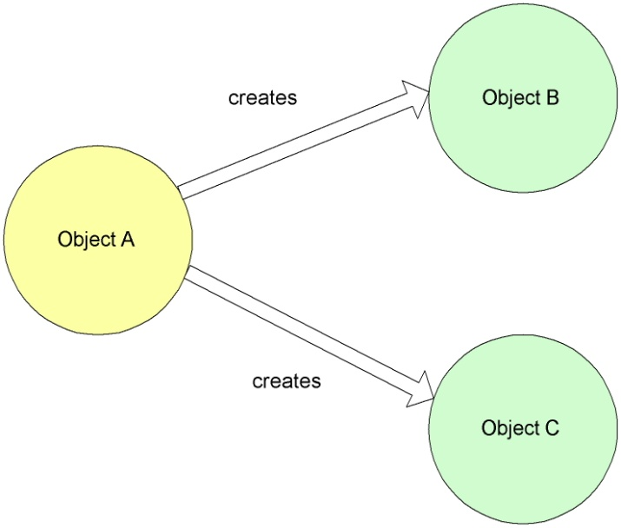
Dependency Injection – Non-IoC
public class MainBookmarkProcessor implements BookmarkProcessor{
private PageDownloader pageDownloader;
private RssParser rssParser;
public List<Bookmark> loadBookmarks()
{
// direct initialization
pageDownloader = new ApachePageDownloader();
rssParser = new JenaRssParser();
// or factory initialization
// pageDownloader = PageDownloaderFactory.getPageDownloader();
// rssParser = RssParserFactory.getRssParser();
// use initialized objects
pageDownloader.downloadPage(url);
rssParser.extractBookmarks(fileName, resourceName);
// ...
}

Slide 20
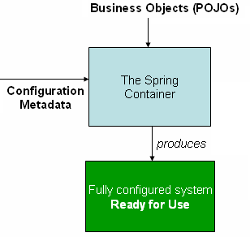
Dependency Injection - IoC
Beans define their dependencies through constructor arguments or properties
Container resolves (injects) dependencies of components by setting implementation object during runtime
BeanFactory interface - the core that
loads bean definitions and manages beans
Most commonly used implementation
is the XmlBeanFactory class
Allows to express the objects that compose
application, and the interdependencies
between such objects, in terms of XML
The XmlBeanFactory takes this XML
configuration metadata and uses it to create a fully configured system

Slide 21
Non-IoC versus IoC
Object B
Object B
creates
setB(IB)
Object A
Object A
Object C
Object C
setC(IC)
creates
Non Inversion of Control approach
Inversion of Control approach
Notes:
IoC - Allows objects to be created at higher levels and passed into object so they can use the implementation directly. Here Object A contains setter methods that accept interfaces to objects B and C. This could have also been achieved with constructors in object A that accepts objects B and C.
Non-IoC - An object creating its dependencies without IoC leads to tight object coupling.

Slide 22
Spring supports two types of dependency injection “setter-based” and “constructor based” injection
Code Example of setter based injection:
<beans>
<bean name="person" class="examples.spring.Person">
<property name="email">
<value>my@email.address</value>
</property>
</bean>
</beans>
*** beans are accessed by there “bean name”
Interpretation of the above code:
Person person = new Person();
person.setEmail(“my@email.address”);
This code creates a Person object and calls the setEmail() method,
passing in the string defined as a value.

Slide 23
Constructor based injection
<beans>
<bean name="fileDataProcessor“ class="examples.spring.DataProcessor"
singleton="true">
<constructor-arg>
<ref bean="fileDataReader"/>
</constructor-arg>
</bean>
<bean name="fileDataReader" class="examples.spring.FileDataReader" singleton="true">
<constructor-arg>
<value>/data/file1.data</value>
</constructor-arg>
</bean>
</beans>
Interpretation of the above code:
FileDataReader fileDataReader = new FileDataReader(“/data/file1.data”);
DataProcessor fileDataProcessor = new DataProcessor(fileDataReader);

Slide 24
Spring provides a JDBC Template that manages your connections for you.
*** Simple example of connecting to a datasource. ***
ProductManagerDaoJdbc implements ProductManagerDao {
public void setDataSource(DataSource ds) {
this.ds = ds;
}
}
*** No need to change java code when changing datasource; change in ‘Spring bean’ XML file below.
<beans>
<bean name="dataSource" class="com.mysql.jdbc.jdbc2.optional.MysqlDataSource" destroy-method="close">
<property name="url">
<value>jdbc:mysql://localhost/test</value>
</property>
<beans>
<bean id="prodManDao" class="db.ProductManagerDaoJdbc">
<property name="dataSource">
<ref bean="dataSource"/>
</property>
</bean>

Slide 25
IoC Basics
Basic JavaBean pattern:
include a “getter” and “setter” method for each field:
Rather than locating needed resources, application components provide setters through which resources are passed in during initialization
In Spring Framework, this pattern is used extensively, and initialization is usually done through configuration file rather than application code
class MyBean {
private int counter;
public int getCounter()
{ return counter; }
public void setCounter(int counter)
{ this.counter = counter; }
}

Slide 26
IoC Java Bean
public class MainBookmarkProcessor implements BookmarkProcessor{
private PageDownloader pageDownloader;
private RssParser rssParser;
public List<Bookmark> loadBookmarks()
{
pageDownloader.downloadPage(url);
rssParser.extractBookmarks(fileName, resourceName);
// ...
}
public void setPageDownloader(PageDownloader pageDownloader){
this.pageDownloader = pageDownloader;
}
public void setRssParser(RssParser rssParser){
this.rssParser = rssParser;
}

Slide 27
Aspect Oriented Programming defined
Attempts to separate concerns, increase modularity, and decrease redundancy
Separation of Concerns (SoC)
Break up features to minimize overlap
Don’t Repeat Yourself (DRY)
Minimize code duplication
Cross-Cutting Concerns
Program aspects that affect many others (e.g. logging)
AspectJ is the top AOP package
Java like syntax, IDE integration
Notes:
Aspect-oriented programming (AOP) is a programming paradigm that aims to increase modularity by allowing the separation ofcross-cutting concerns.
The key unit of modularity in OOP is the class, whereas in AOP the unit of modularity is the aspect. Whereas DI helps you decouple your application objects from each other, AOP helps you decouple cross-cutting concerns from the objects that they affect.
Cross-cutting concerns are aspects of a program that affect other concerns. These concerns often cannot be cleanly decomposed from the rest of the system in both the design and implementation, and can result in either scattering (code duplication), tangling (significant dependencies between systems), or both.
For instance, if writing an application for handling medical records, the indexing of such records is a core concern, while logging a history of changes to the record database or user database, or an authentication system, would be cross-cutting concerns since they touch more parts of the program.
AOP decomposes programs into aspects or concerns

Slide 28
Portable Service Abstractions defined
Services that easily move between systems without heavy reworking
Ideally easy to run on any system
Abstraction without exposing service dependencies
LDAP access without knowing what LDAP is
Database access without typical JDBC hoops
Basically everything in Spring that is not IoC or AOP

Slide 29
What is a bean?
Typical java bean with a unique id
In spring there are basically two types
Singleton
One instance of the bean created and referenced each time it is requested
Prototype (non-singleton)
New bean created each time
Same as new ClassName()
Beans are normally created by Spring as late as possible

Slide 30
What is a bean definition?
Defines a bean for Spring to manage
Key attributes
class (required): fully qualified java class name
id: the unique identifier for this bean
configuration: (singleton, init-method, etc.)
constructor-arg: arguments to pass to the constructor at creation time
property: arguments to pass to the bean setters at creation time
Collaborators: other beans needed in this bean (a.k.a dependencies), specified in property or constructor-arg
Typically defined in an XML file

Slide 31
Sample bean definition
<bean id="exampleBean" class=”org.example.ExampleBean">
<property name="beanOne"><ref bean="anotherExampleBean"/></property>
<property name="beanTwo"><ref bean="yetAnotherBean"/></property>
<property name="integerProperty"><value>1</value></property>
</bean>
public class ExampleBean {
private AnotherBean beanOne;
private YetAnotherBean beanTwo;
private int i;
public void setBeanOne(AnotherBean beanOne) {
this.beanOne = beanOne; }
public void setBeanTwo(YetAnotherBean beanTwo) {
this.beanTwo = beanTwo; }
public void setIntegerProperty(int i) {
this.i = i; }
…
}

Slide 32
What is a bean factory?
Often seen as an ApplicationContext
BeanFactory is not used directly often
ApplicationContext is a complete superset of bean factory methods
Same interface implemented
Offers a richer set of features
Spring uses a BeanFactory to create, manage and locate “beans” which are basically instances of a class
Typical usage is an XML bean factory which allows configuration via XML files

Slide 33
How are beans created?
Beans are created in order based on the dependency graph
Often they are created when the factory loads the definitions
Can override this behavior in bean
<bean class=“className” lazy-init=“true” />
You can also override this in the factory or context but this is not recommended
Spring will instantiate beans in the order required by their dependencies
app scope singleton - eagerly instantiated at container startup
lazy dependency - created when dependent bean created
VERY lazy dependency - created when accessed in code

Slide 34
How are beans injected?
A dependency graph is constructed based on the various bean definitions
Beans are created using constructors (mostly no-arg) or factory methods
Dependencies that were not injected via constructor are then injected using setters
Any dependency that has not been created is created as needed

Slide 35
Multiple bean config files
There are 3 ways to load multiple bean config files (allows for logical division of beans)
Load multiple config files from web.xml
<context-param>
<param-name>contextConfigLocation</param-name>
<param-value>classpath:/WEB-INF/spring-config.xml, classpath:/WEB-INF/applicationContext.xml</param-value>
</context-param>
Use the import tag
<import resource="services.xml"/>
Load multiple config files using Resources in the application context constructor
Recommended by the spring team
Not always possible though
ClassPathXmlApplicationContext appContext = new ClassPathXmlApplicationContext( new String[] {"applicationContext.xml", "applicationContext-part2.xml"});

Slide 36
Bean properties?
The primary method of dependency injection
Can be another bean, value, collection, etc.
<bean id="exampleBean" class="org.example.ExampleBean">
<property name="anotherBean">
<ref bean="someOtherBean" />
</property>
</bean>
This can be written in shorthand as follows
<bean id="exampleBean" class="org.example.ExampleBean">
<property name="anotherBean" ref="someOtherBean" />
</bean>

Slide 37
Anonymous vs ID
Beans that do not need to be referenced elsewhere can be defined anonymously
This bean is identified (has an id) and can be accessed to inject it into another bean
<bean id="exampleBean" class="org.example.ExampleBean">
<property name="anotherBean" ref="someOtherBean" />
</bean>
This bean is anonymous (no id)
<bean class="org.example.ExampleBean">
<property name="anotherBean" ref="someOtherBean" />
</bean>

Slide 38
What is an inner bean?
<bean id="outer" class="org.example.SomeBean">
<property name="person">
<bean class="org.example.PersonImpl">
<property name="name"><value>Aaron</value></property>
<property name="age"><value>31</value></property>
</bean>
</property>
</bean>
It is a way to define a bean needed by another bean in a shorthand way
Always anonymous (id is ignored)
Always prototype (non-singleton)

Slide 39
Bean init-method
The init method runs AFTER all bean dependencies are loaded
Constructor loads when the bean is first instantiated
Allows the programmer to execute code once all dependencies are present
<bean id="exampleBean" class=”org.example.ExampleBean"
init-method=”init” />
public class ExampleBean {
public void init() {
// do something
}
}

Slide 40
Bean values
Spring can inject more than just other beans
Values on beans can be of a few types
Direct value (string, int, etc.)
Collection (list, set, map, props)
Bean
Compound property
Example of injecting a string value
<bean class="org.example.ExampleBean">
<property name="email">
<value>azeckoski@gmail.com</value>
</property>
</bean>

Slide 41
Abstract (parent) beans
Allows definition of part of a bean which can be reused many times in other bean definitions
<bean id="abstractBean" abstract="true"
class="org.example.ParentBean">
<property name="name" value="parent-AZ"/>
<property name="age" value="31"/>
</bean>
<bean id="childBean"
class="org.example.ChildBean"
parent="abstractBean" init-method="init">
<property name="name" value="child-AZ"/>
</bean>
The parent bean defines 2 values (name, age)
The child bean uses the parent age value (31)
The child bean overrides the parent name value (from parent-AZ to child-AZ)
Parent bean could not be injected, child could

Slide 42
AOP in Spring
Provides way to create declarative services and custom aspects
Transaction management is the most common aspect (or concern)
Spring handles AOP via advisors or interceptors
Interception point is a joinpoint
A set of joinpoints are called a pointcut
pointcuts are key to Spring AOP, they allow intercepts without explicit knowledge of the OO hierarchy
Action taken by an interceptor is called advice

Slide 43
AOP advice types
Around
Most common and powerful
Execute code before and after joinpoint
Before
Executes before joinpoint, cannot stop execution
Throws
Executes code if exception is thrown
After return
Executes code after normal joinpoint execution

Slide 44
Spring AOP key points
Pure java implementation
Allows method interception
No field or property intercepts yet
AOP advice is specified using typical bean definitions
Closely integrates with Spring IoC
Proxy based AOP
J2SE dynamic proxies or CGLIB proxies
Not a replacement for AspectJ

Slide 45
Example transaction proxy
This wraps a transaction interceptor around a DAO
<bean id="daoBeanTarget" class="org.example.dao.impl.DaoImpl">
<property name="sessionFactory"><ref bean="mySessionFactory"/></property>
</bean>
<bean id="daoBean" class="org.springframework.transaction.interceptor.TransactionProxyFactoryBean">
<property name="transactionManager" ref="transactionManager"/>
<property name="target" ref="daoBeanTarget"/>
<property name="transactionAttributes">
<props>
<prop key="*">PROPAGATION_REQUIRED</prop>
</props>
</property>
</bean>

Slide 46
Working example
Let’s look at some example code pre and post spring
Simple application that allows a user to add, remove, and list a set of strings
Pre spring code
Programmers Cafe - Example App
Post spring code
Programmers Cafe - Example App Spring

Slide 47
Example App
The example app is a simple command line Java app which is meant to demonstrate a reasonable dependency structure
This app allows a user to save, delete, and list a set of strings associated with their username

Slide 48
Example App Structure
Alpha is the main class
Bravo handles user interaction
Charlie handles application logic
Delta handles data access
Dependency graph is non-cyclical
No A => B => C => A
Alpha
Bravo
Charlie
DeltaImpl
Delta
A B = A depends on B

Slide 49
Non-spring version
Involves using new to create needed dependencies
Each class must know about the dependencies that it needs
Singletons have to be created and handed to the classes that need them at the same time or you need a static way to access them (or a framework)
Tightly coupled code structure

Slide 50
Spring version
No more new use
Classes only have to know about the interface
or class if no interface available
Singletons easy to handle
Loose coupling allows flexible changes

Slide 51
Spring Web
Key Concepts

Slide 52
Spring Web Controllers
In an MVC architecture your controllers handle all requests.
Spring uses a ‘DispatcherServlet” defined in the web.xml file to analyze a request URL pattern and then pass control to the correct Controller by using a URL mapping defined in a “ Spring bean” XML file.

Slide 53
Spring Web Container Setup
In your Web Container, the Spring “bean” XML file exists in the same directory as your web.xml file with a “-servlet.xml” appended to it.
webapps
/tradingapp
/WEB-INF/tradingapp-servlet.xml, web.xml)
/classes
/lib (all jar files)
The dispatcher servlet is mapped to the name “tradingapp” so it knows to look in the “tradingapp-servlet.xml” file to look-up a URL-to- Controller match.

Slide 54
Example of web.xml file
<web-app>
<servlet>
<servlet-name>tradingapp</servlet-name>
<servlet-class>DispatcherServlet</servlet-class>
</servlet>
<servlet-mapping>
<servlet-name>tradingapp</servlet-name>
<url-pattern>*.htm</url-pattern>
</servlet-mapping>
</web-app>
*** Any URL ending with an “.htm” pattern is routed to the DispatcherServlet, the DispatcherServlet loads the tradingapp-servlet.xml file and routes the user to the correct controller.

Slide 55
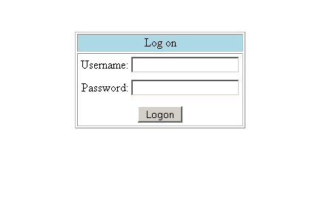
Our Demo Logon Form at URL http://localhost/tradingapp/logon.htm

Slide 56
The tradingapp-servlet.xml file a.k.a. Spring beans XML file is where the majority of your configuration is done.
For example: If working with the URL: /logon.htm
Because the URL ends with .htm the DispatcherServlet loads the tradingapp-servlet.xml file to determine which controller to use.
The tradingapp-servlet.xml file uses Springs SimpleUrlHandlerMapping class to map the URL to a controller, in this case the LogonFormController
Next…what the tradingapp-servlet.xml looks like.

Slide 57
tradingapp-servlet.xml
<bean id="urlMapping" class="org.springframework.SimpleUrlHandlerMapping">
<property name="urlMap">
<map>
<entry key="/logon.htm">
<ref bean="logonForm"/>
</entry>
</map>
</property>
</bean>
<bean id="logonForm" class="com.tradingapp.LogonFormController">
<property name="sessionForm"><value>true</value></property>
<property name="commandName"><value>credentials</value></property
<property name="commandClass">
<value>com.tradingapp.Credentials</value>
</property>
<property name="validator"><ref bean="logonValidator"/></property>
<property name="formView"><value>logon</value></property>
<property name="successView"><value>portfolio.htm</value></property>
</bean>
This class extends Springs SimpleFormController
Which defines a setSuccessView() method
If it passes “validator” then successView, passes to portfolio.htm page

Slide 58
Review of the process so far
User goes to this URL: http://tradingapp/logon.htm
Since the URL ends with “.htm”, the tradingapp-servlet.xml file is loaded to determine what controller to use.
The <bean name urlMapping …/> says to refer to the <bean id="logonForm" class="com.tradingapp.LogonFormController">
Since the LogonFormController extends SimpleFormController we can use the methods defined in the SimpleFormController class to do all kinds of form checking, e.g. validation.

Slide 59
What our LogonFormController Looks Like.
public class LogonFormController extends SimpleFormController {
public ModelAndView onSubmit(Object command) throws ServletException {
return new ModelAndView(new RedirectView(getSuccessView()));
}
}
Remember our tradingapp-servler.xml file?
<bean id="logonForm" class="com.tradingapp.LogonFormController">
<property name="sessionForm"><value>true</value></property>
<property name="commandName"><value>credentials</value></property
<property name="commandClass">
<value>com.tradingapp.Credentials</value>
</property>
<property name="validator"><ref bean="logonValidator"/></property>
<property name="formView"><value>logon</value></property>
<property name="successView"><value>portfolio.htm</value></property>
</bean>
If no validation errors, go here

Slide 60
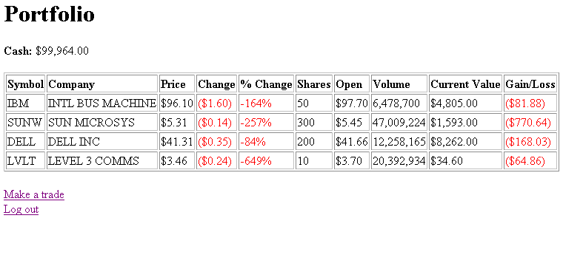
successView /portfolio.htm

Slide 61
Where do I go if there is a validation error in my logon page?
tradingapp-servler.xml
<bean id="logonForm" class="com.tradingapp.LogonFormController">
<property name="sessionForm"><value>true</value></property>
<property name="commandName"><value>credentials</value></property
<property name="commandClass">
<value>com.tradingapp.Credentials</value>
</property>
<property name="validator"><ref bean="logonValidator"/></property>
<property name="formView"><value>logon</value></property>
<property name="successView"><value>portfolio.htm</value></property>
</bean>
<bean id="logonValidator" class="com.devx.tradingapp.web.LogonValidator"/>
*** Your LogonFormController will check the validation “first” without writing
any additional code because your LogonFormController extends Springs SimpleFormController.
Next: The LogonValidator implements Springs Validator interface.
On error go back to formView, that is where you started.

Slide 62
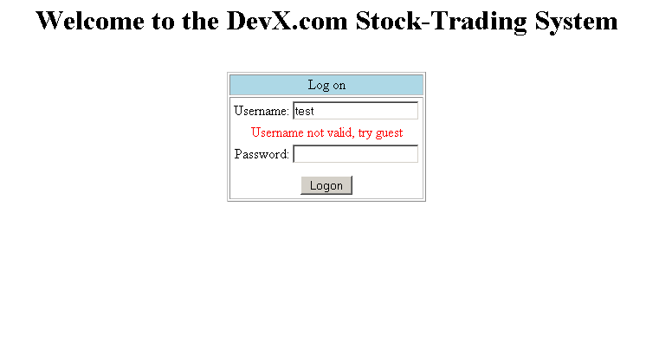
Logon page with error message
Next: code for LogonValidator implements Springs Validator

Slide 63
Example code of validator
tradingapp-servler.xml
<bean id="logonForm" class="com.tradingapp.LogonFormController">
<property name="commandName"><value>credentials</value></property
<property name="commandClass">
<value>com.tradingapp.Credentials</value>
</property>
<property name="validator"><ref bean="logonValidator"/></property>
<property name="formView"><value>logon</value></property>
<property name="successView"><value>portfolio.htm</value></property>
</bean>
<bean id="logonValidator" class="com.devx.tradingapp.web.LogonValidator"/>
public class LogonValidator implements Validator {
public void validate(Object obj, Errors errors) {
Credentials credentials = (Credentials) obj;
if (credentials.getPassword().equals("guest") == false) {
errors.rejectValue("password", "error.login.invalid-pass",
null, "Incorrect Password.");
}
} Next: Command/Form Backing Bean
Command / form backing bean

Slide 64
Command/Form Backing Bean is a POJO
public class Credentials {
private String username;
private String password;
public String getPassword() {
return password;
}
public void setPassword(String password) {
this.password = password;
}
public String getUsername() {
return username;
}
public void setUsername(String username) {
this.username = username;
}
}
Next: Why its called a “command” or “form backing bean”

Slide 65
Command/Form Backing Bean is a POJO
logon.htm form
public class Credentials {
private String username;
private String password;
public String getPassword() {
return password;
}
public void setPassword(String password) {
this.password = password;
}
public String getUsername() {
return username;
}
public void setUsername(String username) {
this.username = username;
}
}
Username:
Password:
The logon form is “backed” by the Credentials bean and given a commandName of “credentials” defined in out springapp-servlet.xml file. “credentials” will be our “command object” we will use to bind the form to the bean.
Next: another look at springapp-servlet.xml file

Slide 66
springapp-servlet.xml file
<bean id="logonForm" class="com.tradingapp.LogonFormController">
<property name="commandName"><value>credentials</value></property
<property name="commandClass">
<value>com.tradingapp.Credentials</value>
</property>
<property name="validator"><ref bean="logonValidator"/></property>
<property name="formView"><value>logon</value></property>
<property name="successView"><value>portfolio.htm</value></property>
</bean>
We use the commandName “credentials” with Spring’s tag library, to bind the Credentials bean to the logon form.
Next: Code that shows logon form binding to commandName

Slide 67
logon form binding to commandName using Springs Tag Library
<%@ taglib prefix="spring" uri="/spring" %>
<html>
<head><title>DevX.com Stock-Trading System Logon</title></head>
<body>
<spring:bind path="credentials.username">
<input type="text" name="username"
<spring:bind path="credentials.password">
<input type="password" name="password" />
</body>
</html>
Spring’s taglib has bound the bean to the form

Slide 68
asf

Slide 69
asf

