Slide 1
Software vs Software Framework
.Net, Angular and Java
Desktop Application, Web Application, Database

Slide 2
Versions: .NET Framework -> 1.0 to 4.8 -> Apr, 2019 .Net Core -> 1.0 to 6 -> November, 2021

Slide 3
.Net Framework vs .Net Core:
Open Source
Cross-Platform
Application Models(Core doesn't support windows/desktop applications)
Support for Micro-Services and REST Services
Android Development(Xamarin)

Slide 4
Project Types: - .Net Framework:
Console Application - That can be executed and there will be no UI
Windows Application
Web Forms - Web application ends with aspx, ascx and asmx
Class Library - Logics are being written and packaged as the dll and it can't run independently. It needs to be integrated with either console, windows, web app etc
MVC - Model view controller design pattern for web applications and it has UI
Web API JSON/XML- It returns only data and will not have any UI
WCF XML- Windows communication foundation. SOAP(xml) based service

Slide 5
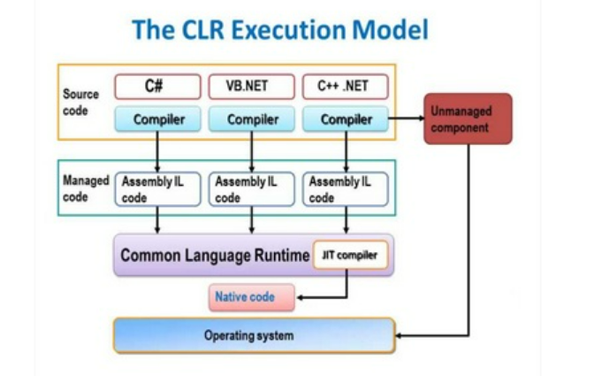
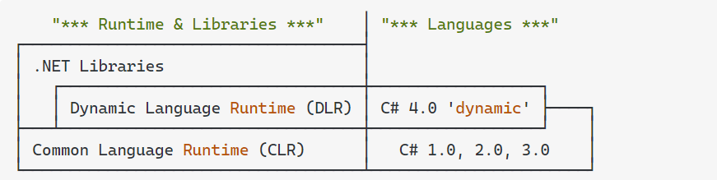
.Net Framework

Slide 6
Project Types: - .Net Core:
Console Application - That can be executed and there will be no UI
Core Web App - Web application ends with aspx, ascx and asmx
Class Library - Logics are being written and packaged as the dll and it can't run independently. It needs to be integrated with either console, windows, web app etc
Core Web MVC - Model view controller design pattern for web applications and it has UI
Web API - It returns only data and will not have any UI
WCF - Windows communication foundation. SOAP(xml) based service from .NET Core 3.1

Slide 7
Development tools:
Microsoft Visual Studio Community 2022 (64-bit)
https://visualstudio.microsoft.com/vs/community/ Code Repository:
https://github.com/Manisoft55/AimorePractice

Slide 8
C#:
Output Comments Variables Data Types Type Casting User Input Operators If...Else Methods Method Parameters

Slide 9
C#: Strings(Length, Upper, Lower, Concat, Interpolation, Substring, IndexOf, Escape character, +, Replace) Booleans Switch (default, goto case) – DEFINE DAYS Arrays(string arr, Int arr, foreach, sort, replace arr element, Linq – Min, max, sum) For Loop/ForEach Math(Min, Max, Abs)
While/Do Loop Break/Continue Method Overloading

Slide 10
C#: OOPs: Classes/Objects Class Members Access Modifiers(Private, Public, Protected, Internal - Assemblies) Count char in an array Inheritence Single MultiLevel A, B, C Multiple Inheritence Hybrid Inheritence A, B, ABC, ABD Hierarchical Inheritance - A, AB, AC Multiple derived class Method overriding vs Method overloading Base keyword Assemblies(Private, Public, Satellite – Resource) Classes: abstract class sealed class – Can’t inherit for security purpose, static class – This, can have static and non-static methods, partial class – Logic can be splitted then can be added as a single class Constructors Collections
Properties Polymorphism Abstraction, Interface, Enums, Files, Exceptions

Slide 11
What – Early beginner How – Beginner Why – Intermediate - Critical because of understanding the concept Why not – Advance

