Slide 1
Software vs Software Framework
.Net and Java
Desktop Application, Web Application, Database

Slide 2





Versions: .NET Framework -> 1.0 to 4.8 -> Apr, 2019 .Net Core -> 1.0 to 6 -> November, 2021

Slide 3
.Net Framework vs .Net Core:
Open Source
Cross-Platform
Application Models(Core doesn't support windows)
Support for Micro-Services and REST Services
Android Development(Xamarin)

Slide 4
Project Types: - .Net Framework:
Console Application - That can be executed and there will be no UI
Windows Application
Web Forms - Web application ends with aspx, ascx and asmx
Class Library - Logics are being written and packaged as the dll and it can't run independently. It needs to be integrated with either console, windows, web app etc
MVC - Model view controller design pattern for web applications and it has UI
Web API - It returns only data and will not have any UI
WCF - Windows communication foundation. SOAP(xml) based service

Slide 5
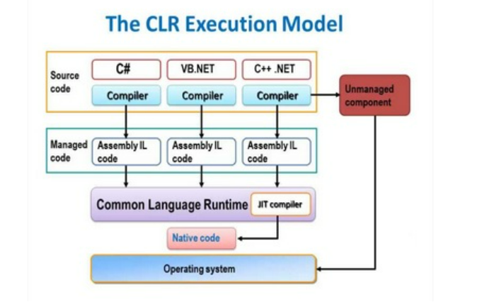
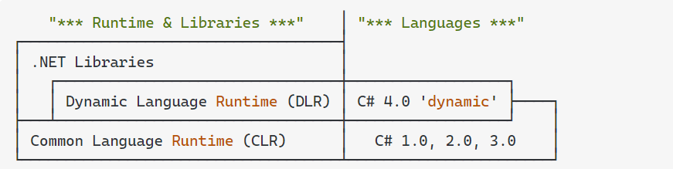
.Net Framework

Slide 6
Project Types: - .Net Core:
Console Application - That can be executed and there will be no UI
Core Web App - Web application ends with aspx, ascx and asmx
Class Library - Logics are being written and packaged as the dll and it can't run independently. It needs to be integrated with either console, windows, web app etc
Core Web MVC - Model view controller design pattern for web applications and it has UI
Web API - It returns only data and will not have any UI
WCF - Windows communication foundation. SOAP(xml) based service from .NET Core 3.1

Slide 7
Development tools:
Microsoft Visual Studio Community 2022 (64-bit)
https://visualstudio.microsoft.com/vs/community/ Code Repository:
https://github.com/Manisoft55/AimorePractice

