Slide 1
Software vs Software Framework
.Net, Angular and Java
Desktop Application, Web Application, Database

Slide 2
Versions: .NET Framework -> 1.0 to 4.8 -> Apr, 2019 .Net Core -> 1.0 to 6 -> November, 2021

Slide 3
.Net Framework vs .Net Core:
Open Source
Cross-Platform
Application Models(Core doesn't support windows/desktop applications)
Support for Micro-Services and REST Services
Android Development(Xamarin)

Slide 4
Project Types: - .Net Framework:
Console Application - That can be executed and there will be no UI
Windows Application
Web Forms - Web application ends with aspx, ascx and asmx
Class Library - Logics are being written and packaged as the dll and it can't run independently. It needs to be integrated with either console, windows, web app etc
MVC - Model view controller design pattern for web applications and it has UI
Web API JSON/XML- It returns only data and will not have any UI
WCF XML- Windows communication foundation. SOAP(xml) based service

Slide 5
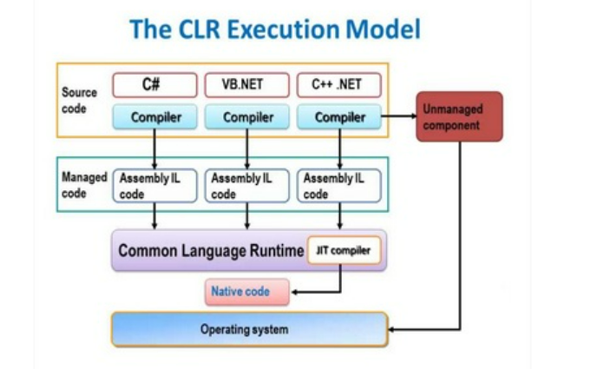
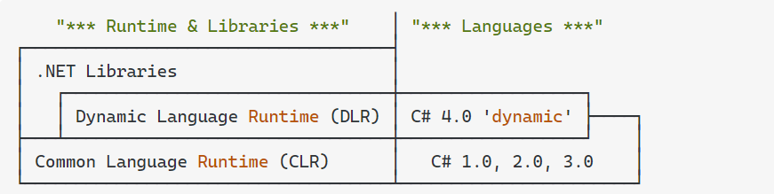
.Net Framework

Slide 6
Project Types: - .Net Core:
Console Application - That can be executed and there will be no UI
Core Web App - Web application ends with aspx, ascx and asmx
Class Library - Logics are being written and packaged as the dll and it can't run independently. It needs to be integrated with either console, windows, web app etc
Core Web MVC - Model view controller design pattern for web applications and it has UI
Web API - It returns only data and will not have any UI
WCF - Windows communication foundation. SOAP(xml) based service from .NET Core 3.1

Slide 7
Development tools:
Microsoft Visual Studio Community 2022 (64-bit)
https://visualstudio.microsoft.com/vs/community/ Code Repository:
https://github.com/Manisoft55/AimorePractice

Slide 8
C#:
Output Comments Variables Data Types Type Casting User Input Operators If...Else Methods Method Parameters

Slide 9
C#: Strings(Length, Upper, Lower, Concat, Interpolation, Substring, IndexOf, Escape character, +, Replace) Booleans Switch (default, goto case) – DEFINE DAYS Arrays(string arr, Int arr, foreach, sort, replace arr element, Linq – Min, max, sum) For Loop/ForEach Math(Min, Max, Abs)
While/Do Loop Break/Continue Method Overloading

Slide 10
C#: OOPs: Classes/Objects Class Members Access Modifiers(Private, Public, Protected, Internal - Assemblies) Count char in an array Inheritence Single MultiLevel A, B, C Multiple Inheritence Hybrid Inheritence A, B, ABC, ABD Hierarchical Inheritance - A, AB, AC Multiple derived class Method overriding vs Method overloading Base keyword Assemblies(Private, Public, Satellite – Resource) Classes: abstract class sealed class – Can’t inherit for security purpose, static class – This, can have static and non-static methods, partial class – Logic can be splitted then can be added as a single class

Slide 11
Abstraction – Hiding the implementation. It has private variable Encapsulation – Encapsulation is data hiding(information hiding) while Abstraction is detail hiding(implementation hiding). While encapsulation groups together data and methods that act upon the data, data abstraction deal with exposing to the user and hiding the details of implementation. Properties { get; set; } Polymorphism – provide a unique interface for different implementations of methods. Early binding(Compile - Overloading), late binding(Run - Overriding) Interface Constructors 1.Default Constructor 2.Parameterized Constructor 3.Copy Constructor - To initialize the members of a newly created object by copying the members of an already existing object. 4.Private Constructor 5.Static Constructor https://www.geeksforgeeks.org/c-sharp-constructors/

Slide 12
Model POCO(Plain Old CLR Objects) class Value type – Value stores directly vs Reference type – Address stores and value will be retrieved based on the address Collections – Array, Dictionary, List, SortedList Enums – To maintain the constant values Files – Create, Write, Delete Exceptions – throw new exception

Slide 13
What – Early beginner How – Beginner Why – Intermediate - Critical because of understanding the concept Why not – Advance

