Slide 1
Summer Winning Camp
DATABASE MANAGEMENT SYSTEM
Department Of Career Planning & Development
May 2026 – July 2026 2027 PO

Slide 2
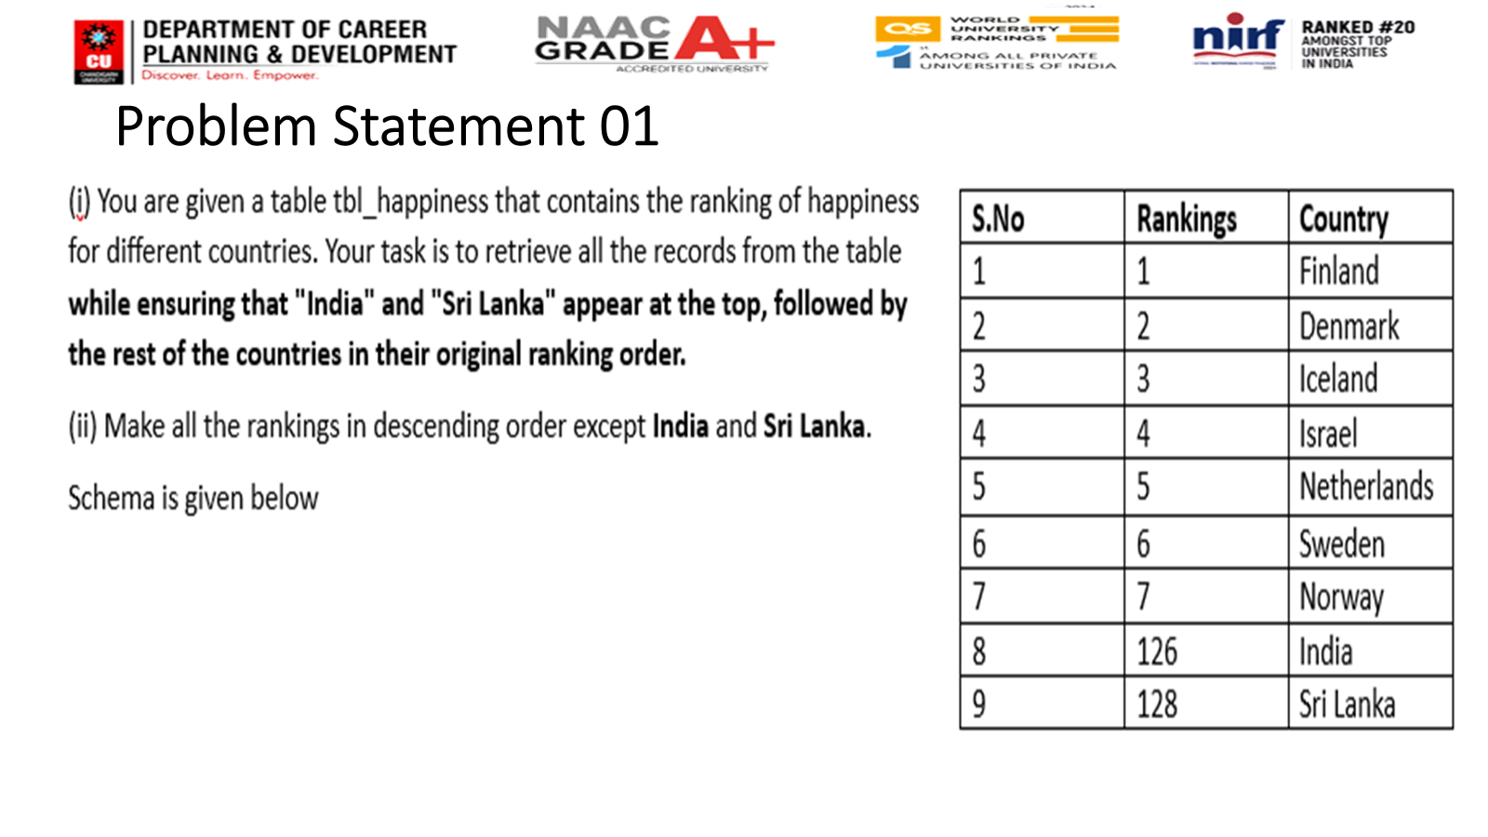


Slide 3
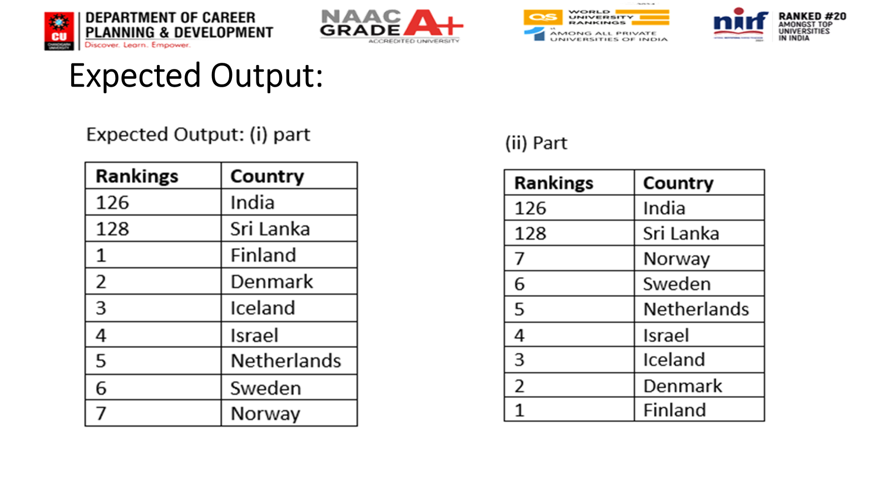

Slide 4
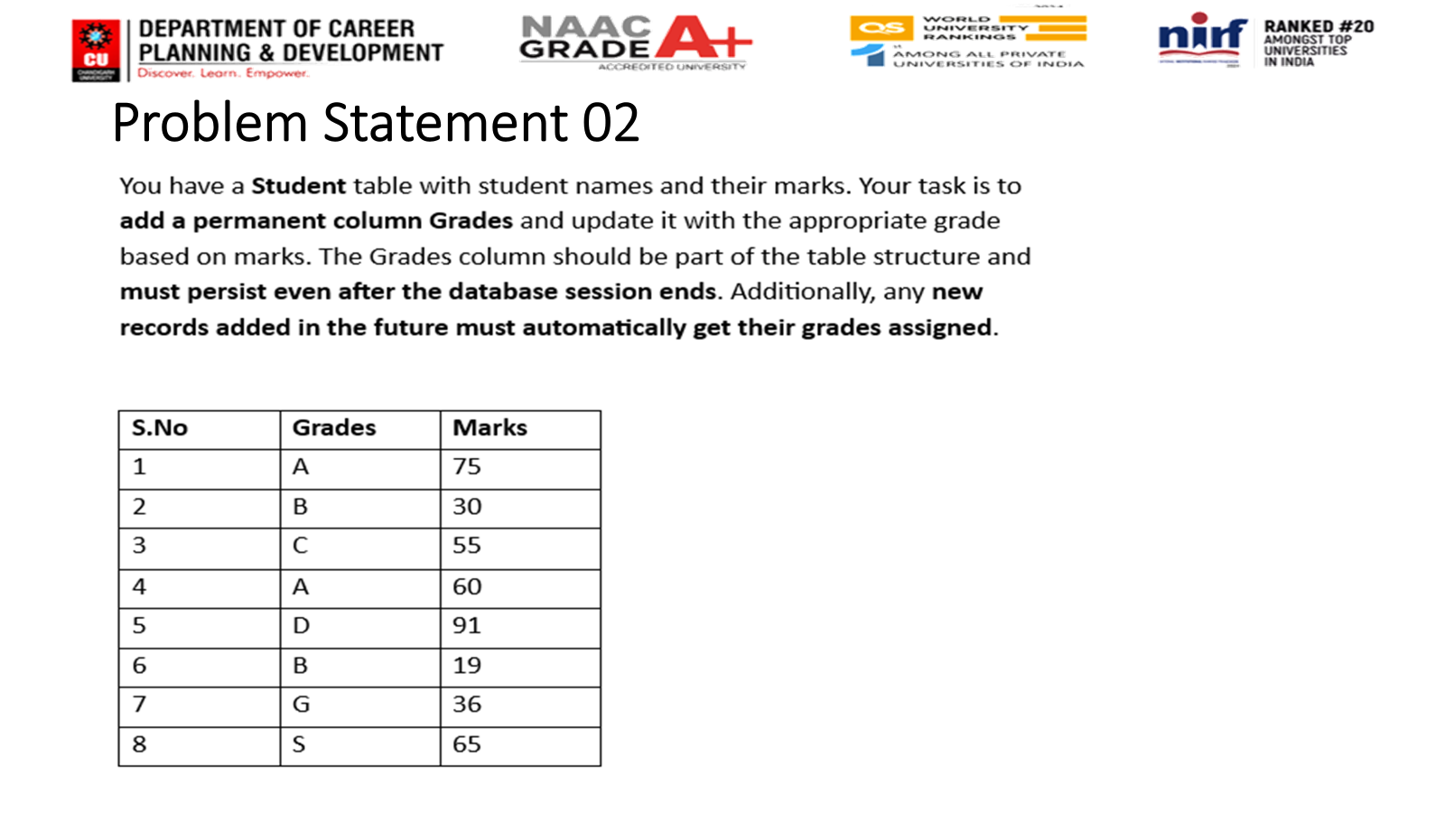


Slide 5
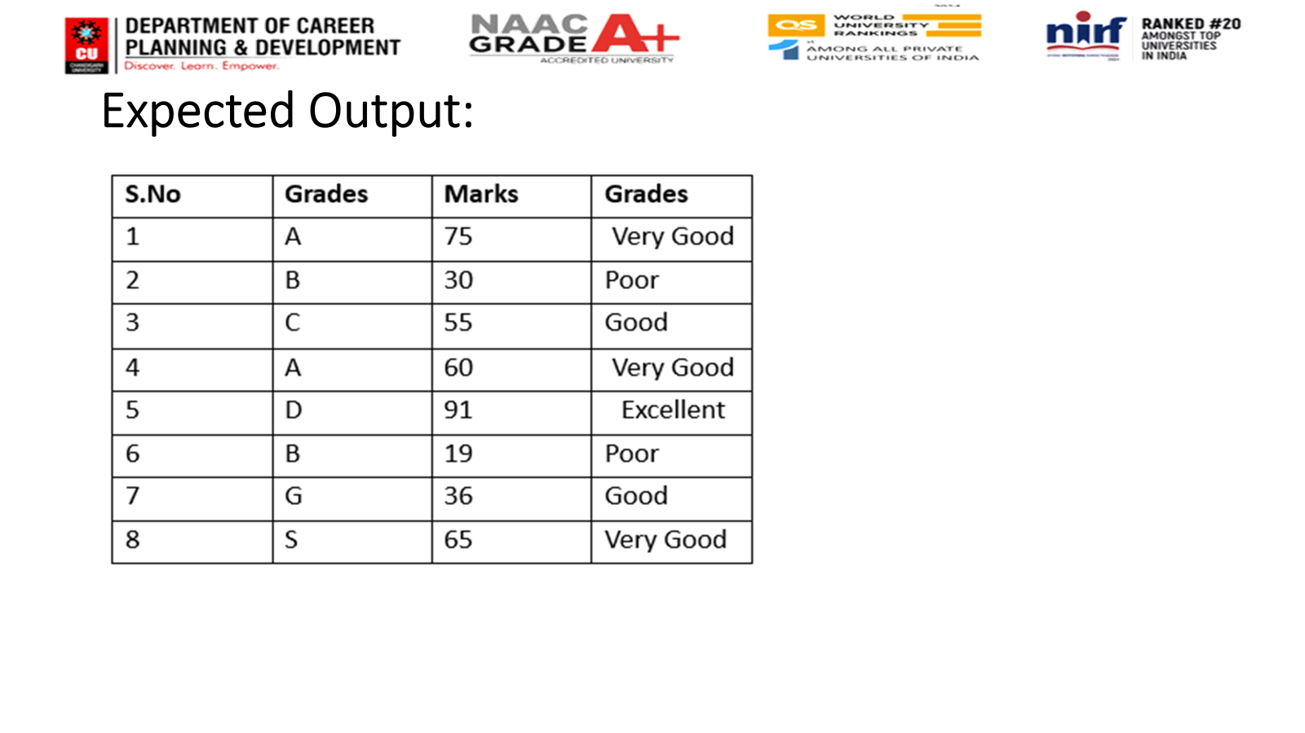

Slide 6
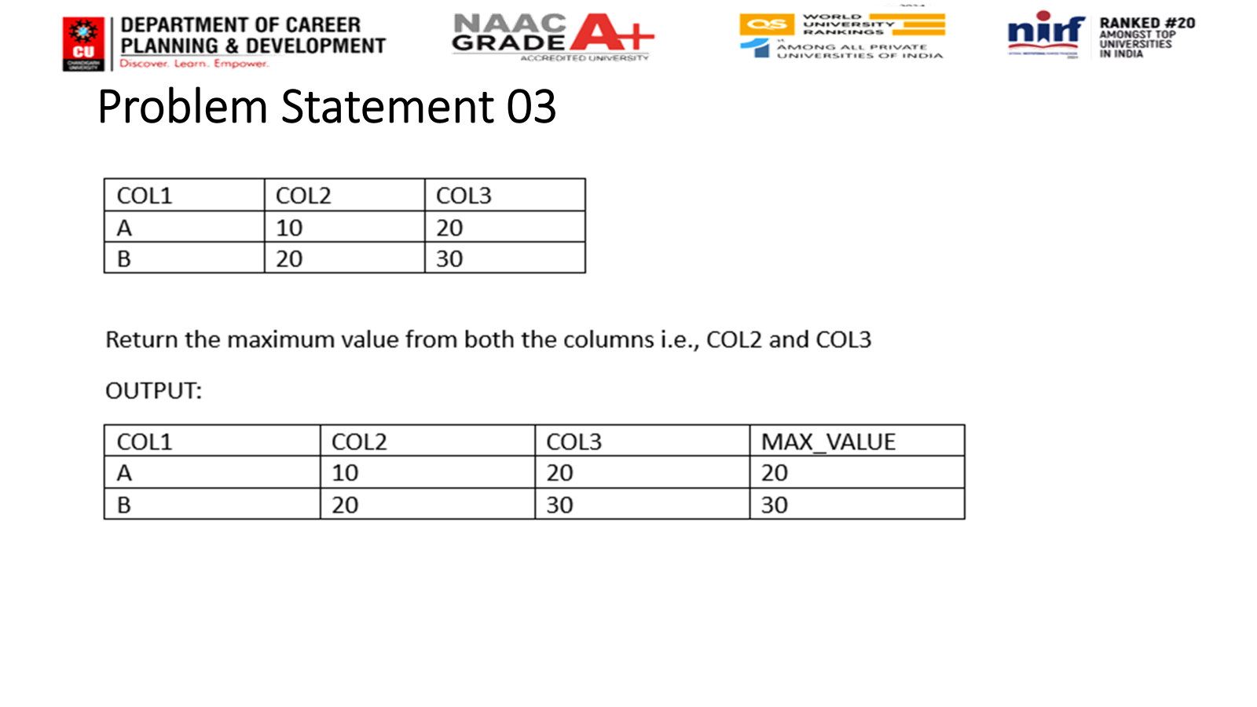


Slide 7
Home-Task
https://platform.stratascratch.com/coding/10285-acceptance-rate-by-date?code_type=1
https://platform.stratascratch.com/coding/10568-daily-revenue?code_type=1

Slide 8
Thanks

