Slide 1
Summer Winning Camp
DATABASE MANAGEMENT SYSTEM
Department Of Career Planning & Development
May 2026 – July 2026 2027 PO

Slide 2
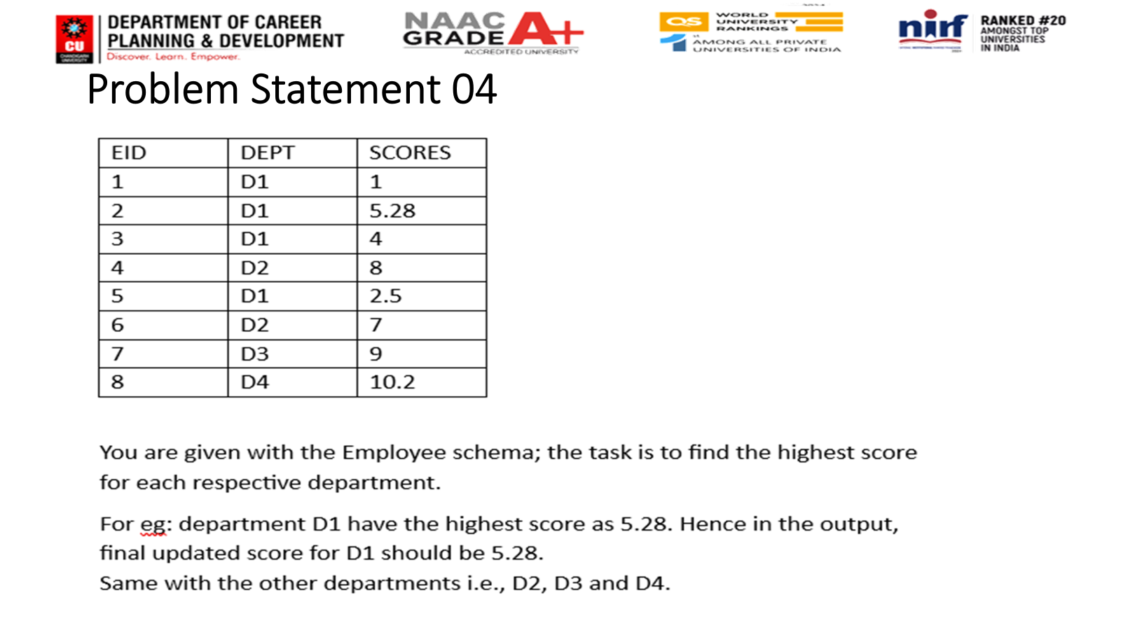


Slide 3
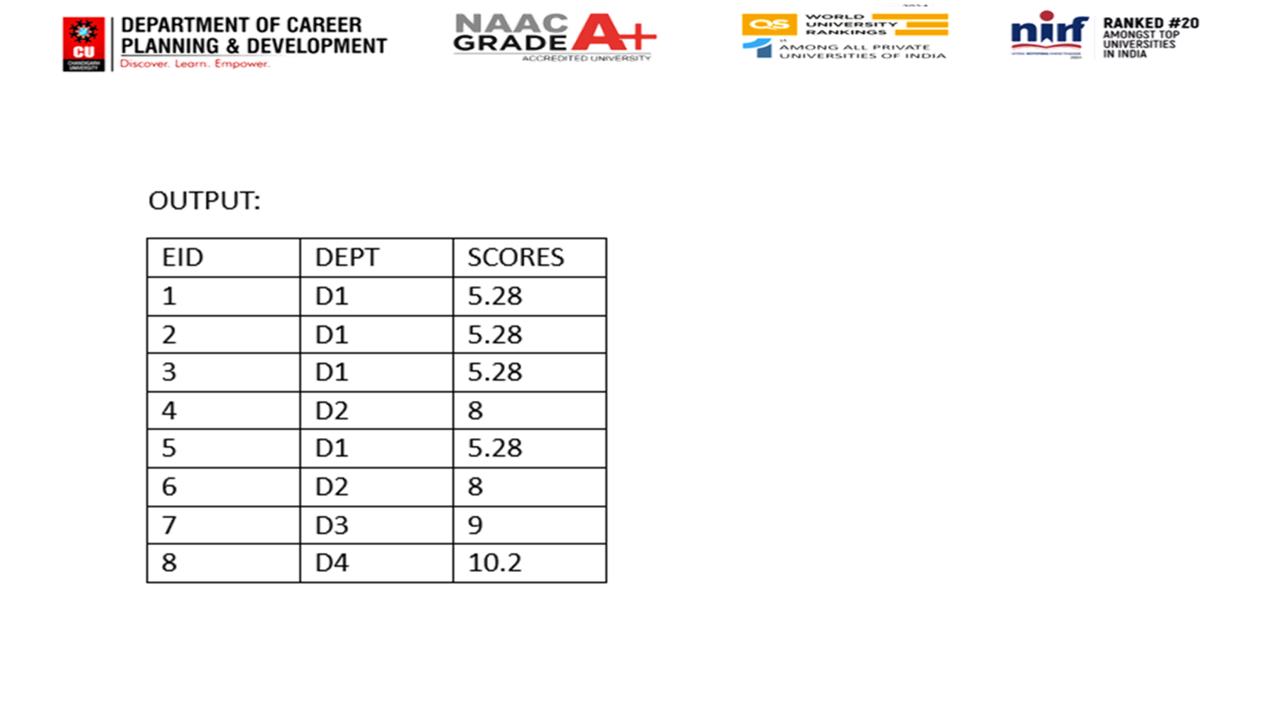

Slide 4
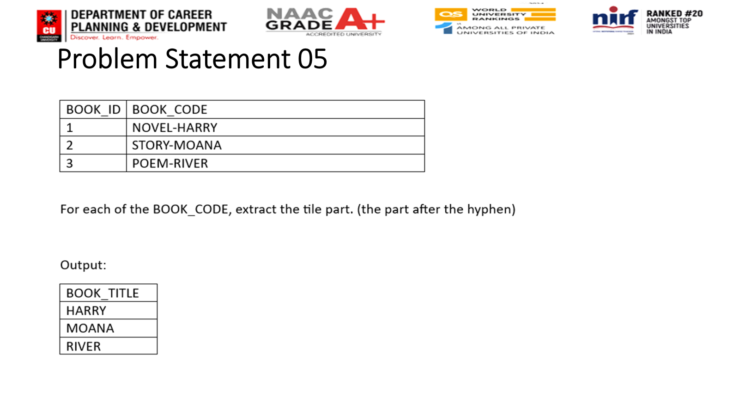


Slide 5
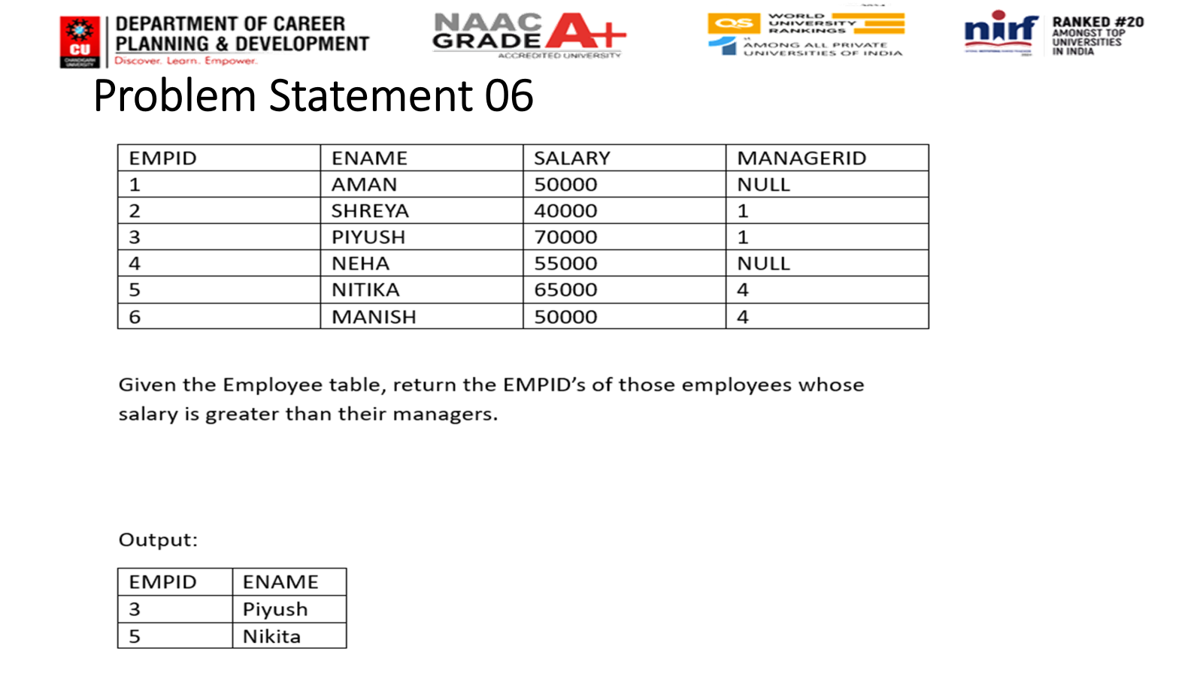


Slide 6
Home-Task
https://platform.stratascratch.com/coding/10322-finding-user-purchases?code_type=1
https://platform.stratascratch.com/coding/10566-search-click-success-rate-by-user-segment?code_type=1

