Slide 1

Domo Layton Analytics Challenge
- By
Abinav Yadamani
Harichandana Gonuguntla
Maniteja Kurukunda
SaiEshwar Tadepalli

Slide 2

Objectives
Understand and manage the workforce dynamics
Analyze employee demographics distribution of current employees
Analyze the Headcount of the employees
Analyze the Turn-over Rate of the employees
Understand why employees are leaving the company
Suggest retention strategies

Slide 3
Implementation of Domo Analytics Solution
1
Data Ingestion
Layton’s employee snapshot data available in DOMO
Data Preparation
2
Utilized Domo’s Magic ETL for necessary data transformation and consistency
3
Data Visualization
Developed custom dashboards to caters to the needs of Layton Construction's stakeholders
Derive Insights
4
Unlock insights and drive strategic recommendations by analyzing diverse dashboard cards

Slide 4
Problem Definition
Diversity Disparities Across Periods:
Our visualizations reveal significant variations in the hiring of diverse talent over different periods.
2. Employee Turnover Insights:
Notably, Generation Millennials exhibit a higher turnover rate compared to other generations.
3. Departmental Challenges:
Analysis indicates that the issue is concentrated in four specific departments, warranting focused attention.

Slide 5
Head Count Analysis
Staff employees are more in number 10 times than craft employees though they are male/female.
Total active employee count – 1415
Active male employee count is 1200
Active female employee count is 215.
Total interns are 40 in number
Only 1 employee is working as a full time among the interns
Only 2.8% of the employees are interns out of the total active employees while 97.2% are not.
5.4% of the employees work part time
94.6 % of the employees work fulltime
Majority of the active employees i.e 28% of them are between the age band 25-35 years
Majority of the active employees i.e 36% of them fall in the tenure band of 1-3 years
Also, majority of the active employees i.e 63% belong to the Home SBU company code 02 and G1

Slide 6
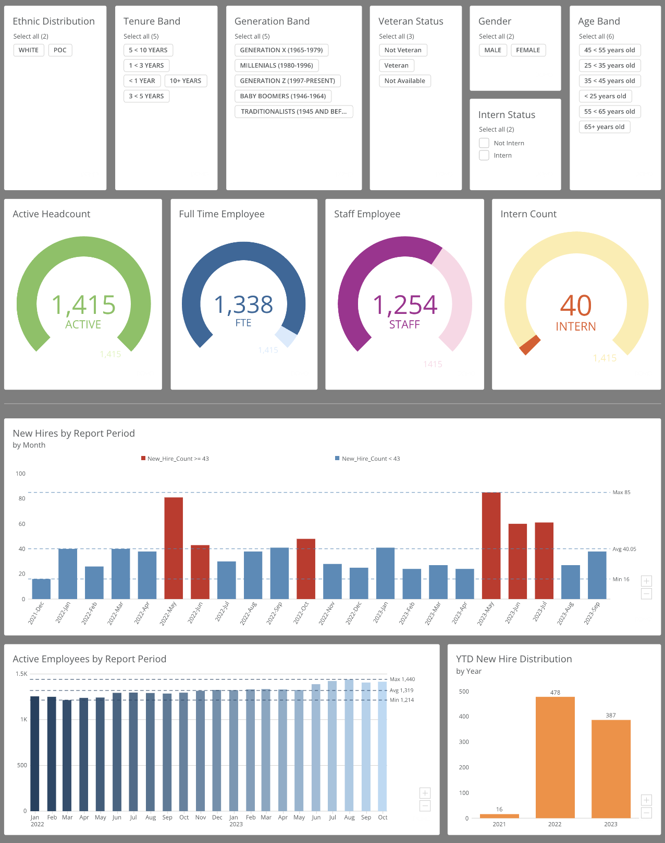
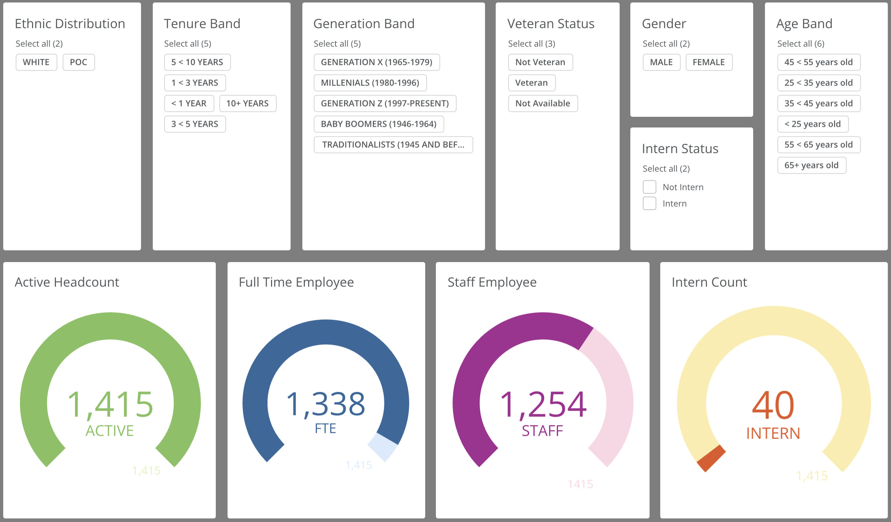

Slide 7
Head Count Analysis – New hires
Hiring is done more in May month
Out of 100% hirings done , 90% are males and just 10 % are females.
Veteran hiring is 0 during last 2 quarters of 2022 year.
In 2023 veterans hiring is more compared to 2022.
Out of the maximum hirings in May, more than 50-60% new hires are less than 25 yrs of age.
>65 years age new hires are very very minimal. And this hiring increased from 2022 to 2023.
Out of the maximum hirings in May, and also in other months 80-90% are whites.
Whites hiring decreased from 2020 to 2023.
POC hiring increased from 2022 to 2023.

Slide 8
Head Count Analysis
The following analysis done for the bonus question 1.6 is across the reporting periods i.e from Dec-2021 to Sep-2023 --
The number of employees with tenure band <1 yr is constantly increasing. People are leaving more within 1 year only.
The number of employees with tenure band 3-5yrs is constantly decreasing.
The number of employees with tenure band 5-10yrs is constantly decreasing but not with a huge difference.
The number of Gen Z employees are constantly increasing
Male hiring is very high than females.
Active employee count decreased in SBU company code -06

Slide 9
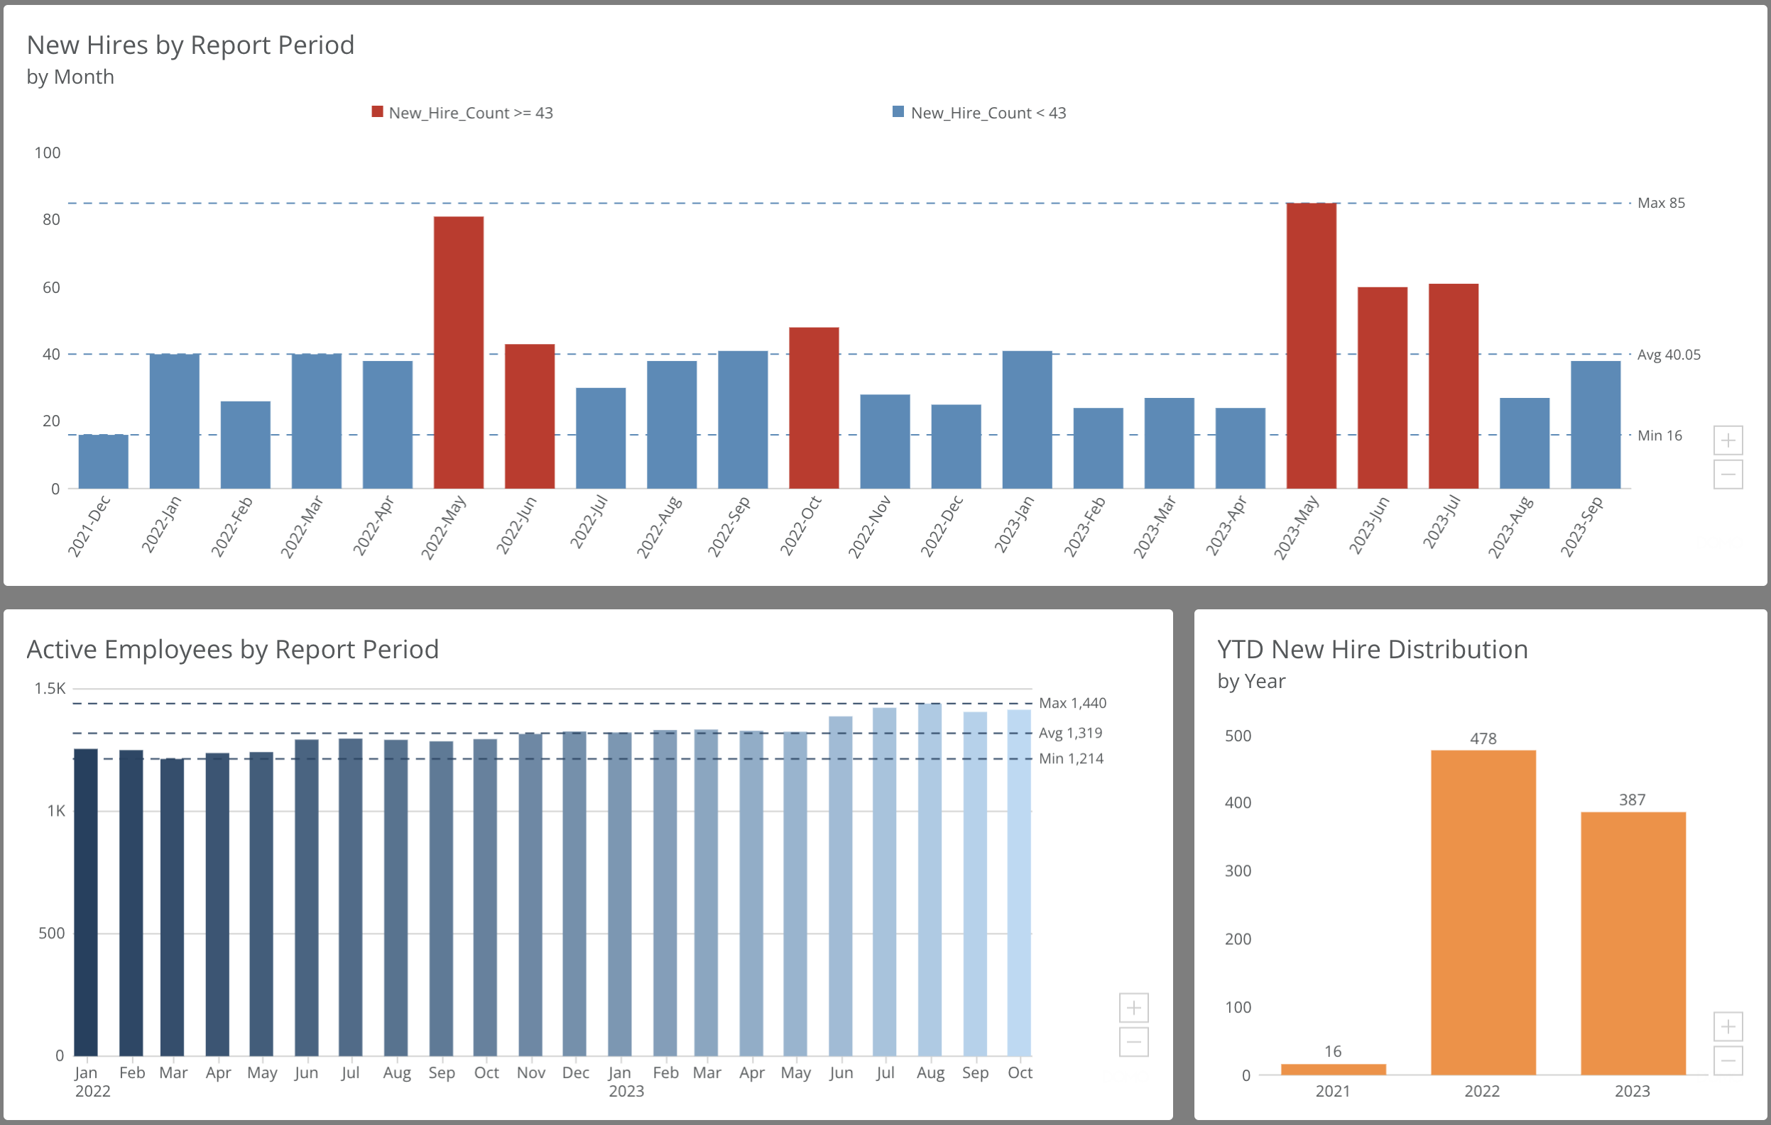

Slide 10

Turn-over Rate Analysis
Turnover rate is usually seen high during August month and the reason code for turn over is RESIGN02.
In 2023 the number of people who left the organization is more when compared to that in 2022.
From the STOBG MGMT TIER, General staff left - 60% , Managers left – 31%
Out of the people leaving , 88% are male and 12% are female
Out of the people leaving, 70% are leaving voluntarily
Out of 460 people who are leaving– 132 are from Trade and Craft , 104 are operation management, 64 are from Project management and 40 are Engineers
Millennials are leaving the company more compared to other generation bands
90% of the people leaving are from age bands <25 and 25-35
90% of the people leaving are from <1 year and 0-3 year tenure band
From the STOBG HR key role group , Project management left 90% voluntarily

Slide 11
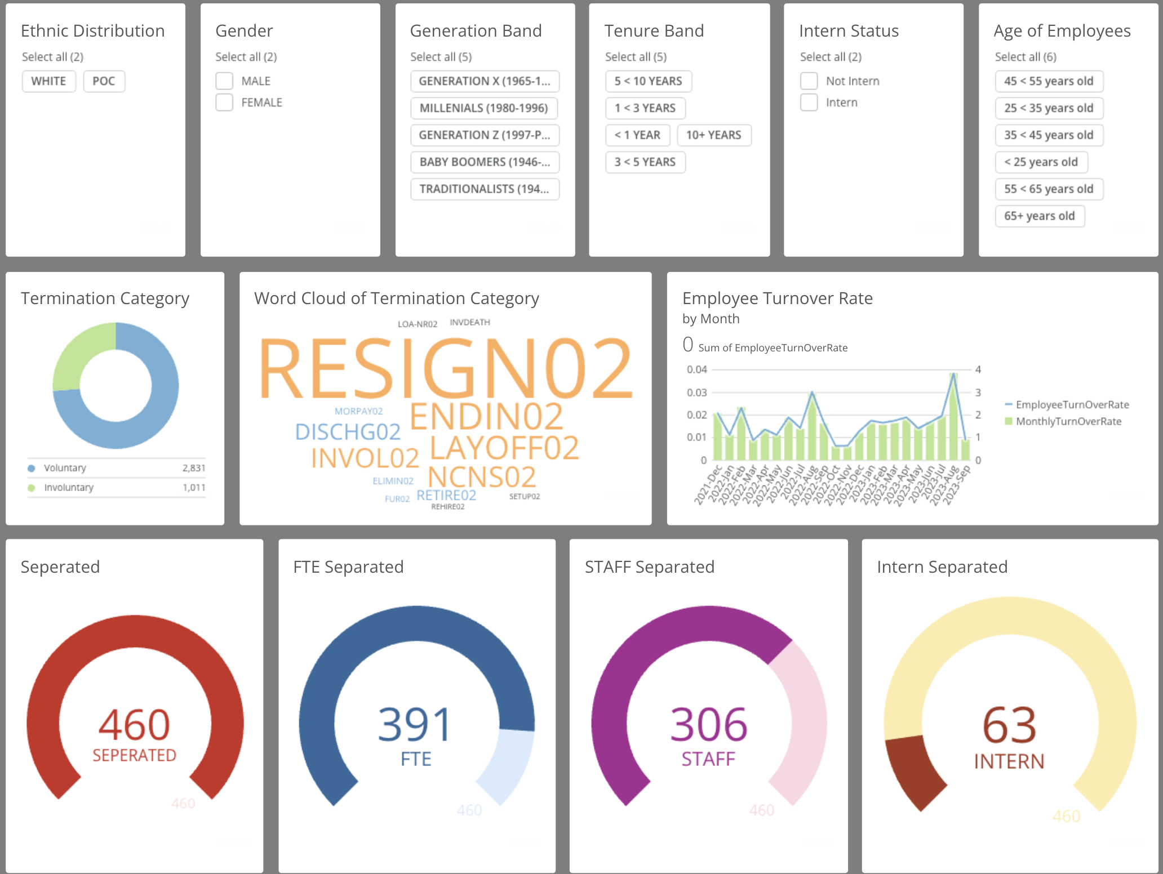

Slide 12
Business Impact and Retention strategies
Address Turnover Peak in August
Targeted Retention Strategies for General Staff and Managers
Gender-Specific Retention Initiatives
Strategies for Age-Specific Groups
Address Voluntary Turnover
Focus on Millennials
Tenure-Based Interventions
Specific Initiatives for Engineers, Project Managers, and Trade & Craft
Tailor Benefits for Different Age Groups
Regularly Monitor and Adjust
By tailoring retention strategies based on the specific demographics and turnover patterns at Layton Construction, the company can address the root causes and create a more targeted and effective approach to retaining its workforce.

Slide 13
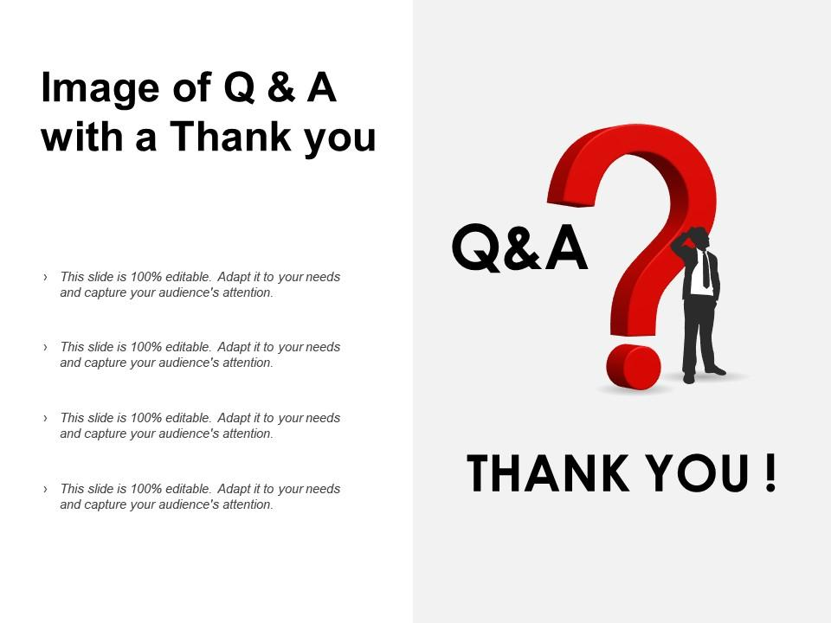
Q&A

