Slide 1




CRUDE OIL Analysis (2020-2025) Source: https://www.data.gov.in/ Dataset: crude oil usage by different oil companies Email: mani777varun@gmail.com Phone : 8317681282 LinkedIn :www.linkedin.com/in/mani-varun-kocherla-55ba5334a
Indian Government Dataset Analysis
MANI VARUN

Slide 2
Introduction
This presentation analyzes crude oil usage trends over the years, focusing on:
- Annual consumption patterns
- Company-wise oil usage distribution
- Regional insights
- Key factors influencing oil consumption

Slide 3
Initial Analysis of the Dataset
Dataset Overview:
* The dataset contains monthly crude oil consumption data.
* It includes oil usage by different companies and regions.
* Data was cleaned to handle missing values.
* The key variables are company names, monthly consumption, and total oil used.

Slide 4
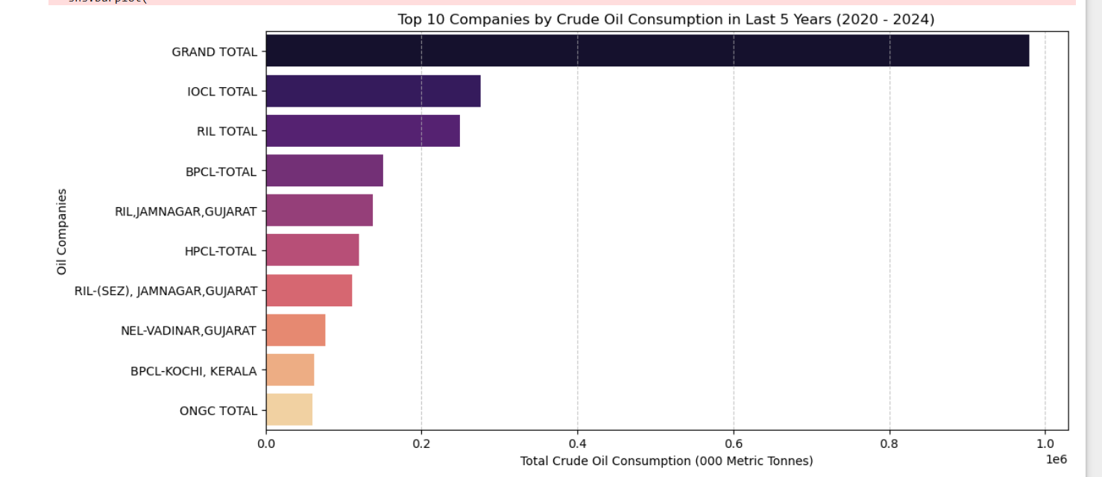
Top 5 Oil Consuming Companies
The above graph represents the top 5 companies consuming more oil

Slide 5
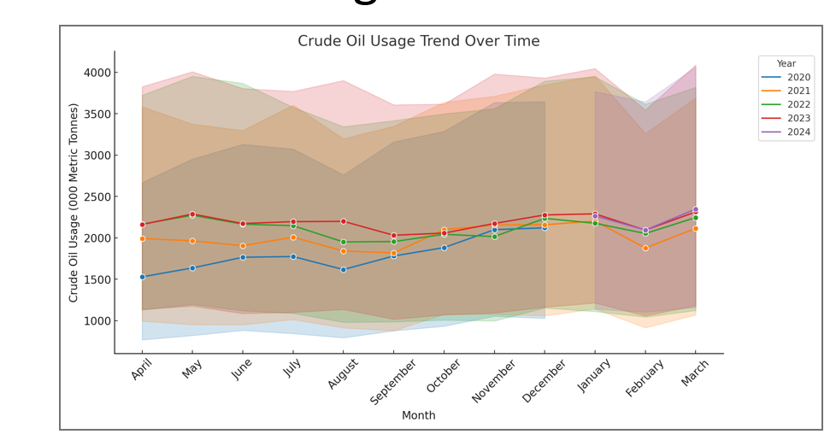
Crude Oil Usage Trend Over Time
The above graph represents the oil usage over time

Slide 6
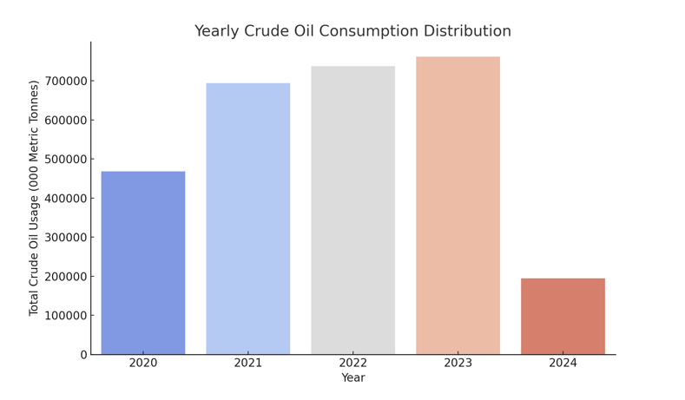
Yearly Crude Oil Consumption Distribution
the bar graph represents Yearly Crude Oil Consumption Distribution

Slide 7
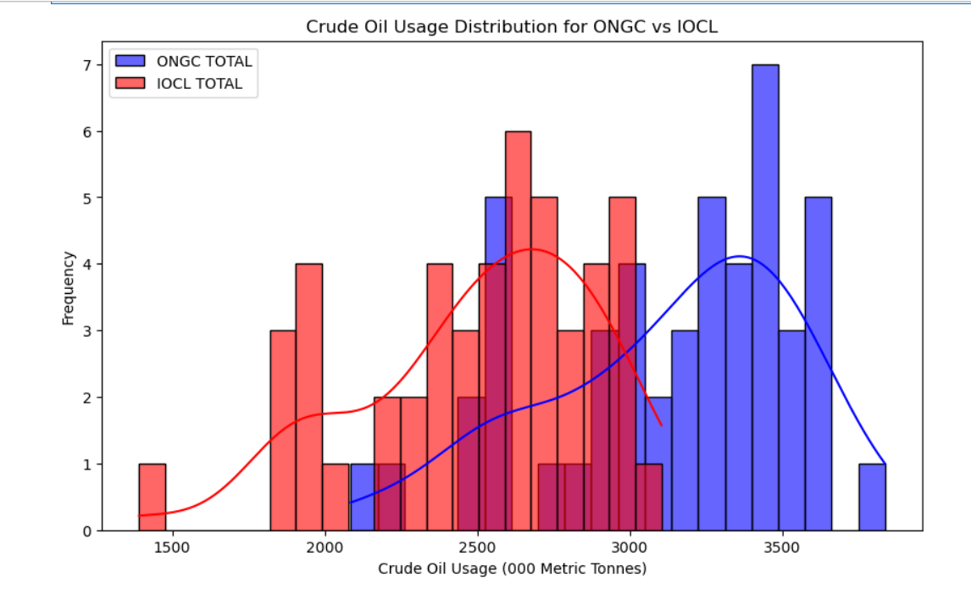
Crude Oil Usage Distribution for ONGC vs IOC
THE ABOVE GRAPH REPRSENTS “Crude Oil Usage Distribution for ONGC vs IOC”

Slide 8
Dataset Observation
Date Range & Missing Data:
The dataset covers crude oil usage from 2020 to 2025.
Some missing values were found in the Quantity (000 Metric Tonnes) column but were handled appropriately.
2. Oil Consumption Trends & Statistics:
The total, minimum, and maximum crude oil consumption fluctuates over time.
Yearly trends show variations, influenced by industrial demand, market conditions, and policy changes.
Monthly trends indicate seasonal fluctuations in oil usage
3. Company-Wise Oil Usage Analysis:
Multiple oil companies are recorded in the dataset.
Some companies have higher crude oil consumption, as seen in the Top 5 Oil Consumers bar chart.Oil
usage distribution varies by company, with IOCL being the highest consumer.

Slide 9
Dataset Observation
4. Regional Oil Usage Patterns:
Gujarat records the highest crude oil usage compared to other states.
The presence of major refineries and industrial hubs contributes to this trend.
Ports in Gujarat facilitate crude oil imports, increasing its consumption share.

Slide 10
Conclusion
Crude oil consumption trends reflect industrial growth and economic conditions.
* IOCL remains the top oil consumer, followed by ONGC and RIL.
* Gujarat leads in oil usage due to its industrial landscape.
* Understanding these trends helps optimize energy policies and resource management.

