Slide 1

G2M Cab Company Investment
Pink Cab vs. Yellow Cab
Virtual Internship
23-Oct-2022

Slide 2
Background –G2M(cab industry) case study
This is an in-depth analysis of business data from two popular cab companies, Pink Cab and Yellow Cab that operate in all major cities of the US. XYZ firm is interested in investing in one of these two companies and the firm is expecting to make a educated investment based on data-analytics and forecasted measures.
Objective : Provide actionable insights to help XYZ firm in identifying the right company for making investment.
The analysis has been divided into four parts:
Data Understanding
Forecasting profit and number of rides for each cab type
Finding the most profitable Cab company
Recommendations for investment

Slide 3
Data Exploration
24 Features( including 9 derived features)
Timeframe of the data: 2016-01-31 to 2018-12-31
Total data points :355,032
Assumptions:
Outliers are present in Price_Charged feature but due to
unavailability of trip duration details ,we are not treating this as outlier.
Profit of rides are calculated keeping other factors constant and only
Price_Charged and Cost_of_Trip features used to calculate profit.
Users feature of city dataset is treated as number of cab users in the city.
we have assumed that this can be other cab users as well(including Yellow and
Pink cab)
Cab_Data.csv
Customer_ID.csv
Transaction_ID.csv
City.csv
USholiday.csv
Final cab data

Slide 4
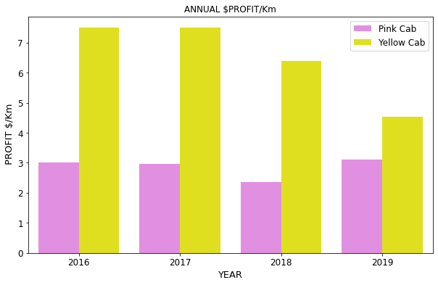
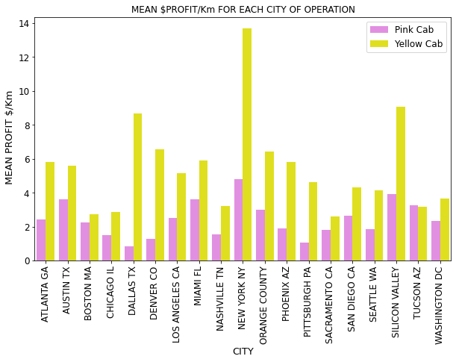
Profit Analysis
Profit Analysis For Each Company
Mean profit/Km is significantly higher for Yellow Cab but a slight downward trend is evident. In contrast Pink Cab’s
Profit/Km is steady since 2016. Yellow Cab’s profit/Km is also high for all cities except for Tuscon AZ

Slide 5
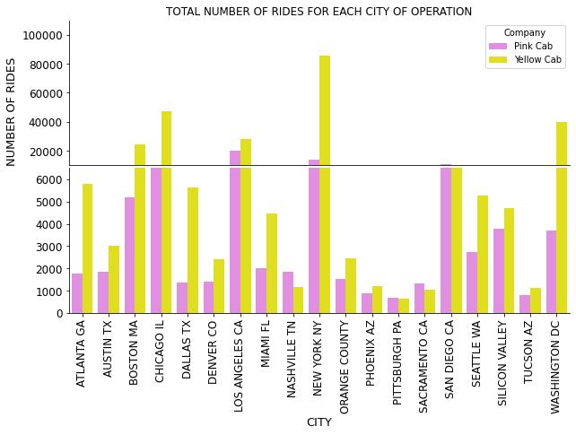
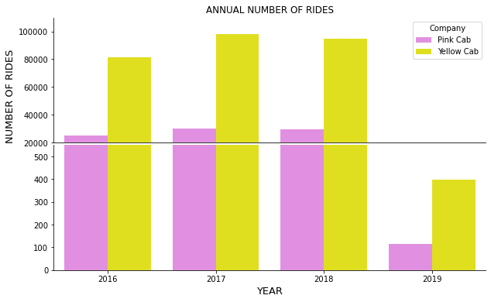
Profit Analysis
Number of Rides For Each Company
The total number of rides handled by Yellow Cab is significantly higher. Data for 2019 is plotted on different
Scale since year total data is incomplete. With the exception of a few cities, Yellow Cab also garners more rides.

Slide 6
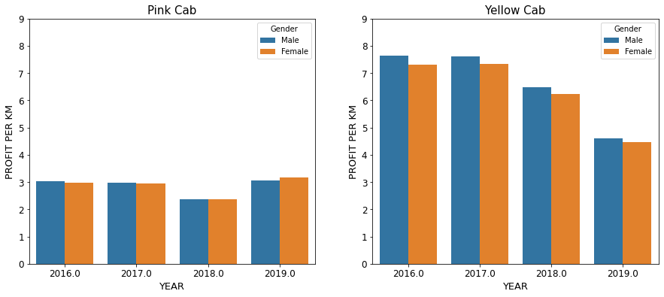
Profit Analysis
Customer Gender Analysis For Each Company:
Company Profit/Km
There is no effect of gender on the profit/km for either company.

Slide 7
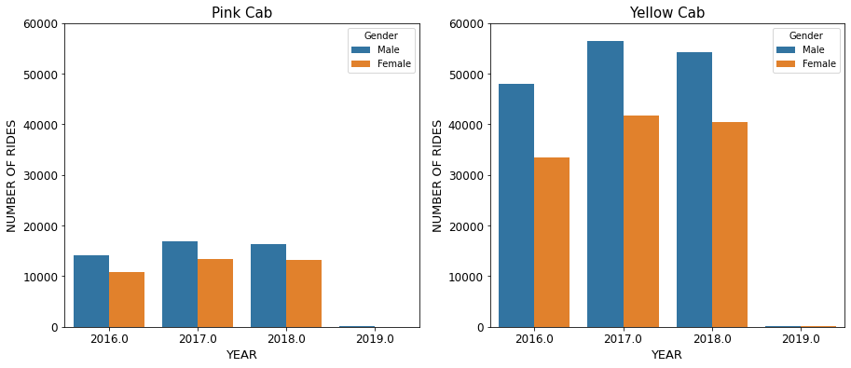
Profit Analysis
Customer Gender Analysis For Each Company:
Total Number of Customers of Each Gender
Both companies have more male customers than female customers. This difference appears to be greater for Yellow Cab.

Slide 8
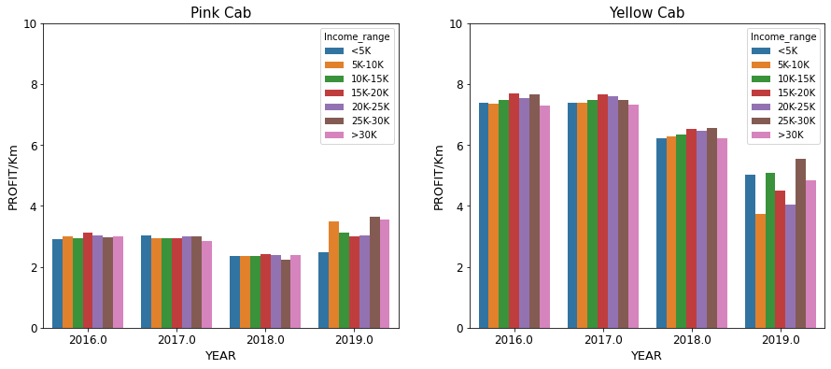
Profit Analysis
Customer Income Analysis For Each Company:
Profit/Km from Different Income Ranges
As seen before, profit/km is higher for Yellow Cab but the profit remains the same irrespective of the income range of the customer

Slide 9
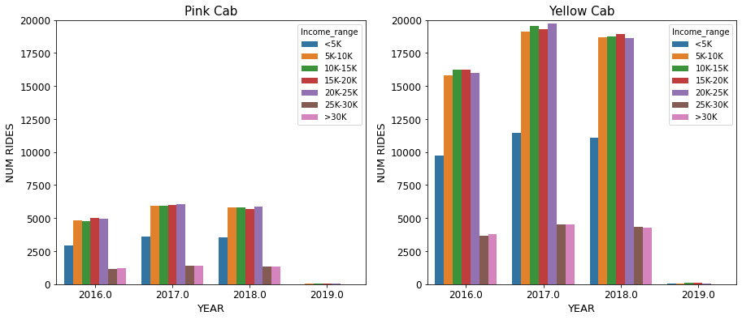
Profit Analysis
Customer Income Analysis For Each Company:
Number of Customers from Different Income Ranges
Customers making less than $5000/mo are less likely to use services of either company compared to those making between $5000 and 25000/mo. Those making over 25000/mo are the least likely customers for either cab company.

Slide 10
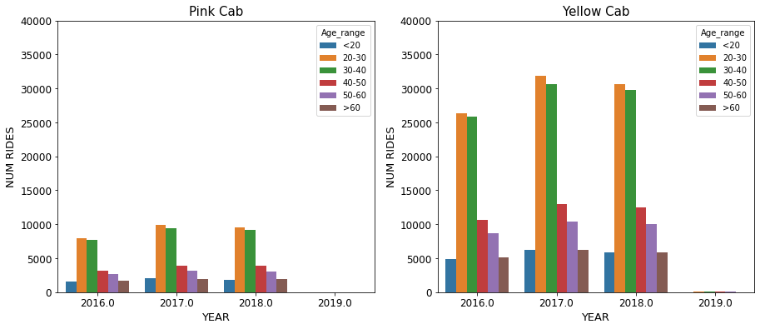
Profit Analysis
Customer Age Analysis For Each Company:
Number of Customers from Different Age Groups
Customers aged 20 to 40 years are more likely to take a cab than any other age groups.

Slide 11
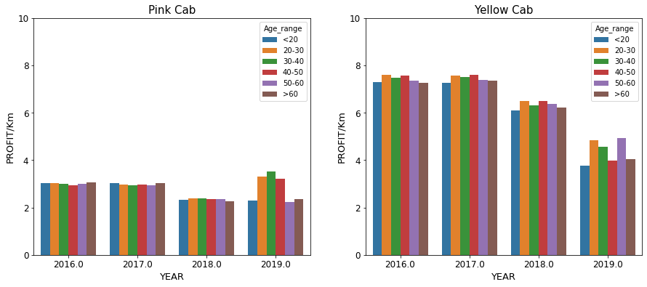
Profit Analysis
Customer Age Analysis For Each Company:
Profit/km from Customers of Different Age Groups
Customer age has no impact on the profit/km for either cab company

Slide 12
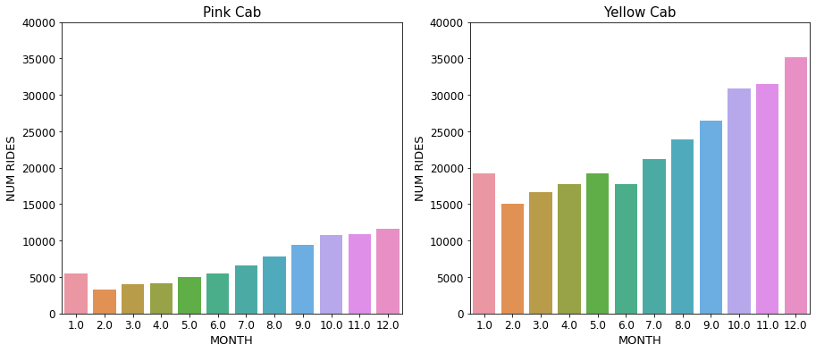
Profit Analysis
Cab Use Shows Seasonality Throughout the Year
The number of rides for each month gradually increases throughout the year and maximizes in December, likely due to the demand during the holidays. The demand dramatically drops in January of each year.

Slide 13
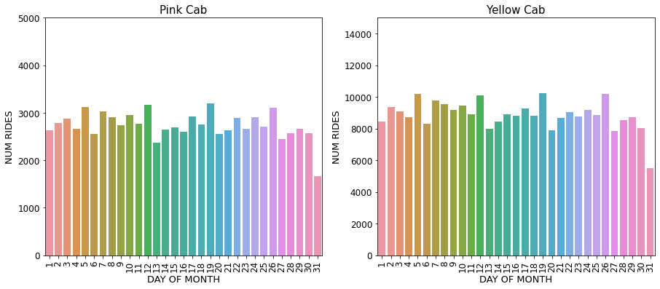
Profit Analysis
Cab Use Shows Seasonality Throughout Each Month
The number of rides for each month show spikes each 7 days (on 5th, 12th, 19th and 26th) for both companies

Slide 14
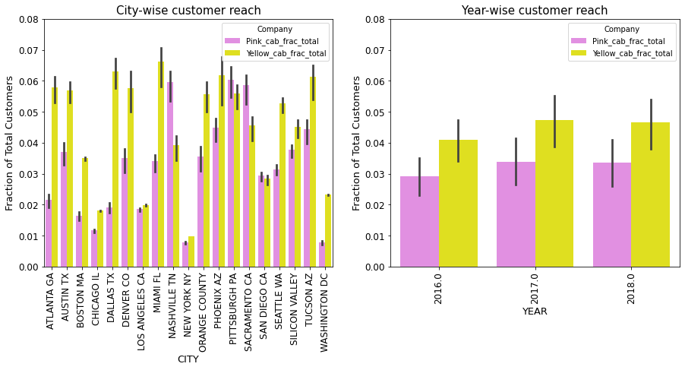
City Users Covered By Company: City-wise or Annually
Yellow Cab has a wider customer reach in all cities except Pittsburgh PA, San Diego CA and Sacramento CA where Pink Cab has an upper hand. Looking at the data annually, Yellow Cab again commands more customers than Pink Cab for the years 2016 to 2018.

Slide 15
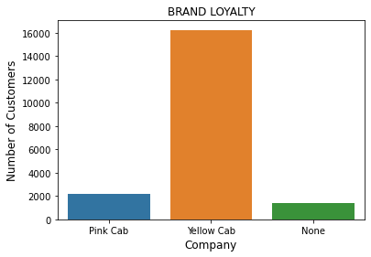
Brand Loyalty
Out of more than 19,000 customers analyzed for brand-loyalty, about 85% of the customers prefer Yellow Cab.

Slide 16
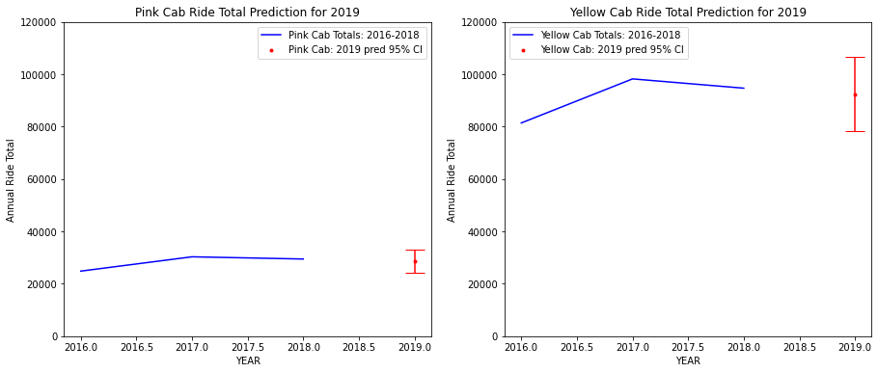
Ride Forecasting for 2019
Both companies are predicted to have fewer rides for the whole of 2019, -2.8% and -2.5% for Pink and Yellow Cab respectively. However, the actual gain/loss within the 95% confidence interval are +12% and -18% for Pink Cab and +11% and -17% for Yellow Cab.

Slide 17
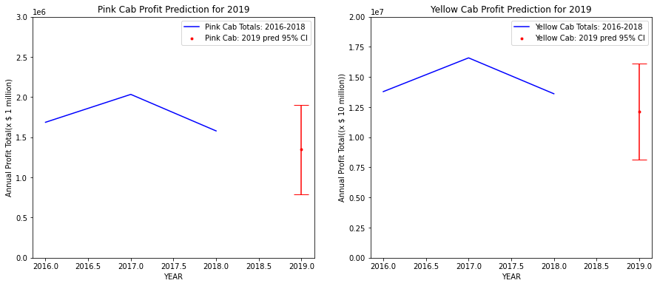
Ride Forecasting for 2019
Both companies are predicted to have smaller profit for 2019, -15% and -11% for Pink and Yellow Cab respectively. However, the actual gain/loss within the 95% confidence interval are +20% and -50% for Pink Cab and +19% and -40% for Yellow Cab.

Slide 18
Analysis
On the basis of various analytical and forecasting approaches, we make the following key findings:
Average Profit per KM: Yellow cab’s average profit per KM is several times higher than that of Pink cab. With the exception of Tucson Az, Yellow Cab’s profit/km is higher is all the cities both companies service.
Customer Reach : With the exception of Nashville TN, Pittsburgh PA, Sacramento CA and, San Diego CA, Yellow Cab commands more passengers in the cities it services compared to Pink Cab.
Customer Loyalty: About 85% of the customers are loyal to Yellow Cab compared to only about 11% for Pink Cab.
Age wise Reach : There is no difference between the two companies when it comes to age of the customer. Customers aged 20-40 years are more likely to take a cab ride compared to other age groups. But as seen before, the number of rides for are much higher with Yellow Cab, and this applies to all age groups.

Slide 19
Analysis Cont. and Recommendation
On the basis of various analytical and forecasting approaches, we make the following key findings:
Income wise Reach : Monthly income between $5K and $25K are more likely to take a cab than higher or lower incomes. This trend is present in both companies though Yellow Cab appears to get business from more of the customers of this income range.
Gender analysis: A greater proportion of customers of both companies are male. However, this proportion appears to be wider with Yellow Cab
Ride count and Profit Forecasting : Both the companies are facing loss in the profit and number of of rides. Yellow cab’s forecasted profit loss is around 11% while Pink cab’s loss is 15% despite the fact that their loss of rides are more or less similar (-2.8% and -2.5%).
Given these analytical insights, especially profit/Km and customer loyalty, we recommend Yellow Cab for future investment.

Slide 20
Thank You

