Slide 1
CAPSTONE PROJECT Data analysis using tableau
Mentor name : Shruti Gode
Student name : Manju Thomas

Slide 2
INTRODUCTION
Examining Consumer Conduct and Churn Trends in the Banking Industry
Understanding consumer behavior and spotting possible churn patterns are essential in today's cutthroat banking market to keep a steady stream of devoted clients.
The goal of this interactive dashboard is to offer thorough insights into the main variables affecting customer attrition, as well as transaction patterns, demographic trends, and the connections between different customer attributes.
We hope to provide light on important trends and correlations that can help with strategic decision-making and the creation of successful retention strategies by carefully examining the dataset that has been provided.
This dashboard is a useful resource for banking professionals looking to maximize customer experience by looking at different aspects of customer data, including gender distribution, income categories, card usage patterns, and interactions with the banking services.

Slide 3
OBJECTIVES
A bank in North America wants to perform customer churn analysis, as the credit card business of the bank is not performing well. Churn analysis will help the bank evaluate the customers who have stopped purchasing the credit card of the bank and figure out measures to reduce the bank's customer loss rate

Slide 4
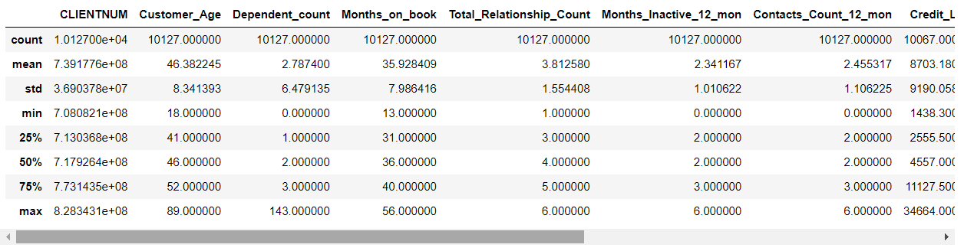
SUMMARY STATISTICS OF THE DATASET
INTERPRETATION:
The count, mean, standard deviation, minimum, maximum, and different quartiles are only a few of the numerical columns in the dataset that are fully summarized by the describe() method.
Count: The amount of non-null values for every column is shown here. It may indicate missing data or possible problems with the quality of the data if any columns have much lower counts.
Mean: Each numerical column's mean value provides an indication of the data's central tendency. As an illustration, the dataset's average value may be found in the mean of a particular attribute. Measure of the data's dispersion or spread is the standard deviation.
Standard Deviation: The data's dispersion or spread is measured by the standard deviation. Higher variability is indicated by a high standard deviation, which implies that the data points are dispersed over a larger range.
Minimum and Maximum Values: These denote the lowest and maximum values, respectively, in each numerical column. It's critical to comprehend these numbers in order to determine the distribution range of the data.
Quartiles (25%, 50%, 75%); they are the percentages that show which data points split the dataset into four equal sections. The intermediate value is represented by the 50% quartile (median), and the first and third quartiles are represented by the 25% and 75% quartiles, respectively. These quartiles shed light on the distribution and spread of the data.

Slide 5
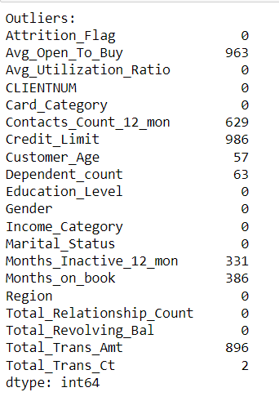
OUTLIERS IN THE DATASET
INTERPRETATION:
It calculates the first quartile (Q1) and the third quartile (Q3) of the data, which represent the 25th and 75th percentiles, respectively, dividing the data into quarters.
It computes the interquartile range (IQR) by finding the difference between Q3 and Q1. The IQR measures the spread of the middle 50% of the data.
It identifies outliers by checking each data point in the Data Frame to see if it is less than Q1 - 1.5 * IQR or greater than Q3 + 1.5 * IQR. Any data point falling outside this range is considered an outlier.
Finally, it prints the count of outliers to the console, labeled as "Outliers."

Slide 6
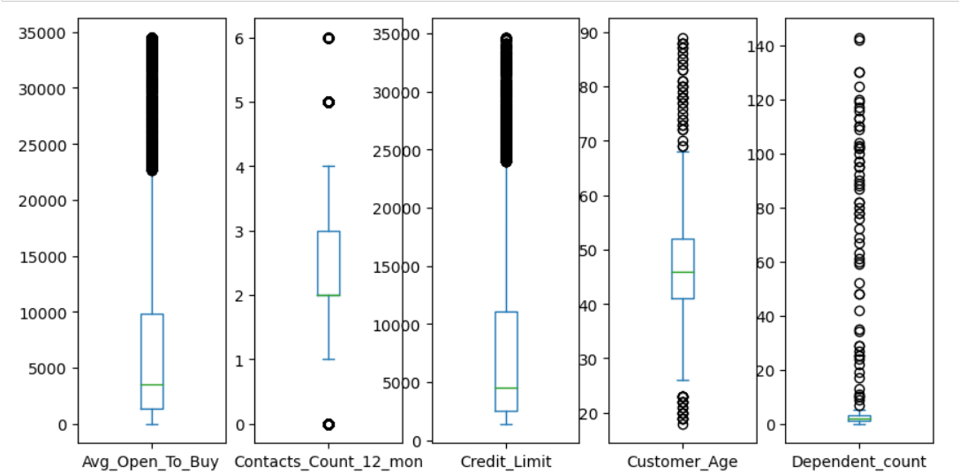
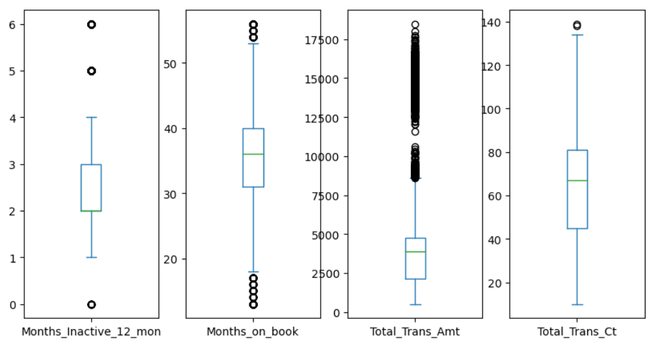
Visualizing the outliers with box plot
INTERPRETATION
1.Box plots provide a quick overview of the central tendency and spread of the data, as well as the presence of outliers.
2.They are a useful tool for initial data exploration.
3.To further analyze ,the outliers and their impact on your analysis, you may want to investigate these data points in more detail and consider whether they should be treated or removed, depending on the context of your analysis.

Slide 7
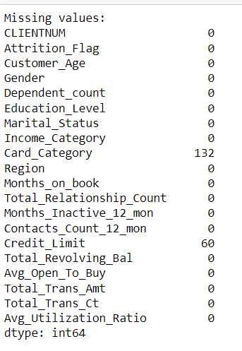
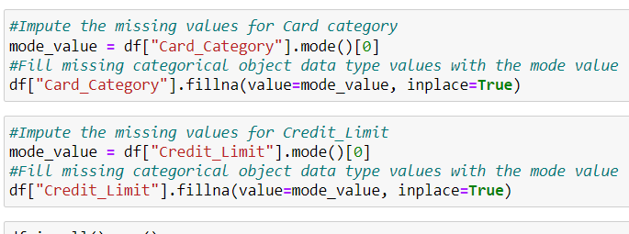
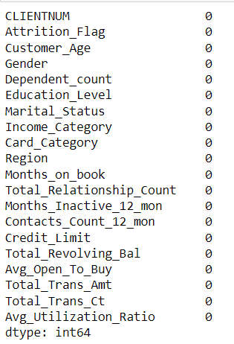
IDENTIFYING AND IMPUTING THE MISSING VALUES
INTERPRETATION:
The code help to identify and report which columns in the Data Frame have missing data and how many missing values each of those columns contains.
This information is valuable for data cleaning and further analysis, to decide how to handle missing data, whether by imputing values, removing rows, or taking other appropriate actions based on my analysis goals.
The "Card category“, ”Credit limit” column is categorical ,can impute the missing values with the mode (most frequent category) since this is a common strategy for categorical data.

Slide 8
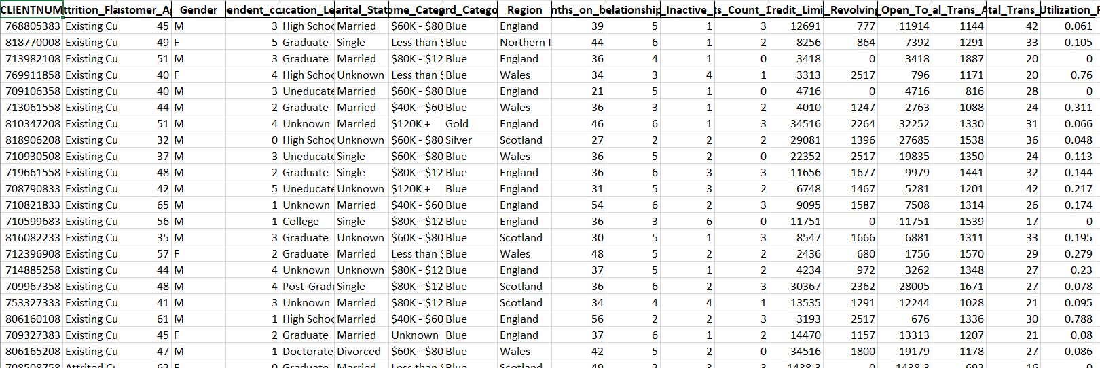
CLEANED DATA
INTERPRETATION
In summary, this code is taking a pandas Data Frame “df” and saving its data into an Excel file named "Tableau_Capstone.xlsx" while omitting the index column.
This is useful for exporting Data Frame data to Excel for further analysis, reporting, or sharing with others in a tabular format.

Slide 9
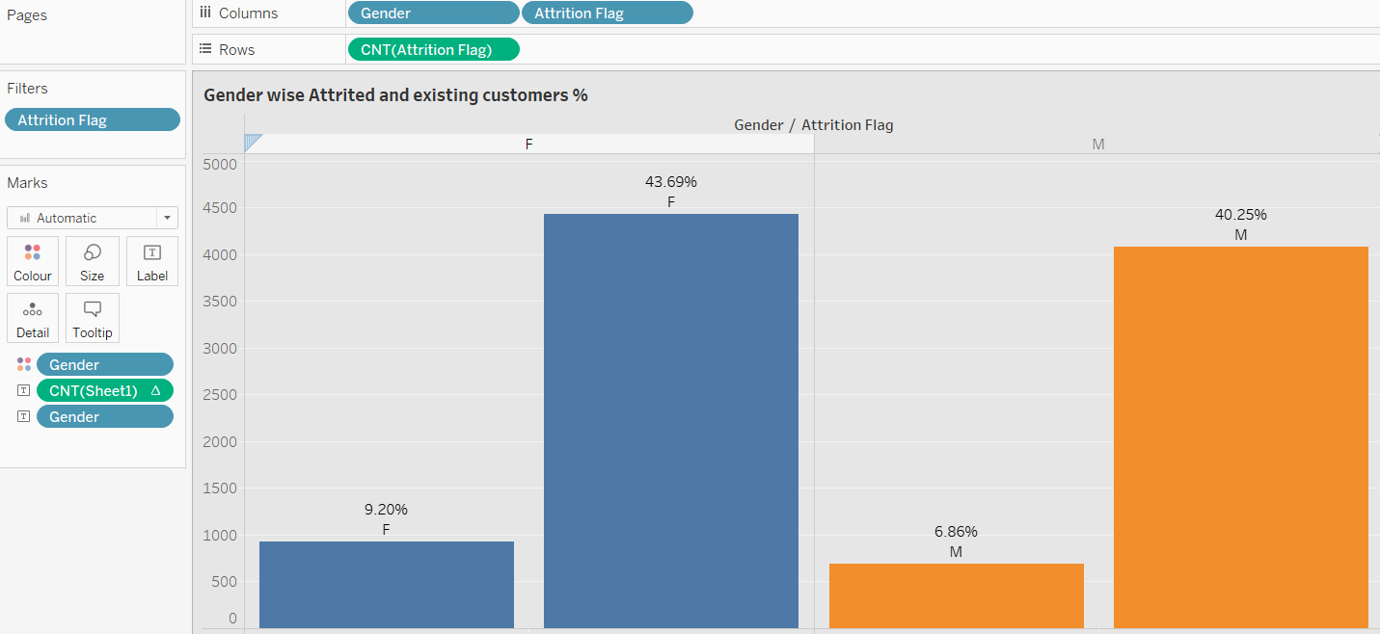
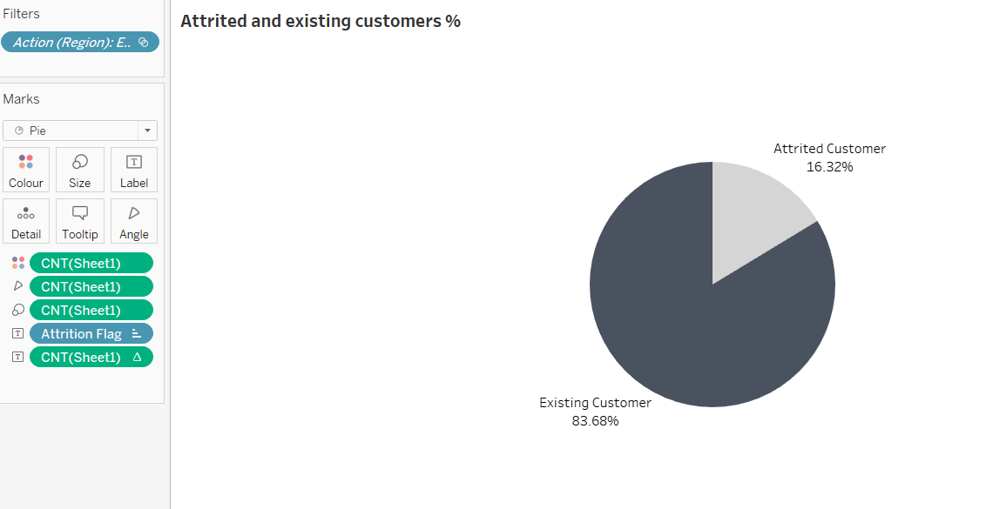
DATA ANALYSIS USING TABLEAU

Slide 10
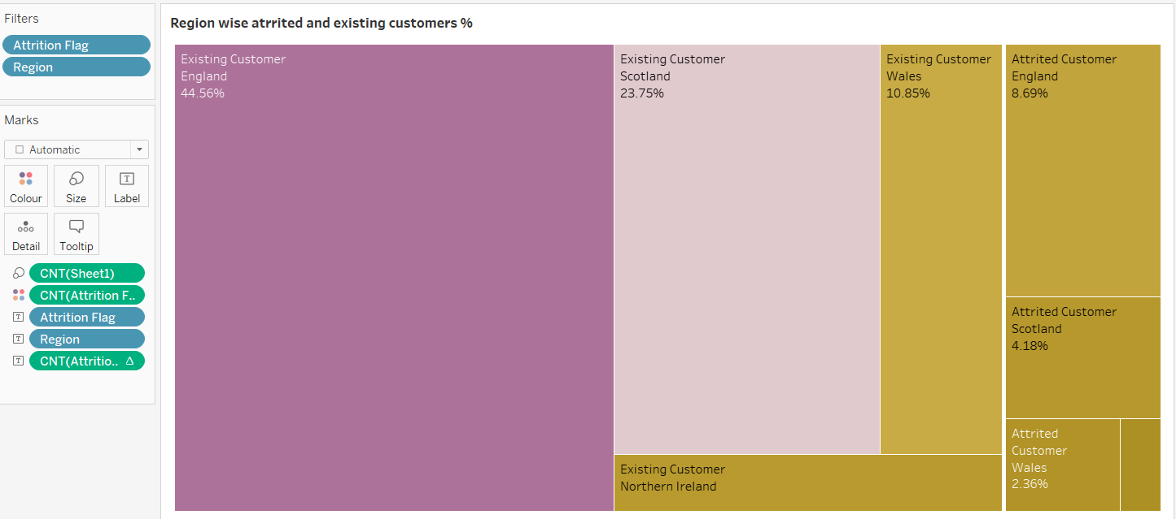
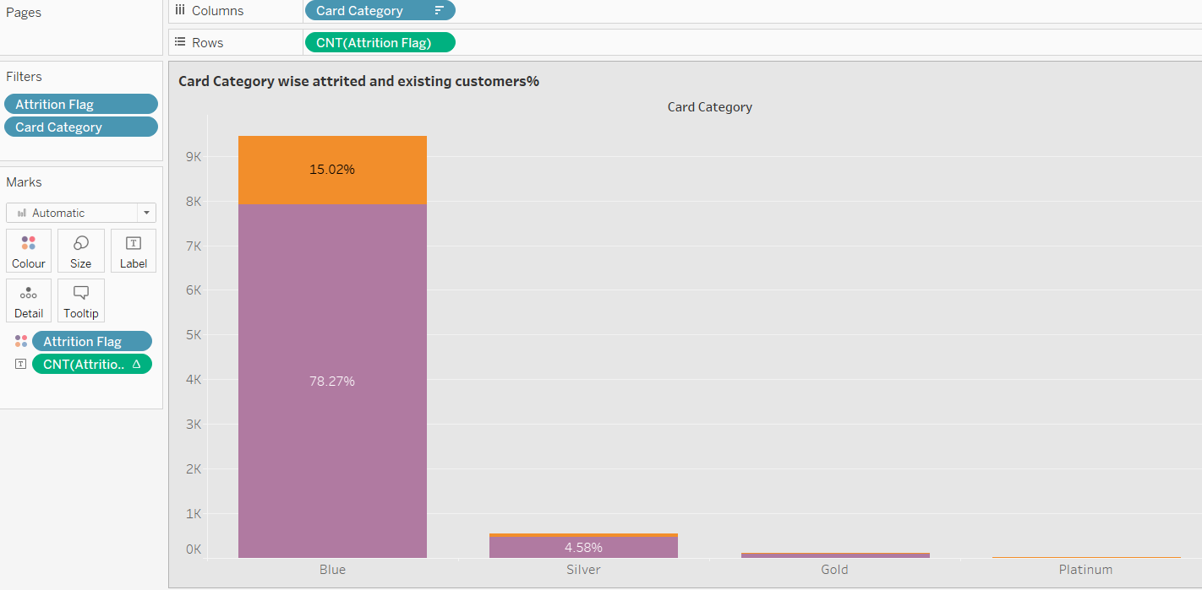

Slide 11
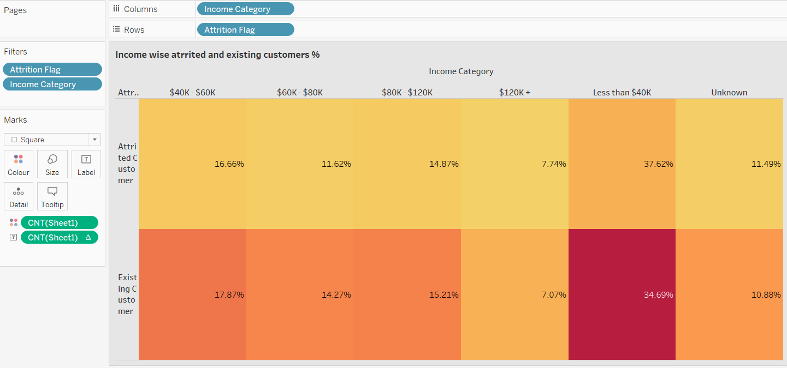
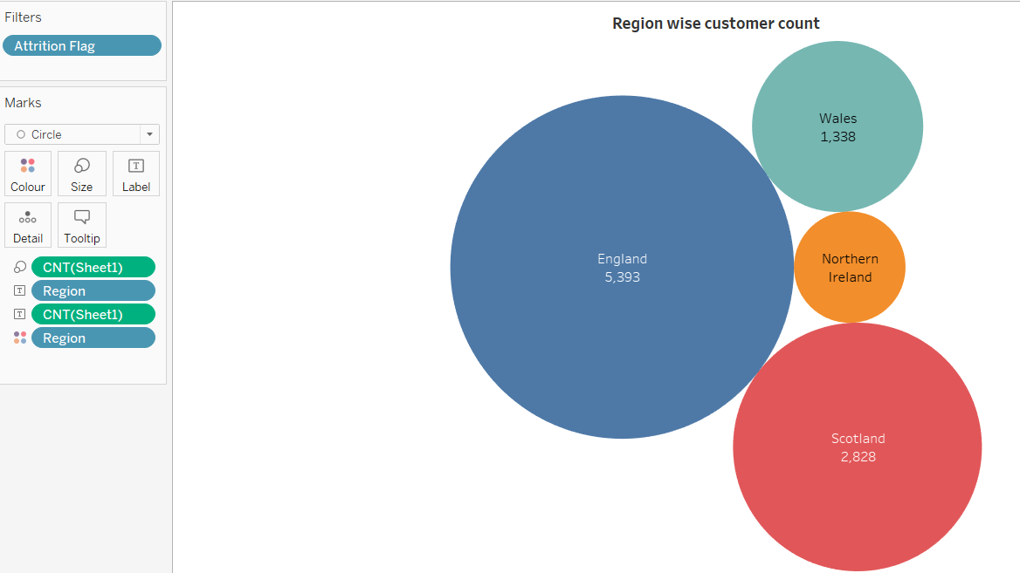
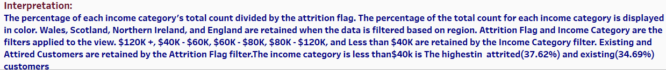

Slide 12
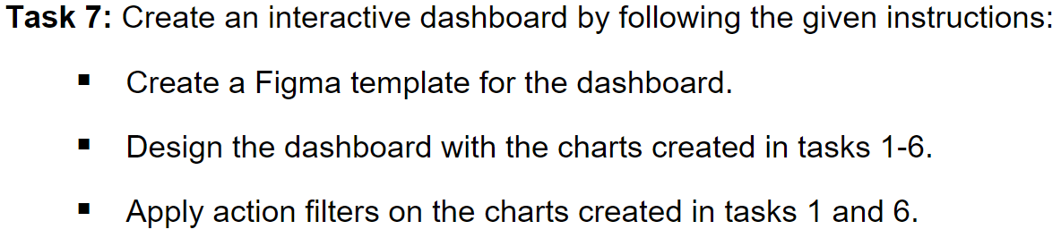
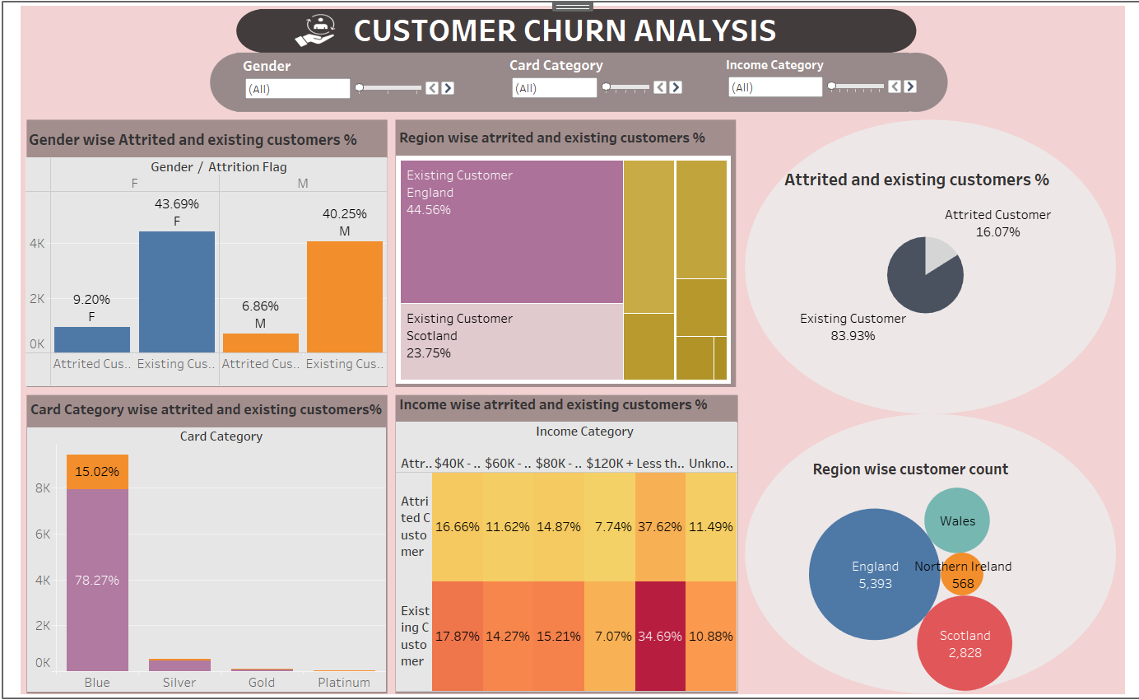

Slide 13
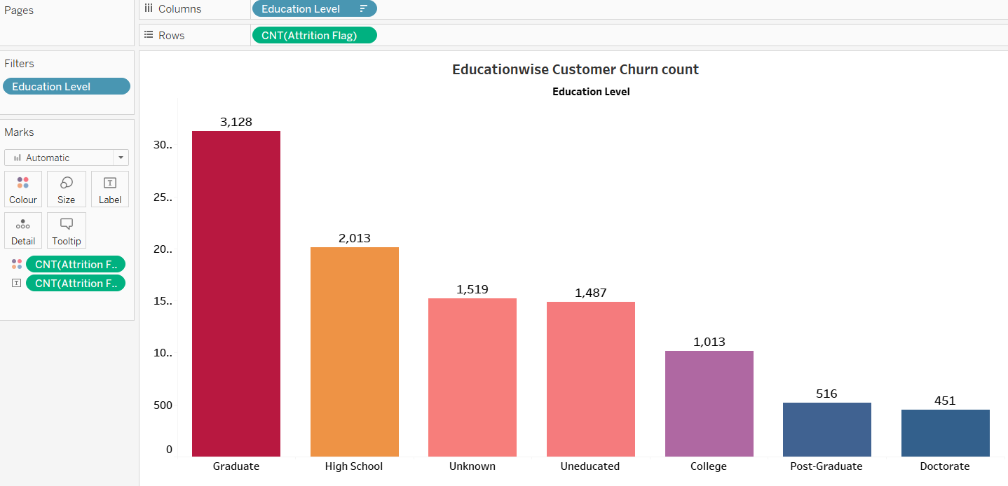
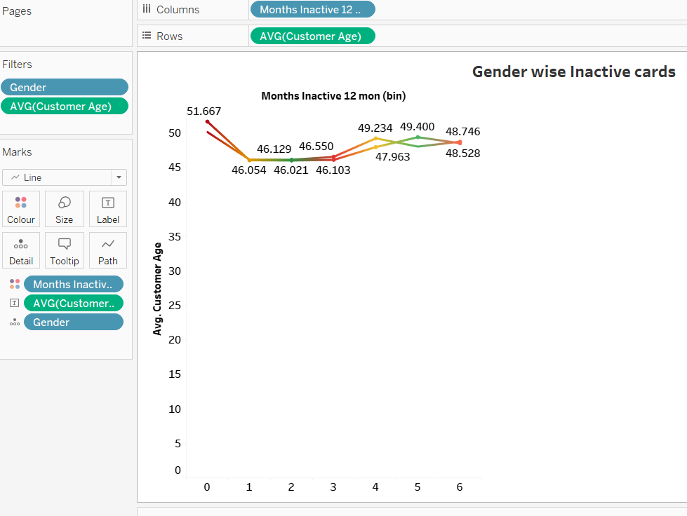

Slide 14
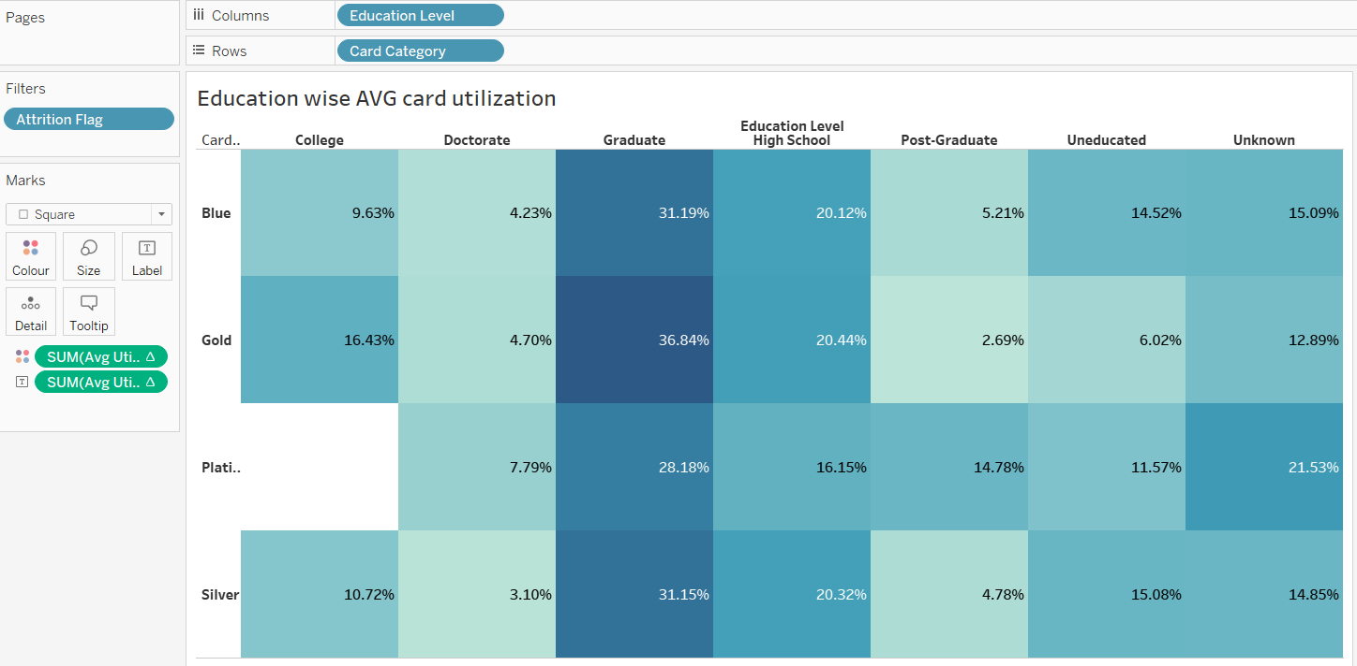
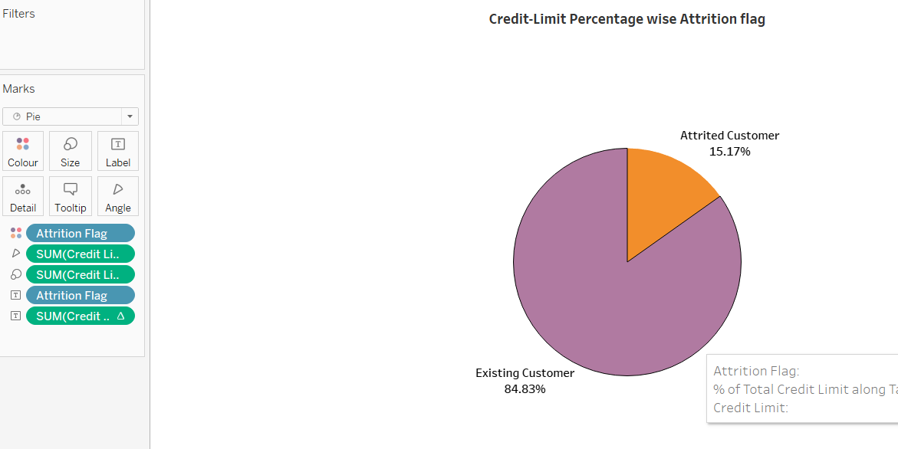

Slide 15
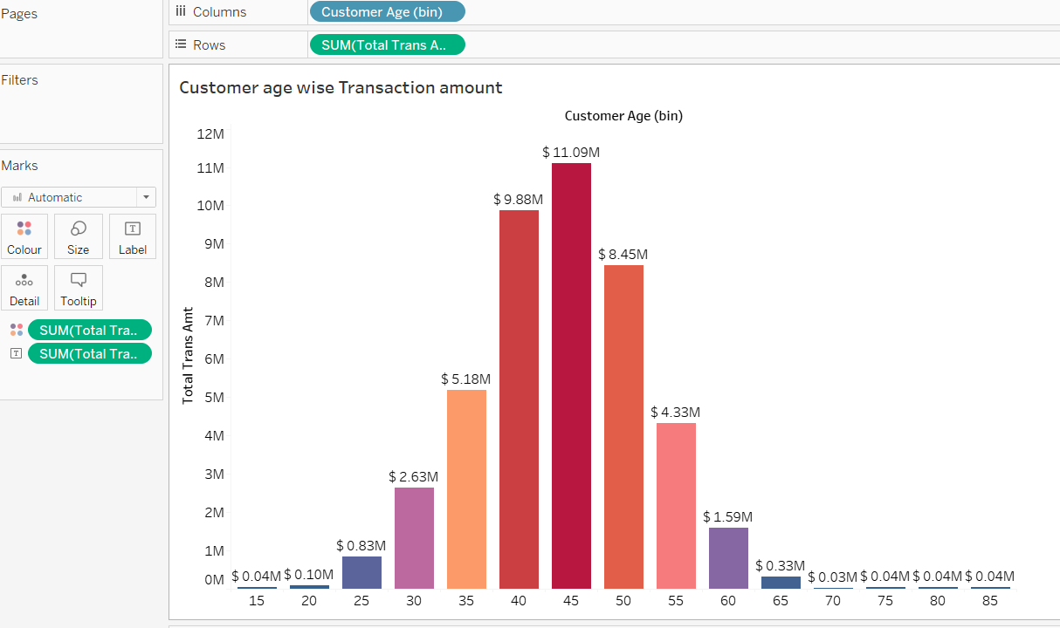
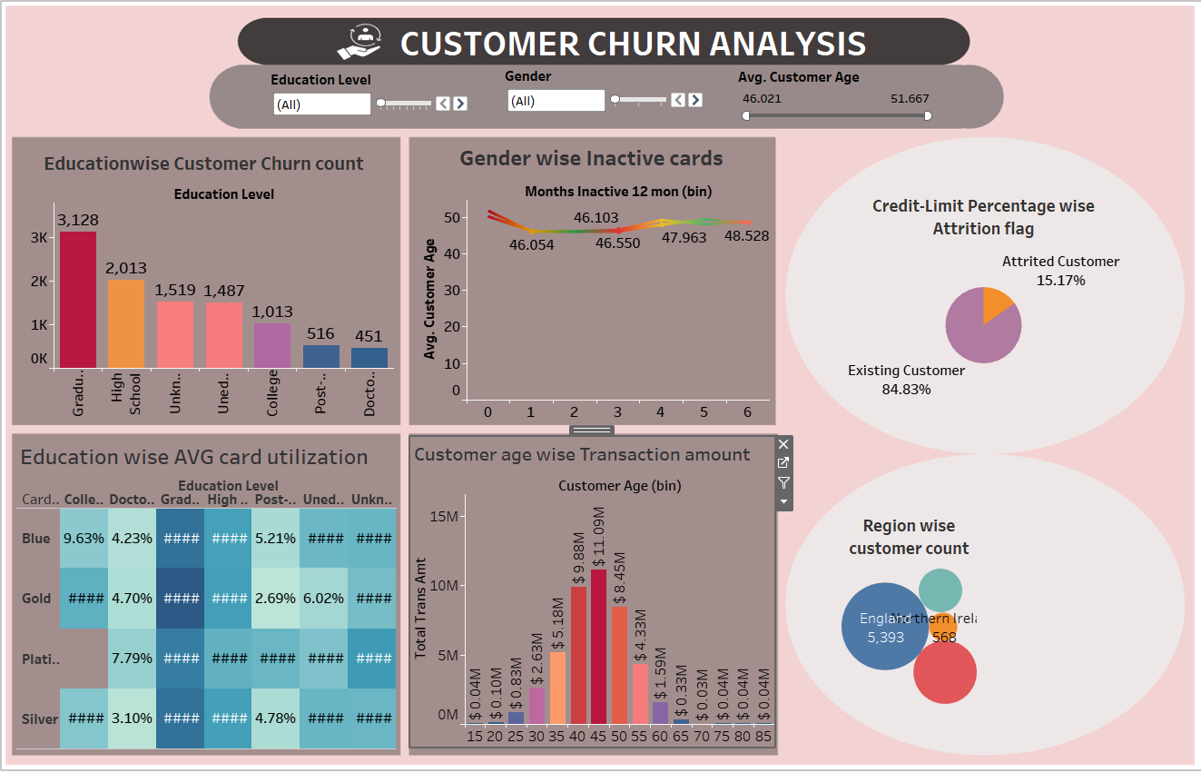

Slide 16
INTERPRETATION
We observe that attrited customer is 16.07% And Existing customer is 83.93%
The analysis shows that the existing customer has 40.25% male and 43.69% female, while the attired customer has 9.20% female and 6.86% male.
The card category Blue is the highest with attrited(15.02%) and existing(78.27%) customers.
The income category is less than$40k is the highest in in attrited(37.62%) and existing(34.69%) customers .
The highest customers are from England(5393) and lowest from Northern Ireland(568).
Graduates are the highest among the attired and existing customers with count 3,128.meanwhile Doctorate are the lowest among the customer churn.
we cannot see any prominent difference of the usage of credit with male and female, but age range 46-52 is having less than one month inactive card. Others are include 2-6 months inactivity of their card, we can say that attrited customers may include in this category.
Graduates customers are using all types of cards. GOLD card is the most using card among graduates. Platinum the least using card.
Observe that Existing customer have the highest credit limit with 84.80% and attrited customer have 15.20% credit limit.
Observe that Customer's age in between 40 and 45 had the most transactions around $20.97M and Customer's age in between 30-60 have considerable transaction amount. Others have very least amount.

Slide 17
CONCLUSION
Ongoing Process: Customer churn data analysis is not a one-time effort. It should be conducted regularly to stay informed about changes in your customer base and market conditions.
Evaluate Customer Health: Regular evaluation of churn rates and trends is crucial to understanding the overall health of your customer base.
Identify Reasons for Churn: Identifying the root causes of customer churn is essential. This involves a deeper analysis of customer feedback, behavior, and interactions to pinpoint areas of concern.
Proactive Measures: Once you've identified the causes of churn, it's important to take proactive measures to retain customers. This may involve improving customer service, addressing pricing concerns, or introducing loyalty programs.
Positive Outcomes: Successful churn analysis can result in improved customer retention, increased revenue, and a better understanding of customer preferences and behavior.

Slide 18
THANK YOU

