Slide 1
Boosting Operational Efficiency in Hospitality
Mentor name: Lopamudra Bera
Student name: Manju Thomas

Slide 2
Objectives
The objective of the project is to analyse a hotel dataset to optimize various aspects of
operations, boost revenue streams, and create a more efficient and satisfying experience for
guests.
Extract actionable insights from the provided data, focusing on key areas such as booking
patterns, customer behavioural segmentation, operational efficiency, and more.
The hospitality industry is a dynamic and data-driven sector, where hotel data analysis plays a
crucial role in understanding guest behaviour, optimizing operations, and boosting revenue.
Hotels can gain valuable insights into booking patterns, booking cancellation analysis,
customer behavioural segmentation, revenue management, operational efficiency, Loyalty
Programs and Repeat Business, Customer Satisfaction, Marketing and Sales Optimization by
analysing vast amounts of given data.

Slide 3
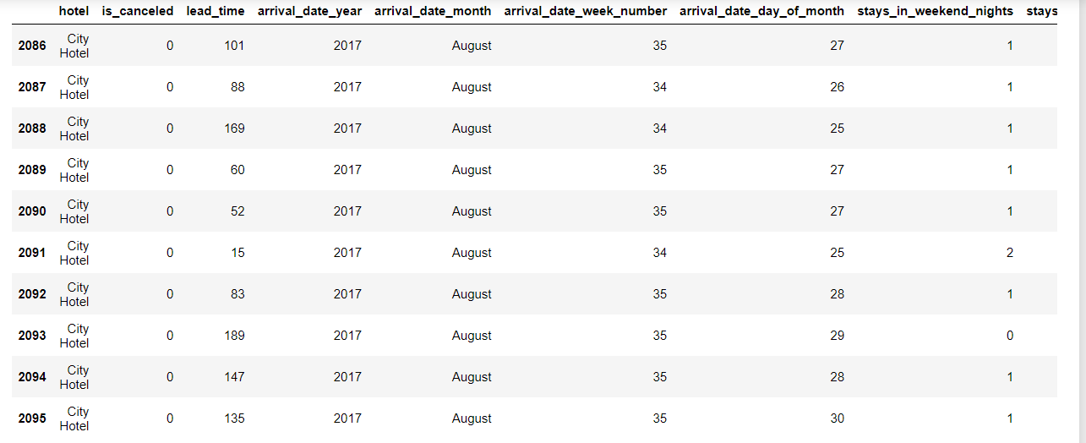

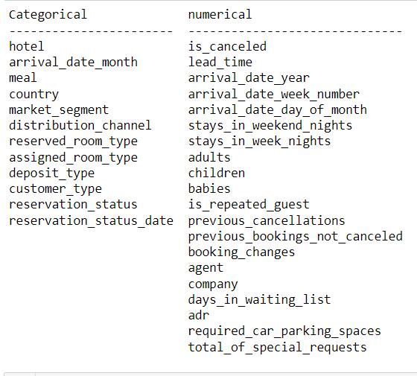
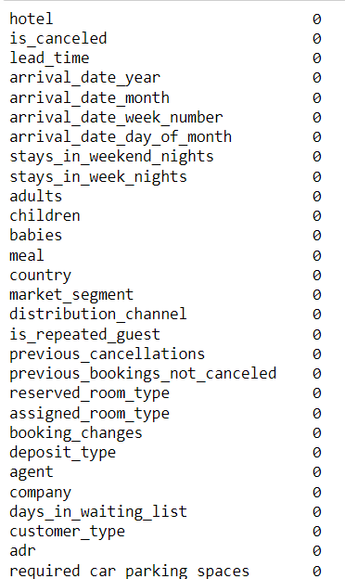
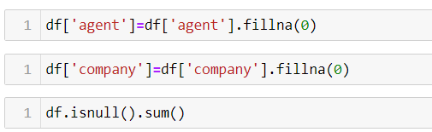
Part 1 Data Cleaning

Slide 4
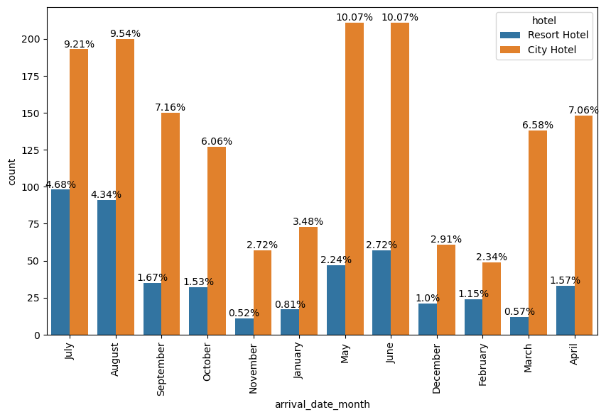
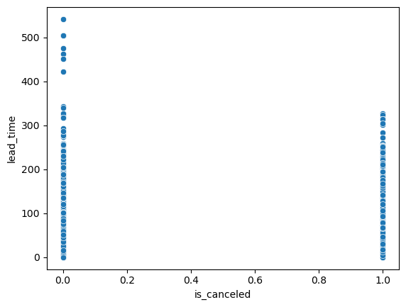
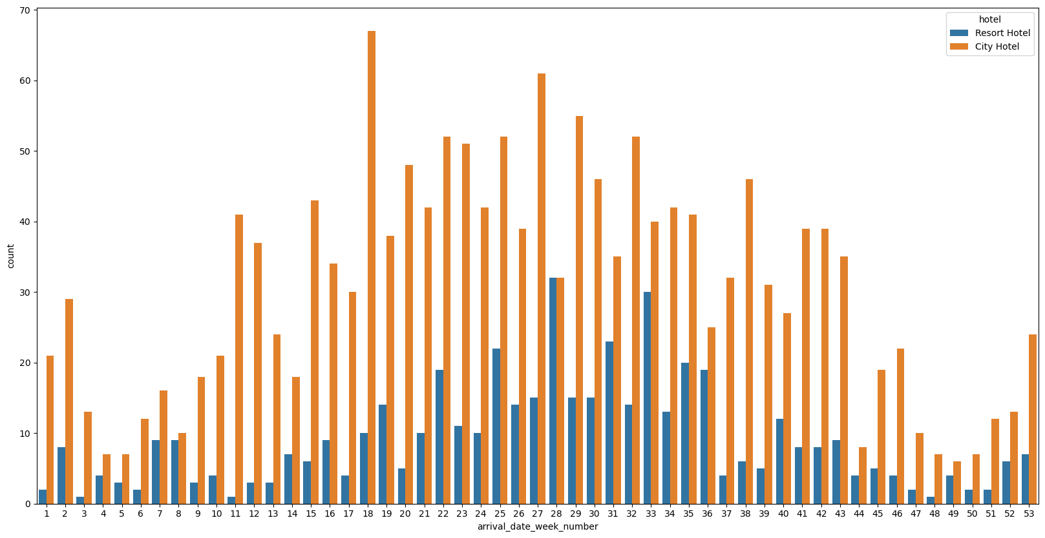
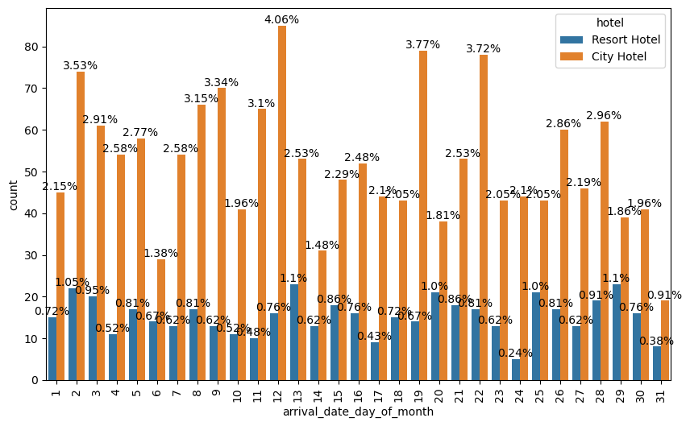
Booking Pattern Analysis
• What are the peak booking periods for the hotel?
• Is there a relationship between lead time and the likelihood of a booking being cancelled?
• How do booking patterns vary by month, week, and day of the week?
Interpretation:
Above graph says no considerable relation between cancelation and lead time. Customers who didn't cancel the booking with more than one year lead time.
But for customers who canceled their booking has not more than 340 days.
we can consider
months: may-Auguest are peak time for booking and january-March,November-December are off season period
days:Only in month end there ia a slight change in bookings.
Week :More booking are from 11-43 weeks.

Slide 5
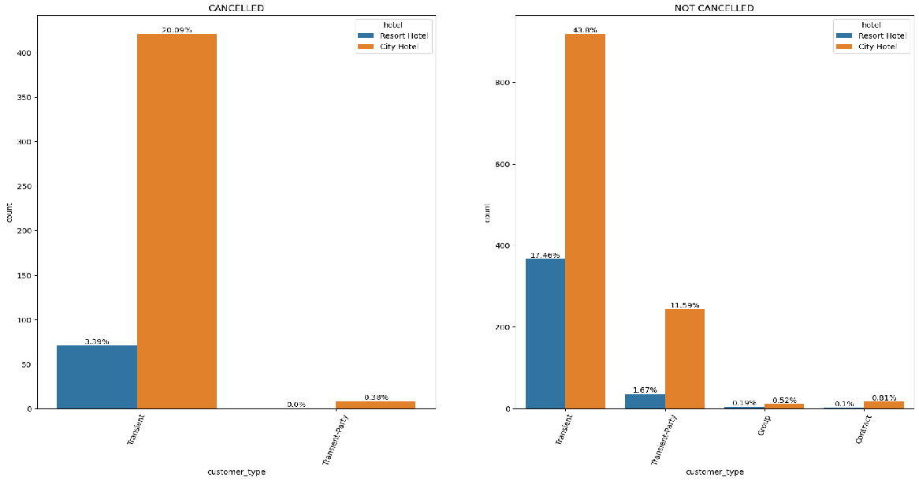
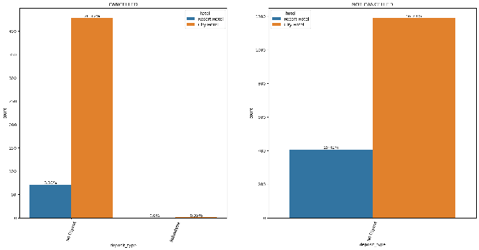
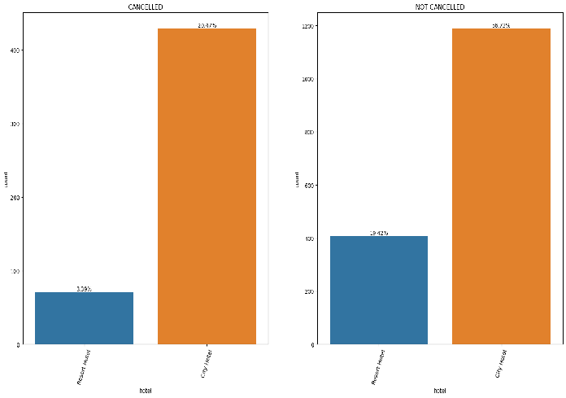
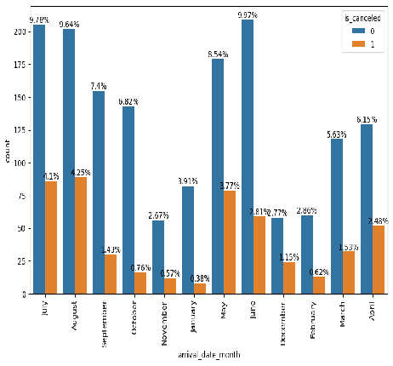
Booking Cancellation Analysis
• What factors influence booking cancellations?
• Are there specific trends or patterns in cancellations over time?
• Can we identify high-risk bookings that are more likely to be cancelled?
Interpretation:
Here market segment online TA have more cancelled bookings, but direct and offline have less number of cancelled booking with hotels.
Distribution channels, A/TO has more cancelled bookings. Direct and GDS have less numbers of cancelation.
​Transients type of bookings are cancelled more. But in groups and contract has no cancelations.
Observe no deposit for cancelled bookings. Refundable are negligible.
Cancelled bookings are more in City hotel with 20.47% and in resort hotel 3.39%.
More cancelation can be observed from April- August.
Observe more cancelation from week 15-35.
Observe no significant changes in cancelation in daily wise.

Slide 6
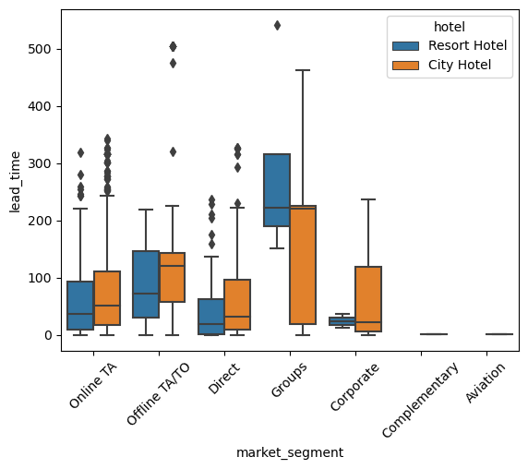
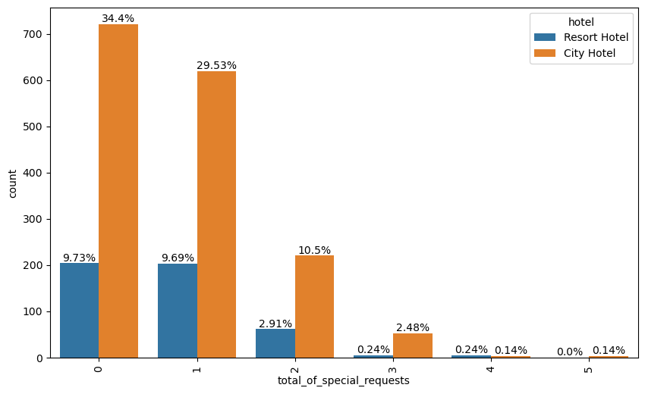
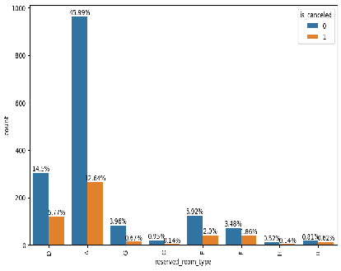
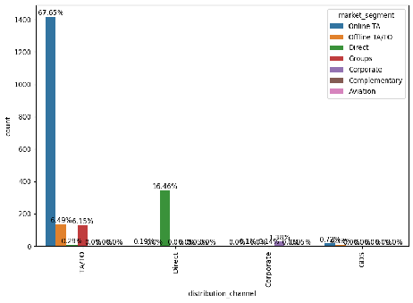
Customer Behavioral Segmentation
• Are there distinct patterns in the lead time, special requests, or room preferences for different customer segments?
• Which marketing channels are most effective for reaching specific customer segments?
• How can marketing strategies be customized to resonate with specific customer segments, considering factors such as previous cancellations, booking lead time, and special requests?
Interpretation:
Observed lead time more than 400 days for groups and offline TA/TO.other segment have lead time btween 0 - 350.
Observed more special requests are 0 and 1 with 34% and 30%.Some customers have 3 request and 4 and 5 are very less.
Most of the customers have prefered A room type ,less customers have preferred room type D,E ,F and G.
Online marketing channels are most effective for reaching specific customer segments.

Slide 7
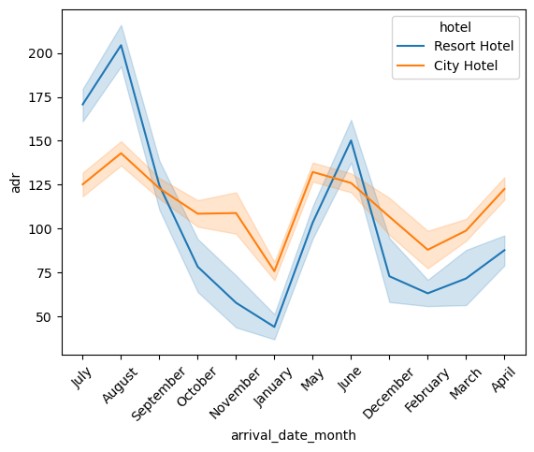
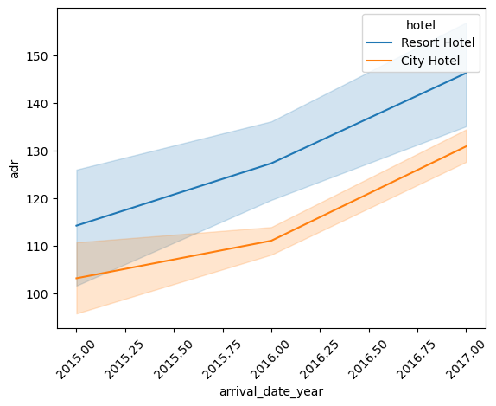
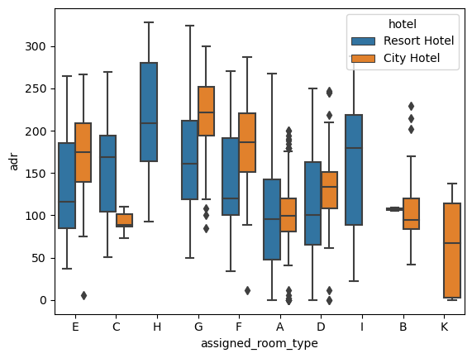
Part 2 Revenue Management
• How does the Average Daily Rate (ADR) vary over time?
• Can we identify pricing strategies that maximize revenue?
• Are there specific room types associated with higher ADR?
Interpretation:
April-August have more revenue.
As per the chart, Revenue increase as year increases.
Room type A, F,G and H can make highest revenue.

Slide 8
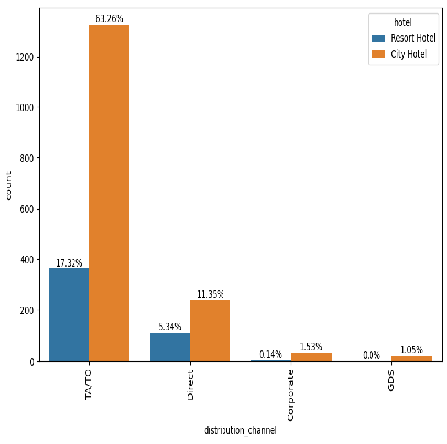
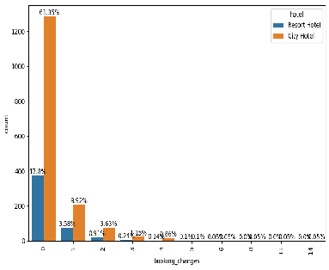
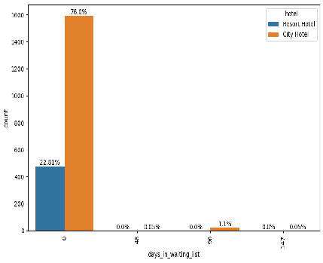
Operational Efficiency
• What is the effectiveness of different booking distribution channels?
• How do booking changes impact hotel operations?
• Is there a correlation between the duration a booking remains on the waiting list and the likelihood of cancellation?
Interpretation:
TA/TO is the most effective distribution channel(81%) and direct is moderate.
Most of the booking has no changes(79%),but 1 and 2 have affected.
There is no correlation between the duration a booking remains on the waiting list and the likelihood of cancellation.

Slide 9
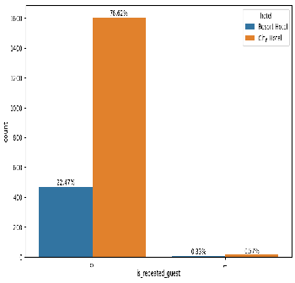
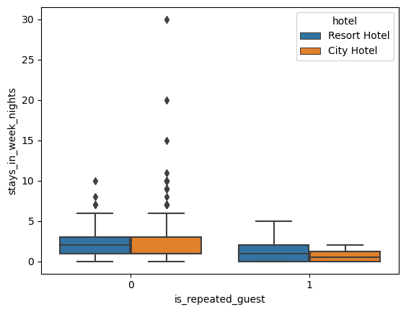
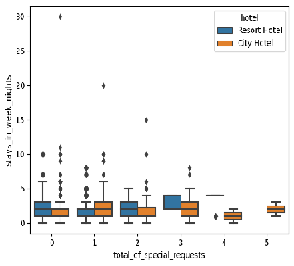
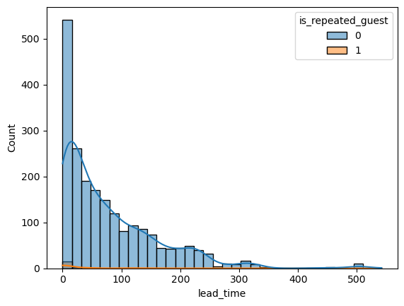
Loyalty Programs and Repeat Business
What is the behaviour of repeated guests with respect to their nature of stay?
• How does the success of loyalty programs relate to the accommodation of special requests from customers?
• What factors contribute to repeat business? Also, what is the distribution of lead time for repeated and non-repeated guests?
Interpretation:
99% of customers are non-repeated guests.
Most of the customers are booked for less than 20 nights.
Most of the customers are booked for less than 10 week end nights.
Most of the customers have booked less than 15 nights.
In above chart,clearly see that repeated guests are less than 50 and thier lead time also less than 50.

Slide 10
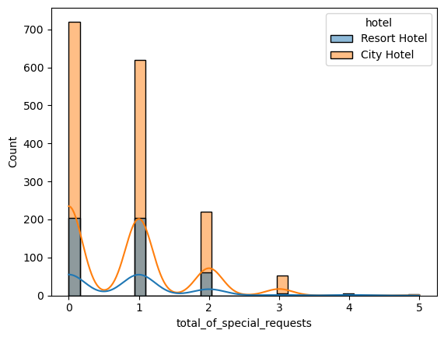
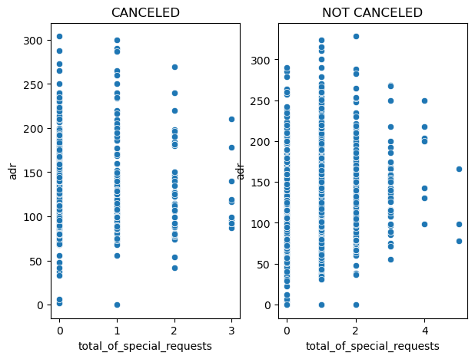
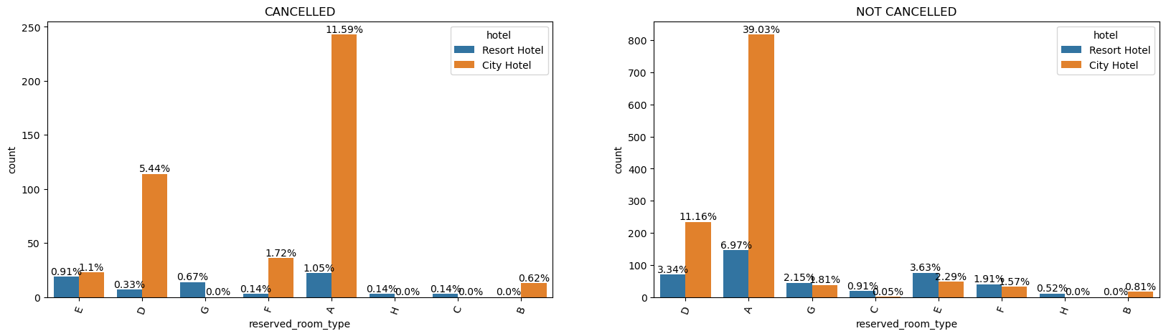
Part 3 Customer Satisfaction
• What is the distribution of the number and types of special requests made by guests?
• Is there any relation between special requests made by customers and the average daily rate? Additionally, explore customer preferences and expectations for different room types.
Interpretation:
Most of customers are made 0,1 and 2 requests.
Not cancelled booking have more adr with 1-5 requests.
Most of the customers have preferred A room.
D room also have more cancelation in city hotel.

Slide 11
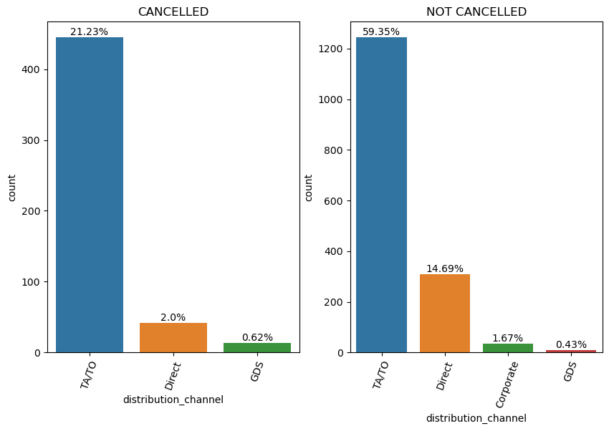
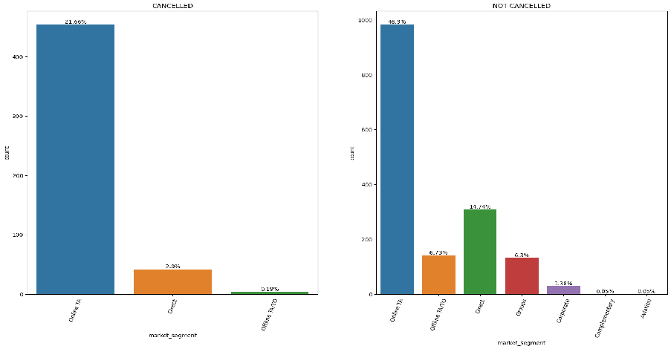
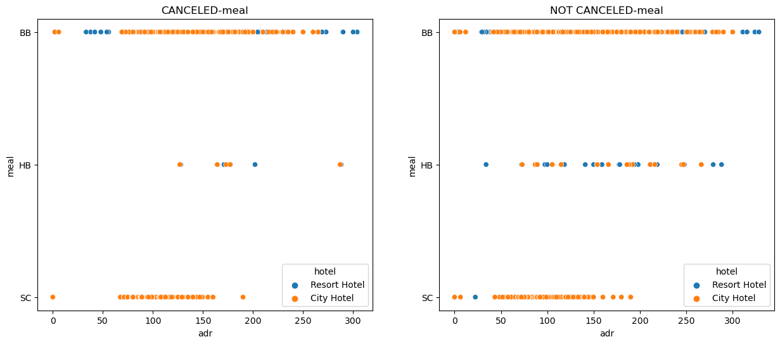
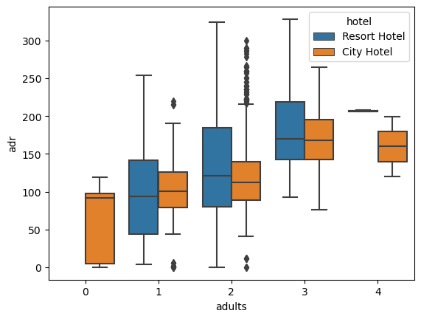
Marketing and Sales Optimization
• Which marketing channels and market segments contribute the most to successful
bookings?
• Which amenities or services have the highest impact on the average daily rate (ADR)?
• What is the distribution of bookings across various distribution channels?
Interpretation:
TA/TO and direct are the major distribution channels.
Online TA and direct are the major distribution channels.
Most of the customer's meal choice is BB.
Observe more booking are from couples or 3 adults.

Slide 12
Conclusion
Customers favoured city hotels more than resort hotels.
The most popular food is BB.
The Online platform is used to make the majority of bookings.
The majority of the bookings are made using TA/TO, the leading distribution channel.
The majority of hotel bookings are made by new guests. Almost no customers are returned.
The customer wants Room A to be reserved the most.
Customers do not wish to make a bookings with a pre-deposit.
Customers (80%) favoured making a hotel reservation for a short visit.
Most visitors are couples.
The inability to assign a reserved room to a customer is not grounds for cancellation.
Booking cancellations are not caused by a longer Lead time.
The busiest months for hotels are April- August, Only in month end there is a slight change in bookings.
More booking are from 11-43 weeks.
Not assigning a reserved room does not affect ADR.

Slide 13
Summary & Recommendation
Majority of customers preferred city hotel. Definitely need to spend the most targeting fund on those hotel.
Observed that the high rate of cancellations can be due to no deposit policies.
We should also target months between April to Aug, because those are peak months.
Hotels has to give promotion for repeated guests in order to increase their repeated bookings.
They can arrange attractive offers for promoting couples bookings.
Encourage Direct bookings by offering special discounts.
Study the distribution channel and market segment to find more cancellation.

Slide 14
THANK YOU

